Slide 1
Predicting the Mortality based on Clinical Data of patients with Cardiovascular Disease
MSDS – 530 Project
Submitted By : Abhigyan Misra

Slide 2
Data to be Analyzed
We have 13 parameters in the dataset
We will be analyzing the effect of below parameters
Age of Patient
CPK Levels
Ejection Fraction
Platelets
Serum Creatinine
Serum Sodium

Slide 3
Explanation of All Attributes
The table below lists out the details of all attributes in the dataset being used for the analysis
Attribute Name | Details about Attribute | Scale/Measurement | Range Of Values
Age | Age of the patient | Years | [40,..., 95]
Anaemia | Decrease of red blood cells or hemoglobin | Boolean | 0, 1
High blood pressure | If a patient has hypertension | Boolean | 0, 1
Creatinine phosphokinase-(CPK) | Level of the CPK enzyme in the blood | mcg/L | [23,..., 7861]
Diabetes | If the patient has diabetes | Boolean | 0, 1
Ejection fraction | Percentage of blood leaving the heart at each contraction | Percentage | [14,..., 80]
Sex | Woman or man | Binary | 0, 1
Platelets | Platelets in the blood | kiloplatelets/mL | [25.01,..., 850.00]
Serum creatinine | Level of creatinine in the blood | mg/dL | [0.50,..., 9.40]
Serum sodium | Level of sodium in the blood | mEq/L | [114,..., 148]
Smoking | If the patient smokes | Boolean | 0, 1
Time | Follow-up period | Days | [4,...,285]
(target) death event | If the patient died during the follow-up period | Boolean | 0, 1

Slide 4
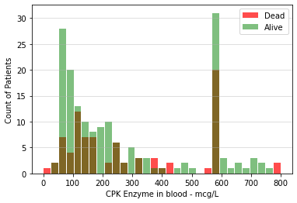
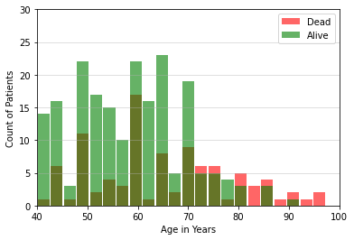
Histogram Plots for the variables in question

Slide 5
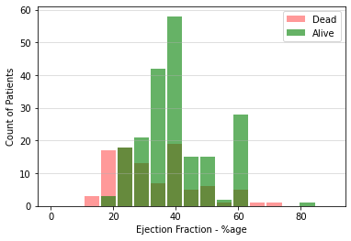
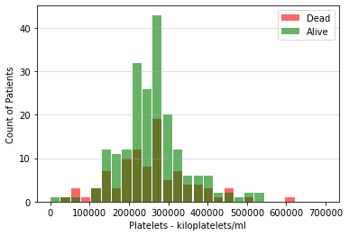
Histogram Plots for the variables in question Contd..

Slide 6
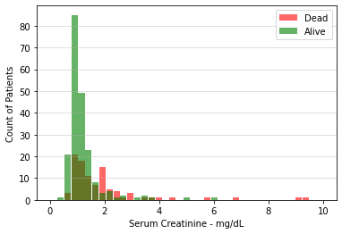
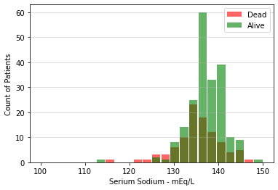
Histogram Plots for the variables in question Contd..

Slide 7
Summary & Analysis on Histograms
From the histograms, we may be able to see something but its not clearly visible
Age effects the mortality. As age increases the risk becomes higher
With lower Ejection fraction the risk increases
With higher serum creatinine levels risk increases
With lower serum sodium levels risk increases
We also see some outliers from the histograms, for Platelet counts, serum creatinine, ejection fraction & serum sodium which suggest things otherwise. For now I let them in the dataset for further analysis, however if they have much effect on the prediction model, then we may try to resample the data. We can't do much removals in this dataset as the sample size is small and we don’t have enough samples to exclude or include.

Slide 8
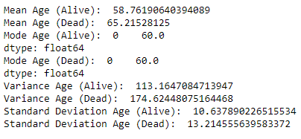
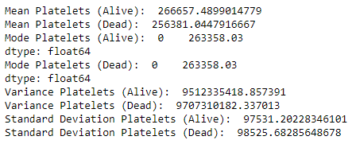
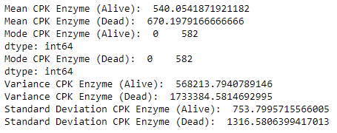
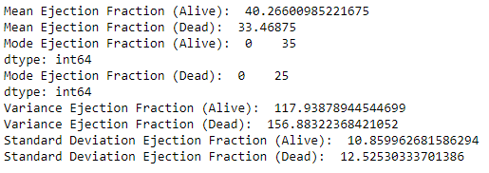
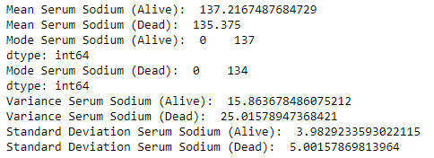
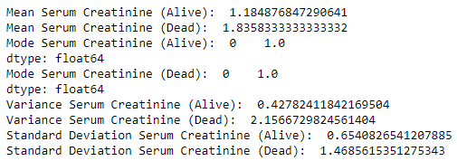
Other Descriptive Characteristics about the Variables in question

Slide 9
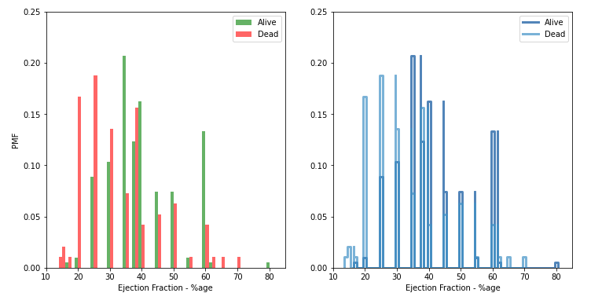
PMF – Ejection Fraction

Slide 10
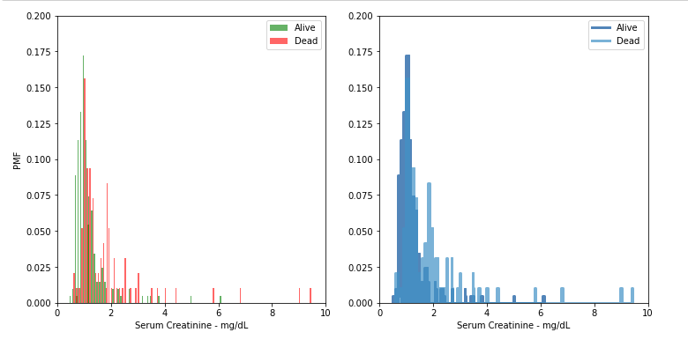
PMF – Serum Creatinine

Slide 11
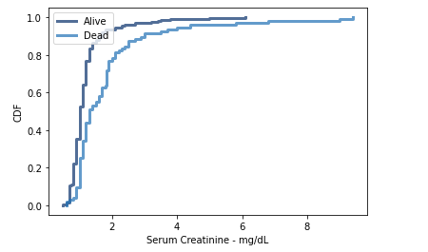
CDF – Serum Creatinine
From the CDF we see that for both Alive and Dead Patients, the max of the population lies between 1 & 2
As per the healthline.com which says:
“In general, however, normal creatinine levels range from 0.9 to 1.3 mg/dL in men and 0.6 to 1.1 mg/dL in women who are 18 to 60 years old. Normal levels are roughly the same for people over 60. High serum creatinine levels in the blood indicate that the kidneys aren't functioning properly.”
So our data seems to reflect the same.
Also if we look at the CDF for Alive vs Dead Patients, the latter population is shifted more towards the higher numbers thus supporting our study

Slide 12
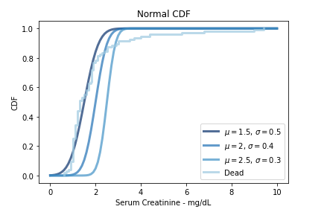
Tried plotting this over the Normal Distribution with different combinations. The data is moving somehow along with it but not fully normally distributed.

Slide 13
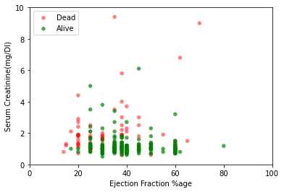
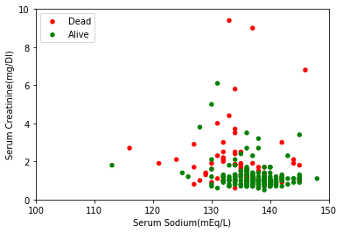
Scatter Plots
We see from the Scatter Plot, as well as the Covariance and Correlation Coefficient values that there seems to be very weak relation between the variables(Ejection Fraction vs Serum Creatinine & Serum Creatinine vs Serum Sodium). The correlation coefficient values for both dead and alive dataset show weak correlation. The correlation coefficients in all the scenarios remained less the absolute value of 22% approx. Hence the parameters don't seem to be correlated

Slide 14
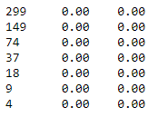
Hypothesis Test – Using Mean difference
So we tested the following hypothesis
1. Ejection Fraction is lower for Dead Patients vs Alive Patients.
2. Serum Creatinine is higher for Dead Patients vs Alive Patients.
We ran the hypothesis testing using mean diff as the test statistic and results are shown with different sample sizes.
The tests for test1, test2 are positive throughout. However this pattern may change if we could get large datasets. This is not evident; this is only my assumption as 299 is a very small number of patients that we are using for this hypothesis. Still based on our data, we may say our hypothesis is right.

Slide 15
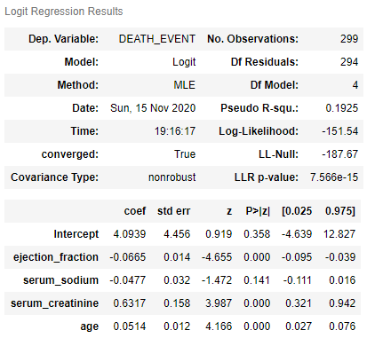
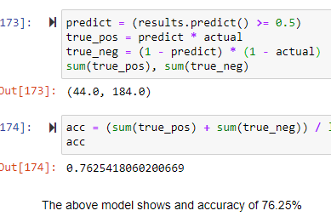
Logistic Regression Model for the dataset

Slide 16
References
https://www.healthline.com/health/creatinine-blood#results
https://www.mayoclinic.org/diseases-conditions/heart-disease/symptoms-causes/syc-20353118#:~:text=The%20term%20%22heart%20disease%22%20is,pain%20(angina)%20or%20stroke.
https://www.kaggle.com/andrewmvd/heart-failure-clinical-data
Authors of this Dataset - Davide Chicco, Giuseppe Jurman: Machine learning can predict survival of patients with heart failure from serum creatinine and ejection fraction alone. BMC Medical Informatics and Decision Making 20, 16 (2020).
Discover Statistics Using R, Andy Field | Jeremy Miles | Zoe Field
R for Everyone, Jared P Lander
Think Stats, Allen B Downey

