Slide 1
Airline Passenger Safety & Revenue
Airline Fatalities Lower than Auto
Airlines Fatalities Decreased compare to similar period
Riskiest Airlines are not Domestic
Revenue & Passengers Continue to grow
Top 10 Flights by ASK are Domestic

Slide 2
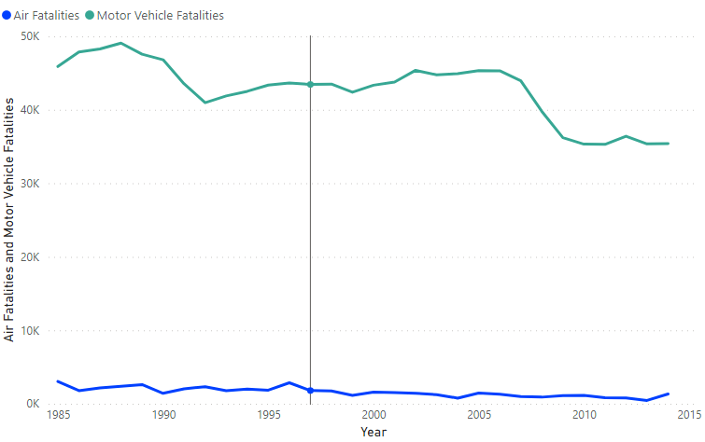
Airline Fatalities Lower than Auto

Slide 3
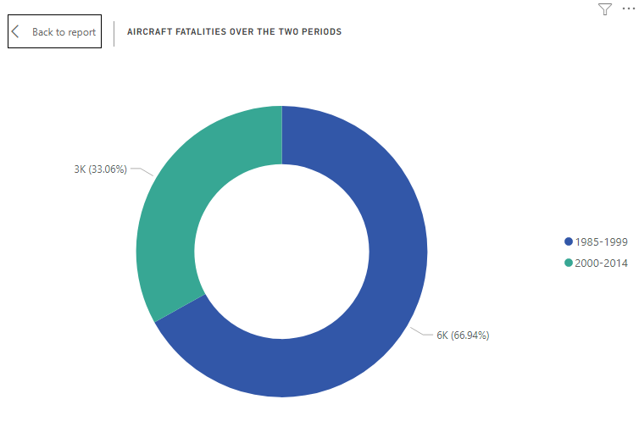
Airline Safer compared to past

Slide 4
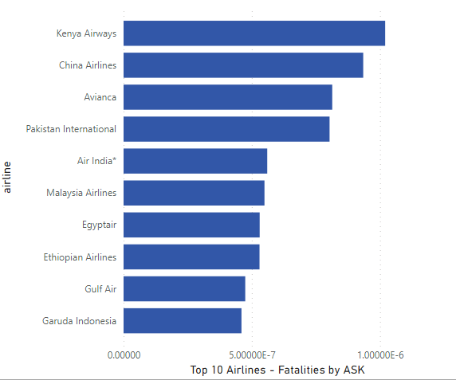
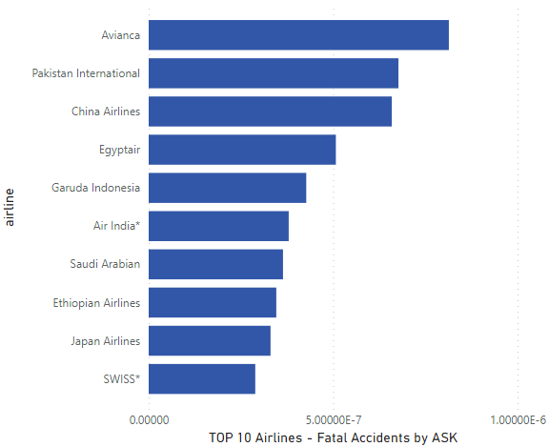
Top 10 – Riskiest Airlines

Slide 5
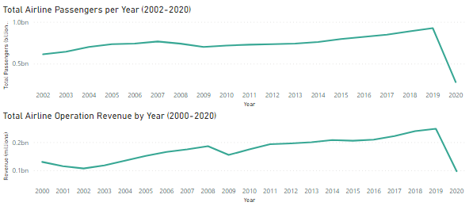
Overall Revenue & Passengers Trend

Slide 6
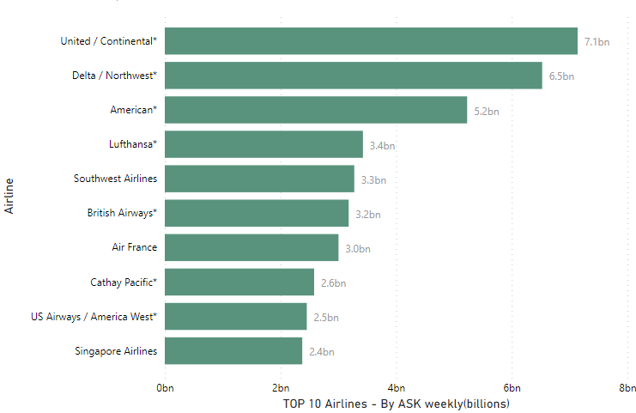
TOP 10 Flights by ASK

Slide 7
References / Data Sources
Death Rate per Year. (n.d.). Retrieved from Bureau of Aircraft Accidents Archives: http://www.baaa-acro.com/statistics/death-rate-per-year?page=0
Historical Fatality Trends. (n.d.). Retrieved from Injury Facts: https://injuryfacts.nsc.org/motor-vehicle/historical-fatality-trends/deaths-and-rates/
Mehta, D. (2018, February 9). Airline Safety. Retrieved from Github - fivethirtyeight: https://github.com/fivethirtyeight/data/tree/master/airline-safety
Operating Revenue (In Thousands of Dollars ($000). (n.d.). Retrieved from Bureau of Transportation Statistics: https://www.transtats.bts.gov/Data_Elements_Financial.aspx?Data=7
https://github.com/abhigyanmisra/dsc640/tree/master/FinalProject

