Slide 1


Switchboard: A Middleware for Wide-Area Service Chaining
Abhigyan Sharma* Yoji Ozawa** Matti Hiltunen*
Kaustubh Joshi* Rick Schlichting*** Zhaoyu Gao****
* AT&T Labs Research
** Hitachi Ltd.
*** U.S. Naval Academy
**** Univ. of Massachusetts, Amherst
Notes:
Work done at AT&T
Transition: Focus is on building network services using network functions.
Network services: think of end-user services such as LTE mobility service and enterprise services
Based on SDN and principles from SOAs

Slide 2
Chaining network functions into network services
Tier-1 ISP networks contain multiple types of network functions
Common network services constructed as service chains
Gateway
Proxy
IDS
Gateway
NAT
Firewall
Proxy
NAT
Internet
Cell phone
LTE Evolved Packet Core Service Chain
Notes:
Hardware middleboxes, static wiring
Transition: Industry moving towards replacing HW devices with VNFs, which allows more flexibility.

Slide 3
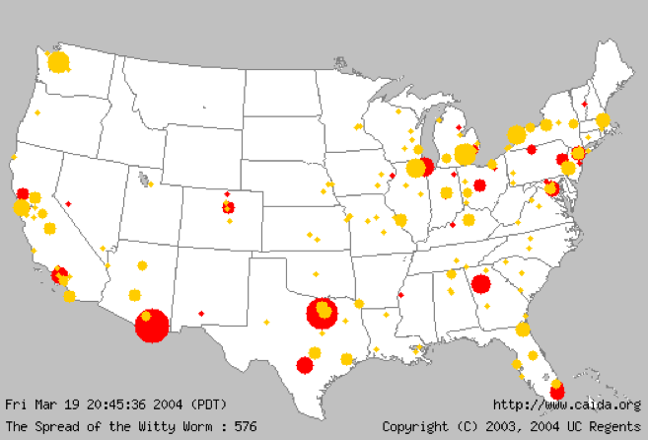
From fixed-function to customized service chains
“Appstore” for virtualized NFs
Custom VNF service chains for customers
VNF service portal
Enterprise customer scenario
ISP VNFs
ISP vendor VNFs
3rd party VNFs
Customer VNFs
Initial chain
DDoS
THREAT!
Updated chain
Traffic scrubber VNF
Notes:
Appstore with multiple types of VNFs, implemented (and run) by various parties.
Goal: be able to stitch these together at runtime.
Enterprise customer service chain
Transition: VNFs are represented here as logical entities, but are really services not only with multiple instances but instances across sites

Slide 4

Service chains in the wide-area
Cloud platforms
heterogenous
geo-distributed
VNFs
multi-site deployments placement constraints
Edge/access networks
diverse types (e.g., cellular, VPN, broadband)
Service chain
multiple edge locations for traffic ingress/egress
3rd party clouds
Provider’s internal network cloud
Packet
Customer premise clouds
Notes:
Consider service chains in the wide area rather than being restricted to a single site
Number of factors that have to be considered
Example placement constraints: cloud platform, sites, regulatory
Service chain will typically have multiple paths (only one is shown)
Transition: How are the VNF and edge instances deployed and managed?

Slide 5
Applying service-oriented principles
VNF and edge services do
Instance creation/deletion/scale-out
Global placement
Allocation of shared instances to chains
Troubleshooting, software updates
SDN-based forwarding middleware does
Customized wide-area chain routing
Holistic route optimization
Packet
Decouple service chaining from
management of constituent VNFs and edge services
Global controller
Notes:
Goal: Reorient structure to allow each VNF to be operated as an independent service rather than something integrated with and managed by the service chain.
Gives a division of responsibility: VNF/Edge instances + forwarding framework (heart of SB)
Note: Instances are shared between chains
Transition: Now do a deeper dive into the SB architecture.

Slide 6
Switchboard architecture
Chain specs
Global Switchboard
VNF catalog
Firewall
Global chain route
Accelerator
Scrubber
Transcoder
IDS
Instance configuration
Global message bus
F
F
e1
F
F
e4
F
F
Chain:ch1
Egress:e4
Packet
e2
e3
F
F
Packet
Notes:
Two parts to slide:
Introduce new control plane components
Show the steps to create a service chain
Transition: One of the roles of Global Switchboard is to do site-level load balancing.

Slide 7
Global SB wide-area traffic engineering
Example wide-area route for service chain
Inputs
models of topology, VNF placement, etc.
Outputs
For VNFs in a chain, sites and traffic splits among them
Goals
Minimize wide-area latency
Improve network-wide throughput
Avoids highly utilized ISP network links
Share compute load across VNF sites
Two techniques
Linear programming-based global optimization across chains
Dynamic programming-based per-chain heuristic for I/E pair
Cost function combines network load, compute load and latency
Ingress
a
VNF
b
80% 20%
Minimize latency
VNF
c
d
VNF
e
Egress
f
g
Notes:
- Boxes within VNFs are sites
VNF controller → global message bus → forwarders
Transition: Forwarders are key to the SB infrastructure, so look at those in more detail now.

Slide 8
Switchboard forwarders
a
Deployment
Runs as a VM on any cloud
Acts as a proxy for VNFs at a site
Customization
Load balancing
Safety
Forwarder scaling
I1
F1
b
O1
F2
c
d
G1
F3
G2
G3
F4
e
Y1
F5
Notes:
Basic question: How can Switchboard forwarder be deployed across heterogeneous cloud platforms including ISP clouds, customer premise clouds and 3rd party cloud?
VMs are a common denominator on any cloud platform, so run forwarders inside a VM running at each site. VNFs at the site configure the local switchboard forwarder as a proxy to route service chain traffic. Thus, this approach uses existing capabilities of cloud platforms and needs just a small configuration change at each VNF instance.

Slide 9
Switchboard forwarders
a
b
Chain:ch1
Egress:e4
Packet
80% 20%
a
Deployment
Customization
Identifies packets based on labels
Chooses next VNF based on chain route
Load balancing
Safety
Forwarder scaling
I1
F1
c
d
Tunnel pkt to
forwarder at b
e
b
O1
F2
f
g
c
d
G1
F3
G2
G3
F4
e
Y1
F5
Notes:
How do forwarders customize service chains?
They need two inputs: first they need to identify service chain that a packet belongs to. The forwarder uses the packet labels applied by the ingress edge instance to identify the chain
Next, they need to know the sequence of VNFs in the chain. The forwarders get this information from the chain route published by the Global Switchboard.
In the example on the slides, forwarder F1 reads from the packet label that the chain is ch1. It reads from the chain route that the packet is to be forwarded next to the orange VNF located at site b. Hence, forwarder F1 tunnels the packet to the forwarder F2 located at site b.

Slide 10
Switchboard forwarders
a
b
80% 20%
a
Deployment
Customization
Load balancing
Inter-site splits published by Global SB Intra-site splits published by VNF controller
Safety
Forwarder scaling
I1
F1
c
d
e
b
O1
F2
f
g
80%
20%
c
d
G1
60%
F3
20%
G2
G3
F4
e
Y1
F5
Notes:
Switchboard forwarders implement for load balancing among VNF sites as well as among VNF instances at a site.
The load balancing among VNF sites is done in accordance with the chain route determined by global Switchboard.
For example, forwarder F2 splits traffic in the ratio of 80% and 20% among the green VNF instances at sites c and d respectively.
The load balancing among VNF instance at a site is done in accordance with the load balancing splits chain route determined by global Switchboard.
In the example on this slide, the forwarder F3 splits traffic among G1 and G2 in the ratio 3:1 as directed by the green VNF’s controller.
The last important point is that, these load balancing weights are only used upon the first packet of a connection. Subsequent packet simply follow the load balancing decision made for the first packet. We explain this point in the next slide.

Slide 11
Switchboard forwarders
a
Deployment
Customization
Load balancing
Safety
Flow affinity
Symmetric return
Forwarder scaling
I1
F1
Chain:ch1
Egress:e4
Packet
b
O1
F2
Chain:ch1
Egress:e4
Packet
Flow table
KEY_FWD | G1, F5
KEY_REV | G1, F2
c
d
G1
F3
G2
G3
F4
e
Y1
F5
Notes:
Some VNFs maintain state about individual connections they are processing. These stateful VNF need two safety properties for correct operation:
(1) Flow affinity: all packets in a connection in a given direction must be processed by the same VNF instance.
(2) Symmetric return: packets in the reverse direction are also processed by the same VNF instance.
Switchboard forwarders provide these safety properties with support of a flow table that they maintain.
The flow table contains two entries for each connection. One for the packets in the forward direction and one for the reverse direction.
These flow entries are created at the time the first packet of a connection is processed at the forwarder.
A flow entry is maintained as a key value pair. The unique key in each direction is computed based on packet header fields.
The values are the sequence of VNF instance and the next forwarder instance that this connection packets are sent to.
For example, the flow table shown on the slide lists that a packet in the forward direction is first forwarded to VNF G1, followed by the forwarder F5.
A packet in the reverse direction is first forwarded to VNF G1, followed by forwarder F2.

Slide 12
Switchboard forwarders
Deployment
Customization
Load balancing
Safety
Forwarder scaling
Proportional to VNF traffic
Controlled by Local Switchboard
c
Local SB
G1
F3
G2
O2
F6
O3
DHT-based flow table
Y2
F7
G4
G5
F8
B1
Notes:
Forwarders can scale in a horizontal manner by adding more instances.
Scale-out/scale-in is controlled by a local switchboard controller running at each site.
A VNF instance attaches itself to one of the forwarders deployed at the site.
To route a packet to a VNF instance, the previous forwarder a packet should be forwarded to that VNFs forwarder only.
This adds some complexity to our design, hence we are working on a clustered implementation of a forwarder.
This design implements the flow table as DHT, and allows all forwarders to function as a single logical forwarder.
But, a discussion of that is a topic of future work.

Slide 13
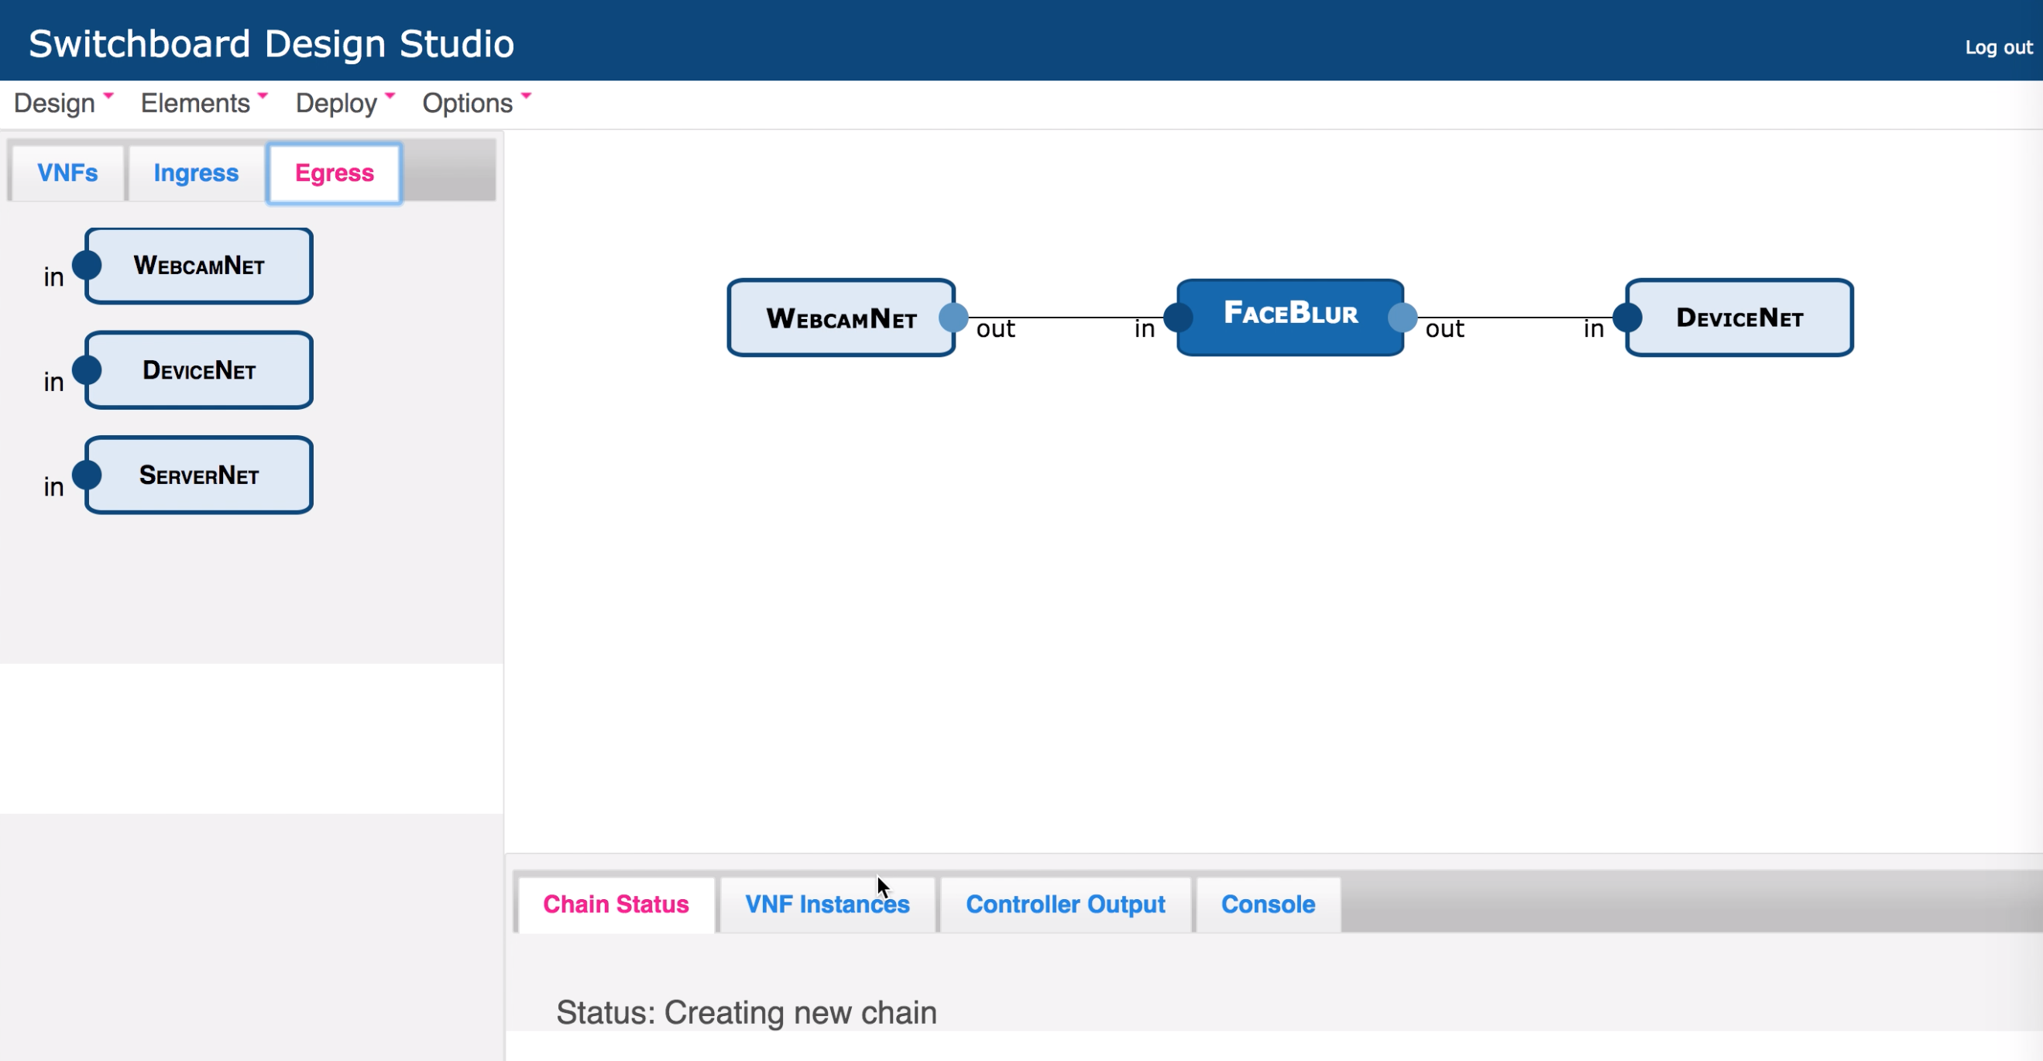

Switchboard implementation
Global Switchboard
OpenDaylight controller
Open vSwitch
Linux NAT
Squid Proxy
Video
Open VPN
Zero MQ
Global message bus
F
Amazon EC2
F
DPDK library
e1
F
F
e4
F
F
Openstack
e2
AT&T Universal Customer Premises Equipment (uCPE)
F
e3
F
Notes:
Our implementation efforts span Switchboard components, setting up some example VNF and edge services and deployment on multiple cloud platforms.
We have implemented Global Switchboard in the OpenDaylight controller as an SDN application.
We have also built a Switchboard portal that exports Global Switchboard’s functionality via a GUI. Customers can see the catalog of VNFs, the ingress and egress services they can configure and use a drag-and-drop actions to construct a service chain.
We implement the Global message bus using the Zero MQ messaging library.
We have tested Switchboard with several kinds of VNF services including a NAT, a caching proxy Squid and a video processing VNF that does face anonymization in real-time.
We have set up some example edge services built using Open vSwitch and Open VPN.
In our testing and demonstrations, we have deployed Switchboard on multiple cloud platforms.

Slide 14
End-to-end comparison
Chain 1 route
Chain 2 route
Holistic route optimization outperforms hop-by-hop route selection
Notes:
Goal of this experiment is to compare Switchboard to existing wide-area routing schemes.
Testbed spans two sites with 150 ms delay between two sites in AWS and 80 ms delay in Openstack case. Two customers chains (orange and green) with one ingress in site A and two egresses in site A and site B respectively
Figure at top shows routes chosen by schemes.
-- Switchboard jointly optimizes both chain’s routes for both egress destination.
-- Anycast chooses route on a hop-by-hop basis for every chain and each destination, choosing the site with closest network latency in each case.
-- Compute-aware does the same but it skips nodes that have a compute bottleneck.
Results show that Switchboard achieves better throughput and latency than both schemes.
Why? Switchboard optimization can distribute load even and minimize the wide-area latencies. Other schemes cannot do both.
Other experiments in the paper, including dynamic service chaining,

Slide 15
Dynamic service chaining
Existing route
Chain route addition latency: 595ms
Throughput doubling upon addition of new route
Site A
Site B
New route
Notes:
We show Switchboard’s ability to update chain routes dynamically and quantify the resulting performance improvements. Our VNF in this experiment is a NAT implemented using IP tables [35]. We performed this experiment at a single AWS EC2 site by creating two virtual sites A and B. Our service chain in this experiment has its ingress at site A and egress at site B. Initially, our service chain uses only a single NAT instance in site A. We manually trigger a new chain route creation by requesting Global Switchboard to create a new route via VNF instances in site B, which results in traffic being routed via VNF instances in both A and B.
We highlight three findings from this experiment. First, as Figure 10a shows, a chain route update takes a total of only 595 ms. While an actual wide-area environment will increase the chain routing update time, our findings show that the overhead of Switchboard’s control plane implementation is small. Second, in the same figure, the new chain route minimally affects the performance of the existing chain route and load is balanced evenly on the two routes. Third, in Figure 10b, the addition of a new chain route doubles the total throughput of the service chain compared to the case where there is no change in chain routing. The increase in throughput is commensurate to the additional capacity available on the new chain route. Thus, Switchboard enables VNFs to react to increases in load that overwhelm the resources in a single site by creating new routes via other sites.

Slide 16
Traffic engineering on Tier-1 ISP datasets
ISP data: node location, link capacity, link delay, traffic matrix, network routing
Parameters: 100 VNFs, 10000 chains, 50% VNF coverage, 20% non-SB traffic
Switchboard’s DP heuristic provides comparable performance to LP optimization
Notes:
This is a simulation of routing schemes on tier-1 network datasets node location, link capacity, link delay, traffic matrix, network routing
Our parameters are 100 VNFs, 10000 chains, 50% VNF coverage, 20% non-SB traffic.
In Figure on left, low values of CPU/byte depict scenarios where the network is the bottleneck, whereas higher values of CPU/byte depict scenarios where the VNF’s compute capacity is the bottle- neck. Switchboard’s schemes vastly outperform Anycast in all
scenarios since Anycast is oblivious to either compute or network load. Surprisingly, SB-DP performs close to SB-LP with the differ- ence being between 0%-11% (Figure 12a) and 11%-36% (Figure 12b).
Figure 12c evaluates latency for an increase in load assuming traffic for all chains increases by the same factor. Anycast cannot handle loads higher than 10% of the load sustained by SB-LP. Its latency is over 40% higher than SB-LP at low loads. Switchboard DP heuristic provides comparable latency even though it has a much smaller running time than SB_LP which can take several hours. SB-DP cost appears to be a efficient, practical strategy for optimizing routes on a per-chain basis.

Slide 17
Switchboard
A middleware to create customer-specific wide-area network services spanning heterogeneous clouds
holistic optimization of wide-area chains
scalable wide-area control plane
scale-out, deployable, affinity-preserving data plane
enables a rich ecosystem of VNFs
Notes:
Experimental prototype
Customize network services inspired by Switchboard

Slide 18
Questions?

Slide 19
Switchboard forwarders
** Not clear what A and B means
Chain c1 route: is global switchboard route
- Also show flow affinity

Slide 20
Applying service-oriented principles
Blue bars are forwarders
Show forwarders splitting traffic
VNF/edge services
Compose chains from already running instances
Services own global placement, lifecycle, capacity
Transition: challenge is how to route traffic across services
Forwarding middleware service
Chain creation and customization
Rules of the road for VNF multitenancy
Chain-based traffic distribution
Forwarding middleware
Edge service
SvcA
SvcB
Conclusion: decouple the problem of service chaining from managing and deploying constituent VNFs/edge
Notes:
Transition: How are the VNF and edge instances deployed and managed?
Enable VNF diversity in placement (edge friendly scrubber vs consolidation friendly cache), internal implementation and dynamism but allow globally optimized traffic and capacity management
VNF lifecycle
Deployment locations
Capacity allocation
Instance placement
Utilization monitoring
Elastic scaling
Chain specification
Chain lifecycle
Wide-area chain routing
Service chain forwarding
Load balancing
Capacity planning analytics

Slide 21
Optimize routes based on traffic, topology ..
Higher latency chain with per-hop routing decisions
FW
Site C
Users
Internet
NA
Lower latency packet rerouting in split-control architecture
Site A
Site D
FW
PR
Site B
NA
FW
PR
Lower latency chain in
split-control architecture
Site A
Internet
Firewall down for software upgrades
Higher latency packet rerouting when making per-hop decisions
NA
FW
PR
Site B
Users
Notes:
- See if we can show an example in the switchboard architecture figure itself

Slide 22
Global Switchboard traffic engineering
Analytics is optional
Analytics API provides
Traffic analytics to VNFs
Global picture of where VNF’s traffic comes from
Hints on where to grow VNF/cloud capacity
Chain routing
Minimizes chain latency
Maximizes network/cloud utilization
Chain routing
VNF capacity planning
Cloud capacity planning
Ingress
VNF1
40% 60%
VNF1
VNF2
Minimize latency
20% 20% 30% 30%
VNF3
VNF2
20% 50% 30%
Existing VNF sites
Egress
New VNF sites

