Slide 1
FillSkills
Filling the skills gap between you and your dream job
Abhishek Arora
Co-Founder

Slide 2
FillSkills
Founders
Abhishek Arora, CEO Anshu Bansal, CTO
Senior Engineer for Wells Fargo Senior Engineer for Microsoft, Google
Charles Schwab etc. and now Amazon.
Launched Hadipa Inc. in Jan’13 Launched multiple startups such as
to build iOS apps and interactive Computer engineering.com,
web applications. Jaadu Deals platform and Talking
Toon iPhone app.
Technology
PHP, MySQL, Job APIs, Course APIs, Algorithms

Slide 3
Market size
FillSkills
$1.3
Trillion
$104
Billion
$7.5
Billion
US Online Tech Education
US Education Market
US Online Education

Slide 4
Business Model – multiple revenue streams
FillSkills
25%-50%
Pay Per Click
Fee Per Course Registration
Job Provider
lead generation

Slide 5
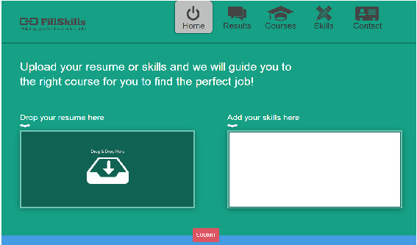
FillSkills
Accomplished
Built relationships with job and course providers
Created algorithms to find top missing skills
Launched prototype
In thirty days with $1000 budget
Where we are going
Improve user work flow
Build more relationships with providers
Improve matching algorithms
We need
Seed funding
Engineer to improve algorithms
UI designer to improve work flow

