Slide 1
Introduction to ClaimCenter
5.0.0
7-July-2009
Notes:
Introduction to ClaimCenter - <number>
Guidewire training materials contain Guidewire’s confidential information subject to confidentiality and non-disclosure agreements. You agree to use the information in this manual solely for the purpose of training to implement Guidewire’s software solutions. You also agree not to disclose the information in this manual to third parties or copy this manual without Guidewire’s prior written consent. Guidewire training may only be given by Guidewire employees or certified Guidewire partners under the appropriate agreement with Guidewire.

Slide 2
Lesson Objectives
By the end of this lesson, you should be able to:
  Describe the value proposition of ClaimCenter
  Describe the ClaimCenter product architecture
  Describe the tools commonly used and tasks commonly accomplished by technical developers during a ClaimCenter implementation
  This lesson uses the notes section for additional explanation and information.
  To view the notes in PowerPoint, choose View→Normal or View→Notes Page.
  If you choose to print the notes for the lesson, be sure to select “Print hidden slides.”
Notes:
Introduction to ClaimCenter - <number>

Slide 3
Lesson Outline
ClaimCenter
ClaimCenter Product Architecture
ClaimCenter Implementation Tasks
Documentation and Support
Notes:
Introduction to ClaimCenter - <number>

Slide 4
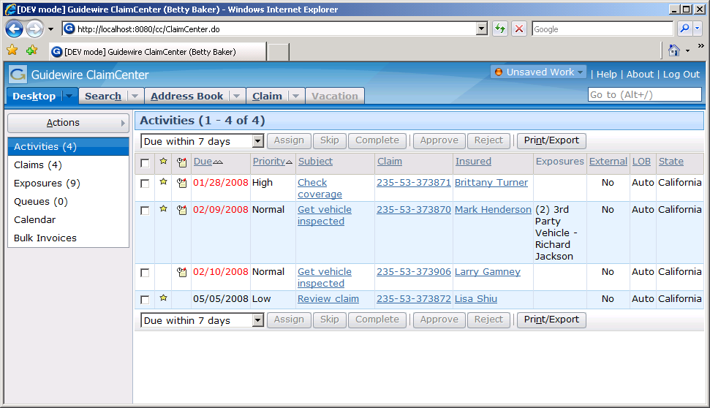
ClaimCenter
customer service rep
adjuster
supervisor
Browser-based application
Supports multiple types of users, such as:
  Customer service representatives (who create claims)
  Adjusters (who act on claims)
  Supervisors (who supervise users and approve work)
Notes:
Introduction to ClaimCenter - <number>
ClaimCenter (CC) is a browser-based application that enables multiple users to participate in claims processing.

Slide 5
The Value Proposition of ClaimCenter
ClaimCenter makes the claims process:
policy
activities
financials
Claim
parties
notes
documents
litigation
  Claim-centric
  Collaborative
  Controlled
Notes:
Introduction to ClaimCenter - <number>
ClaimCenter is a claim-centric solution. All of the data pertaining to a claim is centralized in the claim file. This includes information on policies, financials, diaries, documents, parties involved, and litigation. All users have an integrated and holistic view of the claim.
ClaimCenter facilitates collaboration among claims workers by providing one centralized location where all information needed to adjudicate the claim can be uniformly worked on and shared.
ClaimCenter provides a wide span of control for supervisors by providing them with real-time team statistics and the ability to not only manage the team but to also control and direct team activities.

Slide 6
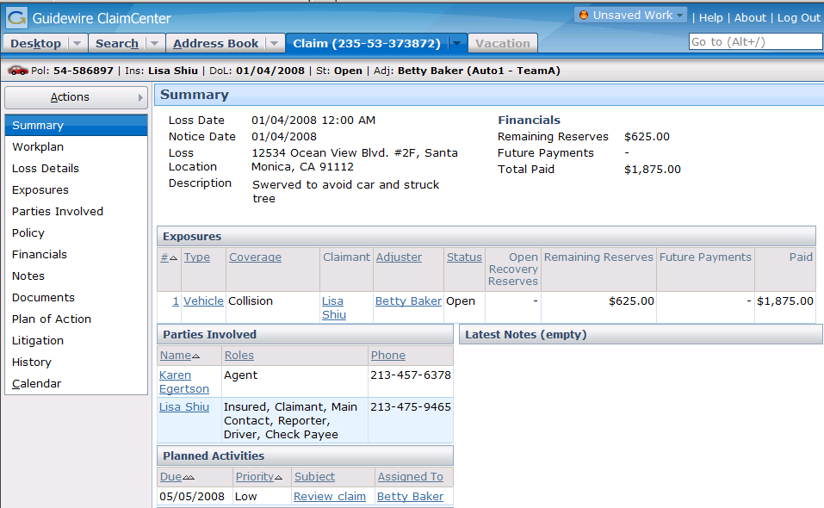
ClaimCenter is Claim-Centric
ClaimCenter is a claim-
centric solution
  All data pertaining to a
  claim is centralized in the
  claim file
Notes:
Introduction to ClaimCenter - <number>
The screenshot above shows the claim file for a claim. Notice all the page links running down the left side of the screenshot. Each one represents a set of information about the claim which can be viewed by clicking the link.

Slide 7
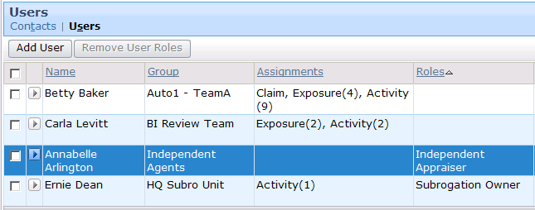
ClaimCenter is Collaborative
Betty
Baker
Carla
Levitt
Annabelle
Arlington
Ernie
Dean
One centralized location for all information about a given claim for every user
Notes:
Introduction to ClaimCenter - <number>
The claim shown above has a team of four adjusters, each with various roles and responsibilities on the claim. For the claim shown above:
Betty Baker is the claim owner, as well as the owner of four exposures and nine activities. (Note that she has no special roles on the claim. She is simply the owner of the claim and certain sub-objects on the claim.)
Carla Levitt owns two exposures and two activities on the claim. (Note that he has no special roles on the claim. She is simply the owner of certain sub-objects on the claim.)
Ernie Dean owns one activity on the claim. He also has the role of “Subrogation Owner".
Annabelle Arlington has the role of “Independent Appraiser" on the claim. (Note that she does not own any sub-objects on the claim. She simply has a role on the claim, which could be used to indicate she is an appropriate resource to go to if a question arises, but she has no active responsibility on the claim.)

Slide 8
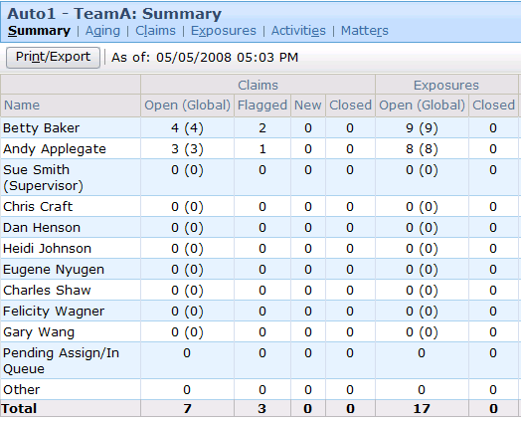
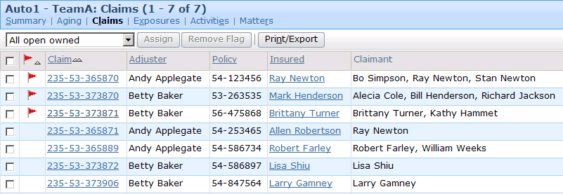
ClaimCenter is Controlled
status of all objects owned by team members
access to objects owned by any team member
Notes:
Introduction to ClaimCenter - <number>
ClaimCenter provides control for supervisors by providing them with real-time team statistics and the ability to not only manage the team but to also control and direct team activities.
The screenshot on the left shows a screen from the Team tab, which lists summary information about the claims and exposures owned by members of Elizabeth Jarvis's team.
The screenshot on the right shows a screen from the Team tab, which lists the actual claims owned by members of Elizabeth Jarvis's team, with links to jump to any given claim.

Slide 9

The Guidewire Product Suite
ContactCenter
ClaimCenter
PolicyCenter
BillingCenter
Guidewire Platform
Notes:
Introduction to ClaimCenter - <number>
Guidewire offers a set of applications designed to help insurance companies efficiently expedite their policies, billing, and claim requirements
All the applications sit on top of a common platform
All the applications can operate standalone or optionally integrate with each other
PolicyCenter is an application designed to issue, modify, and maintain data about policies.
BillingCenter is an application designed to issue and track the premium payments for policies.
ClaimCenter is an application designed to manage the process of reporting, verifying, and making payments on claims against a policy.
ContactCenter is an application designed to manage contact information about people of interest to multiple claims.
Integration between PolicyCenter and BillingCenter is common. Once a policy has been issued, information must be sent to BillingCenter so that bills for the premium can be issued. If bills have not been paid, this may affect whether a policy is renewed and if so how.
Integration between PolicyCenter and ClaimCenter is common. When a claim is filed, the claims process must know which policy it is associated to and whether or not the relevant coverage existed on the policy at the time the loss occurred. Furthermore, the number of claims filed may impact whether a policy is renewed and if so how.
There is typically little or no integration between BillingCenter and ClaimCenter. This is because the billing system is focused on premiums whereas the claim system is focused on indemnification, expense, and recovery payments.
(continued)

Slide 10
(Notes Only Slide)
Notes:
Introduction to ClaimCenter - <number>
There is also typically no integration between ContactCenter and BillingCenter or ContactCenter and PolicyCenter. This is because there isn't a need for a separate system to manage contact information shared across accounts. This information is already contained within BillingCenter and/or PolicyCenter.

Slide 11
The Guidewire Platform
ContactCenter
Data
Model
User
Inter.
ClaimCenter
PolicyCenter
BillingCenter
Bus.
Rules
Int.
APIs
Data
Model
User
Inter.
Data
Model
User
Inter.
Data Model
User
Inter.
Bus.
Rules
Int.
APIs
Bus.
Rules
Int.
APIs
Bus.
Rules
Int.
APIs
Guidewire Platform,
with a common technology for configuring...
Data
Model
User
Interface
Business
Rules
Integration
APIs
Notes:
Introduction to ClaimCenter - <number>
The Guidewire platform includes four main areas of technology. There is one area for configuring:
The data model, which defines the structure of the data.
The user interface, which defines the forms and fields the end user interacts with.
The business rules, which define and enforce business logic.
The integration APIs, which connect a given application to external applications, such as a reporting system or check printing system.
Every application uses this common technology to define its own data model, user interface, business rules, and integration APIs. Each application is distinct, but every application shares common abilities and configuration techniques with all the other applications.

Slide 12
ClaimCenter-Specific Functionality
ClaimCenter
Finan-
cials
Group
Ownership
Claim
Maturity
AB
Integration
PolicyCenter
BillingCenter
Data
Model
User
Inter.
Data
Model
User
Inter.
Data
Model
User
Inter.
Bus.
Rules
Int.
APIs
Bus.
Rules
Int.
APIs
Bus.
Rules
Int.
APIs
Guidewire Platform,
with a common technology for configuring...
Data
Model
User
Interface
Business
Rules
Integration
APIs
Notes:
Introduction to ClaimCenter - <number>
Each application has application-specific functionality. The application-specific functionality is created by implementations of the various platform-level technologies.
The ClaimCenter-specific functionality includes:
Group-based ownership of claims and claim sub-objects, which allows for assignment of objects to users based on the group they are in, as well as user access to an object based on who owns the object.
Claim maturity, which is a set of rules that automatically manage the claim's maturity level, with particular attention paid to whether the claim can be paid out or not and whether activities should be prevented if the claim is not yet payable.
Claim financials, which includes the ability to set aside money for expected payments (reserves), the ability to issue payments (checks), the ability to track recovery opportunities, and the ability to require approval for financial activity in excess of a given user's authority.
Address book integration, which lets contact objects be shared across multiple claims. Guidewire provides an address book application called ContactCenter which can be effortlessly integrated with ClaimCenter.

Slide 13
Lesson Outline
ClaimCenter
ClaimCenter Product Architecture
ClaimCenter Implementation Tasks
Documentation and Support
Notes:
Introduction to ClaimCenter - <number>

Slide 14

The Application Server
Supported application servers:
  IBM
  WebSphere 6.1
  BEA WebLogic 10.0
  Apache
  Tomcat 6.0.14
App. Server Machine
J2EE Application Server
Supported
operating
systems:
  Microsoft Windows 2003 Server
  Linux (as supported by application server vendors)
    For example: SuSe and Redhat Linux, IBM AIX 5.4
Notes:
Introduction to ClaimCenter - <number>
The information listed below is accurate as of ClaimCenter 5.0.0. For earlier or later releases of ClaimCenter, consult the Guidewire Supported Platforms Matrix.
All Guidewire applications, including ClaimCenter, are run within an application server. This is a robust piece of software that can run enterprise-wide applications. There are several different types of application servers. The type of application server used by Guidewire applications is a Java 2 Enterprise Edition (J2EE) server. This type of application server is written to run on the Java 1.5 run-time environments.
The ClaimCenter application is built and deployed as an Web Application Archive (WAR) file to the application server. It contains all the configuration, operational data and data definition files necessary to execute the application.
ClaimCenter supports these J2EE server products:
IBM WebSphere Application Server 6.1 Base
BEA WebLogic 8.1 SP6 Server
Apache Tomcat 6.0.14
The application server typically sits on its own machine. In other words, it sits on a machine that is not dedicated to hosting any other aspects of the architecture, such as the database. This machine must use an operating system supported by Guidewire.
ClaimCenter supports the operating systems for which application servers provide customer support. For details, review the customer viewable document Guidewire Supported Platforms Matrix.
The ClaimCenter application (the center box) consists of a set of business rules, a user interface, a set of integration APIs, and a data model. The technology for configuring these application elements is platform-level (and common to all Guidewire applications), but the specific rules, UI, APIs, and data model for ClaimCenter is distinct.

Slide 15
The Application Database
App. Server Machine
J2EE Application Server
Supported RDBMS:
  Oracle
  10.2.0.3 Enterprise
  Microsoft
  SQL Server 2005
cc
Database
Machine
Application DB
Notes:
Introduction to ClaimCenter - <number>
The information listed below is accurate as of ClaimCenter 5.0.0. For earlier or later releases of ClaimCenter, consult the product documentation.
A relational database is a series of data structure called tables which are linked (or related to) each other. The operational data for ClaimCenter is stored inside a relational database. This database is typically hosted on a machine separate than the machine hosting the J2EE application server.
The war file contains a file called config.xml which specifies which database to connect to and how to establish the connection.
ClaimCenter supports these relational database products:
Oracle 10.2.0.3 Enterprise RDBMS or RAC
Microsoft SQL Server 2005 SP2 Enterprise

Slide 16

The User Machines
App. Server Machine
Supported web browsers:
  Internet Explorer 6.0 or 7.0
J2EE Application Server
User Machine
cc
Database
Machine
Application DB
Notes:
Introduction to ClaimCenter - <number>
The information listed below is accurate as of ClaimCenter 5.0.0. For earlier or later releases of ClaimCenter, consult the product documentation.
End users connect to ClaimCenter using a web browser. ClaimCenter generates a series of standard HTML pages that are rendered within the browser. ClaimCenter is a server-side application. It dynamically generates the HTML pages and data within those pages. It makes only a minimal use of functionality in the client (the web browser). Because there are no static HTML files, you cannot use the browser's Back button. All navigation is controlled on the server side by ClaimCenter.
ClaimCenter supports these web browsers:
Microsoft Internet Expolorer 6.0 or 7.0
In a development envionment, you do not have to stop the ClaimCenter application to deploy configuration changes to the business rules or the user interface. You must stop the ClaimCenter application to deploy configuration changes to the data model. You may or may not need to stop the ClaimCenter application to deploy configuration changes to integration APIs, depending on the nature of the change.
In a production environment, configuration changes are typically made be rebuilding and redeploying the application's WAR (web archive) file. This always involve stopping and restarting ClaimCenter.

Slide 17

The External Systems
Policy
Admin.
App. Server Machine
J2EE Application Server
Address
Book
User Machine
Authen-
tication
Check
Printing
Reporting
cc
Database
Machine
Application DB
Notes:
Introduction to ClaimCenter - <number>
ClaimCenter is typically integrated with a number of external systems. The connections to these systems are configured through the application APIs. The most commonly integrated external systems are detailed on the next slide.

Slide 18
Common Points of Integration
External
System
Adjudicating Claims
  ISO ClaimSearch
  Metro Reporting Bureau
  General ledger
  Check processing
  Financial institutions
  Medical bill review
Supervising Claims
  Reporting
Course Introduction
  Authentication
Claim Intake
  Policy administration
  First Notice application
Claim File
  Address book
  Geocoding service
  Document production
  Document storage
Notes:
Introduction to ClaimCenter - <number>
The integration points are listed above in the order in which they are discussed in the course. A definition for each system appears below:
Authentication - This system takes a user name and either a token or a password and verifies if the two match.
Policy administration - This application stores information about policies issued by the carrier, the coverages on each policy, and the people or assets covered by those coverages.
First Notice application - This application stores First Notice of Loss reports in a standard XML-based file format called ACORD XML.
Address book - This is an integration point to an external address book application for managing contacts used across multiple claims.
Geocoding service - This service provides longitude and latitude coordinates for a street address (or exchanges zip code for city/state and vice versa).
Document production - This is an integration point to an external system used to store document templates and create documents.
Document storage - This is an integration point to an external document storage system which is used for storage and document retrieval.
ISO ClaimSearch - This system is a database of claims filed by carriers across the nation and is used to detect duplicate and fraudulent insurance claims.
(continued)

Slide 19
(Notes Only Slide)
Notes:
Introduction to ClaimCenter - <number>
Metropolitan Reporting Bureau - This system provides a nationwide police accident and incident reports service in the United States used by carriers to improve recordkeeping and to reduce fraud.
General ledger - This system tracks finances for the carrier, and the integration point exists so that the ledger system can stay abreast of the payments ClaimCenter is making.
Check processing - This system prints paper checks and/or manages electronic funds transfers.
Financial institutions - The integration point exists so that ClaimCenter can track when checks have been paid by banks.
Medical bill review - This system provides information about the standard amount of money being charged within the industry for a given medical service.
Reporting - This system provides reports on ClaimCenter business and user data.

Slide 20
Lesson Outline
ClaimCenter
ClaimCenter Product Architecture
ClaimCenter Implementation Tasks
Documentation and Support
Notes:
Introduction to ClaimCenter - <number>

Slide 21



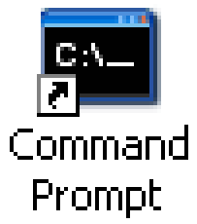
Implementer Tools
Rules, UI, Typelists
J2EE Application Server
Application
Server
Machine
Other XML
Java
CSV
files
Developer
Machine
Notes:
Introduction to ClaimCenter - <number>
Developers responsible for implementing ClaimCenter use a series of tools to configure the ClaimCenter base application to meet the needs of a given carrier. These include:
Guidewire Studio, which is an application used to configure most types of aspects of ClaimCenter such as the user interface, business rules, lines of business and typelists. Business rules are written in GScript, which is Guidewire's proprietary scripting language while most of the other configurable resources are configured in XML.
A third-party XML editor such as Liquid XML (freely available on the internet), XMLSpy or any editor capable of modifying XML is used to configure the resources for which Studio does not provide a specialized editor. This includes the data model, batch scheduling, application-wide configuration and security configuration, amongst others.
A third-party IDE such as Eclipse is used to write the Java code that implements application plug-ins or web services that enable external integration. The IDE often uses ANT, which is a tool for running ANT scripts that execute common application build tasks, such as building the application web archive file, copying changes from the development environment to the deployment environment, or regenerating the data dictionary.
Guidewire command-line utilities for managing tasks such as deploying configuration changes, executing scheduled tasks, or importing user data from comma-separated value (CSV) files into ClaimCenter.
A third-party source control system, which enables multiple developers to work on the same set of code by enforcing check-in/check-out and version control.

Slide 22
Common Implementation Tasks
Task | Studio | XML | Java IDE | Cmnd Prmpt (CSV file)
Configure the data model | X | X
Configure the user interface | X
Configure the business rules (GScript) | X
Configure the integration points |  |  | X
Configure global application behavior |  | X
Import business data (such as users and groups) |  |  |  | X
Import initial configuration data (such as roles + activity patterns) |  |  |  | X
Schedule and run batch processes |  | X
Create and backup the CC database | (through the RDBMS)
Notes:
Introduction to ClaimCenter - <number>
Configuring the data model centers around the creation of new entities, new subtypes, dropdown list values, and/or new fields within existing entities. Only dropdown list values are managed from Studio – the rest in an XML editor.
Configuring the user interface centers around the creation of new screens, the modification of existing screens, and the modification of navigation to screens, as well as GScript functions used within the UI to provide dynamic behavior.
Configuring the business rules centers around the creation of rules for major automated tasks, such as assignment, validation, and transaction approval, as well as GScript functions used within the rules.
Configuring the integration points centers around the writing of Java plugins and adapters to connect to external systems.
Configuring global application behavior centers around specifying behaviors such as whether or not to close a claim automatically when the last exposure is closed, whether to limit search results to only the objects a user has access to, and the amount of time a user can be inactive before he or she is automatically logged off of ClaimCenter.
Importing business data centers around the importing of business data that may already exist in other systems or is otherwise not created directly within ClaimCenter. This could include an existing user and group structure.
Importing initial configuration data centers around importing data used by the application to execute basic functionality, such as sets of permissions (roles) that are assigned to users to denote their level of access, or patterns from which activities are generated.
Scheduling and running batch processes centers around the configuration of batch processes, such as sending check information to the check processing system or processing claim match reports from the ISO database.
RDBMS stands for Relational DataBase Management System.

Slide 23
Lesson Outline
ClaimCenter
ClaimCenter Product Architecture
ClaimCenter Implementation Tasks
Documentation and Support
Notes:
Introduction to ClaimCenter - <number>

Slide 24
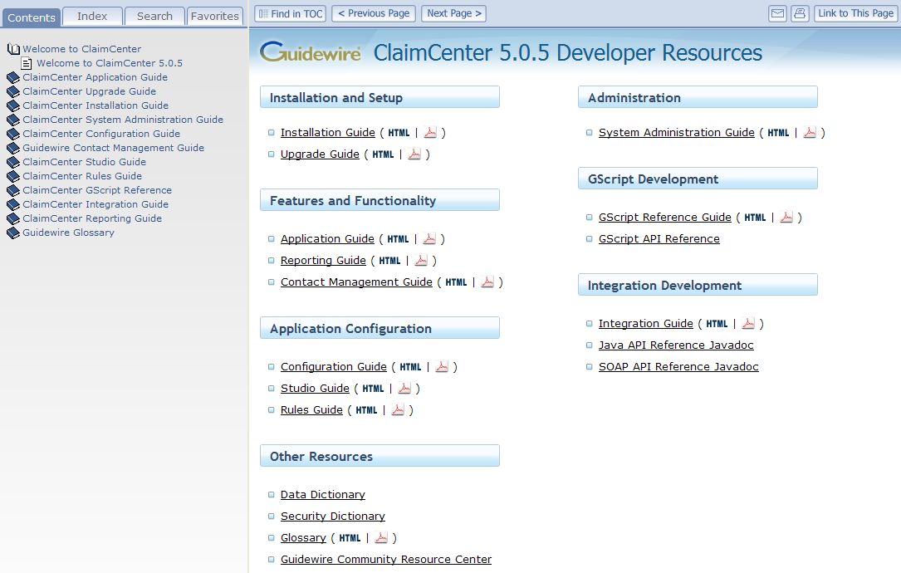
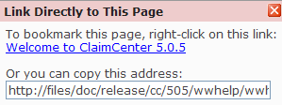
ClaimCenter Documentation Welcome Page
Table of contents
Publication date
Documentation set
Notes:
Introduction to ClaimCenter - <number>
There are two types of ClaimCenter documentation that you can access from the ClaimCenter Welcome page:
Books that are immediately available in both HTML and PDF format
Dynamic documents that need to be generated
Four tabs are provided for searching and navigating the documentation:
The Contents tab displays the table of contents for all books.
The Index tab allows you to select a letter and view all the index entries that start with that letter.
The Search tab allows you to perform a simple word search within the HTML documents. You can select a specific book or choose “All Available Books” to include in your search.
The Favorites tab helps you manage your documentation bookmarks.
The following buttons are available:
“Find in TOC” displays the table of contents with the current topic highlighted.
“Previous Page” and “Next Page” help you navigate sequentially through a document. Note the difference in behavior between “Previous Page” and the back button in your browser: “Previous Page” takes you to the page that immediately precedes the current page whereas the back button redisplays the most recent page you visited.
E-mail opens a new email that includes a link to the current topic.
Print allows you to print the current page.
“Link to This Page” provides a URL for you to copy or bookmark in your browser.

Slide 25
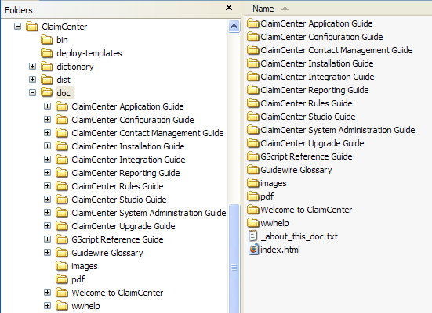
ClaimCenter Documentation
Available from <ClaimCenter home>\doc directory
API references are also available but must be generated
Documentation set in PDF
Always open this file to access full documentation set
Notes:
Introduction to ClaimCenter - <number>
ClaimCenter is shipped with a full set of documentation in both HTML and PDF formats. The recommended way to access the full documentation set is to open the main index.html. You can then bookmark the URL in your browser.
In addition, there are three API references, which you need to generate before you can use them:
GScript API reference is accessible from the Help menu in Guidewire Studio.
SOAP and Java API references are located in <ClaimCenter>\toolkit\doc. Open index.html and then click the link to either the SOAP or the Java API reference.

Slide 26
Using the Documentation
For this task … | Use …
Simple, whole-word search | Search tab to perform a search of all HTML books or of a single book
Comprehensive search | Open a PDF and use the Find facility
Print the current page | Click
Print multiple pages | Open the PDF and print selected pages
Send a link | Click
Bookmark a page in your browser | Click , right-click the link, and select Add to Favorites
Add an entry to the Favorites tab | On the Favorites tab, click Add button to create a link to the current page
Use these facilities for copying and bookmarking instead of using the URL in the address field
Notes:
Introduction to ClaimCenter - <number>
When bookmarking a page or copying the link to a page, do not use the URL in the address field of your browser. Depending on the version of the documentation, the browser URL points either to the root directory of the documentation or to a file name, which is subject to change when topics are added to the documentation. The URLs that are available when you click the E-mail and “Link to This Page” buttons include the topic name instead of the file name so are less likely to change when the documentation is updated. Be sure to use the correct link when sending comments or questions to Guidewire Customer Support.
A simple search facility is provided for HTML documents. This mechanism is especially useful for searching across all HTML documents, but it does not support the use of quotation marks, wild cards, or partial words. For a more comprehensive search, open the PDF version of the document and use the Find facility.
You can perform a cross-book search of the PDF documents but not from your browser:
Open Adobe Reader.
Choose Edit → Search.
Select “All PDF Documents in” and then select the directory that contains the PDF files, such as C:\ClaimCenter\doc\pdf.
Click Search.

Slide 27
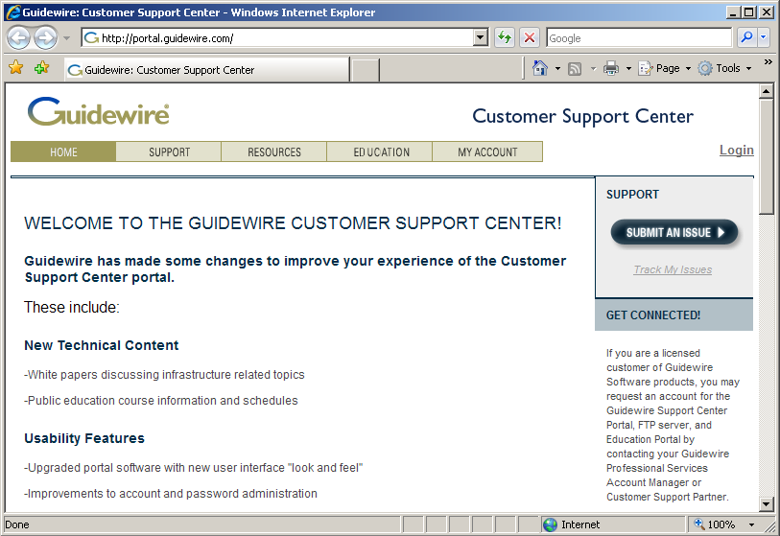
Guidewire Customer Support Center
The Guidewire Customer Support Center is a web site for support and information about Guidewire products
Notes:
Introduction to ClaimCenter - <number>
The Customer Support Center is at http://portal.guidewire.com.
Accounts are automatically created for Guidewire employees and members of the customer implementation team. The credentials to log on to the Customer Support Center are:
User name: firstname.lastname
Default password: portal123
The support and information functionality includes:
Issue management
Product documentation
Infrastructure and methodology white papers
Knowledge base
Implementation highlights
Company events
Users can create and update issues related to their project or organization. Customers can view and submit issues only once they are in production.

Slide 28
Lesson Objectives
You should now be able to:
  Describe the value proposition of ClaimCenter
  Describe the ClaimCenter product architecture
  Describe the tools commonly used and tasks commonly accomplished by technical developers during a ClaimCenter implementation
Notes:
Introduction to ClaimCenter - <number>

Slide 29
Review Questions
App. Server Machine
User Machine
J2EE Application Server
What does
an end user need on his
or her machine to access ClaimCenter?
Name three external systems ClaimCenter is frequently integrated with.
What is stored in the application database?
cc
Application DB
Notes:
Introduction to ClaimCenter - <number>
Answers
1. Internet Explorer (6.0 or higher)
2. Possible answers: Policy administration system, Address book, authentication system, check printing system, reporting system.
3. The operational data for ClaimCenter, as well as metadata which describes the types of entities used in the application, the fields on each entity, and so on.

Slide 30
Reservation of Rights
Copyright © 2008 Guidewire Software, Inc. All Rights Reserved.
This file and the contents herein are the property of Guidewire Software, Inc. Use of this course material is restricted to students officially registered in this specific Guidewire-instructed course. Replication or distribution of this course material electronically or in paper format is prohibited without express permission from Guidewire.
Guidewire, Guidewire Software, Guidewire ClaimCenter, Guidewire PolicyCenter, Guidewire BillingCenter, Guidewire ContactCenter, Guidewire Insurance Suite, Guidewire Education, and the Guidewire logo are trademarks or registered trademarks of Guidewire Software, Inc. All other trademarks are the property of their respective owners.
Notes:
Introduction to ClaimCenter - <number>

