Slide 1
The ClaimCenter User Interface
5.0.0
6-July-2008
Notes:
Guidewire training materials contain Guidewire’s confidential information subject to confidentiality and non-disclosure agreements. You agree to use the information in this manual solely for the purpose of training to implement Guidewire’s software solutions. You also agree not to disclose the information in this manual to third parties or copy this manual without Guidewire’s prior written consent. Guidewire training may only be given by Guidewire employees or certified Guidewire partners under the appropriate agreement with Guidewire.

Slide 2
Lesson Objectives
By the end of this lesson, you should be able to:
  Describe the process of logging into ClaimCenter
  Describe the sections of the user interface
  Describe the hierarchy of screens in the user interface
  Describe the functionality for editing data
  Describe the functionality of setting locales
  This lesson uses the notes section for additional explanation and information.
  To view the notes in PowerPoint, choose View→Normal or View→Notes Page.
  If you choose to print the notes for the lesson, be sure to select “Print hidden slides.”

Slide 3
Lesson Outline
Logging In
Sections of the User Interface
The Screen Hierarchy
Editing Data
Localization

Slide 4
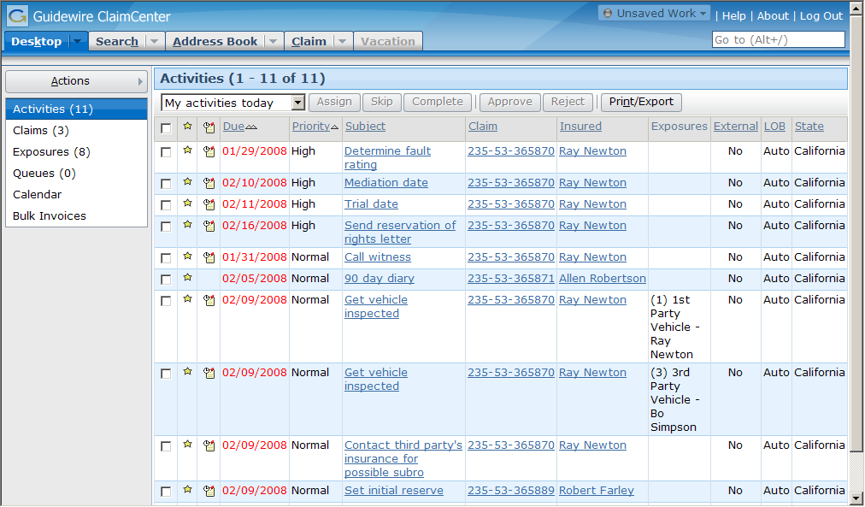
Accessing ClaimCenter
Users must have:
  Internet Explorer
  The ClaimCenter URL
  A user name and password
Notes:
To access ClaimCenter, a user must have:
An instance of Internet Explorer
The URL for connecting to ClaimCenter
A valid user name and password
Internet Explorer is the only web browser currently supported by ClaimCenter. ClaimCenter supports version 6.0 and higher.

Slide 5
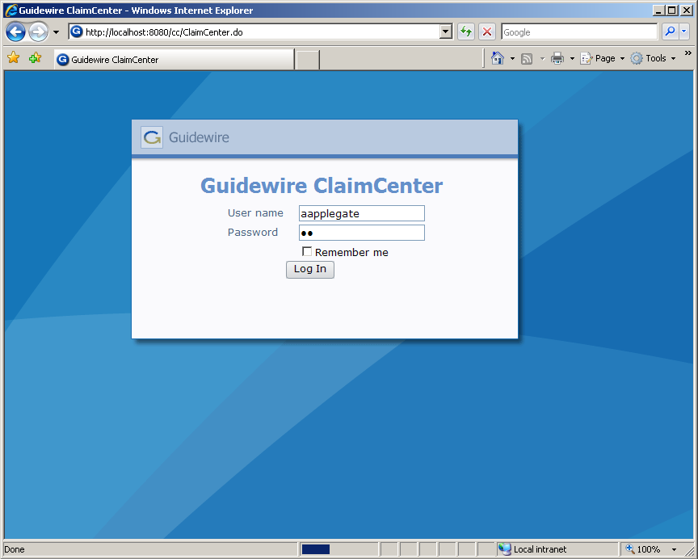
The Login Page
Because the pages are generated dynamically:
  Back is not supported
  You cannot create Favorites to pages (other than the login page)
Notes:
To log in to an application, end users must open an instance of Internet Explorer and access the system through the appropriate URL (Universal Resource Locator, also more commonly known as a "web address"). The URL is:
http://machine:port#/instanceName/ClaimCenter.do, where:
machine is the name of the host machine, and
port# is the port which Internet Explorer should use to access the application, and
instanceName is the name of the instance of ClaimCenter (typically "cc").
Connections to ClaimCenter are usually initiated using one of the following methods:
Providing users with a “Favorite” that links to the URL
Providing users with a shortcut on the computer desktop that invokes Internet Explorer with the URL
Creating a web link on a readily accessible web page that links to the URL
Even though the Back button and favorites to non-login pages are not supported, navigation within ClaimCenter is rarely if ever cumbersome. ClaimCenter contains a number of navigation features to make it easy for users to view commonly referenced information and recently viewed information. These features are discussed through this section.

Slide 6

Authentication and Authorization
username
and password
Desktop: Activities
authenticated?
what permissions?
which start page?
Yes!
View claim, ...
Desktop: Activities
cc
data
Notes:
Authentication is the process of verifying a user is who he or she claims to be. Authorization is the process of determining which objects a user is allowed to view and edit and what actions a user is allowed to take.
When an end user attempts to log on to an application, the following occurs:
The user supplies their user name and password to ClaimCenter via the login page.
ClaimCenter queries the authentication system (which could be a separate system accessed through an integration point or the ClaimCenter database itself) to authenticate the user.
ClaimCenter queries the ClaimCenter database to determine which permissions are assigned to the user and what the user's start page is. Permissions determine which screens the user can navigate to and which actions the user can perform. The startup view is the first page rendered after log in.
ClaimCenter renders the appropriate startup view with permissions appropriate for that user.
Out-of-box, authentication is managed through the ClaimCenter database. There is a table in the database which stores user names and password. (The system can also be configured to authenticate against an existing user domain structure, as discussed on the next slide.)
ClaimCenter can be configured to lock an account after a user attempts to log in a certain number of times without providing the correct password. (This feature is designed to prevent someone circumventing the authentication process to illegal log on to the application.) When an account is locked, it must be unlocked by a manager. In the base application, the number of attempts before locking the account is 3, but this number can be configured.

Slide 7

Authentication Integration
user name, token or
encrypted password
ID
Authentication
System
authentication
results
Almost every instance is integrated with an authentication system, such as ActiveDirectory
  This system takes a user name and either a token or a password and verifies if the two match
Notes:
Information exchange:
ClaimCenter sends the user name and either an encrypted password (if the user is signing on directly to ClaimCenter) or a token (if the user has signed on to another system and is access ClaimCenter via a single sign-on integration point).
ClaimCenter receives information on authentication success or failure
If a user is logging on to ClaimCenter via the login page, then ClaimCenter sends the user name and encrypted password to the authentication system. If a user is logging on to ClaimCenter through some other application which has single sign-on integration with ClaimCenter, then ClaimCenter simply sends the user name and a token.
The effort around planning and configuring this integration point is typically minimal. The data structure of an authentication system is relatively straight-forward, and the amount of information being passed between the two system is small and doesn't change from implementation to implementation.
A given instance of ClaimCenter is typically integrated with a single authentication system.

Slide 8
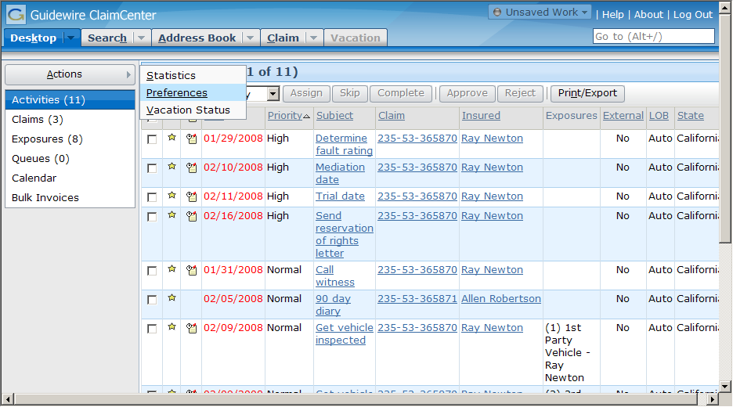
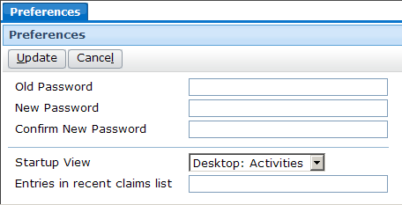
The Startup View
Notes:
Each user has a startup view, which is what is first displayed when the user logs in. This is sometimes referred to as the user's "landing page".
In the base application, a new user's startup view is set to "Desktop: Activities". This page lists all open activities that have been assigned to that user.
Users can change their startup view by clicking the Preferences menu action accessible from the Desktop. This opens a worksheet in the workspace frame. In this worksheet, they can select a different view as their startup view. (The workspace frame displays information that is "stand-alone" from a navigation perspective. The information could be user preferences (which has no impact on business data), or it could be a new note or new activity (which, once created, does not require any change to the data displayed in the screen area). The workspace frame is visible only when a worksheet is rendered. Most of the time, it is collapsed.)
The "look and feel" of ClaimCenter is controlled by a series of cascaded style sheets (CSS). These can be configured if a given instance requires the use of different fonts and/or colors.

Slide 9
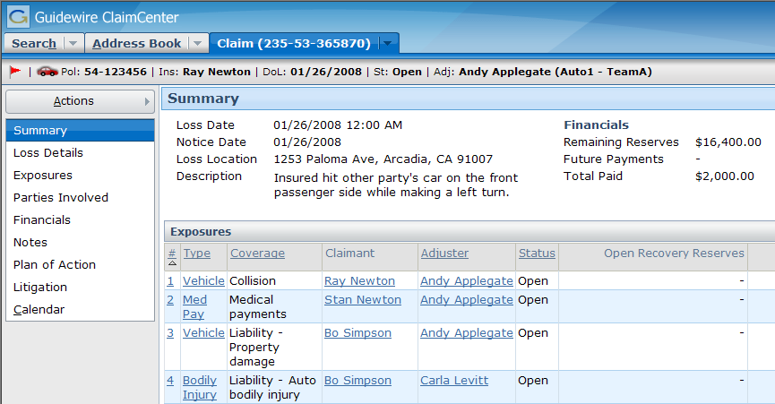
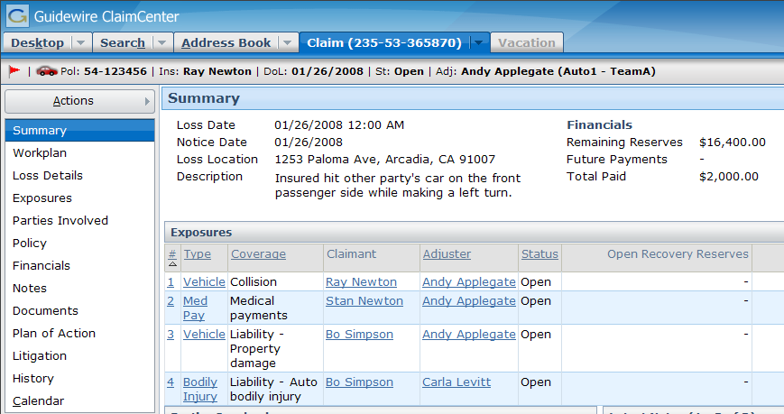
User Permissions
Ida Belt
(Customer Service Representative)
Dana Evans
(Adjuster)
Notes:
A permission is a granular ability to see or do something within ClaimCenter, such as "create activities" or "close exposures".
A role is a named collection of permissions. Typically, a role maps to a job function or job title. For example, the "adjuster" role would contain the set of permissions appropriate to someone who was an adjustor. (This role might, for example, have the "create activities" or "close exposures" permissions, but it would not have the "create users" permission. Similarly, a "customer service representative" role might have only "create activities" and not "close exposures".)
Administrators can assign roles to users. They can also create new roles and modify existing roles (to add or remove permissions to them).
When embedded in Internet Explorer 6.0, the name of the user you are logged on as appears in the title bar (the blue bar at the top of the window). In Internet Explorer 7.0, the name of the user you are logged on as appears in both the title bar and the tab's label.
In the example above, Ida Belt (who is a CSR and is shown in the left screenshot) does not have a Desktop tab. When viewing a claim, she does not have access to the Workplan, Policy, Documents, or History screens. Dana Evans (who is an adjuster and is shown in the right screenshot) has access to all of the things just listed.
User permissions is discussed in detail in the "Permissions" lesson.

Slide 10
Lesson Outline
Logging In
Sections of the User Interface
The Screen Hierarchy
Editing Data
Localization

Slide 11
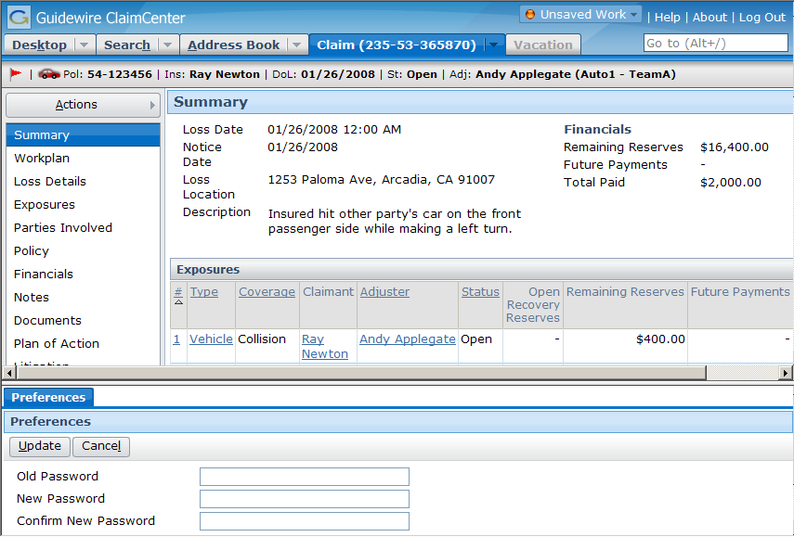
Main Areas of the User Interface
Info Bar
Tab
Bar
Screen Area
Side Bar
Workspace Frame
Notes:
The ClaimCenter user interface can be broken down into the following main areas.
The tab bar is the top portion of the screen. It contains the tabs, a series of tab bar links (such as "Help" and "About") and the Guidewire logo.
The info bar is the horizontal gray strip between the tab bar and the screen area. It is not always visible. (In the base application, it is visible only on the Claim tab.) When it is visible, it either contains summary information about the primary object displayed in the screen area.
The side bar is the vertical bar running down the left side of the user interface. The side bar contains menu links and menu actions that navigate the user to different parts of the application and let the user create new objects and initiate new jobs.
The screen area is the rectangular area to the right of the side bar. When the workspace frame is collapsed, the screen area occupies the lower right corner of the user interface. This is where the majority of the business data is displayed and acted upon.
The workspace frame displays information that is "stand-alone" from a navigation perspective. The information could be user preferences (which has no impact on business data), or it could be a new note or new activity (which, once created, does not require any change to the data displayed in the screen area). The workspace frame is visible only when a worksheet is rendered. Most of the time, it is collapsed.

Slide 12
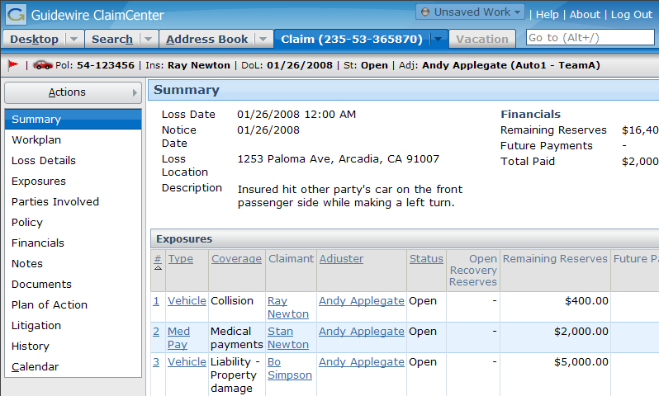
The Tab Bar
A collection of tabs and tab bar links
Each tab has:
  Its own side bar and its own info bar
  Contains one major area of functionality
Notes:
The tab bar is the top portion of the screen. It contains tabs, a series of tab bar links (such as "Help" and "About") and the Guidewire logo.
Each tab has its own side bar, its own info bar (though in some cases it is hidden) and its own set of screens (which are displayed in the screen area). When you click a tab, the associated side bar, (the associated side bar if it is visible,) and one of its screens are displayed.
The tabs shown above are the tabs that adjusters have access to when they first log into ClaimCenter. Customer service representatives do not have access to the Desktop tab in the base application. There are additional tabs (such as Team, Reporting, and Administration) that are available only to users with permissions greater than that of an adjuster.
Adjusters have a Vacation tab. The Vacation tab shows the objects that belong to users who are currently on vacation and for whom you are the designated backup handler. You can manage these objects as if they were your own. If you are not the backup handler for any users currently on vacation, this tab is unavailable (as shown above).

Slide 13
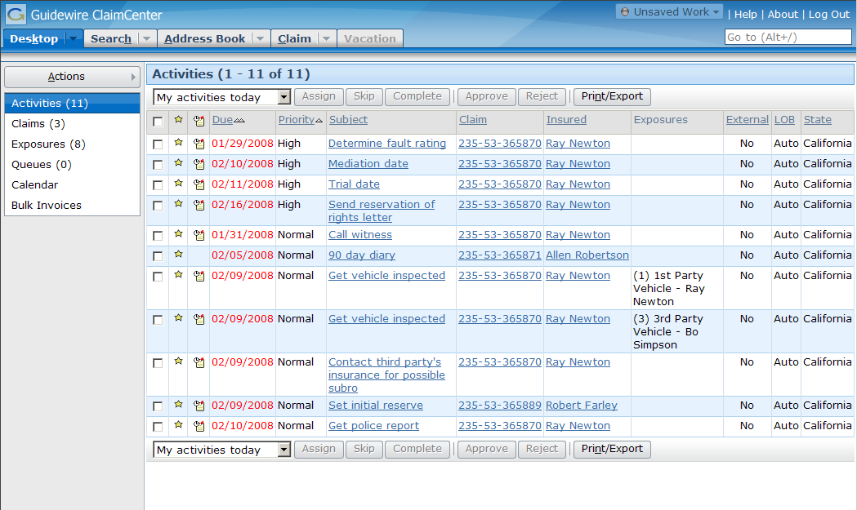
The Desktop Tab
User-centric, listing work you as the user are responsible for (regardless of which claim it pertains to)
Notes:
The Desktop tab is a series of lists of objects for which the user has some responsibility, including:
Activities assigned to the user.
Claims assigned to the user
Exposures assigned to the user
Queues the user has access to (which contain activities that no user has taken ownership of yet)
Customer service representatives do not have access to the Desktop tab in the base application.

Slide 14
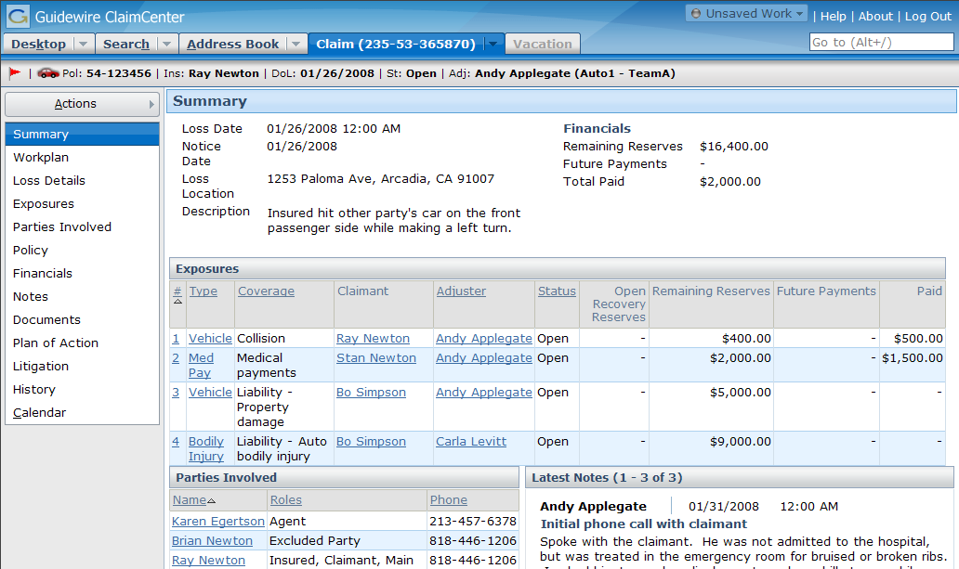
The Claim Tab
Claim-centric, listing work for this claim (regardless of who is doing the work)
Notes:
The Claim tab contains the "claim file", which is a series of screens detailing information about the claim and its exposures.

Slide 15
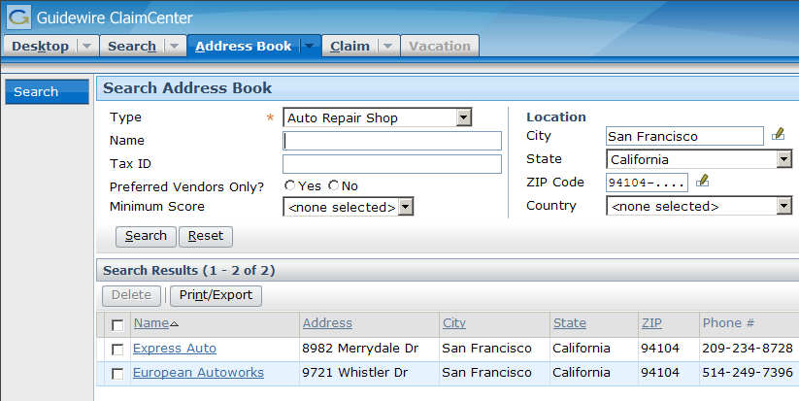
The Address Book Tab
Used to search for contacts listed in an external address book application
Notes:
The Address Book tab is used for searching for contacts listed in an external address book application. This could be Guidewire's ContactCenter application or another customer contact management system.

Slide 16
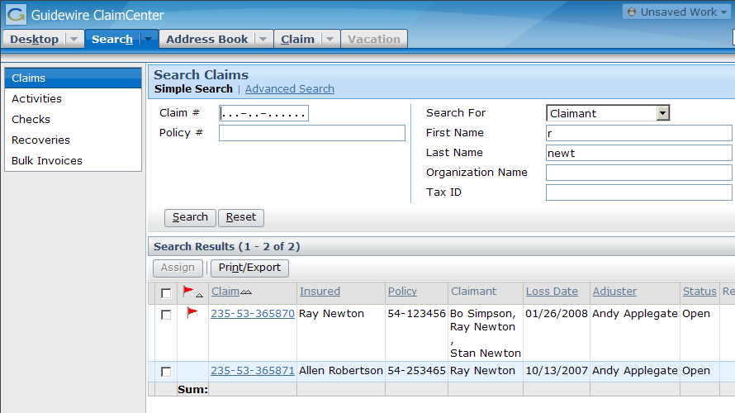
The Search Tab
Text fields are treated as "starts with" conditions
Can have multiple screens with different number of fields
Notes:
The Search tab gives users the ability to search for different types of objects, specifically:
Claims
Activities
Checks
Recoveries
Bulk invoices
Some fields on search screens are text fields. Whenever you enter text into one of these fields, ClaimCenter treats the field as a "starts with" criteria. For example, if you entered "Smith" into the last name field, then the search will return any user whose last name starts with 'Smith', which includes "Smith", "Smithers", and "Smith-Collins".
In the base application, there are two claim search screens, a "simple" one (shown above) and an advanced one with a larger number of search fields. Claim search is the only search which has two screens in the base application, but any entity can have additional search screens created for it.

Slide 17
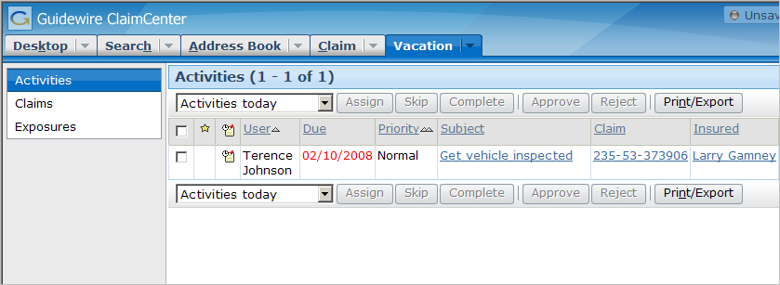

The Vacation Tab
Access to assigned work for user marked as “On vacation”
Visible only if specified as backup user to another user
  Otherwise grayed out
Notes:
Adjusters have a Vacation tab. The Vacation tab shows the objects that belong to users who are currently on vacation and for whom you are the designated backup handler. You can manage these objects as if they were your own. If you are not the backup handler for any users currently on vacation, this tab is unavailable (as shown in previous slides).

Slide 18
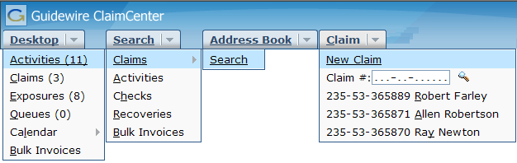
Tab Menus
Tabs usually have menus with shortcuts to screens on that tab
Claim tab menu contains:
  A menu item to initiate the New Claim Wizard
  A special claim search widget
  A list of recently viewed claims
Notes:
Theoretically, the New Claim Wizard can be initiated from any atomic widget. In the base application, the triggering widget is a menu item in the Claim tab menu. This can easily be configured to be a menu action or a button in addition to or in place of the Claim tab menu item.
Users can configure the number of recently viewed claims in the Claim tab menu on the Preferences screen, which is displayed in the workspace frame when you click the Preferences menu action on the Desktop tab.

Slide 19
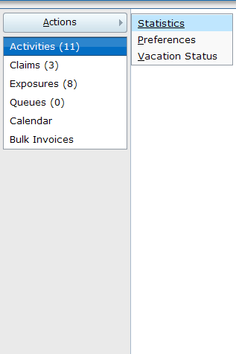
The Side Bar
Menu links display new screens in screen area
Menu actions execute actions (which often display screens in the screen area or workspace frame where a new object can be created)
menu
actions
menu links
Notes:
The side bar is the vertical gray bar running down the left side of the user interface. The side bar contains menu links and the Actions menu, which has embedded menu actions that navigate the user to different parts of the application and let the user create new objects and initiate new jobs.
The behavior described above is true for base application menu links and menu actions. However, any clickable item can be configured to behave in any manner.

Slide 20
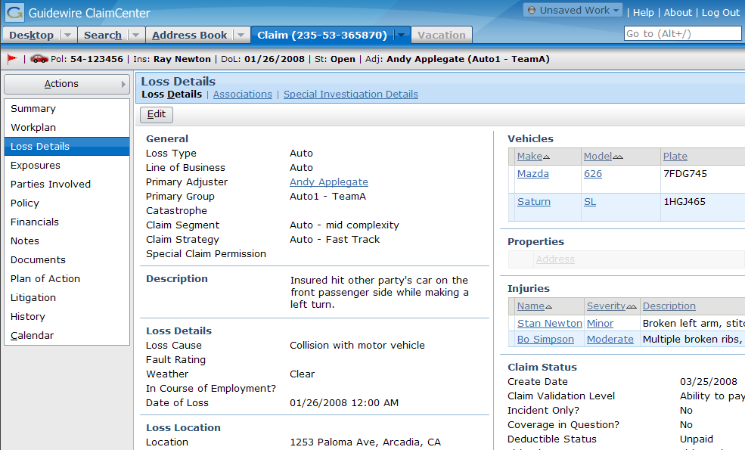
The Screen Area
Screen links
Notes:
The screen area is the rectangular area to the right of the side bar. When the workspace frame is collapsed, the screen area occupies the lower right corner of the user interface. This is where the majority of the business data is displayed and acted upon.
End users typically navigate to a given screen (that is, they cause a screen to be rendered in the screen area) by clicking the appropriate tab and then clicking the appropriate menu link and/or subtab.

Slide 21
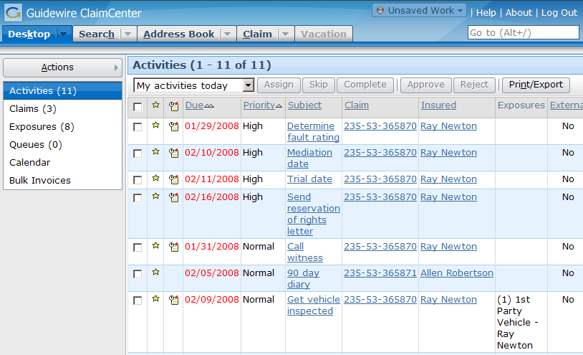
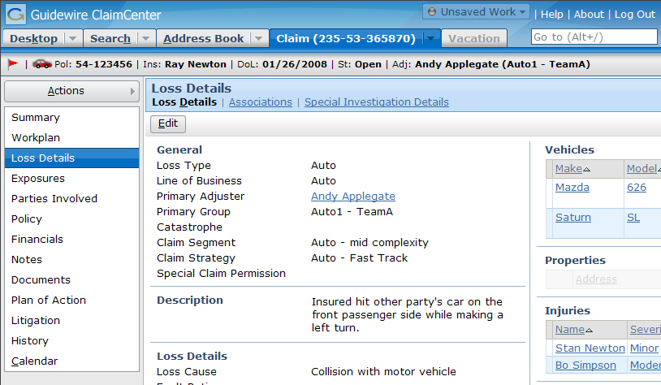
The Info Bar
Notes:
The info bar is the gray strip of UI real estate between the tab bar and the screen area.
The info bar can be visible for some tabs and hidden for others. In the base application, the info bar is visible only for the Claim tab. It contains summary information about the claim, such as the number of the associated policy, the name of the insured, the claim's status, and the adjuster to whom the claim has been assigned.

Slide 22
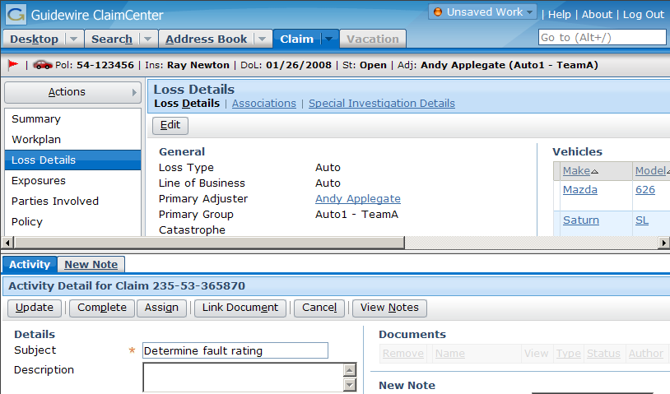
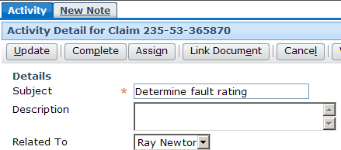
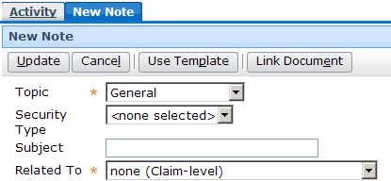
The Workspace Frame
Resizable
Notes:
The workspace frame displays information that is "stand-alone" from a navigation perspective. The information could be user preferences (which has no impact on business data), or it could be a new note or new activity (which, once created, does not require any change to the data displayed in the screen area). The workspace frame is visible only when a worksheet is rendered. Most of the time, it is collapsed.
The workspace frame is resizable. You can adjust the height by dragging the horizontal bar that separates the side bar and screen area from the workspace frame.
Worksheets can have a "scope", which identifies what must be displayed in the screen area in order for the worksheet to be displayed. When the object is displayed in the screen area, the worksheet is visible. When the object is not displayed, the worksheet is not visible. This means that worksheets can appear and disappear (without explicitly being dismissed by the user) as the user moves from one top-level tab to another.

Slide 23
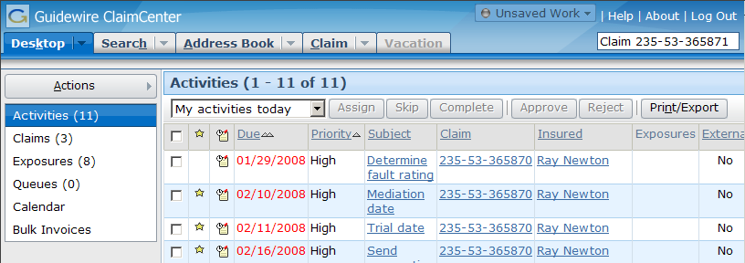
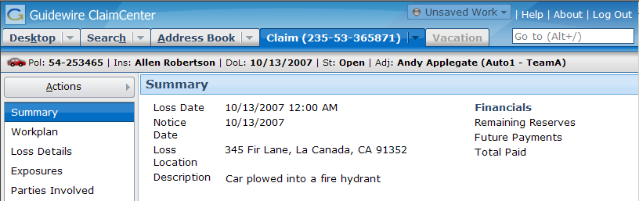
The "QuickJump" Field
ALT+/, and then
"Claim 235-53-365871"
and then Enter
Notes:
The QuickJump field is located in the upper-right corner of the user interface, though it can be accessed using a keyboard shortcut as well. The QuickJump field is designed to let users navigate to virtually any place in ClaimCenter without having to use their mouse.
For example, to navigate to claim 235-53-356871, a user could enter ALT+/ (to activate the QuickJump field) and then "Claim 235-53-365871" and then Enter. This navigates the user to that claim.

Slide 24
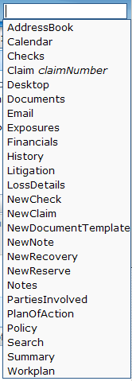
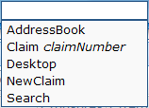
Options for the "QuickJump" Field
From the Claim tab (when a claim is in focus), any of these can be entered into the QuickJump field to navigate to the associated screen
From all other tabs (when no claim is in focus), the set of valid QuickJump options is smaller
Notes:
The valid set of character strings that can be entered in the base application's QuickJump field depends on which tab the user is on.
The largest set of options is tied to the Claim tab. This is because there are a number of places the user can navigate to once a given claim has been selected. The user can:
Navigate to a different tab (for example, "AddressBook" takes the user to the Address Book tab)
Navigate to a screen relevant to the claim in focus (for example, "LossDetails" takes the user to the Loss Details screen for the active claim)
Navigate to a screen where a new object can be created (for example, "NewNote" takes the user to the New Note screen for the active claim)
If there is no claim in focus (which is the case when the Desktop, Search, or Address Book tabs are active), then the user can only go to a given tab or start a new claim.
The QuickJump box is configurable. Developers can remove existing QuickJump strings, modify the spelling for existing strings, and create new ones.

Slide 25

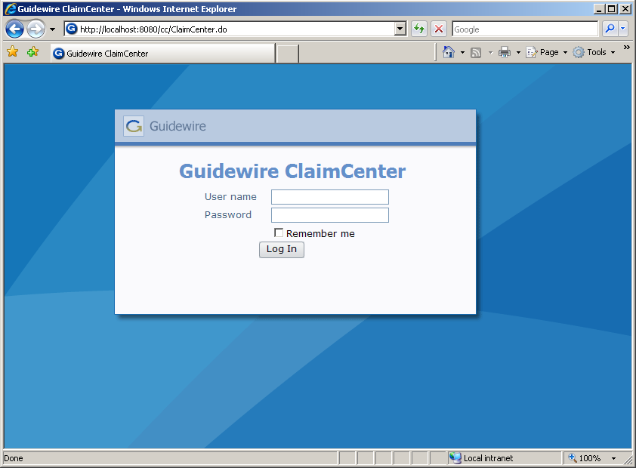
Logging Out
After the configured period of inactivity, OR
when you click...
Notes:
When a user is finished interacting with ClaimCenter, he or she can log out using the Logout link.
The timeout period can be configured in the config.xml file. The default value is 10800 seconds (3 hours).

Slide 26
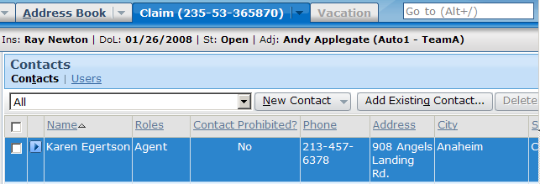
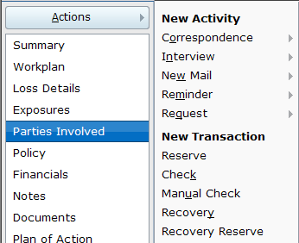
Keyboard Shortcuts
Activating shortcut is equivalent to clicking item
To activate a shortcut, enter
ALT + the_underlined_letter
Notes:
All keyboard shortcuts specific to ClaimCenter must start with the ALT key. Keyboard shortcuts specific to ClaimCenter cannot start with the CTRL key, as that key is already "owned" by Internet Explorer. (For example, CTRL + N opens a new Internet Explorer window. This sequence cannot be used by ClaimCenter.)
Keyboard shortcuts can be reconfigured. For example, if the legacy system had a keyboard shortcut for searches which was ALT + C, then the Search shortcut, which is ALT + H in the base application, could be reconfigured to be ALT + C.
There is also a series of global shortcuts. These shortcuts can be used at any time, regardless of where in the application the user has navigated to. A list of the shortcuts can be displayed by clicking the Help link in the tab bar.

Slide 27
Lesson Outline
Logging In
Sections of the User Interface
The Screen Hierarchy
Editing Data
Localization

Slide 28



Elements of a Screen
Screen
Secondary View
Primary View
Primary View
atomic
widgets
atomic widgets
Notes:
The screen hierarchy describes the levels of information in the screen area (and workspace frame) and the level at which one navigates to that information. It consists of four levels, described below from the lowest to the highest.
The atomic widget level is the most granular level of the user interface. It is the level of individual units of data (such as text, dates, and yes/no values) and individual units of functionality (such as buttons or menu items).
The primary view level is the level at which atomic widgets are organized to display information about a single object (and data related to that object) or a single set of objects. Detail views are the views used for the single-object approach. List views are the views used for the set-of-objects approach.
The secondary view level is the level at which primary views are organized to display information in a format usable to the end users. Card views are used to group different detail and list views so that any view one can easily be accessed but only one view is visible at a time. Listdetail views are used to quickly display complex information about any given object within a set of objects.
The screen level is the level which organizes all data which should be displayed at one time (or in other words, one large area of functionality). The information in a screen occupies the entire screen area or workspace frame.
A navigation widget is a widget that, when clicked, causes new information to be rendered in the screen area (or workspace frame). Navigation involves the rendering of one or more screens.

Slide 29

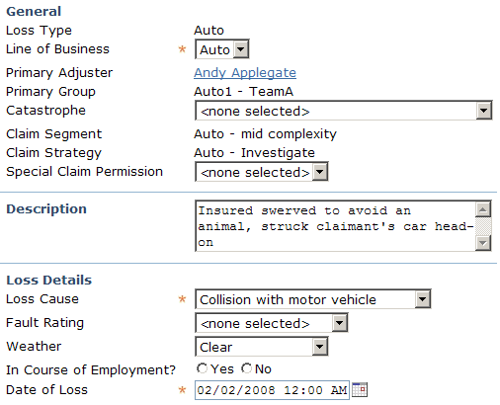
Atomic Widgets
static label
cell
field
button
An atomic piece
of user interface
content
or functionality
(a field, cell,
button, or static
label)
Notes:
The majority of atomic widgets appear in detail views, list views, or on toolbars. Atomic widgets do also appear in the tab bar and the side bar. However, these represent probably less than 20% of the atomic widgets in the ClaimCenter base application.
Within the Guidewire user interface architecture, fields are commonly referred to as "inputs". This is because they are created using an element known as an "input".

Slide 30
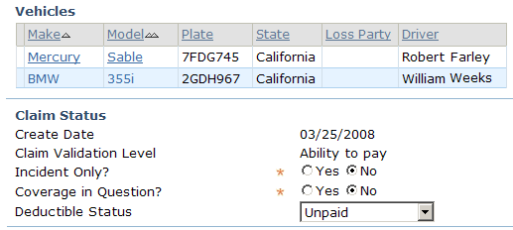
Primary Views
List
View
Detail
View
Organize atomic widgets that display information about one object or one set of objects
  Two types of primary views

Slide 31
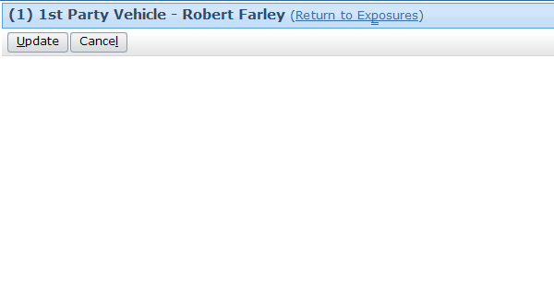
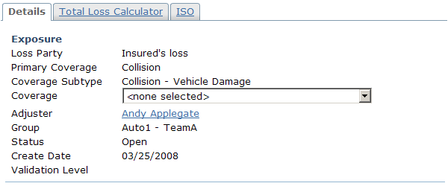
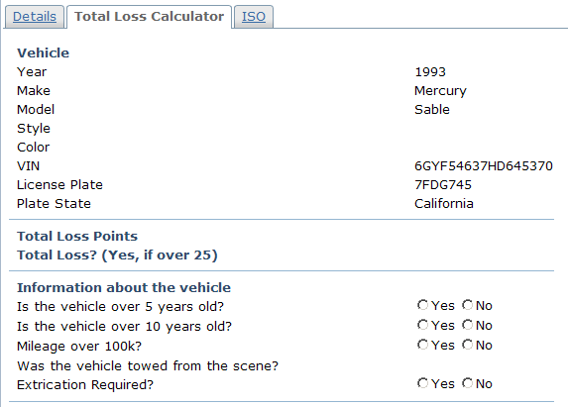
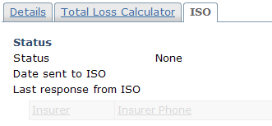
Secondary Views: Card View
A card view is a collection of cards
  Each card contains a detail view, list view, card view, or listdetail view
Notes:
In the example above, the card view is a collection of three detail views.

Slide 32
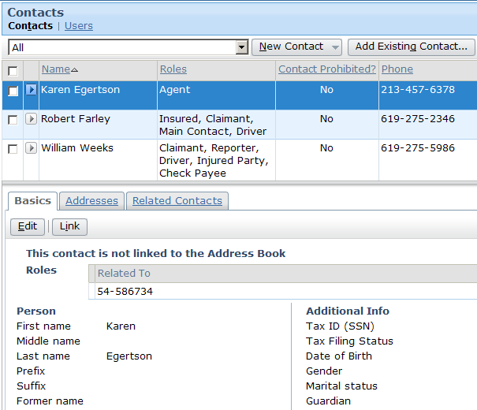
Secondary Views: Listdetail View
Listdetail view
List on top
"Details" of selected row on bottom
Contains a list on top with one object selected and "details" about that object on the bottom
  The "details" could be a detail view, list view, card view, or embedded listdetail view
Notes:
In the example above, the listdetail view is a collection of two views:
A list view (the list of contacts on top)
A card view (a set of three additional lists, each on their own card, on the bottom)

Slide 33
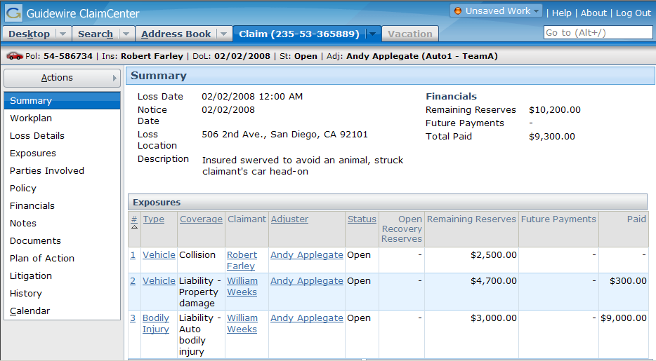
Screens
Entire contents of screen area (or workspace frame)

Slide 34
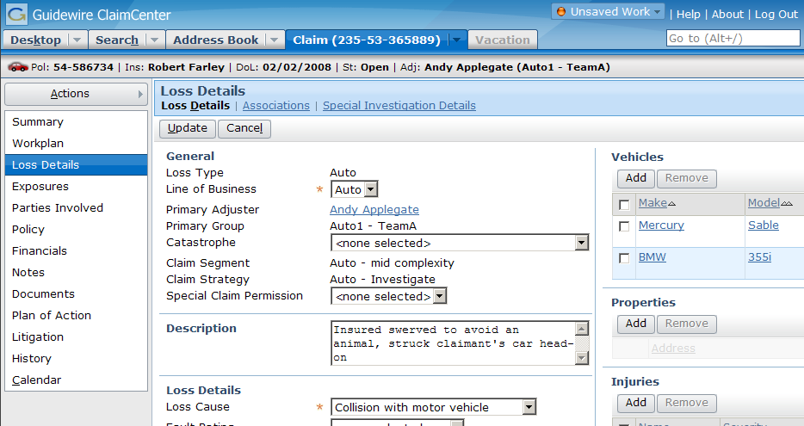
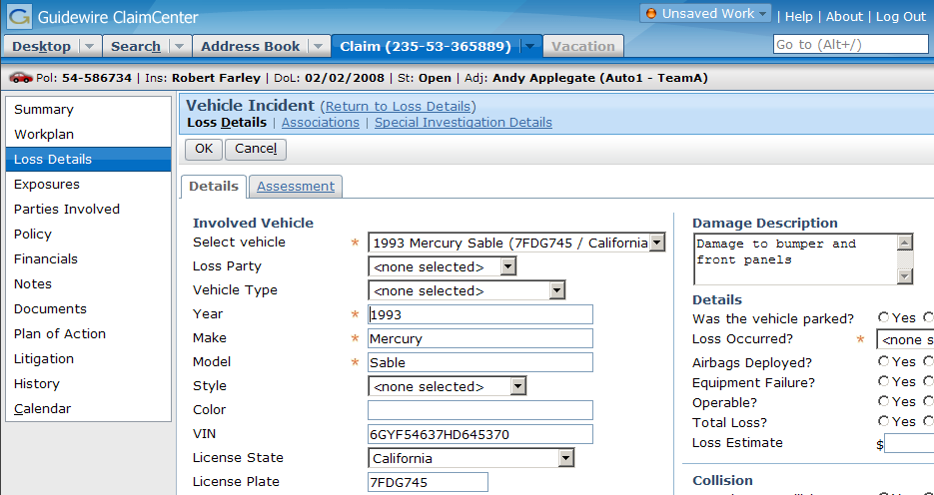
Screen Navigation
Navigation is the act of rendering a new screen (or set of screens)
Notes:
A navigation widget is an atomic widget which is clickable and which causes one or more new screens to be rendered when clicked. Navigation is a property that almost any atomic widget can have.
A navigation specifies:
Which screen or screens to display
Where to display them
Whether the previous "location" should be remembered so that the user can be returned there when the work on the current screen is done

Slide 35
Review: The Screen Hierarchy
Navigation
screen
a top-level container
one can navigate to
Screen
secondary views
collections of primary views organized for usability
Card View / ListDetail View
primary views
a single object (and its related data) or set of objects
Detail
View
List
View
atomic widgets
individual elements of data and/or functionality
Atomic Widgets

Slide 36
Lesson Outline
Logging In
Sections of the User Interface
The Screen Hierarchy
Editing Data
Localization

Slide 37
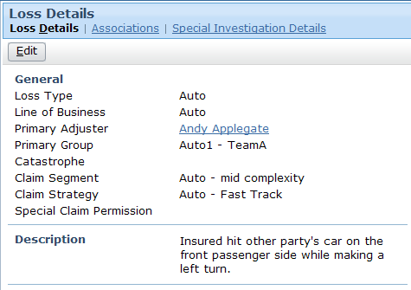
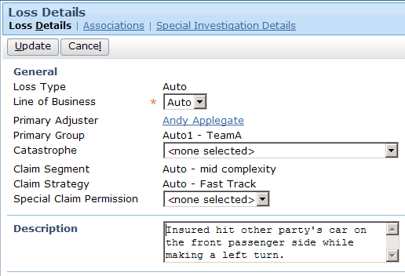
Edit Modes
read-only
editable
Screen has two "edit modes": read-only and edit
Notes:
When a screen is put into edit mode, the widgets that can be edited become editable. In some cases, a widget is not editable even if the screen is in edit mode. This is common when:
The business process doesn't allow the widget value to be changed at this point (such as the loss type for a claim, which is set when the claim is first created and cannot be modified after the claim is created).
The user doesn't have sufficient permission to edit the widget (such as the status field (open or closed) for an activity that is not owned by the given user).
There is a separate mechanism for modifying the widget value (such as the Primary Adjuster field, which is set by reassigning the claim).

Slide 38
Read-Only Mode
Widget values cannot be modified
Depending on functionality and permissions, may be an Edit button
Notes:
Every screen does not always have a toolbar with an Edit button when in edit mode. Some screens are designed to always be read-only (such as the History screen). Consequently, the Edit button appears only if:
The screen has been configured to be editable, and
The user has sufficient permissions to put the screen in edit mode.

Slide 39
Edit Mode
Some (or all) widget values can be modified
Update button and Cancel button
Notes:
Editability can be controlled at many levels, including the screen level and the widget level. In order for a widget to be editable, the screen must be in edit mode and the widget must be editable. If a screen is in edit mode, then any of its widgets which are editable can be modified (such as the Description field shown above). However, if a widget is set to read-only (such as the Loss Type field shown above), then it will always be read-only, regardless of the screen mode.
If a screen is in Edit mode, it should always have Update and Cancel buttons.

Slide 40
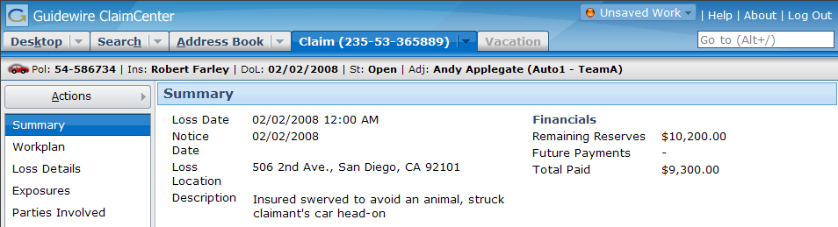
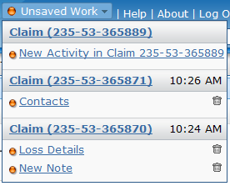
The Unsaved Work Menu
unsaved on current claim
unsaved on previously
visited claims
Notes:
"Unsaved work" refers to either work in a screen for a new object which you created but did not save or work in a screen for an existing object which you put into edit mode without updating or cancelling. In other words, unsaved work refers to any work which you navigated away from without clicking the Update or Cancel buttons.
All of your unsaved work is automatically listed in the Unsaved Work menu. Work for the claim currently in focus is listed at the top, and work for previously visited claims is listed underneath.
From the Unsaved Work menu, you can either navigate to the screen where the unsaved work is (by clicking the link) or discard the work (by clicking the corresponding trash icon).
If you attempt to log off with unsaved work, you are warned that all unsaved work will be discarded. If you click Ok, then all unsaved work is discarded.
The Unsaved Work menu is available only when you have unsaved work. If the menu is unavailable, then you have Update'd or Cancel'led all changes you have made so far.

Slide 41
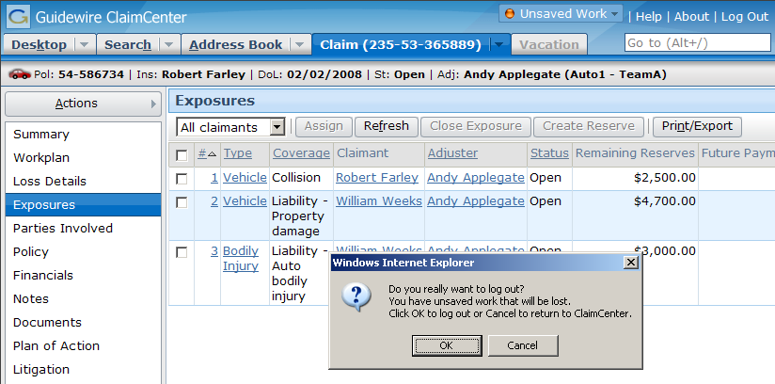
Logging Off with Unsaved Work
If the user attempts to log out and there is unsaved work...
... the user must verify that it is okay to discard the unsaved work.
Notes:
If the user inadvertently closes the web browser (without formally logging off) and he or she reconnects to the server immediately, all unsaved work should be preserved. However, if the user does not reconnect immediately, the session may time out. When a session times out, all unsaved work is discarded.

Slide 42
Lesson Outline
Logging In
Sections of the User Interface
The Screen Hierarchy
The Screen Hierarchy
Localization

Slide 43
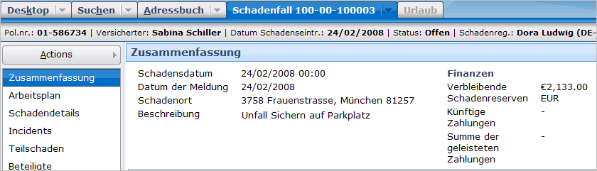
Localization
A locale can define how various elements of the UI are presented, including
  Currency formats
  Date/time formats
  Number formats
  Text labels

Slide 44
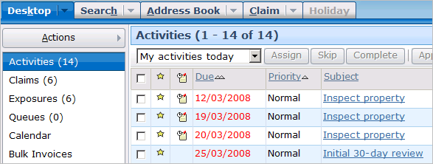
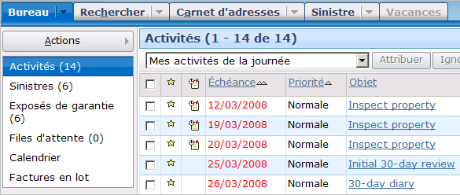
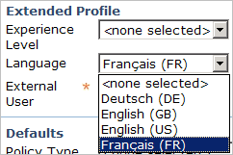
Setting User Locale
Language and locale preference can be set per user
  At logon
  Via preferences

Slide 45
Lesson Objectives
You should now be able to:
  Describe the process of logging into ClaimCenter
  Describe the sections of the user interface
  Describe the hierarchy of screens in the user interface
  Describe the functionality for editing data
  Describe the functionality of setting locales

Slide 46
Review Questions
When a user attempts to log into ClaimCenter, the ClaimCenter database is queried for what three pieces of information?
Name two ways in which the user interface could look different for users with different permissions.
Name two differences between the screen area and the workspace frame.
In the base application, how many different side bars can a user with adjuster permissions see?
Within ClaimCenter, what shouldn’t you do to go back to a screen you previously viewed?
When a navigation occurs, what level of the user interface does the system navigate to?
Name two ways a user could identify if they have any unsaved work.
Notes:
Answers
1. Whether or not the user can be authenticated, what are the user's roles (permissions), and what is the user's startup page.
2. Possible answers:
A given tab might be visible or not visible.
A given menu link might be visible or not visible.
A given menu action may have fewer or more menu items within it.
3. Possible answers:
The screen area is always visible, whereas the workspace frame appears only if something is rendered within it.
The screen area contains the majority of the business data, whereas the workspace frame contains data that is navigationally distinct from the screen area.
If the screen area contains multiple sets of information, each is accessed via a "subtab" link and all subtab links are always visible, whereas if the workspace frame contains multiple sets of information, each is accessed via a tab and that tab may or may not always be visible depending on what is displayed in the screen area.
4. Four (or five). An adjuster can access four tabs (Desktop, Claim, Address Book, Search), and each tab has its own side bar. (If an adjuster is designated as the backup user for another user on vacation, then the Vacation tab becomes active and a fifth side bar can be viewed.)
(continued)

Slide 47
(Notes Only Slide)
Notes:
5. In ClaimCenter, the Internet Explorer Back button is not supported. This is due to limitations with Internet Explorer and the fact that ClaimCenter is a series of dynamic HTML pages (as opposed to static HTML pages). In most cases, to view a screen previously viewed, you must re-navigate to it. Fortunately, there are a large number of shortcuts (such as the list of recently viewed claims in the Claim tab menu). Consequently, viewing a previously viewed screen is typically only a few clicks away.
6. Navigations navigate to the screen level.
7. The Unsaved Work menu is available only when there is unsaved work. If a user attempts to log off ClaimCenter and there is unsaved work, a dialog box alerts them to this fact.

Slide 48
Reservation of Rights
Copyright © 2008 Guidewire Software, Inc. All Rights Reserved.
This file and the contents herein are the property of Guidewire Software, Inc. Use of this course material is restricted to students officially registered in this specific Guidewire-instructed course. Replication or distribution of this course material electronically or in paper format is prohibited without express permission from Guidewire.
Guidewire, Guidewire Software, Guidewire ClaimCenter, Guidewire PolicyCenter, Guidewire BillingCenter, Guidewire ContactCenter, Guidewire Insurance Suite, Guidewire Education, and the Guidewire logo are trademarks or registered trademarks of Guidewire Software, Inc. All other trademarks are the property of their respective owners.

