Slide 1
Course Overview Section Review
5.0.0
6-July-2008
Notes:
Guidewire training materials contain Guidewire’s confidential information subject to confidentiality and non-disclosure agreements. You agree to use the information in this manual solely for the purpose of training to implement Guidewire’s software solutions. You also agree not to disclose the information in this manual to third parties or copy this manual without Guidewire’s prior written consent. Guidewire training may only be given by Guidewire employees or certified Guidewire partners under the appropriate agreement with Guidewire.

Slide 2
The Guidewire Platform
Every Guidewire product is built from what four platform-level technologies?
ClaimCenter
PolicyCenter
BillingCenter
Guidewire Platform,
with a common technology for configuring...
???
???
???
???

Slide 3



The ClaimCenter Architecture
??? Server
Identifies
what is covered...
User Machine
???
Stores reusable contacts...
Verifies user identity...
cc
???

Slide 4
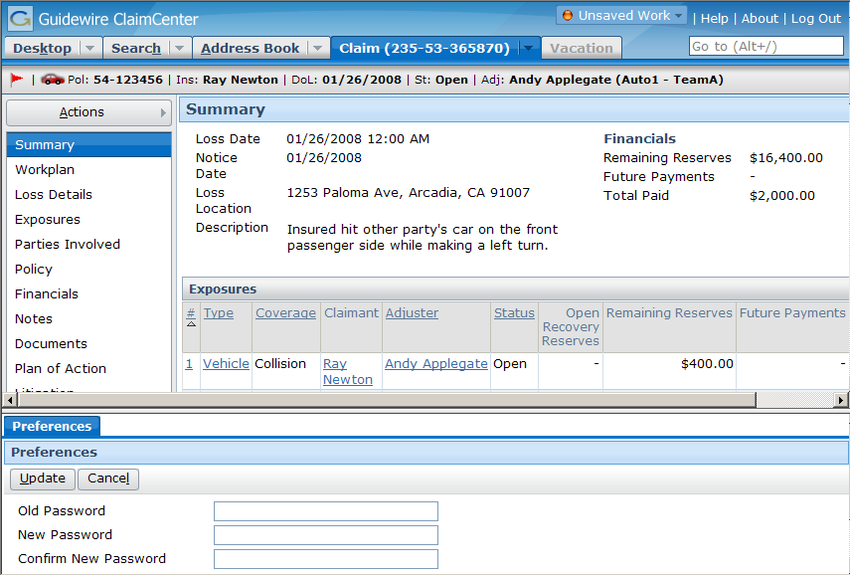
Main Areas of the User Interface
T??? B???
I??? B???
S??? A???
S??? B???
W??? F???

Slide 5
The Screen Hierarchy
Navigation
a top-level container
one can navigate to
S???
secondary views
collections of primary views organized for usability
C??? V??? / L??? V???
primary views
a single record (and its related data) or set of records
D???
V???
L???
V???
A??? W???
individual elements of data and/or functionality

Slide 6


Primary Entities in the Data Model (1)
policy
(and coverages)
Which entity is used to create the "workplan"?
For an auto claim, which entity would be used to detail the damage to the car?
group & user
claim
contact
incident
exposure
activity
document
note
matter
reserve line
check

Slide 7
Primary Entities in the Data Model (2)
Which entity describes the losses that are covered?
Which entity is used to identify the person who reported the claim?
policy
(and coverages)
group & user
claim
contact
incident
exposure
activity
document
note
matter
reserve line
check

Slide 8
Primary Entities in the Data Model (3)
Which entity is defined as "an event in which one or more losses occurred"
Which entity is related to one coverage and one claimant?
policy
(and coverages)
group & user
claim
contact
incident
exposure
activity
document
note
matter
reserve line
check

Slide 9
Primary Entities in the Data Model (4)
Which entity is the money set aside for expected payments?
Which entity identifies who is responsible for processing the claim?
policy
(and coverages)
group & user
claim
contact
incident
exposure
activity
document
note
matter
reserve line
check

Slide 10
The Claim Processes: Business Perspective
L???
F??? D???
I???
S???
I???
A???
P???
R???

Slide 11
The Claims Process: Functional Perspective
(a) Close claim
(01)
(b) Close exposures
(02)
(c) Complete activities
(03)
(d) Create claim
(04)
(e) Create exposures
(05)
(f) Create reserves
(06)
(g) Make claim and exposures payable
(07)
(h) Make payments
(08)

Slide 12
Congratulations
Your work on the Introduction to ClaimCenter is complete!
policy
(and coverages)
group & user
claim
contact
incident
exposure
activity
document
note
matter
reserve line
check

Slide 13
Reservation of Rights
Copyright © 2008 Guidewire Software, Inc. All Rights Reserved.
This file and the contents herein are the property of Guidewire Software, Inc. Use of this course material is restricted to students officially registered in this specific Guidewire-instructed course. Replication or distribution of this course material electronically or in paper format is prohibited without express permission from Guidewire.
Guidewire, Guidewire Software, Guidewire ClaimCenter, Guidewire PolicyCenter, Guidewire BillingCenter, Guidewire ContactCenter, Guidewire Insurance Suite, Guidewire Education, and the Guidewire logo are trademarks or registered trademarks of Guidewire Software, Inc. All other trademarks are the property of their respective owners.

