Slide 1
Introduction to Claim Intake
5.0.0
6-July-2008
Notes:
Guidewire training materials contain Guidewire’s confidential information subject to confidentiality and non-disclosure agreements. You agree to use the information in this manual solely for the purpose of training to implement Guidewire’s software solutions. You also agree not to disclose the information in this manual to third parties or copy this manual without Guidewire’s prior written consent. Guidewire training may only be given by Guidewire employees or certified Guidewire partners under the appropriate agreement with Guidewire.

Slide 2
Lesson Objectives
By the end of this lesson, you should be able to:
  Define the steps of the claim intake process
  Identify the steps of automated claim setup
  Describe how validation is performed for new claims
  This lesson uses the notes section for additional explanation and information.
  To view the notes in PowerPoint, choose View→Normal or View→Notes Page.
  If you choose to print the notes for the lesson, be sure to select “Print hidden slides.”

Slide 3
Lesson Outline
The Claim Intake Process
Automated Claim Setup
New Claim Validation

Slide 4

First Notice of Loss (FNOL)
First Notice of Loss is the event in which the carrier is informed of a potentially covered loss
  For workers' comp claims, also known as First Report of Injury (FROI) or First Notice of Injury (FNOI)
Notes:
The FNOL event is significant because:
It is the point in time at which the claim is created and assigned to an adjuster.
It is the point in time which determines when other events must occur. (For example, the business process may require that all coverages in question be verified within 30 days of the FNOL.)
It is the first major opportunity to control costs with regards to reducing leakage. (For example, if the FNOL process is sufficiently robust, then an auto claim which is a total loss can be assessed rapidly, and costs associated to storing the car can be reduced or eliminated.)
It is the first major opportunity to control costs with regards to business efficiency. (For example, if the FNOL process is sufficiently robust, then general information can be collected by first-tier CSRs, which frees the more expert-level adjusters to spend their time focusing exclusively on the aspects of claim processing that require their expertise.)
It can set the tone for the entire claim process. If the insured feels that the carrier is concerned about the loss, it can expedite processing of the claim and minimize the chance of later legal action.
(continued)

Slide 5
(Notes Only Slide)
Notes:
Across the industry, the term "FNOL" has more than one use. It can be used to mean:
The event during which the carrier is first notified of a loss
The form used to capture information about the loss
The set of information imported into a claims processing system from which a claim is initially generated
This course uses the term "FNOL" to refer to the event.
For simplicity, this course uses the term FNOL to refer to the first notice of loss/injury for all types of claims.

Slide 6
The Claim Intake Process
Claim is entered in New Claim Wizard
Automated Claim Setup
Create and assign activities
Segment
claim
Assign
claim
Validate
claim
import
Claim is entered in external
FNOL application
Notes:
The claim intake process is represented above with six broad steps. Keep in mind that this is a high-level summary. Some steps may occur in a manner different than what the diagram suggests. There may be additional steps depending on the line of business, whether the claim is entered by a customer service representative or an adjuster, and/or whether special issues such as fraud or recovery are relevant.
There are two ways that a claim can come into existence in ClaimCenter. A claim can be created manually when a "reporter" contacts the carrier and reports the loss. This could be across a number of channels, including in-person, telephone, fax, or customer portal. A ClaimCenter user takes the information and creates a claim from it using the new claim wizard.
Alternately, the claim could be created in an external FNOL application and then imported into ClaimCenter.
Once the claim has been created or imported, it enters the automated claim setup process. There are three primary things that occur during claim setup. First, the claim is segmented. Segmentation is the process of determining the strategy for how the claim should be processed. (For example, is the claim straight-forward or is it complex and will it require adjusters with special expertise.) Then, the claim is assigned. Assignment is the act if determining who is responsible for the claim. The user creating the claim can specify who it should be assigned to, or the assignment could be determined using automated rules. Finally, a series of activities known as the "workplan" are created and assigned. These activities identify the work that must be done to process the claim and who must do it.
(continued)

Slide 7
(Notes Only Slide)
Notes:
After claim setup has been completed, validation rules are executed to verify that the claim meets the minimum set of requirements to exist in the system as a claim other users can view and modify. If any of the validation rules fail, then:
If the claim was created in the new claim wizard, the user must either cancel the claim or fix the errors and re-save the claim.
If the claim was imported, then the import of that claim fails. An error might be returned to the FNOL application and/or logged so that a system administrator could investigate the issue as needed.
When validation occurs successfully, the claim intake process is done.

Slide 8
Who Manages the Intake Process?
For larger carriers, intake is typically managed by a customer service representative (CSR)
For smaller carriers, intake is more typically managed by an adjuster
Notes:
When the intake process is managed by a CSR, the following are typically true:
Exposures are either created automatically during the claim setup process, or manually by adjusters after the intake process. They are not created by the CSR while the claim is initially being created.
When the intake process is managed by an adjuster, the following are typically true:
Exposures may be created manually by the adjuster during initial claim creation. This could cause initial reserves to be set during claim setup. It also may mean that the assignment strategy for the claim has the claim assigned to one user and the exposures to other users.

Slide 9
Commonly Specified Data: The Policy
Determines claim type (such as auto for an auto policy)
Provides information about insured and what is covered
Used to verify that loss is covered and whether any deductibles or limits restrict extent of coverage
Notes:
In the base application, the claim may be linked to an "unverified policy". This is a policy which is not imported from an external policy administration system, but rather is created at the moment by the user entering the claim. In practice, most implementations of ClaimCenter require the user to retrieve a "verified" policy from an external system.

Slide 10
Commonly Specified Data: Parties Involved
During intake, certain parties must be specified, such as:
  The insured
  The reporter (who may or may not be the insured and may or may not be a claimant)
Notes:
Recall the following definitions:
The insured is the person covered by the policy.
A claimant is a person requesting compensation for a loss.
A reporter is a person who identifies that a loss has occurred.

Slide 11
Commonly Specified Data: Loss Event
Typically some minimal amount of information about how the loss occurred, such as:
  Date and time of loss
  Location of loss
  Cause of loss (such as theft, vandalism, collision with another car)
Notes:
The loss details are the most line-of-business-dependent set of information. For example, an auto claim potentially requires information about the vehicles involved, the road conditions, the visibility, and any associated police reports. A workers' comp claim potentially requires information about the date the injury was reported to the employer, the nature of the injury, the diagnosis of the physician, and the work location where the injury occurred.

Slide 12
Commonly Specified Data: Incident(s)
Recall that an item that was damaged or lost is known as an "incident"
Typically, incidents are identified during intake, such as:
  A damaged or stolen auto
  A damaged building
  An injured person
Notes:
For property coverages, the incidents are typically listed on the claim. Information about these items can be copied over from the policy, though the user may still have to specify which items are relevant to the claim. For liability coverages, the incidents must typically be entered entirely by the user.

Slide 13
The Intake Process: Manually Entered Claims
Claim is entered in New Claim Wizard
Automated Claim Setup
Create and assign activities
Segment
claim
Assign
claim
Validate
claim
import
Claim is entered in external
FNOL application
Notes:
A claim can be created manually when a "reporter" contacts the carrier and reports the loss. This could be across a number of channels, including in-person, telephone, fax, or customer portal. A ClaimCenter user takes the information and creates a claim from it using the new claim wizard.

Slide 14

The New Claim Wizard
new
auto
claim
new
WC
claim
new
property
claim
A series of screens that guide
users through manual creation
of new claims
  Incorporates multiple lines of business
  Screens and flow are completely configurable
Notes:
All wizards in ClaimCenter are completely configurable. The configuration options include:
Modifying existing screens so that information is captured in a different way
Deleting screens that gather information irrelevant to a given customer's business
Adding screen that gather information relevant to a given customer's business that are not present in the base application
Modifying the order in which the steps appear
Modifying the availability of steps
Modifying the validation requirements to go from one step to the next
The new claim wizard itself is discussed in detail in the "New Claim Wizard" lesson.

Slide 15
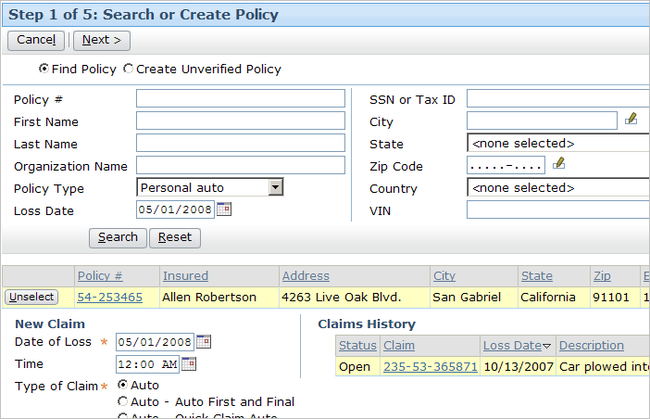
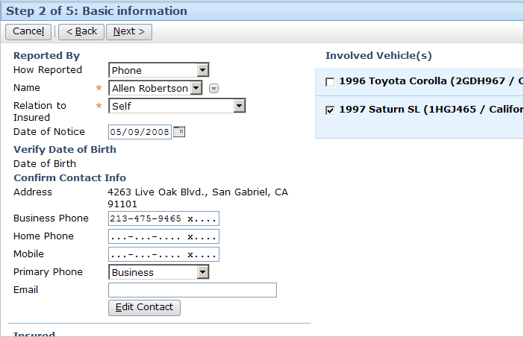
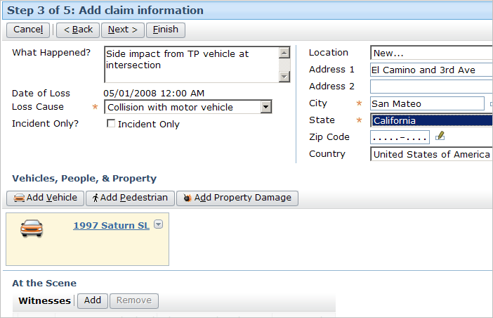
The New Claim Wizard: Sample Screens
Notes:
All wizards in ClaimCenter are completely configurable. The configuration options include:
Modifying existing screens so that information is captured in a different way
Deleting screens that gather information irrelevant to a given customer's business
Adding screen that gather information relevant to a given customer's business that are not present in the base application
Modifying the order in which the steps appear
Modifying the availability of steps
Modifying the validation requirements to go from one step to the next

Slide 16
The Intake Process: Imported Claims
Claim is entered in New Claim Wizard
Automated Claim Setup
Create and assign activities
Segment
claim
Assign
claim
Validate
claim
import
Claim is entered in external
FNOL application
Notes:
A claim could be created in an external FNOL application and then imported into ClaimCenter.

Slide 17



First Notice Application Integration
First
Notice
Application
FNOL reports
Nearly every instance of ClaimCenter has an integration point to a first notice application
  This application stores First Notice of Loss reports in a standard XML-based file format called ACORD XML
  It could be hosted by the carrier or by a FNOL service provider
Notes:
Information exchange:
ClaimCenter does not send any information
ClaimCenter receives FNOL Reports
First Notice Systems (FNS) is a Guidewire partner that handles FNOL intake for all types of insurance carriers. It is the most common FNOL application from which ClaimCenter imports FNOL reports. FNS has both outsourcing services and an application called ClaimCapture. ClaimCapture competes with the Guidewire FNOL/Quick Claim functionality in ClaimCenter to some extent, but the partnership with Guidewire is important because FNS provides a call center service that many of our customers leverage for after-hours operations.
The effort around planning and configuring this integration point is typically minimal. The integration occurs in one direction and the information itself is relatively uncomplicated, inherently structured, and tends to follow at least some accepted industry practices.
A given instance of ClaimCenter may be integrated with one or more first notice applications.
A given FNOL application could be hosted by the carrier. There are also FNOL application providers used by small carriers who cannot afford the infrastructure (such as customer-facing portal) or the round-the-clock access on their own.

Slide 18
Lesson Outline
The Claim Intake Process
Automated Claim Setup
New Claim Validation

Slide 19
The Intake Process: Automated Claim Setup
Claim is entered in New Claim Wizard
Automated Claim Setup
Create and assign activities
Segment
claim
Assign
claim
Validate
claim
import
Claim is entered in external
FNOL application
Notes:
Once the claim has been created or imported, it enters the automated claim setup process. There are three primary things that occur during claim setup. First, the claim is segmented. Segmentation is the process of determining the strategy for how the claim should be processed. (For example, is the claim straight-forward or is it complex and will it require adjusters with special expertise.) Then, the claim is assigned. Assignment is the act if determining who is responsible for the claim. The user creating the claim can specify who it should be assigned to, or the assignment could be determined using automated rules. Finally, a series of activities known as the "workplan" are created and assigned. These activities identify the work that must be done to process the claim and who must do it.

Slide 20
Automated Claim Setup
Automated Claim Setup
Create and assign activities
Segment
claim
Assign
claim
A series of rules designed to:
  Execute any work required for the claim that can be done automatically (such as generating a list of activities to complete)
  Ensure that the claim is ready for adjudication

Slide 21

Pre-Setup
Automated Claim Setup
Create and assign activities
Segment
claim
Assign
claim
WC
claim
Medical
Pre-setup executes rules needed to run before segmentation, such as the automatic creation of exposures
Notes:
For claims associated to an auto policy, there a situations where one or more exposures can be anticipated. For example, if the loss cause is collision, a collision exposure could be created. If a rental car was required, then a rental reimbursement exposure could be created.
For claims associated to workers' comp policies, there is a relatively narrow range of possible exposure scenarios. Therefore, workers' comp exposures are often created automatically during the pre-setup portion of claim setup. The example in the slide above is from a workers' comp policy.
Theoretically, any sort of work can be done during pre-setup.
Exposures are discussed in detail in the "Exposures" lesson.

Slide 22
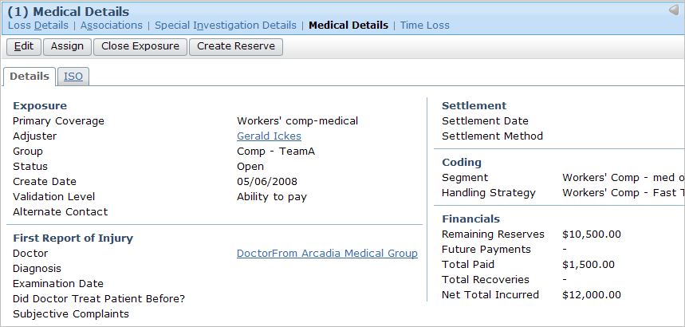
Pre-Setup Rules: Example
if job_related injury = TRUE
and
missed_work = FALSE
then create exposure using medical coverage
Notes:
Automatic exposure creation is common for workers' comp claims because, broadly speaking, there is are only three possible exposure scenarios:
An employee was injured on the job but did not miss any work and the event was not the employer's fault. (For example, John Doe works as a data entry clerk. He slips and falls in a patch of ice while walking from Building A to Building B and sprains his ankle. The injury does not impair his ability to do his job and was not the employer's fault.) In this case, only a single "Medical" exposure is needed.
An employee was injured (or killed) on the job and missed work, but the event was not the employer's fault. (For example, John Doe works as a data entry clerk. He slips and falls in a patch of ice while walking from Building A to Building B and sprains his wrist. The injury does impair his ability to do his job, but it was not the employer's fault.) In this case, two exposures are needed: one for "Medical" and one for "Lost Time".
An employee was injured (or killed) on the job, missed work, and the event is the employer's fault. (For example, John Doe works as a data entry clerk. He slips and falls in a puddle of water in Building A that was caused by improperly maintained plumbing. During the fall, he sprains his wrist. The injury does impair his ability to do his job and it was the employer's fault.) In this case, three exposures are needed: one for "Medical", one for "Lost Time", and one for "Employer Liability".

Slide 23

Segmentation Rules
Segmentation
Rules
Claim 100-00-000027
medium
Segment Types
Assign a segment type value to claim
  Segment type denotes strategy to be used for claim processing, such as:
    "low complexity" for an auto claim involving only windshield damage
    "high complexity" for an auto claim involving a death
easy
medium
hard
Notes:
A claim's segment can be thought of as a label which classifies the general strategy for processing the claim. This strategy could include how the claim is assigned, how reserves are created, and/or the types of activities that are created. Segmentation rules are analogous to a person who looks at a claim and simply affixes a color-coded sticker to it where each color denotes the strategy (as in green means low complexity, blue means normal complexity, and red means high complexity).
Claims have two values which can be used for this classification: segment and strategy. Both of these fields are tied to different hard-coded lists of values. There is no functional difference between the two fields, and a given implementation could chose to use either of them or both.
(continued)

Slide 24
(Notes Only Slide)
Notes:
In the base application, the available values for segment are:
Unknown
Auto - low complexity
Auto - mid complexity
Auto - high complexity
Property - low complexity
Property - mid complexity
Property - high complexity
Liability - low complexity
Liability - mid complexity
Liability - high complexity
Workers' Comp - med only
Workers' Comp - lost time
Auto - glass
Injury - low complexity
Injury - mid complexity
Injury - high complexity
Contents - low complexity
Contents - high complexity
Workers' Comp - employer's liability
In the base application, the available values for strategy are:
Unknown
Auto - Fast Track
Auto - Investigate
Property - Fast Track
Property - Investigate
Liability - Fast Track
Liability - Investigate
Workers' Comp - Fast Track
Workers' Comp - Manage Loss
Injury - Fast Track
Injury - Investigate
Contents - Fast Track
Contents - Investigate
Workers' Comp - Investigate

Slide 25
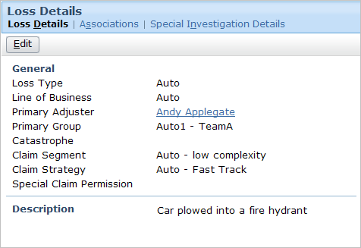
Segmentation Rules: Example
if loss type is auto AND
number of vehicles = 1 AND
injuryOccurred = false
then set segment to "Auto - low complexity"
Notes:
The slide shows an example of a claim a claim segmentation rule. The rule states "for claims where the loss type is auto, there is only one vehicle involved, and there were no injuries, then the claim segment should be set to "Auto - low complexity".

Slide 26
Assignment Rules
Betty Baker
Dana Evans
Western
Auto Adjusters
Claim 100-00-000027
Hank Pym
Janet Van Dyne
medium
Western Complex Auto Adjusters
location: California
Bruce Banner
Tony Stark
Eastern
Auto Adjusters
Notes:
Assignment rules are used to determine the group and user to which a claim is assigned. Assignment rules can make use of the object's segment or strategy value, either by itself or in conjunction with other information (such as the insured's location). Assignment rules can also be written without any reference to the claim's segment.

Slide 27
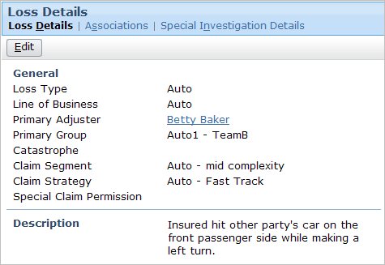
Assignment Rules: Example
if segment is “Auto – mid complexity”
then assign to an auto group in relevant region
AND
assign by round robin to adjuster in that group
Notes:
The slide shows an example of a claim assignment rule. The rule states "If the claim segment is mid-complexity, then assign the claim to a group which is in the same region, and then select a user from that group using round robin assignment." The associated policy has a primary insured who lives in the western region. Therefore, the claim has been assigned to the “Auto1 - TeamB" group, which is a group that exists in the Western Region and which is made up of Auto Adjusters who handle normal auto claims. The type of group can be seen on the Administration tab Group Detail Page (which is visible if you view PowerPoint in Notes view (View | Notes Page)).
Round robin assignment assigns objects to users within a group in a cyclical fashion. The first object goes to the first user, the second object to the second user, and so on. When every user has been assigned an object, the cycle repeats again with the first user. In the example above, Peter Beebe is a user in the US-MW Normal Auto Adjusters group. He is the next user in the round robin cycle when the assignment rules run for this claim. Therefore, the claim is assigned to him.

Slide 28
Contrasting Segmentation and Assignment
easy
medium
hard
Segmentation:
Determines the strategy for processing the object
Is done only for claims and exposures
Sets a single field on the object to a value from a pre-defined list
Is only done once for a given object
Assignment:
Determines the group and owner of the object
Is done for claims, exposures, activities, and matters
Associates object to group and user (chosen from existing groups and users)
Could occur many times for a given object
Notes:
The primary purpose of segmentation is to categorize a claim or exposure with regards to the strategy for processing the claim. This categorization is a simple field value. It may or may not be used by assignment rules, and it may or may not be used in other aspects of claim processing. (For example, certain line items might be written to the claim's history based on its segment, such as details to changes in the parties involved if and only if the claim has a segment of "complex").
The primary purpose of assignment is to determine the owner of an assignable object, which includes activities and matters. The assignment is two foreign keys, one pointing to an existing group and one pointing to an existing user. Assignment may or may not be based on segment.

Slide 29
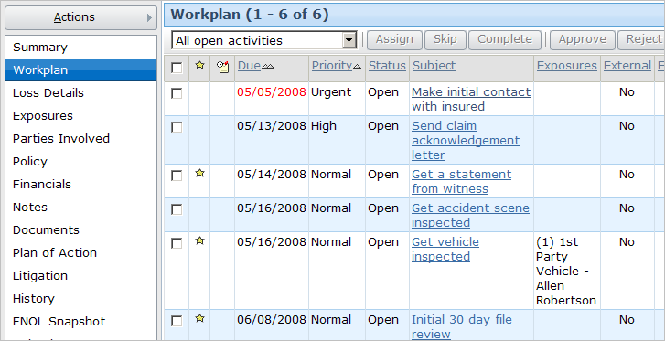
Workplan Rules
The workplan is the list of activities associated to a claim
  Workplan rules create activities
  Activity assignment rules assign activities
Notes:
The workplan itself is simply the set of activities associated to a claim and its exposures. It specifies the work that must be done to process the claim and who must do it.
Activities are assigned using a set of assignment rules. These rules contain logic that identify an owner based on attributes of the activity. For example, a "Contact insured" activity might always get assigned to the owner of the claim. An "Inspect property for mudslide damage" might be assigned to a property inspector who is in the same region as the property which suffered the loss.
Activity creation is not unique to the claim setup process. Activities can also be created automatically when certain events occur. (For example, when the fault rating changes from "no fault" to "other driver at fault", business rules could automatically create an activity to determine if subrogation is appropriate. Subrogation is the act of getting money from the third party or the third party's carrier when the third party is at fault.) Activities can also be created manually by a user. (For example, a user may have a question about the extent of a seldom-encountered coverage, and he or she could create an activity asking a more experienced adjuster to review the policy and the claim.)

Slide 30
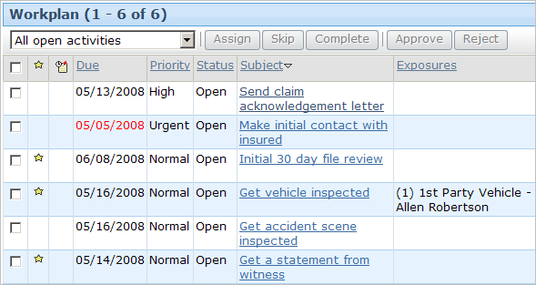
Claim Workplan Rules: Example
if (always)
then create claim acknowledgement activity AND
create initial contact activity AND
create 30 day review activity
Notes:
The slide shows an example of a claim workplan rule. The rule states "Always create three activities - a claim acknowledgement letter activity, an initial contact activity, and a 30 day review activity." The three activities are automatically associated to the claim. Note that the rule only creates the activities. It does not assign them.

Slide 31
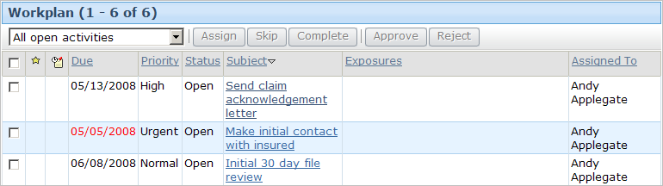
Activity Assignment Rules: Example
if activity is claim acknowledgement activity OR
activity is initial contact activity OR
activity is 30 day review activity
then assign activity to claim owner
Notes:
Similar to claim assignment rules, activity assignment rules assign activities. The slide shows an example of an activity assignment rule. The rule states "Assign all claim acknowledgement activities and initial contact activities and 30 day diary activities to the user who owns the claim."

Slide 32
Summary: Automated Claim Setup
Segment
claim
easy
Assign
claim
Create and assign activities
Notes:
To summarize:
Segmentation rules segment, or determine the strategy for, the claim. The result of these rules is a segment value being assigned to the claim.
Claim assignment rules assign the claim to a group and a user in that group.
Workplan rules create a series of activities for the claim known as the workplan, and assign those activities to appropriate users.

Slide 33
Lesson Outline
The Claim Intake Process
Automated Claim Setup
New Claim Validation

Slide 34
The Intake Process: Claim Validation
Claim is entered in New Claim Wizard
Automated Claim Setup
Create and assign activities
Segment
claim
Assign
claim
Validate
claim
import
Claim is entered in external
FNOL application
Notes:
After claim setup has been completed, validation rules are executed to verify that the claim meets the minimum set of requirements to exist in the system as a claim other users can view and modify. If any of the validation rules fail, then:
If the claim was created in the new claim wizard, the user must either cancel the claim or fix the errors and re-save the claim.
If the claim was imported, then the import of that claim fails. An error might be returned to the FNOL application and/or logged so that a system administrator could investigate the issue as needed.
When validation occurs successfully, the claim intake process is done.

Slide 35
Ensuring Completeness of New Claim
New
Loss
Completion
Intermediate
Levels of
Maturity
Load
Save
ClaimCenter validation levels measure claim maturity
  Also used at end of intake to ensure claim is complete enough to begin adjudication
Policy number is valid
Driver of vehicle is specified
Loss date is specified
If insured at fault, fault rating specified
Notes:
There are three validation levels common to nearly every carrier ("load save", "new loss completion" and "ability to pay"). The intermediate levels vary from carrier to carrier.
In the base application, there are five levels of maturity:
Load save - This is the level a claim must be at in order to be imported from an external system. A claim at this stage has not yet been touched by a user via ClaimCenter. (This level is relevant only for imported FNOLs.)
New loss completion - This is the level a claim must be at to be saved (or modified by a user if the claim is imported).
Valid for ISO - This level is used to signify that the claim has the minimal information needed for filing with ISO.
Send to external (systems) - This level is used to signify that the claim has the minimal information needed to send information about it to external systems within the carrier, such as a policy administration system which is trying to assess policy renewal rates.
Ability to pay - This is the level a claim must be at in order to have payments written against it.
The Valid for ISO and Send to external (systems) levels are configurable. The other three levels are internal levels required by ClaimCenter and cannot be modified. You can also add additional levels not found in the base application.

Slide 36
New Claim Wizard Claims
New
Loss
Completion
Intermediate
Levels of
Maturity
Load
Save
New claim wizard claims must meet all conditions at and below "new loss completion"
Policy number is valid
Driver of vehicle is specified
Loss date is specified
If insured at fault, fault rating specified
Notes:
Claims created through the new claim wizard must meet all conditions at the "new loss completion" level and any level below it. In the base application, the only level below it is "load save".

Slide 37
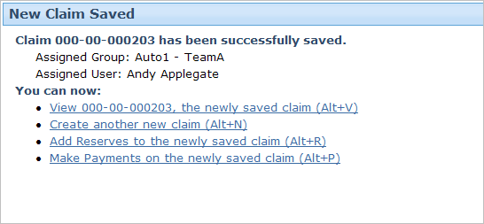
Wizard Claim Passing New Claim Validation
Notes:
When a claim created through the new claim wizard meets all conditions at and below the "new loss completion" level, then the "New Claim Saved" screen is displayed to the user. The information on this screen can be configured, but in the base application it displayed the claim number, the user and group to whom the claim was assigned, and links for likely next steps.

Slide 38
Imported FNOL Claims
New
Loss
Completion
Intermediate
Levels of
Maturity
Load
Save
Claims imported from an external application must meet all "load save" conditions
  Those that do not also meet "new loss" typically need user review
Policy number is valid
Driver of vehicle is specified
Loss date is specified
If insured at fault, fault rating specified
Review
imported FNOL
FNOL
Queue
Notes:
If an imported claim satisfies all conditions at the "load save" level and does not satisfy all conditions at the "new loss completion" level, then an activity is typically generated to review the imported FNOL. This activity is assigned to an "FNOL queue". Users can retrieve the activity from the queue, review the FNOL, and make the changes needed to get it to meet the "new loss completion" level.

Slide 39
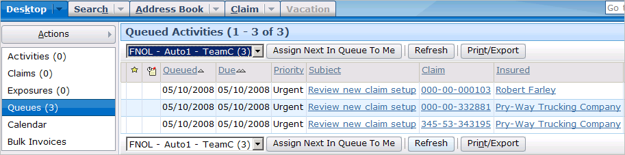
Incomplete Imported FNOLs
Imported FNOLs do not necessarily contain sufficient data to be considered done with intake
  For incomplete FNOLs, an activity is created and placed in an FNOL queue
  From the activity, a user can view the FNOL and modify it as needed
Notes:
Some carriers use FNOL applications that are robust enough such that all imported FNOLs can be considered complete. These carriers do not need to use FNOL queues.
Other carries use FNOL applications that cannot, on their own, ensure that an imported FNOL is complete. These carriers must use a business process where an activity indicates an FNOL needs review and a user review the FNOL and provides the information required to bring to a level of completeness with regards to the intake process. FNOL review is not always assigned to a given user. Instead, the FNOL activities are put into a queue where multiple users can access them and take ownership of them.
If a user has access to an FNOL queue, then he or she can view it by:
Clicking the Queues page link on the Desktop.
Selecting the FNOL queue from the dropdown at the top of the list.
The base application does not contain any logic to create and assign FNOL activities. However, once the logic for processing imported FNOLs has been determined (such as who is responsible for them), this is a relatively simple configuration to make to the application.

Slide 40
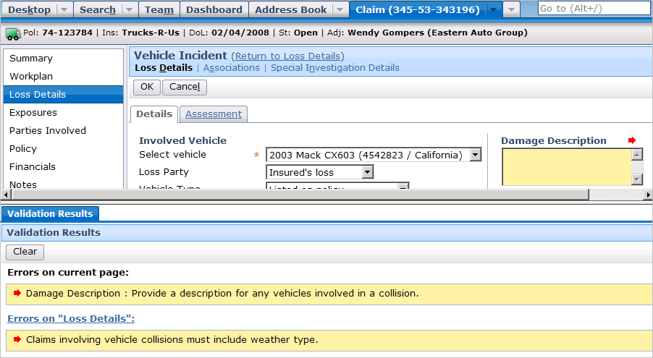
Completing Incomplete Imported FNOLs
To complete the incomplete FNOL, a user must ensure all required information is present
Notes:
During its life cycle, a claim moves through several stages. A claim at the "load save" stage has been imported into ClaimCenter but does not have the minimal information required for the claim to have the setup rules run against it. A claim at the "new loss completion" stage does have the minimal information required for claim setup. Consequently, a user who is responsible for an imported FNOL must determine what changes (if any) are required to move the claim to "new loss completion".
A user can use one of the menu items in the Claim Actions menu to determine this. If the user selects Claim Actions | Validate Claim Only | New loss completion, then ClaimCenter will run the validation rules for a claim at the new loss completion level. This is shown in the screenshot below (which is visible if you view PowerPoint in Notes view (View | Notes Page)). If the claim is at or beyond that level, then ClaimCenter will report that validation was successful and the Review FNOL activity can be closed. If the claim is not at the new loss completion level, ClaimCenter will identify the ways in which the claim must be modified to advance it to the new loss completion level.

Slide 41
Failing New Claim Validation
New
Loss
Completion
Intermediate
Levels of
Maturity
Load
Save
For imported FNOLs, claim is not saved
For wizard claims, user must fix errors or cancel claim
Policy number is valid
Driver of vehicle is specified
Loss date is specified
If insured at fault, fault rating specified
import
wizard
Notes:
An imported claim fails validation if it does not meet all conditions at the "load save" level. In the example above, if the claim is imported but does not have a valid policy number, it will fail validation.
A new claim wizard claim fails validation if it does not meet all conditions at and below the "new loss completion" level. In the example above, if the claim is created in the new claim wizard but does not have a valid policy number and specifies the insured is at fault without a fault rating, then it will fail validation.

Slide 42
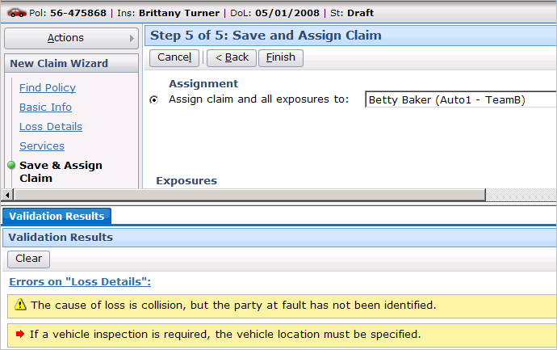
Wizard Claim Failing New Claim Validation
display screen where error exists
Notes:
ClaimCenter contains a set of rules that define the data that must be present within a claim in order for it to be considered a valid "load save" or "new loss" claim. These rules are run at the end of the import process and the end of the new claim wizard. Each rule can produce one of two possible results:
The rule could warn the user of a certain situation. The situation does not need to be attended to immediately, but at some point in the future it will prevent the claim from moving forward within its life cycle. Validation warnings appear in the Validation Results screen with a yellow yield sign icon.
The rule could throw an error. If an error is thrown, the claim cannot be saved until the error is fixed. Validation errors appear in the Validation Results screen with a red arrow icon.
If a claim has no warnings or errors, then the claim is immediately saved and the Validation Results screen is not displayed.
If a claim has only warnings, then the user only needs to click the Finish button a second time. Upon the second click, the claim is saved. The Validation Results screen remains visible until the user clicks the Clear button. (You do not need to clear the validation results to save the claim or vice versa.)
If a claim has errors (or warnings and errors), then the claim cannot be saved. The issues causing the errors must be attended to, or the new claim must be canceled.
In some cases, the "Error on..." label in the validation results is a link. Clicking the link displays the page with the error.

Slide 43
Lesson Objectives
You should now be able to:
  Define the steps of the claim intake process
  Identify the steps of automated claim setup
  Describe how validation is performed for new claims

Slide 44
Review Questions
What type of user manages the intake process?
What four things are almost always specified about a claim?
What information is typically passed to and from ClaimCenter and an FNOL application?
What three things are done during the claim setup process?
During validation, what happens to a wizard claim that:
  Does not meet all "load save" conditions?
  Does not meet all "new loss" conditions?
During validation, what happens to an imported claim that:
  Does not meet all "load save" conditions?
  Does not meet all "new loss" conditions?
Notes:
Answers
1. This typically depends on the size of the carrier. For larger carriers, the intake process may be managed by a CSR, who is responsible for identifying the minimal amount of information for a claim and seeing that it is assigned to an adjuster. For smaller carriers, the intake process may be managed by an adjuster.
2. The policy, the loss date, the parties involved, loss details (such as where, who was at fault, what cars/buildings/body parts were involved).
3. ClaimCenter receives the claim data from the FNOL application but does not typically send any information to the FNOL application.
4. The claim is segmented and assigned and the claim's workplan activities are created and assigned.
5. For both a) and b), validation fails and the user must fix the errors or cancel the new claim.
6. a) The import fails. b) The import succeeds, but an activity is typically generated so that a user will review the claim and bring it up to the new loss level.

Slide 45
Reservation of Rights
Copyright © 2008 Guidewire Software, Inc. All Rights Reserved.
This file and the contents herein are the property of Guidewire Software, Inc. Use of this course material is restricted to students officially registered in this specific Guidewire-instructed course. Replication or distribution of this course material electronically or in paper format is prohibited without express permission from Guidewire.
Guidewire, Guidewire Software, Guidewire ClaimCenter, Guidewire PolicyCenter, Guidewire BillingCenter, Guidewire ContactCenter, Guidewire Insurance Suite, Guidewire Education, and the Guidewire logo are trademarks or registered trademarks of Guidewire Software, Inc. All other trademarks are the property of their respective owners.

