Slide 1
The New Claim Wizard
5.0.0
6-July-2008
Notes:
Guidewire training materials contain Guidewire’s confidential information subject to confidentiality and non-disclosure agreements. You agree to use the information in this manual solely for the purpose of training to implement Guidewire’s software solutions. You also agree not to disclose the information in this manual to third parties or copy this manual without Guidewire’s prior written consent. Guidewire training may only be given by Guidewire employees or certified Guidewire partners under the appropriate agreement with Guidewire.

Slide 2
Lesson Objectives
By the end of this lesson, you should be able to:
  Identify the general features of the new claim wizard
  Initiate the new claim wizard
  Identify the differences between the full claim wizard and the quick claim wizard
  Identify what happens if you leave the new claim wizard while the claim is incomplete
  This lesson uses the notes section for additional explanation and information.
  To view the notes in PowerPoint, choose View→Normal or View→Notes Page.
  If you choose to print the notes for the lesson, be sure to select “Print hidden slides.”

Slide 3
Lesson Outline
The New Claim Wizard
Initiating the New Claim Wizard
Full Claims
Quick Claims
Incomplete Claims

Slide 4

The New Claim Wizard
new
auto
claim
new
WC
claim
new
property
claim
A series of screens that guide
users through manual creation
of new claims
  Incorporates multiple lines of business
  Screens and flow are completely configurable
Notes:
All wizards in ClaimCenter are completely configurable. The configuration options include:
Modifying existing screens so that information is captured in a different way
Deleting screens that gather information irrelevant to a given customer's business
Adding screen that gather information relevant to a given customer's business that are not present in the base application
Modifying the order in which the steps appear
Modifying the availability of steps
Modifying the validation requirements to go from one step to the next

Slide 5
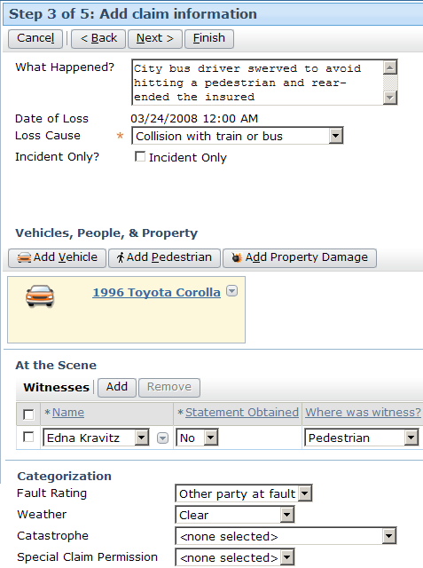
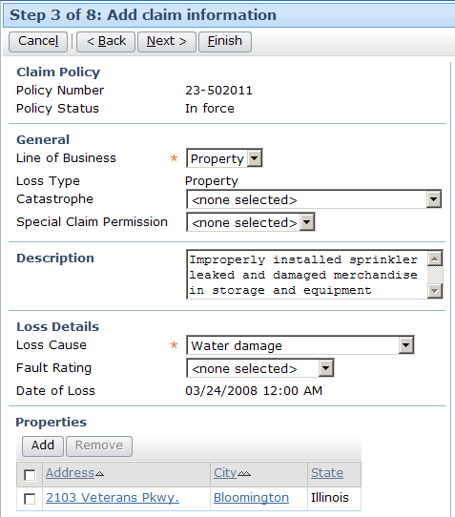
Variations Across Lines of Business
Notes:
Some screens in the new claim wizard vary based on the line of business of the underlying policy. However, the general structure of the new claim wizard can be the same for all lines of business.
The example above shows the "Add claim information" step from claims against policies from different lines of business. The screenshot on the left is a claim on an auto policy. The screenshot on the right is a claim on a property policy. The green rounded rectangles highlight similar information in each claim, and the red rounded rectangles and arrows highlight differences. Notice the following differences:
The list of possible values for Loss Cause vary based on line of business. (You cannot see all the possible values, but one would not expect "Collision with train or bus" to be a loss cause for a property claim, and "Water damage" would be a somewhat atypical loss cause for an auto claim.)
The auto claim has fields not found on the property claim (The "Weather" is a detail which is typical for an auto loss but wouldn't typically pertain to a property loss.)
The auto claim has a list of vehicles, people (drivers and pedestrians) and property damage whereas the property claim has a list of properties.

Slide 6
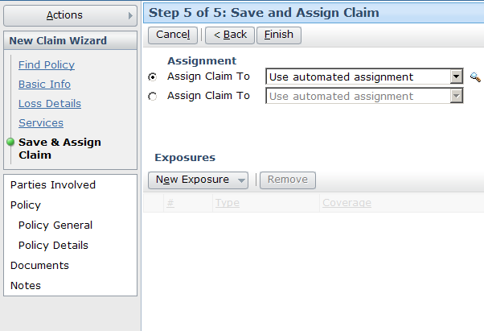
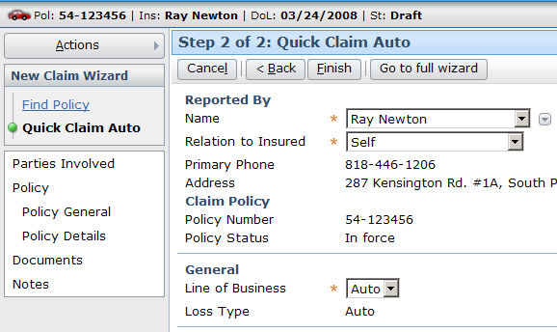
Two Levels of Depth
Full wizard captures greater amount of information
Quick wizard can be done more rapidly
Notes:
Creating a claim through the quick claim wizard can be a better option than using the full new claim wizard when:
The claim is relatively simply and involves a minimal amount of information (such as a broken window claim), or
The user has very little information at the time the claim is created (presumably because the reporter has very little information).
In the example above, the full claim wizard has 5 steps, whereas the quick claim wizard has only 2.

Slide 7
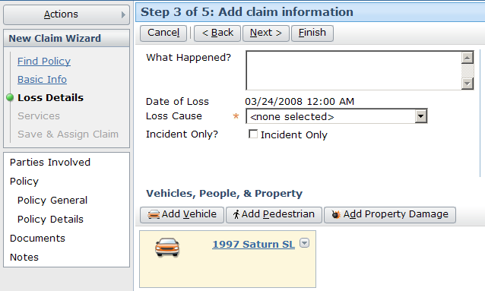
Two Sets of Wizard Steps
ordered
independent
Notes:
A wizard can have two sets of steps: the "ordered" steps and the "independent" steps.
The ordered steps capture the required parts of the business process. Typically, a user must go through those steps in the specified order, and a user cannot go to a given step until all previous steps have been completed. Ordered steps are listed below the wizard name, and a slider with a green knob identifies which step the user is currently at. At any time, a user can jump to any available ordered step, which is typically synonymous to the last step the user has worked on and all steps before it.
The independent steps capture ancillary information which a user is not required to look at or interact with but which a user may want to know about. At any time, a user can jump to any available independent step without losing any work in the wizard.

Slide 8
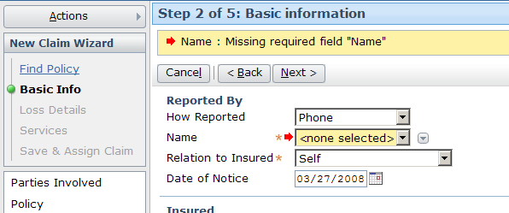
Step-By-Step Validation
Wizard steps can execute validation logic to prevent users from moving from a given step if the data on that step is invalid
Notes:
In the example above, the user is not allowed to move on to step 5 until he or she has provided all required information on step 4.

Slide 9
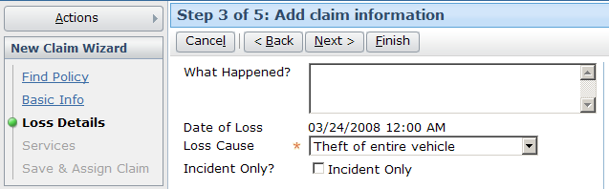
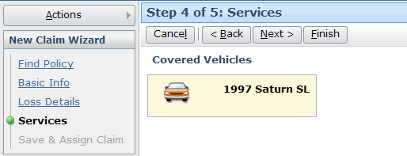
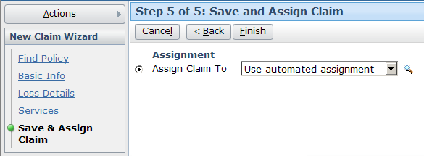

Completing the Wizard
User can complete the claim and exit the wizard without visiting every step
Notes:
The wizard is exited by clicking the Finish button. This button can be made available on any step, including steps other than the final step. However, it should not be made visible until the user has specified all the information required for the claim. (For example, if a claim must have a loss location and the loss location is specified on step 3, then the Finish button should not be made available on Step 2.

Slide 10
Lesson Outline
The New Claim Wizard
Initiating the New Claim Wizard
Full Claims
Quick Claims
Incomplete Claims

Slide 11
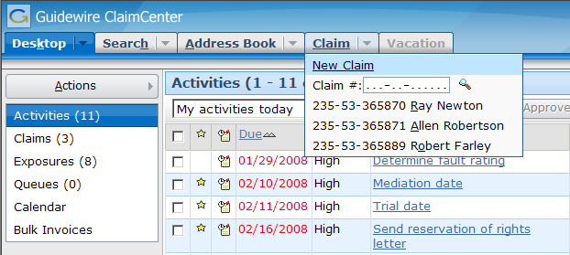
Initiating the New Claim Wizard
Initiated through a widget
  In the base application, a menu item in the Claim tab menu
Notes:
During the new claim wizard, you can navigate away from the Claim tab and then navigate back to it. Your work on the draft claim will still be there.
You cannot create two new claims simultaneously. If you have one claim in progress, the application will not let you start another claim.
If you attempt to log out during the new claim wizard, the application will identify that the draft claim will be discarded and asks you to confirm the logout.
ClaimCenter periodically writes data back to the database. If for some reason the server should go down while the user is working through the new claim wizard, then when the user is able to log back on, he or she should be able to search for the draft claim. Depending on when the server went down, some small amount of work may be lost.
The following slides show one sample realization of the wizard, but keep in mind that it is simply a sample. The new claim wizard is often configured in the following ways:
Information on a given screen is added, removed, or rearranged
The order of the steps are rearranged
New step are added, and/or existing steps removed

Slide 12
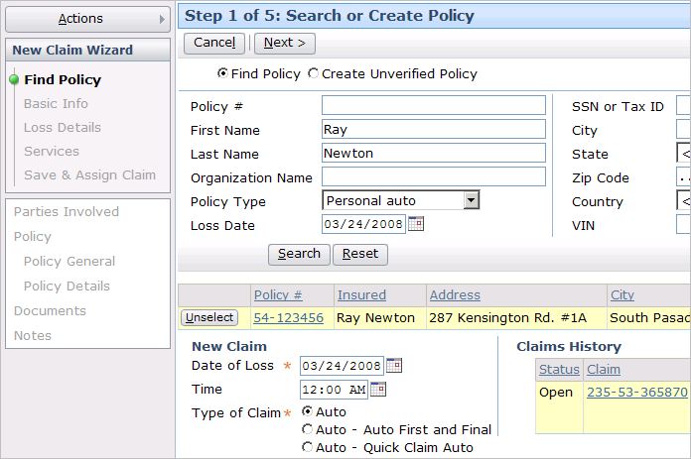

Identifying the Policy
Policy
Admin.
System
Notes:
Typically, the first step in creating a new claim is to identify the associated policy. This is done using the search functionality shown above.
The search is executed against a policy administration system (PAS) through a Guidewire integration point known as the "policy search adapter". The identifying information is sent to the PAS, and a set of zero to many policies are returned, which are then displayed in the results screen.
If only one policy is returned by the search, it is highlighted in yellow (as shown above). If multiple policies are returned, there is an additional "select" button in the first column which lets the user identify the correct policy. The policy number in the "Policy #" column is a link to more detailed information about the policy, which can be useful if multiple policies are returned and the user needs additional information to determine which policy is the correct one.
The system also automatically returns any claims in ClaimCenter associated to that policy. These claims are stored underneath the policy list in the "Claims History" section.
Once the policy has been identified, the application can infer the line of business of the claim based on the policy. For example, claims made against an auto policy are assumed to be auto claims.

Slide 13

Policy Administration System Integration
search criteria
Policy
Administration
System
policy data
Every instance of ClaimCenter has an integration point to a policy administration system, such as PolicyCenter
  This application stores information about:
    Policies issued by the carrier
    Coverages on each policy
    People or assets covered by those coverages
Notes:
Information exchange:
ClaimCenter sends policy search criteria (such as policy number or the insured's name)
ClaimCenter receives selected information about the policies that match that criteria
The policy data sent from the external system to ClaimCenter is configurable, but typically includes the following:
The names, addresses, and nature of people on the policy (such as the insured, additional covered people, people excluded from the policy, and the agent)
Information and locations of assets covered on the policy (such as the VIN number, make, and model of a covered vehicle, as well as where it is garaged)
The coverages on the policy, including information about deductibles and/or limits
Endorsement forms on the policy (An endorsement form is a physical document printed and sent to the insured by the underwriter which further details aspects of the policy, such as forms detailing the legal meaning of language used in the policy, exclusions that identify certain types of losses are not covered by a coverage, and so on)
The effort around planning and configuring this integration point is typically large. This is due in part to the following:
The existing data structure for policies is typically complex and time is needed to determine how it can be mapped to existing or configured data model entities, user interface elements, and business rules.
(continued)

Slide 14
(Notes Only Slide)
Notes:
There are often numerous and complex "edge cases". An edge case is a circumstance where a small number of policies do not work like the majority of the policies, such as a carrier which used a significantly different data model for policies issued in 2001, or a carrier which associates liability coverages to inland marine policies in a significantly different way than for all other lines of business.
Unlike other external systems which typically have similar structures (such as authentication systems or FNOL applications), there is little to no similarity in how legacy policy administration systems are structured. Therefore, there is little or no opportunity to reuse integration code from other Guidewire implementations.
The policy refresh feature is complex to design. It requires a significant amount of logic, and you typically cannot refresh the policy on a claim once a reserve has been created. (This is because reserves are mapped to exposures, which in turn are mapped to policy coverages. If the policy is refreshed, the coverages may change, which causes issues around what to do with established reserves.)
A given instance of ClaimCenter may be integrated with one or more policy administration systems.

Slide 15
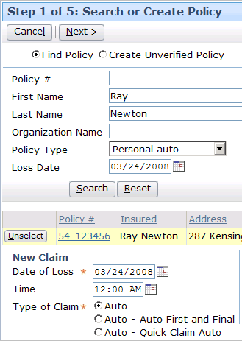
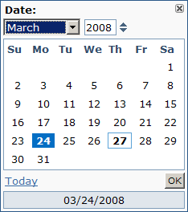
Identifying the Loss Date
Determines which version of the policy to retrieve
Used for potential duplicate claims search
Notes:
The Loss Date is usually specified as part of the search (to determine which policy version to retrieve), but it can be entered in the Date of Loss field once a policy is retrieved using the Date of Loss field.
There is typically a validation rule that prevents users from specifying a future loss date.

Slide 16
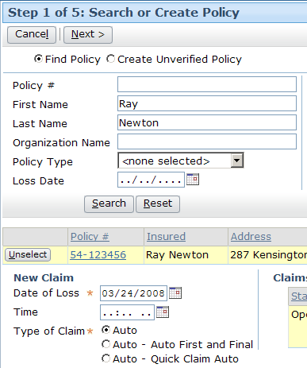
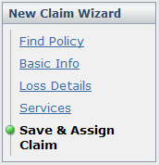


Choosing the Wizard Type
Notes:
For a given line of business, there can be different wizards of different length. In the base application, each line of business features at least two wizard:
A "full" wizard, which contains a large number of steps in which a user can detail a great amount of information about the claim.
A "quick claim" wizard, which contains a smaller set of steps. The user cannot detail as much information, but they can create the claim more quickly.
The Auto line of business has a third choice, the "Auto First and Final" wizard. This option is discussed in greater detail in the "Payments" lesson. (This wizard lets the user detail claim and payment information on a single screen. The wizard automatically creates and closes the underlying exposure. This wizard is designed for simple one-step auto claims, such as windshield damage claims.)

Slide 17
Lesson Outline
The New Claim Wizard
Initiating the New Claim Wizard
Full Claims
Quick Claims
Incomplete Claims

Slide 18



Temporary Claim Number Generation
999-99-991109
(temporary number)
Generated after first step
Used to track claim in draft status
Typically not displayed
Notes:
When the first step of the wizard is completed, a claim object is created and committed to the database. At this time, a temporary claim number is generated. The claim number is typically generated using GScript (which is Guidewire's proprietary scripting language). Older implementations of ClaimCenter had claim generation take place through a claim number generator plug-in, but the current preferred method is for the code to be written in GScript.
The claim number generator is referenced twice by the new claim wizard: once at the beginning to generate a temporary claim number, and a second time when the wizard is finished for the official claim number.
The claim number generator can generate a claim number in any format appropriate for the business.

Slide 19
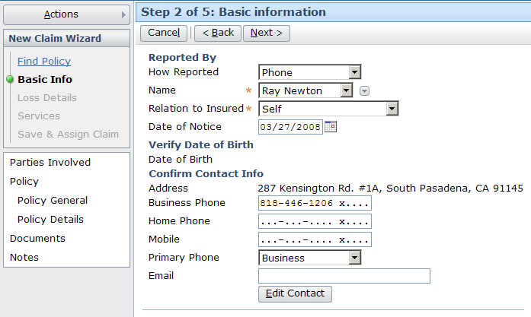
Identifying the Primary Contact
Captured immediately after initial wizard information is known (in case conversation is interrupted)
Notes:
Once the user has identified the policy, the loss date, and the type of wizard to use, the next most important piece of information is who is the primary contact for the claim. This is important because the conversation between the user and the reporter may be interrupted, and the contact information should be captured to know with whom to resume the conversation. Furthermore, if the reporter is the insured, this gives the user an opportunity to confirm that the correct information has been retrieved. (For example, if the reporter provides a birth date different than the one displayed on the Basic Info screen, then the user may have retrieved the wrong policy.)

Slide 20
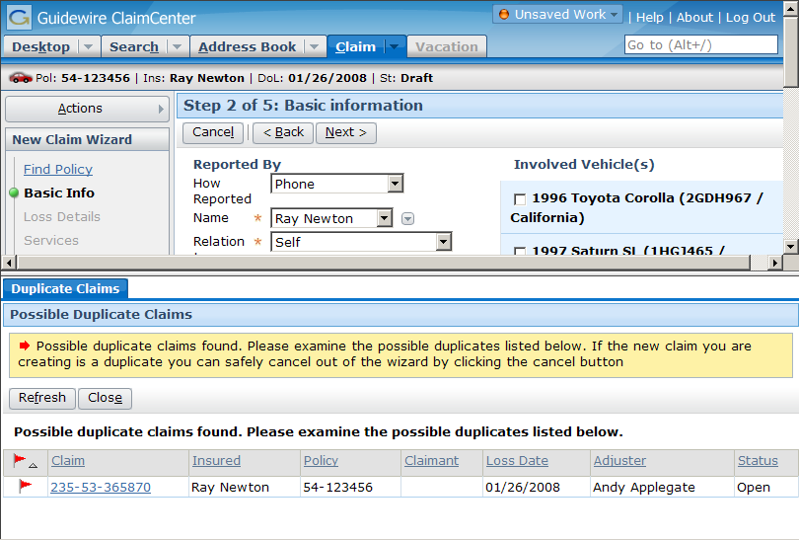
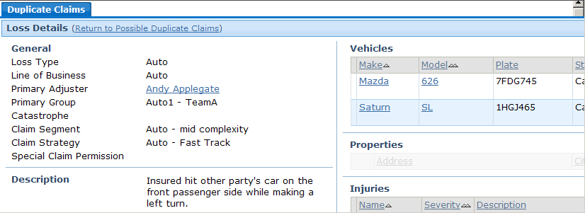
The Possible Duplicate Claims Warning
Notes:
Once the main contact has been identified, when the user attempts to move to the next step, ClaimCenter checks to see if there are any possible duplicate claims. If there are, the possible duplicates are displayed in a list in the workspace frame. The user can view any of the possible duplicate claims by clicking the claim number. This displays the claim in the workspace frame. If the new claim is in fact a duplicate claim, the user should click the wizard's Cancel button. If the new claim is not a duplicate claim, the user should click the Close button in the Possible Duplicate Claims toolbar. This closes the window. A second click of the Next button will advance the user to the next step of the wizard.
The Possible Duplicates search is intended to prevent redundant data from being entered. It is executed only over claims within ClaimCenter. To detect duplicate claims which are fraudulent (such as when an individual files two claims with two separate carriers for the same loss), ClaimCenter is typically integrated with ISO, an organization within the United States that maintains a database across multiple carriers for fraudulent duplicate claim detection. ISO is discussed in greater detail in the "Specialized Claims Processes" lesson.
You can configure the logic used by the system to determine if two claims are possible duplicates or not. This could include some combination of:
Claims made against the same policy
Claims involving the same insured
Claims with the same loss date or with loss dates within a certain number of days
The logic is expressed in the form of a SQL query and thus can contain any logic required.

Slide 21
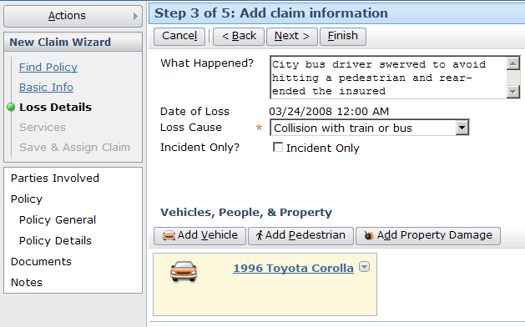
Identifying Details About the Loss Event
Captures information about loss event and incidents (lost or damaged items)
Notes:
The Loss Details step is where required information about the loss is captured, as well as any information which is optional at the intake point in time but known to the intake user.
The required information varies based on the line of business, but might include:
Auto, Liability, or Property: Loss cause, loss location, is this incident-only?
Workers' Comp: Claimant name, claim type (lost time, medical only, catastrophic, death), injury information, is the coverage in question, date employer was notified
An "incident only" claim is a claim which is recorded in ClaimCenter but which will not be processed further and no payments will be made against it. This could include losses which get reported but which are not covered by the policy, or claims where the insured decides not to have it processed (perhaps because the loss amount is just slightly over the deductible or the insured does not want his rates to increase).
In some cases, there is an unresolved dispute between the parties involved in a loss, and one party files a lawsuit against the other. This could occur during the adjudication of the claim, but the lawsuit may already be in progress at the point the claim is first reported to the carrier. A "first notice suit" claim is a claim for which there is a pending lawsuit at the time of first notice.

Slide 22
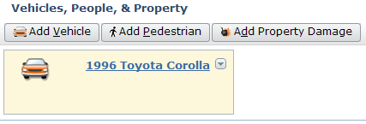
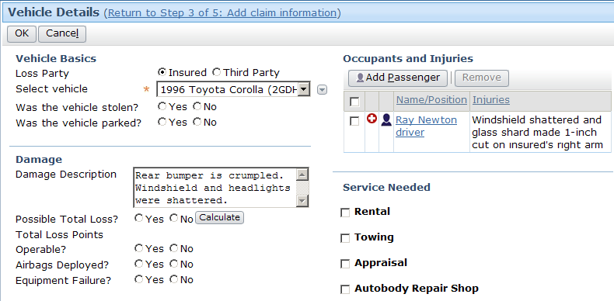
Identifying Details About the Incidents
Notes:
Typically, information about the incidents is gathered during the intake process. This information is useful in determining the indemnities that will need to be paid from the claim. The nature of this information varies across lines of business. For example:
In an auto claim, the list of incidents could include vehicles.
In a property claim, the list of incidents could include fixed properties such as buildings.
In a workers' comp claim, the list of incidents could include injuries.
Incidents serve two primary purposes:
They allow users to capture information about the loss without having to create exposures. This is helpful when the user creating the claim does not have sufficient expertise to create exposures (such as a customer service rep) or when the user is unsure of what exposures will be needed at the time the claim is created (such as when it is not immediately obvious which coverage covers the loss).
They allow information about a lost or damaged item to be shared across multiple exposures. This is helpful when a single item suffers multiple losses covered by multiple exposures (such as an auto policy with separate vehicle damage and towing coverages). Incidents prevent the user from needing to enter identical information into multiple exposures.

Slide 23
Where Can Incident Information Come From?
From the policy administration system
From the user creating the claim
From the adjuster during discovery/investigation
covered vehicle
covered driver
3rd-party vehicle
3rd-party driver
3rd-party property
3rd-party claimant
Notes:
Incidents can be imported or created manually. Incidents which are imported typically come from the policy administration system.

Slide 24
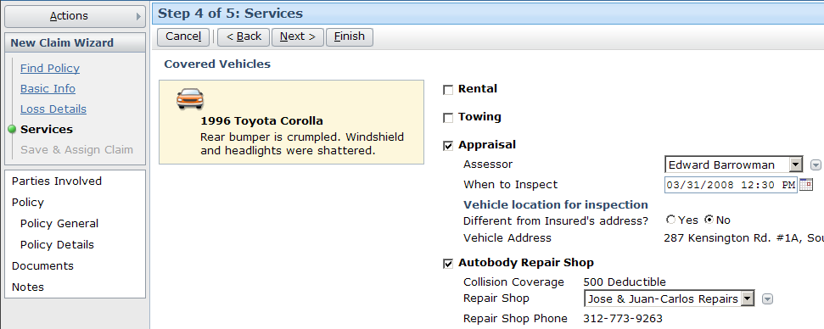
Services
Some steps (such as the auto wizard "Services" step) help users improve customer relationships by offering or capturing information about additional needs the insured may have
Notes:
In the base application, the Services step exists only for the personal and commercial auto lines of business. The Services step is used to identify services that the insured might need in the process of recovering from the loss. This could include:
Identification of coverages relevant to the services (such as the notation that the insured above has collision coverage, but the deductible is $500)
Identification of preferred vendors, in case the insured does not have an existing relationship with a relevant service provider
Identification of service provider contact information, if for example the carrier needs to get an appraisal from an auto inspector

Slide 25

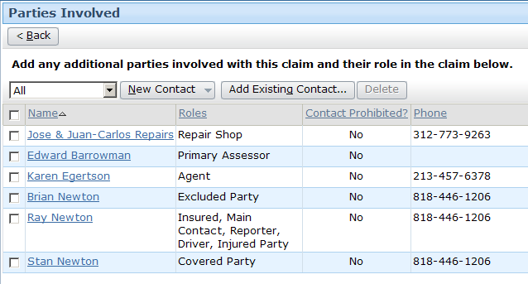
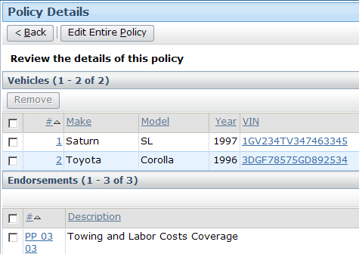
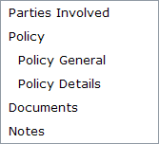
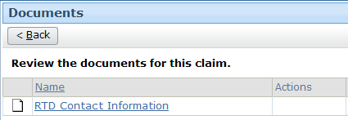
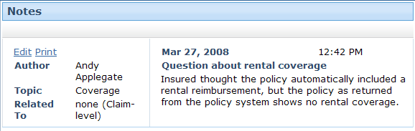
Independent Steps
Notes:
Every wizard can contain a set of independent steps. These steps list information which may be of interest to users during claim creation but do not require user input for every claim. For example, the personal auto new claim wizard includes the following independent steps:
Parties Involved - This step lets you specified people who are known to be related to the claim but are not the insured or the main contact (both of which are specified on the Main Contacts step). The functionality of "people related to the claim" is discussed in the "Contacts" lesson in the adjudication section.
Policy - The policy retrieves from the policy administration system. Further information about these screens appears below.
Documents - A document is a software file (typically a letter or email) associated to the claim. ClaimCenter can either link to documents sent and/or track the existence of documents without letting users view their content. Documents are discussed in the "Documents" lesson in the adjudication section.
Notes - A note is a text entry which details the events, courses of actions, and/or thinking of a user during the processing of a claim which lists any notes created about the claim during intake. Notes are discussed in the "Notes" lesson in the adjudication section.
In the base application, the Policy General screen lists general information about the policy, including:
Its type
Its effective and expiration dates
Any line-level (policy-level) coverages

Slide 26
(Notes Only Slide)
Notes:
A policy-level coverage is a coverage which is added to a policy at a general level without being tied to a specific thing covered by the policy. For example, a business owner's policy might have a pollution liability coverage which is general to the entire policy and not tied to any one building owned by the business.
Editing policy information in ClaimCenter should not be a casual task, as it modifies the policy information such that it is not in sync with the policy administration system information. However, there may be business scenarios where this is an appropriate thing to do, such as when the policy system is not available, the reporter is the insured and challenges the policy information, or the reporter is the insured and has new information which should be transferred to the policy system (such as a new address).
There is also a screen for property covered on the policy. (Underwriters typically refer to this as the policy's "exposures". The term exposure is used differently in ClaimCenter.)
Endorsements might also be listed on this screen. Endorsements are physical forms printed when a policy is issued, modified, or renewed. They typically detail what is and what isn't covered on the policy. ClaimCenter typically lists only the name of the endorsement, not the actual content. To see the content (the actual text) of the endorsement, the user would need to go to reference either another system or a hard-copy library of endorsements.

Slide 27




Finishing the Claim
Automated Claim Setup
Create and assign activities
Segment
claim
Assign
claim
Validate
claim
Notes:
To complete the new claim wizard, click the Finish button in the toolbar. You can finish the New Claim at any point after all of the minimally required information has been provided. You do not need to navigate all the way to the final step to finish the claim.
When the Finish button is clicked (and assuming all of the required information has been provided):
A permanent claim number is generated
Automated claim setup is run, which segments and assign the claim and generates the claim workplan
Validation rules are run on the claim and any exposures or activities created during claim setup
Assuming validation succeeds, information about the assignment and claim number is displayed to the user.

Slide 28

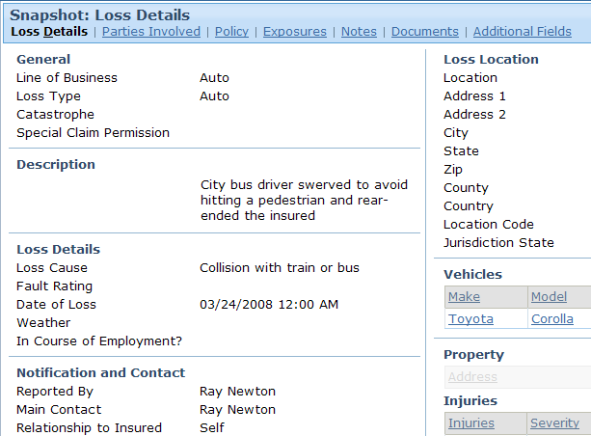
FNOL Snapshot
A read-only view of data reported during intake which is added to the claim file once new claim is complete
  Useful during adjudication to verify what was reported during first notice
Notes:
Claims created manually in ClaimCenter have an FNOL snapshot. Claims imported into ClaimCenter do not have an FNOL snapshot.

Slide 29
Lesson Outline
The New Claim Wizard
Initiating the New Claim Wizard
Full Claims
Quick Claims
Incomplete Claims

Slide 30

Temporary Claim Number Generation
999-99-991109
(temporary number)
Like full wizard claims, generated for quick wizard claims after the first step
Notes:
When the first step of the wizard is completed, a claim object is created and committed to the database. At this time, a temporary claim number is generated. The claim number is typically generated using GScript (which is Guidewire's proprietary scripting language). Older implementations of ClaimCenter had claim generation take place through a claim number generator plug-in, but the current preferred method is for the code to be written in GScript.
The claim number generator is referenced twice by the new claim wizard: once at the beginning to generate a temporary claim number, and a second time when the wizard is finished for the official claim number.
The claim number generator can generate a claim number in any format appropriate for the business.

Slide 31

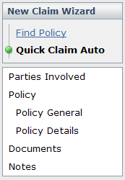
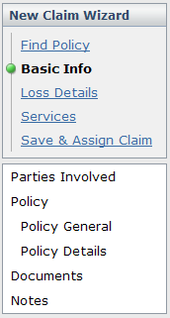
Moving Between Wizards
Quick wizard has button to switch to full wizard
However, full wizard has no mechanism for switching to quick wizard
Notes:
Typically, the full claim wizard exposes more fields than the quick claim wizard. If a user was permitted to go from the full wizard to the quick wizard, then some data which they had already entered would remain in the run-time object even though it wasn't displayed in the user interface. This could prevent a user from completing the wizard if the hidden data was causing unavoidable validation errors. To avoid users falling into this situation, movement from the full wizard to the quick wizard is not typically allowed.

Slide 32
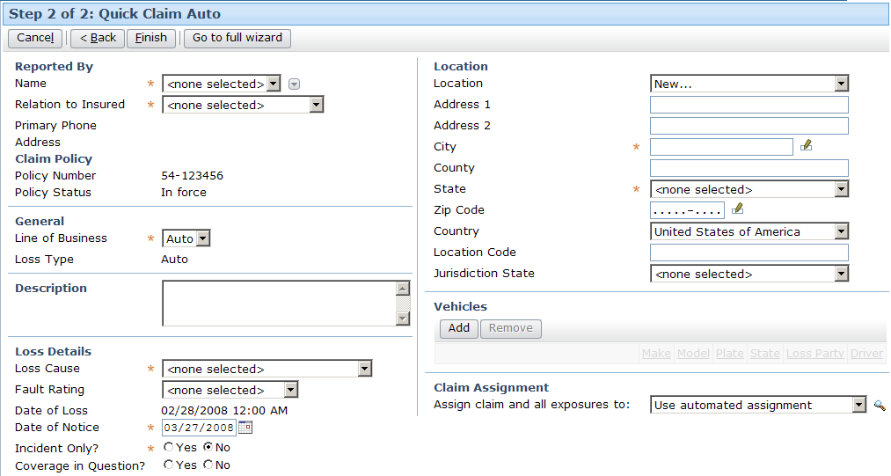
Quick Claim Wizard Example: Auto
Notes:
The screenshot above shows a sample quick claim wizard for auto. Notice that the required information (person reporting claim, loss cause, date of loss, incident only and location) are on this screen as well as some high-level optional information (such as fault rating, vehicles, and the ability to override default assignment rules).
Recall that validation is run at the end of the wizard. A new claim must meet all of the conditions at the "new loss" level in order to be created. These "new loss" conditions must be met regardless of whether the claim was created through the regular new claim wizard or through the quick claim wizard. Consequently, the quick claim wizard must include enough fields so that the user can enter all data needed to satisfy the "new loss" conditions.

Slide 33
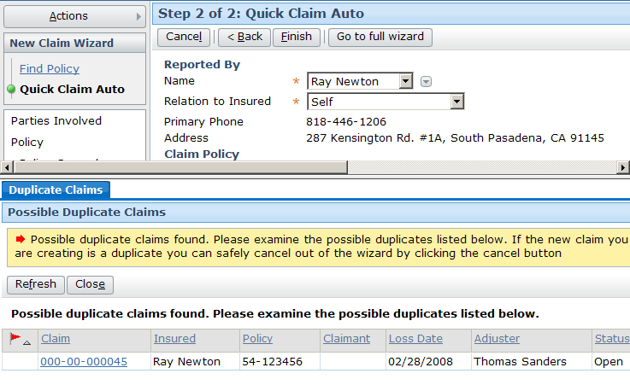
Quick Claim Duplicate Warning
For quick wizard, check is executed at end of wizard
Notes:
Both the full claim wizard and the quick claim wizard check to see if the new claim is potentially a duplicate claim. Because the quick claim wizard is only two steps long, the duplicate claim check does not occur in quick wizards until the end.
Otherwise, the functionality is the same between the two type of wizards. Clicking the Finish button causes possible duplicates to be displayed in a list in the workspace frame. The user can view any of the possible duplicate claims by clicking the claim number. This displays the claim in the workspace frame. If the new claim is in fact a duplicate claim, the user should click the wizard's Cancel button. If the new claim is not a duplicate claim, the user should click the Close button in the Possible Duplicate Claims toolbar. This closes the window. A second click of the Finish button will complete the wizard.

Slide 34
Lesson Outline
The New Claim Wizard
Initiating the New Claim Wizard
Full Claims
Quick Claims
Incomplete Claims

Slide 35

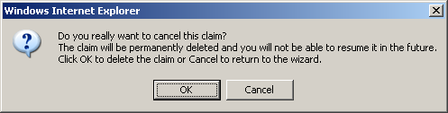
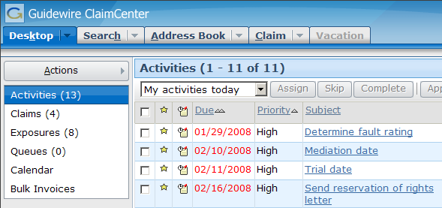
Cancelling a New Claim
Notes:
If you click the new claim wizard's cancel button, you are asked to verify the cancel. If you do, the new claim is discarded and you are returned to the desktop. The claim is no longer accessible and cannot be retrieved at a later time.

Slide 36
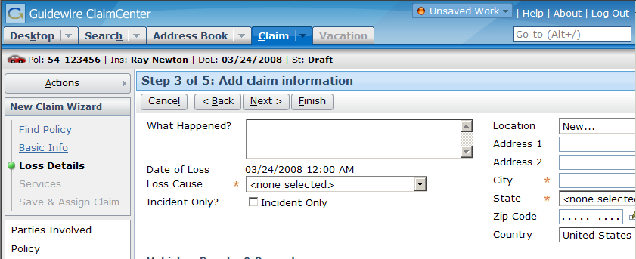
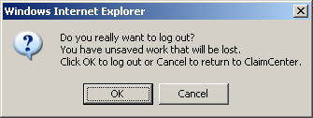
Logging Out During a New Claim
Notes:
If you log out of ClaimCenter using the Logout link and a new claim is in progress, ClaimCenter warns you that the logout will cause unsaved work (including an in-progress new claim) to be discarded. You can verify the logout or cancel out of it. If you log close the Internet Explorer window (or the tab hosting ClaimCenter) without formally logging out, the temporary claim will still be available, though unsaved data will be lost (since there was no opportunity to save it).

Slide 37
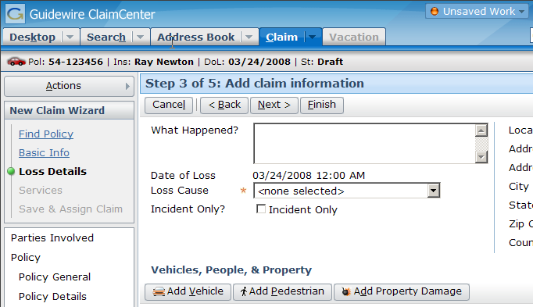
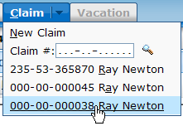
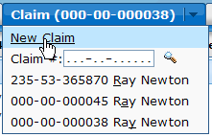
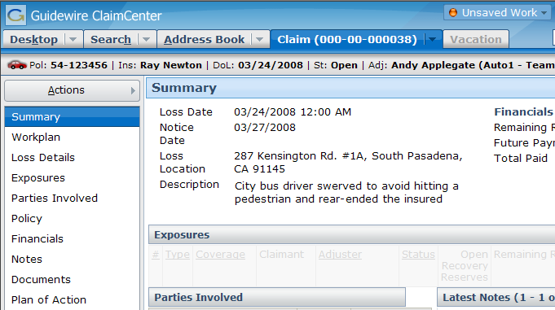
Navigating Away from a New Claim
New
Claim
Wizard
Existing
Claim
Notes:
At any point during the new claim wizard, you can navigate away from the wizard to other aspects of ClaimCenter. (This includes navigating to another tab or navigating to a completed claim on the Claim tab.) To return to the new claim wizard, use the user interface control that initiated the wizard. (In the base application, this is the New Claim menu item in the Claim menu.) When you return to the new claim wizard, you should be returned to the same step that you were on when you left with all information in tact.
Recall that the active Unsaved Work link indicates that some aspect of the user interface is in edit mode and the information has not been saved to the database. This means that the Unsaved Work menu is also used for the new claim wizard when a new claim is in progress. (Information is in edit mode without having been saved.)
In the base application you cannot create more than one new claim at one time. If a new claim is in progress, to start a second claim you would click the Cancel button in the new claim wizard. This will discard all information about the claim currently in progress. However, there is a simple configuration change allowing for multiple draft claims. In this configuration, after exiting an incomplete new claim, you would go to Desktop Claims and search for Draft claims to select which draft claim you want to continue working with. Restarting the new claim wizard would create a second draft new claim.

Slide 38
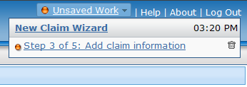
New Claims in the Unsaved Work Menu
New claims are always listed in the Unsaved Work menu
Notes:
Recall that "unsaved work" refers to either work in a screen for a new object which you created but did not save or work in a screen for an existing object which you put into edit mode without updating or cancelling. In other words, unsaved work refers to any work which you navigated away from without clicking the Update or Cancel buttons.
All of your unsaved work is automatically listed in the Unsaved Work menu, including incomplete claims. From the Unsaved Work menu, you can either navigate to the incomplete claim (by clicking the link) or discard the incomplete claim (by clicking the corresponding trash icon).

Slide 39
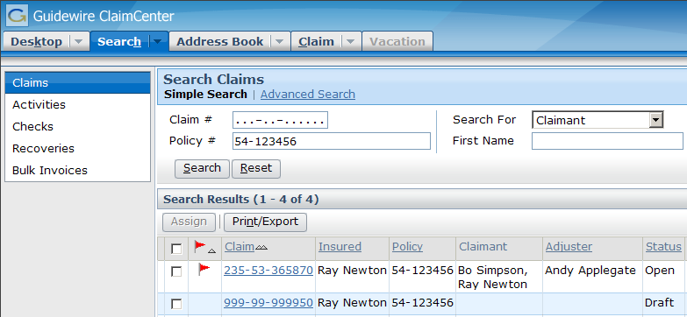
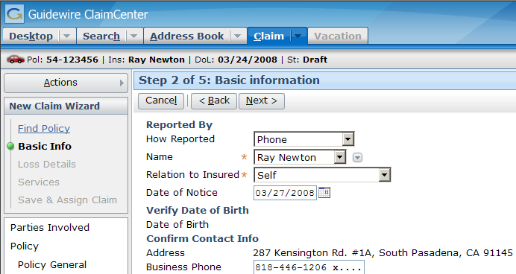
Interrupted New Claims
Notes:
It is possible for a new claim to be interrupted in a situation that doesn't involve you navigating away from the claim or logging off. For example, if the user navigates away from the new claim wizard and then accidentally closes their browser, the application session is terminated. (Or if the machine hosting ClaimCenter fails, then the ClaimCenter application stops running and the new claim is interrupted.)
ClaimCenter generates a temporary claim number for every claim in draft status. (When the claim is completed, a second call is made to the claim number generator for a non-temporary final number.) If a new claim is interrupted for reasons other than cancelling the wizard or logging off, then you can retrieve the in-progress claim by searching for and finding the temporary number and then using this number to access the claim.

Slide 40
Lesson Objectives
You should now be able to:
  Identify the general features of the new claim wizard
  Initiate the new claim wizard
  Identify the differences between the full claim wizard and the quick claim wizard
  Identify what happens if you leave the new claim wizard while the claim is incomplete

Slide 41
Review Questions
Identify if the following are true or false:
  If you do not provide required information on a given step, you cannot move to the next step.
  You can complete the new claim wizard without navigating to the final step in the wizard.
  You cannot create a claim if the system detects possible duplicate claims.
  Once you have started the full claim wizard, you can still switch over to the quick claim wizard.
  If you leave the new claim wizard without clicking Finish, the new claim is discarded.
What does ClaimCenter do after the user clicks the Finish button but before it displays the "claim successfully saved" screen?
Notes:
Answers
1. a) True
b) True (As long as all the required information has been provided, you can finish the wizard by clicking the Finish button at any time, even prior to the last step.)
c) False (Possible duplicate claims are warnings only. They do not prevent you from creating claims.)
d) Mostly false (You can move from the full claim wizard to quick claim wizard, but all your work is discarded. This is unlike moving from the quick claim wizard to the full claim wizard, in which case all your work is preserved.)
e) False (The statement is true if you leave by clicking the Cancel button or by logging out, but if you navigate to another part of ClaimCenter, all of your work is retained, and if ClaimCenter itself goes down, most if not all of your work is retained and can be re-navigated to.)
2. ClaimCenter runs claim setup (which segments and assigns the claim and generates a workplan), and then it runs validation rules against the claim (and any exposures or activities created during claim setup).

Slide 42
Reservation of Rights
Copyright © 2008 Guidewire Software, Inc. All Rights Reserved.
This file and the contents herein are the property of Guidewire Software, Inc. Use of this course material is restricted to students officially registered in this specific Guidewire-instructed course. Replication or distribution of this course material electronically or in paper format is prohibited without express permission from Guidewire.
Guidewire, Guidewire Software, Guidewire ClaimCenter, Guidewire PolicyCenter, Guidewire BillingCenter, Guidewire ContactCenter, Guidewire Insurance Suite, Guidewire Education, and the Guidewire logo are trademarks or registered trademarks of Guidewire Software, Inc. All other trademarks are the property of their respective owners.

