Slide 1
Contacts
5.0.0
6-July-2008
Notes:
Guidewire training materials contain Guidewire’s confidential information subject to confidentiality and non-disclosure agreements. You agree to use the information in this manual solely for the purpose of training to implement Guidewire’s software solutions. You also agree not to disclose the information in this manual to third parties or copy this manual without Guidewire’s prior written consent. Guidewire training may only be given by Guidewire employees or certified Guidewire partners under the appropriate agreement with Guidewire.

Slide 2
Lesson Objectives
By the end of this lesson, you should be able to:
  Describe the functionality of contacts
  Describe the functionality of ContactCenter
  Create contacts in ClaimCenter
  Work with contacts in ClaimCenter
  Describe approaches to searching for contacts
  This lesson uses the notes section for additional explanation and information.
  To view the notes in PowerPoint, choose View→Normal or View→Notes Page.
  If you choose to print the notes for the lesson, be sure to select “Print hidden slides.”

Slide 3
Lesson Outline
Contact Basics
ContactCenter
Creating ClaimCenter Contacts
Working with Linked Contacts
Searching for Contacts

Slide 4


Review: Entities in the Claim File
claim
contact
incident
exposure
activity
document
note
matter
reserve line
check
Notes:
A claim is an event in which one or more (potentially) covered losses occurred.
A contact is a person or organization who has a relationship to a claim, such as:
A claimant requesting compensation for a loss.
The reporter of the claim.
A doctor treating an injury.
An incident is an item that was lost or damaged, such as a vehicle, a property, or a person suffering one or more injuries.
An exposure is a set of data used to track a potential payment from one coverage to one claimant.
A reserve line is an amount of money set aside for expected payments related to a given exposure.
A check is a single transfer of money tracked by an exposure to one or more individuals or organizations.
An activity is a task required to process a claim. The set of activities associated to a given claim is often referred to as the claim's "workplan".
A document is an electronic file or physical piece of paper which contains information relevant to the claim.
A note is a text entry which details the events, courses of actions, and/or thinking of a user during the processing of a claim.
A matter is a set of data pertaining to a single (potential) lawsuit.

Slide 5
Review: The Claims Process
Litigation
Fraud Detection
Intake
Special Investigations
Adjudication
Payment
Recovery
Notes:
During intake, the carrier is informed of a potentially covered loss. For auto and property claims, this is often referred to as First Notice of Loss (FNOL). For workers' comp claims, this is also known as First Report or Injury (FROI) or First Notice of Injury (FNOI).
Adjudication is the process of determining if you are going to pay a claim, and if so, how much you are going to pay.
Once the loss has been assessed and the payment has been approved, the carrier can provide the payments to the claimants. The payment phase involves creating, approving, and issuing the checks.
In some cases, the carrier may also attempt to recover funds paid to the claimant by obtaining money from a third party's carrier if the third party was at fault (which is known as "subrogation") or by taking possession of a significantly damaged property and selling all or parts of it to a third party (which is known as "salvage").
Litigation is an umbrella term for several activities which involve the resolution of disputes.
Fraud detection refers to the activities around detecting claim activity that is indicative of fraud and could warrant further investigation. This is typically a process which is ongoing throughout every portion of the claims process.
If a claim is considered to be suspicious, then it is referred to the special investigations unit. They will investigate the activity and determine the validity of claim. Their investigation runs parallel to the normal claim processing.

Slide 6
Mapping Entities to the Claims Process
Litigation
Intake
Adjudication
Used heavily throughout entire process
Payment
Recovery
Notes:
Theoretically speaking, a given entity type can be used or could be relevant in nearly every part of the claims process. However, some entities tend to be worked on heavily in one part of the process and less so in other parts of the process.
Incidents are created and often fully detailed during Intake.
Exposures and reserve lines are usually associated to adjudication.
Checks are exclusive to payment.
Matters are exclusive to Litigation.
There are four primary entities of the claim file which span all phases of claims processing: contacts, activities, documents, and notes. These four entities are discussed in this section of the course.

Slide 7
Contacts
Contact
Claimant
Reporter
Auto Repair
Shop
Hospital
Court
A contact is a person, organization, or venue which is related to the claim, such as...
  Someone who suffered a loss
  Some company which repaired a damaged asset
  Some place where disputes were resolved
Notes:
A venue is a location for a scheduled event relevant to claims processing. Typically, venues are places where dispute resolution occurs, such as a courthouse or a conference room used for arbitration.

Slide 8
The Contact Subtype Hierarchy
Contact
the primary subtypes
Person
Company
Venue
Person Vendor
Adjudi-
cator
Company Vendor
Legal
Venue
searches at this level return doctors and attorneys
Law Firm
Attorney
Medical Care Org
searches at this level return only doctors
Doctor
Auto Towing
Auto Repair
Notes:
Contacts within ClaimCenter are organized into a set of subtypes which is fully customizable. The organization of the hierarchy helps to specify and enable certain types of functionality. For example:
The hierarchy helps to define the sorts of searches users can do. You can easily configure search screens for any node in the hierarchy. The search results will include all contacts at or below that node. In the example above, a user could do a search for attorneys (which will return just attorneys), or for doctors (which will return just doctors), or for person vendors (which will return both attorneys and doctors, but not law firms or medical care organizations because they are not underneath the "Person Vendor" node of the hierarchy).
The hierarchy helps to define the criteria for identifying two objects as possible matches. For example, if the matching logic for law firms, medical care organizations, auto towing and auto repair shops is identical (the tax ID for the two objects must match), then this logic can be specified at the Company Vendor level.
There are three primary subtypes in the contact subtype hierarchy: person, company, and venue. This level of the hierarchy cannot be modified. All modifications to the hierarchy must be made below this level, and each subtype must be a child (directly or indirectly) of one of these three subtypes.
An adjudicator is not a claims adjuster. An adjudicator is a judge or arbitrator as a type of Person. An adjudicator may have a specific adjudicative domain. A carrier could easily configure ClaimCenter to have adjudicator treated as a child or the "person vendor" note if they desired.

Slide 9

Two Applications Store Contacts
Address Book
contacts relevant to
a
claim
contacts relevant to multiple claims
Two applications store contacts
  ClaimCenter stores contact information as it pertains to a given claim
  Address Book stores contacts that are (potentially) relevant to multiple claims
Notes:
Most carriers with claims processing systems have a contact management application, which is often referred to in the industry as the "address book".
ClaimCenter comes with a separate contact management application called ContactCenter. ClaimCenter and ContactCenter are integrated, and the most of the functionality belonging to ContactCenter appears seamlessly in ClaimCenter. The ContactCenter application functionality is typically referenced within ClaimCenter using the term "Address Book".
This course uses the term "Address Book" to reference functionality found in ContactCenter.

Slide 10
"Single Use" Contacts
Address
Book
Claim
000-00-002006
Doris Schwartz
(witness)
Typically a non-vendor, non-venue contact, such as the insured, a claimant, or a witness
Notes:
A ClaimCenter contact may exist only in ClaimCenter (and not in Address Book). This is typical when the contact is not expected to be used for any other claim (such as a witness or a third-party claimant), which is typically true for a contact which is not a vendor or a venue. There is no need for contact information to be shared across multiple claims, so the contact is not stored in the address book.

Slide 11
"Multi-Use" Contacts
Address
Book
Claim
000-00-002006
Dr. Matt Sawyer (1)
Claim
036-22-934712
Dr. Matt Sawyer (AB)
Dr. Matt Sawyer (2)
Claim
908-00-230166
Typically a vendor (or venue)
Dr. Matt Sawyer (3)
Notes:
A ClaimCenter contact may also exist in the address book. This is typical when the contact is used or is expected to be used for multiple claims. This is typically true for person vendors such as doctors, company vendors such as hospitals, or venues such as courts. Theoretically, it could also include a policy holder with a large number of potential claims, such as a large business with a workers' comp policy. Because there is a need for contact information to be shared across multiple claims, the contact is stored in the address book. (In the diagram above, the "AB" after the Address Book Matt Sawyer stands for "address book".)

Slide 12
Multi-Use Contacts Are Typically "Linked"
Address
Book
in
sync
Dr. Matt Sawyer (1)
phone: 324-6600
out of sync
Dr. Matt Sawyer (AB)
phone: 324-6600
Dr. Matt Sawyer (2)
phone: 453-2331
in
sync
Dr. Matt Sawyer (3)
phone: 324-6600
Notes:
When a contact exists in both ClaimCenter and the address book, every copy of the contact is a unique (but potentially related) object. Notice that there are four Matt Sawyer objects. The Address Book version is suffixed with "AB". All the other version are prefixed with a distinct integer. Even though they all represent the same person, they are four distinct objects.
When a contact exists in both ClaimCenter and Address Book, it can be linked (and most likely is). When a contact is linked:
The ClaimCenter user interface identifies that the contact is linked.
The ClaimCenter user interface identifies when a contact's information is not identical to the corresponding Address Book object. This is referred to as being "out of sync". (Although it is likely that the majority of the fields will store the same data, it is possible for individual fields to differ from one related contact to the next. For example, the phone number for Matt Sawyer (2) is different than the phone number for all the other Matt Sawyer objects.)
A user can recopy the information from the Address Book object to the ClaimCenter object. This is referred to as "syncing the contact".
A user can search for contacts in the Address Book which meet some criteria pertaining to ClaimCenter data. (For example, you can search within Address Book for all claims related to Matt Sawyer. The contact used for the search criteria exists in Address Book, but the claims returned from the search come from ClaimCenter.
(continued)

Slide 13
(Notes Only Slide)
Notes:
Even if two objects are linked, modifications to one of the objects are not inherently replicated to the other linked objects. For example, a change made to the object in ClaimCenter is not inherently copied to the address book, and a change made to the object in the address book is not inherently copied to all instances of the claim in ClaimCenter. However, a user can "sync" objects, which copies the information from the Address Book to the ClaimCenter object.

Slide 14
Types of Users That Work With Contacts
Address
Book
Adjusters...
Work in ClaimCenter
Create "single-use" contacts
Create "multi-use" contacts from AB contacts
Sync information from AB to ClaimCenter
Vendor managers...
Work in Address Book
Create and edit reusable address book contacts
Notes:
Adjusters execute their work within ClaimCenter. They typically create contacts in ClaimCenter (which are either "single-use" contacts or "multi-use" contacts which are created from existing Address Book contacts) and they keep the contact information in sync with Address Book information when necessary. (Adjusters can also link a ClaimCenter contact to an Address Book contact if a ClaimCenter contact is unlinked by identical to an existing Address Book contact.)
Vendor managers execute their work within Address Book. They typically create contacts in Address Book which can be used across multiple ClaimCenter claims.

Slide 15
Adding a Contact within ClaimCenter
Address
Book
Adding a
New Contact
Claim
000-00-002006
Doris Schwartz
(witness)
Dr. Matt Sawyer (AB)
Claim
908-00-230166
Adding an
Existing Contact
Dr. Matt Sawyer
Notes:
Within ClaimCenter, contacts have meaning only when associated to a claim. Consequently, you can only create a contact from a claim. The new contact is associated to that claim. There are two approaches for adding a contact to a claim:
You can add a "New Contact". In this case, the contact is a "single use" contact who exists only in ClaimCenter. The minimal information for a contact must be specified at the time you add the contact to the claim.
You can add an "Existing Contact". In this case, you search for and identify an Address Book contact. A new object is still created in ClaimCenter, but the information for that object is copied from Address Book. The objects are automatically linked.

Slide 16
Syncing Contacts
Address
Book
in sync
out of sync
Dr. Matt Sawyer (AB)
phone: 324-6600
Dr. Matt Sawyer (1)
phone: 453-2331
phone: 324-6600
324-6600
Notes:
A user can recopy the information from the Address Book object to the ClaimCenter object. This is referred to as "syncing the contact". (In the base application, there is no mechanism for pushing information from a ClaimCenter linked contact to the corresponding Address Book contact. The system could be configured to allow for this, but this is not a common business practice as there is typically a tighter control over the modification of contacts in the Address Book than there is in ClaimCenter.

Slide 17
Adding a Contact within Address Book
Address
Book
Adding a Contact
Quake City Explosives Inc. (AB)
Notes:
Within Guidewire's ContactCenter (which is also referred to as Address Book), contacts can exist without a relationship to anything else. The typical approach for adding a contact within Address Book is to log on to Address Book directly and create a new contact. This functionality is typically reserved for a small number of individuals who are responsible for maintaining the contact information for "multi-use" contacts.
There is one other situation in which a contact can be created in Address Book. If you attempt to link a ClaimCenter contact to Address Book, ClaimCenter searches for a matching object. If it cannot find one and if the user executing the linking has sufficient permissions, then an object is created in Address Book and linked to the ClaimCenter contact. This is one of the few circumstances in the base application in which ClaimCenter contact information is pushed to Address Book. However, this is not typically the mechanism used for creating contacts in Address Book.

Slide 18

Address Book Integration
search criteria
Address
Book
Application
general contact data
Every instance of ClaimCenter has an integration point to an address book application
  Nearly every implementation uses Guidewire ContactCenter as the address book application
Notes:
Information exchange
ClaimCenter typically sends search criteria
ClaimCenter receives information about contacts, which could be the objects matching search criteria, but it could also be data about a linked contact which needs to be synced
Although ContactCenter is used for nearly every implementation of ClaimCenter, this is not a requirement. ClaimCenter can be integrated to any external address book application.
ClaimCenter can also send information about new contacts to be created in the address book, but this is less typical. Contacts in the address book are typically created directly in the address book (as opposed to being received from some other system).
The data models for contacts do not have to be identical in both systems. But, the fields shared across the two systems (such as first and last name, phone number, and so on) do need to be identical.
The effort around planning and configuring this integration point is typically minimal. ContactCenter was designed for easy integration with ClaimCenter.
A given instance of ClaimCenter is typically integrated with a single address book application.

Slide 19
Contact Roles
Auto Claim
036-22-934712
Workers' Com Claim
772-12-9000
OmniTech Inc.
- Insured (policy)
Ellen Lopez
- Insured (policy)
- Reporter (entire claim)
- Claimant (exposure 1)
Tommy Duke
- Claimant (exposure 1)
Matt Sawyer
- Doctor (entire claim)
Matt Sawyer
- Doctor (entire claim)
Notes:
Whenever a contact is associated to a claim, the contact has one or more roles on the claim. Each role identifies a relationship between the contact and the claim. Each role can be “related to” the claim or one of its parts. This relationship designates if the contact has this role for the entire claim, for the policy, for a specific exposure, or for a specific incident.
Keep in mind that every contact object in ClaimCenter is unique. It is possible for a single person to be a contact on multiple claims. (In the example above, Matt Sawyer is a doctor for the auto claim and the workers' comp claim.) In this case, there are two unique objects corresponding to the same person. Fields within one object may have the same values as or different values than the corresponding fields in the other object. For example, Matt Sawyer's address may be the same in both contact objects, but his "okay to contact" field may be different. (It could be okay to contact him for the workers' comp claim but not okay to contact him for the auto claim.)
(continued)

Slide 20
(Notes Only Slide)
Notes:
ClaimCenter has a "role constraint" feature which adds additional business logic around contact roles. Role constraints can be used to:
Identify which contact subtypes can hold a given role (such as a contact must be of subtype "person vendor" to hold to role of inspector")
Identify if there must be a contact on the claim with a given role (such as every claim must have a "reporter" and at least one "claimant")
Identify the cardinality of the claim to the role (which identifies if there can only be one contact with that role for a given claim, such as "reporter", or whether there can be many contacts with that role for a given claim, such as "claimants")
Identify whether a contact with a given role can be related to a given entity (such as the role of "driver", which can be related to a vehicle but cannot be related to an exposure)

Slide 21
Lesson Outline
Contact Basics
ContactCenter
Creating ClaimCenter Contacts
Working with Linked Contacts
Searching for Contacts

Slide 22
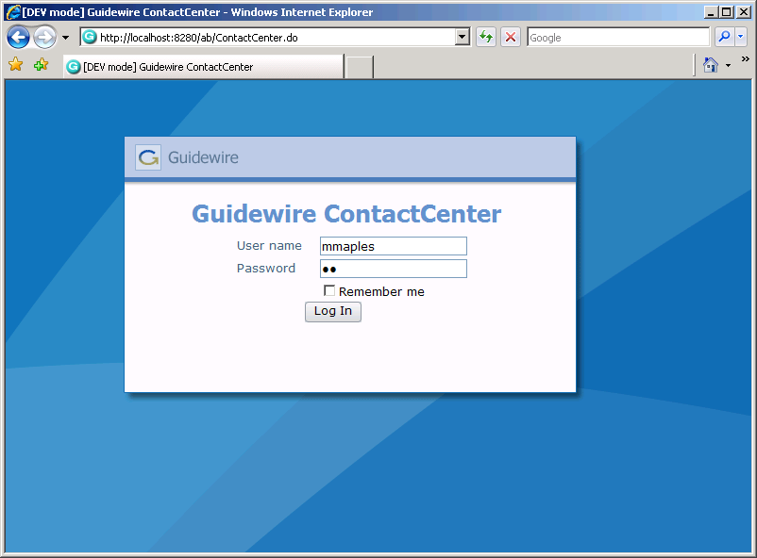

Accessing ContactCenter
Notes:
The process of logging on to ContactCenter is identical to that of ClaimCenter. To log in to an application, end users must open an instance of Internet Explorer and access the system through the appropriate URL (Universal Resource Locator, also more commonly known as a "web address"). The URL is:
http://machine:port#/instanceName/ContactCenter.do, where:
machine is the name of the host machine, and
port# is the port which Internet Explorer should use to access the application, and
instanceName is the name of the instance of ContactCenter (typically "ab", for address book).
Other than the URL itself, the process of logging on to ClaimCenter and ContactCenter is identical.

Slide 23
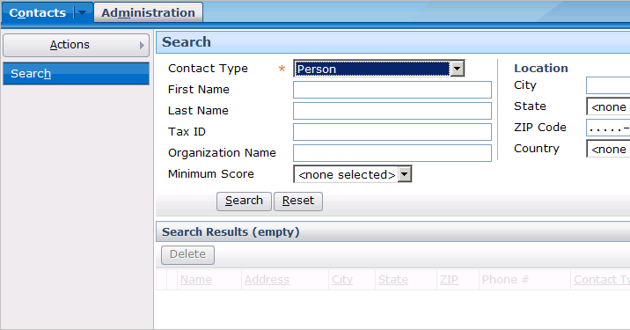
The ContactCenter Interface
Notes:
The ContactCenter interface is relatively simple compared to ClaimCenter. It has the five areas (tab bar, info bar, side bar, screen area, workspace frame) with the same screens and navigation conventions, but:
The base application has only two tabs.
The base application makes no use of the workspace frame.
The base application has only four major aspects of functionality (creating contacts, searching for contacts, viewing/modifying contacts, and creating users).

Slide 24
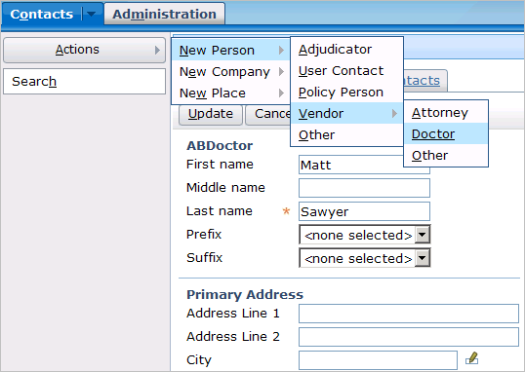
Creating New Contacts in ContactCenter
Notes:
New contacts in ContactCenter are created using the appropriate menu action from the Contacts tab's navigation bar. The menus and fields are self-explanatory, and all of the functionality used to create contacts (such as required fields, dropdowns, validation, and so on) are also used in ClaimCenter and have already been discussed in this course.
Recall that there are three primary subtypes in the contact subtype hierarchy: person, place, and company. They correspond to the three page actions on the Contacts tab.
In both ContactCenter and ClaimCenter, there is a Related Contacts tab (which is visible if you view PowerPoint in Notes view (View | Notes Page)).
This tab is used to specify that this contact has a relationship to some other contact (such as Matt Sawyer is an employee of Hartford Medical Group). The other contact automatically gets the inverse relationship. (In other words, Hartford Medical Group becomes linked to Matt Sawyer with the relationship of employer.) This is a structured way of establishing when someone is to be contacted through someone else.

Slide 25
Lesson Outline
Contact Basics
ContactCenter
Creating ClaimCenter Contacts
Working with Linked Contacts
Searching for Contacts

Slide 26
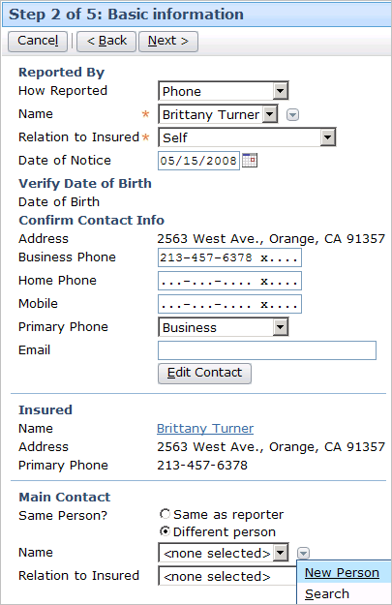
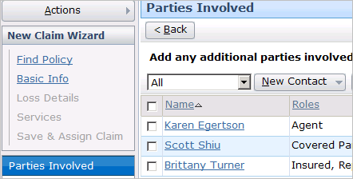
Creating Contacts from the New Claim Wizard
Contacts added on the Main Contacts step have a pre-defined role
Contacts added on the Parties involved step can have any role
Notes:
During the New Claim wizard, you can add contacts to a claim at multiple points, including the Main Contacts step and the Parties Involved step.
In some places, such as the Basic Information step, a given contact has a pre-defined role. For example, the contact specified in the Reported By section has the role "reporter". The contact specified in the Main Contact section has the role "main contact".
In some places, such as the Parties Involved step, a given contact can have any role. For example, a contact added here could be "insured", "witness", "doctor" and so on.

Slide 27
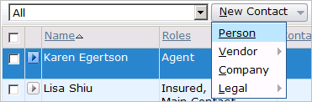
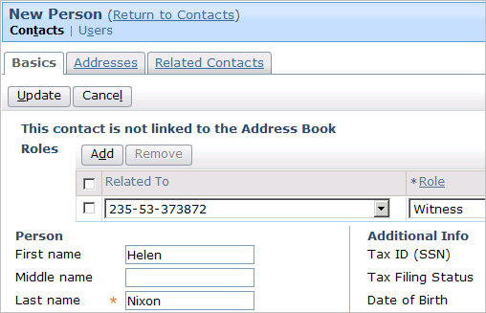
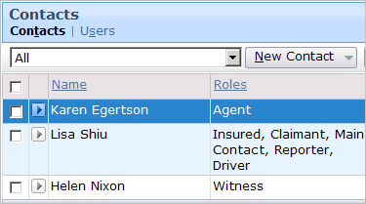
Adding a New "Single Use" Contact
Notes:
To create a new contact (as opposed to copying a "multi-use" contact from Address Book):
Navigate to the Contacts screen.
Click New Contact and choose the appropriate choice from the sub-menus. This displays a card view.
On the Basics card, supply the required information. On that card and the other cards, supply additional information as appropriate.
You must add at least one role to the contact. To add a role, click the Add button in the Roles list view. Complete the information in the new row.
When the information about the contact is complete, click Update. This returns you to the Contacts list.
The new contact should appear in the list of contacts.
In the base application user interface, the term "not linked" is used to denote a "single use" contact.
In both ContactCenter and ClaimCenter, there is a Related Contacts tab. This tab is used to specify that this contact has a relationship to some other contact (such as Matt Sawyer is an employee of Hartford Medical Group). The other contact automatically gets the inverse relationship. (In other words, Hartford Medical Group becomes linked to Matt Sawyer with the relationship of employer.) This is a structured way of establishing when someone is to be contacted through someone else.

Slide 28
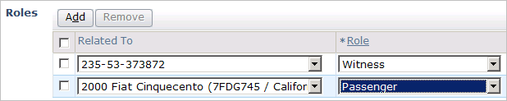
Roles
Claim
235-53-373872
witness
Helen
Nixon
passenger
Incident
2000 Fiat
(entire claim)
Notes:
Recall that a contact may have more than one role and that each role is held in relation to the entire claim or to a specific exposure, incident, or policy.
The default relationship for each role is the entire claim, which appears in the Owner dropdown as the claim number.
In the example above, Helen Nixon:
Has the role of witness for the entire claim.
Has the role of passenger only for the 2000 Fiat incident.

Slide 29
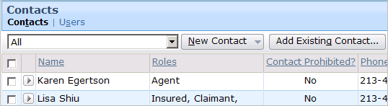
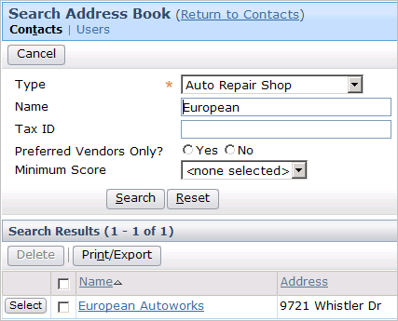
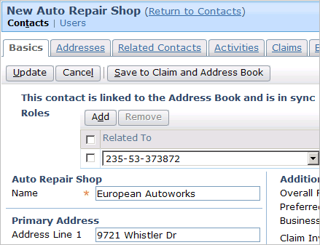
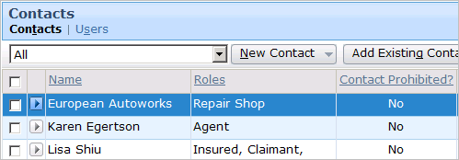
Adding an Existing "Multi-Use" Contact
Notes:
To copy an existing contact from Address Book (as opposed to creating a new "single use" contact):
Navigate to the Contacts screen.
Click Add Existing Contact. This opens a Search Address Book screen.
Specify search criteria as needed.
Click the Search button.
Click the Select button corresponding to the desired contact. This creates a copy of the contact in ClaimCenter.
Modify the new contact object as appropriate. You must also add at least one role to the contact. To add a role, click the Add button in the Roles list view. Complete the information in the new row.
When the information about the contact is complete, click Update. This returns you to the Contacts list.
The new contact should appear in the list of contacts.

Slide 30
Lesson Outline
Contact Basics
ContactCenter
Creating ClaimCenter Contacts
Working with Linked Contacts
Searching for Contacts

Slide 31
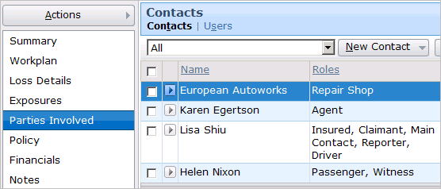
Review: Viewing Contacts
Notes:
Recall that all the contacts for a claim are listed on one of the two Parties Involved screen. The Contacts screen lists both "single use" contacts (who have no logically corresponding object in Address Book) and "multi-use" contacts (who have a logically corresponding object in Address Book to which they are linked).

Slide 32
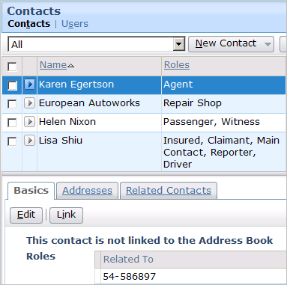
Identifying If a Contact Is Linked
phone:
457-7378
Notes:
Recall that an unlinked contact is a contact that exists only in ClaimCenter with no corresponding object in Address Book.
When a contact is unlinked, the following label appears at the top of the "Basics" card below the Contacts list:
"This contact is not linked to the Address Book"

Slide 33
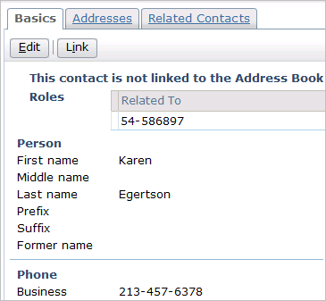
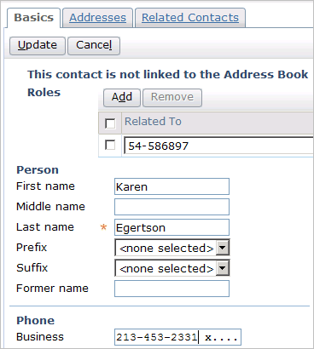
Editing an Unlinked Contact
phone:
457-7378
Notes:
To edit an unlinked contact, simply click the Edit button, make the appropriate changes, and click the Update button. Because the contact is unlinked, changes made to the contact have no impact on its functionality or on any other contact.

Slide 34
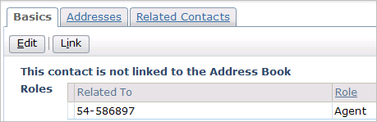
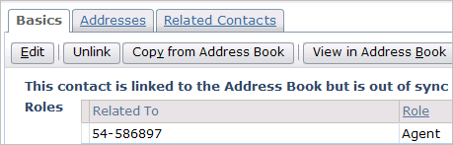
Linking an Unlinked Contact
phone:
457-7378
phone:
324-6600
Notes:
When you link an unlinked contact, ClaimCenter first searches Address Book for a possible match. If a match can be found, then it links the ClaimCenter object with the identified Address Book object. If multiple matches are found, then ClaimCenter asks the user to identify the correct match. If no match is found, then a new object is created in Address Book and linked to the ClaimCenter object. Linking does not automatically sync the objects. A ClaimCenter contact may be out of sync even upon immediately being linked to a ContactCenter contact.
To link a contact when no corresponding contact exists in Address Book, you must have the "Create address book contacts" permission. If you attempt to link a contact without the "Create address book contacts" permission, then the following error is displayed in the user interface (which is visible if you view PowerPoint in Notes view (View | Notes Page)).
You can also unlink a contact. This functionality is designed primarily for cases where you incorrectly linked a ClaimCenter contact to the wrong Address Book contact.

Slide 35
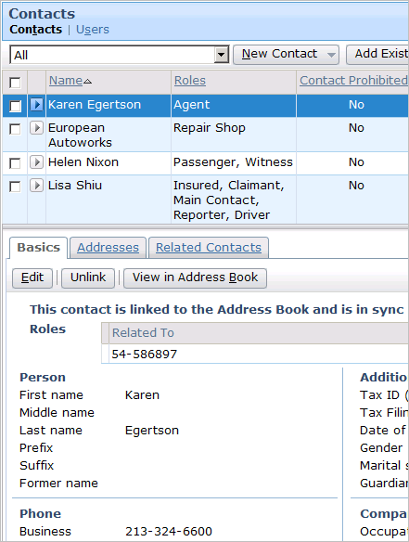
Identifying If a Contact Is Linked (In Sync)
phone:
324-6600
phone:
324-6600
Notes:
Recall that a linked contact is a contact that exists both in ClaimCenter and Address Book. Also, recall that when all of the fields in both objects are identical, the contacts are considered to be in sync.
When a contact is linked and in sync, the following label appears at the top of the "Basics" card below the Contacts list:
"This contact is linked to the Address Book and is in sync"

Slide 36
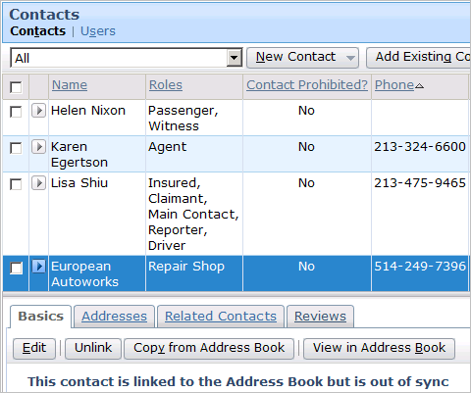
Identifying a Linked Contact (Out of Sync)
phone:
249-7396
phone:
249-7300
Notes:
Recall that a linked contact is a contact that exists both in ClaimCenter and Address Book. Also, recall that when any field in one object does not have the same value as the corresponding field in the other object, the contacts are considered to be out of sync.
When a contact is linked and in sync, the following label appears at the top of the "Basics" card below the Contacts list:
"This contact is linked to the Address Book but is out of sync"

Slide 37
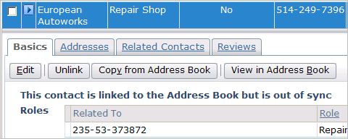
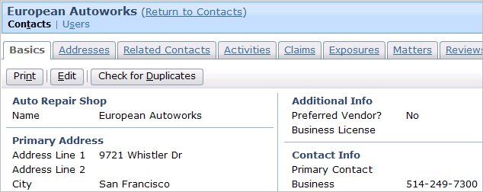
Viewing Each Contact
phone:
249-7396
phone:
249-7300
Notes:
When two contacts are linked, you can easily access either version of the contact.
The ClaimCenter contact is listed in the contact card view below the contact list view. To view the ClaimCenter contact, simply click the desired contact in the list view.
The Address Book contact can be seen by clicking the "View in Address Book" button. This navigates to a screen with a slightly different card view. The information on the Basics, Addresses, and Related Contacts tab may be similar or, if the contacts are in sync, identical. But you are in fact looking at a different copy of the contact that the one seen in the contact card view underneath the contact list view.

Slide 38
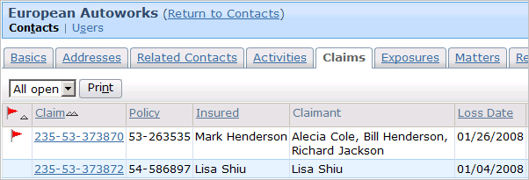
Viewing Objects Related to an AB Contact
Notes:
The Address Book contact card view has four additional cards which list objects in ClaimCenter which the Address Book contact is related to. These are the Activities, Claims, Exposures, and Matters cards. An Address Book contact is never related directly to a ClaimCenter claim (or activity, exposure, or matter). An Address Book contact is always linked to a claim through a ClaimCenter contact.

Slide 39
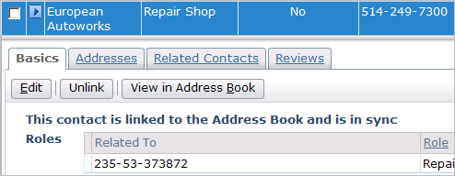
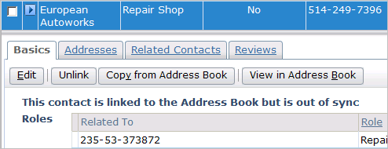
Editing the ClaimCenter Contact
phone:
249-7300
phone:
249-7300
249-7396
Notes:
You can edit a linked ClaimCenter contact by clicking the Edit button in the contact card view. Once the edits has been made, the contact remains linked but is no longer in sync with its Address Book counterpart. This may be desirable when you want the ClaimCenter contact to vary from the Address Book contact (such as a circumstance where a contact is normally contacted through one phone number but for a given claim contact should happen through a separate phone number).

Slide 40
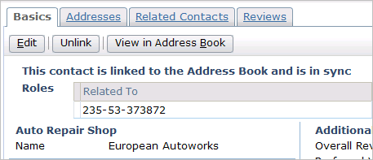
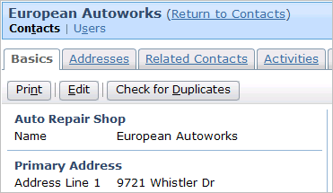
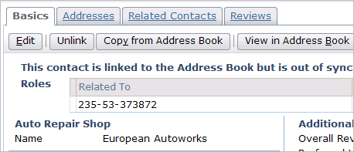
Editing the Address Book Contact
phone:
249-7300
phone:
249-7300
249-7396
Notes:
You can edit a linked Address Book contact by clicking the View in Address Book contact, clicking the Edit button from the Address Book's view of the contact, and clicking Update. Once the edits has been made, the contacts remains linked but are no longer in sync with its Address Book counterpart. Once again, this may be desirable when you want the ClaimCenter contact to vary from the Address Book contact (such as a circumstance where a contact is normally contacted through one phone number but for a given claim contact should happen through a separate phone number).

Slide 41
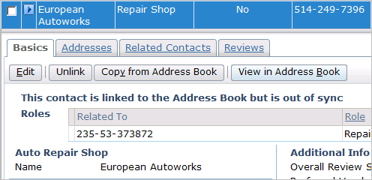
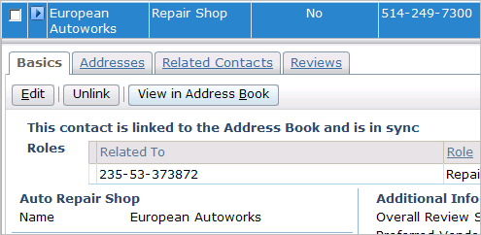
Syncing a Linked Contact
phone:
249-7396
phone:
249-7300
249-7300
Syncing can be
  Manually initiated from CC
  Automatically triggered from AB when an AB contact is updated
Notes:
When you sync a contact, the information from the Address Book contact is copied over to the ClaimCenter contact. Any discrepancies between the two objects are discarded.
To sync an out-of-sync contact, click the Copy from Address Book button. This changes the label on the Basics card from "...but is out of sync" to "...and is in sync".
Synchronization can be automated such that for each contact (or type of contact) the change in AddressBook will automatically post an update of the change to be applied to the linked ClaimCenter contact.

Slide 42
Lesson Outline
Contact Basics
ContactCenter
Creating ClaimCenter Contacts
Working with Linked Contacts
Searching for Contacts

Slide 43
Searching for Address Book Contacts
Searching for contacts can be done using different approaches to reduce time and improve quality of service. This includes searching
  by Name and/or Type of contact
    For example, an Auto Repair Shop named Aamco Transmissions
  by Location and/or Proximity
    For example, any Auto Repair Shop within 5 miles of the loss location
  by Preferred Status and/or by Performance Score
    For example, an Auto Repair Shop who is a Preferred Vendor and whose Average Review Score is at least 80

Slide 44
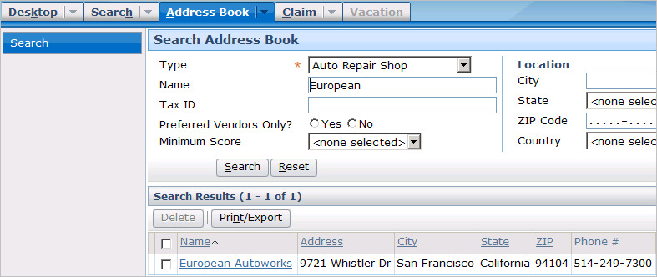
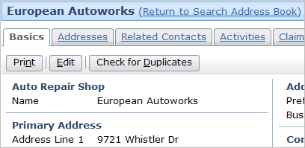
Searching for a Specific Contact
Notes:
In addition to searching from ClaimCenter in order to create a new “multi-use” contact, you can also search the Address Book for contacts without being within the context of a claim. (For example, you may want to know the mailing address for an auto repair shop even though you are not currently working on any claim associated to that repair shop.) Address Book searches are conducted from the Address Book tab.
From the Search results, you can view and edit an Address Book contact.
In the screenshot shown here, the search criteria is simply the name and type of contact. Name uses a “starts with” query to identify contacts matching the entered values. This is most common when the adjuster or claimant have already identified the service provider.

Slide 45
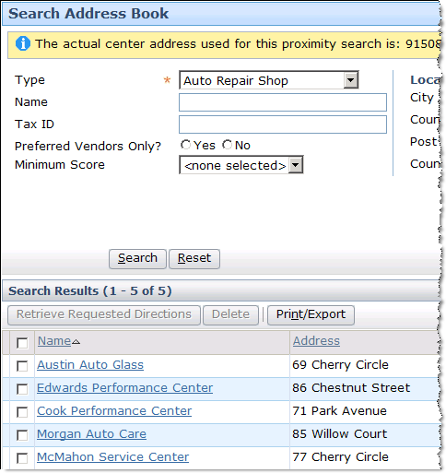
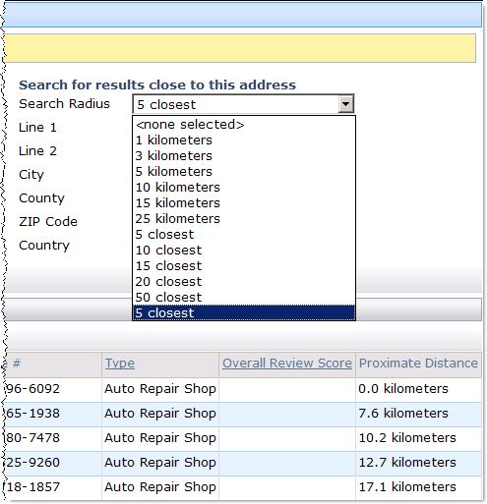
Searching Contacts Using Proximity Criteria
You can search either ClaimCenter or Address Book for contacts that meet a given proximity criteria
Notes:
There are two common proximity criteria:
Find all contacts within a given distance of a given location (such as find all auto shops within 25 miles/kilometers of the loss location)
Find the top X closest contacts to a given location (such as find the five auto shops closest to the loss location)
Proximity searches are accomplished using geocoding. Geocoding assigns geographic coordinates to locations and uses them to find contacts within a given proximity. Geocoding requires integration with a geocoding system, which is typically provided by a vendor.

Slide 46
Geocoding Integration
address
Geocoding
Service
map coordinates, zip code data
Many instances of ClaimCenter have an integration point to a geocoding service, such as Microsoft's MapPoint
  This service provides longitude and latitude coordinates for a street address (or exchanges zip code for city/state and vice versa)
Notes:
Information exchange
ClaimCenter sends the address
ClaimCenter receives coordinates, which it can use to do proximity calculations, or exchanges city/state and zip code information
Geocoding services can be used to provide a list of valid zip codes for a given city and state, or a list of valid cities for a given zip code.
The amount and nature of the information provided from the geocoding service varies from provider to provider, and as a result there can be other uses for geocoding. For example:
Geocoding can be used with some services to provide the zip code for a given city and state, or to provide the city and state for a given zip code.
Geocoding can retrieve proximate distances (the direct distance between two points) and/or driving distances (which are typically longer as this does not connect two points directly but rather through a route of streets).
Geocoding can retrieve driving directions.
The effort around planning and configuring this integration point is typically minimal. Geocoding services exist to provide this type of service, and therefore they typically expend effort to make the integration straight-forward.
A given instance of ClaimCenter is typically integrated with a single geocoding service.

Slide 47
(Notes Only Slide)

Slide 48
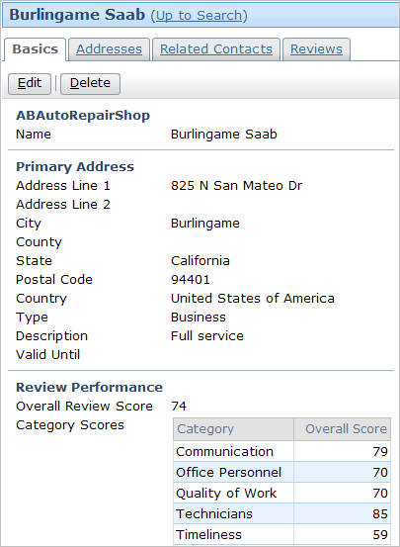
Service Provider Reviews
Service Providers are contacts such as Auto Repair, Lawyers or Doctors
You can review and track the performance of a service provider at the claim level for different categories of service
Reviews are sent to ContactCenter which calculates aggregate review scores across different claims

Slide 49
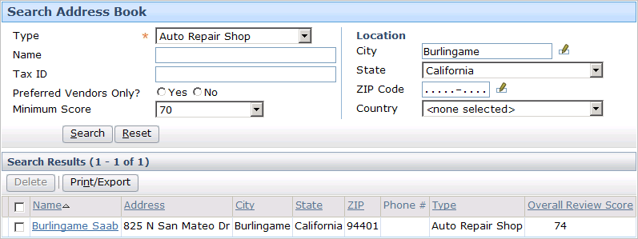
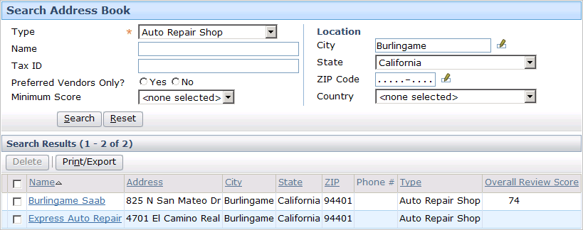
Searching Contacts Using Performance Scores
Adjusters can search to only add providers that have a good track record
1st
Notes:
In the first search only those Auto Repair Shops located in Burlingame, CA are returned who have an aggregate review score and that score is at least 70.
In the second search all those Auto Repair Shops located in Burlingame, CA are returned regardless of whether they have an aggregate review score or not.

Slide 50
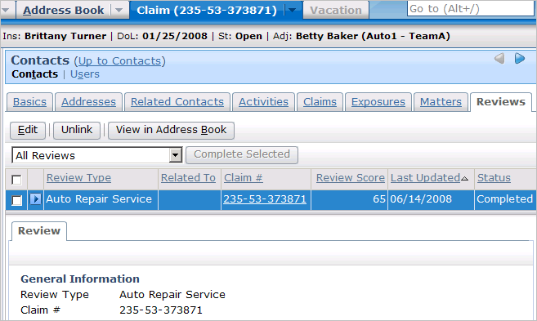
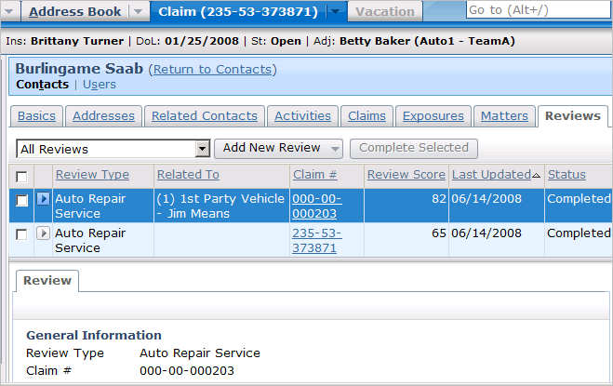
Viewing Performance Reviews
Claim view
Contact view
Notes:
When viewing a contact from the ClaimCenter Parties Involved screen, you have access to the particular reviews for that claim. In there is a single review submitted for claim number 235-53-373871.

Slide 51
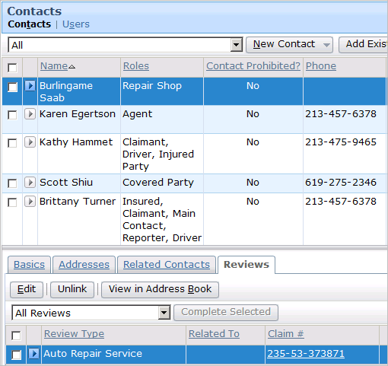
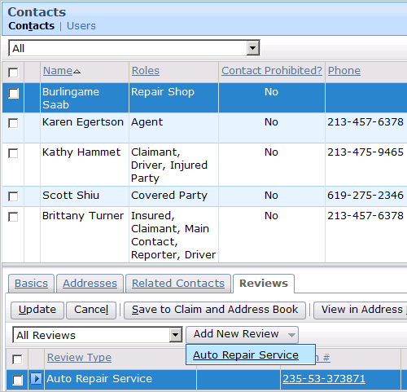
Creating New Performance Reviews
You must be in edit mode in order to add a new review
A drop down allows selection of service provider review types
Notes:
In the base application, a single review type is provided for Auto Repair Shop. It is possible to configure other review types for Doctors or Lawyers. These review types could re-use some of the same categories and questions, or could be entirely different.

Slide 52
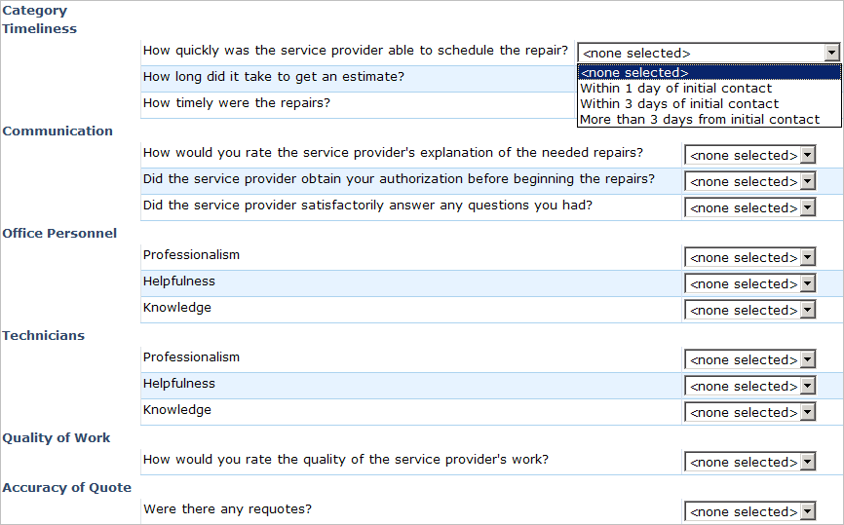
Performance Review Question Sets
Notes:
Each Review Type contains one or more Categories.
Categories are used for grouping sets of similar questions.
Each answer is associated with a score.
The score for each question answered is used to computer the Category Scores.
In the base application, if a question is not answered, it’s not used in the calculation.

Slide 53
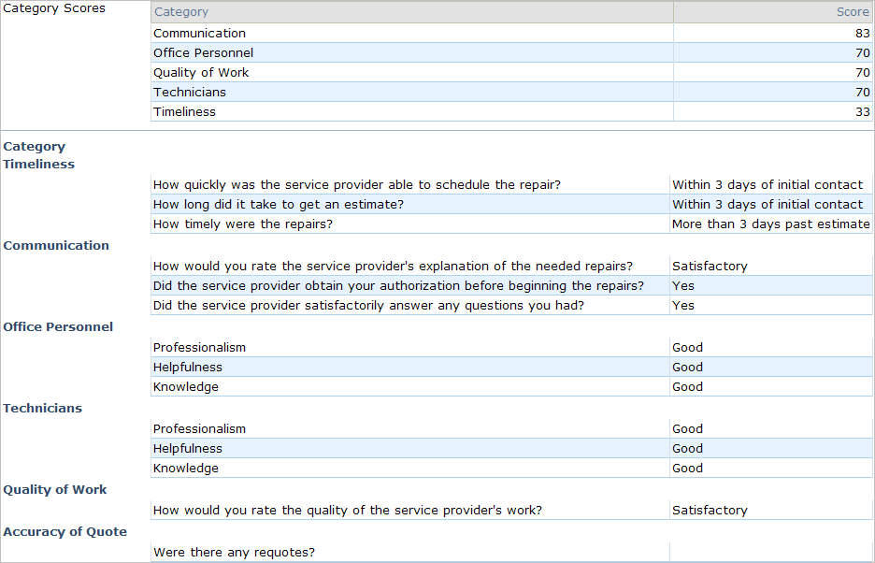
Completed Provider Review and Scores
Notes:
Notice that Accuracy of Quote was not answered and thus not included in the final score.

Slide 54
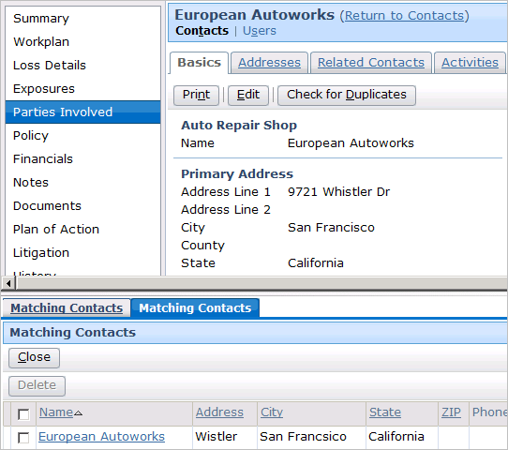
Checking for Duplicates in the Address Book
Is the same
auto repair shop?
Notes:
Duplicate contact search returns results using a configurable potential match query criteria. However, if a duplicate is found, there is no functionality in Address Book that lets you merge the two objects. This is because the complexity involved in resolving this type of situation almost always requires the manual intervention of a user.
The Contact list has a Merge Roles button, which lets you collapse multiple contacts with potentially redundant role information into a single contact. One contact (the "survivor") remains on the contact and inherits all roles of the other selected contacts. The other selected contacts are then removed from the claim. This is shown in the screenshots on the next page (which are visible if you view PowerPoint in Notes view (View --> Notes Page)).
To merge roles:
Select the "survivor" contact by clicking that row. (Recall that the selected row of a listdetail view appears with a blue background.)
Select one or more other contacts by checking the checkbox.
Click Merge Roles. The contacts selected in step 2 are removed from the claim, and any roles that these removed contacts had are added to the "survivor" contact.
(continued)

Slide 55
Lesson Objectives
You should now be able to:
  Describe the functionality of contacts
  Describe the functionality of ContactCenter
  Create contacts in ClaimCenter
  Work with contacts in ClaimCenter
  Describe approaches to searching for contacts

Slide 56
Review Questions
If "John Doe" is in the Address Book and is associated to three claims, how many contacts have the name "John Doe"?
Is it common or uncommon to have a contact that exists only in ClaimCenter? Only in Address Book?
What is true about a ClaimCenter contact when it is linked? When it is in sync?
What is the purpose of a contact role? A contact role "owner"?
How can you tell if a contact is linked and/or in sync?
How could you identify all the claims that a given contact is associated to?
Notes:
Answers
1. Four. There would be one contact in Address Book and three in ClaimCenter. Every contact, whether it is linked or not, is a unique and separate object.
2. It is common to have a contact that exists only in ClaimCenter. This is true for contacts that are relevant to only one claim (such as a witness). It is uncommon to have a contact exist only in Address Book. The primary purpose for creating a contact in Address Book is to have it associated to multiple claims, and if it is associated to even one claim, then the contact will also exist in ClaimCenter.
3. A linked ClaimCenter contact object has a logical matching object in Address Book. A ClaimCenter contact object that is in sync is linked to an Address Book contact and all of its field values are identical to the Address Book version.
4. A contact role identifies the relationship that the contact has with the claim (such as insured, witness, doctor, and so on). The contact role owner identifies if the contact has that role for the entire claim or for just the policy, a given exposure, or a given incident.
5. You can tell that a contact is linked and/or in sync by selecting the contact from the Parties Involved - Contacts screen. A label on the Basic card identifies the contact's state.
6. Assuming that the contact is a "multi-use" contact which has linked instances in both ClaimCenter and Address Book, you could view the contact in Address Book (either by finding the contact from a Parties Involved - Contacts screen and clicking the "View in Address Book" button or by searching for it via the Address Book tab), and then view the Claims card, which lists all claims the contact is linked to.

Slide 57
Reservation of Rights
Copyright © 2008 Guidewire Software, Inc. All Rights Reserved.
This file and the contents herein are the property of Guidewire Software, Inc. Use of this course material is restricted to students officially registered in this specific Guidewire-instructed course. Replication or distribution of this course material electronically or in paper format is prohibited without express permission from Guidewire.
Guidewire, Guidewire Software, Guidewire ClaimCenter, Guidewire PolicyCenter, Guidewire BillingCenter, Guidewire ContactCenter, Guidewire Insurance Suite, Guidewire Education, and the Guidewire logo are trademarks or registered trademarks of Guidewire Software, Inc. All other trademarks are the property of their respective owners.

