Slide 1
Notes
5.0.0
6-July-2008
Notes:
Guidewire training materials contain Guidewire’s confidential information subject to confidentiality and non-disclosure agreements. You agree to use the information in this manual solely for the purpose of training to implement Guidewire’s software solutions. You also agree not to disclose the information in this manual to third parties or copy this manual without Guidewire’s prior written consent. Guidewire training may only be given by Guidewire employees or certified Guidewire partners under the appropriate agreement with Guidewire.

Slide 2
Lesson Objectives
By the end of this lesson, you should be able to:
  Describe the functionality of notes
  Work with notes
  This lesson uses the notes section for additional explanation and information.
  To view the notes in PowerPoint, choose View→Normal or View→Notes Page.
  If you choose to print the notes for the lesson, be sure to select “Print hidden slides.”

Slide 3
Lesson Outline
Notes Basics
Working with Notes

Slide 4
Notes
Claimant reported that the driver was a teenage boy, so there may be a question of coverage.
A note is a detailed record of the actions or thinking behind the processing of a claim
  Notes are typically created by users
Notes:
Notes can be created in business rules, and in some cases it may make sense for a given business rule to create and attach a note to a claim after some automatic action has been taken. But the majority of notes associated to a given claim are user-created notes.

Slide 5
Note Fields
Topic: Coverage
Subject: Coverage in question
Related To: Entire claim
Confidential: No
Text: Claimant reported...
Topic - the general category of the note
Subject - a short description of the note content
Related To object - whether the note is appropriate to the entire claim or to a particular exposure or contact
Confidential - whether the note is visible to everyone or to only you, your supervisors, and people with permission to view confidential notes
Text - the text of the note itself
Notes:
The sub-objects a note can be attached to are exposures, contacts, and matters.
When you create a note, you can mark it as confidential. A confidential note that you create is visible only to you, your hierarchy of supervisors, and anyone who explicitly has permission to view all confidential notes.
Notes may also be set to a specific security type which determines which users may be allowed to see this note. This concept of access control for notes and other claim subobjects is covered in the Permissions and Access Control Lists lessons.

Slide 6
Note Templates
Witness Statement Template
Topic: Investigation
Text:
When did it occur?
Where did it occur?
Witness Statement Note
Topic: Investigation
Text:
When did it occur?
October 7 at 2:35 pm
Where did it occur?
The corner of 5th and Main
A note template is a template for commonly created notes
  A user can create a note using a template, which will automatically set the topic, set the subject, and/or add text to the text field

Slide 7
Lesson Outline
Notes Basics
Working with Notes

Slide 8
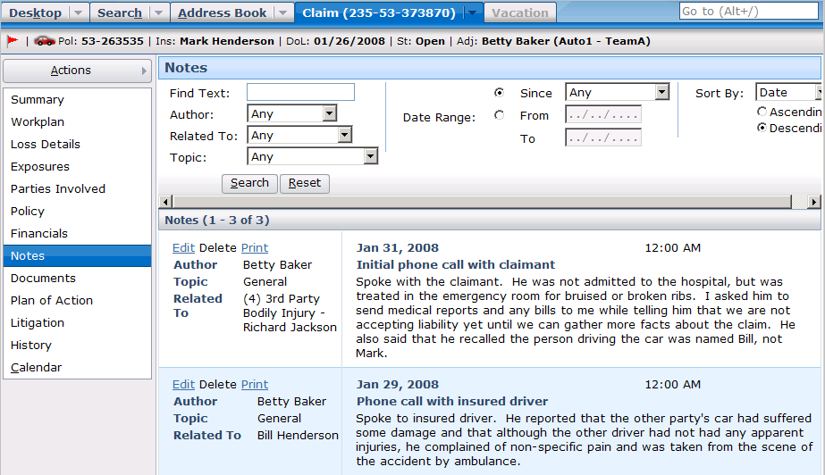
Viewing Notes
Notes:
To view the notes for a given claim, navigate to the claim and click the Notes page link. If the claim has any notes, they are displayed in the screen. You can also use the search controls at the top of the screen to filter out notes you don't wish to see. For example, you could view all notes related to a given contact.

Slide 9
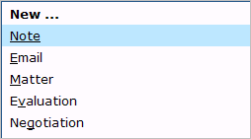
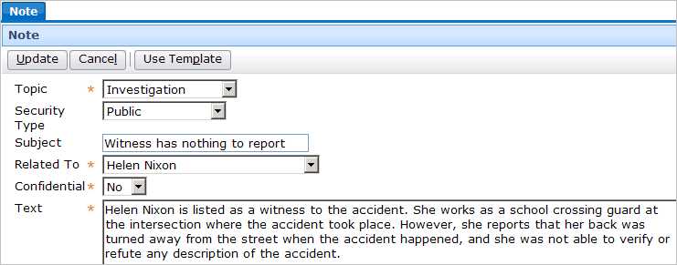
Adding Notes to a Claim
Notes:
To create a new note for a claim:
Navigate to the claim.
Click New Note.
Enter the information about the note as appropriate.
Click Update.

Slide 10
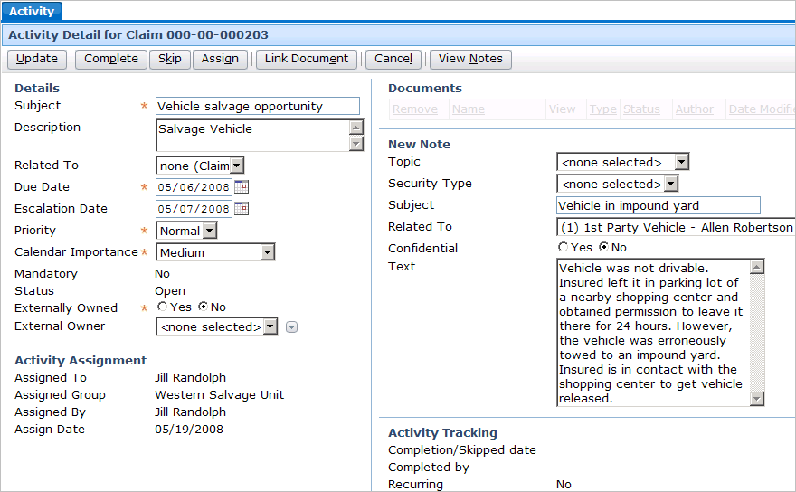
Adding Notes via an Activity
Notes:
When you view an activity, there are fields that can be used to create a note.
To create a new note from an activity:
Navigate to the activity.
Enter the information about the note in the New Note section as appropriate.
Click Update.

Slide 11
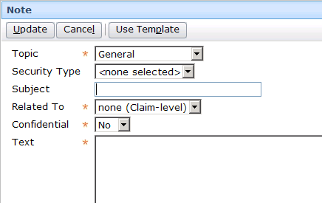
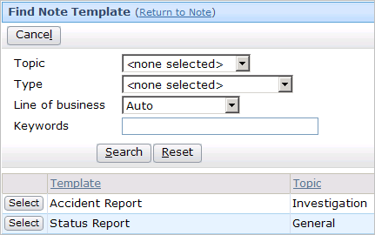
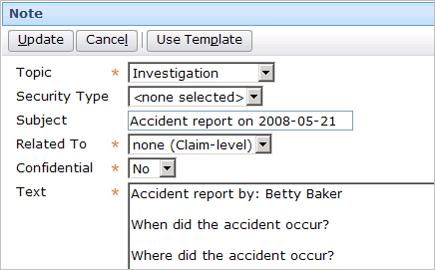
Using a Note Template
Notes:
You can also use a Note template to generate a note. To select a note template:
Within the New Note screen, click Use Template. This displays the Find Note Template screen.
Enter in criteria to identify the desired template and click Search. From the search results list, click the Select button corresponding to the desired template.
The note template will potentially populate the Topic, Subject, and Text fields. Some of the fields may include dynamic data values, such as a subject of "Accident statement on <current date>" or a text line of "Status report by: <user name>". Users can still modify these fields or, in the case of the Text field, add additional text.

Slide 12
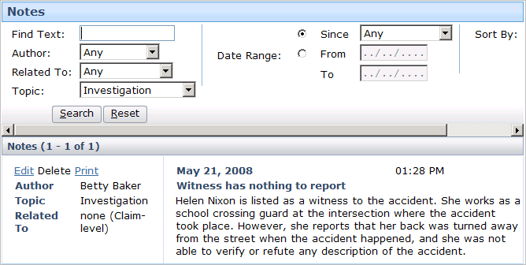
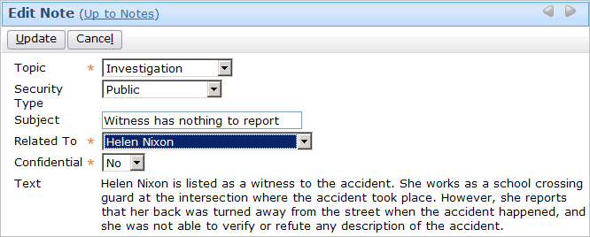
Editing Notes
Notes:
To edit a note, click the Edit link from the Notes list.
In the base application, the text of a note cannot be edited once it has been created. This is usually mandated to provide a true reflection of the actions taken on a claim. This behavior is configurable, and any field can be editable or not once the note has been created.

Slide 13
Lesson Objectives
You should now be able to:
  Describe the functionality of notes
  Work with notes

Slide 14
Review Questions
For each of the following descriptions, identify if it is a description of activities, documents, and/or notes. Some descriptions apply to multiple types of objects.
It has an owner.
It involves integration to a third-party system.
In the base application, it has an attribute which, when selected, makes it viewable only by you, your supervisors, and people with the appropriate permissions.
You can specify that it pertains to the entire claim or to a single sub-object.
It has a MIME type.
It has a due date.
It can be created using a template.
Notes:
Answers
1. Activities
2. Documents
3. Documents and notes (The setting for documents is "sensitive". The setting for notes is "confidential".)
4. Activities, documents, and notes
5. Documents
6. Activities
7. Documents and notes (though one could argue that it is all three if activity patterns are thought of as a "template" for activities)

Slide 15
Reservation of Rights
Copyright © 2008 Guidewire Software, Inc. All Rights Reserved.
This file and the contents herein are the property of Guidewire Software, Inc. Use of this course material is restricted to students officially registered in this specific Guidewire-instructed course. Replication or distribution of this course material electronically or in paper format is prohibited without express permission from Guidewire.
Guidewire, Guidewire Software, Guidewire ClaimCenter, Guidewire PolicyCenter, Guidewire BillingCenter, Guidewire ContactCenter, Guidewire Insurance Suite, Guidewire Education, and the Guidewire logo are trademarks or registered trademarks of Guidewire Software, Inc. All other trademarks are the property of their respective owners.

