Slide 1
Claim Objects Section Review
5.0.0
6-July-2008
Notes:
Guidewire training materials contain Guidewire’s confidential information subject to confidentiality and non-disclosure agreements. You agree to use the information in this manual solely for the purpose of training to implement Guidewire’s software solutions. You also agree not to disclose the information in this manual to third parties or copy this manual without Guidewire’s prior written consent. Guidewire training may only be given by Guidewire employees or certified Guidewire partners under the appropriate agreement with Guidewire.

Slide 2

ClaimCenter Contacts vs. Address Book Contacts
Address
Book
When would you store a contact only in ClaimCenter? When would you store a contact in the address book?
Claim
000-00-002006
Claim
000-00-002006
Claim
036-22-934712

Slide 3
Contact Terminology
What is a linked contact?
What is an in-sync contact?
What is an out-of-sync contact?
Address
Book
in
sync
out of sync
in
sync

Slide 4
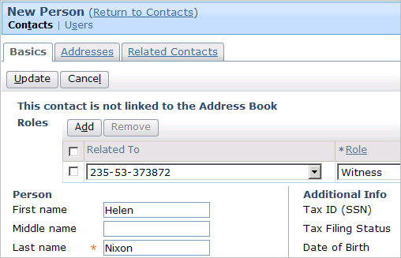
Contact Roles
What is the purpose of a contact role?
What is the purpose of a contact role owner?

Slide 5





The Life Cycle of an Activity
What does the star mean?
What does the red date mean?
What does the icon mean?
What are the two ways an activity gets closed?

Slide 6
How Are Activities Created?
Verify Coverage P???
priority: medium
due days: 5
Verify Coverage
priority: medium
due: Oct. 12, 2007
What type of entity is used to create an activity?
Other than priority and due days, what might be specified in this entity for a given type of activity?

Slide 7
What Can You Do With Activities?
Activities associated to a claim:
Activities in a queue:
Activities you own:
Identify if the functionality below is available for activities associated to a claim, in a queue, or ones that you own. Each item belongs to only one category, except as noted.
  Complete or skip them
  View them from the Desktop (two answers)
  Take ownership of them
  Modify them
  View them from the workplan
  Reassign them

Slide 8
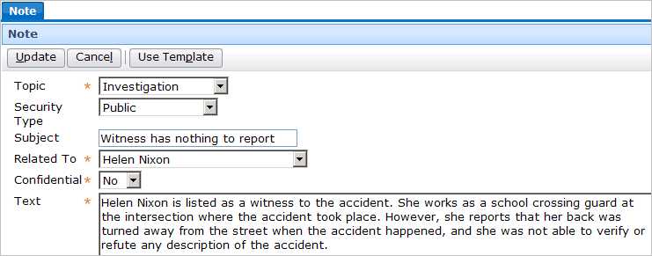
Note Functionality
What is a note for?
What is a note template?
What happens when a note is confidential?

Slide 9


Congratulations
Your work on the "cross-process" entities is complete!
Litigation
Intake
Adjudication
Used heavily throughout entire process
Payment
Recovery

Slide 10
Reservation of Rights
Copyright © 2008 Guidewire Software, Inc. All Rights Reserved.
This file and the contents herein are the property of Guidewire Software, Inc. Use of this course material is restricted to students officially registered in this specific Guidewire-instructed course. Replication or distribution of this course material electronically or in paper format is prohibited without express permission from Guidewire.
Guidewire, Guidewire Software, Guidewire ClaimCenter, Guidewire PolicyCenter, Guidewire BillingCenter, Guidewire ContactCenter, Guidewire Insurance Suite, Guidewire Education, and the Guidewire logo are trademarks or registered trademarks of Guidewire Software, Inc. All other trademarks are the property of their respective owners.

