Slide 1
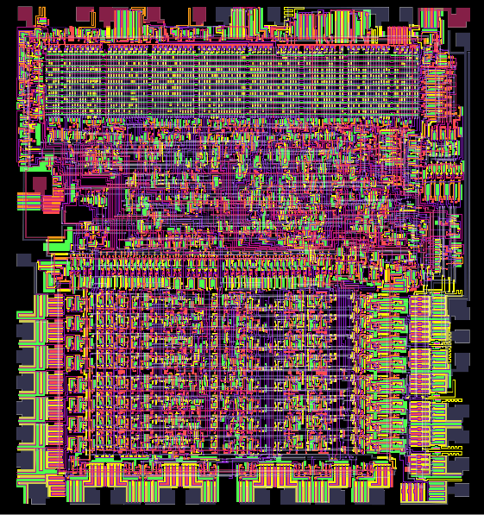
Visual Transistor Level Simulation of the 6502 CPU
Virtual Machine Simulating
a 6502 Processor
Presented By:
Abhishek Raj
Shobhit Sinha
Satyam Govind Rao

Slide 2
Problem Statement:
The aim of this project is to develop a software-based virtual machine capable of accurately replicating the behaviour of a 6502-like processor. This processor, known for its historical significance in early computing systems, poses a unique challenge in emulation due to its specific instruction set, addressing modes, and timing.
Objective:
The primary goal is to create a fully functional virtual machine capable of executing 6502 assembly code with a high degree of accuracy. This accuracy is measured by comparing the outcomes of virtual machine execution to those of an actual 6502 processor, with a target of achieving a 95% or higher instruction accuracy rate.
Specifications :
This includes emulating its instruction set, addressing modes, registers (such as the accumulator, X, and Y registers), and condition flags (e.g., negative, zero, overflow).

Slide 3
Measurable: The accuracy of instruction emulation will be measured by executing a wide range of 6502 assembly programs and comparing the virtual machine's output to the expected results.
Achieving a high accuracy rate ensures that the virtual machine closely mimics the original processor's behaviour.
Achievable: The project's feasibility is grounded in the utilization of modern software development practices. These practices encompass the use of version control systems, and automated testing to facilitate efficient development and maintainability. The selection of an appropriate programming language, such as C++, ensures performance and cross-platform compatibility.
Relevant: The project's relevance lies in providing a practical tool for 6502-based system emulation and debugging. This tool will be valuable to retro-computing enthusiasts, software developers and educators.
It will enable the running of legacy software and serve as a teaching aid for understanding early computing systems. Additionally, it contributes to the preservation of computing history.
Time-Bound: The project is planned to be completed within a 2-month timeframe, ensuring that development remains focused and timely.

Slide 4
Functional Requirements
Implement 6502 CPU instructions: Develop functions or methods to simulate the behaviour of each 6502 instruction, including addressing modes, operand handling, and execution.
Handle memory addressing modes: Create mechanisms to correctly manage various addressing modes, such as immediate, absolute, zero page, and indexed.
Emulate registers and flags: Maintain and update registers (A, X, Y) and flags (N, V, Z) according to instruction execution
Support input and output: Develop interfaces for interacting with memory and registers, enabling data input and output.
Create an assembler for 6502 code: Implement a tool that can convert human-readable assembly code into machine code.
Provide debugging capabilities: Develop debugging features, including breakpoints, step-through, and memory inspection, to aid in code analysis.
Support loading and saving memory snapshots: Allow users to save and load system states for experimentation and debugging.

Slide 5
Non-Functional Requirements
1. Performance: Ensure that the virtual machine achieves real-time or near-real-time execution for responsive user experiences.
2. Portability: Develop the virtual machine as a cross-platform solution to accommodate various operating systems and environments.
3. Extensibility: Design the architecture to allow for future expansion and the ability to support other 6502-like processors, enabling broader applicability.

Slide 6
Design
Workflow outline of the complete process from loading 6502 code to executing it while supporting debugging for your virtual machine simulating a 6502-like processor:
1. Loading 6502 Code: The user initiates the process by loading a 6502 assembly code file or binary executable into the virtual machine.
2. Initializing the Virtual Machine: The virtual machine sets up its internal state, initializing registers, memory, and flags. - Debugging features like breakpoints and step-through settings are configured based on user preferences.
3. Execution Loop: The virtual machine enters an execution loop, continuously fetching and executing instructions. - Each instruction is fetched based on the program counter (PC) and decoded.
4. Instruction Decoding and Execution: The instruction is decoded to identify the operation and addressing mode. The virtual machine carries out the instruction, updating registers and memory as specified by the instruction's behaviour.

Slide 7
6. Handling Branching and Jumps: If the instruction involves branching or jumps (e.g., conditional branches or subroutine calls), the virtual machine correctly calculates the new PC. - Users can monitor and control branching behaviour during debugging.
7. Continuation or Termination: After each instruction, the virtual machine checks for the end of the program or user-requested termination. - If the program is not complete, execution continues from the updated PC.
8. Memory Snapshots: Users have the option to save memory snapshots at any point during execution. These snapshots can be used for future reference or to restore the system to a specific state for debugging.
9. Completing Execution: Execution continues until the program finishes, a breakpoint is encountered, or the user decides to stop the simulation.
10. Reporting and User Output: The virtual machine provides output to users, which may include the results of executed code, debugging information, and any errors encountered during emulation.
11. Error Handling: The virtual machine must manage errors and exceptions, reporting them to the user for debugging and analysis.

Slide 8
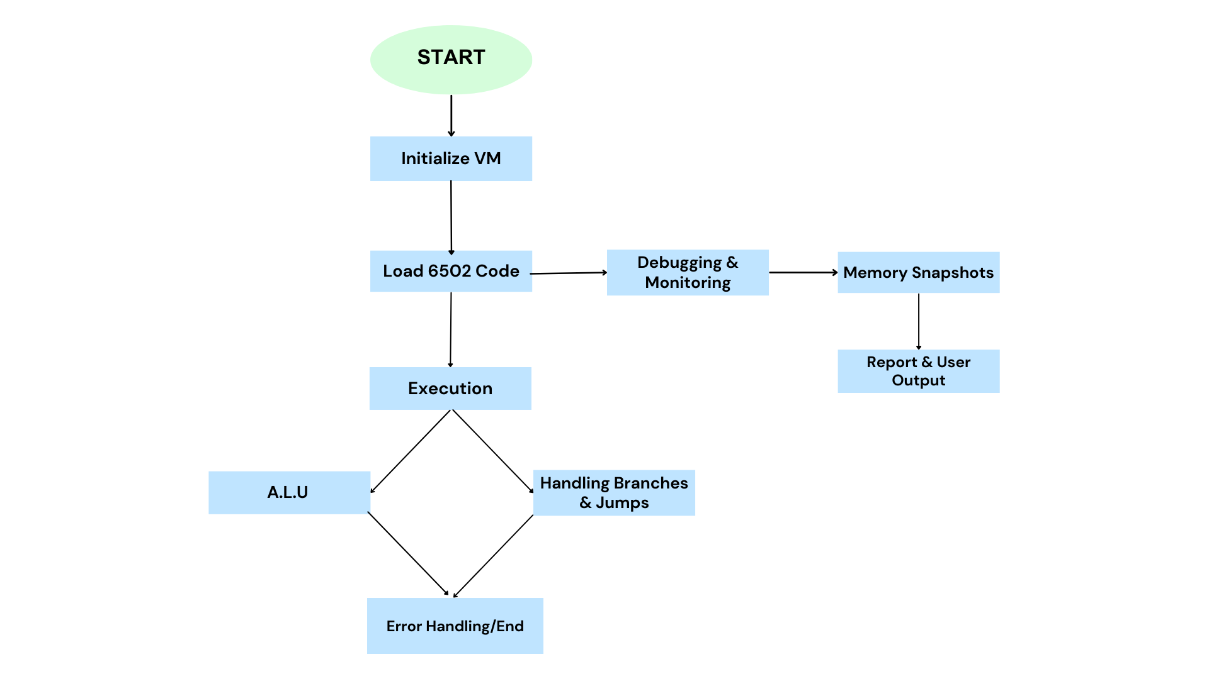

Slide 9
Application:
VMs are useful for executing code in a secure or isolated way .
Reproducing Behaviour - It can reproduce the behaviour of some specific computer which are not in production anymore.
It can be used to run legacy software (including retro games, older applications) which can’t run on modern processors.
Hardware Prototyping – Design and architecture modifications can be tested before actually producing the hardware.
As a learning tool – Our VM also acts as a tool to understand and appreciate the working of the fundamentals of modern processors in general and the specifics of 6502 in particular.

Slide 10
Tools Used
Programming Language :
C, C++ - for the implementation of the virtual machine.
Make - for simplifying building and compilation of the project.
Development Tools :
Utilize industry-standard development tools.
These tools enhance productivity and code quality, making collaboration and debugging more efficient.
Git – for Version Controlling
GDB Debugger – for debugging
Integrated Development Environment – for writing

