Slide 1

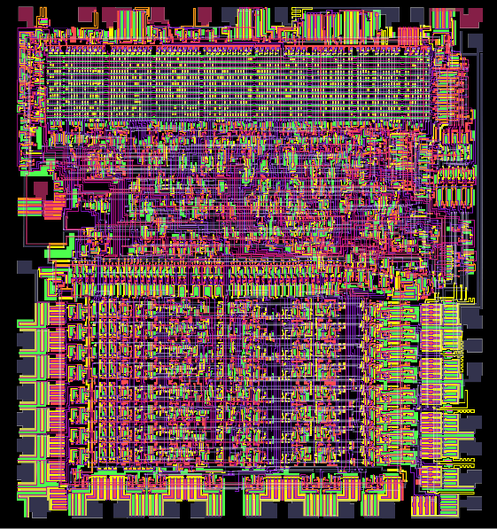
Die of the 6502 Processor
Virtual Machine Simulating
A 6502 Processor
Presented By:
  Abhishek Raj
  Shobhit Sinha
  Satyam Govind Rao
Mentored By:
Ms. Bhavna

Slide 2
Introduction:
The primary goal of a processor emulator is to replicate the instruction set architecture (ISA) and behaviour of the target processor so that software designed for it can be executed without modification on a different processor.
Through our project we aimed to write an emulator for the iconic 6502 processor, this project helped us in understanding the fundamentals of computing, also provided us with a unique opportunity to bridge the gap between theory and hands-on application.
Specifications :
This includes emulating its instruction set, addressing modes, registers (such as the accumulator, X, and Y registers), and condition flags (e.g., negative, zero, overflow).

Slide 3
Application:
Debugging – This emulator can be used as a debugger to point out any logical error in the program which is being executed.
Running Programs Written For 6502 Processor – Older programs written for the 6502 processor can be executed on modern machines by using this emulator.
Learning the working of a processor – Apart from practical application, this emulator can also be used to understand how a processor actually works at the Instruction Level.

Slide 4
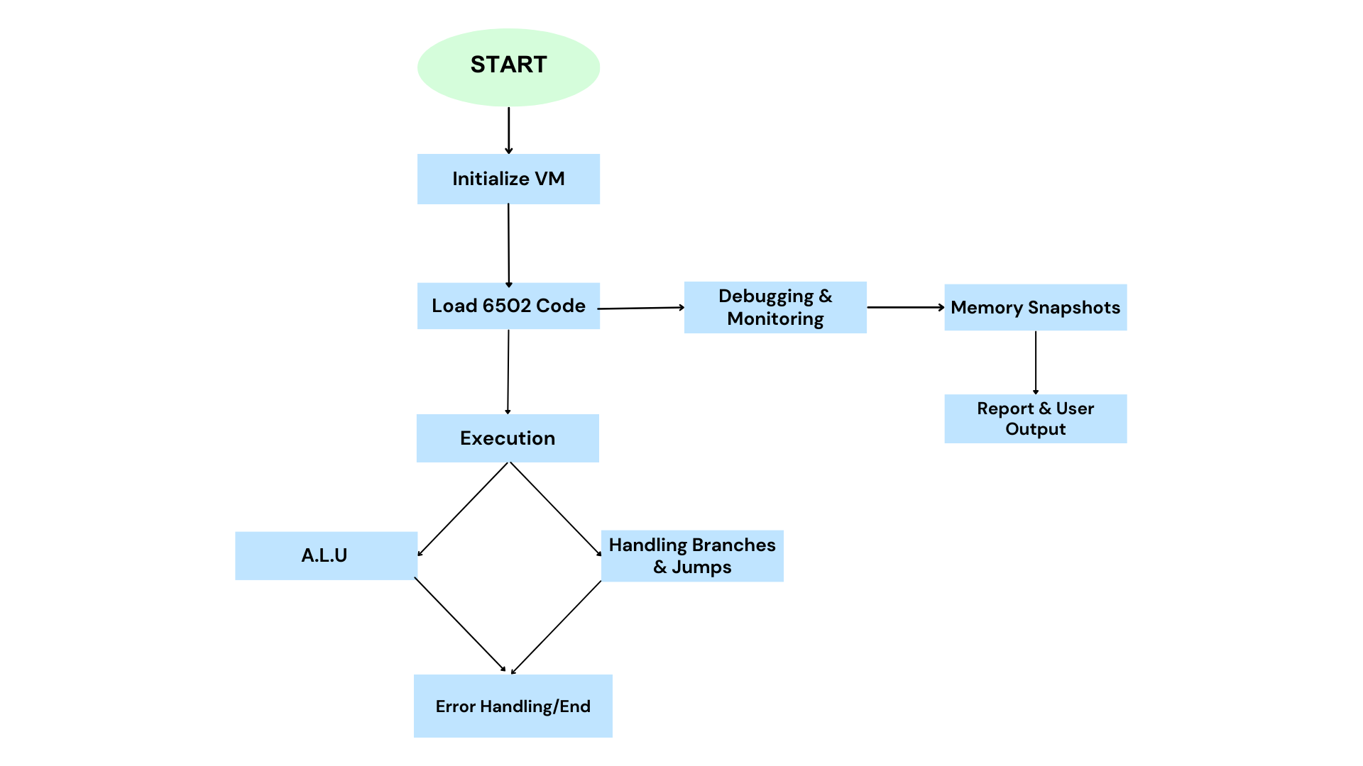

Slide 5
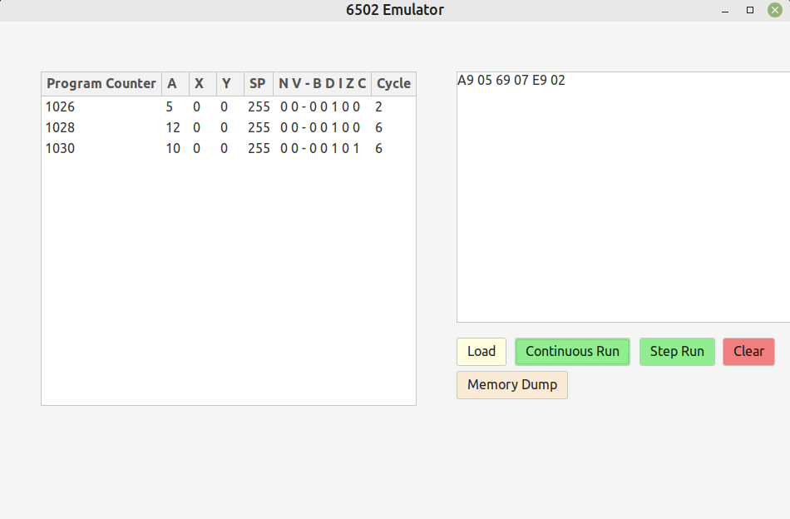
How to use:
Upon launching the application, you will be greeted by an intuitive Graphical User Interface (GUI) design
The opcode can be inserted into the input window, and the the code can then be loaded into the Memory using “Load” button.
Once the opcodes are loaded, the program can be executed.
There are two modes of execution in the emulator
1) Continuous Run – which executes all the instruction in just one click
2) Step Run – executes the program one instruction at a time.
Memory Dump button can be used to open a new window which shows the first 512 memory words.
Clear Button can be used to reset the emulator.

Slide 6
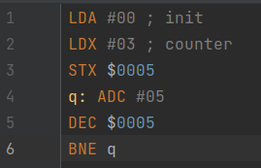

Example 1 : Multiply 3 and 5
Equivalent Opcode
Assembly instructions multiplying 3 and 5

Slide 7
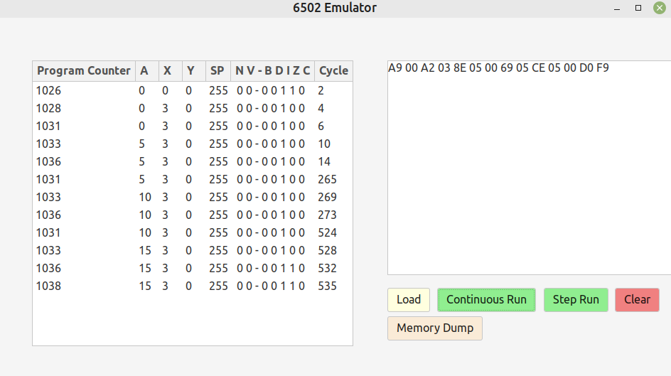
Output:
6502Emulator executing the multiplication progran and showing the values of the Program Counter, Resgisters (A, X, Y), and the clock cycle.

Slide 8
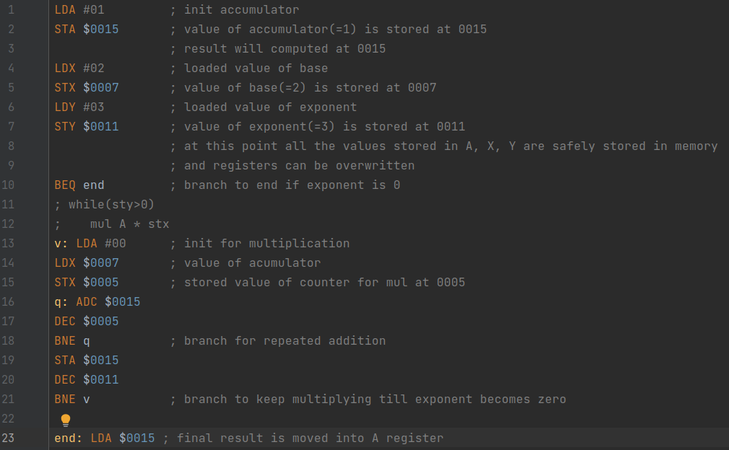
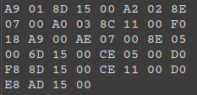
Example 2 : Calculate 2 raised to power 3
Equivalent Opcode
Assembly instructions calculating 2 raised to power 3

Slide 9
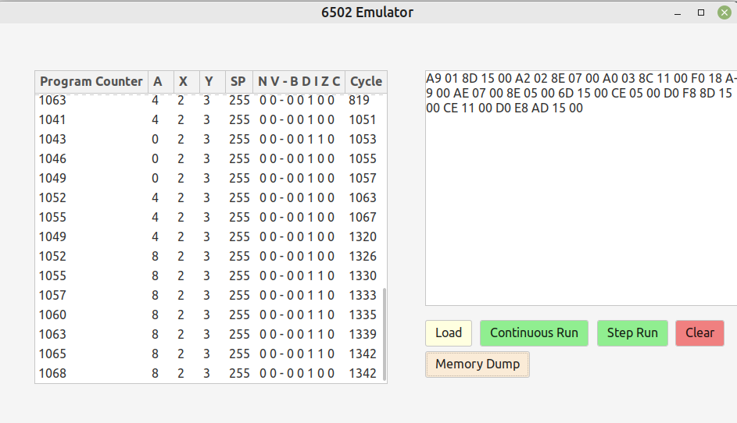
Output:
6502Emulator executing the progran calculating 2 raised to power 3.
Final result is stored in A register.

Slide 10
Further Development:
Assembler Integration: Currently, the emulator only accepts opcodes as the input, and in order to generate opcode from the assembly instructions, third party assembler are required.
The next phase involves the development of an assembler which will allow users to directly insert the assembly instructions as input.
Virtual Memory Implementation: To further enhance the emulation environment, a virtual memory system will be introduced. This feature provides a dynamic space for the 6502 emulator to simulate memory operations, offering a more realistic and expansive platform for code execution.
Addition Of A Graphics Unit: Addition of a graphics window in the emulator, to support graphic rendering using the 6502 assembly.
Generate Log Files: Currently, once the emulator is closed all the snapshot of register values gets lost, to improve this log files will be generated. This feature will aids in post-execution analysis.

Slide 11
Tools And Technologies Used
Programming Language :
C++ - for the implementation of the virtual machine.
Make - for simplifying building and compilation of the project.
GUI Toolkit :
GTK-3.0
Development Tools :
Git – for version controlling
GDB Debugger – for debugging

Slide 12
Contribution:
Shobhit Sinha:
Written the core structure of the 6502 emulator.
Implemented GUI using GTK toolkit.
Written instruction functionality
Abhishek Raj:
Developed a clock management function for precise timing during emulation.
Created and maintained the tables, used to update PC and clock cycle.
Implemented several 6502 instructions.
Satyam Govind Rao:
Implemented 6502 instructions ensuring functionality.
Conducted testing to validate the correctness of the instructions.

Slide 13
Reference:
https://www.masswerk.at/6502/6502_instruction_set.html#INX
http://6502.org/
https://www.atariarchives.org/2bml/chapter_10.php
https://sites.cc.gatech.edu/data_files/public/doc/gtk/tutorial/gtk_tut.html#toc4
https://devdocs.io/gtk~3.20/
https://www.reddit.com/r/GTK/

