Slide 1
Peptide Splicing Program
Nic Chapman and Arpit Bajaj

Slide 2
Introduction
Goal of program
to compute which of the spectrum present in an MGF file could have been formed via linear, cis or trans splicing.
Program is written in python
User Interface allows the analysis to be dynamic and easily repeatable
Please give us feedback regarding interface!
We have introduced a number of pre and post processing programs.
Investigated the use of machine learning in the context of our project.

Slide 3
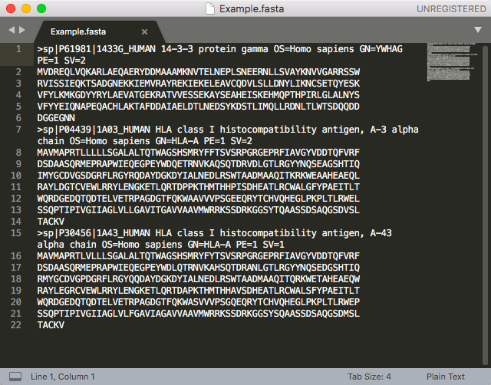
Input FASTA File

Slide 4
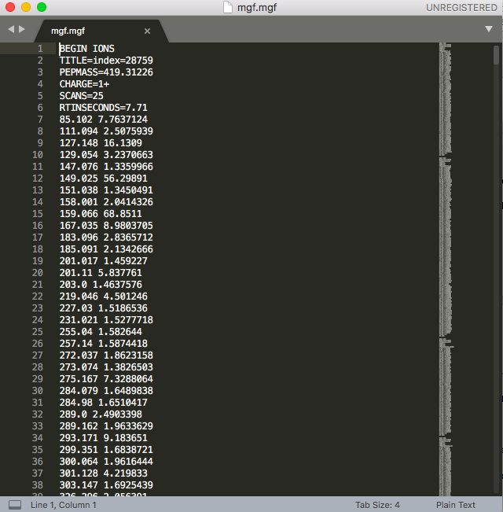
Input MGF File

Slide 5
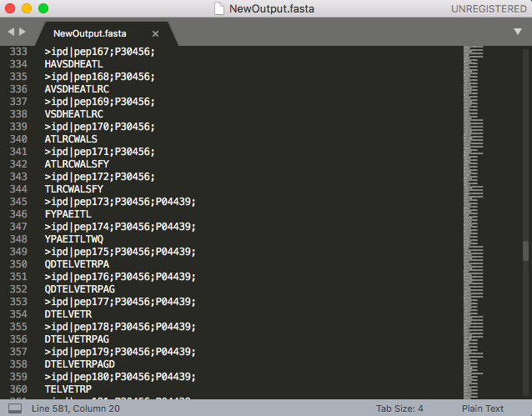
Output FASTA File

Slide 6
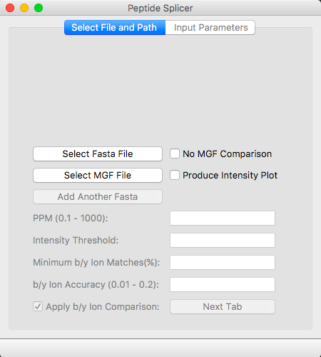
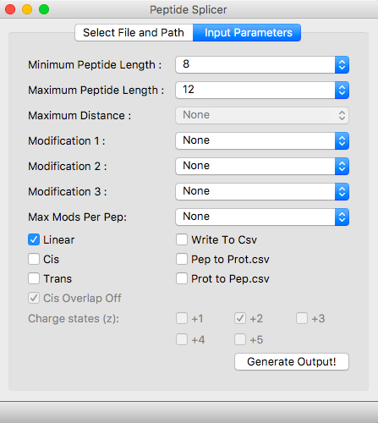
Demonstration of Program
Notes:
Nature of all Inputs:
Purpose
Limitations
Nature of Output
Demonstrate Changing of inputs and its effect on output

Slide 7
Flow of Program
Extract data from input Fasta and MGF files
Compute all possible linear, cis and trans peptides
Remove based on matching with MGF Data:
Pepmass
B/Y Ions
Write final output to Fasta File
Notes:
Define linear, cis and trans

Slide 8
New Functions
Upload of multiple FASTA files.
Produce output without input MGF file.
Max modification per peptide input.
New b/y ion comparison algorithm.
Allow user to input the output file name.
Added a progress bar which represents the proportion of the output completed.
Ensured linear peptides aren’t present in cis splicing, and linear and cis aren’t present in trans.
Added multiprocessing for trans splicing.
Removal of all peptides that exceed max monoisotopic mass of MGF file before MGF comparison occurs.
Check that input FASTA file has less than 2000 amino acids in total if trans selected.
Process generation changes and multiple outputs when memory threshold is reached.
Notes:
Elaborate on each one. Don’t think need to elaborate on each one too much, just the main important ones. Important ones:
New b/y ion comparison, the previous algorithm albeit quicker would get a lot of false negatives. This was as we were only checking the b/y ions for the closest ppm match. If there were other ppm matches, it was often the case that we would have the b/y threshold satisfied for one of the other ppm match. This is now taken into account.
UI is a lot more fluid and error proof, with the parameters being thoroughly sanitized before the output generation can begin.
- Process Generation and memory threshold changes essentially means that the program should be able to handle all input sizes with the caveat being that the multiple output files could contain duplicates across the different files.

Slide 9
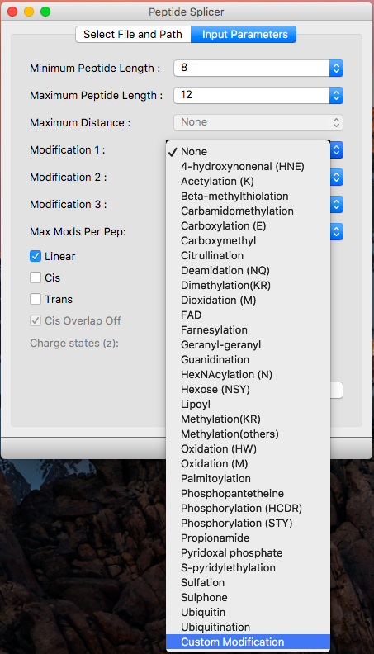
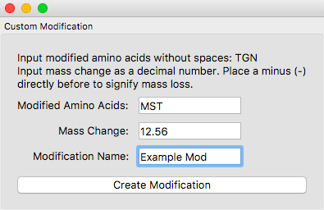
New Functions – Custom Modifications
Enables the user to create their own modifications.
Selecting ”Custom Mod” from the drop down box opens a new window.
The new mod is added to the list if all information has been input correctly.

Slide 10
New Functions – Trans Origins
Inclusion of origin protein information in trans splicing.
Linear and cis splicing simply required a reference to the protein the peptide was derived from.
Trans peptides are from two peptides, so different syntax required.
Pairs of peptides separated by slash.
Brackets refer to the location of the cleavage within the peptide (only included for cleavages of more than 5)
“Overlap” peptides also considered trans splicing.
Notes:
Explain what is meant by origin: which proteins the cleavages which were combined to create the peptide were from.
Explain overlap

Slide 11
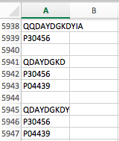
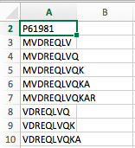
New Functions – Output CSV Files
Output csv files containing:
Proteins as headers with all peptides from that protein listed below.
Peptides as header with all peptides that protein generated listed below.

Slide 12
New Functions – Info File
An info text file automatically prints when an output is run.
It contains:
The user selected settings.
A count of the number of times each selected modification was found in one of the output peptides.
Notes:
Explain that the count is not entirely accurate.

Slide 13
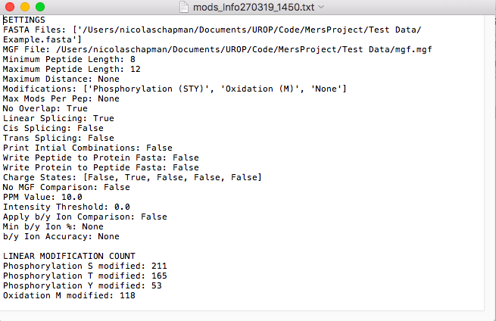
Example of Info File

Slide 14
Current Tests
Human Proteome database as input FASTA against the following MGF files and settings:
A2: 7-16mers, 30%, 10ppm, 0.02Da, O(M), P(STY), +2, +3
5.5 hours.
BLCL: 7-16mers, 30%, 15ppm, 0.1Da, O(M), P(STY), +2, +3
4.5 hours
B57: 7-15mers, 30%, 15ppm, 0.1Da, O(M), P(STY), +2, +3
9 hours.
Ran all reviewed proteins from Uniprot with the A2 MGF and settings above.
Took almost exactly 4 days and produced X peptides

Slide 15
Future Work
We ae in contact with MASSIVE to hopefully run the program on their system.
Documentation…..
Incorporation of Artificial Intelligence (discussed shortly).
Incorporate the program into a workflow that improves peptide recognition.

Slide 16
Pre and Post Processing Programs
6Frame Translation Pre-processing Program
Reverse Splicer Post Processing
Reverse MGF Post Processing
All these programs use similar multiprocessing, interfaces and logic to the original splicing program.

Slide 17
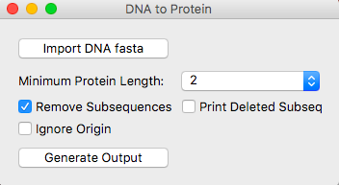
6 Frame Translation Program
Takes an input FASTA file containing DNA sequences.
Produces all proteins over a minimum length that result from the 6 Frame Translation of the input sequences.
Removes proteins which exist as subsequences in longer proteins.
Aim to pass this output into our main splicing program as proof that it can handle large data sets

Slide 18
6 Frame Translation – Subset Deletion
Subset proteins provide no new peptides to the peptide splicing program.
However, they do provide additional origin locations.
Thus we included the option to print deleted subsequences.
Also prompted us to allow the user to ignore origin data to reduce the size of the output further.

Slide 19
6 Frame Translation – Current Tests
We ran the B57_1_S38_Merge.fasta
Produced an output of 73 million proteins in about 1.5 hours.
After removing subsets this output was reduced to 15 million proteins.
Took an additional 3 hours.
We are yet to run this through the splicing program.
Initial tests suggest it will take 1-2 weeks on a 16 core computer.

Slide 20
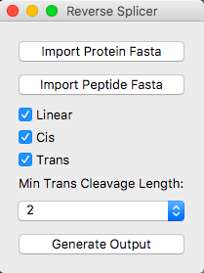
Reverse Splicer
Takes a FASTA file of peptides and a second FASTA file of proteins as input.
Returns an excel file containing where each peptide could have been produced from in the protein list.
Returns separate outputs for linear, cis and trans.
Leucine and Isoleucine are considered identical.

Slide 21
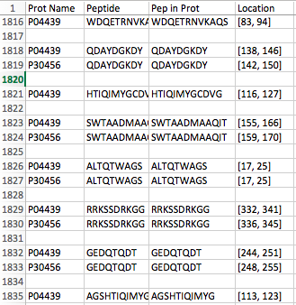
Reverse Splicer – Linear Output

Slide 22
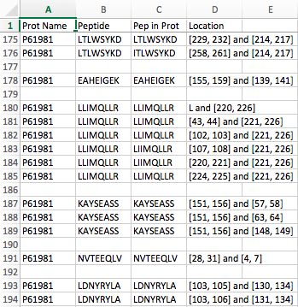
Reverse Splicer – Cis Output

Slide 23
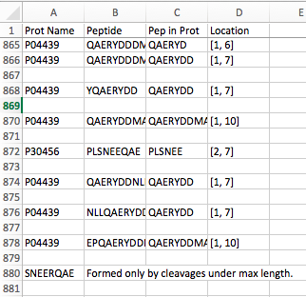
Reverse Splicer – Trans Output
Notes:
Conducted with min trans cleavage length equal to 6. Explain the affect this has on the output with respect to what cis and lin looks like.

Slide 24
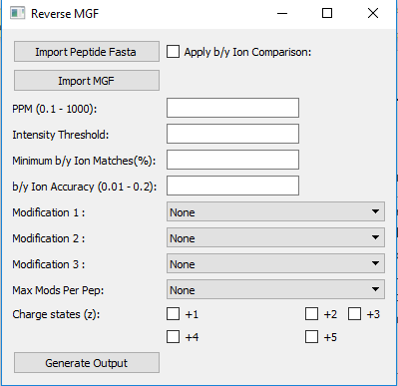
Reverse MGF
Takes an MGF file and FASTA file of peptides as input.
For each peptide, it computes every spectra in the MGF file that matches based on precursor mass comparison and b/y ion comparison.

Slide 25
Future Work on These Programs
Run time tests on Reverse MGF and Reverse Splice
Possibly look to incorporate the Splicing Program memory threshold checking and process generation
Documentation….
Look to run on MASSIVE is feasible

Slide 26
Machine Learning
Predict b/y ion intensity based on the precursor sequence and b/y ion sequence.
Currently ion intensities are not used effectively in the peptide prediction process.
We have only been using m/z of spectra in our program.
A number of projects have successfully used ion sequence data to predict intensity.
To incorporate it into our programs we were hoping to specifically do so for b/y ions.

Slide 27
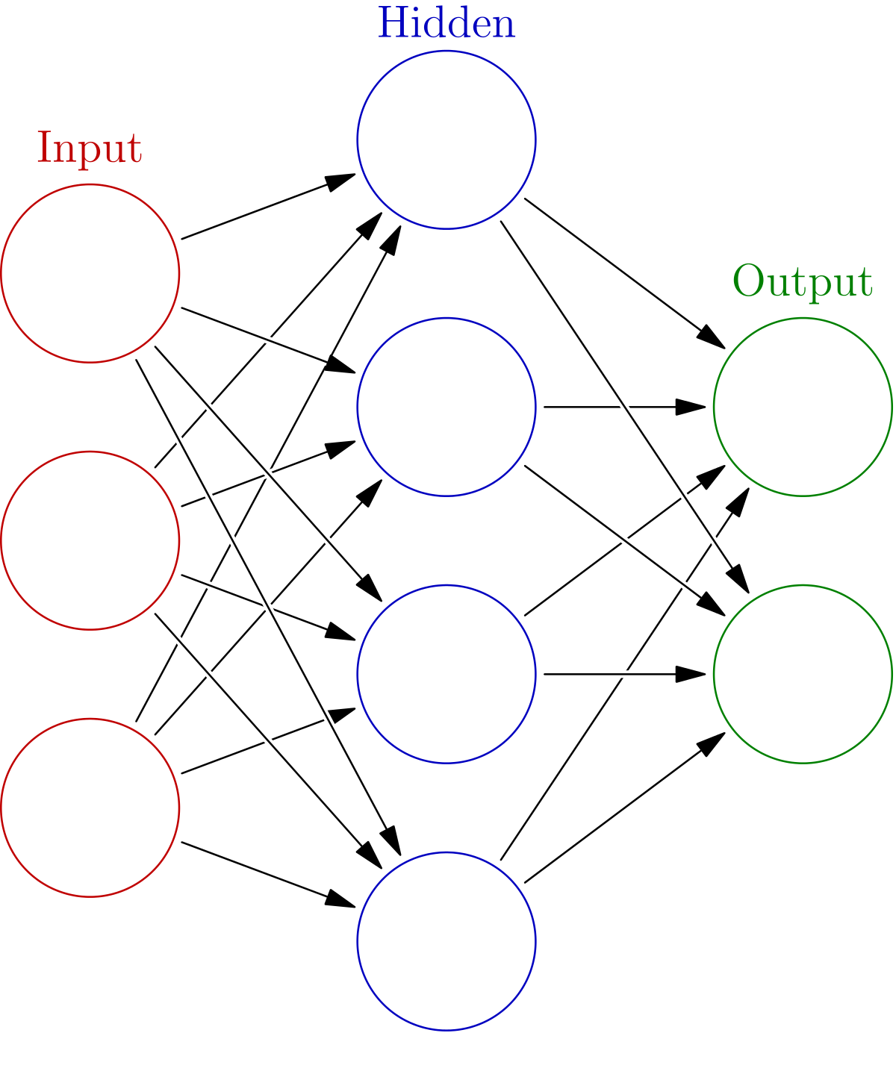
Machine Learning – Basic Neural Network
Early attempts to solve this problem used simple neural nets with 1 or two hidden layers.
It was shown to improve peptide recognition when incorporated into existing workflows.
Notes:
Emma went through this in some detail a few weeks ago so we aren’t going to again.

Slide 28
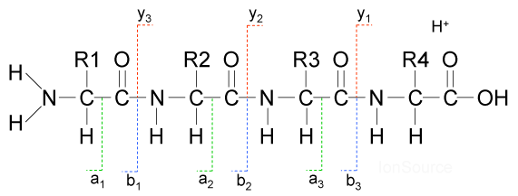
Machine Learning – Recurrent Neural Networks
More recent work has shown recurrent neural networks are superior for intensity prediction.
Instead of taking an individual input and calculating the output, recurrent networks take a set of inputs and calculate the corresponding set of outputs simultaneously.
They take into account the result of the previous output when calculating a given output
Such a network would be able to predict how the intensities of a previous b/y ion pair affect the intensities of the next pair.

Slide 29
Machine Learning – Our Proposed Model
Bi-lateral recurrent neural network: considers the output before AND after when calculating a given predicted intensity
Treat a b/y ion cleavage site as a unique input
For each protein we have a set cleavage site inputs which is fed into the network
Each input includes the following data:
Encoded precursor sequence
Normalised precursor mass
Normalised precursor length
Encoded first and last amino acids
Normalised b/y ion lengths
Normalised b/y ion mass
Normalised cleavage site number
Encoded amino acids either side of cleavage site

Slide 30
Machine Learning - Progress
We have written the basic code to to create the network.
Haven’t had time to fine tune the model and set hyper parameters.
This is the real challenge in neural network design.
Ideally, the neural network would be incorporated into our other programs to provide more confident matches between MGF spectra and potential peptides.
This is a big task, and we likely won’t have time.

