Slide 1
Peptide Splicing Program
Nic Chapman and Arpit Bajaj

Slide 2
New Pre and Post Processing Programs

Slide 3
Introduction
Goal of program
to compute which of the spectrum present in an MGF file could have been formed via linear, cis or trans splicing.
Program is written in python
User Interface allows the analysis to be dynamic and easily repeatable
Please give us feedback regarding interface!
We have introduced a number of pre and post processing programs.
Investigated the use or machine learning in the context of our project.

Slide 4
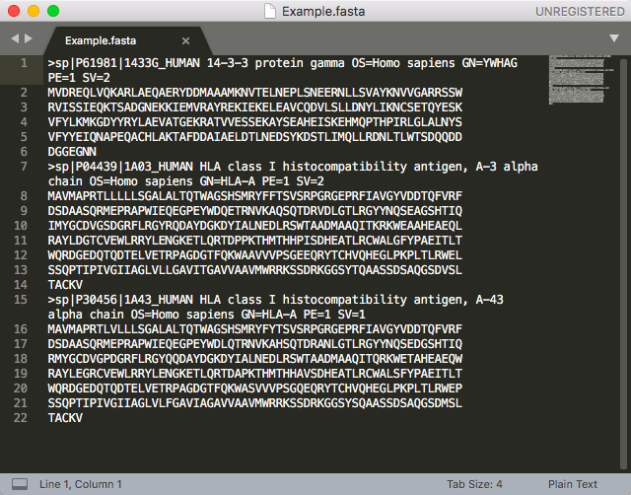
Input FASTA File

Slide 5
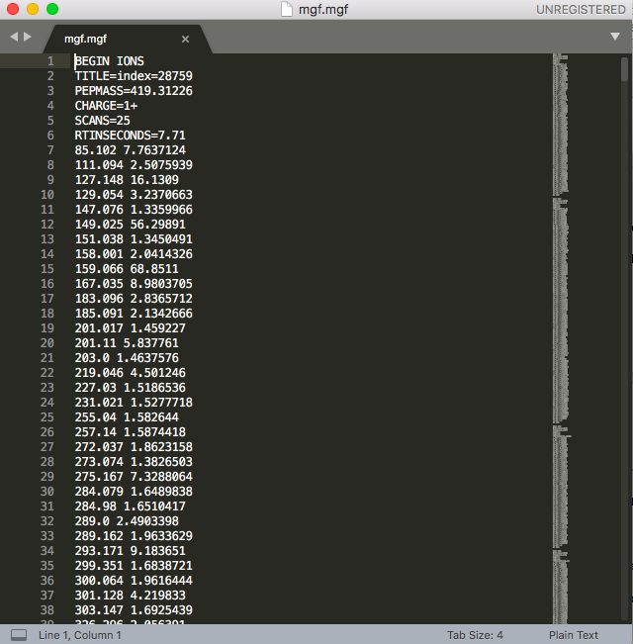
Input MGF File

Slide 6
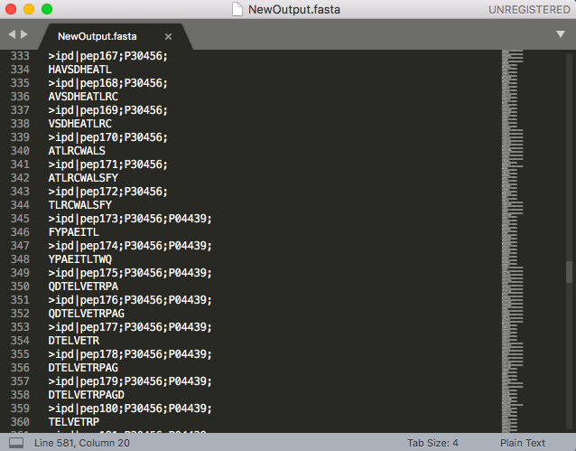
Output FASTA File

Slide 7
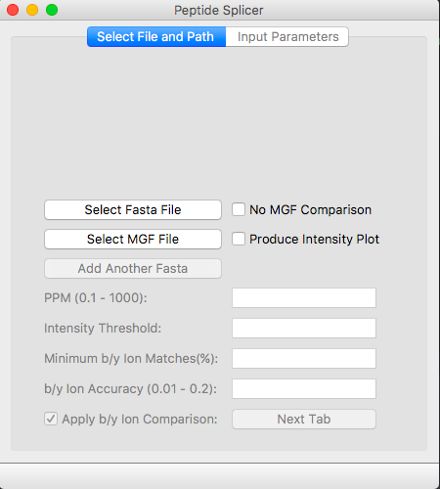
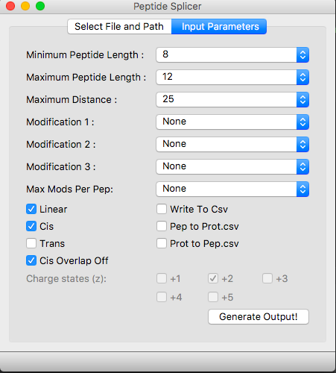
Demonstration of Program
Notes:
Nature of all Inputs:
Purpose
Limitations
Nature of Output
Demonstrate Changing of inputs and its effect on output

Slide 8
Flow of Program
Extract data from input Fasta and MGF files
Compute all possible linear, cis and trans peptides
Remove based on matching with MGF Data:
Pepmass
B/Y Ions
Write final output to Fasta File
Notes:
Define linear, cis and trans

Slide 9
New Functions
Upload of multiple FASTA files.
Produce output without input MGF file.
Output csv files containing:
Proteins as headers with all peptides from that protein listed below.
Peptides as header with all peptides that protein generated listed below.
Inclusion of origin protein information in trans splicing.
Max modification per peptide input.
New b/y ion comparison algorithm.
Allow user to add custom modifications.
Allow user to input the output file name.
Added a progress bar which represents the proportion of the output completed.
Ensured linear peptides aren’t present in cis splicing, and linear and cis aren’t present in trans.
Added multiprocessing for trans splicing.
Removal of all peptides that exceed max monoisotopic mass of MGF file before MGF comparison occurs.
Check that input FASTA file has less than 2000 amino acids in total if trans selected.
Returns an info file containing the settings, and details of how many times a given modification was found in the output peptides.
Process generation changes and multiple outputs when memory threshold is reached.

Slide 10
Current Tests
Human Proteome database as input FASTA against the following MGF files and settings:
A2: 7-16mers, 30%, 10ppm, 0.02Da, O(M), P(STY), +2, +3
5.5 hours.
BLCL: 7-16mers, 30%, 15ppm, 0.1Da, O(M), P(STY), +2, +3
4.5 hours
B57: 7-15mers, 30%, 15ppm, 0.1Da, O(M), P(STY), +2, +3
9 hours.
Ran all reviewed proteins from Uniprot with the A2 MGF and settings above.
Took almost exactly 4 days and produced X peptides

Slide 11
Future Work
Are in contact with MASSIVE to hopefully run the program on their computer.
Documentation…..
Incorporation of Artificial Intelligence (discussed shortly).
Show that using our program before input to PEAKS and other proteomics software yields better data.

Slide 12
Pre and Post Processing Programs
6Frame Translation Pre-processing Program
Reverse Splicer Post Processing
Reverse MGF Post Processing
All these programs use similar multiprocessing, interfaces and logic to the original splicing program.

Slide 13
6 Frame Translation Program
Takes an input FASTA file containing DNA sequences.
Produces all proteins over a minimum length that result from the 6 Frame Translation of the input sequences.
Removes proteins which exist as subsequences in longer proteins.
Aim to pass this output into our main splicing program.
Example of prorgam.

Slide 14
Reverse Splicer
Takes a FASTA file of peptides and a second FASTA file of proteins as input.
Returns an excel file containing where each peptide could have been produced from in the protein list.
Returns separate outputs for linear, cis and trans.
Example of output needed for each splice type.
Example of program.

Slide 15
Reverse MGF
Takes an MGF file and FASTA file of peptides as input.
For each peptide, it computes which spectra in the MGF file match based on b/y ion and precursor mass comparison.

Slide 16
Machine Learning

Slide 17
Future Work on These Programs

