Slide 1
Peptide Splicing Program
Nic Chapman and Arpit Bajaj

Slide 2
Introduction
Goal of program
to compute which of the spectrum present in an MGF file could have been formed via linear, cis or trans splicing.
Program is written in python
User Interface allows the analysis to be dynamic and easily repeatable
Please give us feedback regarding interface!

Slide 3
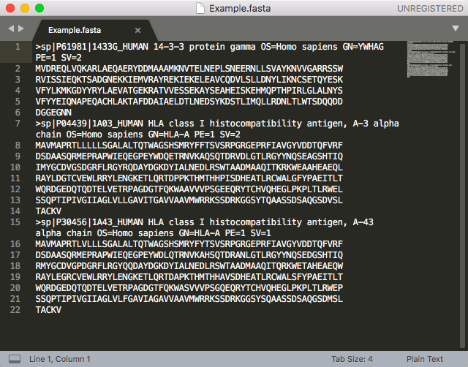
Input FASTA File

Slide 4
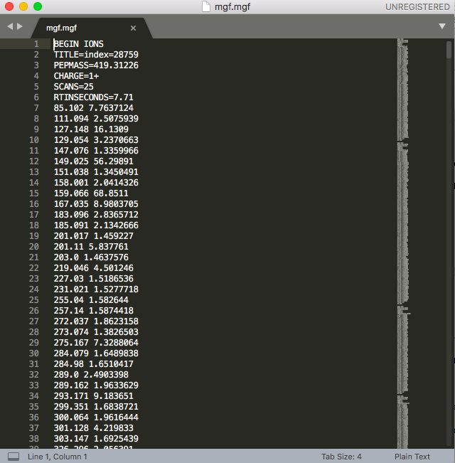
Input MGF File

Slide 5
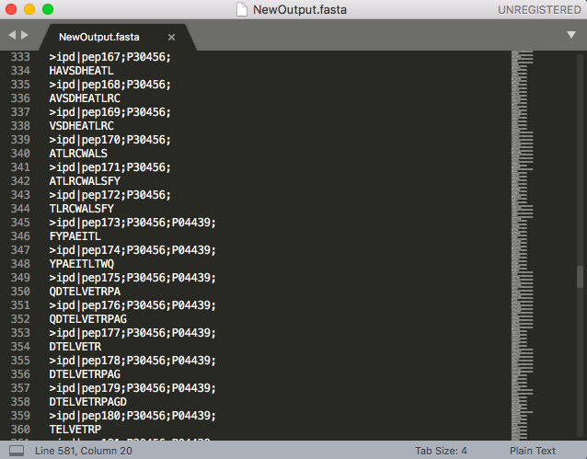
Output Fasta File

Slide 6
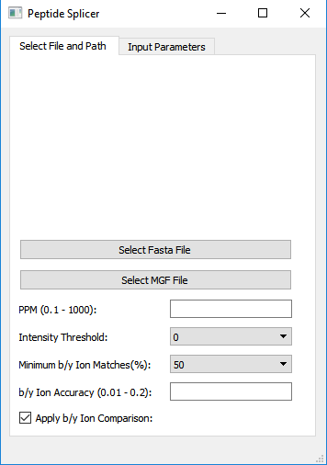
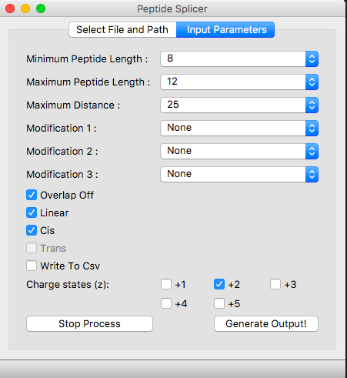
Demonstration of Program
Notes:
Nature of all Inputs:
Purpose
Limitations
Nature of Output
Demonstrate Changing of inputs and its effect on output

Slide 7
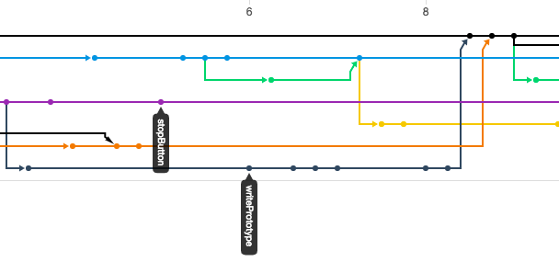
Version Control
Completed using Git
Allows simultaneous programming of different functionality
Maintains a history of all changes made in an online repository

Slide 8
Logic
Extract data from input Fasta and MGF files
Compute all possible linear, cis and trans peptides
Remove based on matching with MGF Data:
Pepmass
B/Y Ions
Write final output to Fasta File
Notes:
Define linear, cis and trans

Slide 9
Linear Splice Logic Example
Starting Protein: NEDLR
NE
NED
NEDL
NEDLR
ED
EDL
EDLR
DL
DLR
LR

Slide 10
Cis and Trans Logic
Involves recombining linearly spliced peptides
Only one difference:
For trans we concatenate all proteins in the input file before recombining
Cis we only analyse one protein at a time

Slide 11
Cis and Tran Spliced Example
Starting Protein: NEDLR
Linear Peptides:
NE
NED
NEDL
NEDLR
ED
EDL
EDLR
DL
DLR
LR
NE
+ DL
= NEDL
AND REVERSE:
DL
+ NE
= DLNE
NE + DLR = NEDLR
AND REVERSE:
DLR + NE = DLRNE
Notes:
Mention Overlap after logic is shown

Slide 12
Creation of Peptide and Mass Data-Frame
Mass calculation is completed every time a new peptide is computed
The m/z values of that peptide are then calculated and stored
These values store for further analysis
peptideMassData = { peptide1: [ [z1, m/z1], [z2, m/z2] ] }

Slide 13
Pepmass Comparison
Pass the peptides that have a matching pepmass in the uploaded MGF Files to the next test.
Relevant input variable:
PPM

Slide 14
B/Y Ion Comparison
Add peptides based on the number of b/y fragmented ions that appear in the spectrum to a new list which are then written to an output fasta file.
Creation of b/y Ions:
NEDLN
B Ions
Y Ions
N
EDLN
NE
DLN
NED
LN
NEDL
N

Slide 15
B/Y Ion Comparison
Extracts the Ion m/z data for the matching pepmass
Compares based on:
Minimum b/y Ion %
b/y Ion Accuracy
If this test is satisfied, the peptide is added to the output file

Slide 16
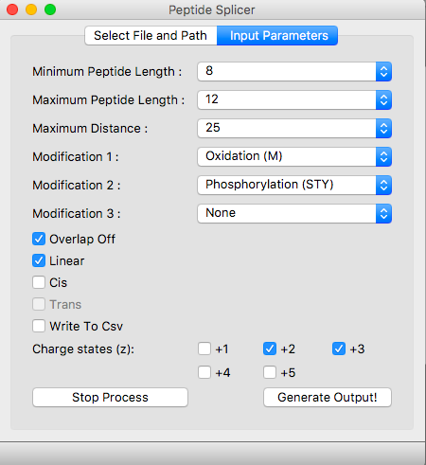
Run Times – Linear Only
Input parameters →
Test Data (16 Cores):
Fasta file contained 20170 proteins
MGF file was 918MB

Slide 17
Run Times – Linear Only
Initial prototype without B/Y Ion Check and writing to console:
40 hours to run logic
38 mins to extract file data
Writing to fasta file and optimizing algorithm
7 hours to run
38 mins to extract file data
Ignoring modified duplicates when comparing Pepmass and uploading MGF data to a different data structure:
20 mins to run
5 mins to extract file data
Adding b/y Ion comparison
5 mins to extract file data
56 mins to run

Slide 18
Multiprocessing
Multiprocessing uses multiple cores to run parallel processes simultaneously
Protein 1
Cis
Writer Function
Output Fasta
Protein 2
Inputs
Linear
Protein 3
Trans

Slide 19
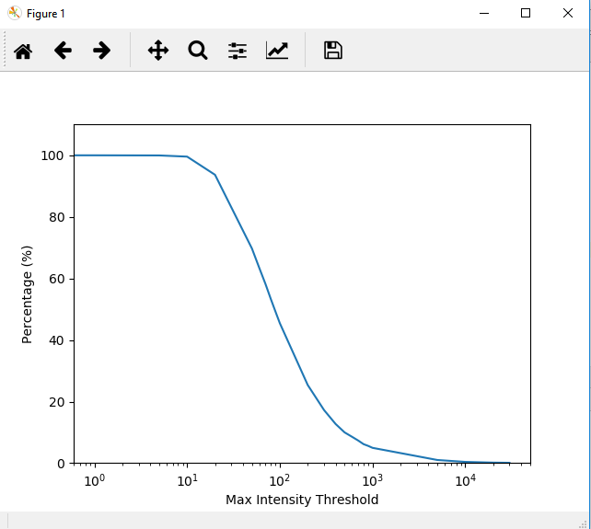
Future
Add an intensity plot to pick an accurate threshold and filter out low quality spectrum
Data analysis to test accuracy of output
Decrease trans and cis runtime for larger file sizes
Integration of program into Pouya’s research

Slide 20
Thank You!
Nathan
Pouya

