Slide 1
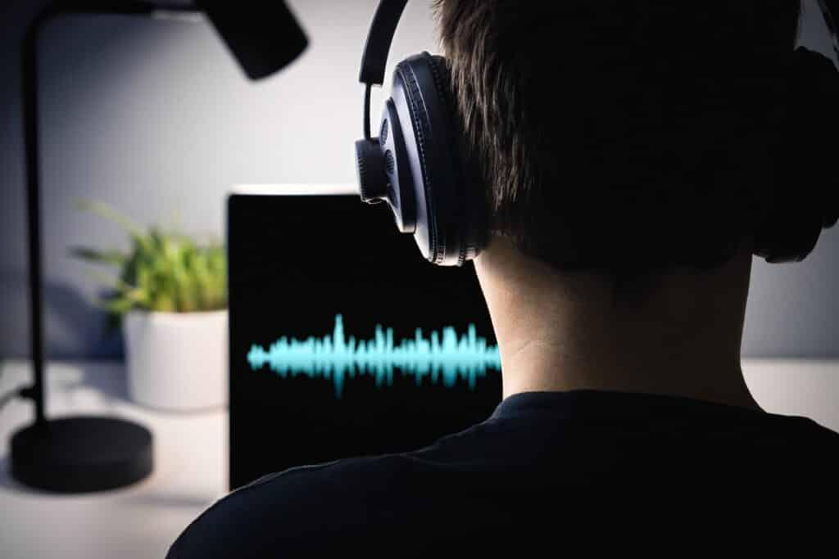
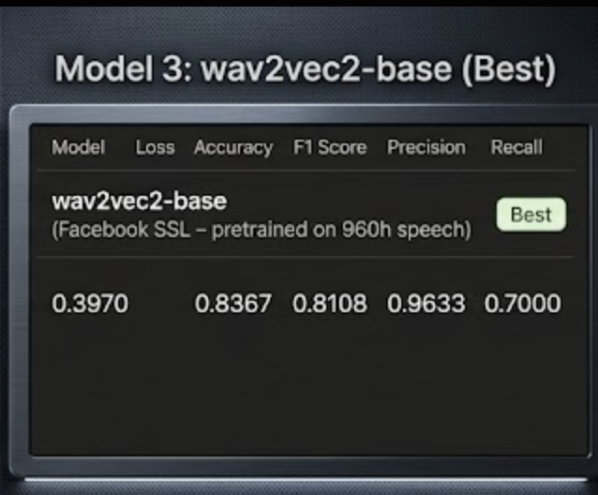
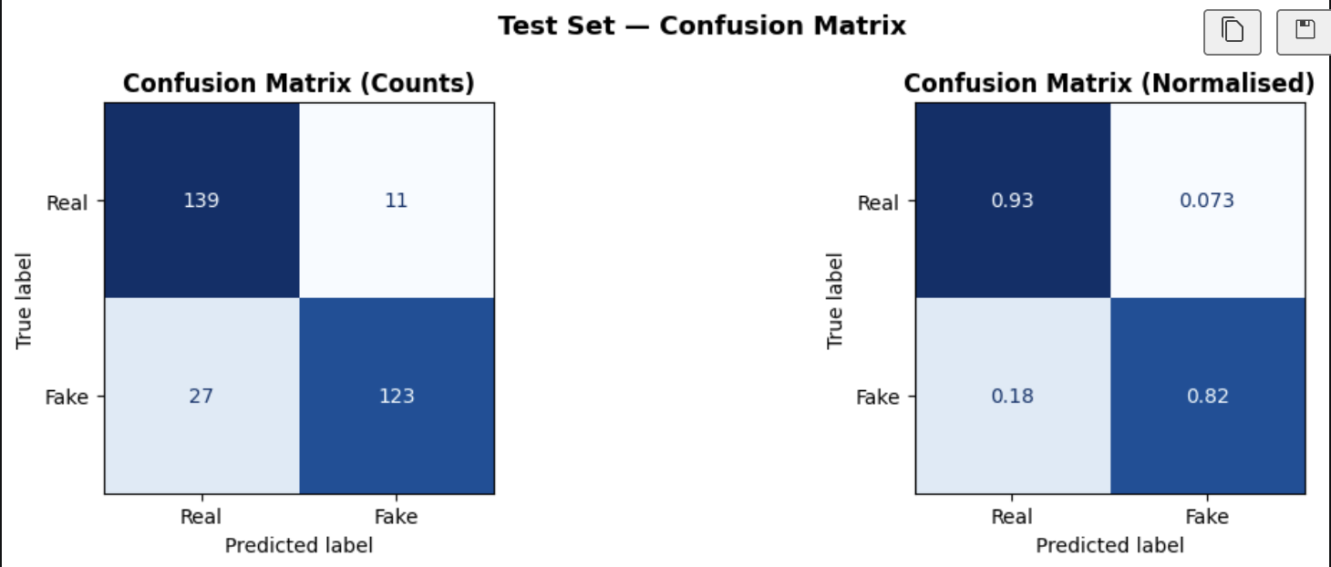
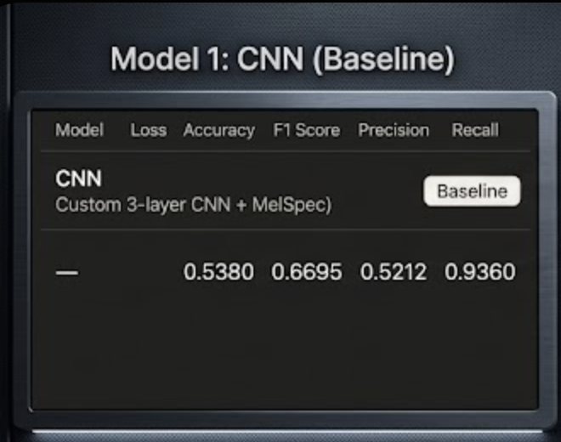
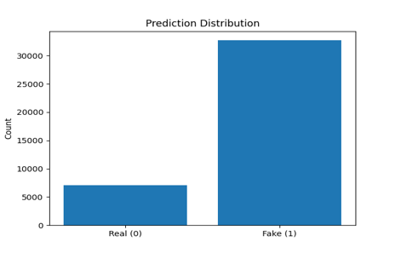
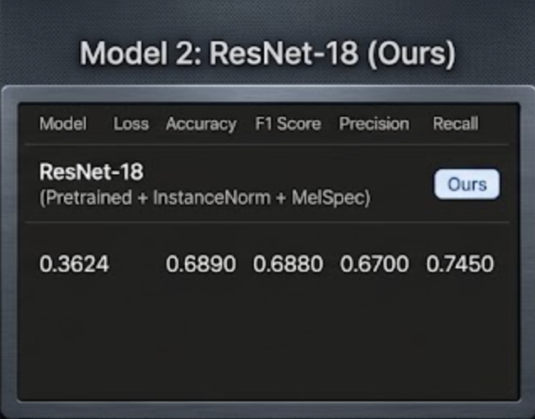
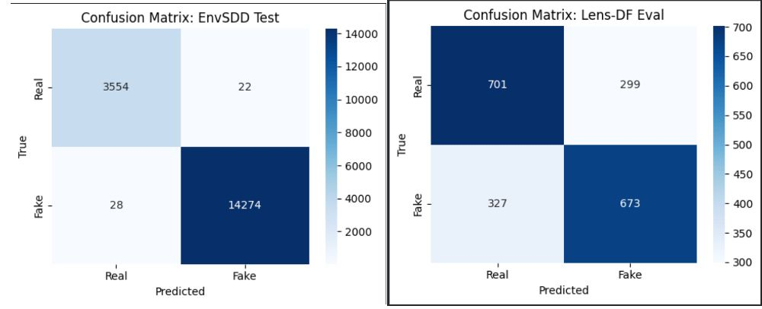
Detection of AI Generated Background noise using Deep Learning
CSE 676: Deep Learning
Jaden Peacock, Ritik Verma, Abhishek Rajagopalan
Problem Statement
We are developing a deep learning system to distinguish between authentic and AI-generated background audio. This system focuses on detecting the subtle artifacts and patterns found in deepfake background noise
Dataset
EnvSDD - ~360 hours of environmental audio with synthetic artifacts
LENS-DF - long-form audio with complex background noise
ASVspoof- Large real-world audio
Methodology
Balanced Partitioning: We apply a stratified split with anequal distribution of real and fake samples to ensure unbiased training.
Robust Augmentation: Training data is diversified via time and pitch shifting to improve model generalization across different acoustic environments.
Standardized Evaluation: All architectures are trained within a unified framework
Models
Results
CNN Baseline: Our initial model struggled with generalization, achieving high recall but near-random accuracy. Its shallow architecture couldn't differentiate between real environmental sounds and synthetic artifacts across different recording qualities
ResNet & Data Fusion: We moved to ResNet to leverage deeper layers and merged datasets to bridge the domain gap. This significantly boosted performance on environmental audio but still faced limitations with high-fidelity studio recordings.
Wav2Vec 2.0: We finally transitioned to Wav2Vec2 to extract more sophisticated audio embeddings. This self-supervised approach captured the subtle synthetic signatures in clean studio speech that traditional spectral methods failed to detect.
Conclusion
Transitioning from basic CNNs to ResNet and Wav2Vec2 proved that merging data with specialized waveform analysis is key to spotting deepfake artifacts. This multi-model approach successfully bridged the gap between noisy environmental sounds and clean studio audio, providing a more robust system for audio authentication
References
CNN (Baseline): LeCun, Y., Bottou, L., Bengio, Y., & Haffner, P. (1998). Gradient-based learning applied to document recognition. Proceedings of the IEEE, 86(11), 2278–2324. https://doi.org/10.1109/5.726791
ResNet: He, K., Zhang, X., Ren, S., & Sun, J. (2016). Deep residual learning for image recognition. IEEE Conference on Computer Vision and Pattern Recognition (CVPR).
Wav2Vec 2.0: Baevski, A., Zhou, H., Mohamed, A., & Auli, M. (2020). Wav2Vec 2.0: A framework for self-supervised learning of speech representations. Advances in Neural Information Processing Systems (NeurIPS).
Analysis
Fixing Generalization Gaps: Initial models failed on studio-grade audio after training on environmental noise. We merged datasets to force the system to recognize synthetic patterns across different recording qualities
.
Deeper Feature Learning: Switching to ResNet on the combined data allowed the model to use its depth to catch complex artifacts. This reduced false negatives and improved detection of subtle acoustic nuances
Advanced Waveform Analysis: We integrated Wav2Vec2 to handle uncertain predictions in high-fidelity audio. Its specialized embeddings successfully spotted deepfake signatures that traditional spectral methods missed.
​
Computer Science and Engineering
School of Engineering and Applied Science
buffalo.edu

