Slide 1
Wipro
Capstone Project Presentation
by Abhinandan Ballav
Superset Id: 4580921

Slide 2
Objectives
The objective of this project is to design and implement a Selenium TestNG automation framework with BDD support, leveraging TestNG parameterization and Excel-driven inputs for data-driven testing. The framework will generate detailed Extent Reports, integrate with Jenkins for continuous integration, and use Git for version control. JIRA with Zephyr will be utilized for managing requirements, test cases, defects, and overall project tracking.

Slide 3
Tools used for Test Framework
BDD
Eclipse
Page Object Model
TestNG
Data driven Model
HTML reporting
JIRA Zephyr

Slide 4
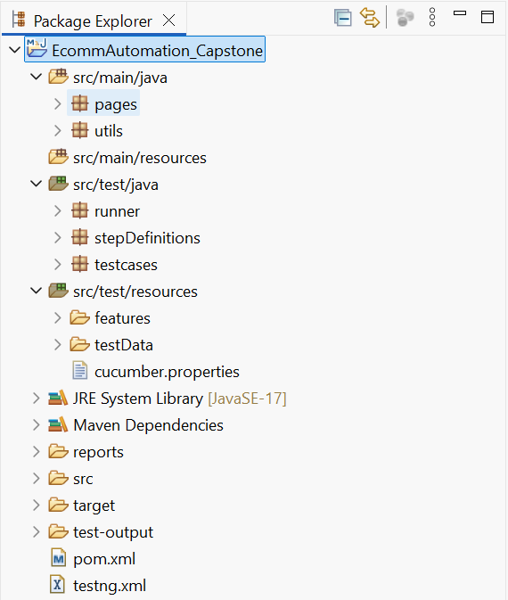
Architecture of the Project
src/main/java contains reusable components like Page Object classes (pages) and utility methods (utils).
src/test/java includes the runner, step definitions for Cucumber BDD, and test case implementations.
src/test/resources holds feature files defining BDD scenarios, test data (Excel files) for data-driven testing, and configuration files like cucumber.properties.
The pom.xml file manages project dependencies, plugins, and build configurations using Maven.
testng.xml is used to configure TestNG suites, parameters, and execution flow.

Slide 5
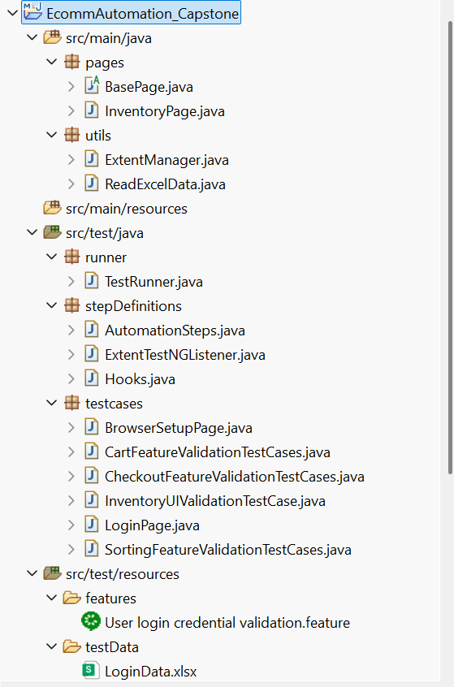
Architecture of the Test Framework
ReadExcelData.java – Used for reading Excel data
ExtentManager.java & ExtentTestNGListener.java – Used for Extent Report
TestRunner.java – Cucumber Runner File
AutomationSteps.java- Steps definition of feature file
Hooks.java – Initialize the chrome browser
Package “testcases” contains methods for all the automated test cases.
Feature file – Used for cucumber test scenario (BDD)
“testData” folder has the user credential details (LoginData.xlsx)

Slide 6
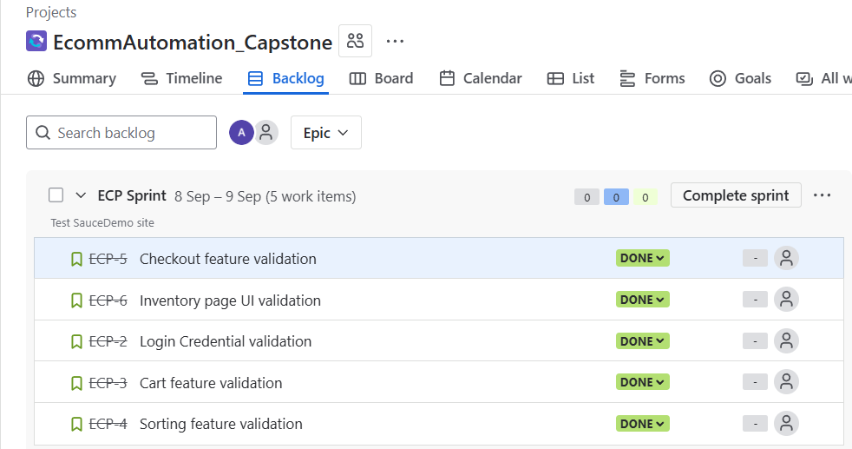
Jira Snapshot of the Sprint

Slide 7
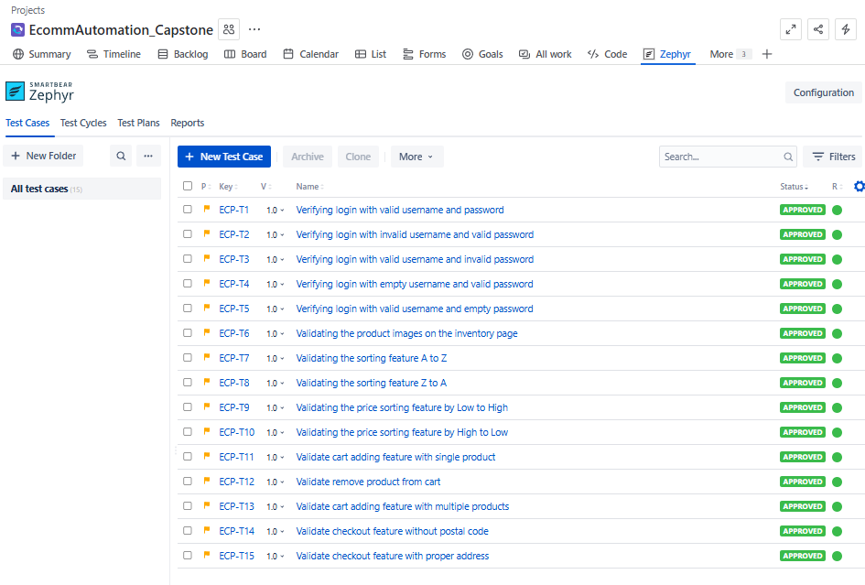
Test Case snapshot from Jira – Zephyr

Slide 8
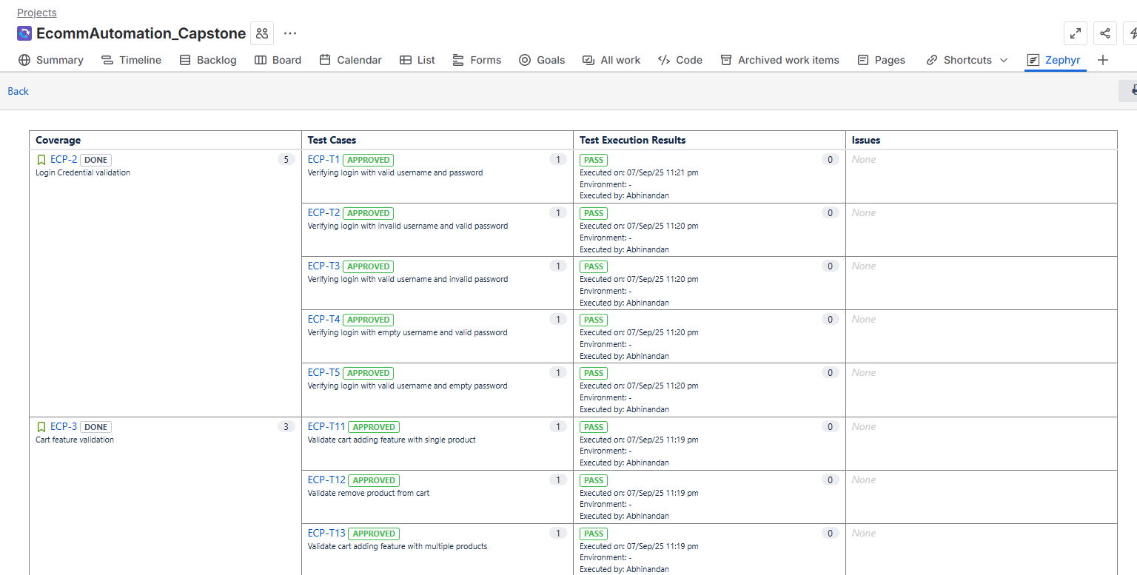
Jira Snapshot Zephyr Test Report -1

Slide 9
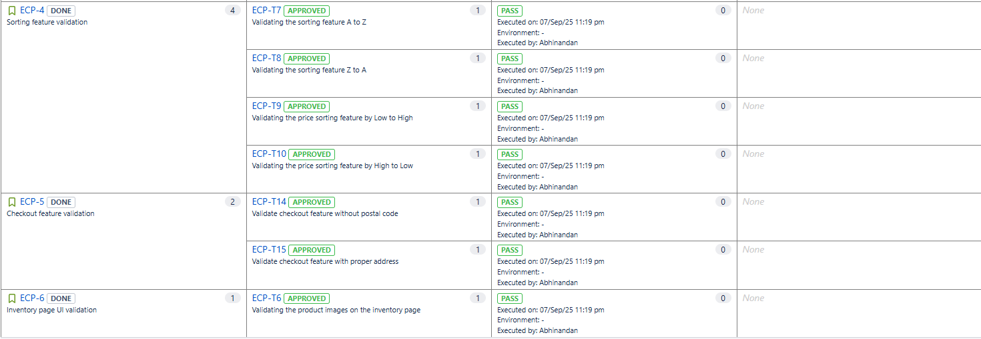
Jira Snapshot Zephyr Test Report -2

Slide 10
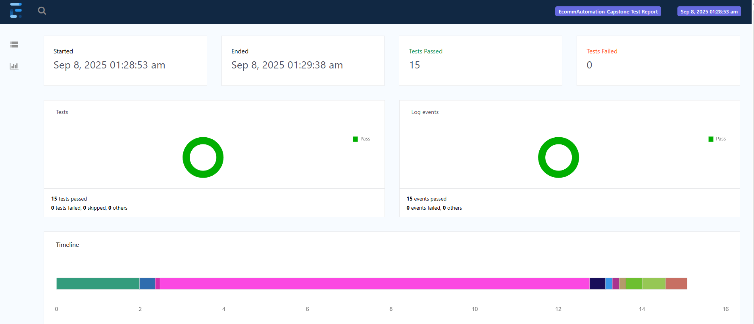
TestNG Extent Report Snapshot

Slide 11
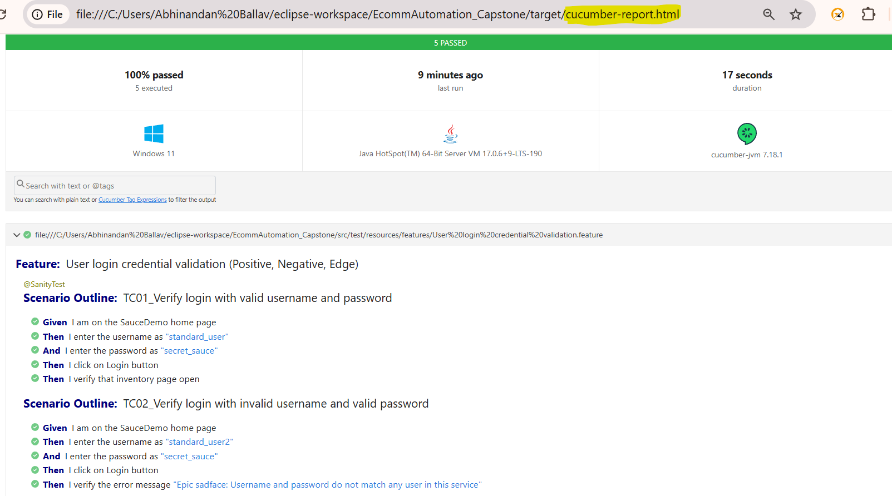
Cucumber Report with Scenario Details -1

Slide 12
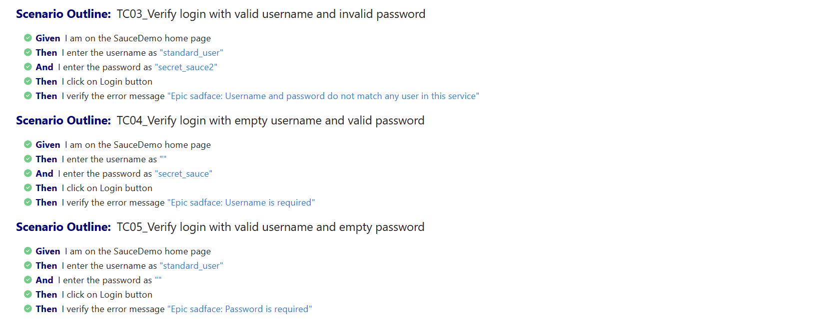
Cucumber Report with Scenario Details -2

Slide 13
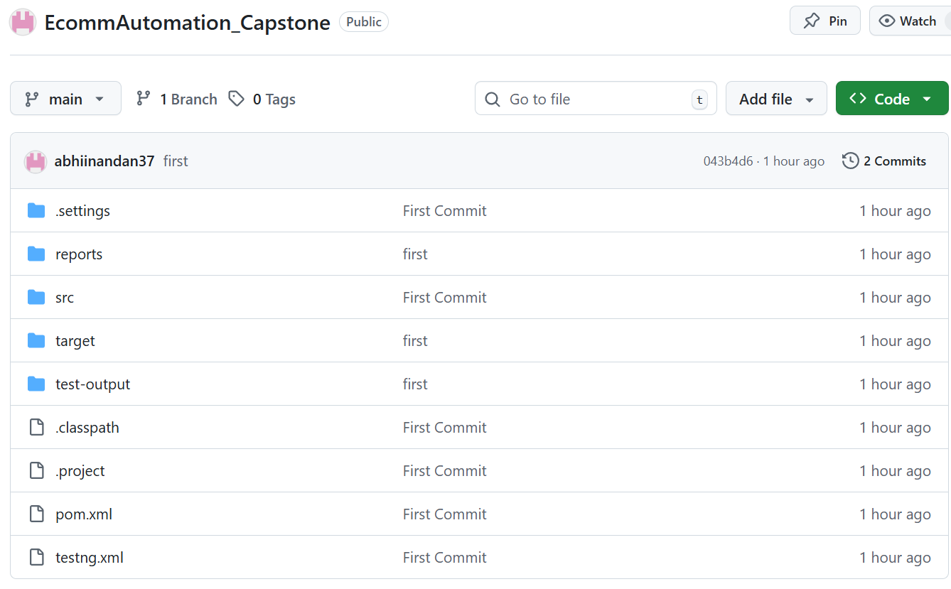
Github Repository Snapshot
Repo Link : https://github.com/abhiinandan37/EcommAutomation_Capstone.git

Slide 14
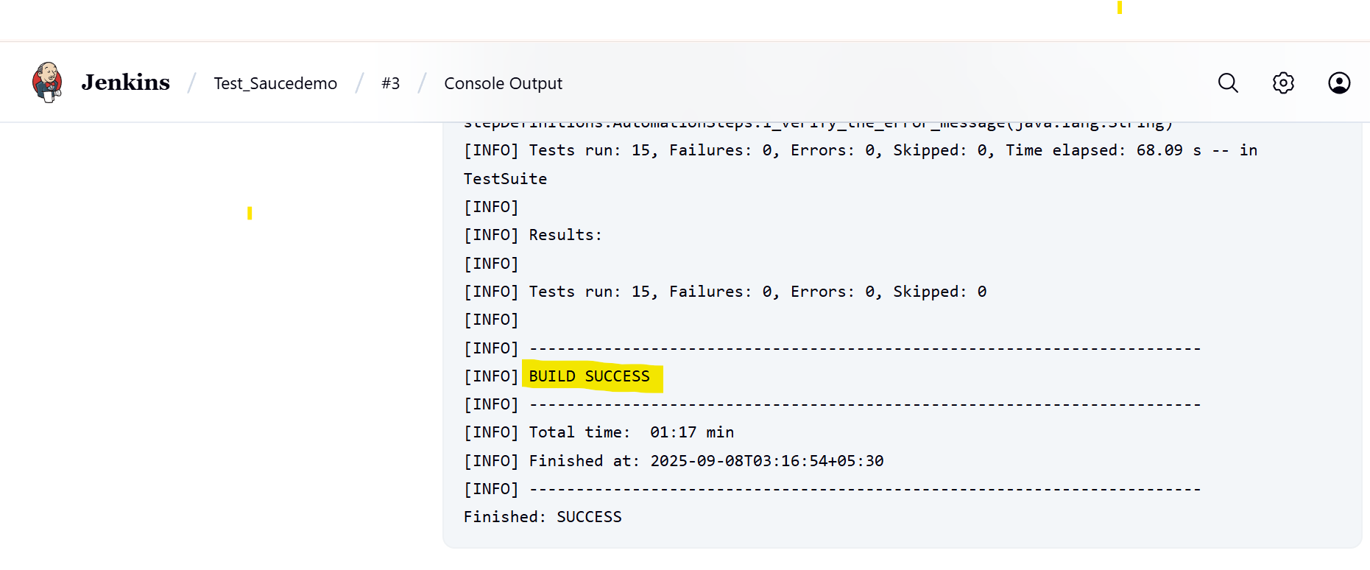
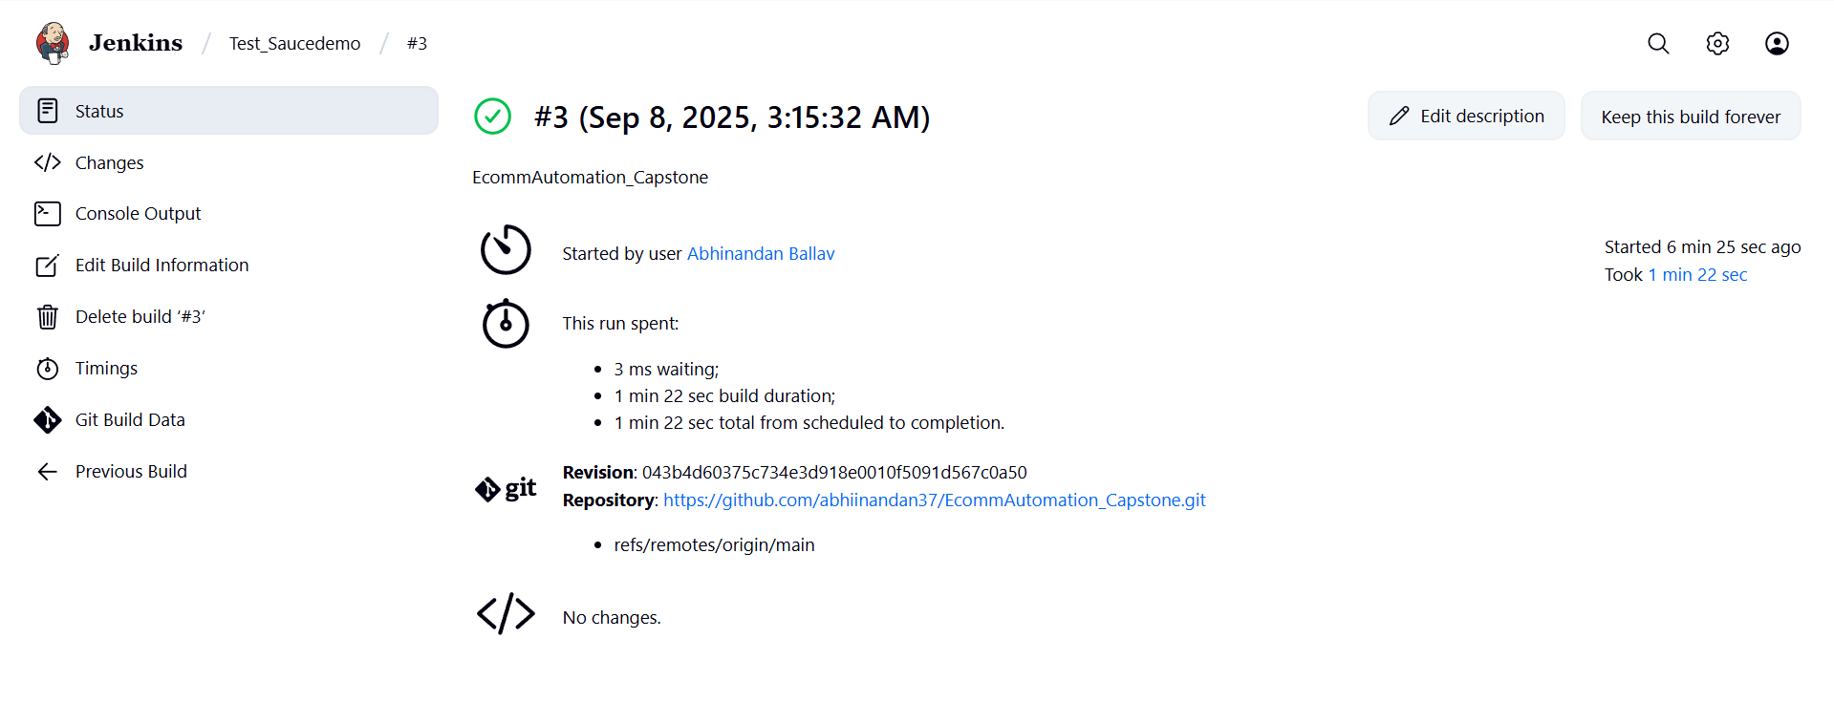
Jenkins build running Snapshot

Slide 15
Thank You

