Slide 1

Banking Transaction Insights & Fraud Detection
"Detecting fraudulent banking transactions using data analysis, SQL, machine learning & interactive dashboards."
Data Analysis | Machine Learning | Dashboard
By: Abhishek Singh

Slide 2
Problem Statement
• Rising financial frauds lead to billions in losses.
• Manual fraud detection is slow and inefficient.
• Need automated fraud detection with real-time insights.
• Analyzing geographic and Device-Type concentration of
fraud.
• High fraud incidence among middle age groups between (18-57).

Slide 3
Dataset Overview
• Source: Bank Transactions Dataset.
• Key Columns: Customer_ID, Transaction_Amount, Merchant_Category, Transaction_Device, Is_Fraud.
• Includes demographic, transactional, and fraud labels.
• Total Transactions: (to be filled after data analysis).

Slide 4
SQL Analysis & Data Validation
• Checked missing values, duplicates, max/min transaction amount.
• Fraudulent vs Non-Fraud transaction counts.
• Top cities & devices with highest fraud activity.
• All types of Transaction Devices.
• Sample Queries written in MySQL.

Slide 5
Exploratory Data Analysis
• Age Group vs Fraud trends.
• Device Type vs Fraud.
• Transaction Amount distribution.
• Fraud concentrated in online & high-value transactions.

Slide 6
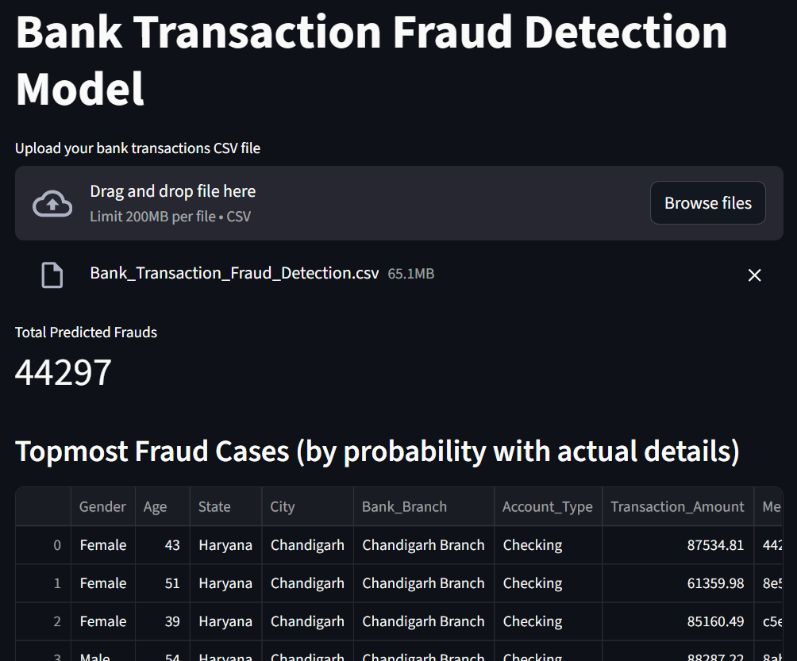
Fraud Detection Model
• Algorithm: Random Forest Classifier, XGBClassifier.
• Data Preprocessing: Encoding, Scaling, SMOTE for imbalance.
• Evaluation Metrics: Accuracy, Precision, Recall, ROC-AUC.
• Fraud Probability predictions.

Slide 7
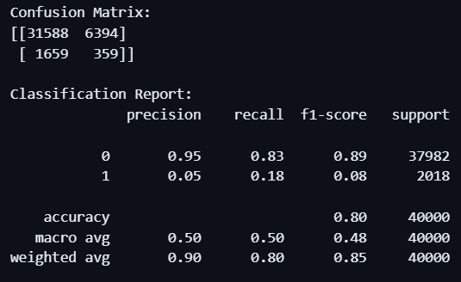
Model Output & Metrics
• Confusion Matrix.
• Fraud Probability examples.
• Accuracy: 80% | Precision: 0 = 0.95, 1 = 0.05
Recall: 0 = 0.83, 1 = 0.18 | f1- score: 0 = 0.89, 1 = 0.08.

Slide 8
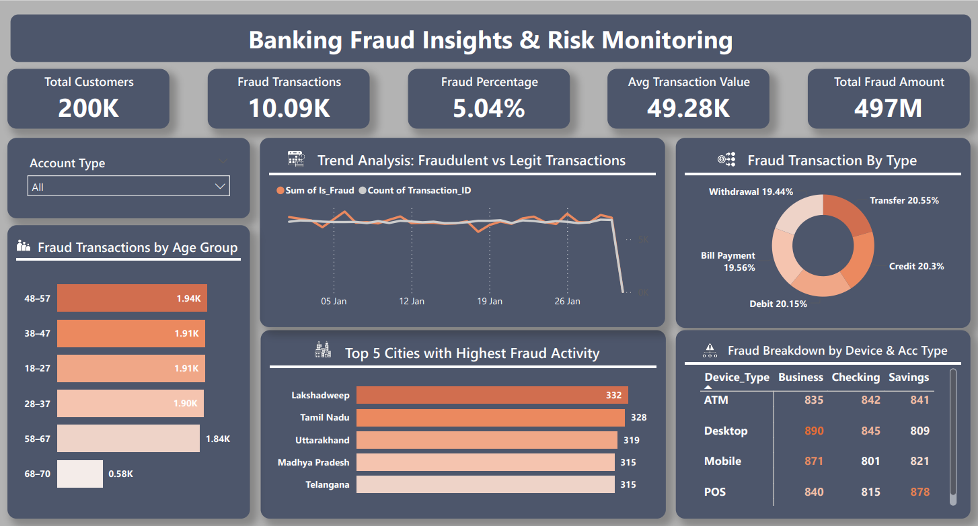
Power BI Dashboard
• KPIs: Total Transactions, Total Fraud, Fraud %.
• Fraud by State/City (Map).
• Fraud by Device Type.
• Age Group Fraud Trends.
• Heatmap of Fraud Risk.

Slide 9
Tools & Technologies
• SQL – Data storage & cleaning.
• Python – EDA & ML Model (Pandas, Sklearn, Xgboost, Matplotlib, Seaborn).
• Power BI – Dashboard & visualization.
• Jupyter Notebook – Experimentation.
• GitHub – Version control & sharing.

Slide 10
Business Impact
• Automated fraud detection reduces financial losses.
• Real-time monitoring of suspicious activity.
• Provides valuable customer behavior insights.
• Improves decision-making for banks.
• Risk Mitigation through Proactive Monitoring.

Slide 11
Conclusion & Future Scope
• SQL + ML + Dashboard pipeline for fraud insights.
• Can be integrated with banking applications.
• Future: Deploy as real-time API.
• Add real-time fraud alerts system.

Slide 12
GitHub & Contact
• GitHub Repo: https://github.com/abhiishek04/Banking-Transaction-Behavior-Predictive-Fraud-Risk
• LinkedIn/Portfolio: https://www.linkedin.com/in/abhishek-singh-50506329a/
• Contact: info.abhisheksingh004@gmail.com

