Slide 1

blinkit Retail Forecasting
Predictive Sales Analytics for Strategic Planning
Data Analysis | Forecasting Model | Dashborad
By: Abhishek Singh

Slide 2

Problem Statement:
Blinkit faces challenges in accurately forecasting retail demand due to seasonality, customer behavior variations, and regional sales distribution.
The goal is to build a data-driven forecasting and visualization solution to optimize inventory, enhance customer satisfaction, and support business decisions.

Slide 3

Data Collection & Sources
- Blinkit retail sales data (CSV).
- SQL analysis for data profiling & insights.
- Python (Jupyter Notebook) for forecasting model.
- Power BI for interactive dashboards.
- Data covers order-level details: order_id, customer_id, order_date, order_total, area, segment, etc.

Slide 4

Data Analysis Using SQL
- Total Orders, Revenue & Average Order Value calculated.
- Monthly Sales Trends extracted.
- Customer segmentation analysis.
- Seasonal impact on sales identified.
- Area-wise sales distribution.
- Order frequency & top customers by revenue.

Slide 5

Numerical Insights (SQL)
- Total Orders: 5,000+
- Total Revenue: ₹11,009,308.50
- Avg Order Value: ₹2201.868
- Premium customers drive ~25% of total revenue.
- Top 10 customers contributed ~8% of sales.
- Sales peak observed in festive seasons.

Slide 6

Forecasting Model Approach
- Built using Python (SARIMAX / Prophet tested).
- Daily sales aggregated & resampled to monthly.
- Data split into train/test for evaluation.
- Forecast horizon: up to Dec 2025.
- Evaluation metrics: MAE, RMSE, MAPE, SMAPE.

Slide 7
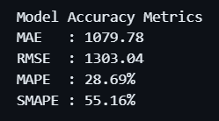

Forecasting Model Results
- MAE: 1079.78
- RMSE: 1303.04
- MAPE: 28.69%
- SMAPE: 55.16%
- Average Daily Sales: ~18,348
- Forecast highlights demand spikes during festivals.

Slide 8

Power BI Dashboard
- Sales Overview: Revenue, Orders, Avg Order Value
- Time-Series Trends: Monthly & Seasonal
- Customer Segmentation & Revenue Contribution
- Geographical Sales Distribution
- Forecast Line Charts integrated
- Interactive filters for recruiter demonstration

Slide 9
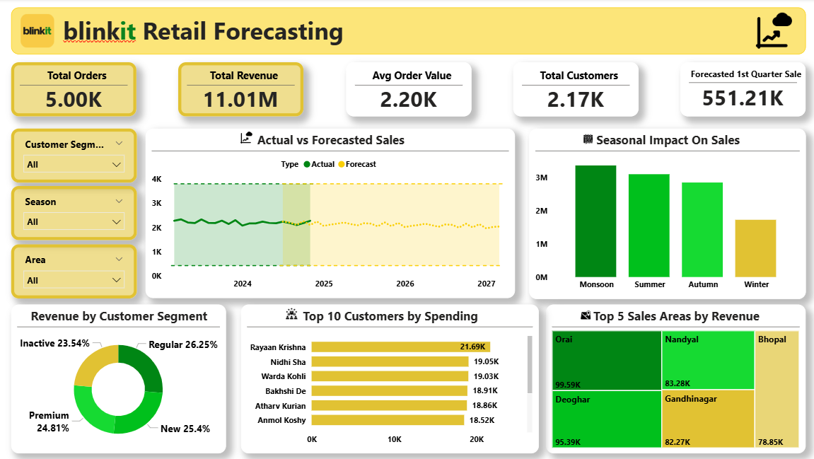
PowerBI Dashboard

Slide 10

Technologies & Tools Used
- SQL → Data Profiling & Business Insights
- Python (Pandas, NumPy, Statsmodels, Prophet, Matplotlib) → Forecasting
- Power BI → Visualization & Dashboarding
- Excel/CSV → Raw Data Storage
- Jupyter Notebook → Experimentation & EDA

Slide 11

Business Impact
- Accurate demand forecasting reduces stockouts & overstock
- Improved supply chain efficiency
- Data-driven decisions on pricing & promotions
- Customer retention via segmentation insights
- Better revenue planning across regions & seasons

Slide 12

Future Enhancements
- Automating ETL pipelines for real-time dashboards
- Incorporating external data (weather, festivals, inflation)
- Advanced ML models (XGBoost, LSTMs)
- AI-driven recommendation system for customers

Slide 13

Conclusion:
The Blinkit Retail Forecasting Model & Dashboard provide a comprehensive solution for demand prediction, customer insights, and business optimization.
With SQL, Python, and Power BI integration, this project demonstrates the end-to-end data analytics capability expected at Big 4 firms.

Slide 14

GitHub & Contact
GitHub Repo: https://github.com/abhiishek04/blinkit-Retail-Forecasting
Linkedin / Portfolio: https://www.linkedin.com/in/abhishek-singh-50506329a/
Conatct: info.abhisheksingh004@gmail.com

