Slide 1
MANAGEMENT BRIEFING
Every business app deserves help, a guided tour and tests
?
Quick help
on every screen
▶
Guided tour
of the basic flow
A standard, AI-assisted way to build all three — fast, consistent and under human control.
✓
Automated tests
instead of manual re-testing
Notes:
Opening: one sentence. Most business applications we deliver work well, but nobody can easily learn them and nobody can cheaply prove they still work after a change. This briefing shows a simple, standard way to fix both, with AI doing the heavy lifting and people staying in control.

Slide 2
THE PROBLEM
Our applications work — but they are hard to learn, and costly to change safely
?
▶
✓
No help on screen
No guided tour
No safety net of tests
Users cannot find out what a button or field is for without asking someone or reading a long document.
The basic business flow is not shown anywhere. New users and new team members depend on other people to learn it.
Every new feature means testing everything again by hand — or hoping that nothing else broke.
Users find the application hard to learn. The team finds it expensive to prove that it still works.
TourD · Help, tours and tests for business apps
2
Notes:
Three gaps that we see in almost every side-by-side extension application. None of them is about the quality of the application itself.

Slide 3
THE COST OF DOING NOTHING
The same effort is spent again and again
Repeated knowledge-transfer sessions
every time someone joins a project in the middle
The same basic questions
asked again and again to colleagues and support
People do not open a big document each time they have a question. It is slow and boring — so they ask a colleague, or they give up.
Manual re-testing before every release
slow, tiring and easy to get wrong
Problems found late, by users
when they are the most expensive to fix
Help has to be on the screen, at the moment the question comes up.
Knowledge that lives in people’s heads
and leaves the project with them
TourD · Help, tours and tests for business apps
3
Notes:
These are not one-off costs. They come back with every new joiner, every release and every new question. Ask the room which of these they recognise.

Slide 4
WHY IT HAPPENS
It is not neglect — it is a missing standard
1
Time and budget
2
Skills
Delivery dates come first. Help, tours and tests are the first things to be cut.
Good test automation and good help writing need expertise that not every team has.
3
No standard
4
Awareness
There is no agreed way to create help or tours for these applications. Each team invents its own — or does nothing.
Clients often do not know these things are possible, so they never ask for them.
The result: the work is skipped — and the cost comes back later, and bigger.
TourD · Help, tours and tests for business apps
4
Notes:
Be generous here: teams are not lazy. Time, budget and skills are limited, and nobody has given them a standard way to do this. Clients cannot ask for what they do not know exists.

Slide 5
THE IDEA
Use the application once. Get help, a tour and tests.
1
2
3
4
›
›
›
Use it once
AI drafts everything
A person reviews
One click to deliver
Walk through the app the normal way.
Help texts, a guided tour and tests.
Edit, improve or reject any part.
It becomes part of the application.
What the organization gets
Quick help
on every screen, searchable
Guided tour
of the basic business flow
Automated tests
re-run any time, no manual clicking
?
▶
✓
TourD · Help, tours and tests for business apps
5
Notes:
One real walk-through of the application is the starting point for all three. AI turns it into drafts in seconds; a person reviews and approves; one click puts the result into the application.

Slide 6
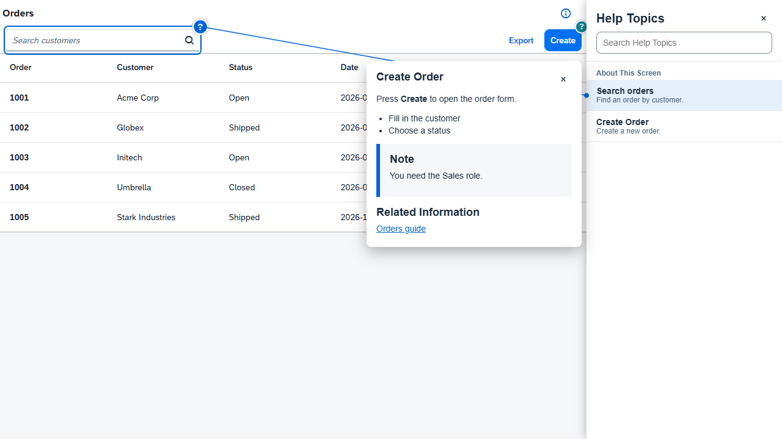
WHAT USERS SEE
Help right where they work
Help for the screen they are on
A panel lists the topics of the current screen. Nothing to look up.
Click a ? to learn what it is for
A short explanation, a note and links — next to the control itself.
Search instead of reading a manual
Type a word, get the answer.
Same experience in every application
Also works on standard SAP Fiori apps.
Sample ordering application with the help panel open
TourD · Help, tours and tests for business apps
6
Notes:
This is a real screenshot from our working prototype: a help panel docked next to the application, question-mark badges on the controls, and a popover that explains one control with a note and links to further reading. It also works on standard SAP Fiori applications; we checked it on a standard list report.

Slide 7
AI AND HUMAN REVIEW
AI makes it fast. People make it right.
AI does the heavy lifting
People stay in control
Drafts in seconds — a person finishes the job
Every decision has a human owner
✓
Drafts the wording of every help topic
✓
Review every change as a before-and-after comparison
✓
Proposes the guided tour from a real walk-through
✓
Edit the wording, or reject it
✓
Writes the steps of the automated tests
✓
Nothing enters the application until it is approved
✓
Rewrites on request: shorter, friendlier, another language
✓
Anything the AI is unsure about is flagged — never guessed
The organization chooses the AI service — or switches AI off completely. The tool works either way.
TourD · Help, tours and tests for business apps
7
Notes:
This is the key message on trust. The AI produces drafts quickly. A person sees every proposed change as a before-and-after comparison and decides. The tool checks the AI output and flags what it is unsure about instead of guessing. The organization also decides which AI service is used, or whether AI is used at all.

Slide 8
BUSINESS VALUE
Less rework, faster onboarding, problems found earlier
Faster onboarding
Fewer support questions
Release with confidence
New joiners learn the basic flow from the application itself — not from repeated KT sessions.
The answer is on the screen at the moment the question comes up.
Automated checks replace repeated manual re-testing.
Problems found early
One standard
Knowledge stays
A broken flow is caught before users see it — when it is cheapest to fix.
The same quality and way of working across the whole organization.
Flows and explanations live in the product, not only in people’s heads.
TourD · Help, tours and tests for business apps
8
Notes:
Each card is a value we can measure in a pilot: time to become productive, support questions, hours of manual regression testing, defects caught before release. We do not claim numbers yet — the pilot will produce them with our own applications.

Slide 9
WHY EARLY MATTERS
The later a problem is found, the more it costs
Relative cost of fixing (illustrative)
What changes
Automated tests re-run after every change, so a broken flow shows up the same day it was introduced — not weeks later in front of a user.
Cheaper fixes. Fewer surprises. Less firefighting.
While building
In testing
After release
In production, by a user
TourD · Help, tours and tests for business apps
9
Notes:
Illustrative only: this is the well-known shape of the cost of fixing a defect, not measured data from our projects. Automated tests move the moment of discovery to the left.

Slide 10
BEFORE AND AFTER
From repeated effort to a repeatable standard
Today
With the platform
New joiner
Repeated KT sessions
A guided tour inside the application
A question about a screen
Ask a colleague or read a document
Quick help on the screen itself
After a change
Test everything by hand
Re-run the automated tests
Defects
Found late, often by users
Caught early, before release
Across applications
Every team does it differently
One standard for the organization
TourD · Help, tours and tests for business apps
10
Notes:
A side-by-side view for the room. The right-hand column is what the working prototype already does today, with review by a person.

Slide 11
PROPOSED NEXT STEP
Prove it on one real application
A short pilot
What we will measure
1
Choose one live application
Time for a new joiner to become productive
Basic support questions per month
2
Create help, a tour and tests with the platform — AI drafts, a person reviews
Hours of manual re-testing per release
Problems caught before release
3
Measure the result against today
Where we are today
What we need from you
A working prototype already creates help, tours and tests from a real walk-through, with AI assistance and human review.
A sponsor, one pilot application and one reviewer from the business team.
TourD · Help, tours and tests for business apps
11
Notes:
The ask is small: one application, one sponsor, one reviewer. The pilot gives us our own numbers instead of promises. A working prototype already exists, so the pilot starts on real work, not on slides.

Slide 12
Build it once.
Keep it current.
Make every application easier to learn and safer to change.
Questions?
Notes:
Close with the pilot ask: one application, one sponsor, one reviewer.

