Slide 1
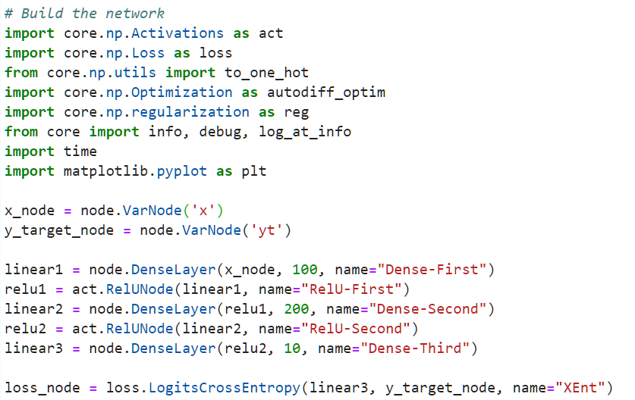
Model
linear1
relu1
linear2
relu2
linear3
Loss
X
y

