Slide 1
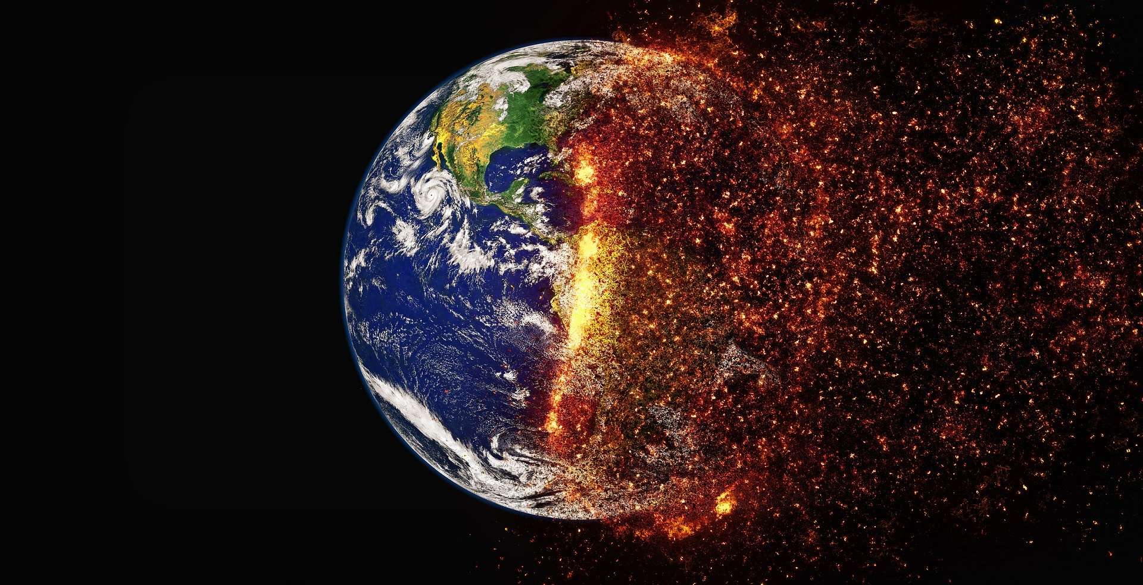
Climate-Change-Analysis

Slide 2
Team (manav):-
Ajit Tiwari
Vivek Mishra
Nikhil Yadav
Mridul Kumar Singh
Abhijat Singh

Slide 3
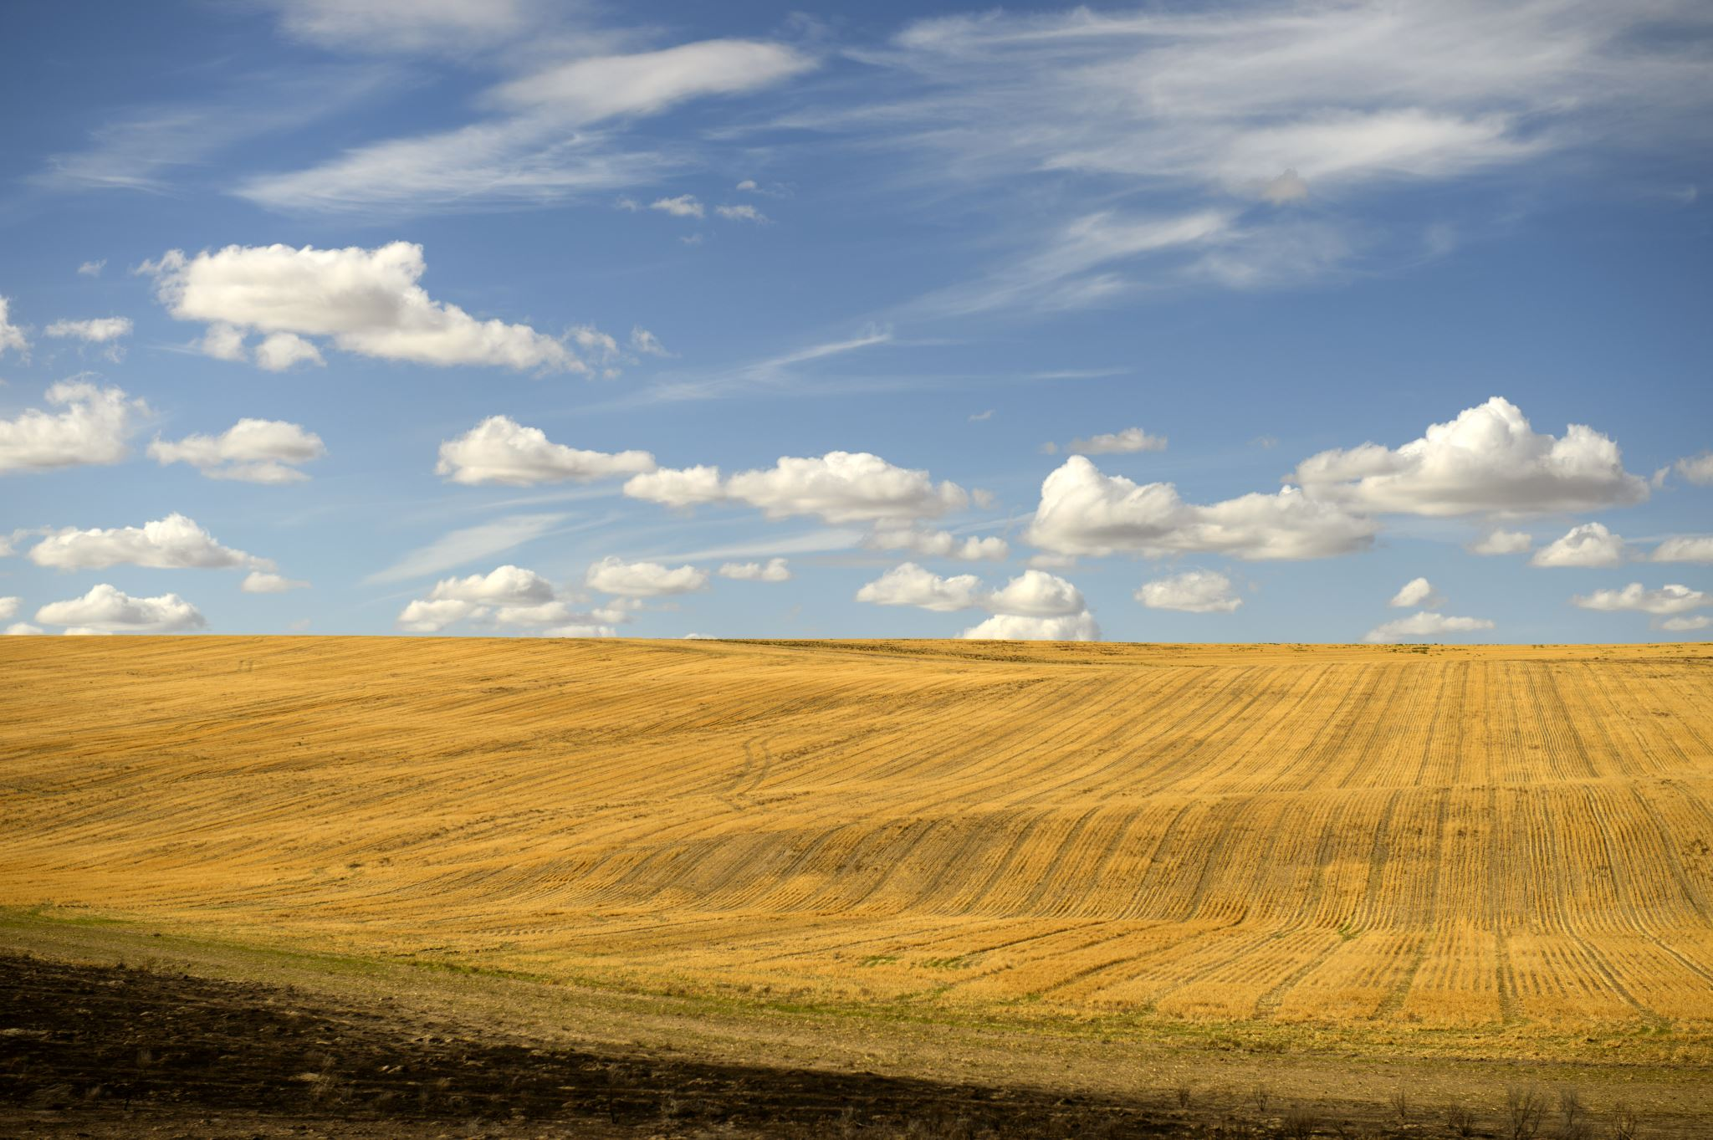
introduction
Climate change
Here's a potential introduction to the topic of climate change: "Climate change refers to the long-term warming of the planet due to an increase in average global temperatures, primarily caused by human activities that release greenhouse gases, such as carbon dioxide and methane, into the atmosphere. This phenomenon has far-reaching consequences, including rising sea levels, more frequent and severe weather events, and altered ecosystems, impacting biodiversity, human health, and the economy. As the world grapples with the challenges of climate change, understanding its causes, effects, and potential solutions is crucial for developing strategies to mitigate its impacts and create a sustainable future."

Slide 4
Project summary
Climate change is a pressing global issue with far-reaching impacts on local climates. In India, the effects of climate
change are already evident in various regions, manifesting as temperature fluctuations increased frequency of
extreme weather events, and alterations in seasonal patterns. Understanding these changes is crucial for developing
In this project we will identify the States/UTs temperature change in the last deacde using (MS excel, Python, Matplotlib and Seaborn)

Slide 5
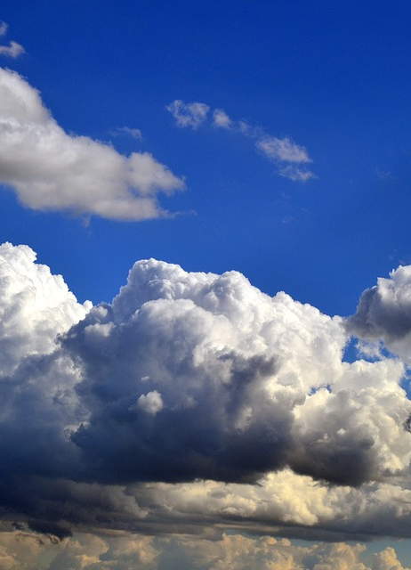
Purpose of the project
To examine the zone-wise temperature change scenario in India over the decade.
To outline the seasonal temperature change patterns in India.
And our goal is to provide complete analysis and detection from the predefined dataset

Slide 6
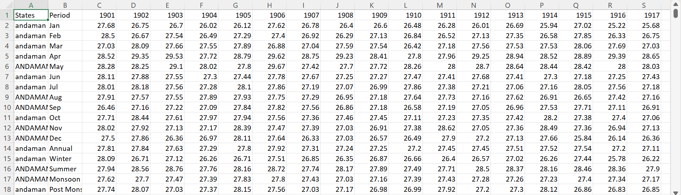
Data before cleaning

Slide 7
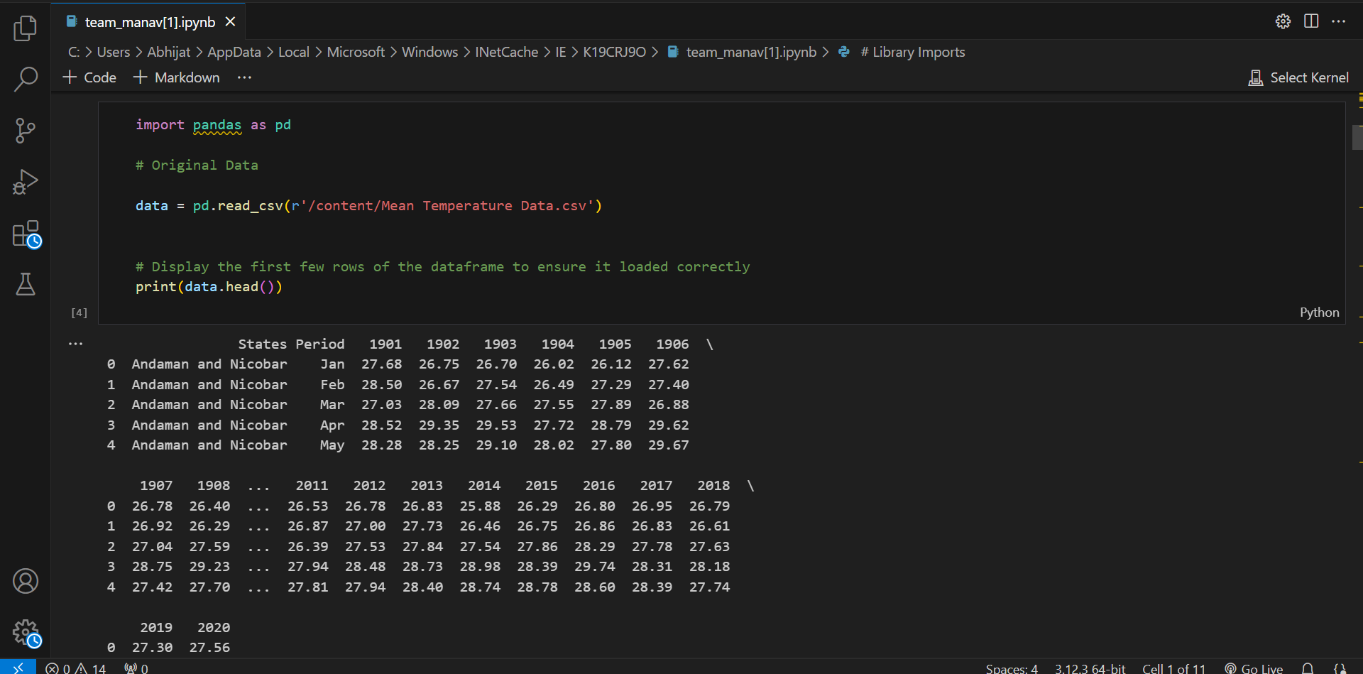
Data after cleaning

Slide 8
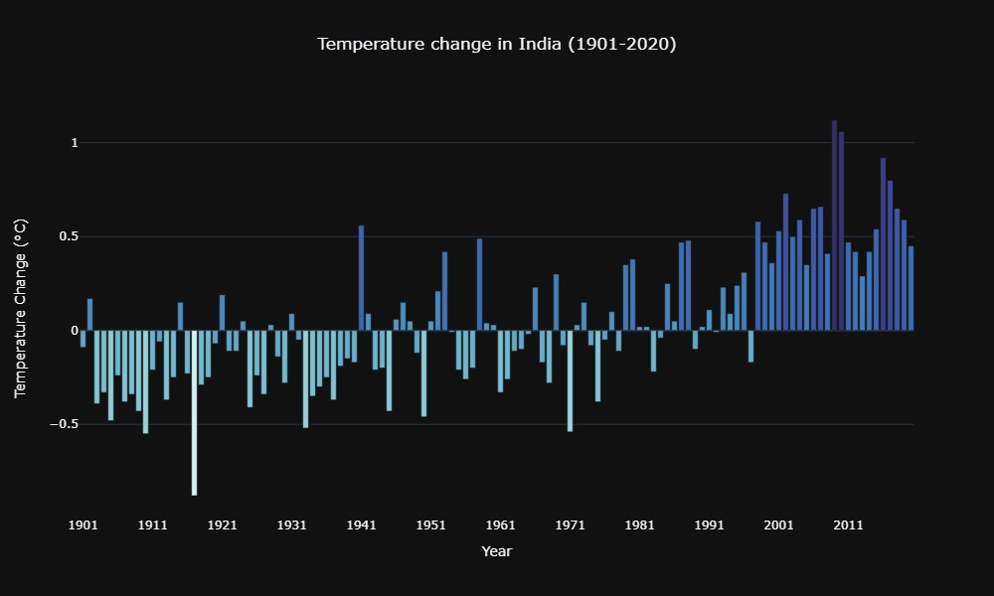
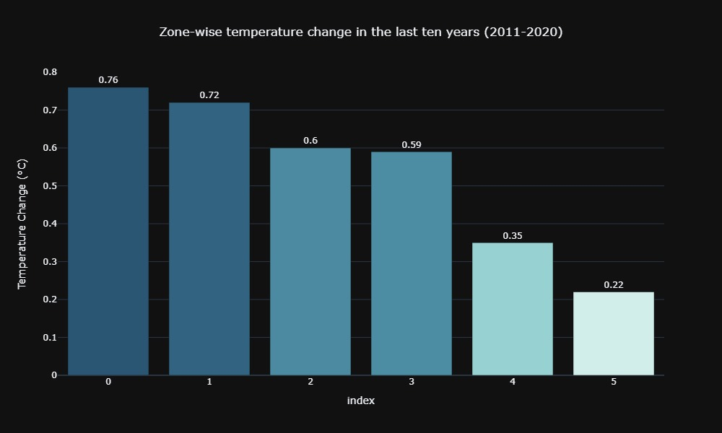
Data visualization
Temperature change in india (1901-2020)
Zone wise temperature change in the last ten years (2011-2020)

Slide 9
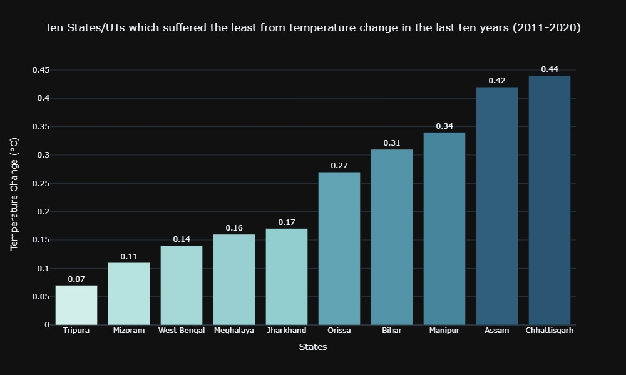
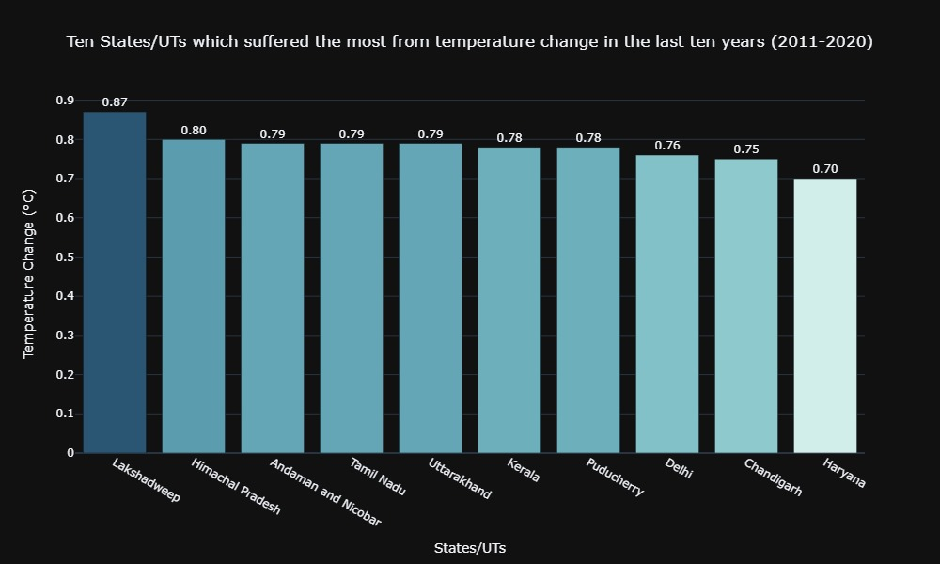
Data visualization
Ten States/uts which suffered the least from temperature change in the last ten years (2011-2020)
Ten states/uts which suffered the most from temperature change in the last ten years (2011-2020)

Slide 10
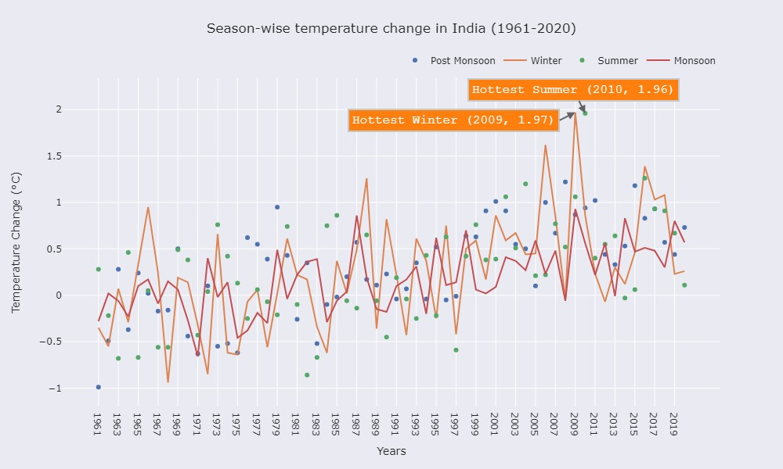
season wise temperature change in india (1961-2020)

Slide 11
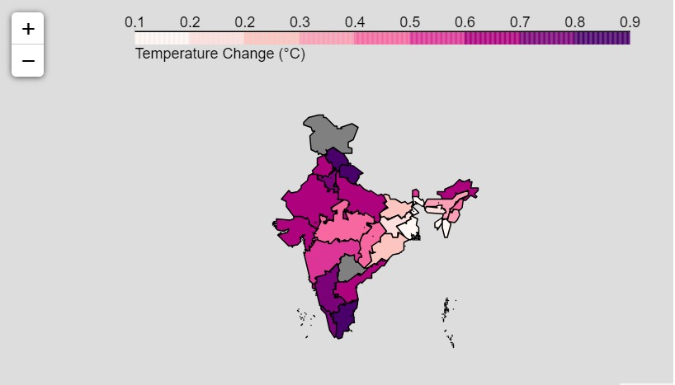
Final outcome of temperature change in india

Slide 12
conclusion
In this project, I examined and analyzed how the surface temperature changed in India between 1901 and 2020. I tried to visualize temperature change in India and find trends and patterns of the same and how it varies over different states and union territories. I found that all States & UTs in India have experienced a continuous increase in temperature in the last decade. 22 out of 33 ( ≈ 67%) States & UTs have experienced a temperature change of more than 0.5 °C. Island groups ( Lakshadweep and Andaman & Nicobar) are the most impacted by temperature change. Southern and northern regions have witnessed maximum changes, whereas Eastern and North-Eastern states have experienced the least. The temperature change trend in India (as a whole) shows a continuous temperature rise, particularly in the last few decades. A look at the seasonal temperature change reveals that the winters witnessed the most erratic temperature changes followed by summer, post-monsoon and monsoon. The IPCC Working Group II's report titled 'Climate Change 2022: Impacts, Adaptation and Vulnerability' [10] goes into depth regarding all climate-related threats to agriculture and food systems in parts of Asia. The study also mentions that under RCP8.5 (high emissions scenario), at the end of the century, Lucknow and Patna are among the cities predicted to reach wet-bulb temperatures of 35 degrees if emissions continue to rise, while Bhubaneswar, Chennai, Mumbai, Indore and Ahmedabad are all identified as at risk of reaching wet-bulb temperatures of 32-34 degrees with continued emissions. Overall, Assam, Meghalaya, Tripura, West Bengal, Bihar, Jharkhand, Odisha, Chhattisgarh, Uttar Pradesh, Haryana and Punjab will be the most severely affected, but if emissions continue to increase, all Indian states will have regions that experience wet-bulb 30 degrees or more by the end of the century. The conclusion is that India is already experiencing a warming climate. Unusual and unprecedented spells of hot weather are expected to occur far more frequently and cover much larger areas. Under 4°C warming, the west coast and southern India are projected to shift to new, high-temperature climatic regimes with significant impacts on agriculture.

