Slide 1

MAJOR PROJECT PRESENTATION ON AUTO-RANKING OF AMAZON REVIEWS
MAULANA AZAD NATIONAL INSTITUTE OF TECHNOLOGY BHOPAL
Presented by-
Abhijeet Rawat
Shubham Dangarh
Vipin Singh Shekhawat
Kannali Jaswanth Kumar
Under the guidance of- Dr. Manasi Gyanchandani

Slide 2

Outline
Introduction
Why auto-ranking?
Problem statement
Work flow
Methodology and work description
Tools and libraries
Model description
Results
Conclusion
Future work

Slide 3

Introduction
Online shopping is more convenient and efficient than shopping at a department store.
There are a number of perks of shopping online but there are few drawbacks as well. One of the main ones being the inability to physically hold and assess the quality of the product before purchase.
In such cases, we rely on the reviews of that particular product to see if it matches our needs.

Slide 4


Example reviews of iPhone X

Slide 5

Why auto-ranking?
For popular products reaching hundreds or thousands of reviews, it is difficult for potential buyers to efficiently sort through the more helpful reviews.
Most of the reviews have either very low or zero votes. Especially for popular products that have a high number of reviews, it’s difficult for newly written reviews that are helpful to be read by people.

Slide 6

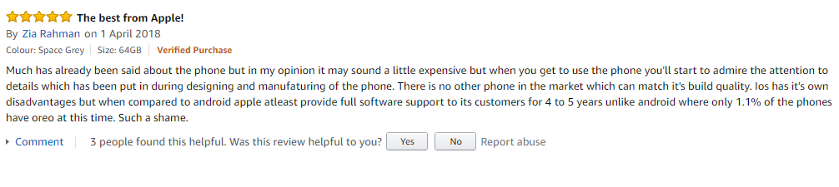
Look at this newly written product review which is being displayed at the bottom of the list but is indeed useful.
This type of reviews should come at top.

Slide 7

Problem statement
We pose the problem of designing a supplemental way to rank reviews by looking at their certain features, such that these reviews which could potentially be helpful can be surfaced to the top of the list.
We attempt to use machine learning algorithms that are appropriate for string data and ranking. By analyzing the portion of reviews that have enough visibility and a high number of votes, we aim to build a model that could predict the helpfulness of reviews with zero or few votes.

Slide 8
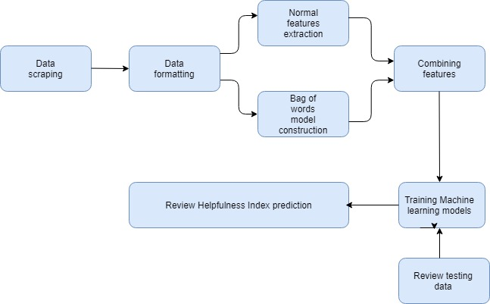
Work flow of Review Ranker

Slide 9

A. Datasets
The original dataset contained 2.25 million reviews.
We then filtered the review data and extracted trustworthy features on the basis of following criteria-
Each review needs to have more than 10 votes.
The review should exist in popular products having enough number of reviews e.g. say 15.
After filtration we have 60,000 reviews left for training and testing.

Slide 10
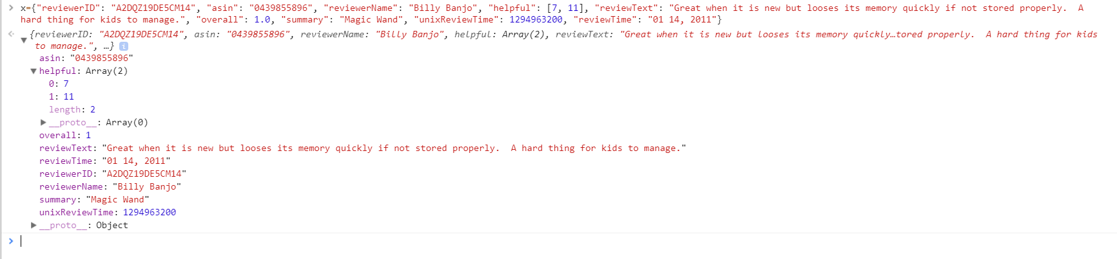
Snapshot of Dataset

Slide 11
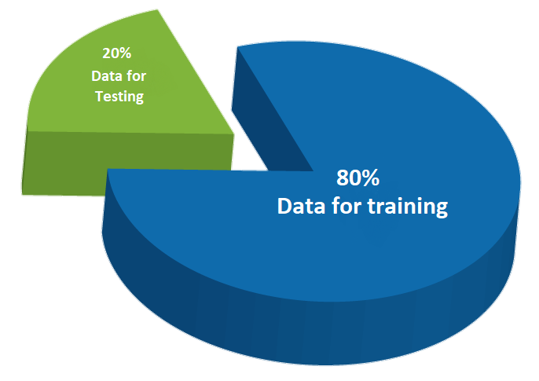
Distribution of Training and Testing data

Slide 12


B. Outcome variable
we define the following quantity to provide a measure of the sense of helpfulness a review provides given the ith review:

Slide 13

C. Features
We used the following features extracted from each review text, classified into broad categories.
Text Length
Character Count
Word Count
Unique Word Count
Sentence Count
Automated Readability Index
Bag of words

Slide 14
D. Metadata features
We used the number of stars that a reviewer has given
product in his/her review as part of our feature set.
E. Bag of words
The bag of words model uses a large- dimensional, sparse vector to count word occurrences in a review text with respect to some vocabulary of words.

Slide 15

Tools and Libraries
Tools:
Jupyter notebook, Jetbrains PyCharm community addition 2017.2.1 x64
Front end design tools- Jetbrains webstorm 2017.3 x64.
Libraries:
NLTK, NumPy, Scikit Learn, Pandas, Matplotlib
Front end delelopement- ReactJS

Slide 16

We modeled the problem as a regression. And the performance of regression models is calculated by –
Model description
R : Coefficient of determination
y(i): Actual value of outcome variable
Ῡ(i): Mean of all values of outcome variable
Ŷ(i): Predicted value of the outcome variable
Lesser values of R² mean that the model doesn’t fit the data . While it typically ranges
from 0 to 1, for very low-performance cases R² can be negative.

Slide 17

A. Linear Regression
Linear regression poses the problem of solving for the parameters θ that minimizes the following cost function:
X is the design matrix of size m × n
y^{T} = y⁽¹⁾ y⁽²⁾ . . . y^{(m)} is the vector containing the target variables for
each sample.
Given θ, we make a prediction given a new data point x` as follows:
Ŷ

Slide 18


B. Ridge regression
Similar to linear regression, ridge regression attempts to minimize the least squares cost function with the additional term In particular, we have:
The additional term makes the regressor less susceptible to outliers in
data. To understand this intuitively, note that if the parameters are
unconstrained, each parameter can be arbitrarily large, and this
happens when the model tries to fit outliers.

Slide 19

C. Support vector machine
While typically used for classification problems, Support Vectors Machines (SVMs) can be used for regression as well. Like SVMs for classification, Support Vectors Machines for Regression (SVR) contain all the main features that characterize maximum margin algorithm.
SVR’s mathematical foundation:

Slide 20
Results
Linear regression
linear regression has the intrinsic assumption that the considered data is linear, it did not perform well.
However, due to the high number of features, the performance was still relatively decent.
The accuracy for training set was 19.76 % while for testing it was coming out to be 19.62%.

Slide 21
B. Ridge regression
Ridge regularization resulted in a slight improvement in the performance. At the expense of slightly higher bias, we were able to improve the performance.
The accuracy for training dataset comes out to be 19.85% and for the test dataset it is coming out to be 19.72%

Slide 22
C. Support Vector Machine
The textual features dominate the bag words features.
The words relevant to the subject are at the top among bag of words.
Star rating given to the product by the reviewer is the most significant feature.
Investigating data, we see that most helpful reviews are the ones which rated the products highest.
Textual features based on text length are highly correlated with each other.
Therefore, it is hard to argue which ones are more significant than others. However, their combined significance is clear.
The accuracy for the model is coming out to be the best with 84.99% for training dataset and 32.48% for test dataset.

Slide 23
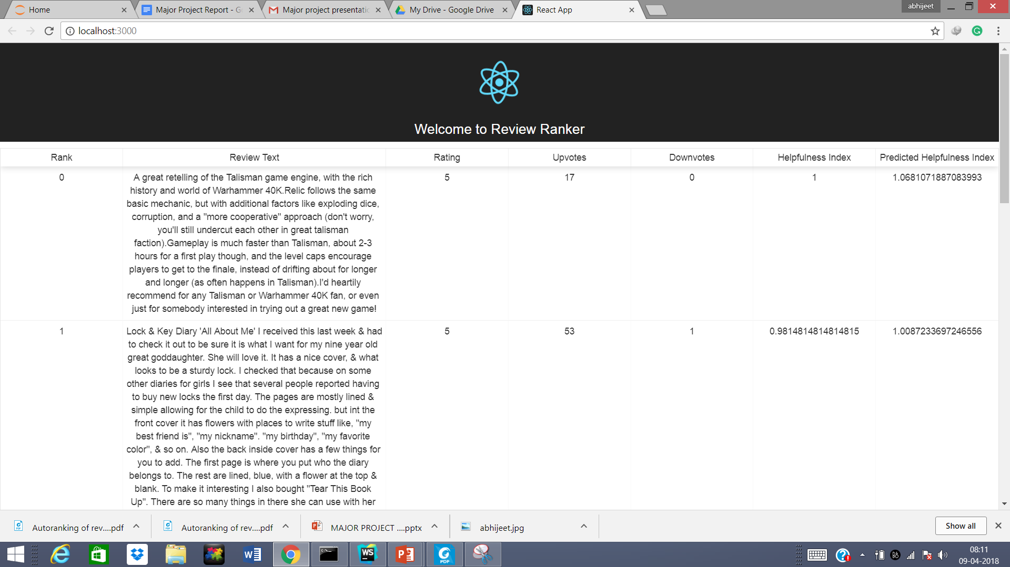
Review ranker user interface

Slide 24
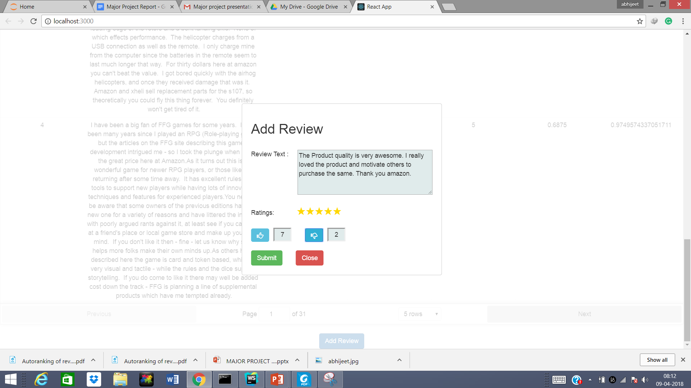
Here’s how you can add a new review.

Slide 25
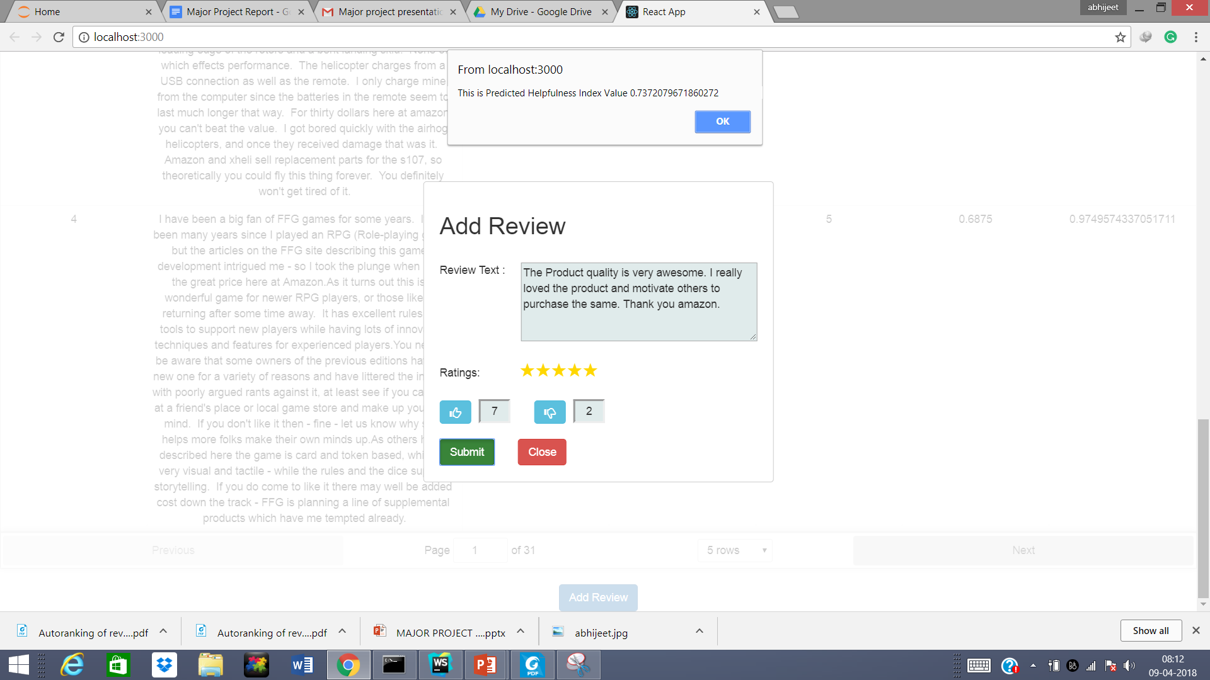
Alert box showing the predicted helpfulness index of the review. On the basis of which reviews are ranked.

Slide 26
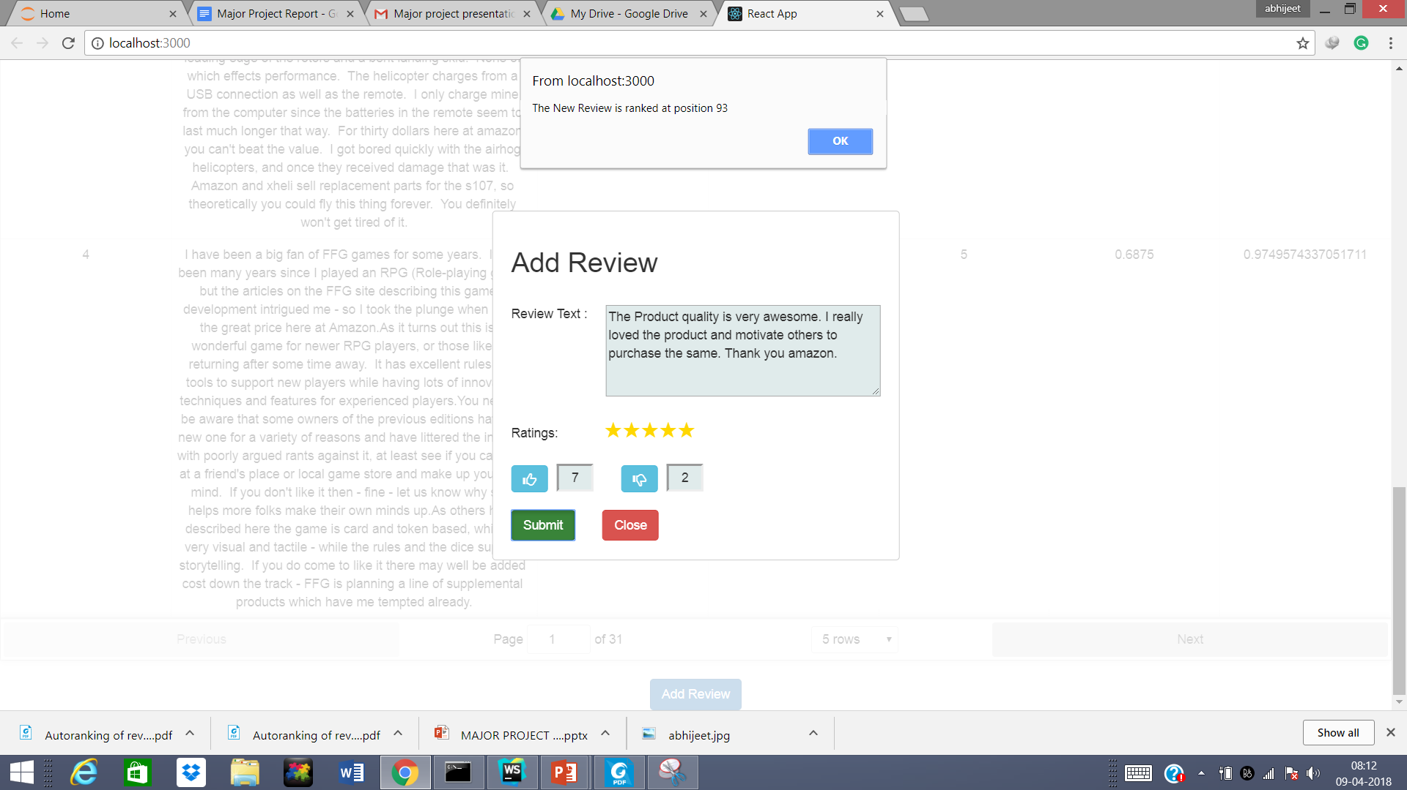
The alert box displaying the rank of the review.

Slide 27
Conclusion
We have successfully shown that there is a possibility to automatically rank reviews.
We modeled the problem as regression and extracted features that represented the data.
We observed that Support Vector Machine performed the best.

Slide 28
Future work
Due to the complexity of the problem at hand, we believe there is a lot of room for improvement in the future work by addressing three main challenges:
Creating a more complex feature set.
Reducing high dimensionality.
Overcoming skewness.

Slide 29
Thank you

