Slide 1
IoT Based Vehicle Health Monitoring and Driver Alert System
PG-Diploma in Embedded Systems and Design (PG-DESD)
Submitted By:
Abhijeet Singh | [250840130001]
Ajay Vyas | [250840130003]
Pratik Datir | [250840130013]
Nikita Pawage | [250840130037]
Subodh Hurgat | [250840130050]
Guided By:
Mr. Rhugved Rane

Slide 2
Introduction
Modern vehicles require continuous monitoring of engine performance and driver behavior to improve safety and reduce mechanical failures. This project presents an IoT-based Vehicle Health and Driver Alert System that monitors critical engine conditions and driver hand presence in real time. The system processes data locally, communicates reliably using an automotive-grade network, and transmits information to the cloud for remote monitoring. An event-based alert mechanism generates real-time email notifications when predefined safety thresholds are exceeded. The proposed solution follows a scalable, reliable, and automotive-style architecture suitable for real-world vehicle safety applications.

Slide 3
Problem Statement
Lack of real-time monitoring of engine performance parameters such as temperature, Engine oil level, and vibration.
Delayed detection of engine faults leading to increased maintenance cost and safety risks.
Absence of effective driver alert systems to detect unsafe driving behavior.
Limited use of reliable automotive communication protocols in existing low-cost systems.
No integrated cloud-based monitoring and alert mechanism for remote supervision.
Notes:
The first problem is the lack of real-time monitoring of engine parameters such as temperature, oil level, and vibration. Because of this, faults are detected late.
Second, delayed fault detection increases maintenance cost and may cause serious engine damage.
Third, there is no effective driver alert mechanism in many systems to detect unsafe behavior like removing hands from the steering wheel.
Fourth, many low-cost systems do not use reliable automotive protocols like CAN, leading to communication failures.
Finally, there is no integrated cloud-based monitoring and alert system, so remote supervision is not possible.

Slide 4
Objectives
To design a real-time system for monitoring engine performance parameters such as temperature, Engine oil level, and vibration.
To implement a driver alert mechanism using touch sensors to detect unsafe driving behavior.
To use the CAN protocol for reliable and automotive-grade data communication and display system data on TFT display.
To integrate IoT functionality for remote monitoring using cloud services.
To generate real-time alerts and notifications during abnormal or unsafe conditions.

Slide 5
Components Used (Hardware)
STM32F407VGT6
ESP32-WROOM
MCP2551 CAN Module
LM35 Temperature Sensor
HC-SR04 Ultra Sonic Sensor
16X2 TFT Display
ADXL345
HW-763
Buzzer Sensor

Slide 6
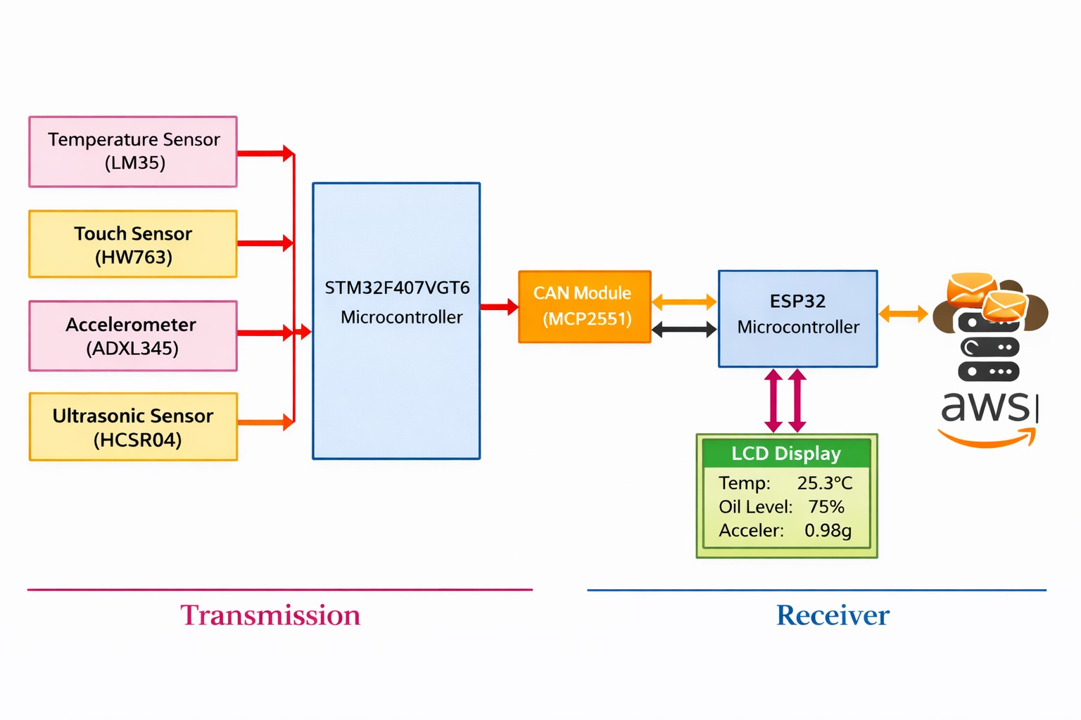

Slide 7
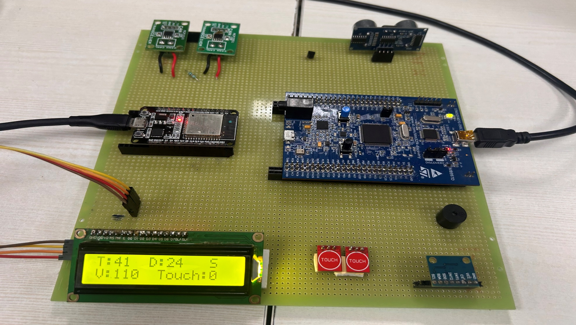

Slide 8
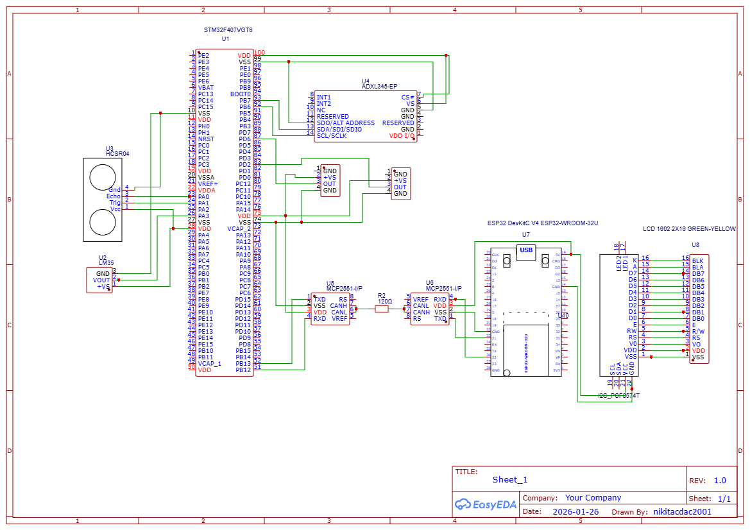
HW-763
HW-763

Slide 9
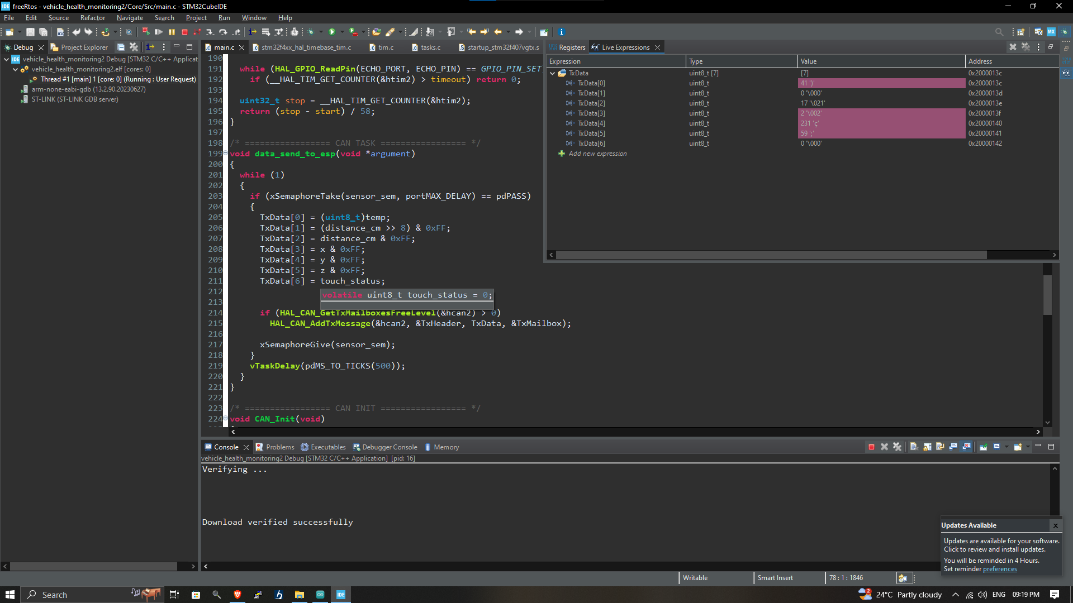

Slide 10
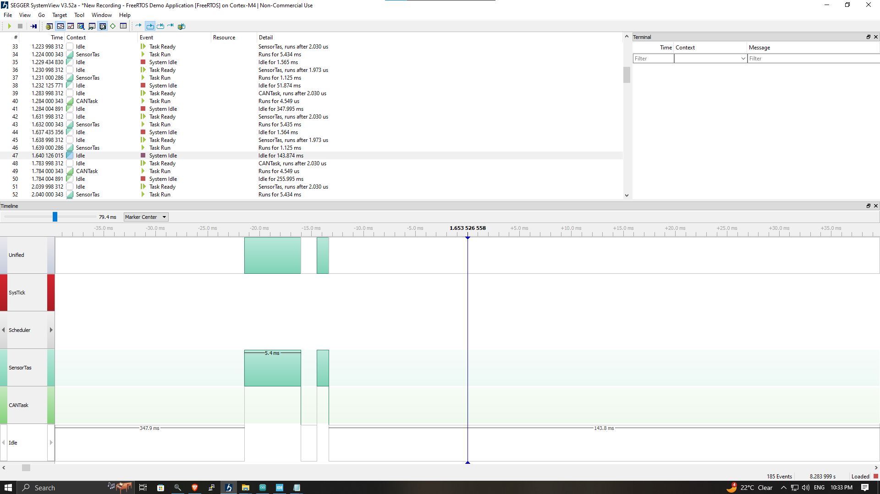

Slide 11
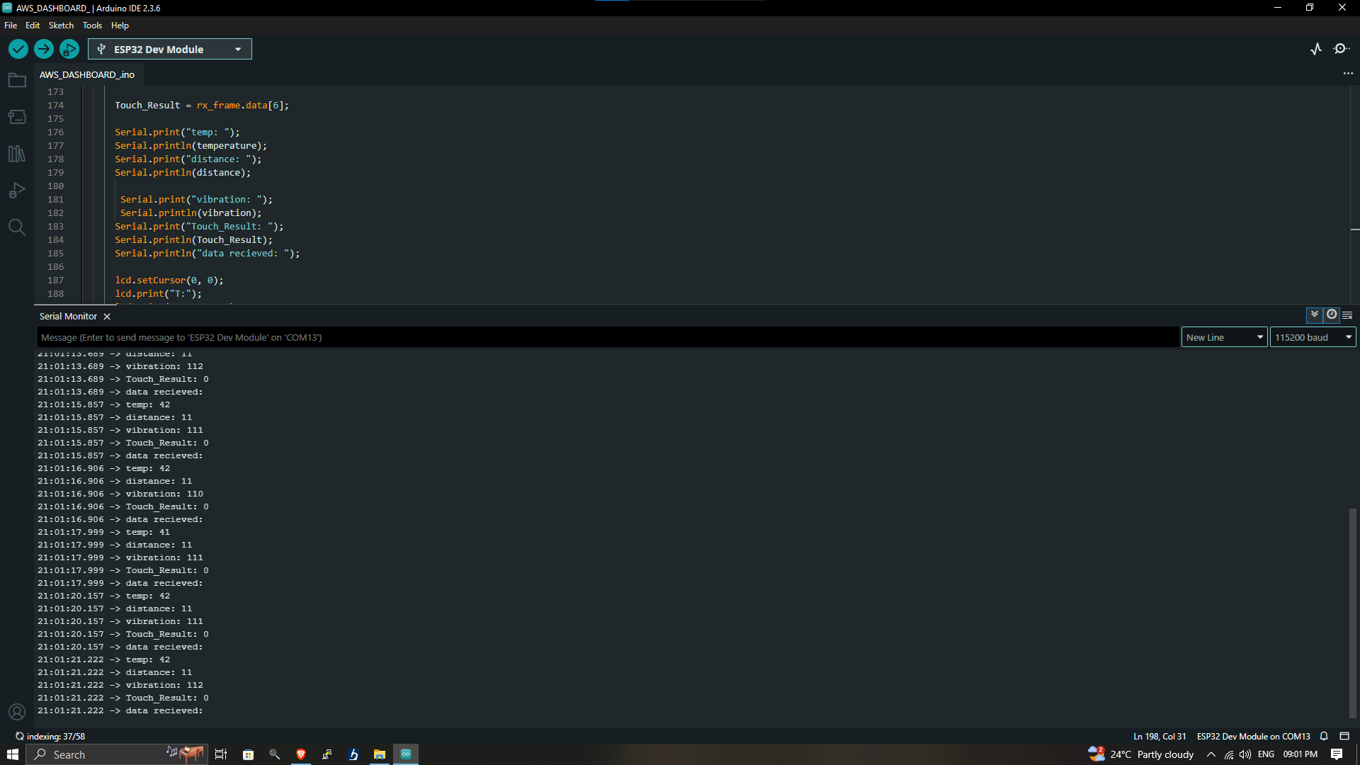

Slide 12
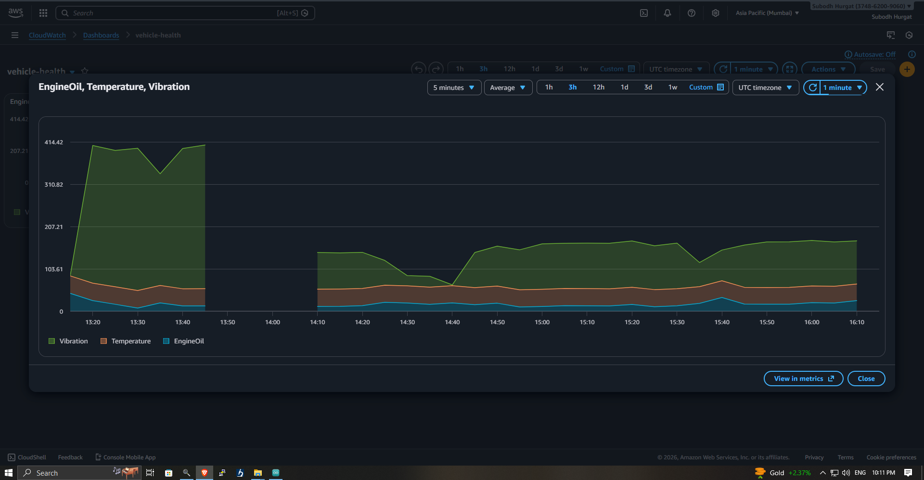

Slide 13
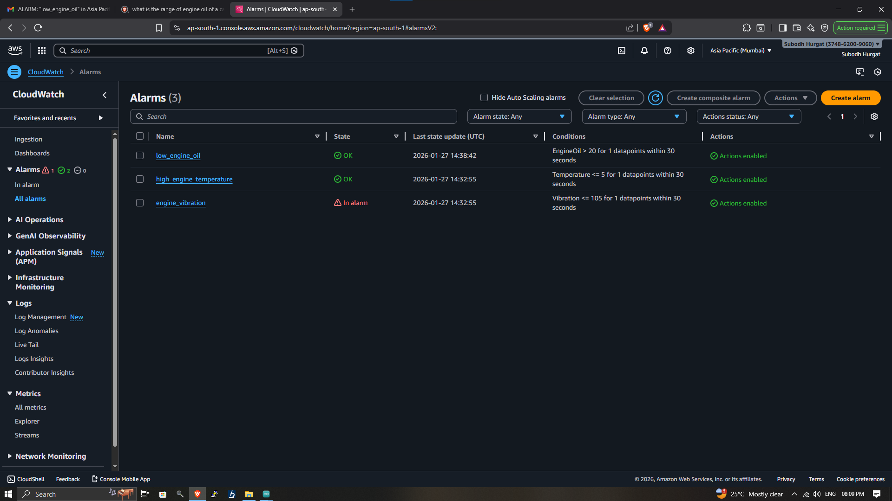
Q Thin gSp eak
Channels-
Apps-
Devices
Support
Comme rc Tal Use How to Buy PS
Oil level
Door Status

Slide 14
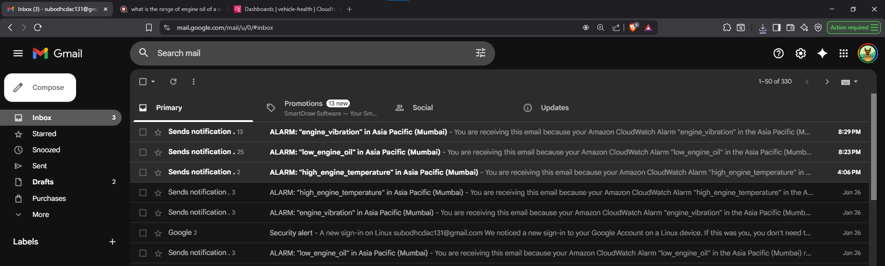

Slide 15
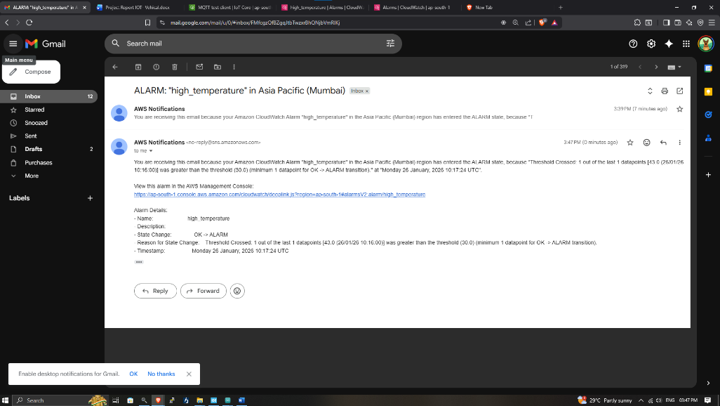

Slide 16
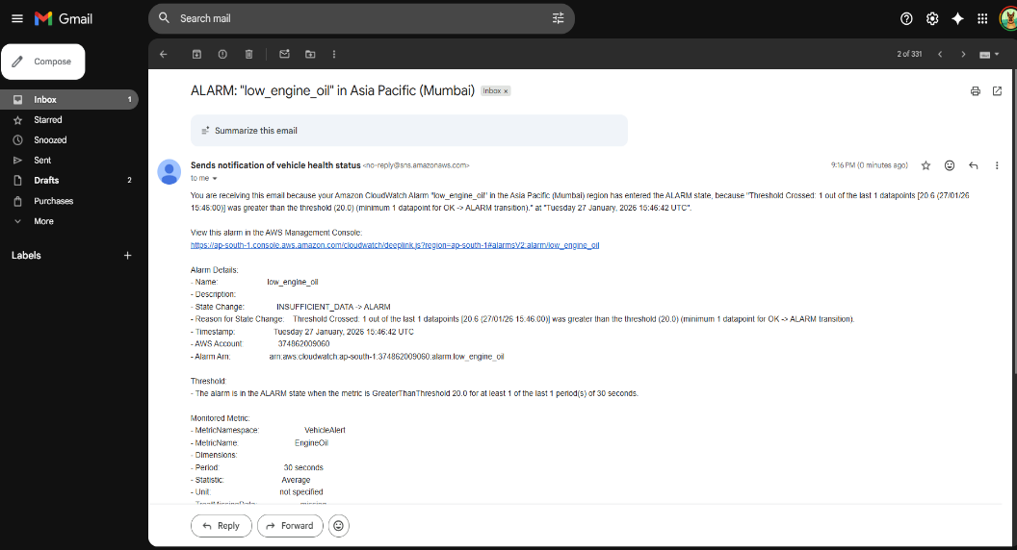

Slide 17
Conclusion
Real-time engine and driver safety monitoring implemented
Supports local and cloud monitoring
Cost-effective and scalable design for smart vehicle applications
Reliable CAN communication achieved

Slide 18
Future Scope
Add more sensors (RPM, TPMS, braking)
Use AI for predictive maintenance
Integration with vehicle ECU and mobile app
Deploy in real vehicle fleets for field use

Slide 19
THANK YOU

