Slide 1





MCA(336) MINOR PROJECT
FACE ATTENDANCE SYSTEM WITH ANTI-SPOOFING AND MULTIPLE FACE RECOGNITION
MENTOR : DR. TUMPA BANARJEE, HOD MCA
TEAM MEMBERS :
Abhijeet Karmakar , MCA 3nd sem
Biswajit Sarkar , MCA 3nd sem
Renu Gupta, MCA 3nd sem

Slide 2
Introduction
In modern times, facial recognition technology has emerged with a secure and efficient means of authentication and identification with high resolution camera. Traditional attendance systems, such as manual registers and ID card-based systems, often face issues like inefficiency, proxy attendance, and faking. Biometric is the prevalent for attendance system and security industry.
Face recognition is most accepted system for identification and anti-spoofing as it is convenient, user friendly, fast and avoid physical contact. Face recognition attendance not only emphasize recognition of face also include mechanism to differentiate between the live face or face from videos, images, and face mask. Therefor liveness detection is a major challenge for any face recognition system.
Our objective is to develop an attendance system that can be used by any institute or organization for marking attendance of the system. Liveness detection is also taken consideration to defend any type of spoofing. This system will record attendance of the candidate with in-time, out-time, and working day and working hour per day/month will be calculated automatically.

Slide 3
Why Automatic-Based Attendance Systems?
Challenges with Traditional Systems:
- Time-consuming processes.
- Vulnerable to manipulation (proxy attendance and fake attendance).
Advantages of Automatic-Based Systems:
- Seamless and contactless attendance marking.
- Includes anti-spoofing mechanisms to distinguish between real faces and images, videos, or masks.
- Automates attendance recording with timestamps, reducing human intervention and errors.

Slide 4
Tools and Technologies Used
Technologies & Libraries:
- Python (with TensorFlow, TensorFlow.Keras, OpenCV, Numpy, Pandas, Pytorch, Django for web creation, and many more).
Trained model for anti-spoofing using TensorFlow and Keras.
Face Recogniton using RESNet models also Using OpnCV for face recognition.
Django MVT-based web application for displaying and maintaining the system.
Videos and Images:
- Real and Fake videos and using those videos to create labeled and unlabelled images for model creation
Database:
- MySQL3 for secure attendance data storage and retrieval.

Slide 5
Objectives of the System
Primary Goals:
- Implement Face Liveness Detection to enhance security.
- Use CNN-based models for efficient face recognition.
- Accurately record in-time, out-time, date, and working hours.
- Automate leave calculations and hierarchical approvals for employees.

Slide 6
How the System Works
1. User Registration:
- A Web-based GUI captures picture input for face registration.
2. Attendance Marking:
Recognizes faces using OpenCV and Face Recognition models.
Checks authenticity with the anti-spoofing model and face matching using face_recognition.
Real-time video recognition and attendance will be noted in in_time and out_time.
- Records attendance details in a database with timestamps.
3. Data Management:
Attendance logs stored securely for real-time retrieval and reporting.
Supports leave management and hierarchical approvals.
Start
Capture Video Stream
Detect Faces in Frame
Extract Features for Analysis
Anti-Spoofing Verification
Real Face
Identify Individuals
Log Attendance
Store in Database
End
Fake Face
Notify Warning
Discard Frame

Slide 7
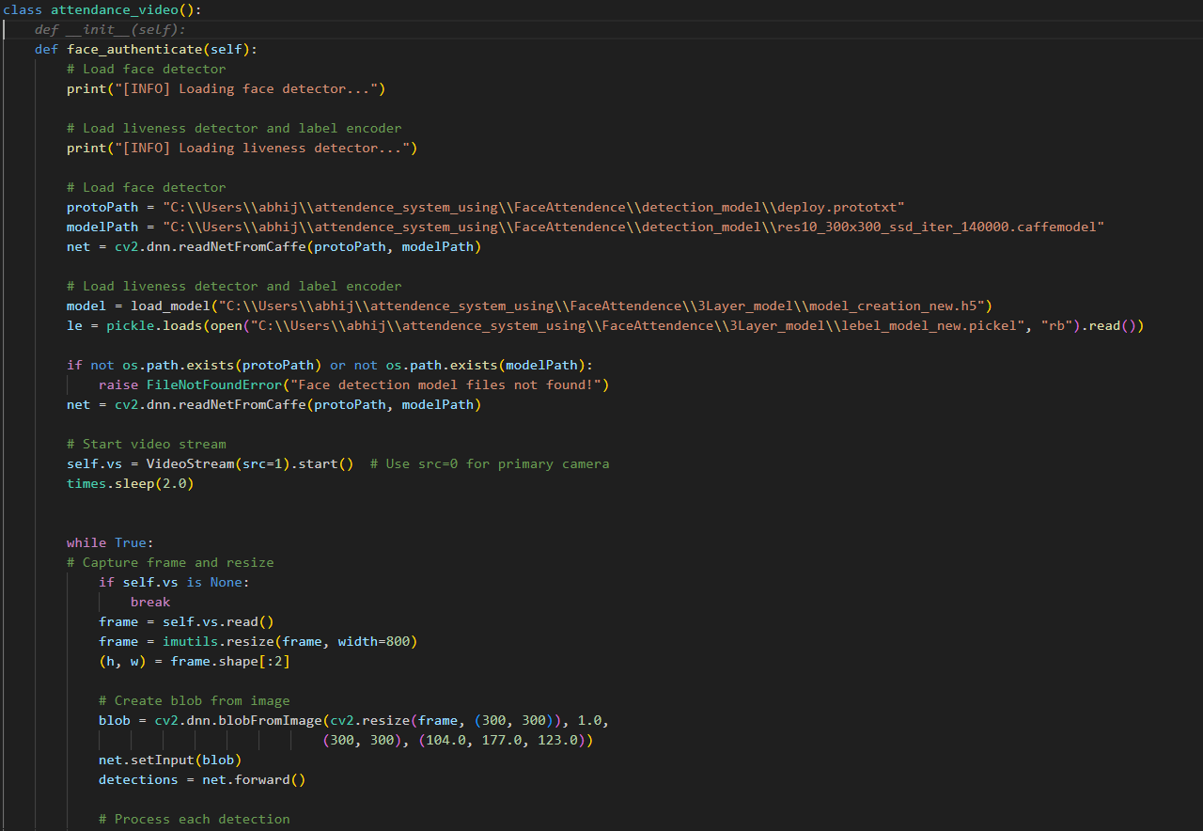
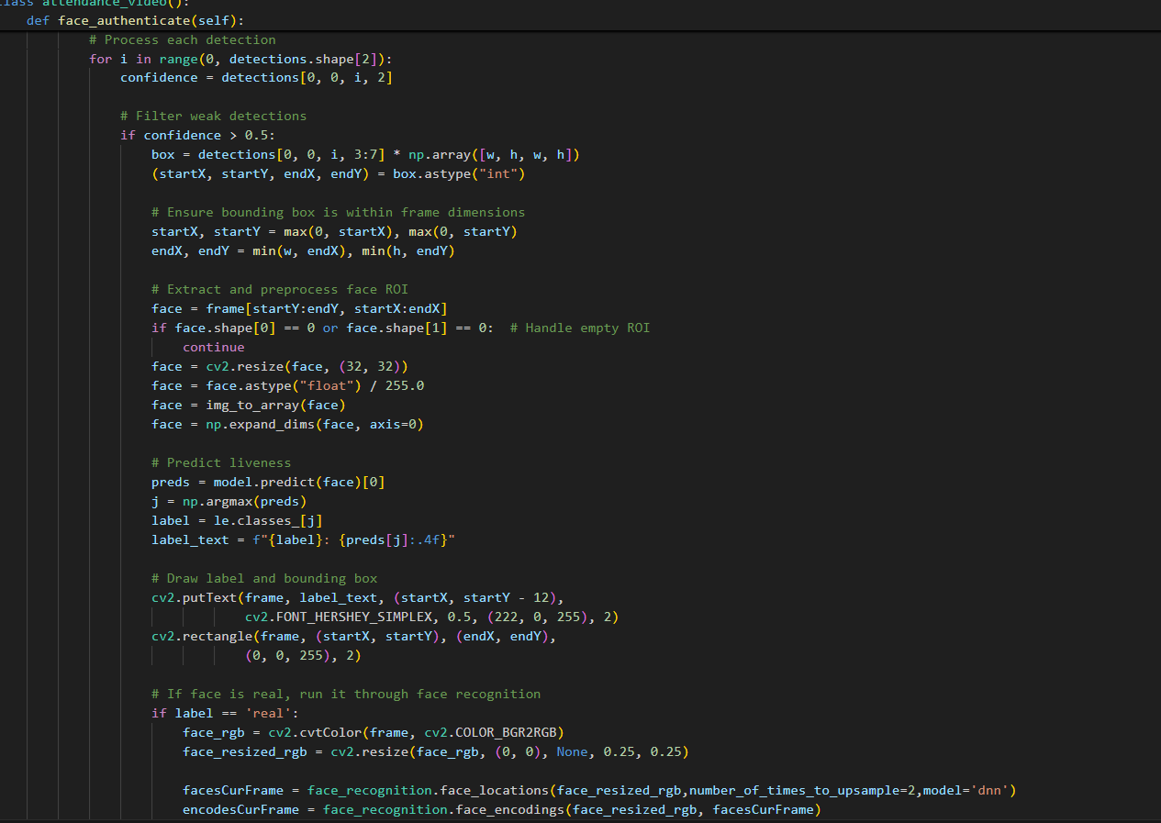
Coding Implementation

Slide 8
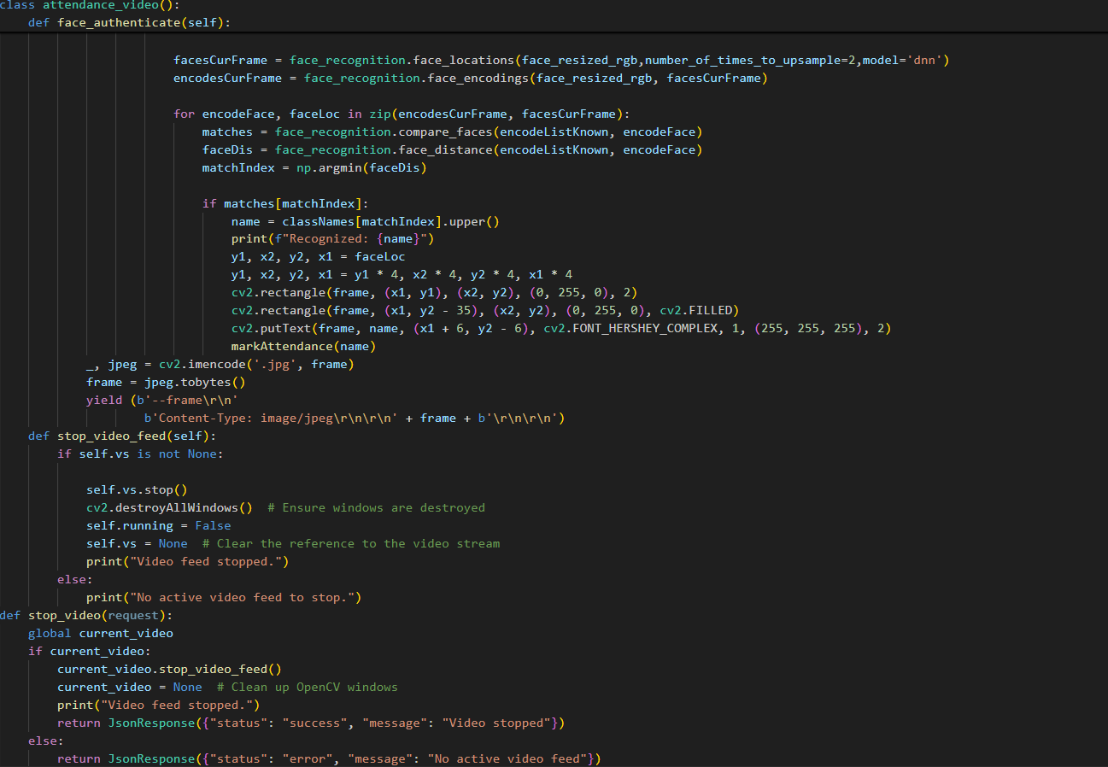
Coding Implementation

Slide 9
Current Development Status
Developed a GUI using Django for live video input and maintaining attendance and register data.
Integrated OpenCV for face registration and recognition.
Implemented a basic anti-spoofing check and recognition using the trained model.
Current features:
Attendance recording with in-time and out-time logging.
Real-time video recognition and attendance will be noted in in_time and out_time.
Attendance will be noted in database format, and attendance will be able to be seen.
- Store the face data model using pickle files.

Slide 10
Future Scopes
Training the model with deep neural networks for recognition to improve performance.
Currently working on filtering data by day and displaying it on the website.

Slide 11


