Slide 1
Building Large-Scale Visual Augmented Q&A with Vision Language Models
Abhijeet Kumar,
Director, Data Science

Slide 2
Agenda
01. Issue with Text-RAG
02. Developing Vision-RAG
Pain points. Use-cases: Visual augmented Q&A
Multi-modal LLM & Large context length problem
Vision Language Models.
Vision Embeddings LMs like ColPali, ColQwen
State-of-the-art Late Interaction
03. Challenges in Scaling
04. Building Scalable Visual Q&A
05. Benchmark Results & Takeaways
1. Storing multi-vectors ?
2. In-memory Late Interaction
3. Inflated memory
Making conventional Vector-DB work.
Late interaction Re-ranker
Pooling vectors
Benchmark results on ViDoRe
State of vector-DBs

Slide 3
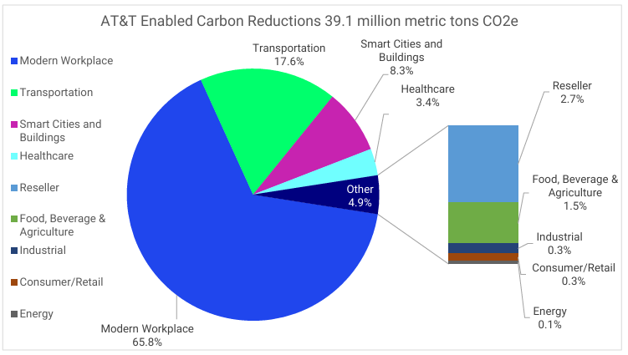

Problems with Text-RAG
AT&T sustainability document
Humans convey complex information to readers using infographics (visual elements of information) such as tables, charts, graphs, images etc.
How much carbon reduction was enabled in Transportation by AT&T in 2023 ?

Slide 4
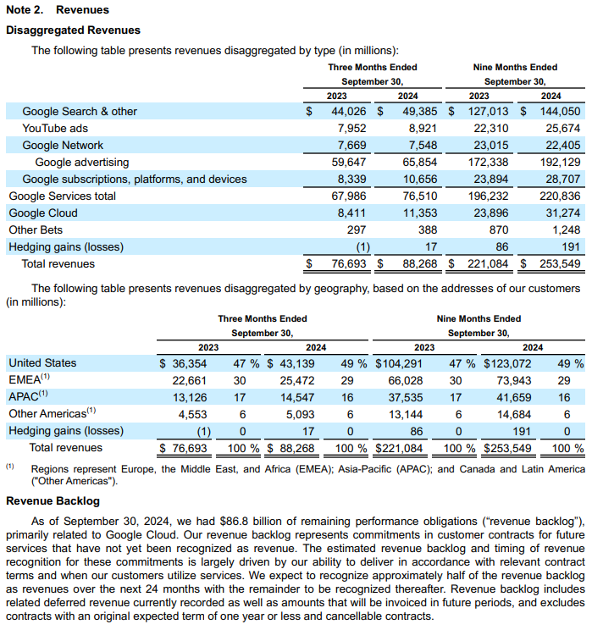
Problems with Text-RAG
Alphabet 10-Q Form (2024)
Text-RAG systems can not process beyond text.
Traditionally, large effort went into OCR, document layout detection, and table extraction etc.
What is the quarterly revenue from Google Cloud for 2023 and 2024 ?

Slide 5

Multi-modal LLMs: Understands visual elements
AT&T sustainability document
How much carbon reduction was enabled in Transportation by AT&T in 2023 ?
The pie chart shows that the transportation sector accounts for 17.6% of the total carbon reductions enabled by AT&T. To find the specific amount of carbon reduction in the transportation sector, we need to calculate 17.6% of the total 39.1 million metric tons CO2e.
Answered by Qwen 2.5VL-3B
Multi-modal LLMs
Qwen 2.5 VL
Llama 3.2 Vision
Sonnet 3.5 & more
Open AI GPT4o & more
Gemini Pro

Slide 6






Transitioning from text-RAG to Vision-RAG
All models deteriorate after a certain number of tokens. (Lost in the middle, RULER, Long context - LLM Performance)
Finding needle in the haystack problem (High search space)
Question
Text embedding models (qwen3-embedding, gemini-embedding, text-embedding-3-large, cohere & jina)
Large Language Model
(Claude, GPT4, Llama, Mixtral, DeepSeek)
Response Generation
Corpus
Vector DB
Conventional RAG system

Slide 7

Transitioning from text-RAG to Vision-RAG
All models deteriorate after a certain number of tokens. (Lost in the middle, RULER, Long context - LLM Performance)
Finding needle in the haystack problem (High search space)
Question
Text embedding models (qwen3-embedding, gemini-embedding, text-embedding-3-large, cohere & jina)
Large Language Model
(Claude, GPT4, Llama, Mixtral, DeepSeek)
Response Generation
Can we replace this with Multi-modal LLMs ?
Multi-modal LLMs
Qwen 2.5 VL
Llama 3.2 Vision
Sonnet 3.5 & more
Open AI GPT4o & more
Gemini Pro
Corpus
Vector DB
Conventional RAG system

Slide 8
Transitioning from text-RAG to Vision-RAG
All models deteriorate after a certain number of tokens. (Lost in the middle, RULER, Long context - LLM Performance)
Finding needle in the haystack problem (High search space)
Question
Text embedding models (qwen3-embedding, gemini-embedding, text-embedding-3-large, cohere & jina)
Multi-modal LLMs
(Sonnet 3.5, Qwen-2.5 VL, Llama 3.2 Vision, GPT4o, Gemini Pro)
Response Generation
Are there Embedding Models which can encode Visual Information along with text ?
Vision Language models encodes visual elements along with textual information which can be used for complex documents retrieval.
ColPali, ColQwen
Jina CLIP-V1, Nomic-AI
Azure AI: multimodal embeddings
Corpus
Vector DB
Conventional RAG system

Slide 9
Developing Vision-RAG based Q&A System
RETRIEVER
RERANKER
Question
Vision embedding models (ColPali, ColQwen, Jina Clip-V1, Nomic-AI, Azure-AI multimodal embeddings text)
Multi-modal LLMs
(Sonnet 3.5, Qwen-2.5 VL, Llama 3.2 Vision, GPT4o, Gemini Pro)
Response Generation
Corpus
Vector DB
Vision based RAG system

Slide 10

Vision Language Models

Slide 11
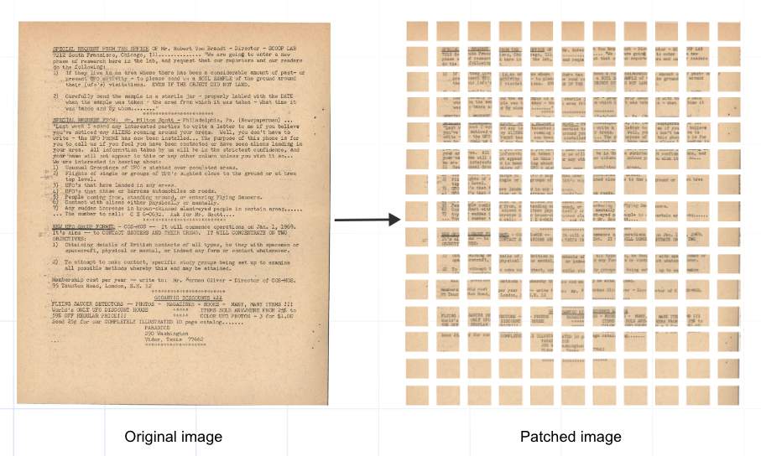

ColPali: How does VLM works ?
Converts a page in fixed sized 32X32 patches.
Each patch is encoded by ColPali model into 128 dim embeddings.
Each page (chunk) is a multi-vector representation i.e 1024X128
Text embeddings and image embeddings are jointly encoded during training.
Late Interaction Mechanism
Colpali uses late-interaction mechanism to compute retrieval score using multi-vector representation of both text query & document patches.
Text query is represented by tokens X 128
Late Interaction is an in-memory operation i.e. all page patches and text vectors are required for similarity computation.
Employs a “MaxSim” operation for similarity score
Source: Qdrant blog

Slide 12

Challenges with Scaling
There are majorly two problems with scaling Visual Language Models
How do we store multi-vector embeddings ?
Earlier a text chunk is stored as single dim vector.
Easy cosine scoring, Matching meant relevant text chunk found.
What does a patch match mean here?
Can we aggregate matched patches to page ?
Needs huge in-memory computation.
State-of-the-art Late interaction mechanism needs all vectors in memory (check Math)
How do we leverage scalable ANN indexing methods like HSNW ?
Inflated Index memory ?
In text-RAG, 1 page is ~ 2 KB
In vision-RAG, 1 page is 256 KB
Can we reduce vector DB storage ?
Let’s do a quick math....
1 parameter = 2 bytes (16-bit float)
For each page,
1024 X 128 parameters = 2 x 128KB = 256KB
Corpus of 1000 pages,
1000 X 256 KB per page = 256MB
How about a million pages ?

Slide 13




Scaling Visual Q&A: Using Vector DB
Document Indexing Process
patch embedding.
patch num.
page num.
document name
2D Patch Embeddings
1D patches with patch id, page id
PDF Reports
ColPali VLM
Open Search
Hybrid search
similar pages
Top pages
Question
Query Embeddings
ColPali
Re-ranker
Multi-Modal LLM
Response (source)
GPT4o, Claude Sonnet 3.5

Slide 14
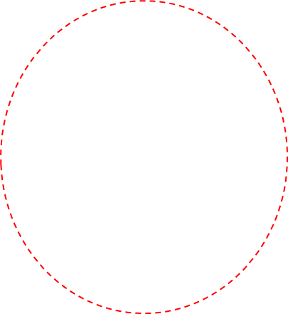
Scaling Visual Q&A: Using Vector DB
Document Indexing Process
patch embedding.
patch num.
page num.
document name
2D Patch Embeddings
1D patches with patch id, page id
PDF Reports
ColPali VLM
Let’s uncover the workaround
Open Search
Hybrid search
similar pages
Top pages
Question
Query Embeddings
ColPali
Re-ranker
Multi-Modal LLM
Response (source)
GPT4o, Claude Sonnet 3.5

Slide 15
Uncovering the workaround
patch embedding.
patch num.
page num.
document name
Issue of Inflated memory of Index remains !!
flattened patch embedding & metadata with patch id, page id
Top scoring patches (>0.90)
Match query
(Hybrid search)
Open Search
Yes
Fetch Page ID of matching patches
&
Add page ID to list
Filter Query
(Page IDs)
For each token embedding in query
iteration end
end of token
Top pages
ColPali Late Interaction Re-ranker
stop

Slide 16
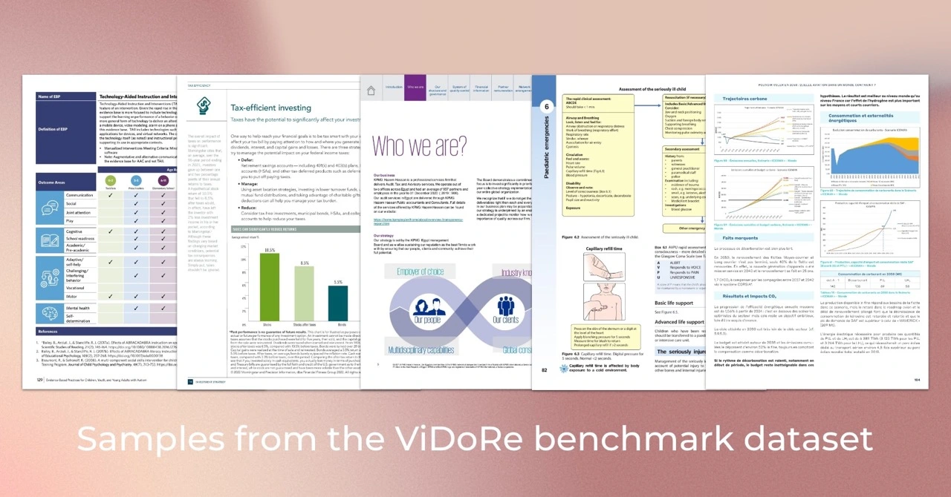
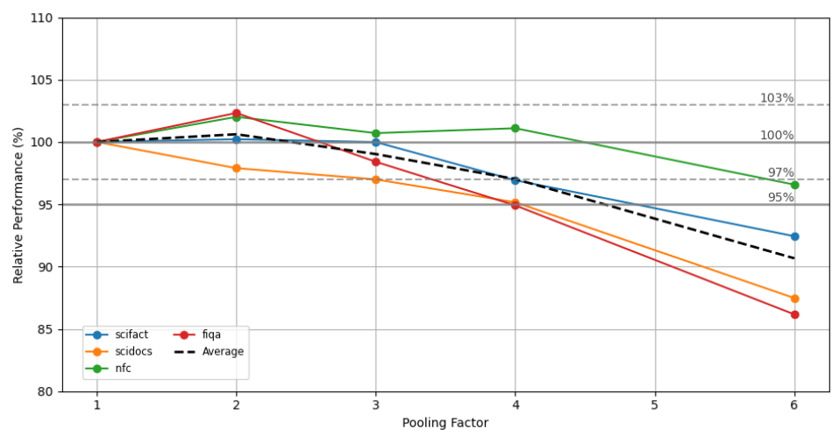
ViDoRe Benchmark
ViDoRe, composed of various page-level retrieval tasks spanning multiple domains, languages, and practical settings.
We did following experiments:
ColPali as retriever (in-memory)
Open-search as retriever (1st pass), ColPali as in-memory re-ranker (2nd pass)
Open-search (retriever) - Colpali (re-ranker) with Pool Factor 2
Token Pooling: Reducing Memory Footprint
Research showed a pooling factor of 3 achieves an average performance degradation of less than 1%, despite reducing storage requirements by over 66%.
We observe a starker degradation from pooling factors of 4 onwards.

Slide 17
Benchmark Results: ViDoRe
With open-search as 1st pass retriever & 2nd pass in-memory re-ranker, there is negligible performance degradation.
A pooling factor of 2 achieves an average performance degradation of ~2%, despite reducing storage requirements by over 50%.
 | ArxivQ | DocQ | InfoQ | TabF | TATQ | Shift | AI | Energy | Gov | Health | Avg Score
Colpali 1.2 (in-memory) | 69.2 | 42.4 | 73.2 | 83.57 | 52.61 | 60.6 | 96 | 92 | 84 | 92 | 74.5
Colpali 1.2 - OpenSearch | 68.4 | 42.4 | 73.2 | 83.57 | 52.07 | 62 | 96 | 92 | 84 | 92 | 74.5
ColPali 1.3 (in-memory) | 77.6 | 49.4 | 79.8 | 81.4 | 57.1 | 63 | 97 | 94 | 91 | 93 | 78.33
ColPali 1.3 (in-memory) - pool factor 2 | 77.8 | 44.6 | 75.4 | 76.4 | 55.8 | 61 | 97 | 98 | 87 | 94 | 76.7
Colpali 1.3 - opensearch - pool factor 2 | 77.8 | 44.6 | 75.4 | 76.4 | 55.3 | 61 | 96 | 93 | 87 | 94 | 76.05

Slide 18
Current State of Vector DBs
Qdrant vector DB has an offering with ColPali, ColQwen integration (Jan, 2025)
Weaviate DB started offering multi-vector embedding support from v1.29 (Feb, 2025)
Elasticsearch has rolled out ColPali implementation in March, 2025
Milvus vector DB completed integration with ColPali (multi-vector) by May, 2025.

Slide 19
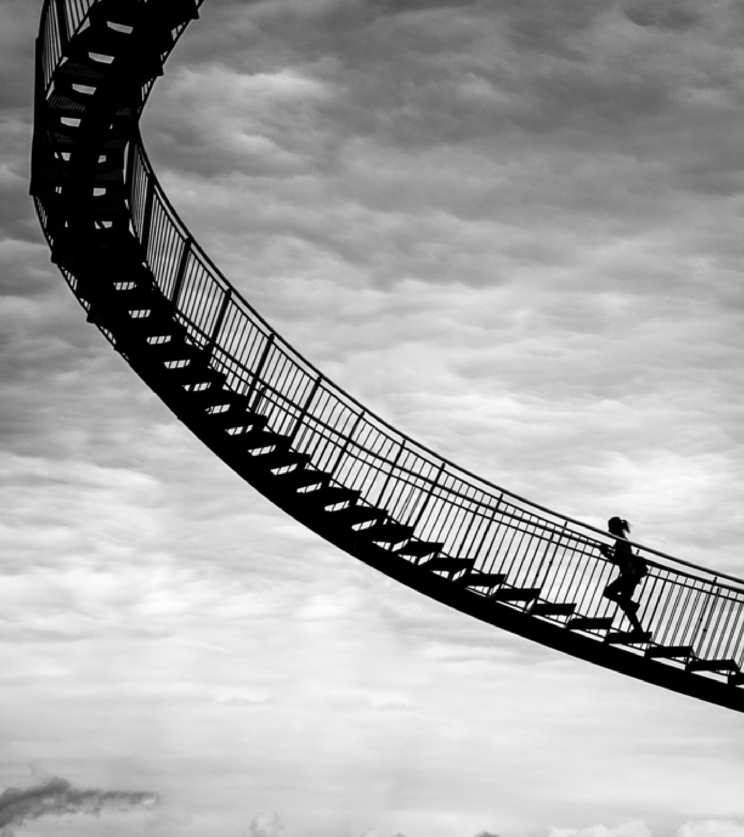
Thank you

