Slide 1
Bash Scripting or Shell Programming
LogicOps lab by ravish rawat

Slide 2
Roadmap
Need of Shell scripting
What is Shell / What is Bash?
Use of Variables and Comments
Read User Input
Pass Arguments to Bash script
If Statement(If then, if then else, if elif else)
File test operators
How to append output to the end of file
Logical “AND” “OR” operator

Slide 3
Roadmap (Contd)
Arithmetic operations
The Case statement
While loop
UNTIL loop
For loop
Select loop
Break and Continue
Functions
Interview questions & programs hands-on

Slide 4
Pre-requisites
Oracle Virtual Box
CentOS vdi (Virtual Desktop Infrastructure)
Internet
How to install and configure the mentioned softwares

Slide 5
Guest Additions
Guest Additions
- The VirtualBox Guest Additions consist of device drivers and system applications that optimize the operating system for better performance and usability. One of the usability features required in this guide is automated logons, which is why you need to install the Guest Additions in the virtual machine.
How to add Guest Additions? (Installations and Commands)

Slide 6
Initial Setup
Initial setup to make the environment ready
Writing and Running our first Bash Script
Various ways of executing a shell file in a Linux environment
How to get icons visible in CentOS on Desktop? GNome Tweaks.
How to install git in Linux and How to clone a repository in Linux?
How to install Visual Studio Code in Linux? How to run a script using Visual Studio Code

Slide 7
Introduction
What are Scripts?
Components of a script.
Variable usage in the scripts.
How to accept input from a user?
How to make decisions?
Performing tests and a lot more.

Slide 8
Scripts
Series of commands to achieve something
These commands are executed by an interpreter (Here shell acts as an interpreter)
Any command in a format can be written into a script
Why do we need it? – To automate mundane tasks and save some time.
Example
#!/bin/bash
echo “Hello, World”
(Need of #! Before the script, the script runs using your shell. It might or might not run, as different shells have a bit of varying syntaxes)

Slide 9
Variables
Storage location having a name or a Name-Value pair
Case sensitive
No spaces before or after the = sign
Uppercase
Syntax:
VAR_NAME=“Any Value”
Eg –
#!/bin/bash
SHELL_NAME=“bash”
echo “I am $SHELL_NAME” -> I am bash
Or echo “I am ${SHELL_NAME}ing -> I am bashing
(If you don’t give a curly brace, the shell will treat it as an additional text)

Slide 10
Variables (Contd)
Things to remember while declaring a Variable:
Not Valid
1One=“Ravish”
one@two=“LogicOpsLab”
ONE-TWO=“Rawat”
Valid
ONETWO=“RAVISH”
ONE_TWO=“LogicOpsLab”
oneTwo=“Rawat”

Slide 11
Operators
We have 5 types of operators
Arithmetic Operators
Relational Operators
Boolean/Logical Operators
Bitwise Operators
File Test Operators

Slide 12
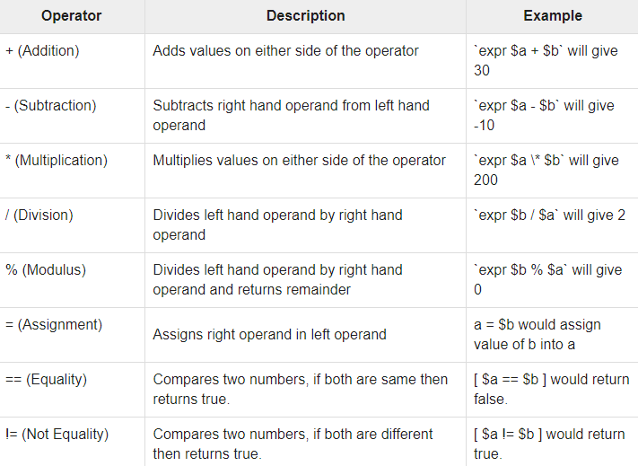
Arithmetic Operators

Slide 13
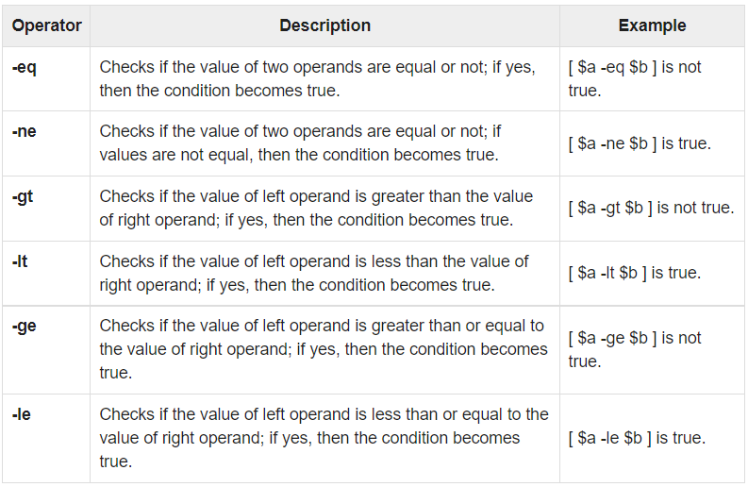
Relational Operators

Slide 14
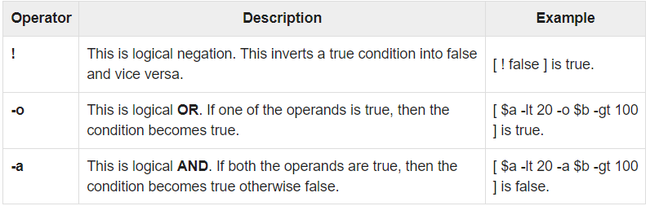

Boolean/Logical Operators

Slide 15
BITWISE Operators
Bitwise And (&): Bitwise & operator performs binary AND operation bit by bit on the operands.
Bitwise OR (|): Bitwise | operator performs binary OR operation bit by bit on the operands.
Bitwise XOR (^): Bitwise ^ operator performs binary XOR operation bit by bit on the operands.
Bitwise complement (~): Bitwise ~ operator performs binary NOT operation bit by bit on the operand.
Left Shift (<<): This operator shifts the bits of the left operand to left by number of times specified by right operand.
Right Shift (>>): This operator shifts the bits of the left operand to right by number of times specified by right operand.

Slide 16
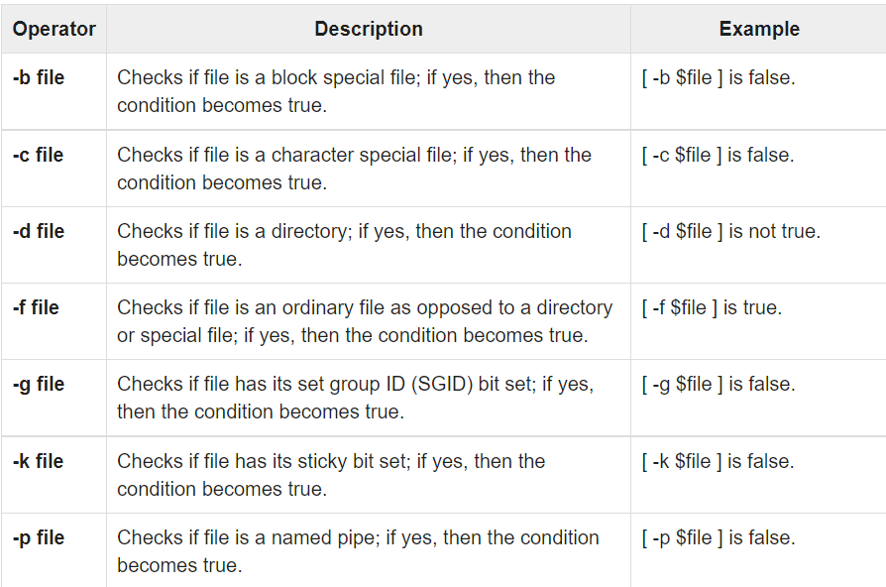
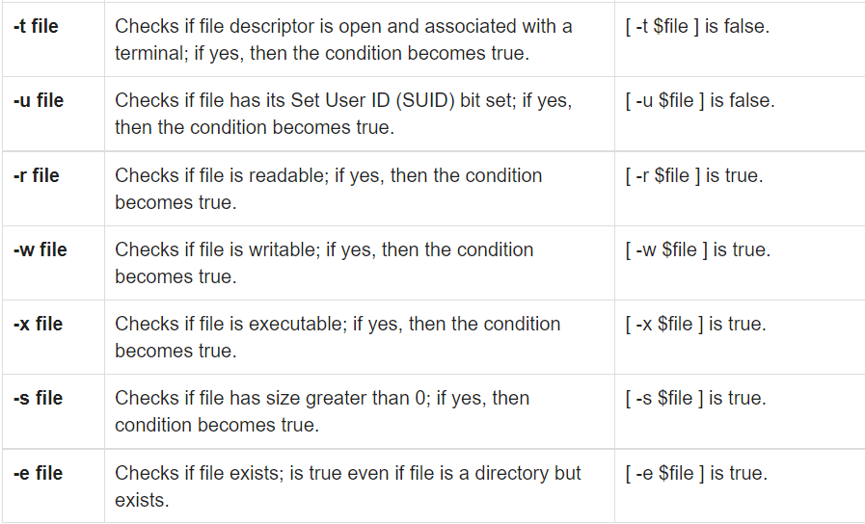
File test Operators

Slide 17
Making Decisions / CondItional Statements
There are total of 5 Conditional Statements in Bash Scripting/Programming
if statement
if-else statement
if..elif..else..fi statement (Else If ladder)
if..then..else..if..then..fi..fi..(Nested if)
switch statement

Slide 18
Tests
Test is used by virtually every shell script written. It may not seem that way, because test is not often called directly.
Syntax:
[ test-condition ]
Test condition can be anything; a number comparison, a file exists or not, etc
Example
[ -e /etc/passwd ]
This will check if the /etc/passwd exists or not. Returns TRUE if it does, FALSE if there is no file.
Test is most often invoked via the if-else and the while loops-statements

Slide 19
Making Decisions
If Statement
Syntax
if [ true-condition ]
then
do this
do that
fi
Here, fi is just if spelled backwards

Slide 20
Making Decisions (Contd)
If-else Statement
Syntax
if [ true-condition ]
then
do this
else
do that
fi

Slide 21
Making Decisions (Contd)
Else if ladder
Syntax
if [ expression1 ]
then
statement1
statement2
.
elif [ expression2 ]
then
statement3
statement4
.
else
statement5
fi

Slide 22
Making Decisions (Contd)
Nested if
if [ expression1 ]
then
statement1
statement2
.
else
if [ expression2 ]
then
statement3
.
fi
fi

Slide 23
Making Decisions (Contd)
switch case
Syntax
case in
Pattern 1) Statement 1;;
Pattern n) Statement n;;
esac

Slide 24
Return code & exit status
What is exit status or a return code?
Checking exit status
What to do on the basis of the status?
Can we use exit status in scripts?
Demo

Slide 25
Return code & exit status
Every command returns an exit status
It ranges from 0 (which is success) to 255
Anything apart from 0 is an error condition
We can use commands like info and man to understand the meaning of an exit status
Explicitly define Return Codes – exit 0 to exit 255
You can use exit anywhere in the shell script.

Slide 26
functions
What are Functions?
Why Functions?
How to declare and use them?
What is a variable scope?
How to call a Function?
Parameters in a Function
Exit status and Return codes
Demo

Slide 27
functions
A function is a block of code that is reusable, performs certain operations, and gives you a result.
Functions are popular because:
DRY – Don’t Repeat Yourself.
Help to reuse a piece of code, thus reduce script length
Improves the readability
Modular approach
Easy maintenance as we have single place to edit and troubleshoot
Whenever you are repeating a code, write a function
Functions can call other functions.

Slide 28
functions
Creation / Declaration
Function function-name( )
{
# Your code here
}
Or
Function-name( )
{
# Your code here
}
Calling a Function
Function-name
( That is all, no brackets/paranthesis like other languages)

Slide 29
Wildcards
What are Wildcards?
Where they can be used?
How can we use them?
Types of Wildcards
Ranges in Wildcards
Demo

Slide 30
Wildcards
Wildcards (also referred to as meta characters, glob characters) are symbols or special characters that represent other characters
You can club it with some command for usage, like ls, rm, cp
Types :
Asterisk (*) – matches one or more occurrences of any character, including no character.
Question mark (?) – represents or matches exactly one character.
Bracketed characters / Character class ([ ]) – matches any occurrence of character enclosed in the square brackets. You can use different types of characters. Like, numbers, letters, other special characters, etc.
[!] – Matches any of the characters NOT included between the brackets

Slide 31
Wildcards
Ranges – You can use 2 characters separated by a hyphen to create a range
[a-d]* - Will match all the files that starts with a, b, c, or d
Named character classes – They are predefined
[[:upper:]] - matches any uppercase letters
[[:lower:]] – matches any lowercase letters
[[:digit:]] - matches numbers from 0-9
[[:space:]] - matches whitespace like spaces and tabs
[[:alpha:]] - matches alphabetical letters, both upper and lower case
[[:alnum:]] - matches alphanumeric characters, both upper and lower case, decimal also

Slide 32
Loops
What is a Loop?
Types of Looping statement or Loops
Statements – break and continue
Usage of loops with break and continue
Demo with examples

Slide 33
Loops
Loop –
A loop is a sequence of instructions that is repeated continuously until a certain condition is matched or reached.
If the condition has not matched, the next instruction in the sequence is an instruction to return to the first instruction in the sequence and repeat the sequence.
If the condition has been met, the next instruction will fall through to the next sequential instruction or it will branch outside the loop.
Infinite loop – A loop that does not have an exit condition, which is why it keep on repeating itself.
Types –
While loop
For loop
Until statement

Slide 34
SYntax
While –
while
do
Your code here
done
For –
for var in word1 word2 till wordn
do
Your code here
done
Until –
until
do
Your code that needs to be executed until command is true
done

Slide 35
logging
What is Logging?
Why do we need logging?
How to generate logs?
syslog
Demo

Slide 36
logging
Helpful when there are no debugging tools
Logs help localize a problem and narrow it down
Logs help to check if everything is working as expected
Helps figure out if there is a security concern like malware, virus, trojan, unexpected intrusion, etc.
If you run your scripts unattended; Logging plays an important role
Syslog-ng is a very famous tool that helps security experts, system admins, and DevOps managers in centralizing all of the log messages coming from servers, network devices, applications, printers, etc
Reduces downtime

Slide 37
Logging (SysLOG)
Syslog is a protocol for logging and tracking system messages in linux
Application use syslog to export all their error, status messages, to the file in the /var/log directory (which is configurable)
Components
Listener - Gathers and processes syslog data
Database – To store the data
Management and filtering software

Slide 38
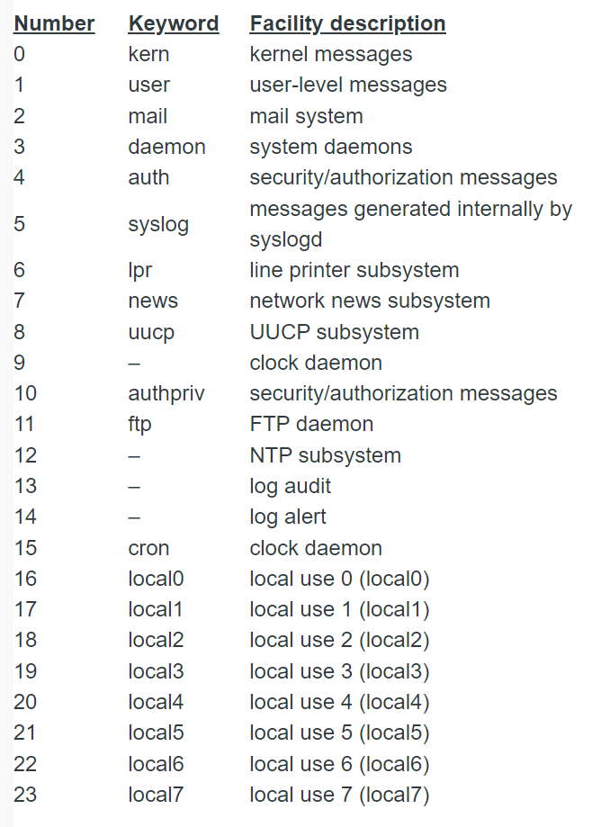
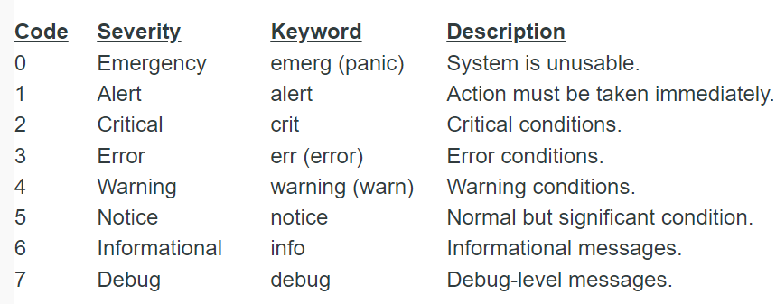
Logging (SysLOG)
Logsys uses Facilities and Severities to categorize messages
Note that, when you specify a priority, you are actually specifying everything at that priority or higher. For example, mail.info would mean all messages coming from the mail facility with the info, notice, warning, err, crit, alert or emerg priority.

Slide 39
Case Statements
One way to work on a multiway branch is that you can use multiple if...elif statements. But, sometime, it is not the best solution, especially when all of the branches depend on the value of a single variable.
For that we have case...esac statement. This handles exactly this type of situation. While comparing, case…esac does so more efficiently than repeated if...elif statements.
Syntax :
case word in
pattern1)
Statement(s) to be executed if pattern1 matches
;;
pattern2)
Statement(s) to be executed if pattern2 matches
;;
*)
Default condition to be executed
;;
esac

Slide 40
Case Statements
Each case statement starts with the case keyword, followed by the case expression and the in keyword. The statement ends with the esac keyword
You can use multiple patterns separated by the | operator, Using ) operator we terminate a pattern list
A pattern can have special characters
A pattern and its associated commands are known as a clause which must be terminated with ;;
The code block of first pattern that matches the expression will be executed
Wildcard asterisk symbol (*) should be the final pattern to define the default case. This pattern will always match

Slide 41
Debugging
What is Debugging?
How to Debug?
Editing in Terminal
Debugging options
DEBUG method

Slide 42
Debugging
Debugging - In computer programming and software development, debugging is the process of finding and resolving bugs (defects or problems that prevent correct operation) within computer programs, software, or systems.
Editing in Terminal – VI editor
Debugging options
#! /bin/bash –x OR #! /bin/bash –v OR #! /bin/bash –xv
Separately
-x ( xtrace or execution trace)
-v (verbose)
-u (unset)
-n (noexec)
DEBUG function : _DEBUG=“on”

Slide 43
SED – Stream Editor
What is SED?
Usage of SED
Syntax
Workflow
Standard Options
Demo

Slide 44
SED – Stream Editor - Introduction
It performs editing operations on text coming from a file or standard input.
sed edits line-by-line and in a non-interactive way.
This means that you make all of the editing decisions as you are calling the command, and sed executes the directions automatically.
This tutorial will cover some basic operations and introduce you to the syntax required to operate this editor.

Slide 45
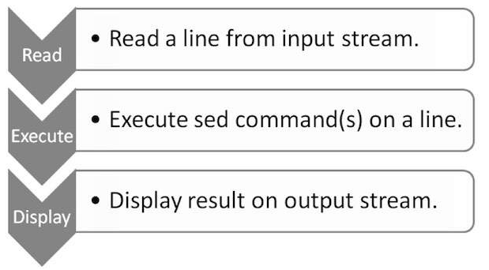
SED – Stream Editor - Usage
SED performs text transformations on streams
Substituting text for some other text
Line removal
Appending text before and after the given lines
Non-interactive editing of text files
Syntax
‘s / Search Pattern / Replacement /’ filename
‘s / Search Pattern / Replacement /i’ filename – I or i is ignore case
‘s / Search Pattern / Replacement /g’ filename – g is global, more than one occurrences

