Slide 1

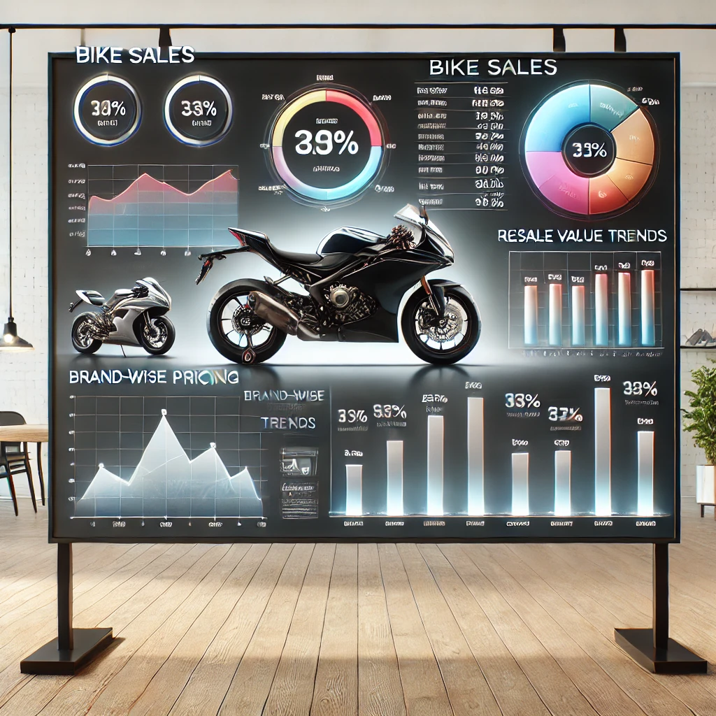
Unveiling Data-Driven Insights: Advanced SQL Analysis on Bike Sales

Slide 2
Unveiling Data-Driven Insights: Advanced SQL Analysis on Bike Sales
The goal of this analysis is to evaluate bike sales trends, understand brand-wise pricing, and analyze resale value insights to help businesses and consumers make informed decisions.
Objectives & Business Impact
Analyze bike sales trends to identify market patterns.
Evaluate brand-wise pricing to determine the most expensive and affordable models.
Assess resale value insights to understand depreciation rates.
Identify factors influencing bike prices and their impact on sales.
Provide data-driven recommendations for buyers and businesses.
SQL Techniques Used
Window Functions (rank, row_number, dense_rank)
Common Table Expressions (CTEs) for structured analysis
Subqueries for filtering and trend detection
Aggregations & Grouping for business-level insights

Slide 3
Table Description
brand (text) – Represents the motorcycle brand (e.g., Yamaha, Honda, Bajaj, etc.).
avg_original_price (numeric) – The average original purchase price of the bike before resale.
avg_resale_price (numeric) – The average resale price of the bike in the second-hand market.
resale_value_percentage (numeric) – The percentage of the original price retained during resale.
mileage_category (text) – Categorizes bikes based on mileage (Low, Medium, High).
fuel_type (text) – Indicates the fuel type of the bike (Petrol, Hybrid, Electric).
total_sales (bigint) – The total number of units sold for a given category.
insurance_status (text) – The insurance status of the bike (Active, Expired, Not Available).
owner_type (text) – Specifies whether the bike is First, Second, or Third-hand.
year_of_manufacture (integer) – The year in which the bike was manufactured.

Slide 4
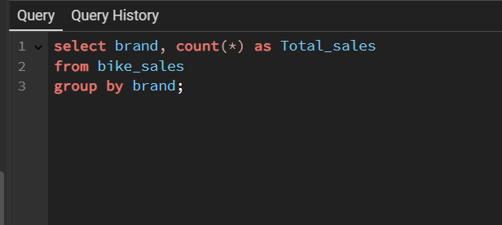
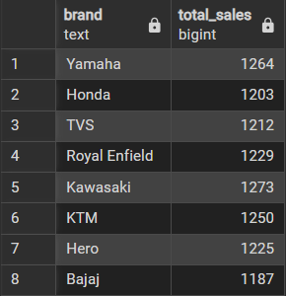
Total Sales By Brand

Slide 5
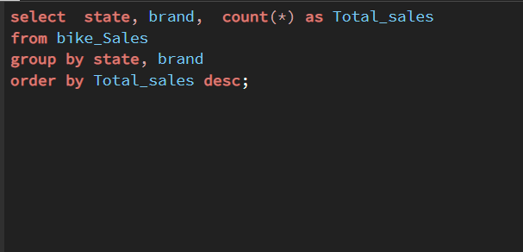
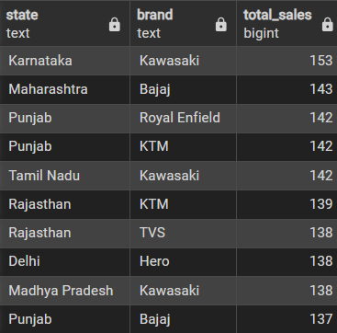
Total sales of brand in States

Slide 6
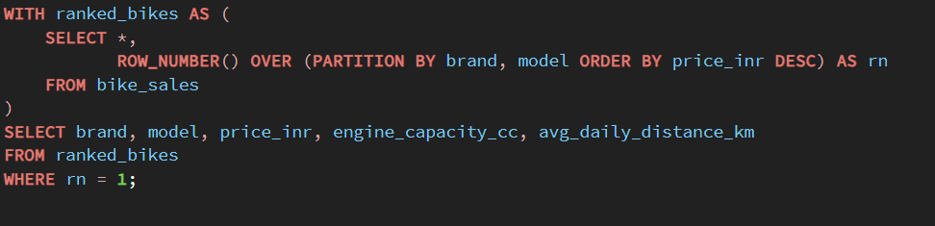
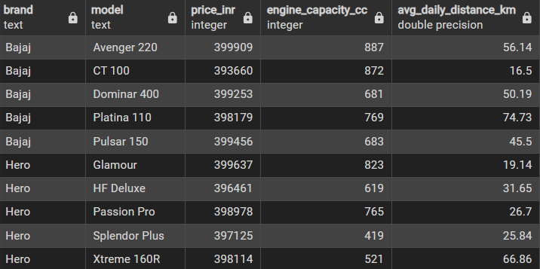
Analyzing Relationship between Engine capacity and average distance travel
There is no direct relationship between these two columns.

Slide 7
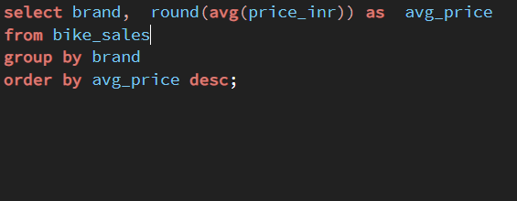
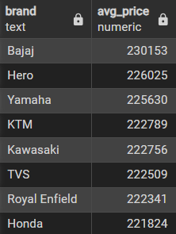
Average Price of each brand

Slide 8
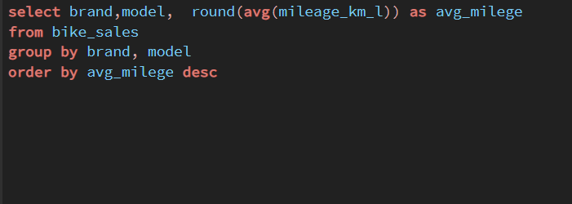
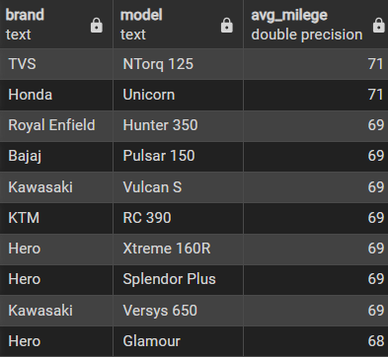
Average mileage of each brand and model

Slide 9
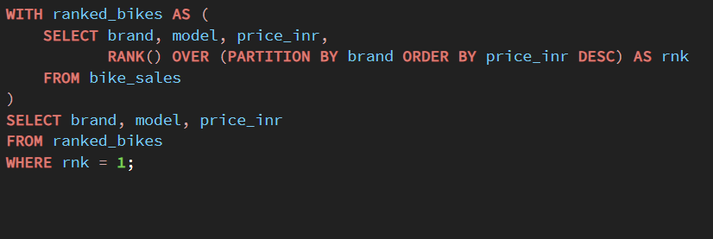
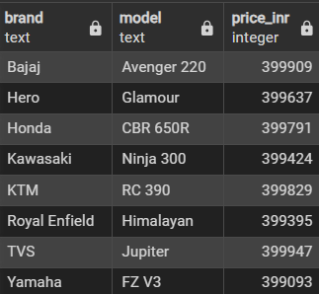
Maximum price of the model by each brand

Slide 10
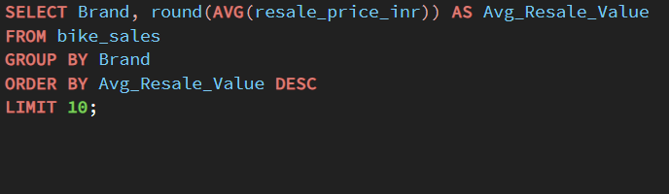
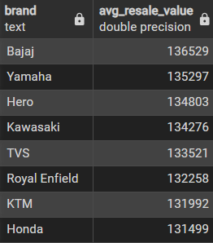
Average resale price of each brand

Slide 11
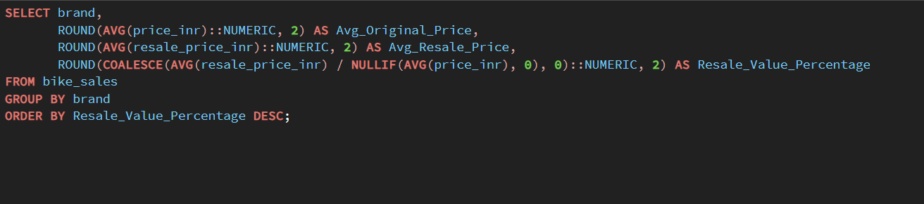
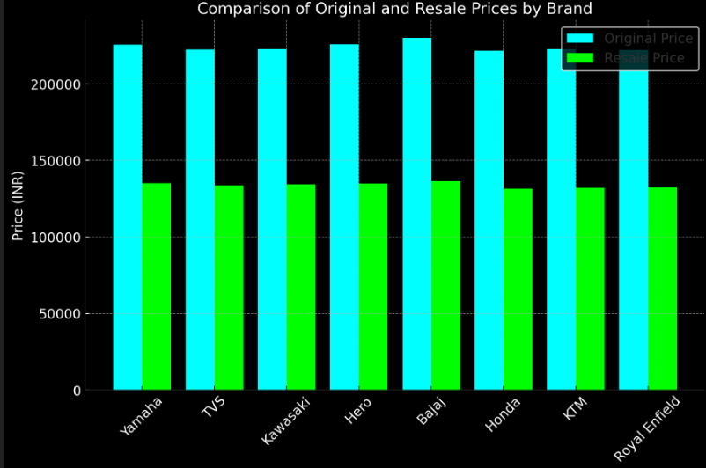
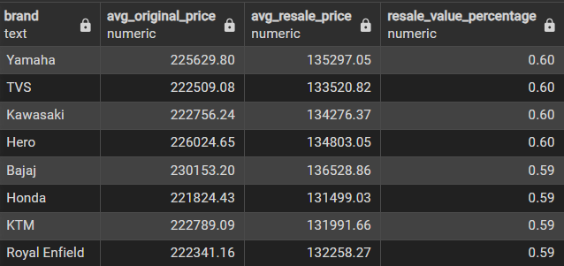
Comparison of Original Price, Resale Price, and Resale Value Percentage Across Bike Brands

Slide 12
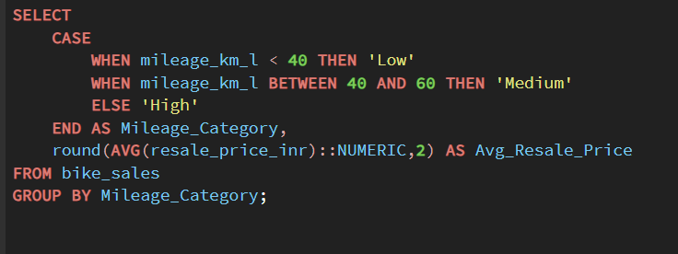
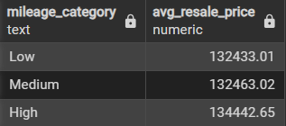
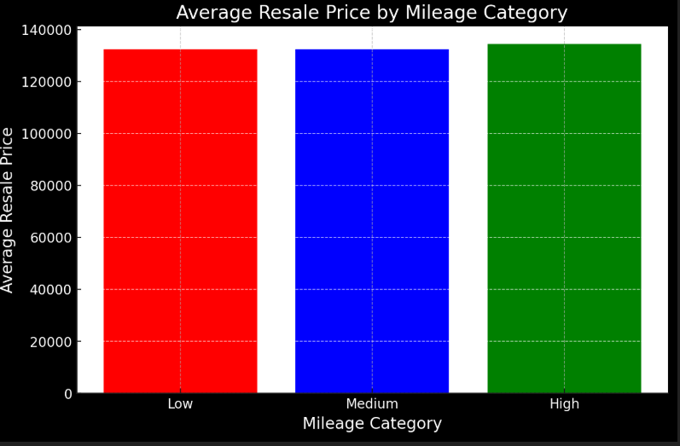
Average Resale Price Based on Mileage Category

Slide 13
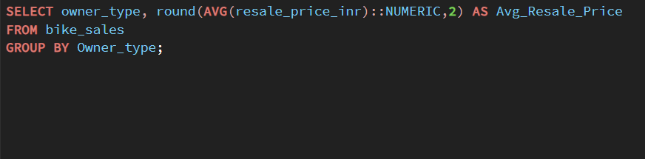
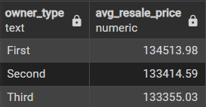
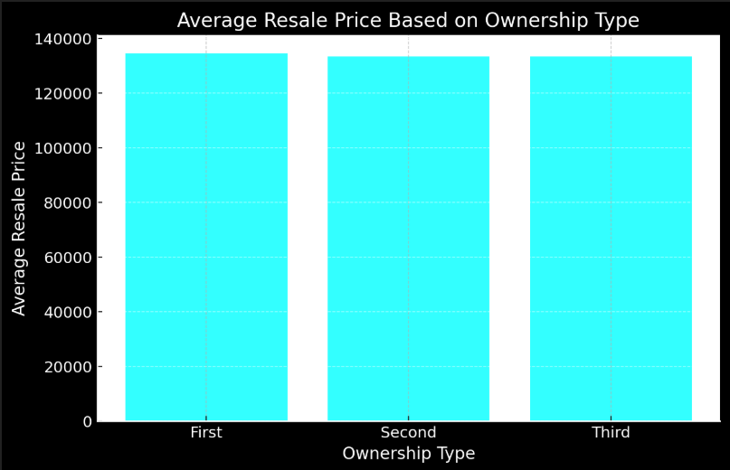
Average Resale Price Based on Ownership Type

Slide 14
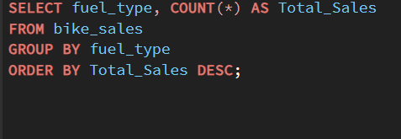
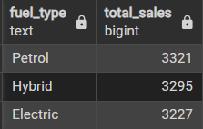
Fuel Type vs. Total Sales Comparison

Slide 15
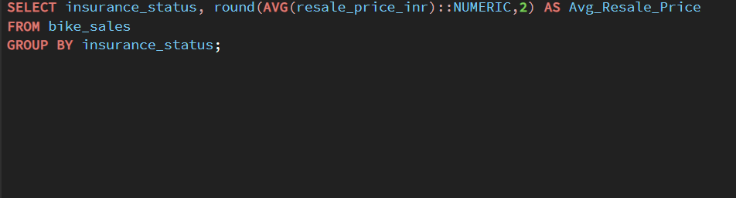
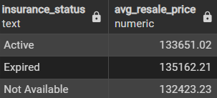
Impact of Insurance Status on Average Resale Price

Slide 16
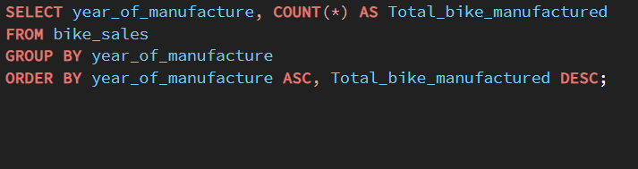
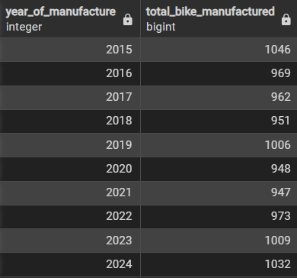
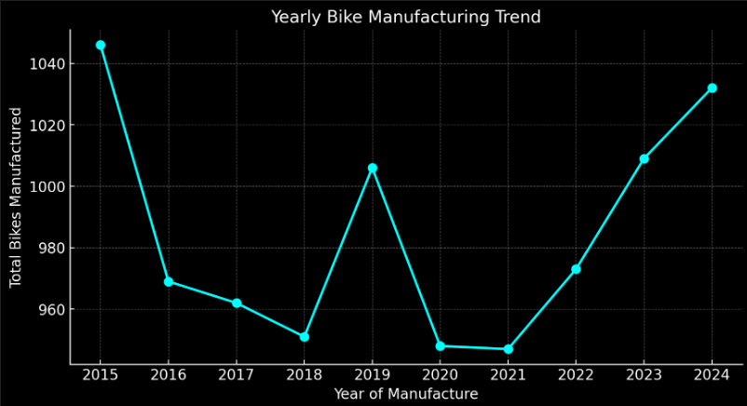
Total Vehicle Sales by Year of Manufacture (2015–2024)

Slide 17
Insights from the Analysis
Manufacturing Trends
Fluctuations in production; decline from 2015-2018, recovery post-2022.
Peak production: 2015 (1,046 units) & 2023 (1,009 units).
Brand & Resale Insights
Premium brands hold higher original prices.
First-hand bikes & high-mileage models retain better resale value.
Engine Capacity vs. Distance
No direct correlation found; factors like riding habits impact travel.
Fuel Type & Sales
Petrol bikes lead, but electric/hybrid models are gaining traction.
Insurance & Resale Value
Insured bikes have higher resale value; buyers prefer secured purchases.

Slide 18
Final Business Recommendations
1. Increase Production to Meet Growing Demand
The data suggests a recovery in bike production post-2022.
Continue increasing production to meet the rising demand in 2024 and beyond.
2. Focus on Brands with Higher Resale Value
Promote brands that retain high resale value, as second-hand buyers prefer these.
Create marketing campaigns around "best resale value" models.
3. Expand into Electric and Hybrid Bikes
Despite petrol bikes dominating sales, electric and hybrid models are gaining traction.
Invest in R&D and marketing for eco-friendly models to align with market trends.
4. Introduce Extended Warranty & Insurance Packages
Since insurance status impacts resale value, provide buyers with options for extended warranty and easy insurance renewals.
Offer bundled packages to increase buyer confidence.

Slide 19
Final Business Recommendations
5. Optimize Pricing Strategy
Affordable pricing strategies for budget buyers while maintaining premium models.
Introduce seasonal discounts or financing options to boost sales.
6. Leverage the Second-Hand Market
Since resale value influences buying decisions, develop a certified pre-owned program.
This can help increase trust in used bike sales and enhance brand reputation.

