Slide 1
Technology Hackathon
Name Pronunciation

Slide 2
Team Name: ICONIC TEAM
Team Members
Sneha Rao S
Chhetri Koushik
M D Bopaiah
Shekhar Abhijeet
Harsh Sharma

Slide 3
Problem Statement
User find themselves struggling with the pronunciation of the names of the other users or co-workers
Mispronouncing the names might lead to inconvenience on both the sides. It might lead to negative and disheartening experience.
Repeatedly mispronouncing a name is disrespectful.
Some of the users might not want their name to be pronounced as per standard pronunciation.

Slide 4
Solution
API is built based on react-speech-kit(React hooks for in-browser Speech Recognition and Speech Synthesis)
Speak function is used which will make browser to pronounce the names.
Language drop down is populated from the voices functionality of the speech synthesis.
An array of available voices is passed to the speak function which will pronounce as per the chosen language.
Speed and pitch is implemented where the user can adjust the speed and pitch of the pronunciation.
User can voice their customized name in the chosen language that will be stored for future usage.

Slide 5
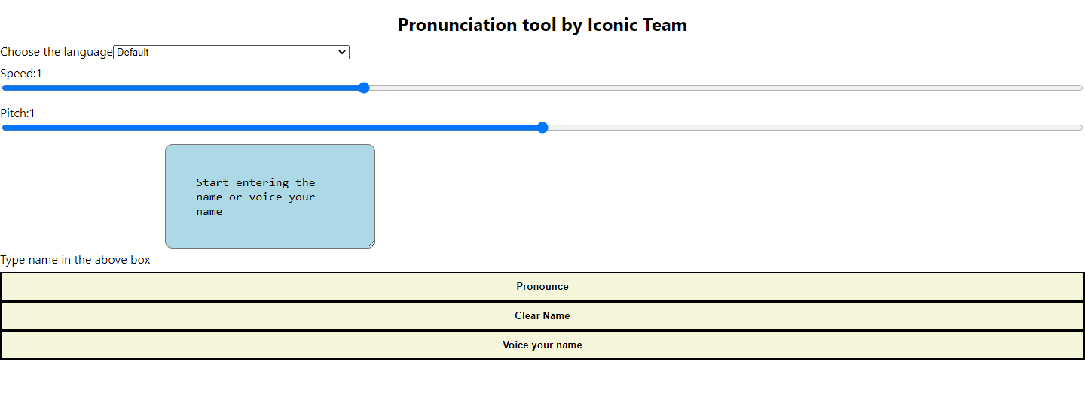

Slide 6
Business Value
Ability to deliver a solution for the phonetic pronunciation of names.
Provides the option for the users to provide the customized name using the voice option.
User can choose the language for the pronunciation.
User can adjust the speed and pitch of the pronunciation which will ease to get the names clearly.
Pronouncing the person’s name correctly affirms that person may add to his or her self worth.

