Slide 1
Physics-Informed Neural Networks for Mechanics Problems
UE24CS352A Machine Learning | Mini-Project, Problem 13
Data-driven solutions and discoveries in mechanics
Team of two | SRN: PES1UG24CS648 | Based on Zhang, Chen and Yang, Stanford CS229

Slide 2
Problem and motivation
Mechanics problems are written as differential equations: heat flow in a plate, water draining from soil, a damped spring. Two usual ways of solving them both have weaknesses.
Numerical solvers
Standard neural networks
PINN (this project)
Finite elements and finite differences divide the object into a mesh. They are accurate but need meshing, must be re-run for every new case, and cannot easily discover unknown constants.
Learn from labelled input-output pairs, so they need many examples. They know nothing about the governing equation and can give physically impossible answers.
The network is trained on the equation itself. It needs no mesh and little or no labelled data, gives a smooth differentiable solution, and can find unknown parameters.
Goal: reproduce the paper's two problem classes in PyTorch and check the results against exact or numerical solutions.
Data-driven solutions (forward): the equation is known, find the solution
Data-driven discovery (inverse): some constants are unknown, find them from measurements

Slide 3
How a PINN learns
The network takes the inputs (t, or x and y, or x and t) and outputs the solution. Training minimises a loss that measures how badly the output breaks the physics.
PDE residual L_f
Boundary / initial L_b
Data L_d
Plug the output into the equation at random collocation points. The residual should be zero. Derivatives come from automatic differentiation, so no mesh is needed.
Penalise violations of known edge values and the starting state, for example T = 0 on the plate edge, or u(0) = 1.
Penalise mismatch with measurements. Used only in the inverse problem, where 50 observations of displacement are given.
L = w_f L_f + w_b L_b + w_d L_d (each term is a mean squared error)
Inverse problem: c and k are trainable parameters, updated together with the network weights
Loss is non-convex, so we use Adam first, then L-BFGS to refine (consolidation)
Task type: non-linear regression, physics-informed

Slide 4
Connection to the syllabus
Syllabus topic | How it appears in our project
Perceptron, multi-layer networks | Each neuron is a weighted sum plus bias and an activation. Hidden layers: 3x32, 4x50, 5x50
Back-propagation | Gradients of the loss reach the weights through derivatives of the output (create_graph=True)
Activation functions | tanh in hidden layers: smooth, so second derivatives exist. ReLU would give zero second derivative
Optimizers | Adam (momentum plus adaptive step), then L-BFGS (quasi-Newton) for refinement
Regression and metrics | MSE, maximum absolute error, relative error of the identified c and k
Hypothesis and inductive bias | The physics equation restricts the hypothesis space and acts as a regulariser
Hyperparameters | Layers, width, learning rate, epochs and loss weights, taken from the paper
Not used: decision trees, kNN, SVM, boosting, Bayesian models, clustering, reinforcement learning, CNNs, cross-validation.

Slide 5
Implementation pipeline
Each of the three scripts (pinn_oscillator.py, pinn_heat.py, pinn_consolidation.py) follows the same six steps.
1 Sample
2 Network
3 Derivatives
Random collocation points inside the domain, boundary and initial points. 50 observations for the oscillator
PyTorch MLP: tanh hidden layers, linear output. Glorot initialisation. Inputs scaled to about 1
torch.autograd.grad gives u_t, u_x and u_xx from the output, with create_graph=True
4 Loss
5 Train
6 Evaluate
Weighted MSE of the equation residual, boundary or initial error, and data error
loss.backward() then Adam steps for 20,000-30,000 epochs; L-BFGS for consolidation
Compare with the reference on a dense grid: MSE, max error, plots
Because every step uses all the points, one epoch is one weight update, so epochs and iterations are the same thing
Output transform in consolidation: p = x * NN(x, t) makes p(0, t) = 0 hold exactly
Time is divided by T in the oscillator so tanh units do not saturate

Slide 6
Three experiments
 | Oscillator (inverse) | Heat conduction (forward) | Consolidation (forward)
Equation | m u'' + c u' + k u = 0 | T_xx + T_yy + 1 = 0 | p_t - p_xx = 0
Unknown | c and k | T(x, y) on [-1,1] x [-1,1] | p(x, t), t up to 0.5
Conditions | u(0)=1, u'(0)=1 | T = 0 on the boundary | p(0,t)=0, p_x(1,t)=0, p(x,0)=1
Network | 3 x 32 tanh | 4 x 50 tanh | 5 x 50 tanh
Points | 50 observations, 100 residual | 1500 interior, 500 boundary | 500 residual, 250 initial, 125 Neumann
Optimiser | Adam, 30,000 epochs, lr 1e-3 | Adam, 20,000 epochs, lr 5e-4 | Adam 20,000 (lr 1e-3), then L-BFGS
Reference | Analytical solution | Finite differences | Analytical series
All data is synthetic: random points plus observations generated from the analytical solution. No external dataset is used.

Slide 7
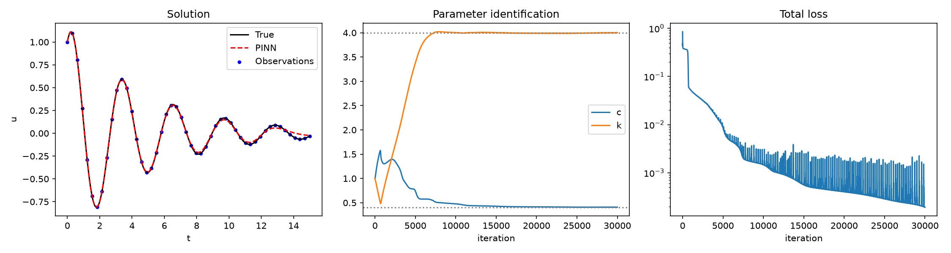
Oscillator: identifying c and k
c = 0.4099
k = 4.0019
50 points
true 0.4 (2.5% off)
true 4.0 (0.05% off)
noise-free observations, 30,000 epochs
Left: the PINN curve lies on the exact solution; small drift after t = 13 where the signal has almost died out
Middle: c and k start at a wrong guess of 1; k settles first, c overshoots to about 1.5 then slowly falls to about 0.41
Right: loss falls from about 1 to 2e-4; the spikes are normal Adam noise

Slide 8
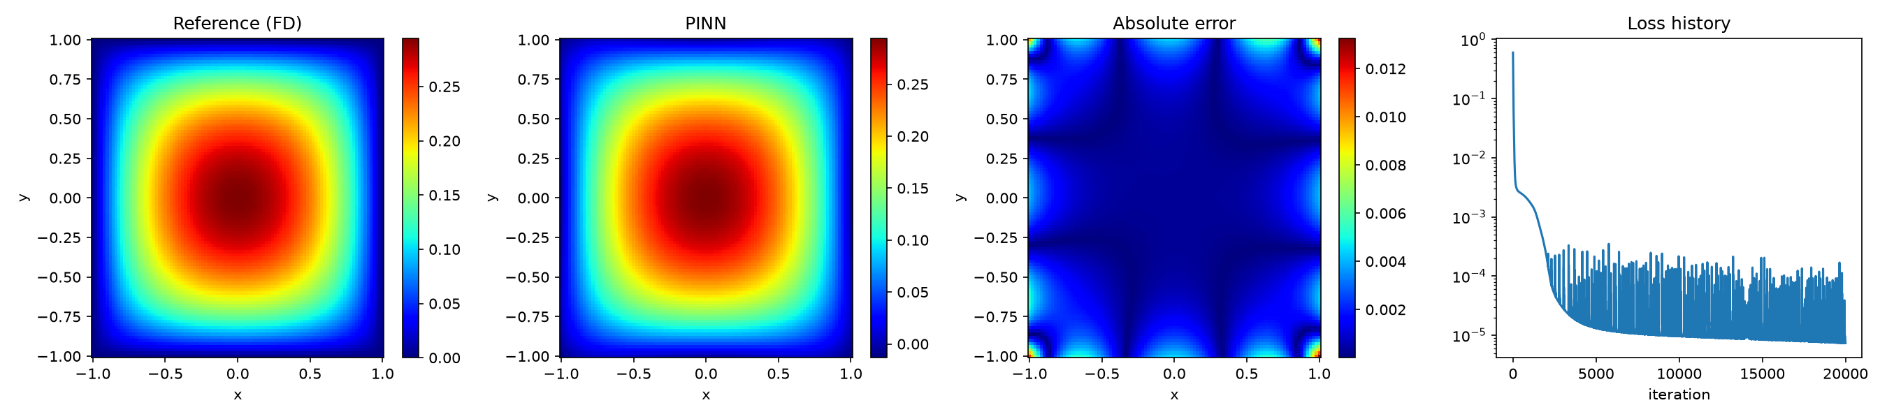
Heat conduction vs finite differences
MSE 2.5e-6
Max error 0.013
Corners
against the finite-difference solution
peak temperature is about 0.29
largest error: boundary is a soft constraint
The PINN and reference panels are visually identical: hottest at the centre, zero at the edges
Error is below 0.013 everywhere and brightest at the corners, where two edges meet
Fix suggested in the paper: multiply the output by a smooth distance function to enforce T = 0 exactly

Slide 9
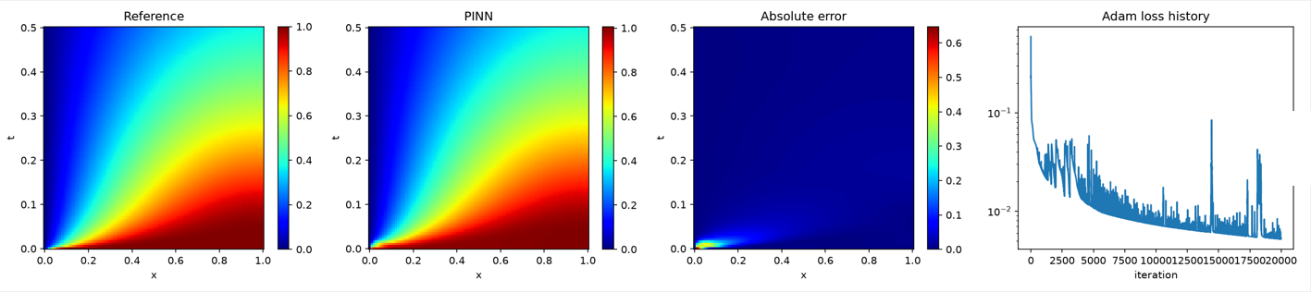
Consolidation vs analytical solution
MSE 7.1e-4
MSE 2.4e-4
Origin
full domain, max error 0.65
for t of 0.02 or more, max error 0.14
error is concentrated at x = 0, t = 0
Pressure starts at 1 everywhere and drains out through x = 0, so the low-pressure region spreads right over time
At the origin the true solution drops from 1 to 0 almost instantly, which a smooth network cannot copy exactly
Loss plot shows the Adam stage only; L-BFGS then lowered the loss to about 7.8e-4

Slide 10
Results summary and comparison with the paper
Problem | Metric | Ours | Paper
Oscillator | Identified c, k (true 0.4, 4.0) | 0.4099, 4.0019 | 0.40125, 3.9933 (100,000 epochs)
Heat | MSE / max error vs reference | 2.5e-6 / 1.3e-2 | Max error about 5e-3 (FEM reference)
Consolidation, full domain | MSE / max error | 7.1e-4 / 0.65 | Max error about 0.045 (50,000 epochs plus L-BFGS)
Consolidation, t of 0.02 or more | MSE / max error | 2.4e-4 / 0.14 | Not reported
Why our errors are a little larger:
We trained for 20,000-30,000 epochs; the paper used 50,000-100,000
Heat reference is a finite-difference solution, not the paper's deal.II finite-element solution
Fixed learning rate with no decay, so the loss keeps some Adam noise

Slide 11
Conclusions and future work
Conclusions
A PINN recovered the oscillator parameters to within 2.5% and 0.05% from only 50 observations
Both forward solutions match their references without any mesh
Errors concentrate where gradients are sharp: the origin (consolidation) and the corners (heat)
The physics loss acts as a regulariser, so little or no labelled data is needed
Limitations and future work
Longer training with learning-rate decay to reduce the loss noise
Hard boundary constraints using a distance function, as the paper suggests
More training points near sharp gradients (adaptive placement)
Coupled poromechanics equations and hyperparameter search (grid, random or Bayesian)

