Slide 1
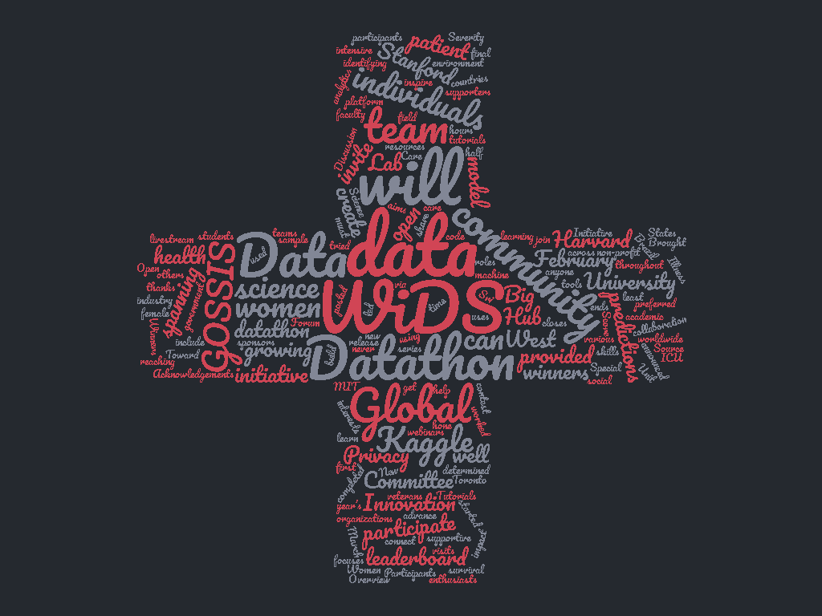

Slide 2







Problem
WiDS Datathon 2020focused on
patient health through data from
MIT’s GOSSIS (Global Open Source Severity of Illness Score) initiative.
The challenge was to create a model that uses data from
the first 24 hours of intensive care to predict
patient survival.

Slide 3

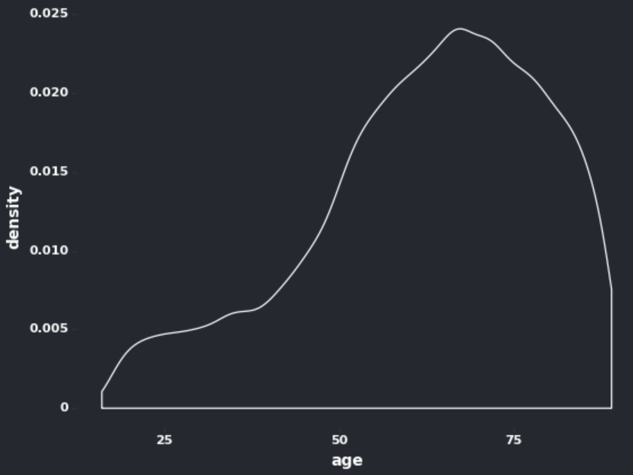
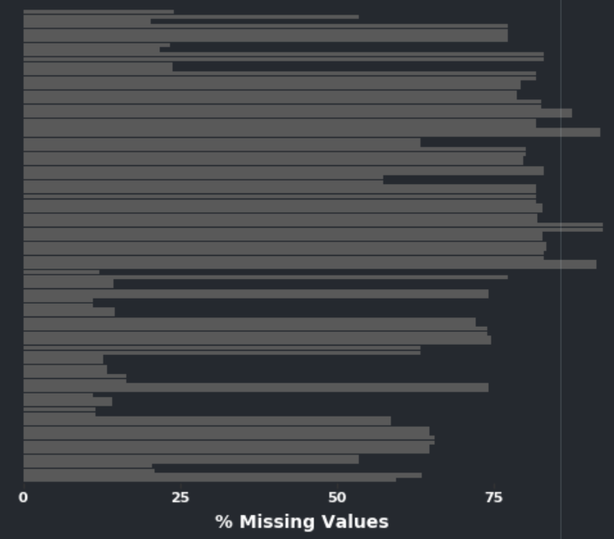
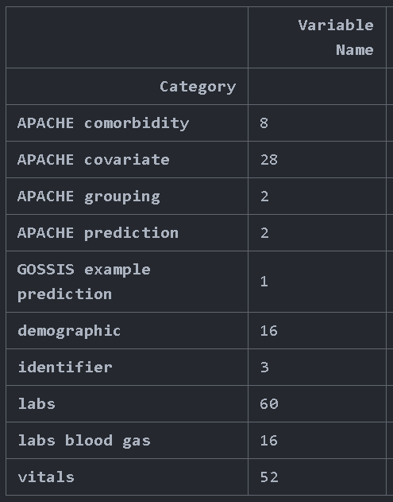
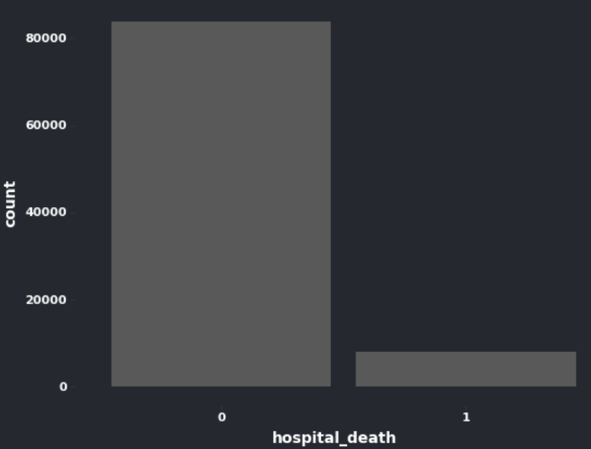
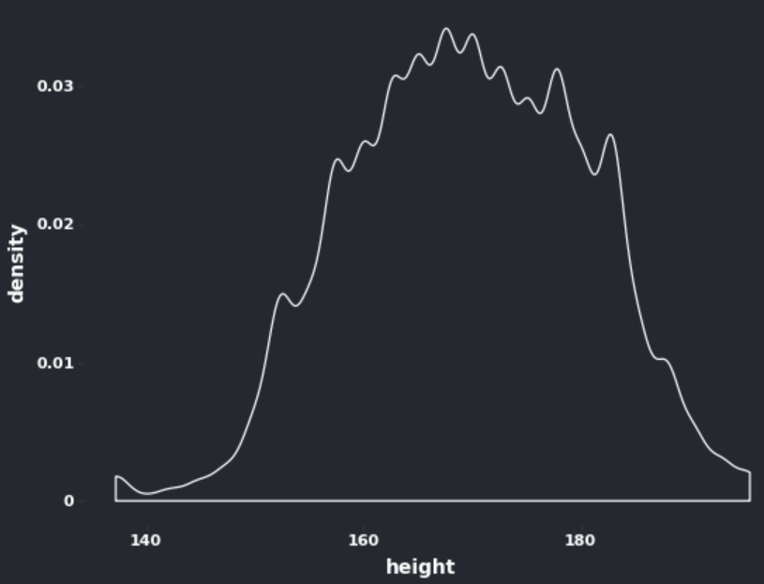
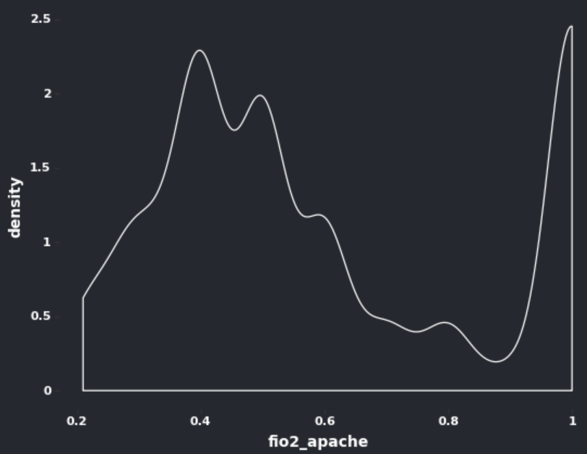
Data
Messiness
Shape
Skews
Missing Values
Column Categories
Target Variable

Slide 4






Models
Ensemble
Stacking
Generalized Knowledge
KNN
Experience/
Case-Based Knowledge

Slide 5
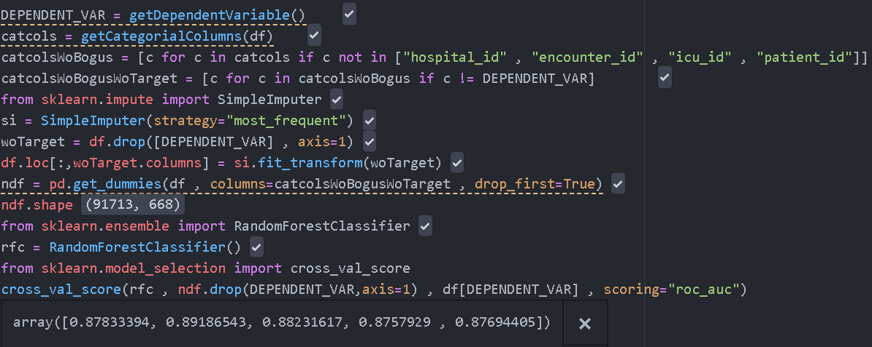
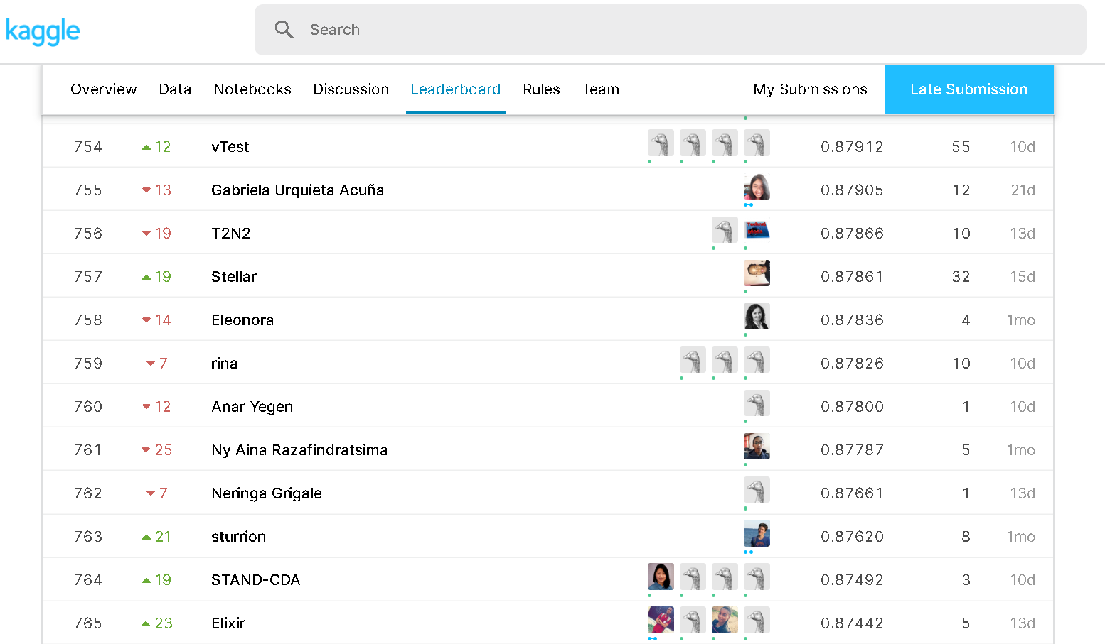
Baseline
Missing values
Categorical Columns
Modelling
Score
0.878
760/940

Slide 6
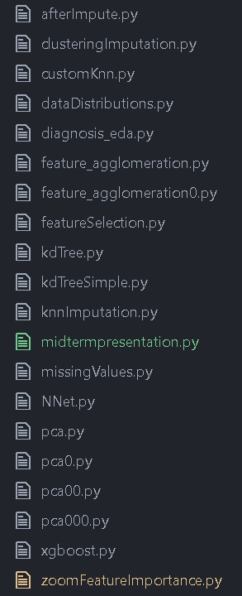

Missing values | Feature Engineering | Modelling
Simple Imputation | PCA | Random Forest
Knn Imputation | Agglomerative Clustering | NNet
KDTree |  | XGBoost , LGM
Random Forest Imputation |  | Stacking
Variance Based Drop Column

Slide 7

More to Come
KNN

