Slide 1

Microsoft Authentication Library

Slide 2
Introduction to MSAL
What is MSAL?
Microsoft Authentication Library
What is MSAL for JavaScript?
The MSAL library for JavaScript enables client-side JavaScript applications to authenticate users using Azure AD [AAD]
It offers organization/school account, Microsoft Personal Accounts [MSA], social identity providers like Google, Facebook, LinkedIn, Etc. through AD B2C – Business-To-Customer

Slide 3
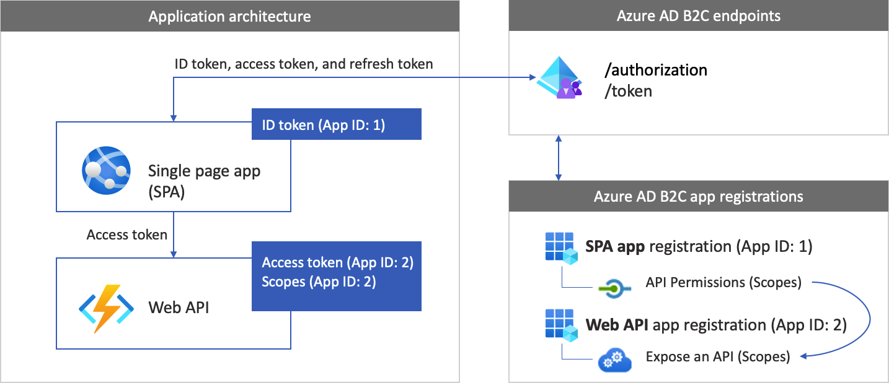
MSAL and JavaScript Application

Slide 4
Signing In With Azure AD B2C
Register Angular and .NET 6 Web API application with Azure AD B2C
Angular app registration enables your app to sign in with AAD
During app registration, you specify the redirect URI
User will get redirected after successful authentication to the redirect URL
App registration generates Application Id also known as Client Id
The Web API registration enables your app to call a protected Web API
The registration exposes the web API permissions (scopes)
The app registration process generates an application ID that uniquely identifies your web API
App registration generates Application Id also known as Client Id

Slide 5
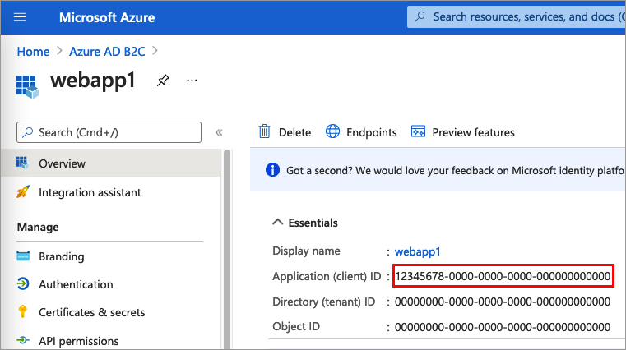
JavaScript Application Registration

Slide 6
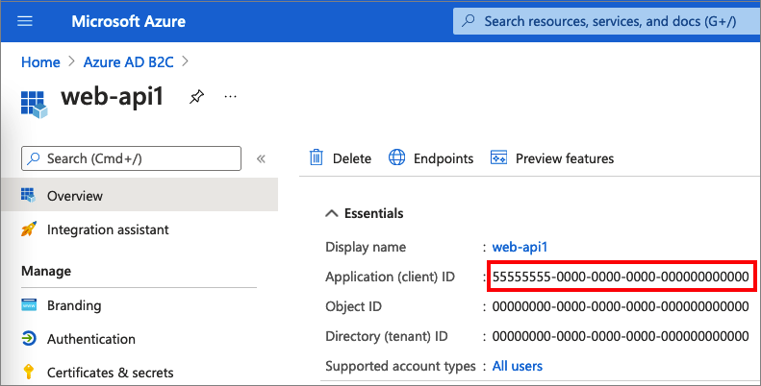
.NET 6 Web API Application Registration

Slide 7
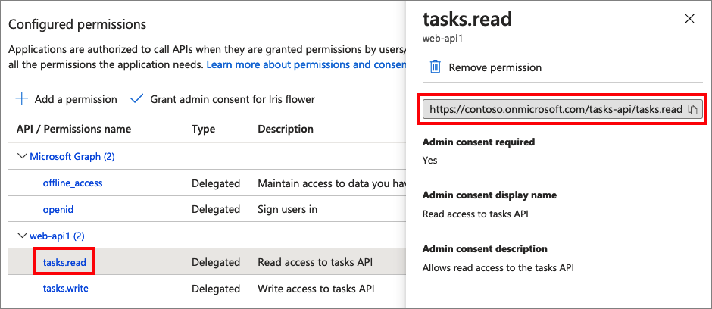
Grant Permission To Web API – Scopes
Select the API (App ID: 2) to which the web application should be granted access

Slide 8
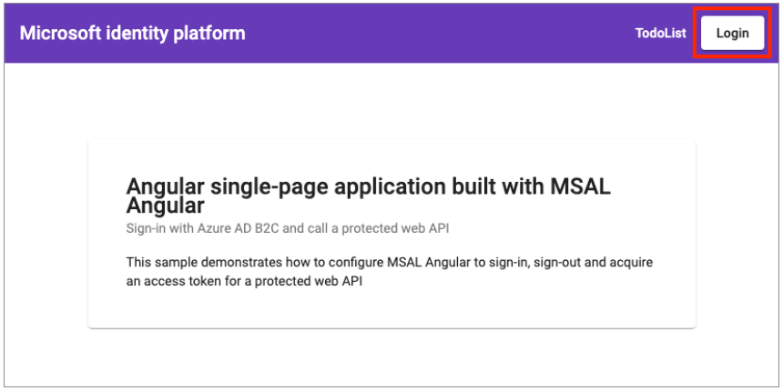
Login Screen

Slide 9
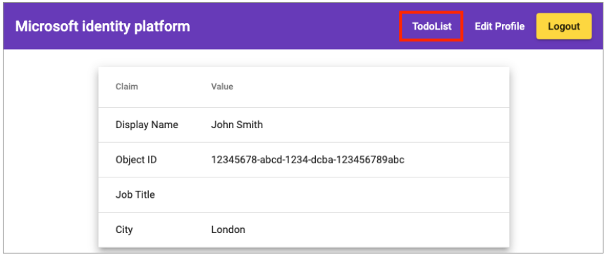
Successful Login

