Slide 1

Notes:
Imagine you are building an app to convert kilometers to Miles but don’t remember the exact formula but you have knowledge of two pieces.

Slide 2
Calculus – A gentle introduction
Notes:
Imagine you are building an app to convert kilometers to Miles but don’t remember the exact formula but you have knowledge of two pieces.

Slide 3
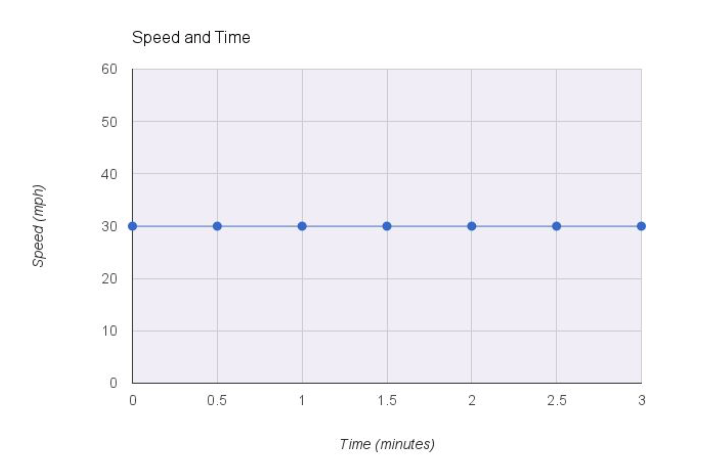
Example 1
Time (mins.) | Speed (mph)
0.0 | 30
0.5 | 30
1.0 | 30
1.5 | 30
2.0 | 30
2.5 | 30
s =30 (speed)

Slide 4
Rate of change
What is the rate of change of speed with time ?
ds/dt = 0
Rate of change of speed with respect to time is 0
Speed is independent of time
Notes:
Calculus is all about establishing how things change as a result of other things changing. Here with the passage of time speed doesn’t changes.

Slide 5
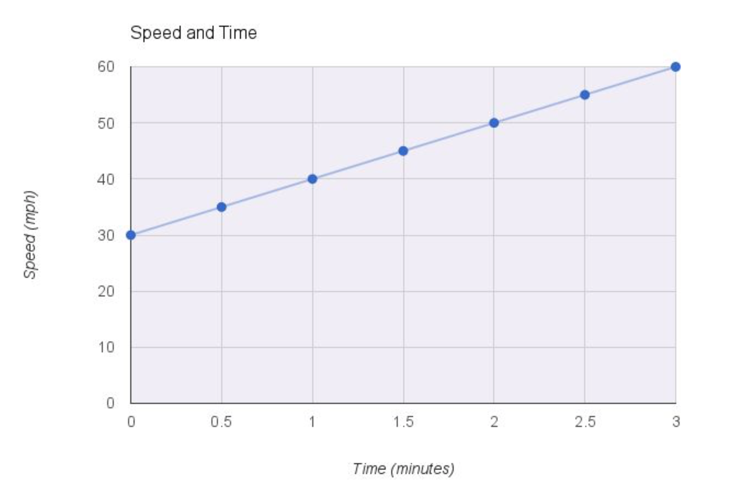
Example 2
Time (mins.) | Speed (mph)
0.0 | 30
0.5 | 35
1.0 | 45
1.5 | 50
2.0 | 55
2.5 | 60

Slide 6
Rate of change
What is the rate of change of speed with time ?
Function → s =30 + 10t
ds/dt = 10
Rate of change of speed with respect to time is 10
Notes:
Did you notice that 10 is slope or gradient of the line.

Slide 7
Example 3
Time (mins.) | Speed (mph)
0.0 | 0
1 | 1
2 | 4
3 | 9
4 | 16
5 | 25

Slide 8
Rate of change
What is the rate of change of speed with time ?
Function → s =t²
First order
^{1 percent of 100 = 1/100}
1 percent of 1 percent = 1/10000
Second order
x² + 2x · dx + (dx) ²
Ignored
Notes:
In order to find the rate of change here let us think about ds – It is an indefinitely small bit of s. same is the case du. To understand this think of how much minutes are there in a week – 10080. 1 min. is extremely small compared to total min. in a week. If you think of 1 min. to be small compared to week then think of 1 sec. in a week. In a calc

Slide 9
Calculating ds/dt
s = t²
s + ds = (t+dt)²
s + ds = t² + 2.t.dt + dt²
s + ds = t² + 2.t.dt
s + ds = s + 2.t.dt
ds = 2.t.dt
ds/dt = 2t

Slide 10
Example 5
What is the rate of change (ds/dt) for
s = 3t² + 3?

Slide 11
Calculating ds/dt
s = 3t² + 3
s + ds = 3(t+dt)² + 3
s + ds = 3(t² + 2.t.dt + dt²) + 3
s + ds = 3(t² + 2.t.dt) + 3
s + ds = 3t² + 6.t.dt + 3
s + ds = s + 6.t.dt
ds = 2.t.dt
ds/dt = 6t

Slide 12
Pattern
y = ax^{n}
dy/dx = nax^{n-1}

Slide 13
Functions of Functions
f =y² where y = x³ + x
What is df/dx ?
Notes:
Two problems here –
Output size is reduced.
Corner pixels are only touched once. Information loss

Slide 14
df/dx
f =y² where y = x³ + x
df/dy
df/dy = 2y
dy/dx
df/dy = 3x² + 1
df/dx =df/dy * dy/dx
df/dx = 2y(3x² + 1)
df/dx = (2(x² + x))(3x² + 1)
df/dx = (2x² + 2x)(3x² + 1)
Chain rule
Notes:
The computation of a neural network is organized around two steps- First step is left to right to calculate the value of the network and then a backward propagation to calculate gradients or derivatives. But why this is so?

Slide 15
Building the base for gradient descent
J(a,b,c) = 3(a+bc)
u = bc
v = u + a
J = 3u
Computation graph
a
b
c
u = bc
v = u + a
J = 3v
Source ;- Deeplearning.ai
Notes:
Imagine that we want to optimize J. left to right helps in calculating the value of j and right to left in calculating the derivates.

Slide 16
Calculating derivates
a
b
c
dJ/dv = 3
dJ/du
= dJ/dv * dv/du
= 3. 1
= 3
u = bc
v = u + a
J = 3v
dJ/da
= dJ/dv * dv/da
= 3 * 1
= 3
dJ/db
= dJ/du * du/db
= 3 * c
= 3c
dJ/dc
= dJ/du * du/dc
= 3 * b
= 3b
Source ;- Deeplearning.ai
Notes:
Why we have to calculate derivate of j w.r.t v to calculate the derivate of j w.r.t. a,b and c. This is because change in a causes changes in v which in turn causes change in J

