Slide 1

Notes:
Imagine you are building an app to convert kilometers to Miles but don’t remember the exact formula but you have knowledge of two pieces.

Slide 2
Embeddings
Notes:
Imagine you are building an app to convert kilometers to Miles but don’t remember the exact formula but you have knowledge of two pieces.

Slide 3
Word Representations
V = [milk, butter, bread……<UNK>]
| V | = 10,000
1-hot representation
Man
Woman
Queen
King
Orange
Apple
I want a glass of Orange_Juice
I want a glass of Apple___?__
0 . . 1 0 . .
0 . . . 1 . .
0 1 . . . . .
0 . . . . 1 .
10k Dimensions
Source deeplearning.ai

Slide 4
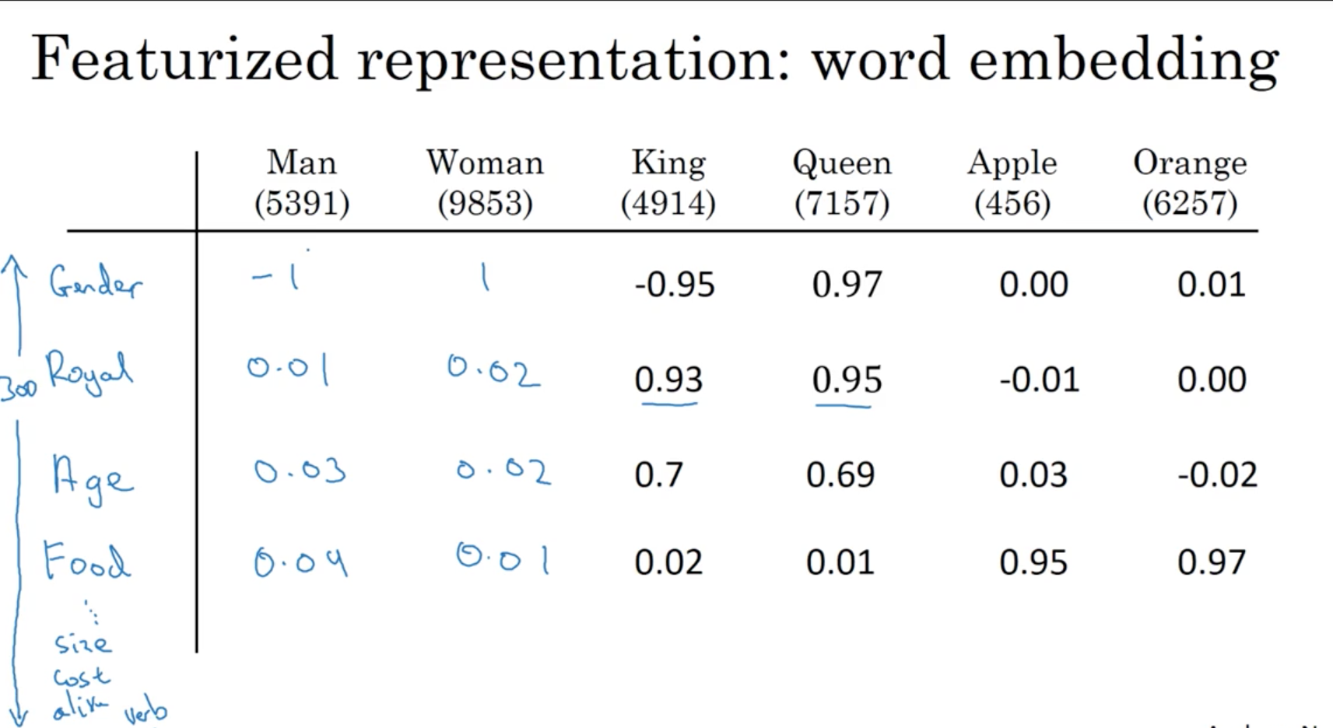
Feature Representation
Source deeplearning.ai

Slide 5
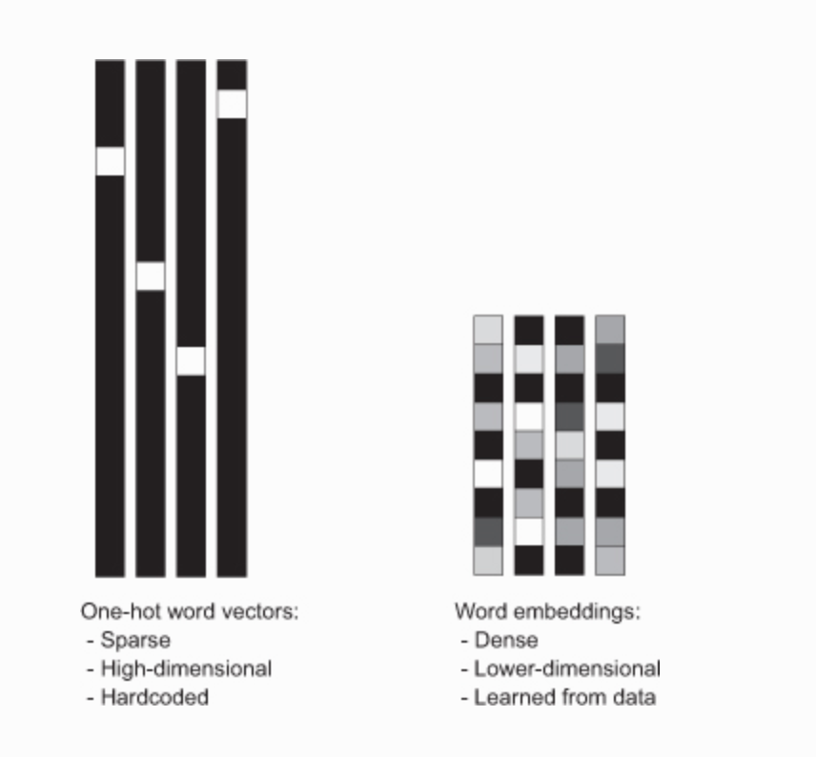
One hot encoding vs Word embeddings

Slide 6
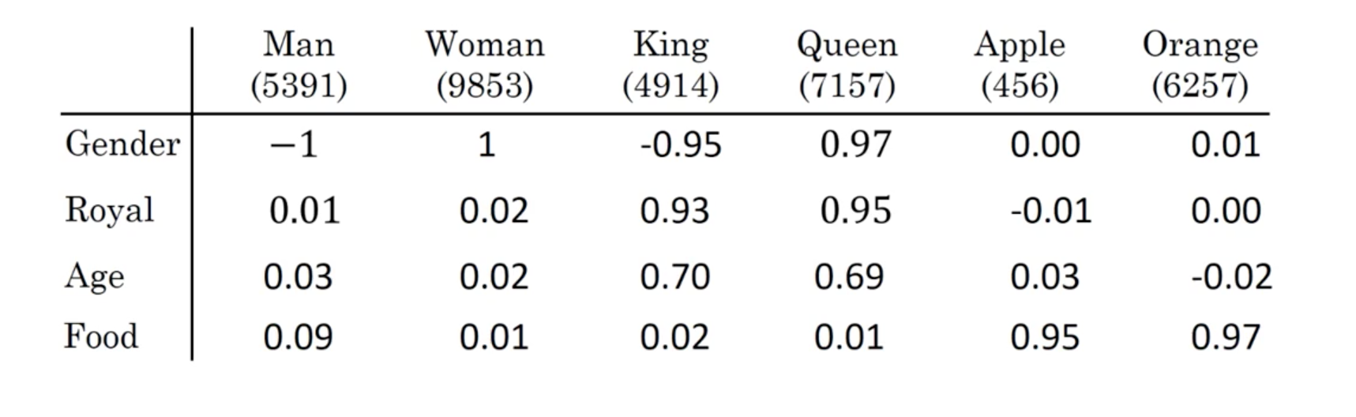
Properties of word embeddings
Source deeplearning.ai

Slide 7
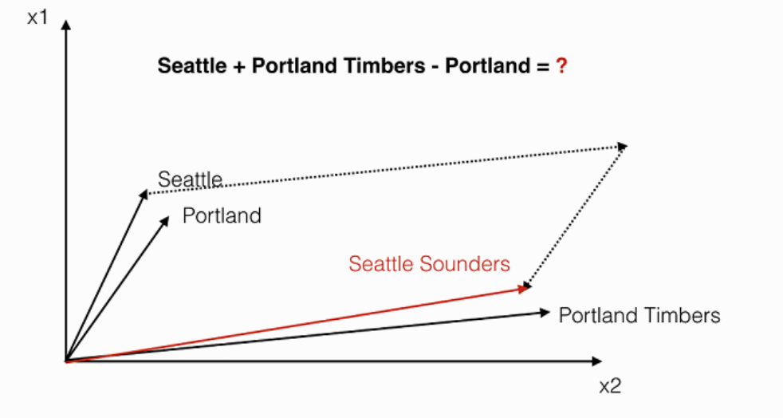
Geometry with embeddings
Portland Timbers + Seattle – Portland = ?

Slide 8
Geometry with embeddings

Slide 9
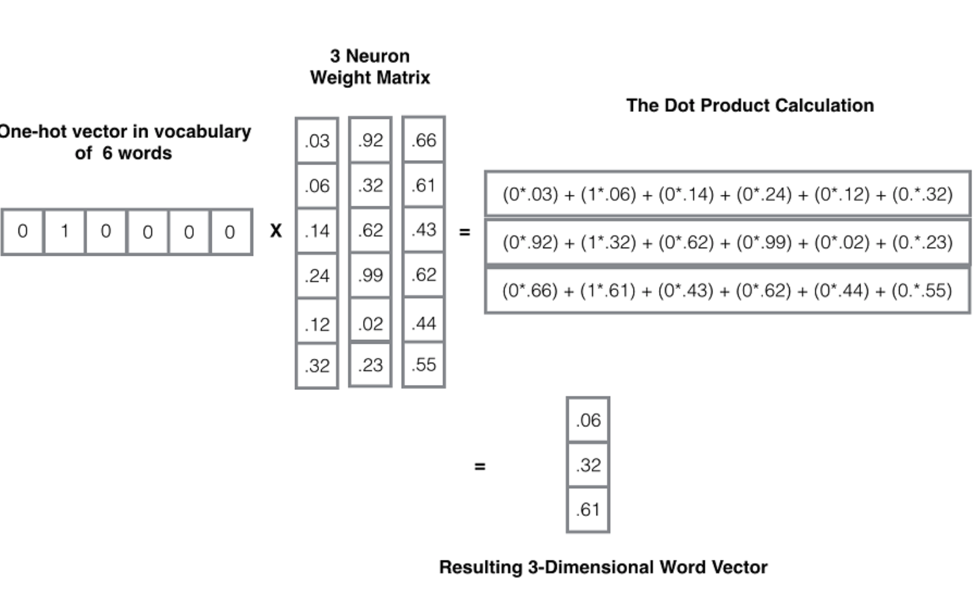
Embedding Matrix

Slide 10
Learning Word Embeddings
Notes:
Two problems here –
Output size is reduced.
Corner pixels are only touched once. Information loss

Slide 11
Word Embeddings
WordVec -https://www.youtube.com/watch?v=ERibwqs9p38
GloVe - https://nlp.stanford.edu/projects/glove/
Fastext - https://fasttext.cc/docs/en/supervised-tutorial.html
Notes:
Two problems here –
Output size is reduced.
Corner pixels are only touched once. Information loss

Slide 12
Word embeddings applications – Sentiment Classification
The dessert is excellent
Service was quite low
Service was quite low
Notes:
Two problems here –
Output size is reduced.
Corner pixels are only touched once. Information loss

Slide 13
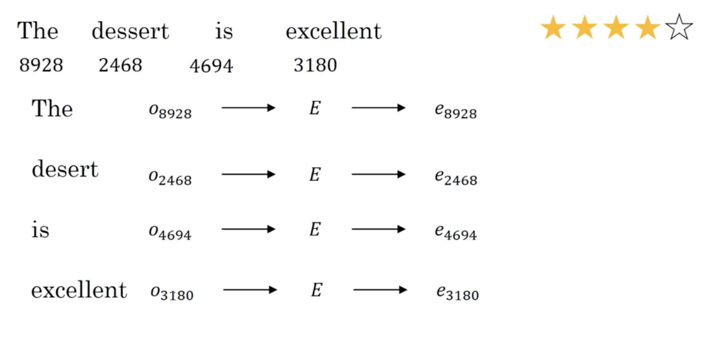
Simple classification model
Avg
Calculated rating
Softmax
Notes:
Two problems here –
Output size is reduced.
Corner pixels are only touched once. Information loss

