Slide 1
Sprint 1 Retrospective
Indranil Guha, Nabeel Khan, Abhijeet Kharkar, Ali Asgher

Slide 2
Accomplishments
Set up Elastic Search database
Loaded data into Elastic Search from multiple course API’s
Intial Frontend and Backend app for the project
Continuous integration environment (Semaphore CI)

Slide 3
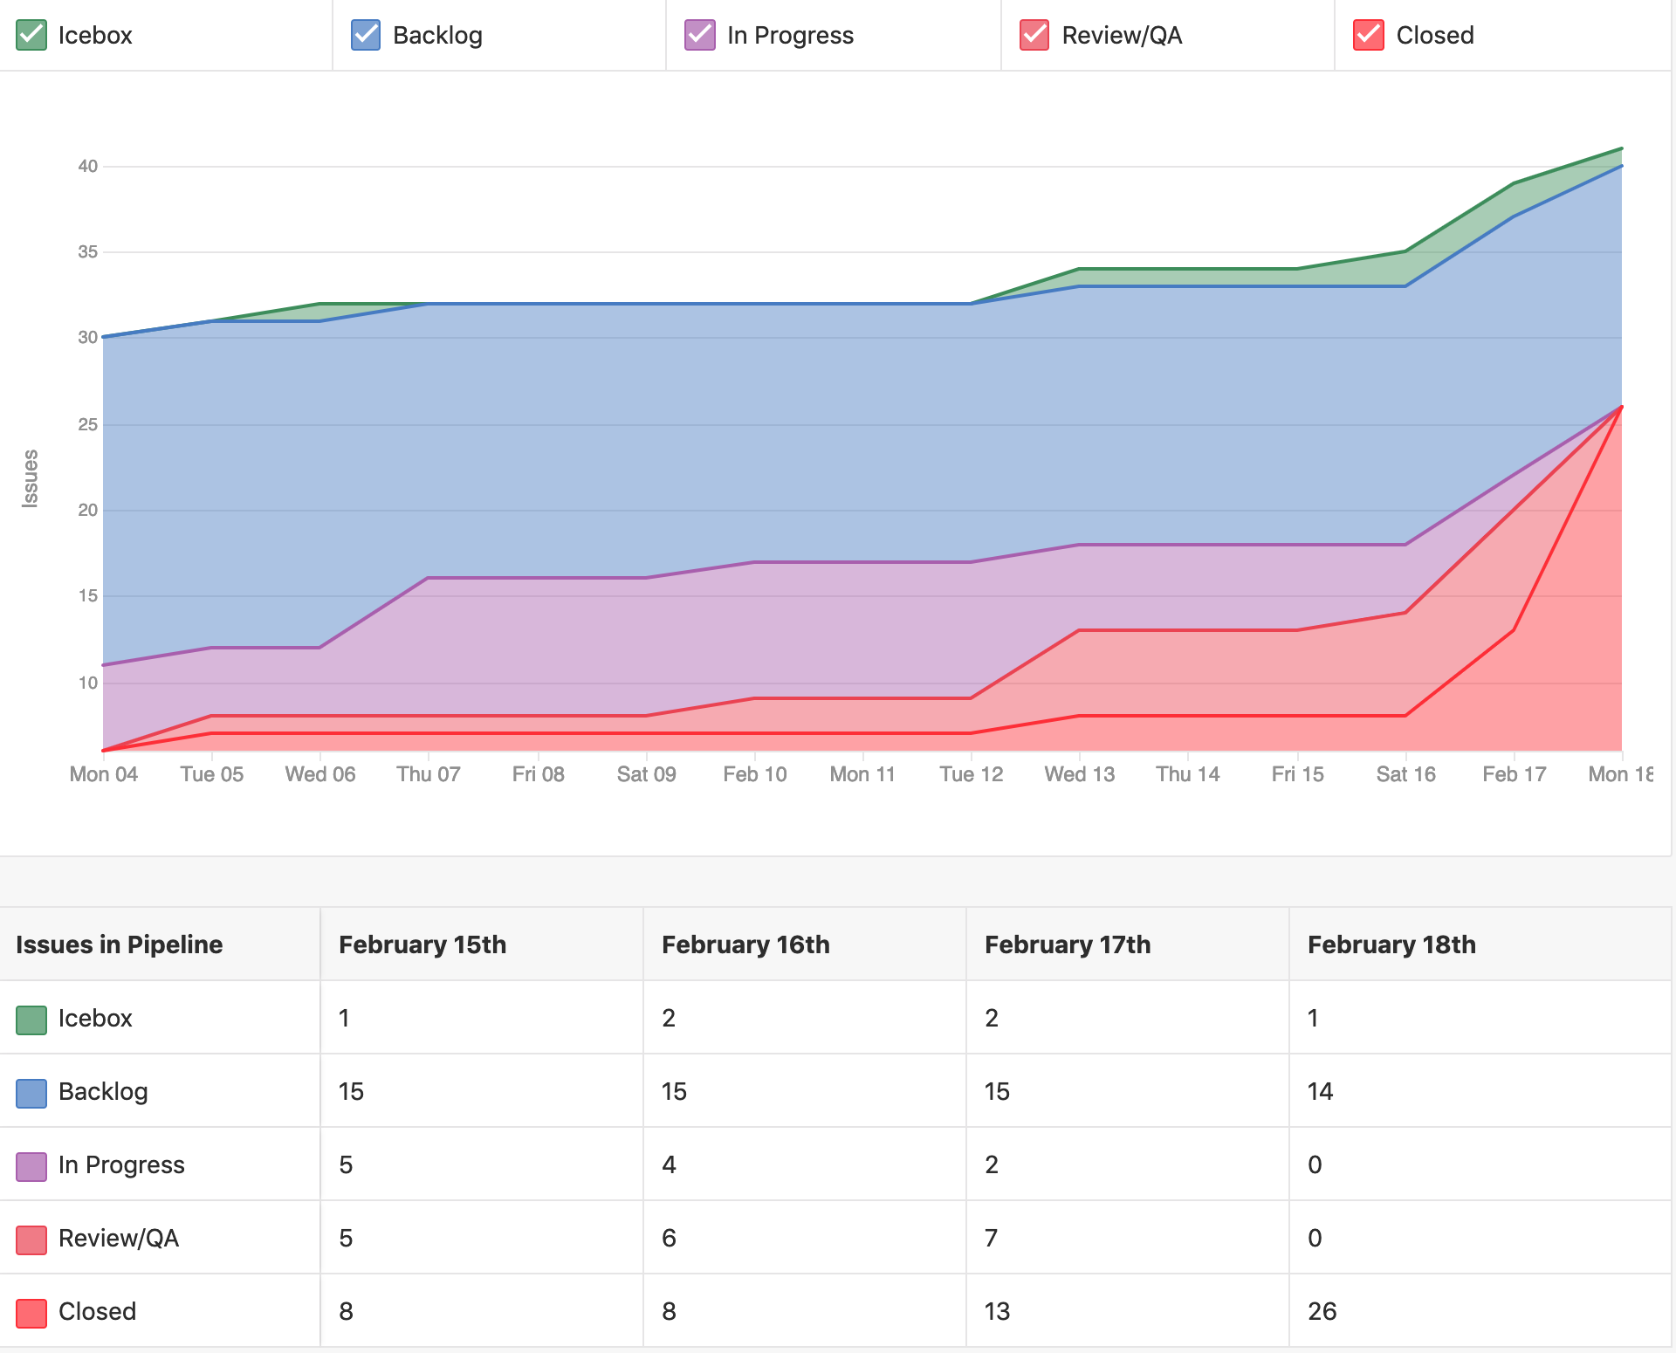
What went Well?
All story points completed
~90% unit test coverage
Healthy knowledge transfer

Slide 4
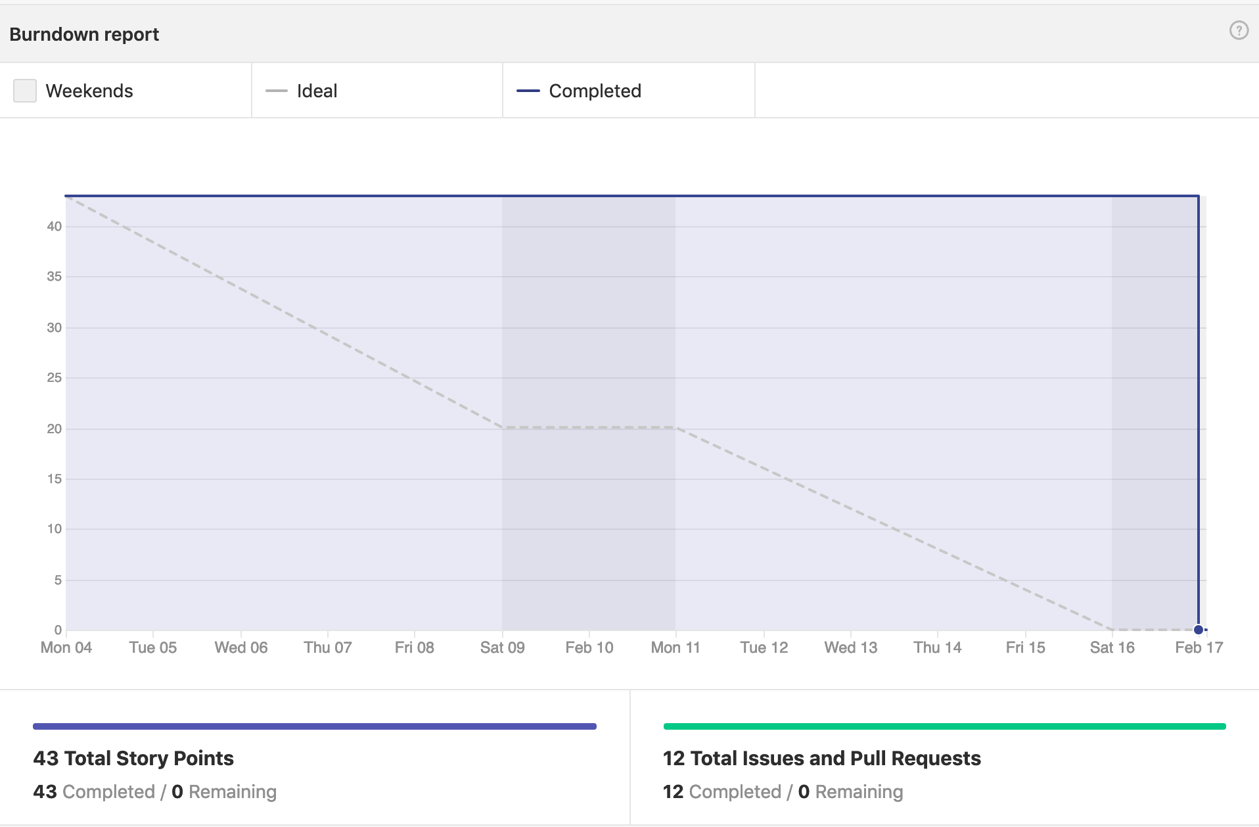
What went wrong?
Continuous Integration issues
Issues in writing unit tests using mocha and chai
Big tasks took long to complete
Delayed review of the pull requests
Issues with having multiple apps in the same repository

Slide 5
Changes needed
Break down big task into multiple smaller tasks
Timely review and merger of pull requests
Regular stand-ups

Slide 6
Questions?

