Slide 1
Sprint 2 Retrospective
Indranil Guha, Nabeel Khan, Abhijeet Kharkar, Ali Asgher

Slide 2
Accomplishments
Implemented autosuggest during course search
Authentication and Using Firebase
Profile Management using ElasticSearch
App Setup using Webpack and Babel
Overall test coverage 75%

Slide 3
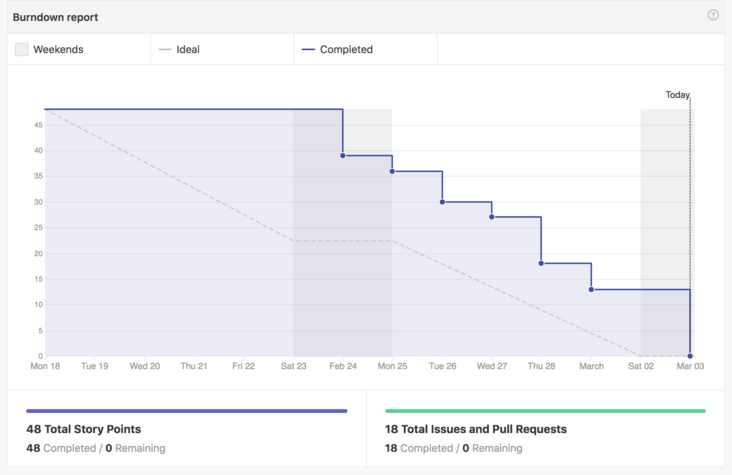
Velocity and BurnDown Rate
All story points completed
Initial time due to learning curve.

Slide 4
Issues and Changes needed
Improve on linking Commits and PR’s with the User Stories
Thorough Unit Testing before generating PR
Planned team meetings
Overall test coverage 75%

Slide 5
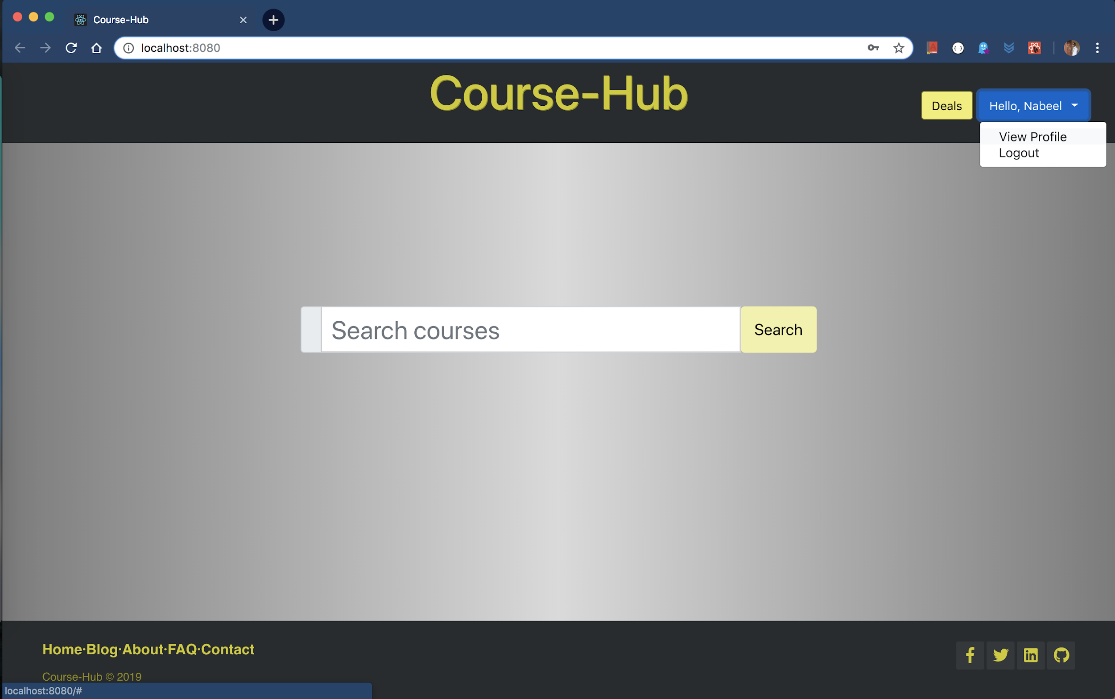
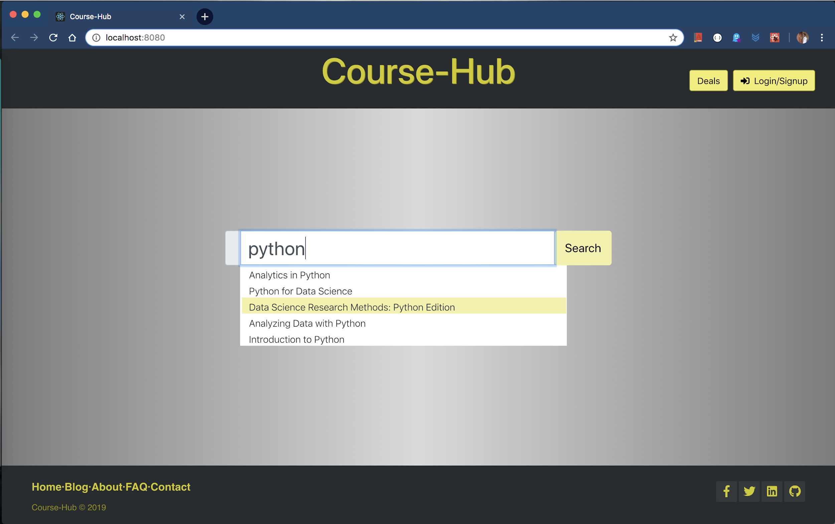
Snapshots

Slide 6
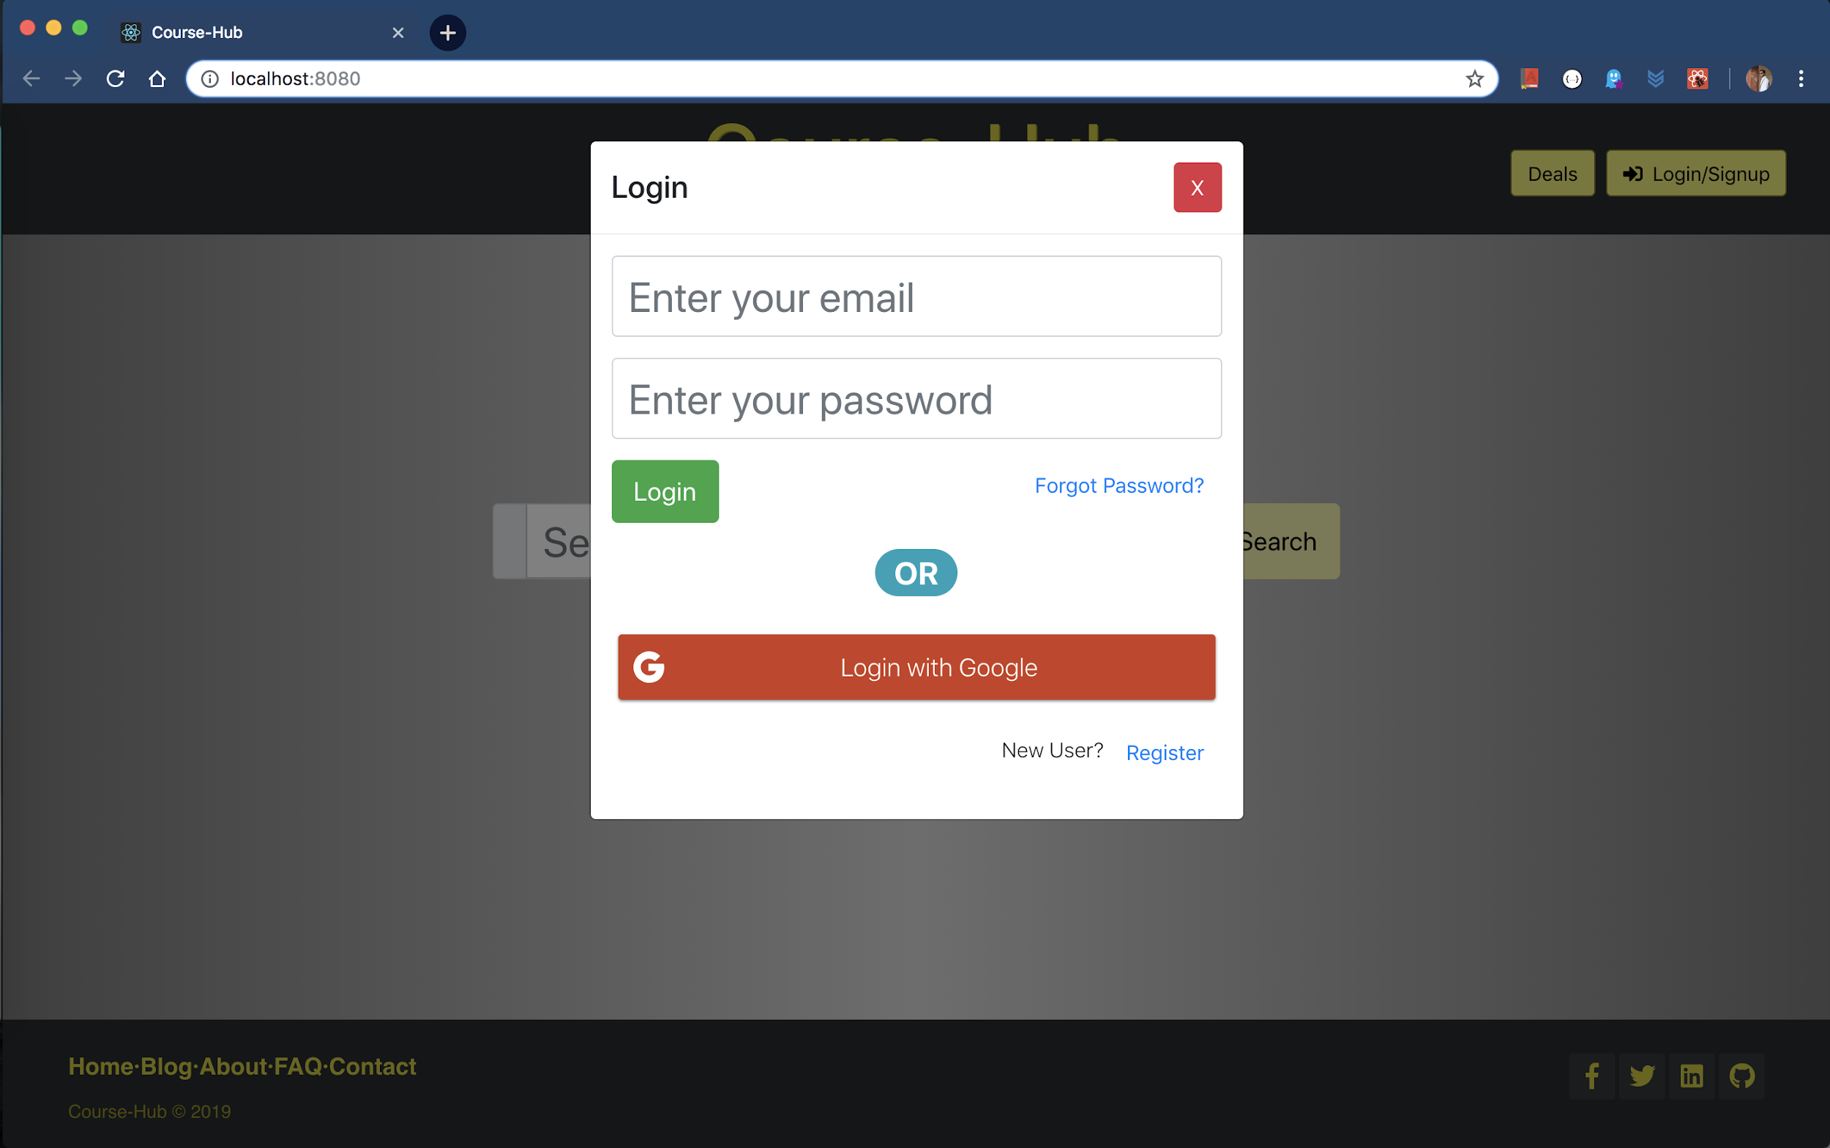
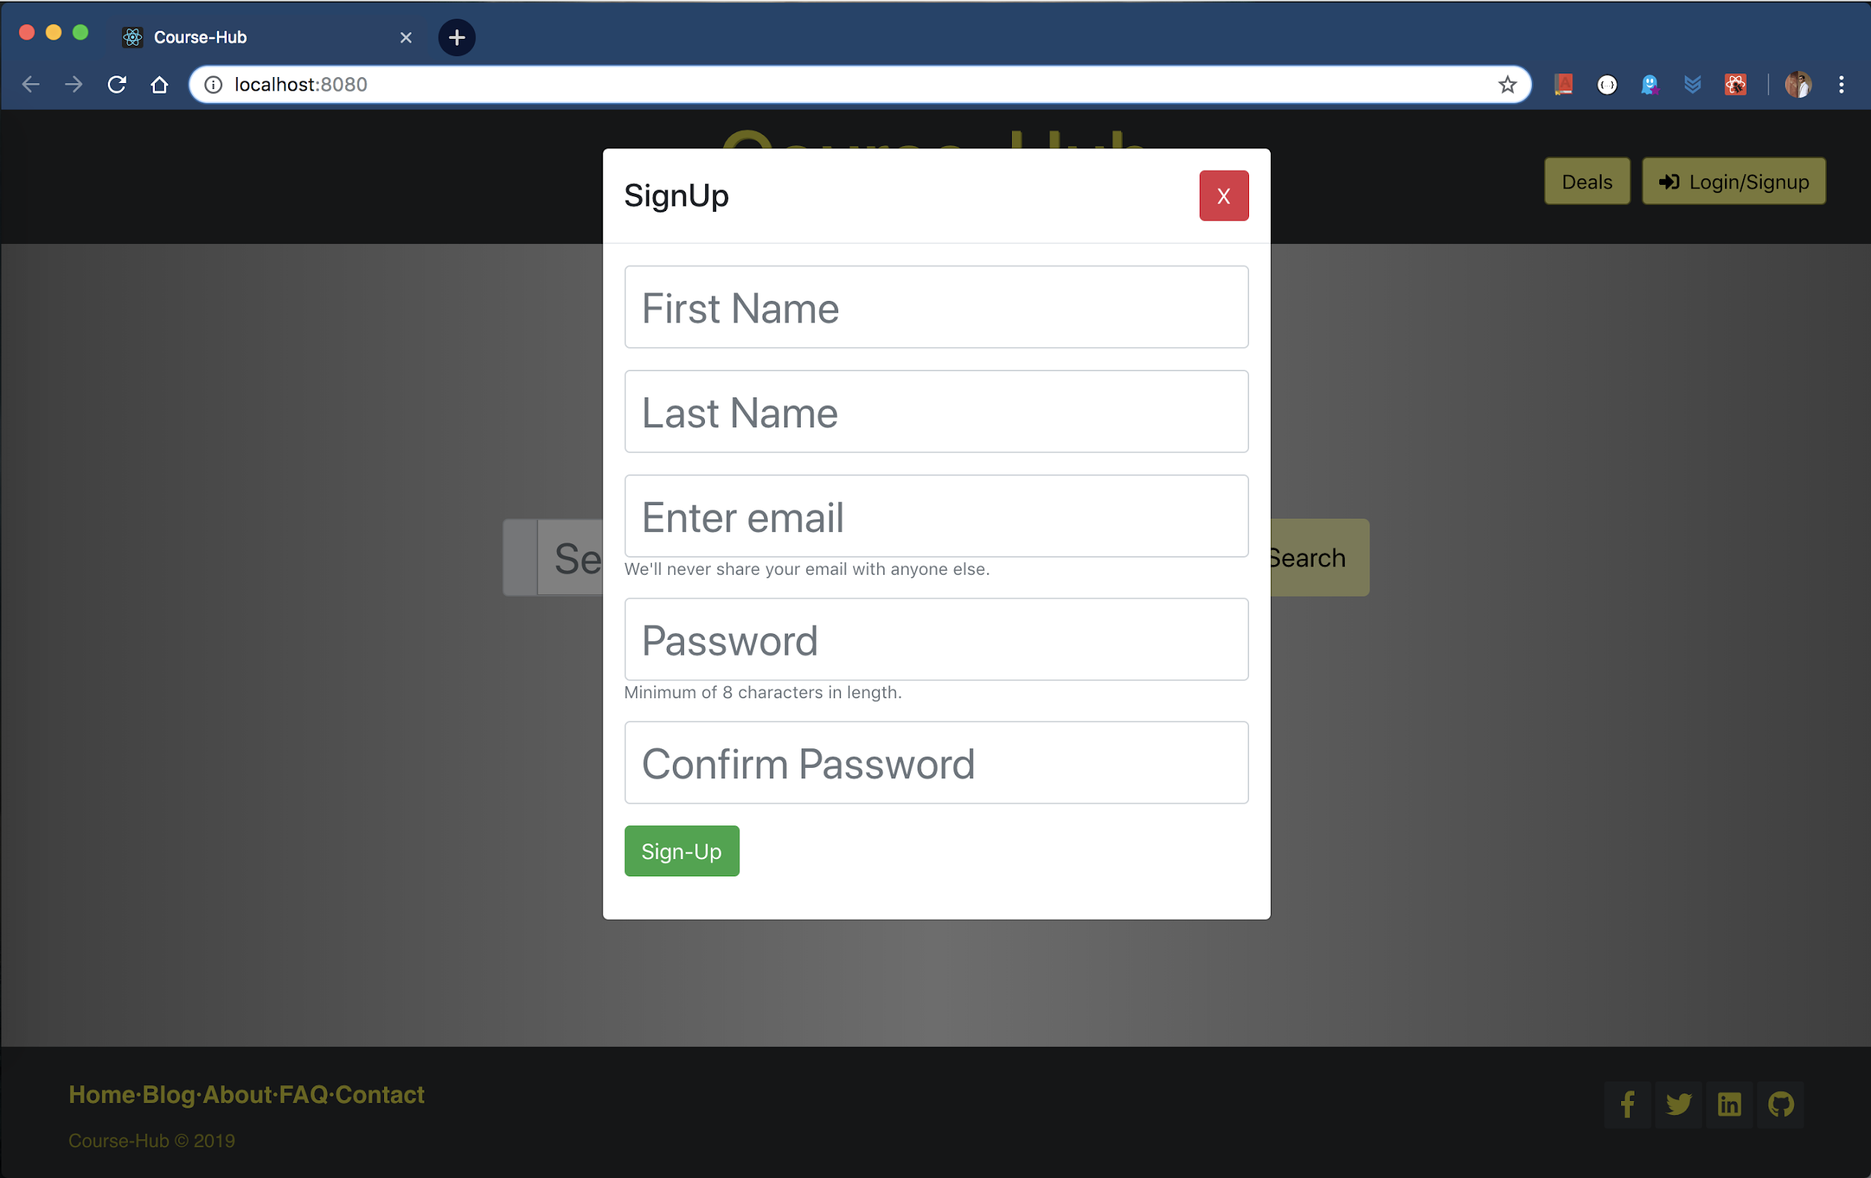
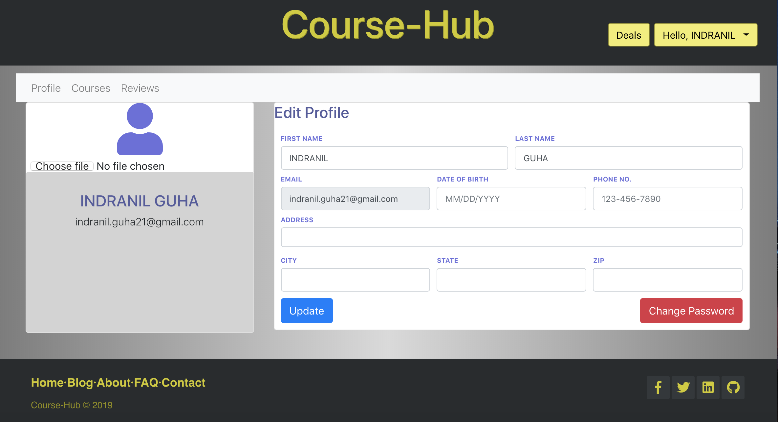
Snapshots

Slide 7
Questions?

