Slide 1
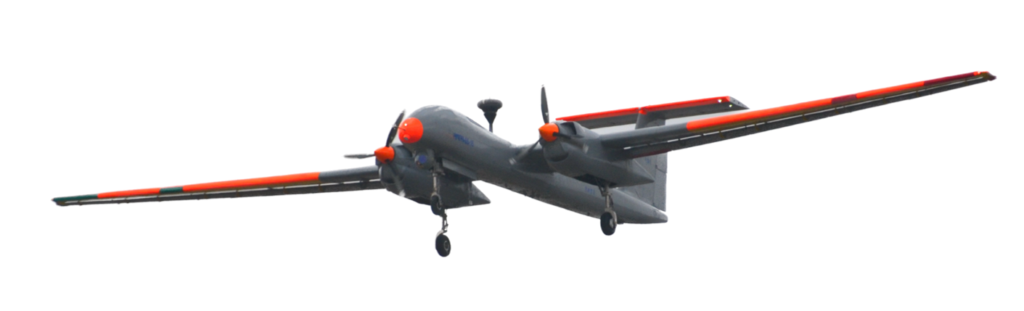
FLIGHT SYSTEMS BRIEFING
UAV: Unmanned Aerial Vehicles
From early experiments to the connected aircraft system
HISTORY / AIRFRAME / PROPULSION / AVIONICS / GROUND SEGMENT
UAV / SYSTEMS • HISTORY • OPERATIONS
01
Notes:
An unmanned aerial vehicle is the aircraft. A complete unmanned aircraft system includes the aircraft, its control station, communications, people and support equipment. This presentation uses the repository images as supplied. Aircraft identities follow asset filenames; internal diagrams are generic teaching illustrations, not verified layouts. It focuses on engineering, civil uses, history and safe operations. No model-specific dimensions or mission performance are inferred from photographs.

Slide 2
01 / ORIENTATION
The aircraft is only one part of the system
01
02
03
UAV
UAS
RPA / RPAS
The flying platform: airframe,
propulsion, sensors,
computers, payload and
onboard radios.
UAV + ground station +
datalinks + launch/recovery +
operators + maintenance.
Remotely piloted aircraft /
system. A remote pilot remains
responsible; automation can
assist.
UAV / SYSTEMS • HISTORY • OPERATIONS
02
Notes:
UAV, UAS and RPAS are related terms, but not interchangeable. A drone may also be an unmanned surface or underwater vehicle in everyday language. An autopilot is not proof of full autonomy. A flight controller stabilizes the aircraft; a mission system manages objectives and payload tasks. Distinguish human authority from the degree of automation. The same physical aircraft can support different system configurations.

Slide 3
01 / ORIENTATION
A guided journey through nine core topics
01
02
03
Past → platform
Inside the aircraft
System → mission
Global evolution
India’s development
Classification and missions
Structure and aerodynamics
Engine and energy
Datalink and antenna
Flight control computer
Important LRUs and payloads
Ground control station
Ground data terminals
Operations and maintenance
Safety and future trends
UAV / SYSTEMS • HISTORY • OPERATIONS
03
Notes:
Read the deck as a system walkthrough. First establish historical context and mission needs, then follow the airframe and internal equipment, and finally connect the aircraft to its ground segment. The later sections explain how the subsystems interact in an illustrative civil survey mission. The main slides stay visual; these speaker notes provide the deeper technical explanation.

Slide 4
01 / ORIENTATION
Mission requirements shape the configuration
01
02
03
Fixed wing
Multirotor
Hybrid / VTOL
Efficient forward flight;
long-range survey and
endurance. Usually needs a
launch and recovery method.
Vertical takeoff, hover and
precise positioning. Hover
power demand limits
endurance.
Combines vertical lift with
wing-borne cruise. Extra
propulsion and transition logic
add complexity.
UAV / SYSTEMS • HISTORY • OPERATIONS
04
Notes:
Configuration is selected from the mission rather than from appearance. Compare payload mass, flight time, launch area, wind tolerance, maintainability and regulatory constraints. HALE and MALE describe altitude/endurance categories, not a single geometry or guaranteed performance. A high-aspect-ratio wing can improve aerodynamic efficiency but increases structural and handling challenges. Tiltrotors, lift-plus-cruise aircraft and tailsitters make different compromises.

Slide 5
02 / GLOBAL HISTORY
Global history: experiments become aircraft
Selected milestones • early predecessors differ from today’s reusable UAVs
1849
1917–18
1930s
1940s
Balloon precursor
WWI experiments
Radio-controlled
targets
Remote control
matures
Uncrewed balloon
attacks; limited control.
Aerial Target and
Kettering Bug.
Reusable aircraft
support air-defence
training.
Target drones and
experimental pilotless
aircraft.
UAV / SYSTEMS • HISTORY • OPERATIONS
05
Notes:
Uncrewed balloon attacks in 1849 are commonly cited as an early precursor, not as controllable powered UAVs. During World War I, the British Aerial Target and American Kettering Bug explored unmanned flight. The Kettering Bug was an experimental aerial torpedo and did not see combat in that war. Radio-controlled target aircraft became important during the interwar years. The British Queen Bee target aircraft is associated with the popularization of the term drone. These milestones should not be treated as a single uncontested invention date.

Slide 6
02 / GLOBAL HISTORY
Global history: persistence, sensors, connectivity
From reconnaissance drones to widespread civil systems
1950s–70s
1980s–90s
2000s–10s
2020s
Reconnaissance
Integrated
systems
Connected
operations
Smarter onboard
systems
Target-drone technology
evolves into
surveillance.
Live imagery, ground
control and long
endurance.
Satellite links and
affordable civil drones.
Perception, automated
inspection and
integration.
UAV / SYSTEMS • HISTORY • OPERATIONS
06
Notes:
Cold War reconnaissance drones such as the Ryan Firebee family demonstrated remote reconnaissance. In the 1980s, Israeli UAV operations helped establish practical integration of imagery, datalinks and ground operators. The Predator first flew in 1994, and later systems increased endurance and sensor capability. In the 2000s, satellite links extended operations beyond local radio line of sight. In the 2010s, lower-cost inertial sensors, GNSS, batteries and embedded computing expanded civil multirotor use. Modern developments include onboard perception and increasingly automated mission management, subject to safety and regulation.

Slide 7
03 / INDIA
India: a path from targets to indigenous systems
01
02
03
Early foundations
Broader capabilities
Current ecosystem
DRDO’s Aeronautical
Development Establishment
developed target and
reconnaissance programmes,
including Lakshya and Nishant.
Imported Searcher and Heron
systems expanded operational
experience; Rustom-family
efforts pursued indigenous
capabilities.
TAPAS, ABHYAS and
demonstrator programmes
coexist with Indian civil drone
manufacturers and service
providers.
UAV / SYSTEMS • HISTORY • OPERATIONS
07
Notes:
India’s history includes different programme categories: reusable targets, reconnaissance aircraft, technology demonstrators and operational systems. Lakshya is a pilotless target aircraft; Nishant is a reconnaissance UAV programme with a distinctive launch and recovery approach. Searcher and Heron supplied by Israel are part of India’s operating history, not indigenous designs. Rustom and TAPAS represent continuing indigenous development. Programme development, flight testing, user trials and operational induction are distinct stages. Avoid assuming induction merely from a public demonstration.

Slide 8
03 / INDIA
India: selected milestones and policy shifts
A selective timeline • programme stages are not equivalent to operational induction
1990s
2009
2016
2021–22
Lakshya / Nishant
Rustom-I
Rustom-II
Policy +
demonstrators
Target and
reconnaissance
foundations.
Early indigenous UAV
flight milestone.
TAPAS development
lineage.
Drone Rules; flying-wing
technology trials.
UAV / SYSTEMS • HISTORY • OPERATIONS
08
Notes:
Selected widely reported milestones include Lakshya induction in the 1990s, Nishant’s first flight in 1995, Rustom-I’s first flight in 2009 and Rustom-II’s first flight in 2016. Rustom-II is associated with TAPAS-BH-201. ABHYAS development concerns an expendable aerial target. A DRDO autonomous flying-wing technology demonstrator flew in 2022. The Drone Rules, 2021 helped frame the civil regulatory environment. This is not an exhaustive record; current programme status, certification and individual flight permissions must be checked with authoritative sources.

Slide 9
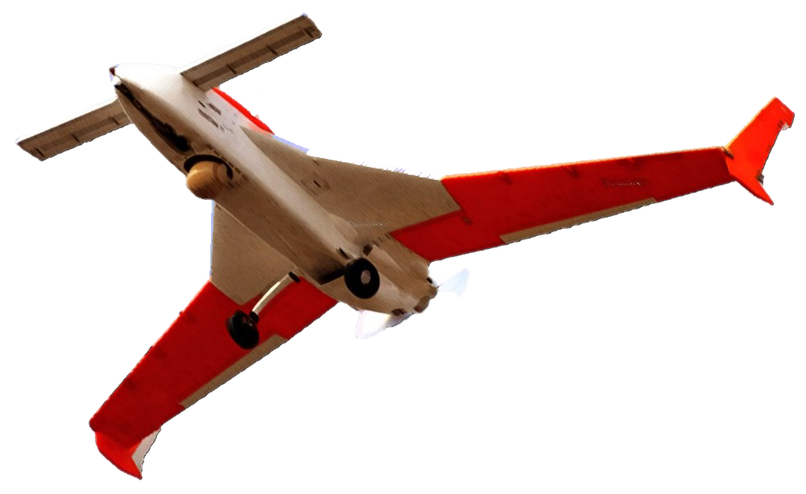
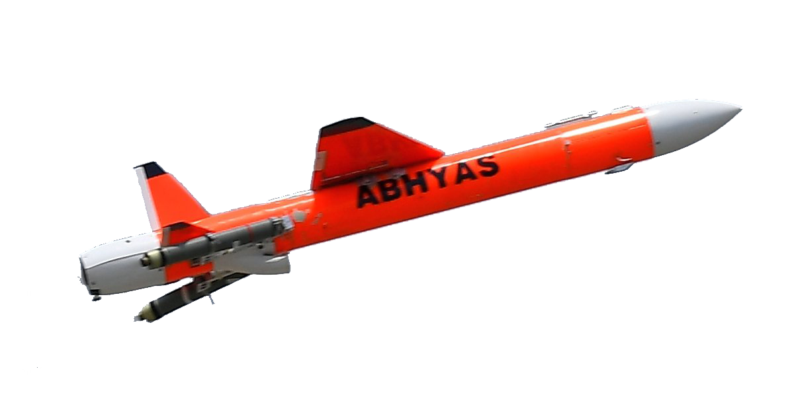
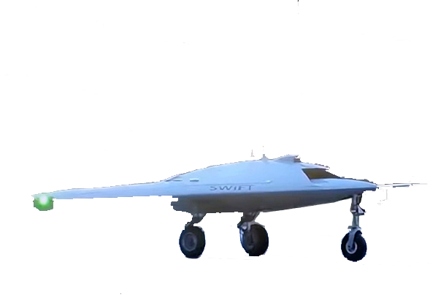
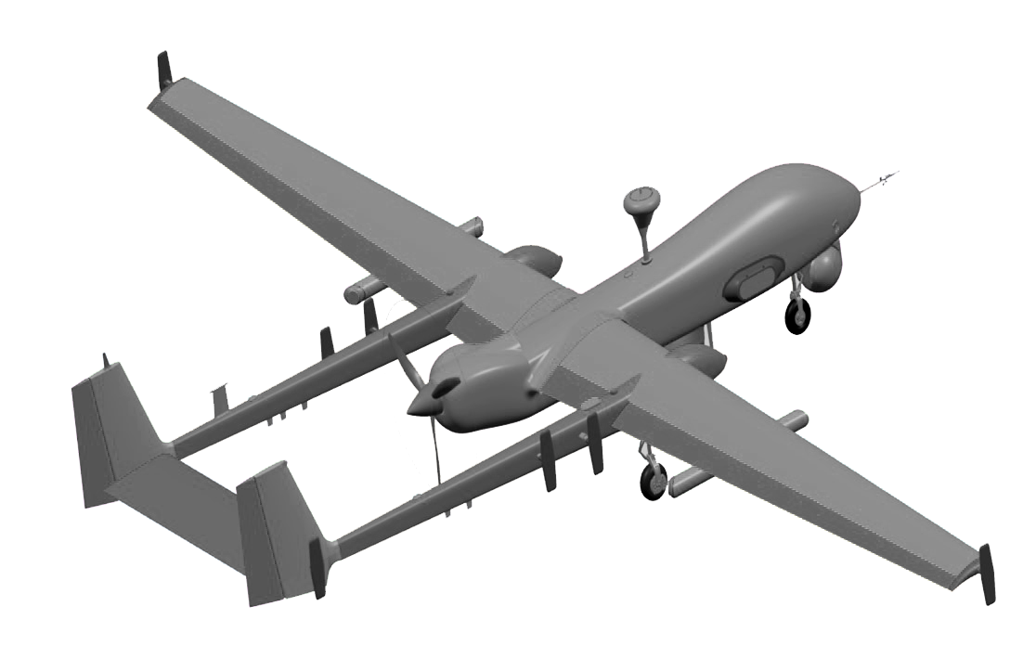
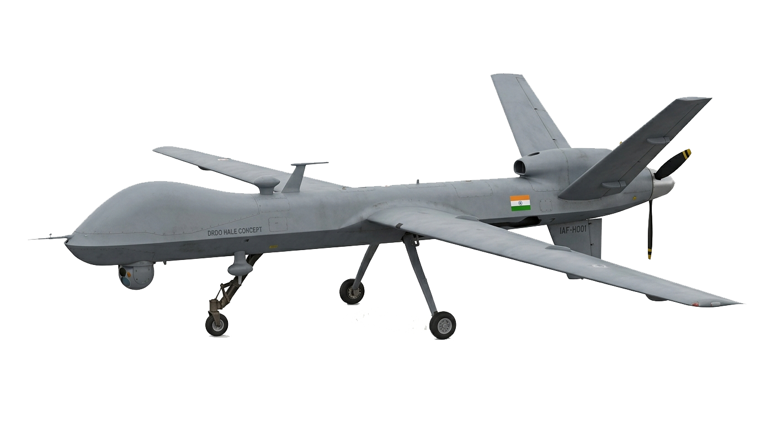
03 / INDIA
An Indian programme gallery
Repository labels identify these images; no performance or induction claims are inferred.
TAPAS
ARCHER
ABHYAS
SWIFT-K • asset label
SETB • asset label
HALE • asset label
UAV / SYSTEMS • HISTORY • OPERATIONS
09
Notes:
Use this gallery to discuss form and function. The asset names TAPAS, ARCHER, ABHYAS, SWIFT-K, SETB, HALE and SLM-UAV come from the user’s repository. They are not a verified aircraft registry. ABHYAS is a high-speed expendable aerial target programme. TAPAS is associated with medium-altitude long-endurance development. Flying-wing shapes support discussion of configuration and control rather than a claim about payload, range or stealth. HALE is a category label; a filename alone does not establish a specific programme’s current status.

Slide 10
03 / INDIA
TAPAS: an airframe to study visually
High-span wing
Discuss aerodynamic efficiency and structural
stiffness.
Twin propulsion layout
Discuss integration, asymmetric thrust and
vibration.
Payload + ground system
Treat the aircraft as part of a larger UAS.
UAV / SYSTEMS • HISTORY • OPERATIONS
10
Notes:
The supplied photograph is used for visible configuration discussion. It is not a dimensional drawing. Do not infer exact engine type, fuel quantity, internal redundancy or sensor capability from it. Public programme specifications can vary with test configuration and reporting date. The engineering topics here apply generically: balancing payload, energy, drag, wing bending, flight controls and ground communications.

Slide 11
04 / SYSTEM ARCHITECTURE
One system, four tightly coupled layers
A mission succeeds only when aircraft, links, ground systems and people work together
GROUND CONTROL
DATALINK
AIR VEHICLE
PAYLOAD
Plan • supervise
Display • record
Remote pilot
Command uplink
Telemetry downlink
Payload data
Flight control
Propulsion
Navigation
EO / IR
Mapping
Other sensors
SUPPORT LAYER / PEOPLE • MAINTENANCE • WEATHER • AIRSPACE • CONFIGURATION
UAV / SYSTEMS • HISTORY • OPERATIONS
11
Notes:
Flight-critical control is performed onboard and must remain bounded and predictable when communication is delayed. The command-and-control channel carries operator intent and aircraft status. Payload data may share the physical link but should not overwhelm control traffic. The ground station provides planning, supervision and display. Support infrastructure includes weather information, maps, maintenance, configuration management and energy supply. Arrows in this diagram show functional relationships, not a model-specific wiring topology.

Slide 12
05 / STRUCTURE
Structure: the blueprint view
Generic fixed-wing teaching diagram • editable vector geometry • not to scale
WING + SPAR
FUSELAGE
Lift, bending and torsion.
Equipment bays and load transfer.
CONTROL SURFACES
BOOMS + TAIL
Roll, pitch and yaw moments.
Stability and tail-load path.
UAV / SYSTEMS • HISTORY • OPERATIONS
12
Notes:
Wing lift is distributed along the span. Spars carry most wing bending loads while skins, ribs and closed sections distribute local loads and resist torsion. The fuselage supports equipment and transfers loads between major assemblies. Twin booms connect the tail to the wing or fuselage structure. Control surfaces alter moments and forces. Structural design must address fatigue, vibration, landing loads and environmental degradation. A planform drawing cannot establish material allowables or structural margins.

Slide 13
05 / STRUCTURE
Structure is a balance of strength and mass
01
02
03
Load paths
Materials
Integration
Spars resist bending.
Ribs preserve section shape.
Skins and closed sections resist
shear and torsion.
Composites offer high specific
strength. Metals simplify some
joints and repairs. Material
choice affects inspection.
Access panels, harnesses,
cooling paths and hardpoints
must preserve stiffness, mass
balance and serviceability.
UAV / SYSTEMS • HISTORY • OPERATIONS
13
Notes:
Structural efficiency means meeting stiffness and strength requirements with reasonable mass. Carbon-fibre composites can offer high specific stiffness but are anisotropic and require damage-aware inspection. Sandwich structures can be efficient but susceptible to core damage and water ingress. Metals have different fatigue, corrosion and repair considerations. Joints and attachments often dominate local design constraints. Maintenance access is an engineering requirement, not an afterthought. Structural substantiation needs loads, analysis and testing; a visual blueprint is only a teaching aid.

Slide 14
05 / STRUCTURE
Aerodynamics: four forces, one energy budget
Steady level flight approximately balances lift with weight and thrust with drag
LIFT
THRUST
DRAG
WEIGHT
L = ½ ρ V² S Cₗ | More mass requires more lift; more drag requires more propulsive power.
UAV / SYSTEMS • HISTORY • OPERATIONS
14
Notes:
Lift is perpendicular to the relative airflow; drag is parallel and opposite to it. In steady level flight, lift approximately equals weight and thrust approximately equals drag. During climb, acceleration and turns, the force balance changes. The lift equation is L = one-half rho V squared S C_L. Density, speed, wing area and lift coefficient all matter. Stall relates to exceeding the critical angle of attack; it is not defined by a single universal speed. Aircraft configuration and loading change operating margins.

Slide 15
05 / STRUCTURE
Mass, balance and aeroelasticity
01
02
03
Centre of gravity
Stability + trim
Vibration + flutter
Payload and fuel placement
shift balance. Stay within
approved loading limits
throughout the mission.
Tail or wing configuration
provides moments. Excess trim
demand increases drag and
reduces margins.
Structural flexibility couples
with aerodynamics. Propeller
vibration can degrade sensors
and fatigue hardware.
UAV / SYSTEMS • HISTORY • OPERATIONS
15
Notes:
Mass and centre of gravity must be assessed for launch, cruise and landing configurations. Fuel consumption may shift the centre of gravity, depending on tank location. Static stability is not the same as dynamic stability or closed-loop handling quality. Control-surface free play and mass balance affect aeroelastic behaviour. Flutter is a coupled instability requiring analysis and test, not a cosmetic vibration issue. Isolation for avionics must avoid introducing harmful resonances. Never substitute a generic diagram for aircraft-approved limits.

Slide 16
06 / INTERNAL SYSTEMS
X-ray view: the major internal zones
Conceptual equipment arrangement • no claim about actual TAPAS or ARCHER internals
PAYLOAD BAY
AVIONICS BAY
Sensor, gimbal and processor.
FCC, navigation and link electronics.
ENERGY / POWER
PROPULSION
Tank or battery; power distribution.
Engine / motor and local control.
UAV / SYSTEMS • HISTORY • OPERATIONS
16
Notes:
This transparent schematic separates functional equipment zones. A typical fixed-wing UAV includes payload electronics, navigation sensors, flight control computers, power distribution, communication radios, energy storage or fuel and propulsion. Actual locations depend on centre of gravity, electromagnetic compatibility, thermal needs, safety separation and maintenance access. Equipment may be duplicated or distributed. The colour blocks are conceptual and deliberately do not identify a verified internal design. An LRU is an item intended to be replaced at the line-maintenance level; not every component is an LRU.

Slide 17
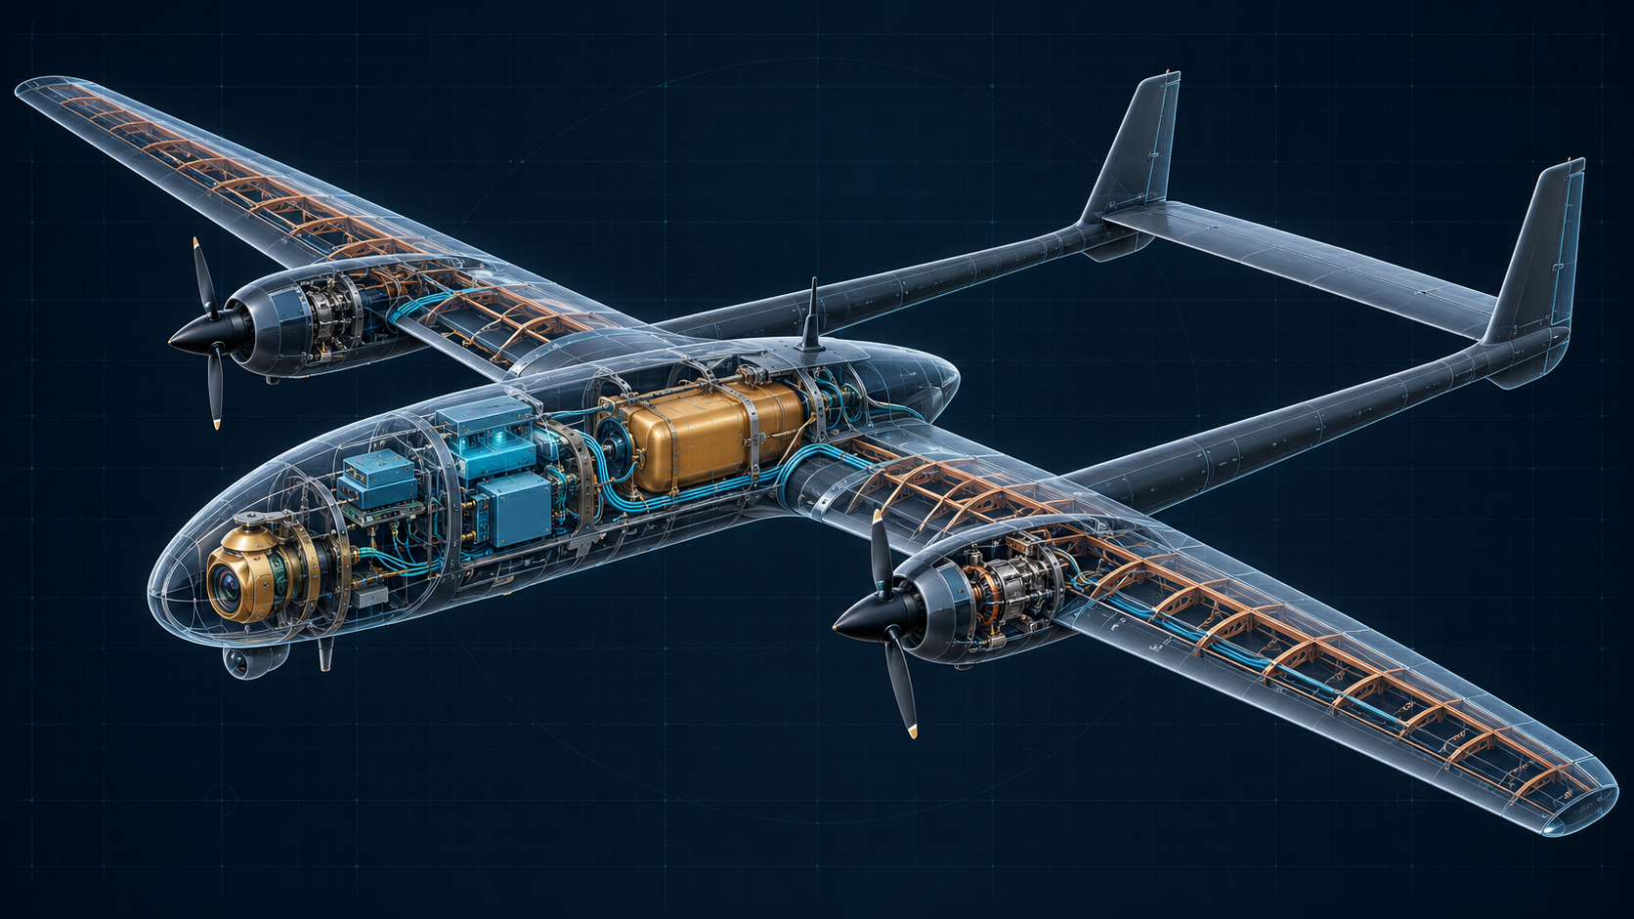
06 / INTERNAL SYSTEMS
Inside the aircraft: a conceptual cutaway
Illustrative visualization • generic UAV • not a verified layout of any pictured aircraft
PAYLOAD / AVIONICS / ENERGY / HARNESS / SPARS + RIBS / PROPULSION
UAV / SYSTEMS • HISTORY • OPERATIONS
17
Notes:
This generated technical visualization is an artistic conceptual cutaway. The glowing shell suggests access to the internal architecture, while the colours indicate payload, avionics, energy and structural components. Exact placements, sizes, materials and connections are not verified engineering data. Use the adjacent editable vector schematic and LRU table for the functional explanation. Do not identify this generic aircraft as TAPAS, ARCHER or another repository model. Real installations depend on mass balance, cooling, electromagnetic compatibility and maintenance access.

Slide 18
07 / PROPULSION
Engine choices follow the mission
01
02
03
Piston + propeller
Turbine systems
Electric motor
Fuel endurance and
mechanical complexity.
Cooling, ignition, lubrication
and vibration need attention.
Higher power density for
suitable missions. Fuel flow,
hot sections and installation
losses matter.
Fast torque response and
fewer moving parts. Battery
mass, temperature and usable
energy limit duration.
UAV / SYSTEMS • HISTORY • OPERATIONS
18
Notes:
Propulsion may use reciprocating engines, rotary engines, turboprops, turbojets, electric motors or hybrid architectures. A propeller accelerates a large mass of air by a moderate amount; jet propulsion uses a different balance of mass flow and exhaust velocity. No engine class is universally best. The selection depends on flight speed, altitude, endurance, payload, acoustic requirements and infrastructure. Electrification shifts substantial complexity into batteries, power electronics and thermal management. Hybrid systems add both energy-conversion options and integration burden.

Slide 19
07 / PROPULSION
Piston propulsion: energy to thrust
Functional chain • installation determines reliability and efficiency
FUEL SYSTEM
ENGINE
SHAFT / DRIVE
PROPELLER
ECU
Tank • filter
Delivery • metering
Combustion
Cooling • lubrication
Torque transfer
Optional gearbox
Shaft power
→ aerodynamic thrust
Engine health
Control limits
SECONDARY OUTPUT / Generator → conditioned electrical power → avionics and payload
UAV / SYSTEMS • HISTORY • OPERATIONS
19
Notes:
Fuel passes through storage, filtration and delivery before metering into the engine. Combustion generates shaft power, which reaches the propeller directly or through a gearbox. The engine control unit may manage fuel, ignition and limits depending on architecture. Cooling and lubrication remove heat and protect mechanical components. A generator supplies onboard electrical loads. Propeller installation influences inlet airflow, cooling, vibration and sensor placement. Twin-engine configurations require procedures and control authority for asymmetric thrust; redundancy is not automatic immunity from common failures.

Slide 20
07 / PROPULSION
Electric propulsion and the energy budget
01
02
03
Power chain
What consumes
energy
Endurance tradeoff
Battery → protection /
distribution → electronic speed
controller → motor → propeller.
Propulsion dominates many
missions. Payload, avionics,
heating and links also draw
power.
Usable energy / average power
gives a first estimate. Preserve
reserve and account for losses
and temperature.
UAV / SYSTEMS • HISTORY • OPERATIONS
20
Notes:
A first-order estimate is flight time in hours approximately equal to usable energy in watt-hours divided by average electrical power in watts. For example, 800 Wh usable at 400 W average gives 2 hours before mission-specific reserve and other adjustments; this is an illustrative calculation, not a UAV specification. Battery voltage sag, cell ageing, discharge rate, temperature and state-estimation uncertainty reduce confidence in nameplate energy. Electrical propulsion needs protection against overcurrent, thermal faults and undervoltage. Hover and forward-flight power differ significantly.

Slide 21
07 / PROPULSION
Power and thermal management are flight systems
01
02
03
Electrical architecture
Heat rejection
Fault isolation
Generation or battery supply;
regulated rails; load shedding;
protected distribution and
monitored buses.
Engines, motors, batteries, RF
amplifiers and processors all
generate heat. Cooling
changes with altitude and
speed.
Separate critical loads where
appropriate. Avoid a single
connector, bus or cooling fault
defeating redundancy.
UAV / SYSTEMS • HISTORY • OPERATIONS
21
Notes:
The power distribution unit routes and protects electrical supplies. DC-DC converters supply voltages needed by individual LRUs. Essential flight controls should have an assessed power continuity strategy. Nonessential payload loads can be shed to protect essential functions. Thermal design must cover worst-case ambient conditions, low-speed ground operation and reduced-density altitude. Redundant computers can still fail together if they share an unprotected supply, thermal path or software defect. Quantitative safety analysis is needed before making reliability claims.

Slide 22
08 / DATALINK
Datalink: three traffic classes, different priorities
A high-resolution video feed must not starve flight-critical command and telemetry
COMMAND / CONTROL
Mode requests • acknowledgements
Bounded authority and freshness
TELEMETRY
State • health • link quality
Timely and unambiguous status
PAYLOAD DATA
Video • imagery • sensor products
High throughput; tolerate graceful degradation
UAV / SYSTEMS • HISTORY • OPERATIONS
22
Notes:
Command and control carries authority, modes, mission updates and status. Telemetry includes position, attitude, energy state, faults and link health. Payload traffic carries imagery or other mission data and often consumes more bandwidth. Logical separation and scheduling are important even when traffic shares hardware. Link quality includes latency, jitter, loss, availability and integrity, not only received signal strength. Cryptographic authentication protects against unauthorized messages; encryption protects confidentiality. Actual spectrum use and communication architecture must comply with applicable approvals.

Slide 23
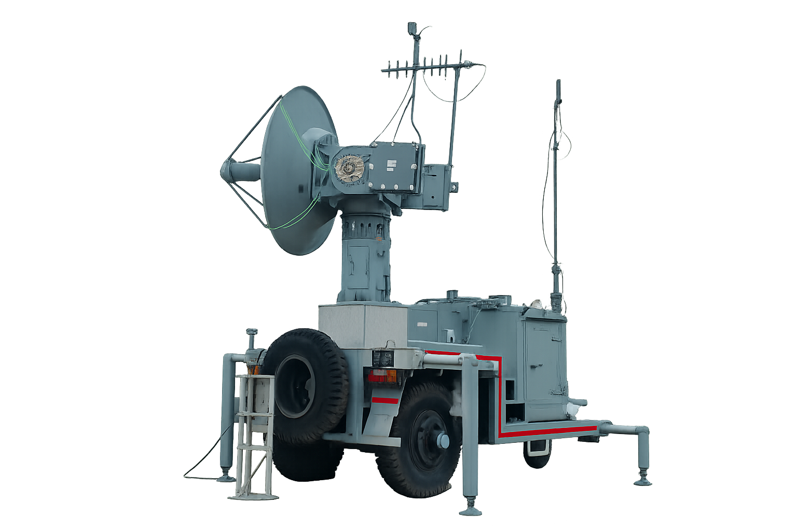
08 / DATALINK
Ground data terminal: the RF gateway
GDT role
Connect ground-station networks to the air-ground
radio path.
Tracking and RF chain
Antenna, pointing, transceiver, filtering and
interface equipment.
Readiness
Verify alignment, link quality, time sync and traffic
priority.
UAV / SYSTEMS • HISTORY • OPERATIONS
23
Notes:
The GDT is the ground data terminal. A ground control station may be physically separate from its antennas and RF terminal. A generic ground RF chain includes a modem, transceiver, amplifier, filtering, cabling and antenna. Directional antennas may need mechanical or electronic tracking. Antenna placement must account for obstructions, Fresnel clearance, interference and ground safety. The user-provided image is labelled gdt; its exact configuration and capabilities have not been independently verified.

Slide 24
08 / DATALINK
Line of sight and beyond line of sight
LOS = local radio geometry; BLOS = relayed or extended communications
BLOS PATH
SATELLITE / RELAY
Optional BLOS path
GCS / GDT
AIRCRAFT
Operator and RF link
LOS PATH
Onboard radio and FCC
Link coverage, flight authorization and collision avoidance are separate requirements.
UAV / SYSTEMS • HISTORY • OPERATIONS
24
Notes:
Radio line of sight is affected by terrain, buildings, antenna height and Earth curvature. Fresnel-zone obstruction can impair a link even when the endpoints are visually visible. Beyond-line-of-sight communication may use satellites or approved relay networks, but adds latency, dependencies and potential service interruptions. Regulatory BVLOS flight permission is a separate question from having technical BLOS communication capability. The graphic is a functional illustration rather than a statement about a specific aircraft system.

Slide 25
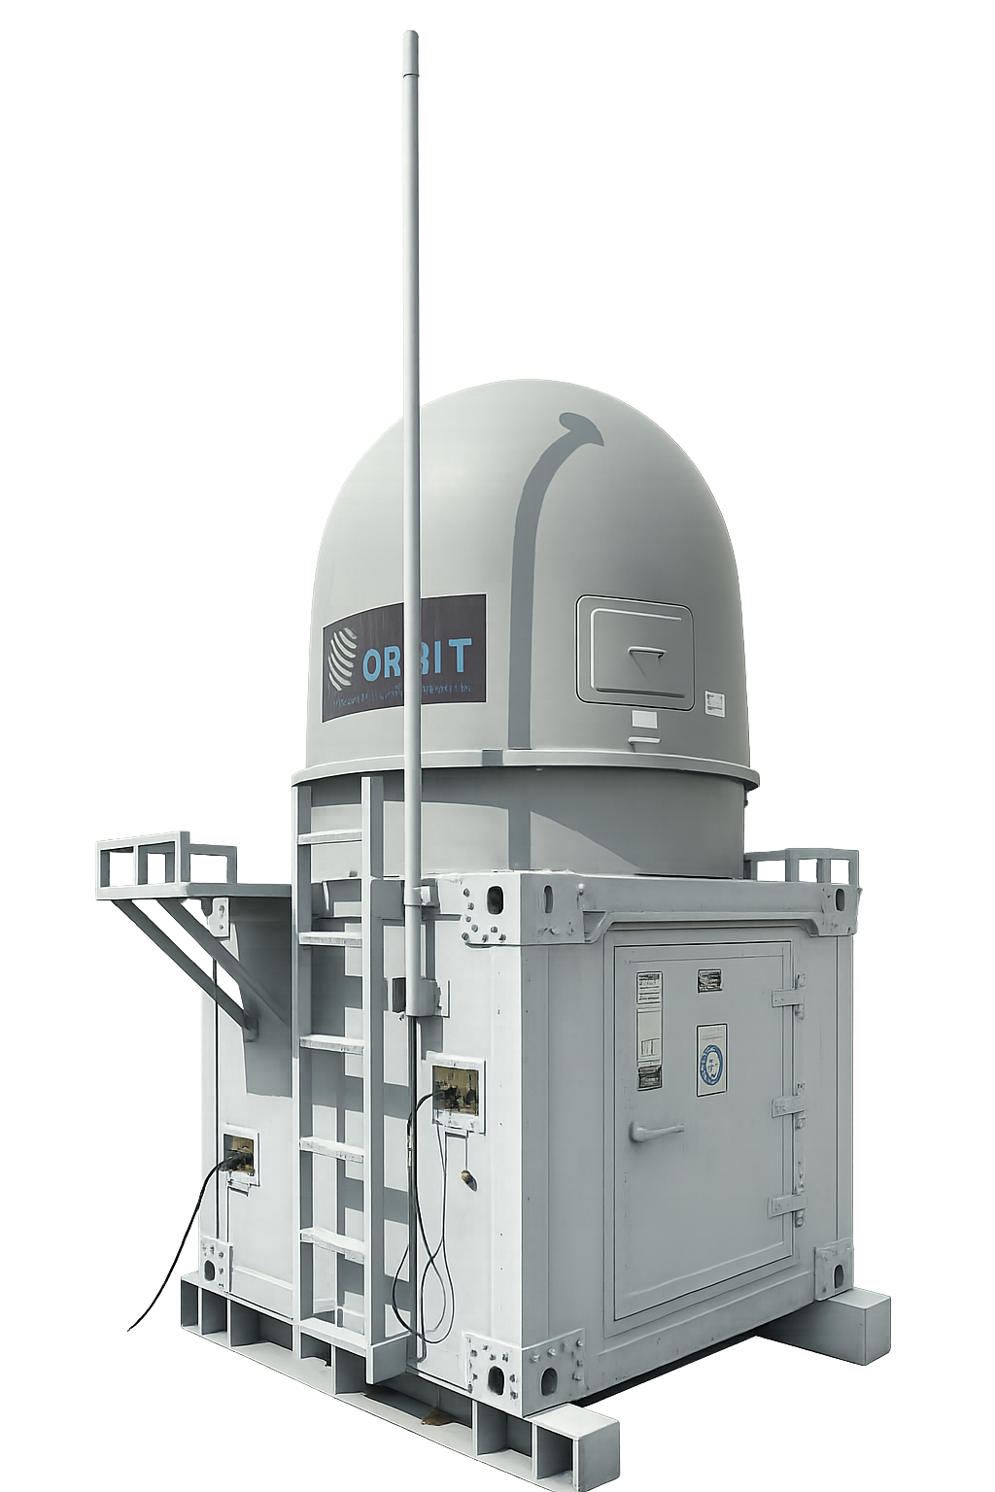
08 / DATALINK
Satellite data terminal: another system
dependency
SDT role
A satellite terminal can support remote
connectivity where equipped.
More than coverage
Service availability, pointing, latency and
throughput affect usability.
Shared infrastructure
Power, network interfaces and operator procedures
remain essential.
UAV / SYSTEMS • HISTORY • OPERATIONS
25
Notes:
SDT is used here as the repository’s satellite data terminal label. The image alone does not prove which satellite network or service it supports. Satellite links can support a ground communications segment and, when the aircraft is equipped appropriately, beyond-line-of-sight paths. Do not assume the pictured ground terminal is an airborne terminal. Account for antenna pointing, obstructions, service authorization, weather-related degradation where applicable, and operational latency. Satellite availability does not replace airspace permission or flight safety provisions.

Slide 26
08 / DATALINK
Link budget: reliability is engineered
01
02
03
Received power
Margins
Operational quality
Transmit power + antenna
gains − path loss − cable /
pointing / other losses. All
terms use consistent units.
Account for fading, polarization
mismatch, obstructions,
interference and equipment
variation.
Monitor packet loss, latency
and usable throughput. Signal
strength alone is insufficient.
UAV / SYSTEMS • HISTORY • OPERATIONS
26
Notes:
A simplified budget is P_rx in dBm = P_tx in dBm + G_tx in dBi + G_rx in dBi − losses in dB. Free-space path loss increases with distance and frequency for a specified antenna-gain comparison; it is only one component of a real propagation model. Link margin compares received performance with receiver requirements and the selected modulation and coding. Robustness may trade against throughput. Link-budget calculations require verified parameters and licensing limits, so no operational frequency, power or coverage is prescribed here.

Slide 27
09 / ANTENNA
Antenna: the bridge between RF and space
Pattern, polarization and installation can matter as much as transmitter power
OMNIDIRECTIONAL
DIRECTIONAL
DIVERSITY
Broad coverage
Lower directional gain
Concentrated beam
Pointing / tracking needed
Multiple placements
Reduce some shadowing effects
UAV / SYSTEMS • HISTORY • OPERATIONS
27
Notes:
An antenna converts guided electromagnetic energy into radiated energy and vice versa. Omnidirectional antennas provide broad azimuth coverage but do not have uniform three-dimensional gain. Directional antennas concentrate energy and need alignment. Polarization mismatch can reduce received power. Aircraft attitude changes can create pattern nulls or polarization changes; the airframe and cables can alter the installed pattern. GNSS antennas receive navigation signals and are separate in purpose from communication antennas. Diversity helps only when placement and switching logic are engineered appropriately.

Slide 28
09 / ANTENNA
Antenna integration: placement is a system
decision
01
02
03
Aircraft installation
Coexistence
Ground installation
Clearance from conductive
structures; assessed radiation
patterns; protection against
vibration and weather.
Separate sensitive receivers
from noisy electronics and
transmitters. Assess filters,
cable shielding and grounding.
Good siting, verified pointing,
sound cables and safe mast
procedures. Keep the path
clear of obstructions.
UAV / SYSTEMS • HISTORY • OPERATIONS
28
Notes:
Electromagnetic compatibility is assessed at installed-system level. A communications transmitter can desensitize a navigation receiver or interfere with other electronics if filtering and layout are inadequate. Coaxial cable loss and connector condition affect the link budget. Bonding and shielding strategies must work with the structural material. Carbon composites are not electrically identical to metal skins. Antennas may require radomes whose material properties affect performance. Field checks should follow approved procedures and should not expose personnel to unsafe RF or mast hazards.

Slide 29
10 / FLIGHT CONTROL COMPUTER
Flight control computer: the onboard control loop
Sense → estimate → decide → command → verify
SENSORS
ESTIMATOR
GUIDANCE
CONTROL
ACTUATORS
IMU • GNSS
Air data
Attitude
Position • velocity
Path • setpoints
Mode logic
Feedback laws
Limit handling
Servos / motors
Aircraft response
FEEDBACK: measurements close the loop
UAV / SYSTEMS • HISTORY • OPERATIONS
29
Notes:
The FCC processes sensor measurements, estimates state and issues commands that stabilize and guide the aircraft. Inner loops are generally faster than navigation and mission-management loops. The controller uses feedback to reduce error, but actuator authority, latency and sensor validity bound performance. Mission commands should be checked before affecting the control system. FCC and payload-processing functions may be hosted separately. This diagram shows functional blocks, not prescribed hardware or software timing.

Slide 30
10 / FLIGHT CONTROL COMPUTER
Navigation: no single sensor tells the whole story
01
02
03
IMU
GNSS + air data
Sensor fusion
Gyroscopes and
accelerometers support fast
motion estimation. Biases and
drift accumulate.
GNSS supports absolute
position / velocity. Airspeed
and pressure aid
aerodynamic-state awareness.
Combine complementary
measurements; check
consistency, timing and
degraded-sensor behaviour.
UAV / SYSTEMS • HISTORY • OPERATIONS
30
Notes:
An IMU measures angular rate and specific force, not absolute position directly. GNSS can bound long-term inertial drift but can degrade or be unavailable. Air data may include static pressure, differential pressure and temperature; calibration and installation error matter. A magnetometer may aid heading on some systems but is sensitive to local magnetic disturbances. Filtering, often using a Kalman-family estimator, combines models and measurements. Time synchronization, sensor alignment, vibration filtering and fault detection are essential. No architecture makes navigation immune to all environmental or data-quality problems.

Slide 31
10 / FLIGHT CONTROL COMPUTER
Modes, redundancy and graceful degradation
01
02
03
Mode management
Fault tolerance
Lost-link response
Manual / assisted / automatic
modes need clear authority,
guarded transitions and visible
status.
Redundant channels,
watchdogs and health
monitoring help when
independent failure paths are
assessed.
Aircraft-approved hold, return,
alternate or landing logic
depends on context, energy,
weather and airspace.
UAV / SYSTEMS • HISTORY • OPERATIONS
31
Notes:
A lost-link action is not a universal return-to-home instruction. The appropriate behaviour is designed and approved for the aircraft and operation. A return path may be unsuitable because of terrain, weather, energy state or airspace restrictions. A watchdog can detect some software hangs but not all incorrect outputs. Redundancy requires common-cause analysis, including shared power, sensors and software. Mode confusion is a human-factors risk; the ground display and onboard logic must agree on command authority and current state. Fault response should be validated by appropriate simulation and controlled tests.

Slide 32
11 / LRUS
Important LRUs: the replaceable building blocks
LRU = line-replaceable unit • maintainability boundary depends on the aircraft design
FCC / autopilot
Stabilization, guidance and flight modes
Control continuity; software configuration
INS / GNSS / air data
Navigation and measured flight state
Calibration; alignment; time synchronization
Radio / modem
Command, telemetry and payload transport
Link integrity; interface compatibility
Power distribution unit
Protected and monitored electrical supply
Essential bus continuity; fault isolation
ECU / ESC
Engine or motor control and monitoring
Propulsion limits; thermal condition
Payload + actuator units
Mission sensing and physical control
Image quality; motion; installation integrity
UAV / SYSTEMS • HISTORY • OPERATIONS
32
Notes:
An LRU is defined by the maintenance concept, not by its physical size alone. Replacing a failed LRU at line level can reduce downtime, while detailed repair happens at a workshop. A system may combine multiple functions in one LRU or distribute a function across several LRUs. Typical items include FCC, navigation unit, radio, power distribution, engine controller, payload electronics and actuators. Some may instead be subassemblies or shop-replaceable units. Replacement must preserve software compatibility, configuration, calibration, connectors and approved release-to-service procedures.

Slide 33
11 / LRUS
Actuators, buses and wiring
01
02
03
Actuators
Data interfaces
Harness engineering
Servos move control surfaces.
Position feedback and
mechanical condition
determine command
execution.
CAN, serial, Ethernet or
avionics buses may connect
units. Architecture determines
timing and reliability.
Routing, strain relief, connector
keying, shielding and
separation prevent many
integration failures.
UAV / SYSTEMS • HISTORY • OPERATIONS
33
Notes:
A controller output is useful only if the actuator can execute it. Torque, speed, travel, backlash and power demand affect control design. Bus choice depends on bandwidth, determinism, environmental qualification and legacy compatibility. A communications bus failure can affect multiple apparently independent LRUs. Harness damage can produce intermittent faults that built-in tests miss. Maintenance should inspect connector retention, corrosion, grounding, routing and chafing. Aircraft-specific wiring documents and approved test procedures are required for actual troubleshooting.

Slide 34
12 / MISSION SYSTEMS
Payload: the reason the aircraft flies
01
02
03
EO / IR imaging
Mapping sensors
Integration budget
Electro-optical and infrared
sensors; stabilized gimbals;
daylight, thermal and
inspection products.
RGB cameras, multispectral
sensors or LiDAR. Accuracy
depends on calibration,
position and processing.
Mass, power, data rate,
cooling, field of view and
vibration must fit the platform
and mission.
UAV / SYSTEMS • HISTORY • OPERATIONS
34
Notes:
Payload performance is a chain from scene conditions through optics, detector, stabilization, compression and geolocation to the user display. Infrared contrast depends on environmental conditions and sensor characteristics. Mapping accuracy requires careful calibration and georeferencing; pixel resolution is not the same as positional accuracy. LiDAR adds range measurements but requires precise timing and pose. Mission sensors can impose large data and thermal loads. A payload should not compromise critical aircraft functions when it draws excess power or fails.

Slide 35
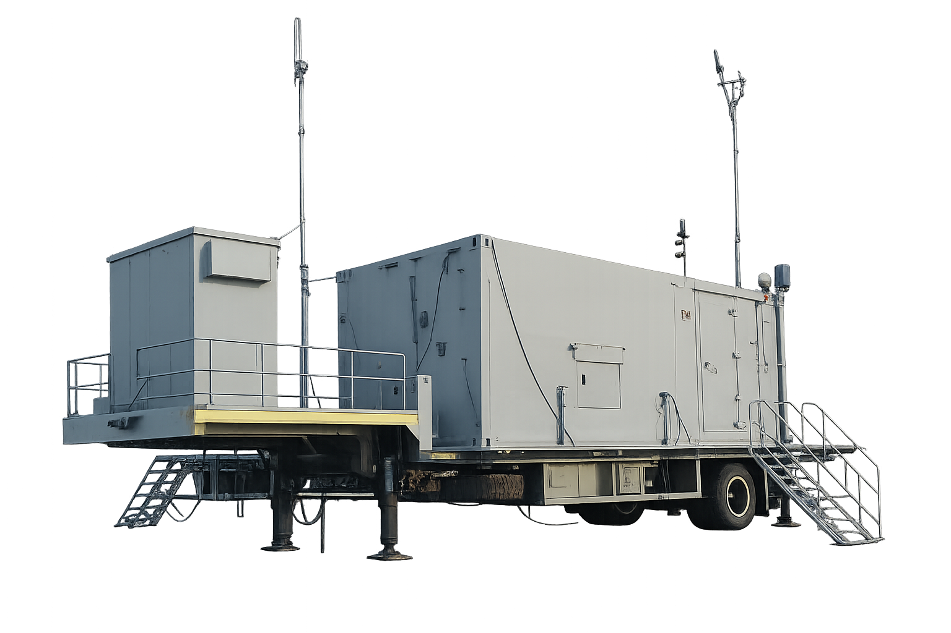
13 / GROUND CONTROL STATION
Ground control station: the human interface
Flight supervision
Aircraft state, modes, energy and link health.
Mission management
Plan routes, coordinate payload use and assess
data.
Operational support
Communications, logs, power, cooling and crew
workspace.
UAV / SYSTEMS • HISTORY • OPERATIONS
35
Notes:
A GCS may be a laptop, portable console or sheltered multi-operator facility. The pictured shelter is from the repository and is not proof of a particular internal arrangement. Remote pilots need current aircraft state and command acknowledgement. Payload operators may use separate consoles. Ground support includes network infrastructure, power conditioning, backup supplies, ventilation and recording. The GCS should support operation under workload and degraded conditions, not only normal flight. Personnel roles depend on the system and applicable regulations.

Slide 36
13 / GROUND CONTROL STATION
Inside the GCS: a conceptual console
Illustrative human-machine interface • all values below are placeholders
MISSION MAP / ROUTE OVERVIEW
FLIGHT STATE
W4
Mode • authority • position
W5
SYSTEM HEALTH
W2
Energy • navigation • propulsion
W3
LINK + ALERTS
W1
Freshness • warning priority
UAV / SYSTEMS • HISTORY • OPERATIONS
36
Notes:
This is a training mock-up, not flight software. A useful interface distinguishes flight-critical status from mission products. It should show mode, command authority, link quality, navigation health, energy state and warning priority. A map alone is insufficient, particularly when its data are stale. Alarms should be actionable, with clear acknowledgement and recovery procedures. The interface must make degraded data visible. Operational values, limits and colour meanings must follow the specific system and approved procedures.

Slide 37
13 / GROUND CONTROL STATION
Ground station people and procedures
01
02
03
Remote pilot
Payload operator
Support team
Maintains operational
authority, situational
awareness and safe decisions
appropriate to the operation.
Manages mission sensors and
products while coordinating
requests with the flight crew.
Maintenance, airspace
coordination and data
handling. Roles may be
combined in small operations.
UAV / SYSTEMS • HISTORY • OPERATIONS
37
Notes:
Crew design depends on workload and mission complexity. A remote pilot and payload operator should understand who controls aircraft motion and who may request changes. Handover needs positive confirmation of authority and status. An observer may be required or useful depending on the operation, but cannot substitute for the required system capability or approval. Ground crews also need documented maintenance, emergency and communications procedures. Good interface design and training address workload, fatigue, delayed information and mode confusion.

Slide 38
14 / OPERATIONS
Launch to recovery: the operational sequence
Illustrative civil survey workflow • follow aircraft-specific procedures in practice
PLAN
PRE-FLIGHT
LAUNCH
MISSION
RECOVERY
POST-FLIGHT
Objective
Airspace
Weather
Inspection
Configuration
Link / sensors
Area clear
Method ready
Mode checked
Monitor health
Collect data
Maintain reserve
Approach
Landing area
Shutdown
Inspect
Review logs
Record defects
Launch methods vary: runway, catapult, hand launch or VTOL. Recovery may be runway, VTOL or parachute.
UAV / SYSTEMS • HISTORY • OPERATIONS
38
Notes:
Plan the survey objective, terrain, airspace, weather limits, reserve and alternate recovery options. Inspect the aircraft and verify configuration, sensor calibration, control direction and communications using approved procedures. Launch and takeoff need a confirmed area and method. During the mission, monitor aircraft health, coverage and link quality while supervising payload collection. Recovery is planned before launch and revised only within authorized procedures. After flight, isolate energy safely, inspect, preserve logs and assess anomalies. This is an overview, not a substitute checklist.

Slide 39
14 / OPERATIONS
Built-in test, maintenance and configuration
01
02
03
Detect + isolate
Replace + verify
Close the loop
Built-in test reports useful
symptoms. Correlate logs with
physical inspection and
approved diagnostics.
Correct LRU part, software and
calibration. Inspect interfaces;
complete the required
functional checks.
Record configuration and
defects. Track recurring faults,
life limits and changes across
aircraft and GCS.
UAV / SYSTEMS • HISTORY • OPERATIONS
39
Notes:
Built-in test can identify some faults but may not isolate the root cause. A radio fault indication might arise from power, cabling, cooling or software. An LRU swap should follow maintenance authorization and avoid introducing a configuration mismatch. Log timestamps and configuration baselines are important when comparing aircraft and ground records. Firmware changes can affect sensor drivers, control laws and interface behaviour. Testing after maintenance is determined by approved procedures and the nature of the work. Repeated resets are not an adequate response to recurring unexplained faults.

Slide 40
15 / RESPONSIBLE OPERATIONS
Safety, cyber resilience and regulation
01
02
03
Flight safety
Cyber resilience
Legal + social duties
Weather limits, terrain
clearance, reserve energy,
contingencies and collision-risk
management.
Authenticated commands,
controlled access, verified
updates, protected keys and
trustworthy logs.
Airspace permissions, operator
responsibilities, privacy and
responsible data handling.
UAV / SYSTEMS • HISTORY • OPERATIONS
40
Notes:
Technical capability does not establish legal permission. In India, consult current DGCA rules, Digital Sky information and applicable airspace restrictions; requirements vary with aircraft, location and operation. Similar checks apply with the relevant regulator elsewhere. Navigation and communication failures require a system-level response. Cybersecurity complements safety engineering by controlling access and verifying software integrity. Privacy and data retention need consideration for imaging missions. This deck provides educational context rather than a legal or operational authorization.

Slide 41
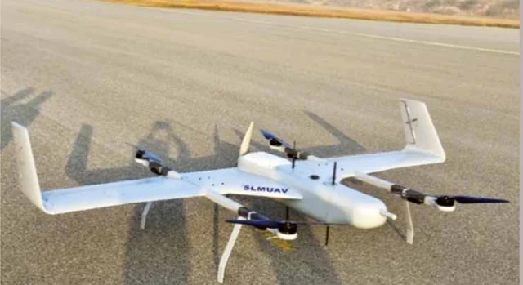
16 / BROADER ECOSYSTEM
Small UAVs: the same architecture, tighter budgets
Different scale
Smaller systems compress avionics, energy and
payload into limited volume.
Similar interfaces
Control, navigation, power, payload and ground
communication remain coupled.
Careful identification
SLM-UAV is the supplied asset label; capabilities
are not inferred.
UAV / SYSTEMS • HISTORY • OPERATIONS
41
Notes:
The repository filename SLM-UAV is not expanded because the image and filename alone do not verify its meaning. The picture is used only to discuss scale and packaging. Compact aircraft often share processors and power rails, which reduces mass but changes fault-isolation boundaries. Small size does not remove airspace, privacy or maintenance responsibilities. Comparisons should distinguish verified aircraft data from assumptions based on appearance.

Slide 42
16 / BROADER ECOSYSTEM
Civil applications turn flight into useful data
01
02
03
Infrastructure
Land + environment
Logistics + science
Inspect power lines, bridges,
roofs and industrial assets.
Sensor choice determines
useful defect visibility.
Map terrain, monitor crops,
assess forests and support
disaster-response situational
awareness.
Carry approved payloads or
sample the atmosphere.
Reliability, access and
operating approvals shape
feasibility.
UAV / SYSTEMS • HISTORY • OPERATIONS
42
Notes:
The value of a UAV mission lies in its delivered product, not simply in flying. Inspection workflows need repeatable views and clear defect criteria. Agriculture benefits from calibrated imagery and agronomic interpretation. Disaster response needs coordination so drones do not conflict with emergency aviation. Logistics requires robust operational and regulatory planning, including safe loading and delivery. Scientific measurements depend on calibration and sampling conditions. Each application changes the payload, flight path, data processing and maintenance priorities.

Slide 43
17 / FUTURE
The future: more autonomy, more assurance
01
02
03
Onboard perception
Energy + architecture
Airspace integration
Vision and other sensors
support inspection, navigation
assistance and obstacle
awareness.
Improved storage, hybrid
power, efficient structures and
tailored VTOL configurations.
Remote identification, traffic
services and detect-and-avoid
capabilities must be validated
together.
UAV / SYSTEMS • HISTORY • OPERATIONS
43
Notes:
Future systems may place more decision making onboard, but assurance remains central. Machine-learning perception can fail under unfamiliar conditions and needs defined operating limits and monitoring. Detect and avoid is a system capability with sensing, decision and manoeuvre requirements, not just an obstacle sensor. Traffic-management services do not replace all collision-avoidance obligations. Improvements in energy density and aerodynamic efficiency may extend mission duration but must still satisfy safety, thermal and lifecycle constraints. Avoid treating research demonstrations as mature universal capability.

Slide 44
18 / SYNTHESIS
A UAV is an integrated chain of decisions
Structure supports the mission; onboard control keeps flight stable; links connect people and data.
AIRCRAFT
Structure + propulsion + flight control
CONNECTIVITY
Datalink + antenna + ground terminals
MISSION SYSTEM
Payload + crew + maintenance +
assurance
UAV / SYSTEMS • HISTORY • OPERATIONS
44
Notes:
The central message is that a UAV is a coupled system. Mission needs drive the configuration and payload. Structure and propulsion define the physical envelope; navigation and the FCC control flight within that envelope. Datalinks and antennas connect the aircraft to ground operators. LRUs make the system serviceable, while power, cooling and configuration management sustain reliability. The GCS is the human interface, not merely a monitor. History explains how these capabilities evolved; safety and regulation govern how they are used.

Slide 45
APPENDIX A
Glossary: the terms behind the diagrams
Acronyms used throughout this presentation
UAV / UAS
Unmanned aerial vehicle / system
RPA / RPAS
Remotely piloted aircraft / system
FCC / LRU
Flight control computer / line-replaceable unit
GCS / GDT / SDT
Ground control / ground data / satellite data terminal
IMU / INS / GNSS
Inertial measurement unit / inertial navigation / satellite navigation
EO / IR
Electro-optical / infrared
ECU / ESC
Engine control unit / electronic speed controller
LOS / BLOS
Line-of-sight / beyond-line-of-sight communications
VLOS / BVLOS
Visual / beyond visual line-of-sight operations
MALE / HALE
Medium / high altitude long endurance
UAV / SYSTEMS • HISTORY • OPERATIONS
45
Notes:
Use this page as a quick audience reference. C2 means command and control, not simply any data traffic. INS is the navigation system; IMU is the sensor unit, and the two are not synonymous. EO and IR refer to sensor domains. GDT and SDT refer to data terminals, while GCS is the control-station function. LOS and BLOS describe communication geometry, whereas VLOS and BVLOS describe visual-operational conditions. MALE and HALE are category descriptions rather than guaranteed numerical specifications.

Slide 46
APPENDIX B / FURTHER READING
Reference guide: history and Indian programmes
Official reference links • these sites were blocked by this session’s network policy
National Museum of the U.S. Air Force
Kettering Bug and reconnaissance-drone history
https://www.nationalmuseum.af.mil/
Imperial War Museums
Early British target aircraft and drone history
https://www.iwm.org.uk/
DRDO / Aeronautical Development Establishment
Lakshya, Nishant, Rustom / TAPAS, ABHYAS and demonstrators
https://www.drdo.gov.in/
Ministry of Defence / Press Information Bureau
Dated Indian programme announcements and trial reports
https://pib.gov.in/
UAV / SYSTEMS • HISTORY • OPERATIONS
46
Notes:
The linked institutions are recommended starting points for verification and further study. Their pages were not retrieved in this session because the network proxy returned access denials. They should not be represented as newly reviewed evidence. Programme-specific claims and current status should be checked against dated DRDO, Ministry of Defence and regulator releases. The history is intentionally selective. Photos are supplied by the user via the named GitHub repository; filenames alone do not verify identities or image rights.

Slide 47
APPENDIX B / FURTHER READING
Reference guide: engineering and operating rules
Verify current rules and aircraft-specific limits before any real operation
NASA aeronautics education
Aerodynamic forces, lift, drag and propulsion
https://www.nasa.gov/
FAA unmanned aircraft systems
UAS operations and regulatory resources
https://www.faa.gov/uas
DGCA / Digital Sky
India: current rules, airspace and civil drone requirements
https://digitalsky.dgca.gov.in/
ICAO unmanned aviation
RPAS terminology and international integration context
https://www.icao.int/
UAV / SYSTEMS • HISTORY • OPERATIONS
47
Notes:
Technical concepts are general educational summaries rather than extracted aircraft specifications. NASA education resources explain lift, drag and propulsion. FAA and ICAO resources provide unmanned-aircraft terminology and regulatory context. Indian civil operations require current DGCA and relevant Digital Sky checks. The authoritative documents for a particular aircraft are its approved operating and maintenance manuals, interface-control documents and limitations. None of the diagrams are approved design documents or operational instructions.

Slide 48
APPENDIX C / PRODUCTION NOTES
Assets, diagram scope and Canva import
An editable 16:9 PowerPoint, with a matching PDF reading copy
IMAGE PROVENANCE
ILLUSTRATION SCOPE
IMPORT TO CANVA
abhijeetkr1436802/codex_env
Commit: 084ac3a561b7…
10 repository images used
Asset names retained
Generic vector blueprint
Conceptual internal zones
Functional block diagrams
No verified model cutaway
Upload the .pptx to Canva
Open as a presentation
Check layout and fonts
Add animations if desired
UAV / SYSTEMS • HISTORY • OPERATIONS
48
Notes:
All ten source images in repository commit 084ac3a561b70c9446c0d865be670f0e4e44a82e were used. The original attached collage contains views corresponding to the repository assets; the deck uses the higher-quality individual repository images. The WEBP image is transcoded to PNG for PowerPoint compatibility without visual retouching. Vector diagrams and text are editable. Canva was not available as a connected tool; this deck is therefore a PowerPoint prepared for import, not a Canva-created or Canva-verified design. Import may alter fonts, grouping, notes or layout, so inspect the imported result. Speaker notes are available in the PowerPoint and companion Markdown guide.

