Slide 1
ROBOTICS · PATH PLANNING
A* ROBOT PATHFINDING
AND CONFLICT-BASED
ADAPTIVE A*
Intelligent single-robot and multi-robot path planning.
A* PATHFINDING
HEURISTIC COMPARISON
MULTI-ROBOT COLLISION AVOIDANCE
CONFLICT-BASED ADAPTIVE A*

Slide 2
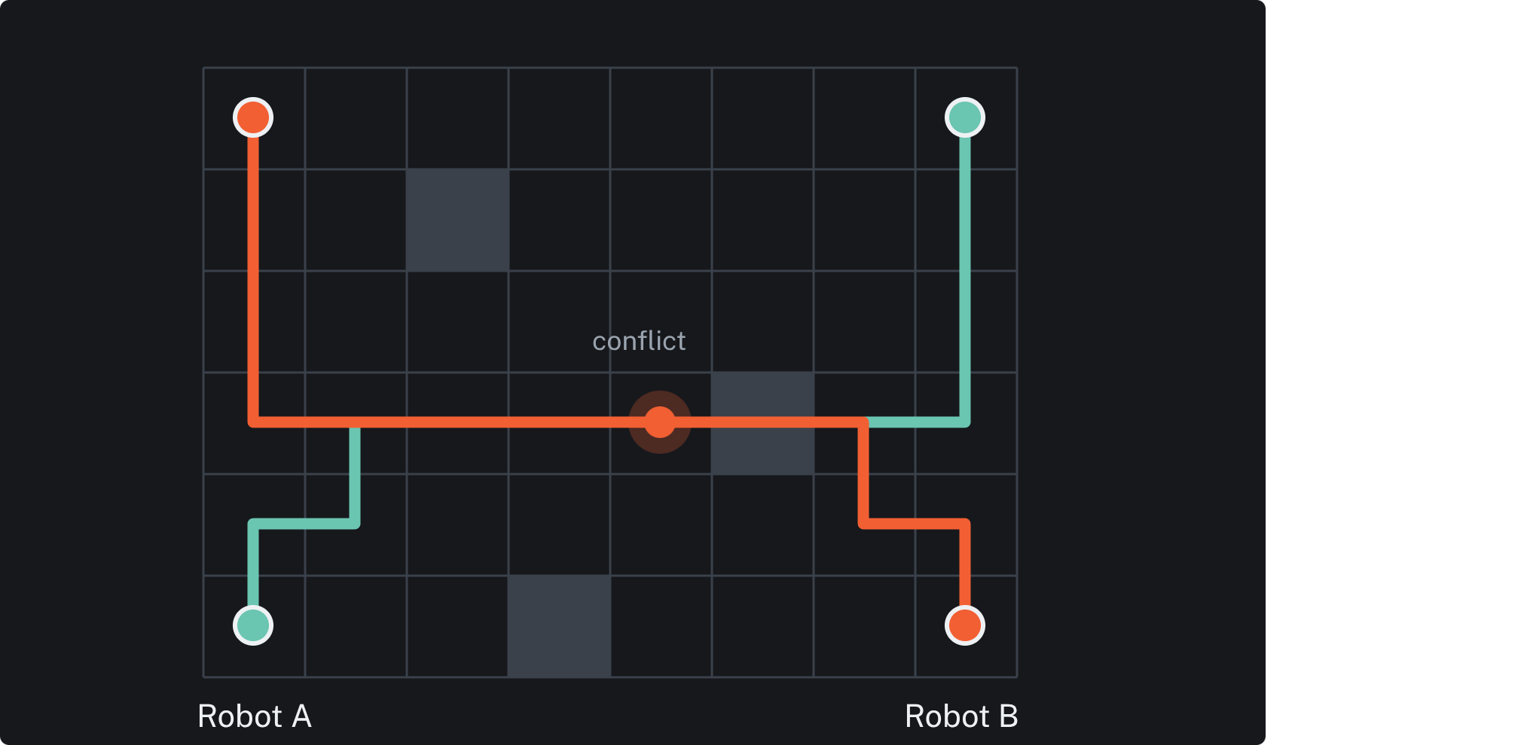
Robots need paths that are short, safe, and coordinated
Move from start to goal while avoiding obstacles.
Find efficient routes and prevent vertex collisions and edge swaps.
Implement single-robot A*, compare five heuristics, and develop CBA* for conflict resolution.
The planning problem: two individually reasonable routes can meet at the same place and time.
02

Slide 3
A* balances distance traveled with estimated distance remaining
01
02
03
04
CORE SCORE
Explore neighbors
Calculate f(n)
Select the lowest score
Reach the goal and reconstruct the path
Path cost so far plus estimated cost to the goal.
With an admissible heuristic, A* finds optimal paths and is more efficient than uninformed search.
03

Slide 4
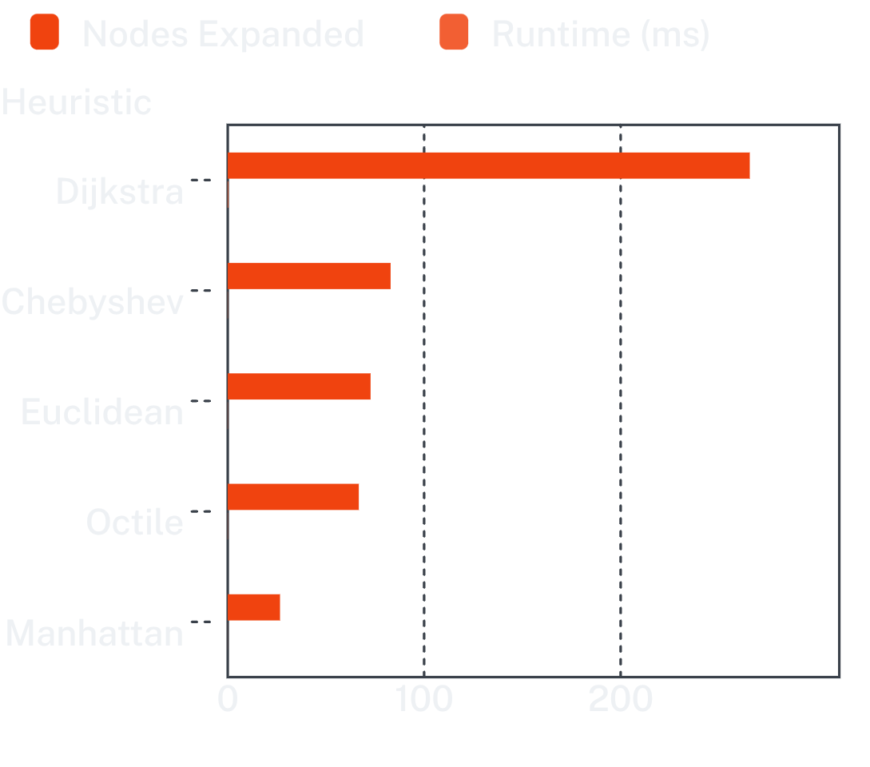
Manhattan distance was the best fit for four-directional grids
Dijkstra: h(n)=0 · Manhattan: |dx| + |dy| · Euclidean: √(dx² + dy²)
Chebyshev: max(dx, dy) · Octile: max(dx,dy) + (√2−1)min(dx,dy)
KEY RESULT
0.045
26.6
ms runtime
expanded nodes
04

Slide 5


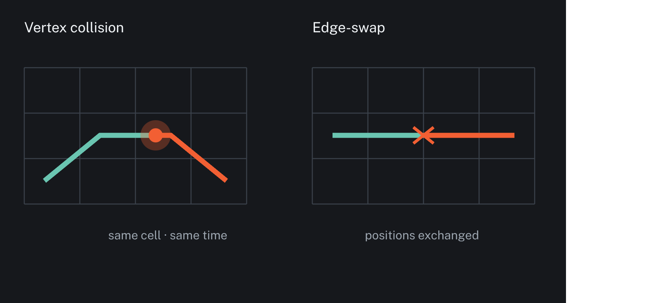

Independent A* plans well for one robot, but ignores the team
Independent planning
Each robot plans independently.
Team failure
Individually optimal paths can collide. Vertex collision: two robots occupy one cell at the same time. Edge-swap: two robots exchange positions between consecutive steps.
Observed result
Independent A* achieved approximately 55% benchmark success.
05

Slide 6
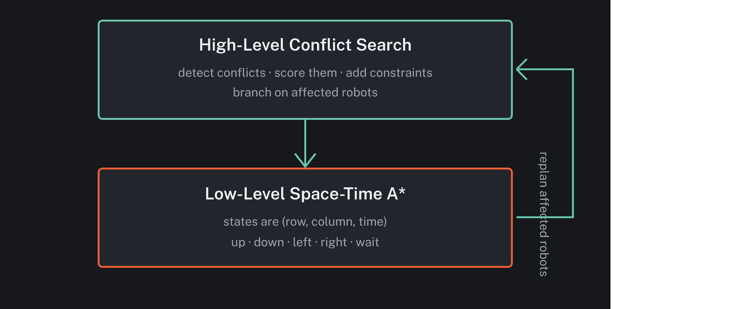
CBA* adds a conflict-aware layer above space-time planning
Conflict-Based Adaptive A* separates coordination from movement search.
The high level decides what to constrain; the low level finds a new safe path.
06

Slide 7
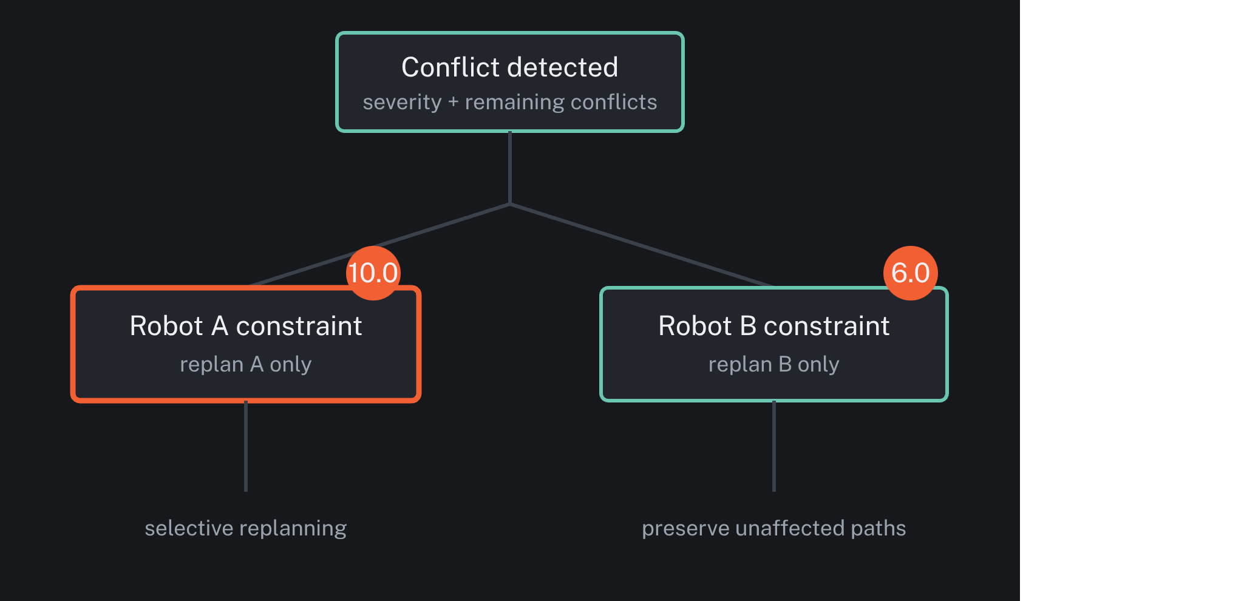
Adaptive prioritization makes conflict resolution selective
Priority = Cost + 10 × Remaining Conflicts.
Vertex collision base score: 10.0.
Edge-swap collision base score: 6.0.
Local obstacle density increases severity.
07

Slide 8
The benchmark stresses scale, density, and coordination
DIMENSION | CONFIGURATION | DIMENSION | CONFIGURATION
Grid sizes | 15×15 and 20×20 | Obstacle density | 15% and 25%
Robot counts | 3 and 5 | Trials | 8 configurations × 5 trials
Start-goal distance | Minimum 6 cells | High-level limit | 200 expansions
MEASURED OUTPUTS
Success rate · collisions · makespan · planning time · nodes expanded
08

Slide 9
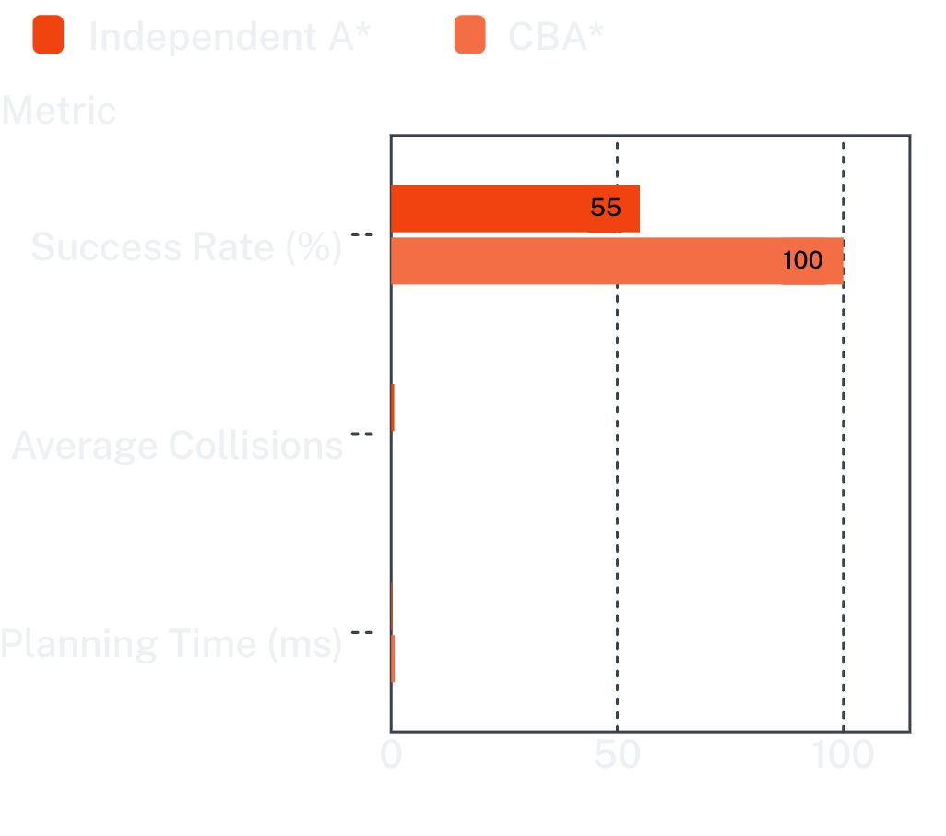
CBA* traded a little planning time for reliable coordination
CBA* sharply improves reliability and collision avoidance while adding modest planning cost.
RELIABILITY
SAFETY
100%
0.00
CBA* success rate
average collisions
Average makespan: inf due to failures vs ~20 steps. CBA* achieved zero average collisions across the tested configurations.
COST
~0.8
ms planning time
09

Slide 10
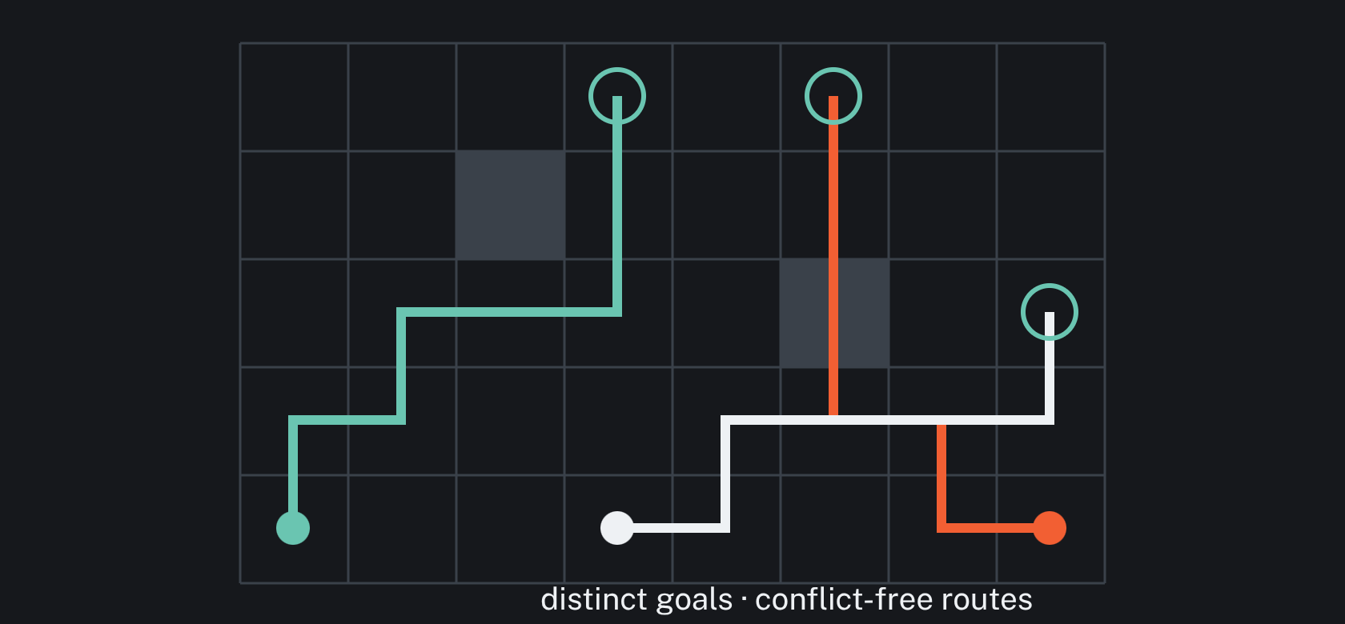
Safe multi-robot navigation needs conflict-free paths
A* efficiently solves single-robot pathfinding.
Manhattan is highly effective for four-directional grids.
Independent A* can create conflicting multi-robot paths.
CBA* combines conflict detection, constraints, and Space-Time A*.
CBA* reached 100% benchmark success with 0 average collisions, at the cost of additional planning time.
FUTURE WORK
Larger grids and more robots · Dynamic obstacles and real-time replanning · Different robot speeds · ROS or real-robot integration · Large-scale multi-agent experiments

