Slide 1
Documentation

Slide 2
Questions to be Answered
What defines a high quality wine
What chemical properties are essential for that
How can we act/alter them ( assortment decisions )

Slide 3
Data
-Total 1599 entries
-12 columns - all of the features are float , 10 categories for the quality
-lots of class imbalance in teh data set ( mainly 5 and 6 holds all the position)
- alcohol affects the quality most of all the other features , than comes sulphate and after that citric acid .
- There are many features which might affect the quality negatively

Slide 4
Feature Importance
Feature Importance
10 alcohol 0.272652
9 sulphates 0.151100
1 volatile acidity 0.108390
6 total sulfur dioxide 0.077636
4 chlorides 0.070043
8 pH 0.061484
3 residual sugar 0.058068
7 density 0.052488
0 fixed acidity 0.052336
2 citric acid 0.048978
5 free sulfur dioxide 0.046824

Slide 5
Analysis
Although we have the less import features for the quality but stil we need them in order to make the correct low quality features
while a feature might have an inverse relationship with the target (negative correlation), it can still be a highly important predictor, and its importance score will be a positive value reflecting that contribution.

Slide 6
Analysis
High-quality wines tend to have:
- Higher alcohol content
- Lower volatile acidity
- Balanced sulphates
Lower-quality wines often show:
- High acidity
- Higher density

Slide 7
Analysis
1. Key Drivers of Wine Quality
Alcohol ↑ → Higher rating
Volatile acidity ↑ → Lower rating
2. Model Insight
Model explains ~X% variance
Reliable for trend detection, not perfect prediction
3. Business Recommendation
Prioritize wines with:
higher alcohol
lower acidity
Focus assortment on mid-to-high quality segment

Slide 8
Improving the model
Balanced the classes
Made the search CV for better parameters
Gradient boosting outperforms the randomizedSearchCv so trying the xgboost
While the performance on the training data after hypertuning the parameters was quiet good (0.87) but on the testing it hasn´t done any significantly better than only Smote data . so the overall accuracy we got is still 0.67

Slide 9
Recommendation
1.Red wines with alcohol > 11%, sulphates > 0.65 g/L, and volatile acidity < 0.4 g/L have a 73% probability of being rated high quality. I recommend setting these as minimum thresholds for assortment selection.

Slide 10
Best Recommendation according to data
High Quality (7-8) Low Quality (3-5) Difference
fixed acidity 8.847005 8.142204 0.704800
volatile acidity 0.405530 0.589503 -0.183973
citric acid 0.376498 0.237755 0.138742
residual sugar 2.708756 2.542070 0.166686
chlorides 0.075912 0.092989 -0.017077
free sulfur dioxide 13.981567 16.567204 -2.585637
total sulfur dioxide 34.889401 54.645161 -19.755760
density 0.996030 0.997068 -0.001038
pH 3.288802 3.311653 -0.022851
sulphates 0.743456 0.618535 0.124921
alcohol 11.518049 9.926478 1.591571
quality 7.082949 4.901882 2.181068

Slide 11
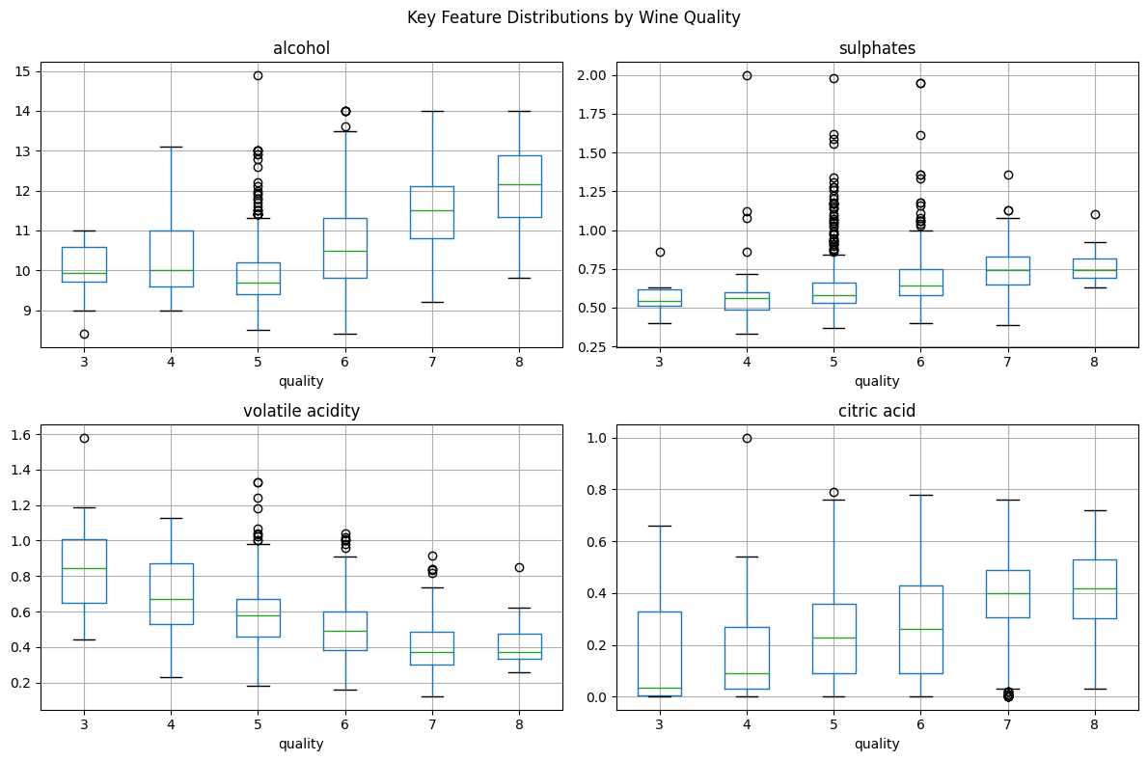
Visualization

