Slide 1
Lending Club Case study
Analysis and Recommendation

Slide 2
Lending Club
Business
The company is the largest online loan marketplace, facilitating personal loans, business loans, and financing of medical procedures. Borrowers can easily access lower interest rate loans through a fast online interface.
Objectives
To reduce credit loss by defaulters.
Utilizing previous knowledge to the identify driving factors.
Problem statement
Perform EDA to understand how consumer attributes and loan attributes influence the tendency of default
Identify the driving factor which are indicators of defaulters

Slide 3
Steps taken for analysis
Data Understanding and cleaning
Identify the shape, columns and data type of the data frame
Drop columns with null and single category values. Convert column values to proper datatype.
Univariate Analysis
Identify numerical and categorical variables.
Segmented Univariate Analysis
Create required categories(bins) of the numerical variables for ease of understanding.
Bivariate Analysis
Conclusion
Correlation analysis of the data frame.
Show plots with analysis comments and suggest recommendation
Make null, missing values to 0%
Check distribution and frequency of above variables.
Identify target variable.
Analyse identified variables with other segmented variables and list the insights
Next, check how two variables behave with each other and affect the third variable.

Slide 4
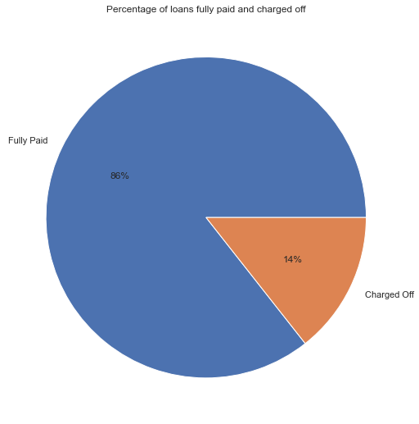
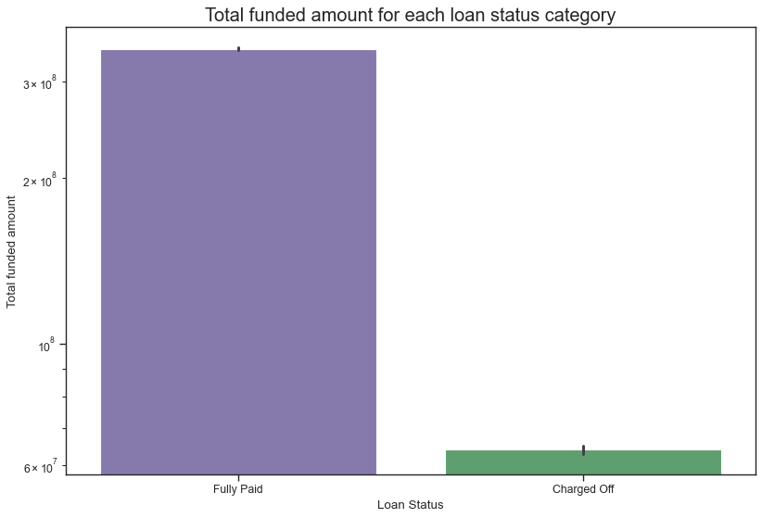
Lending analysis
The pie chart shows that 14% of the total loans have been charged-off.
It accounts for a loss of 15.67% of the total funded

Slide 5
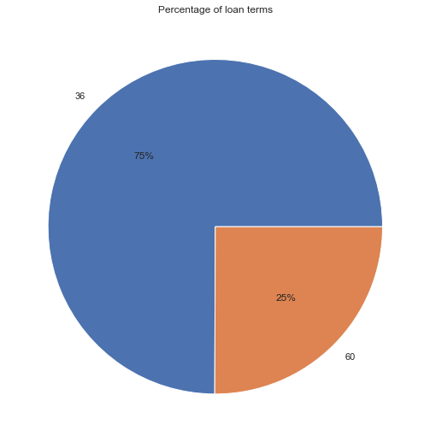
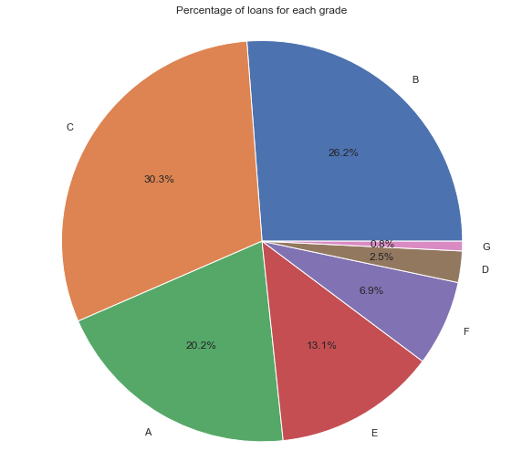
Lending analysis
It accounts for a loss of 15.67% of the total funded
The pie chart shows that 14% of the total loans have been charged-off.

Slide 6
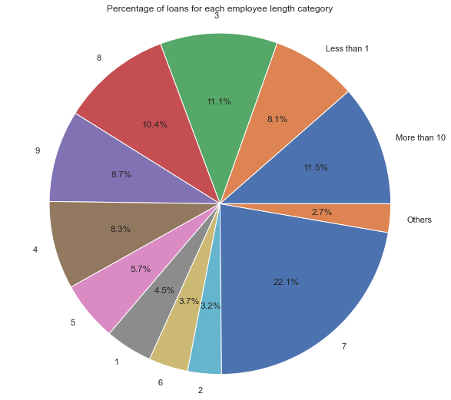
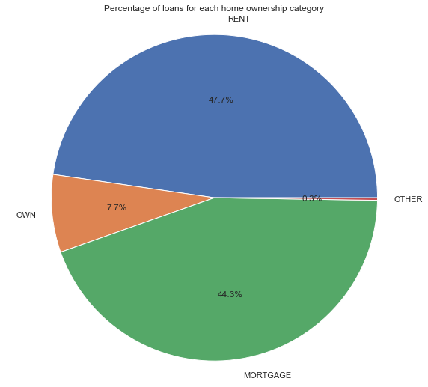
Lending analysis
The pie chart shows that 14% of the total loans have been charged-off.
It accounts for a loss of 15.67% of the total funded

Slide 7
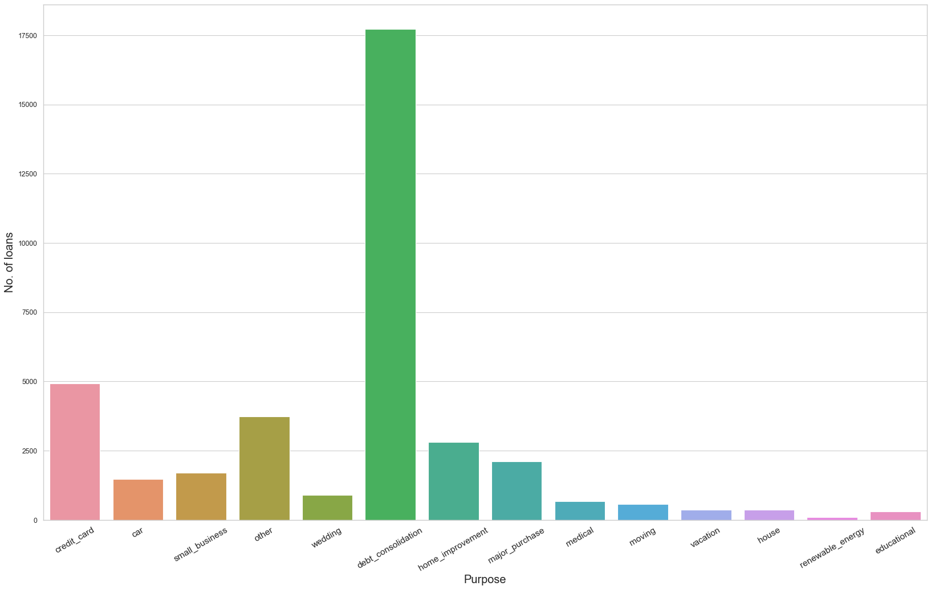
Lending analysis
The pie chart shows that 14% of the total loans have been charged-off.

Slide 8
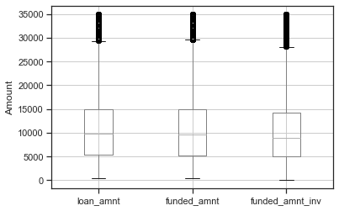
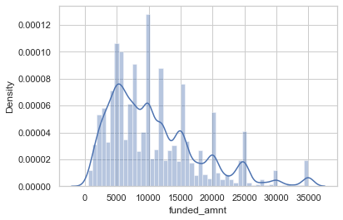
Lending analysis
The pie chart shows that 14% of the total loans have been charged-off.

Slide 9
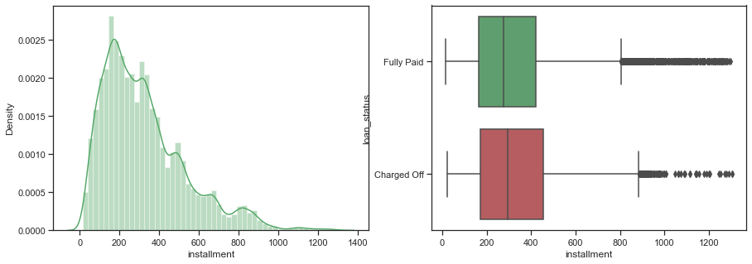
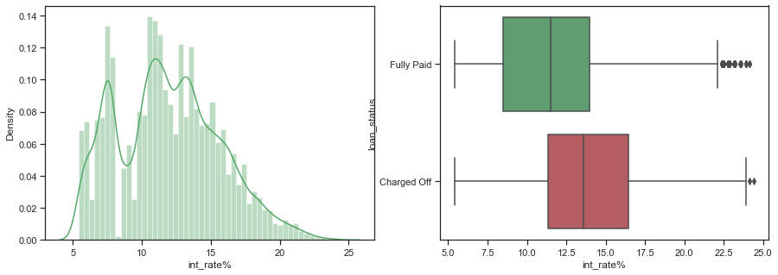
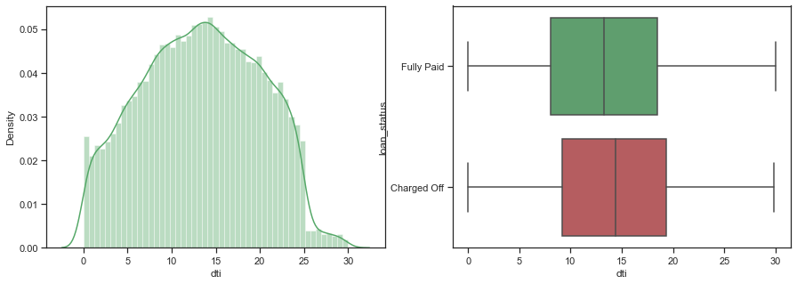
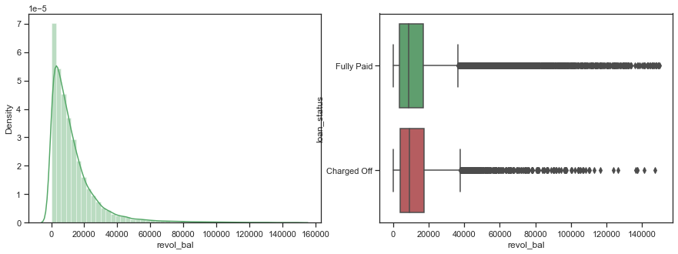

Slide 10
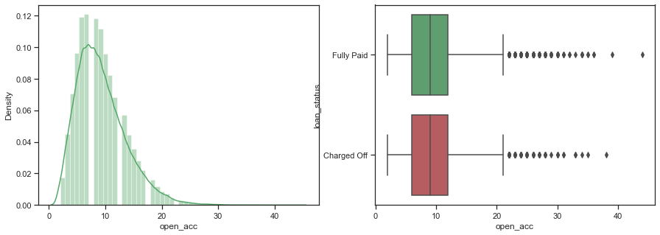
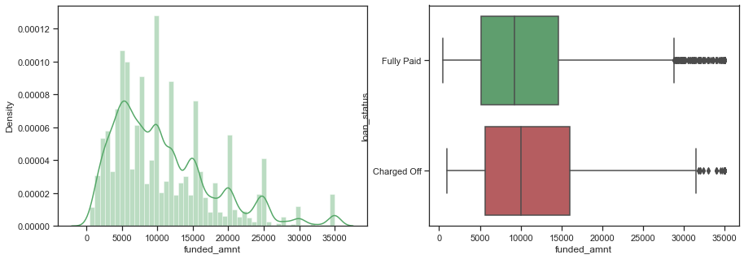

Slide 11
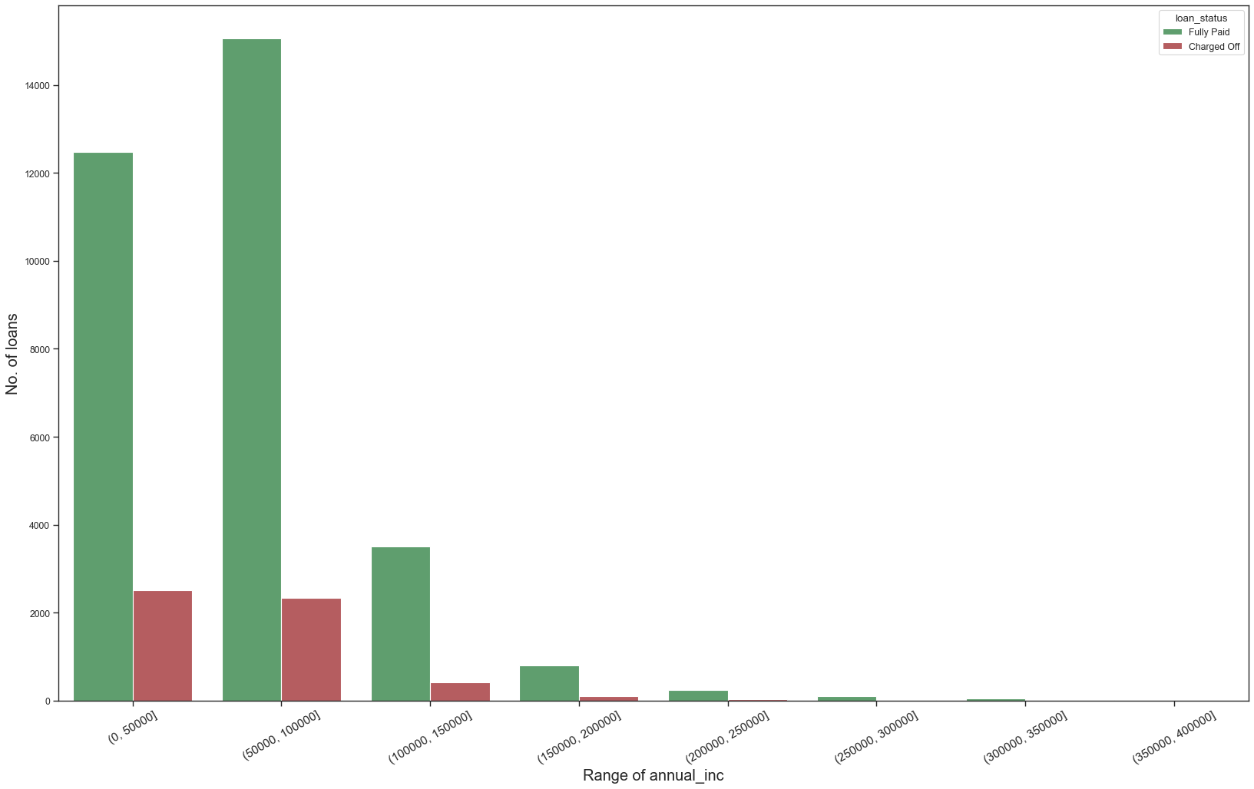
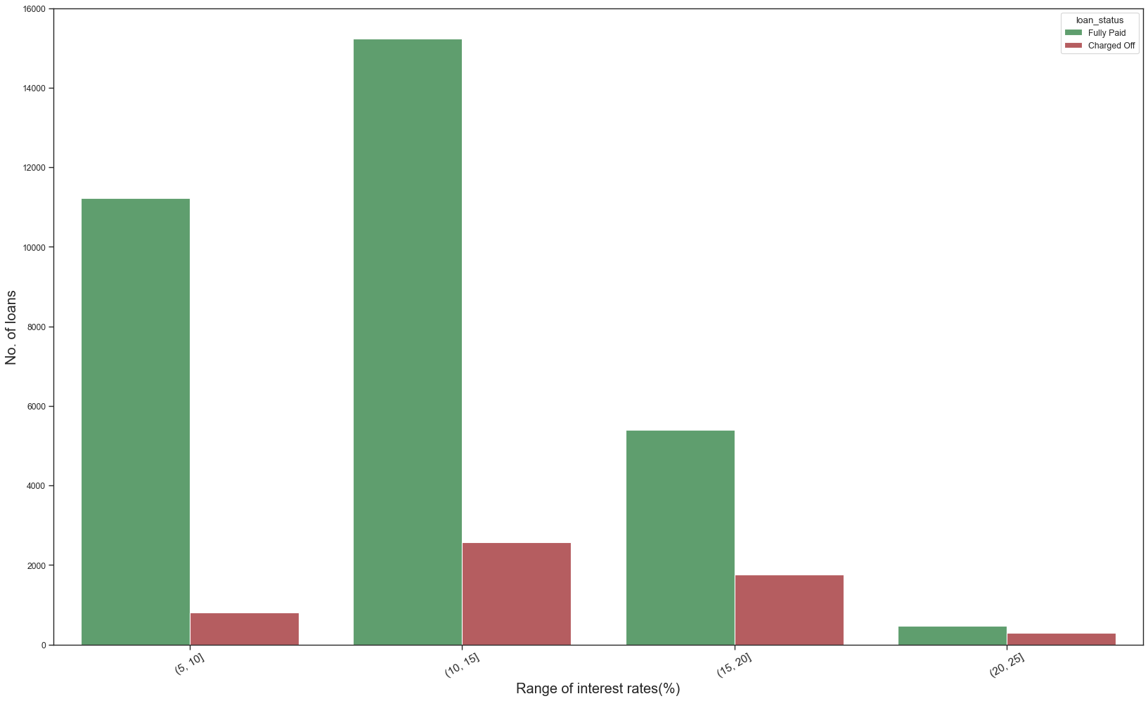

Slide 12
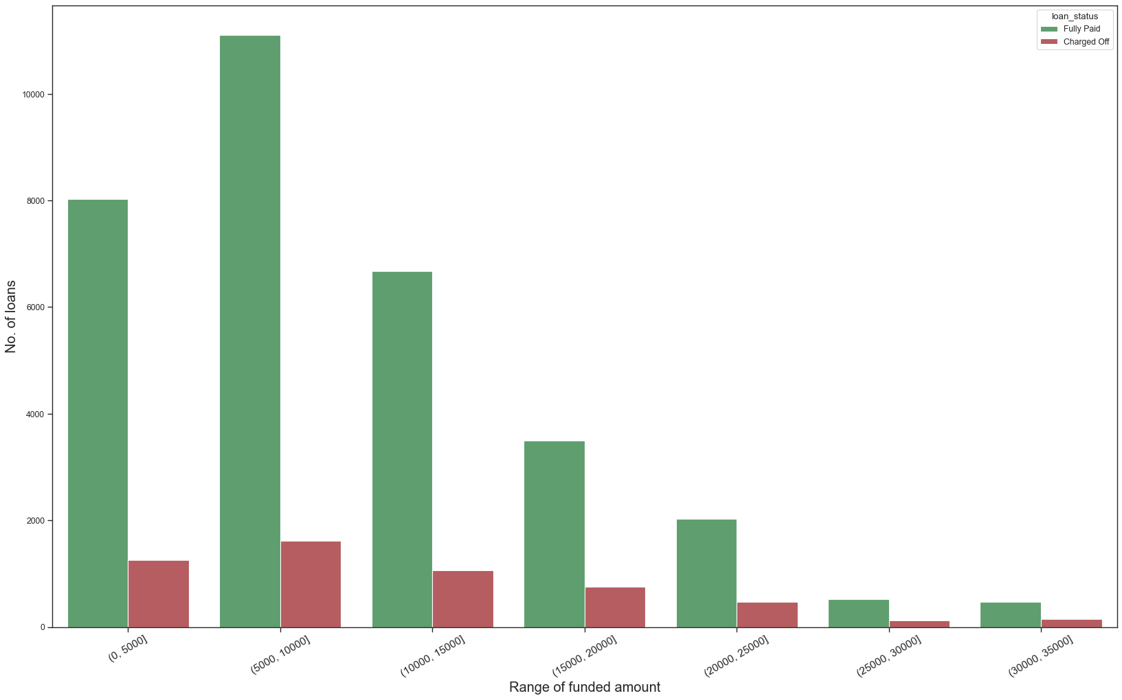
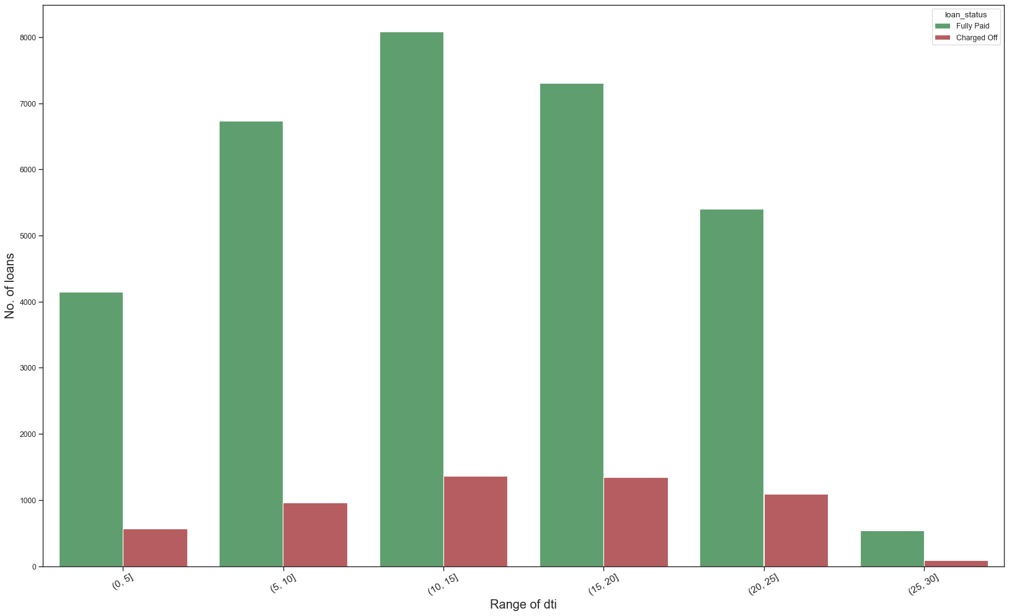

Slide 13
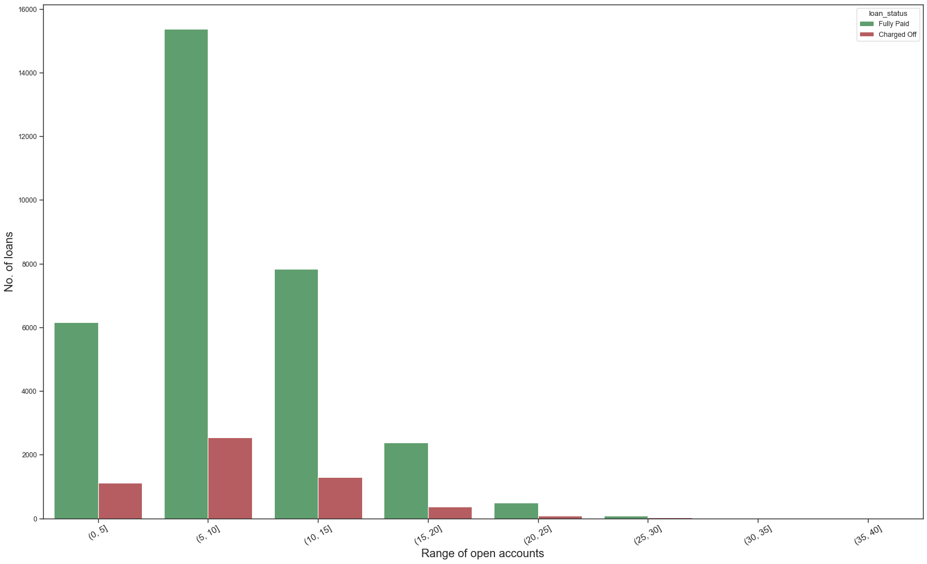
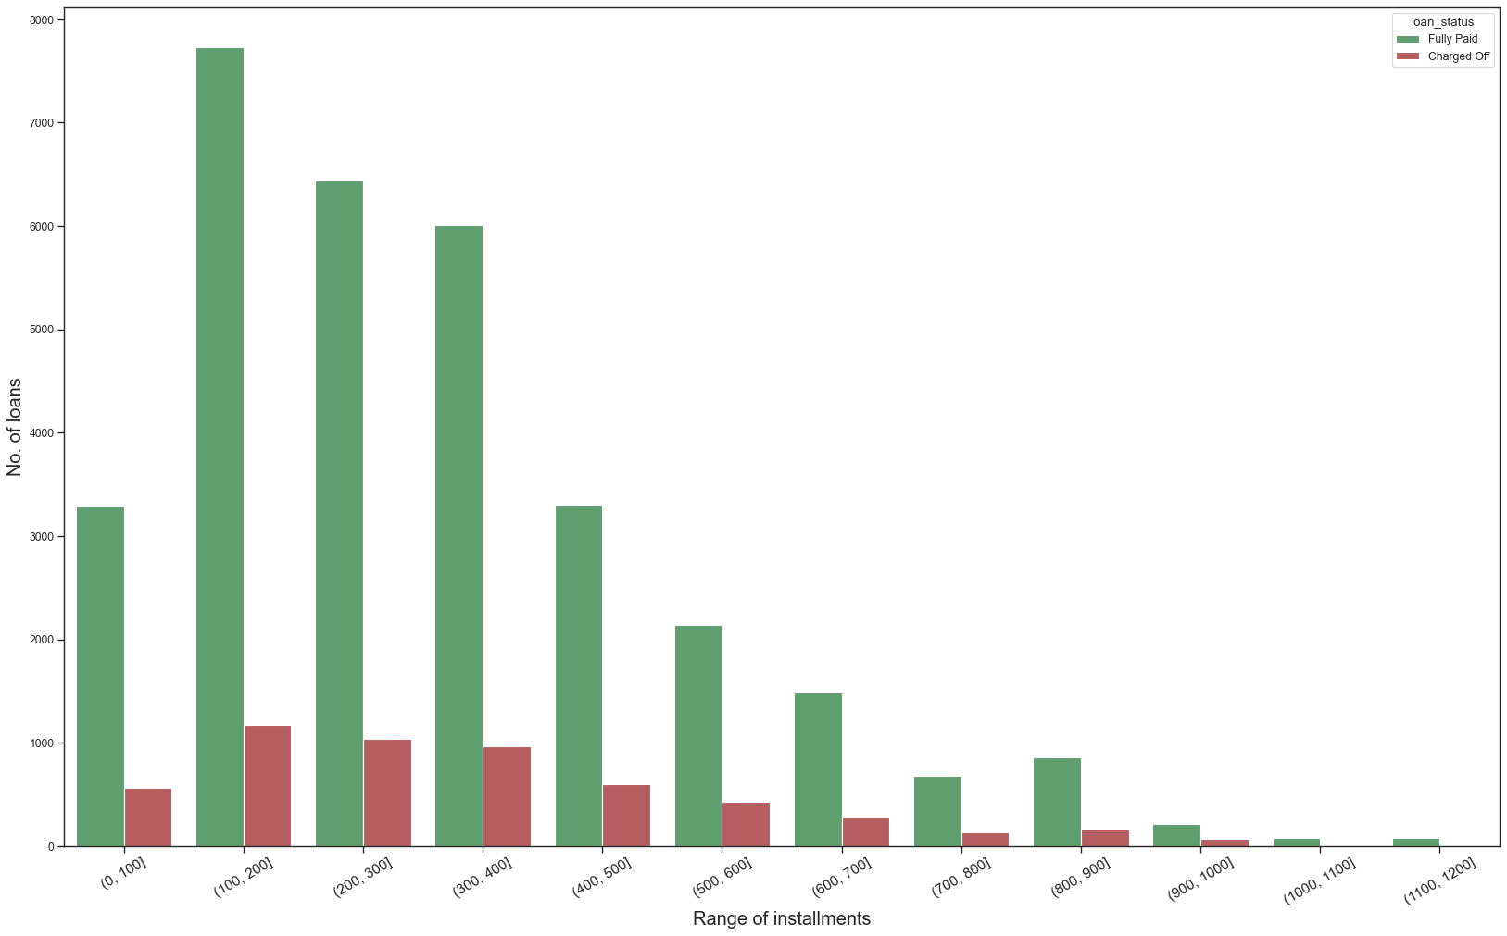

Slide 14
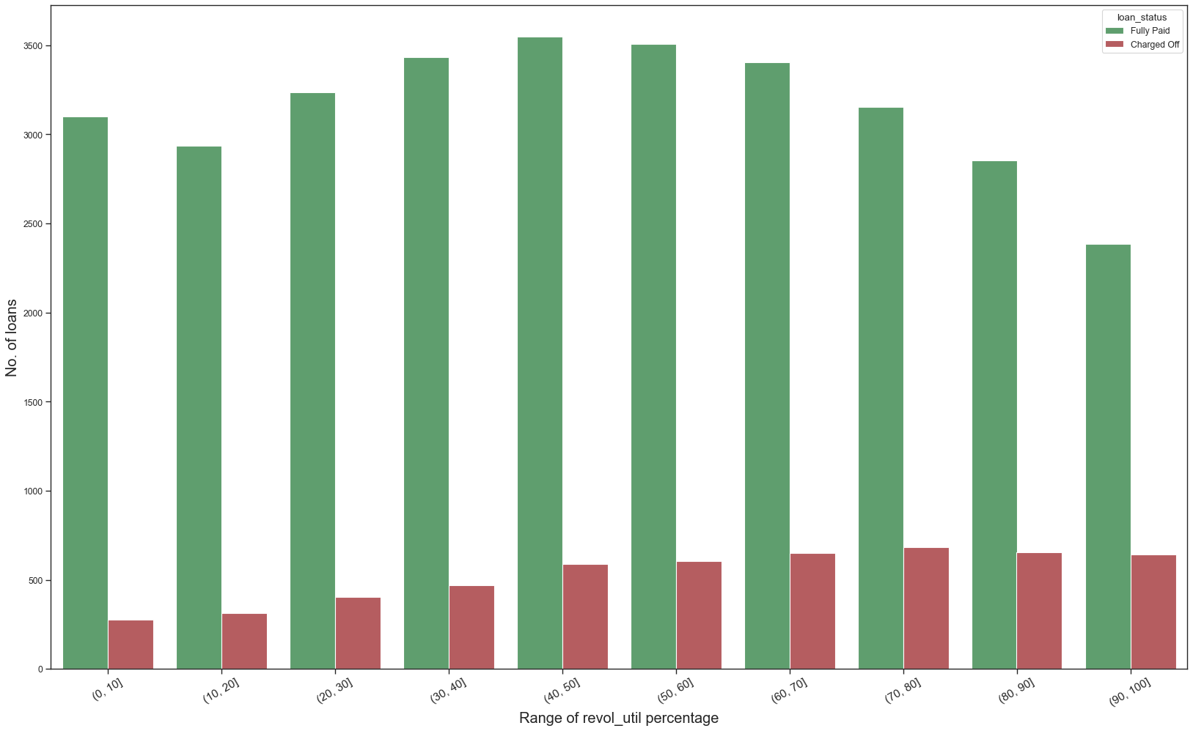
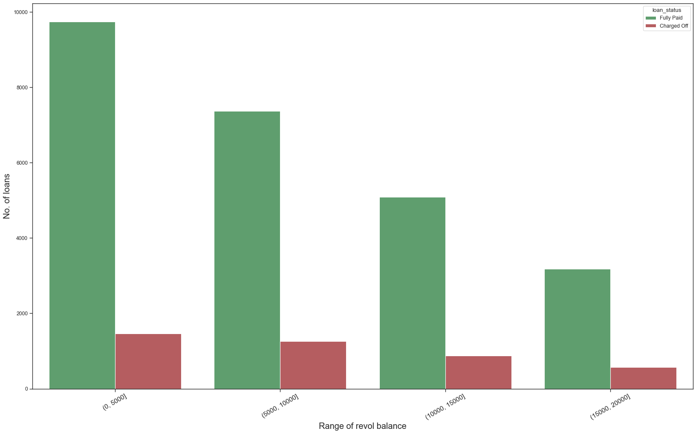

Slide 15
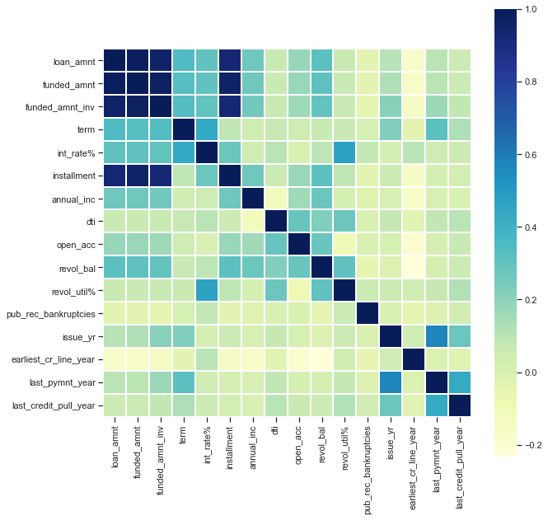

Slide 16
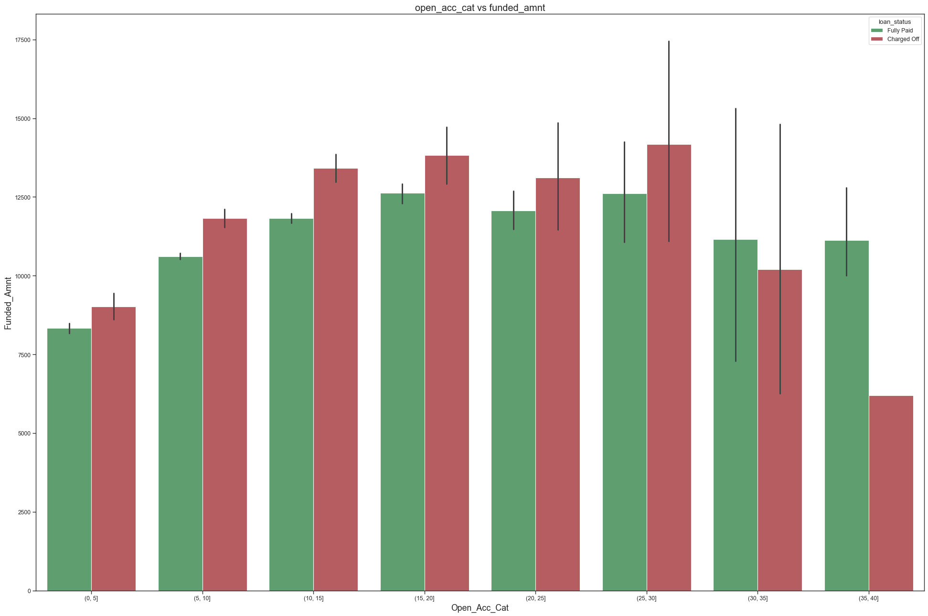
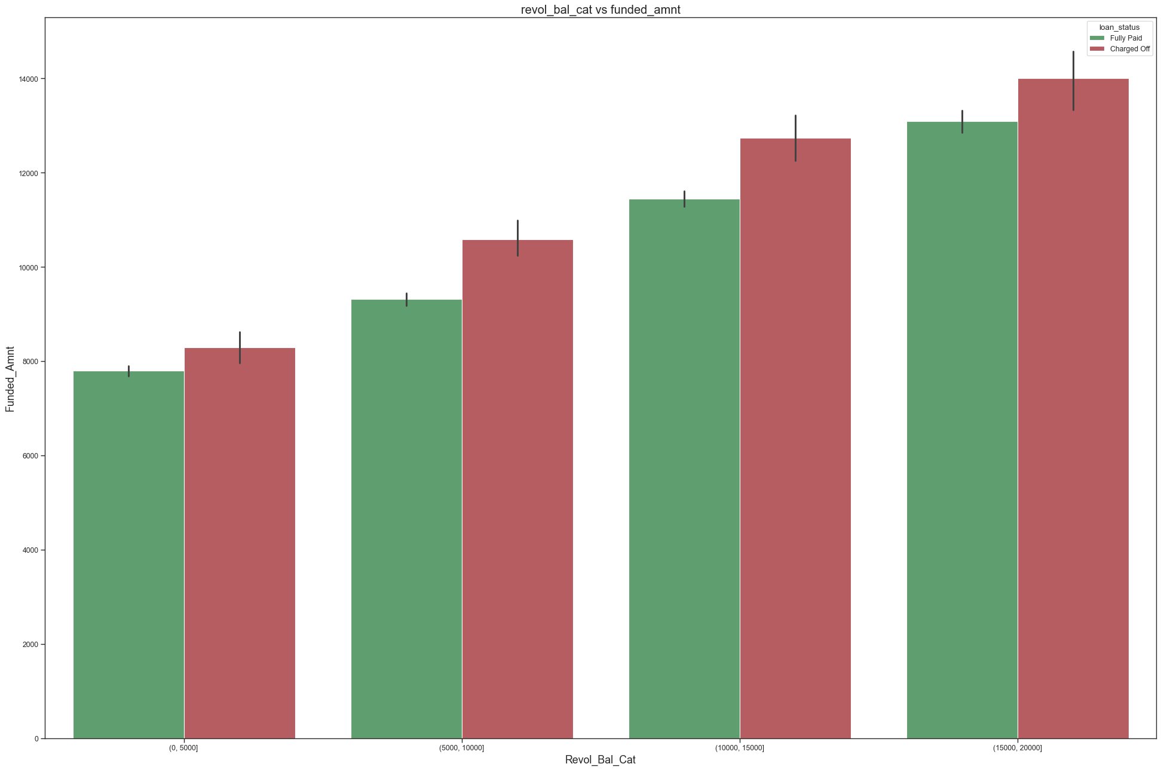

Slide 17
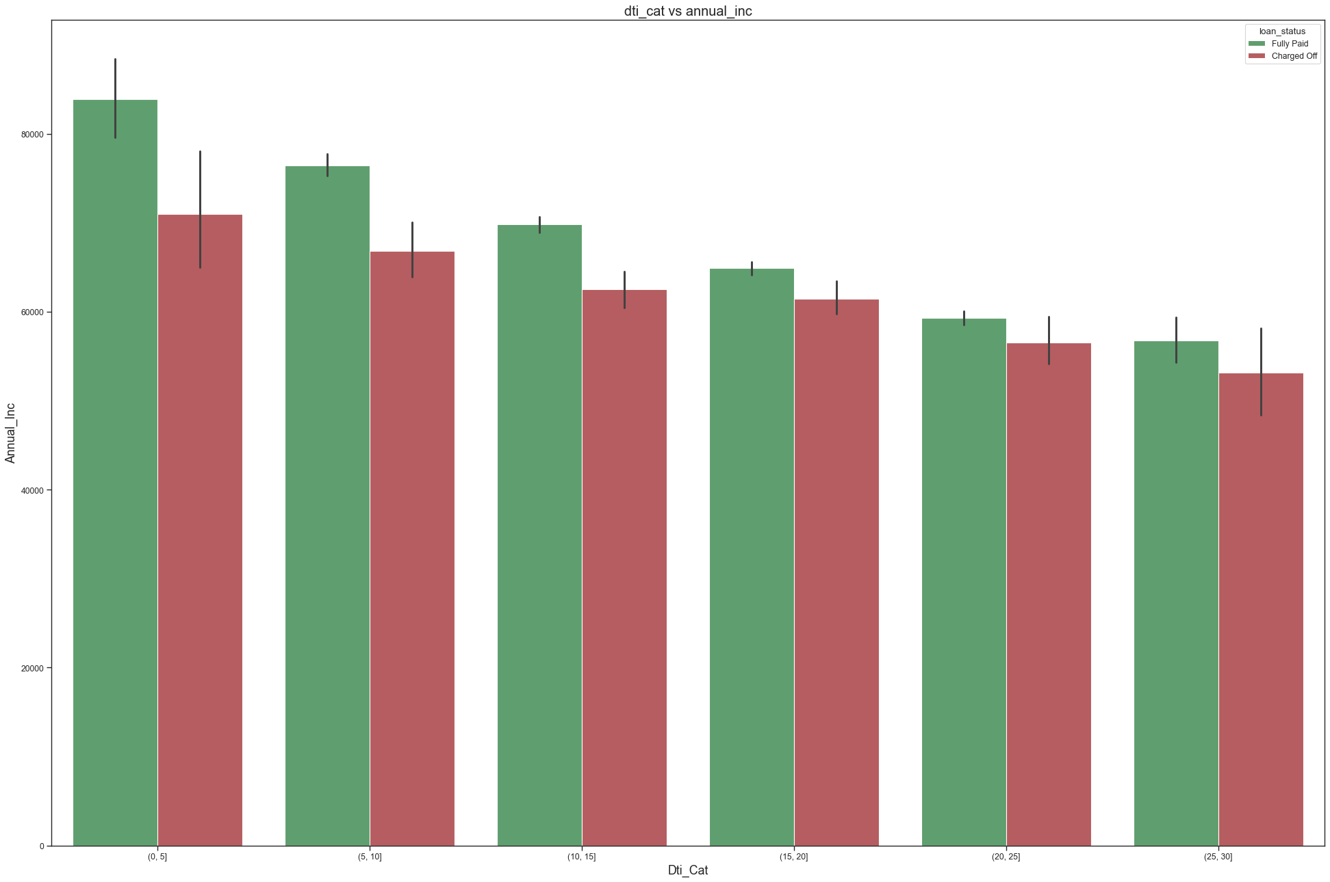
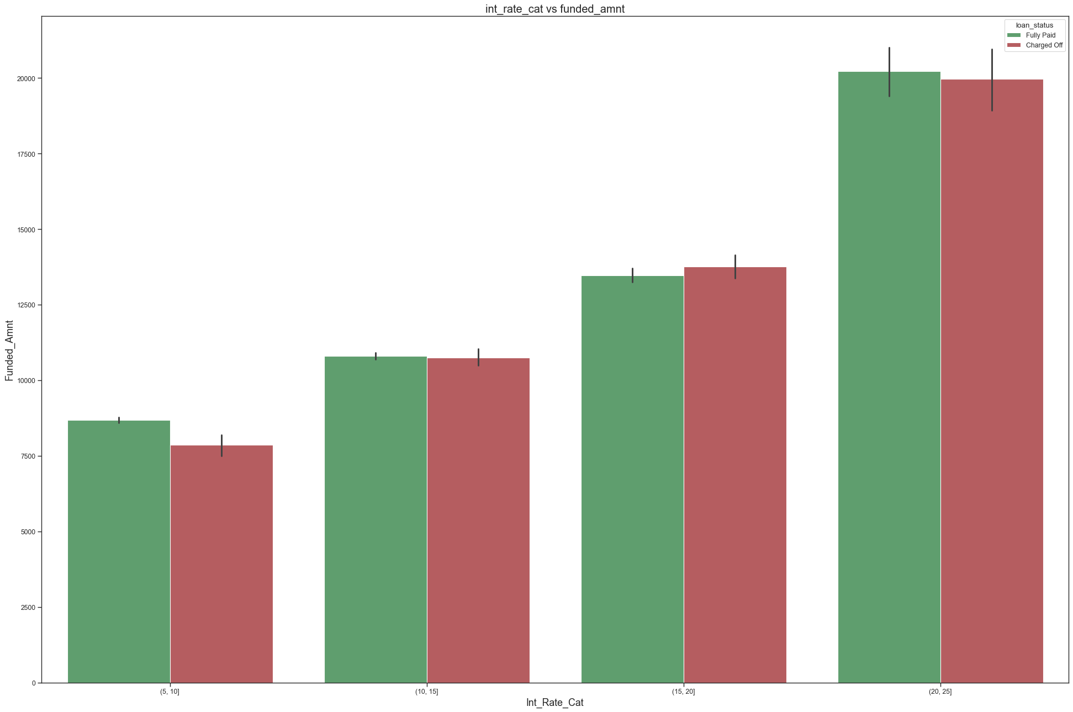

Slide 18
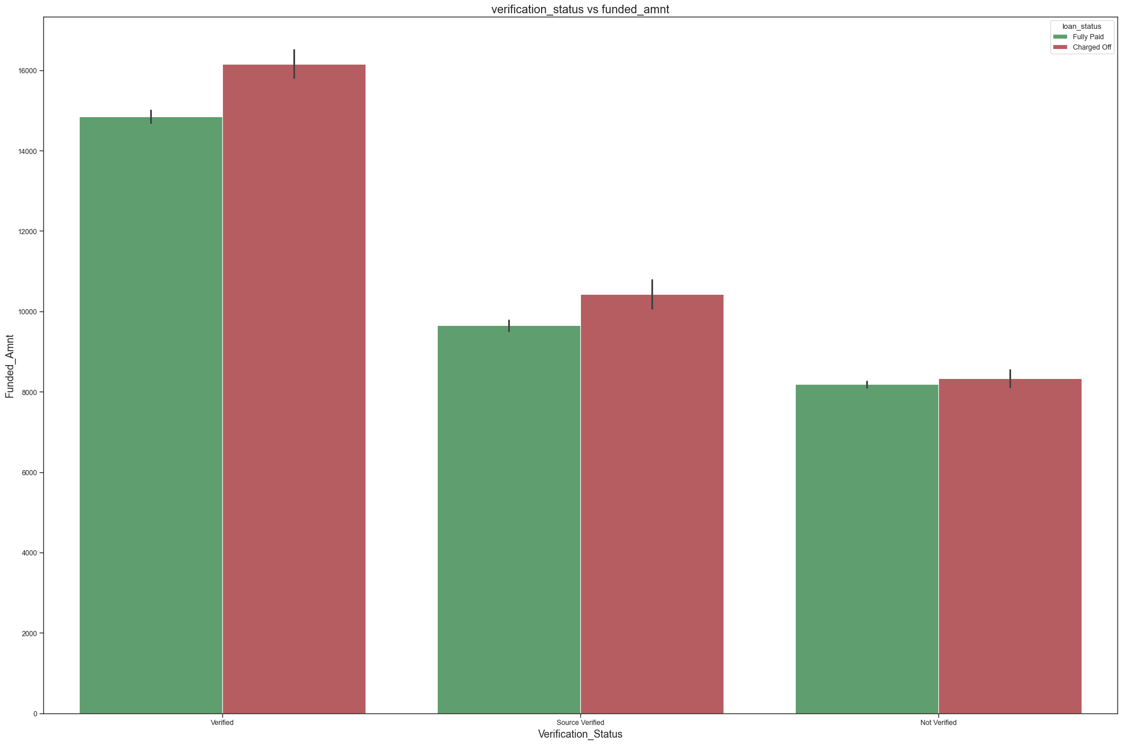
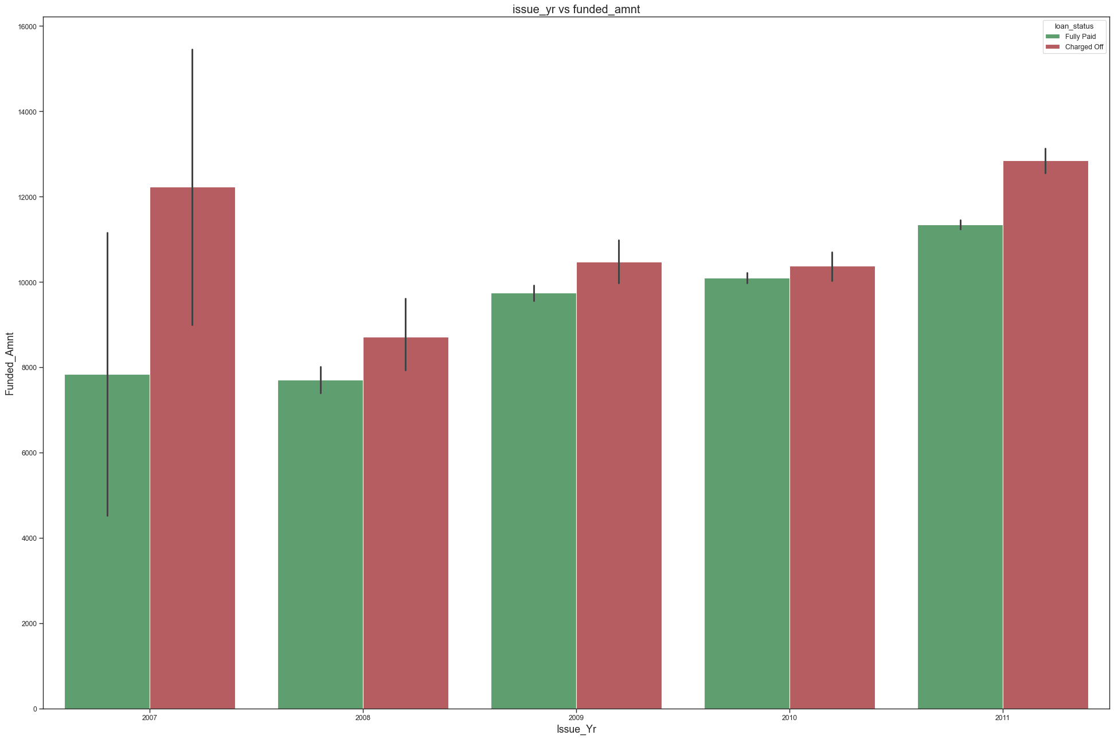

Slide 19

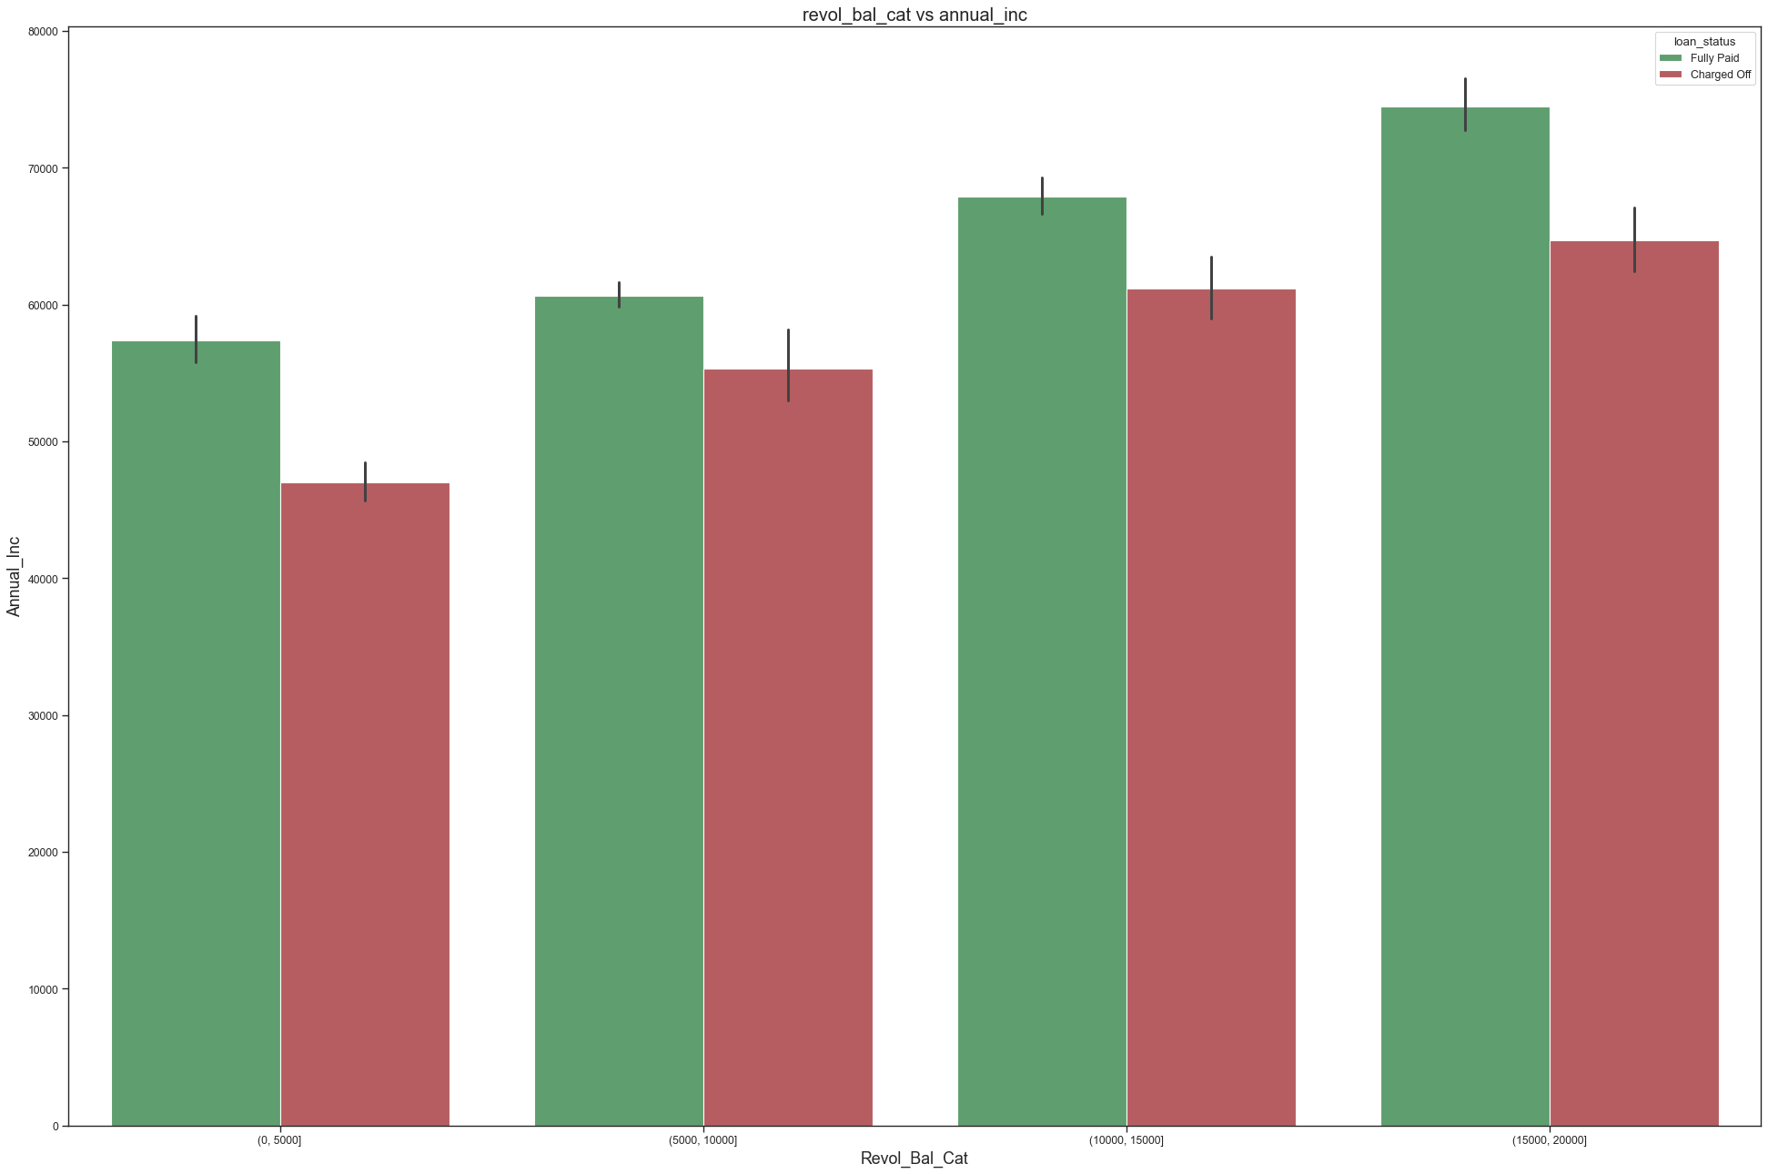

Slide 20
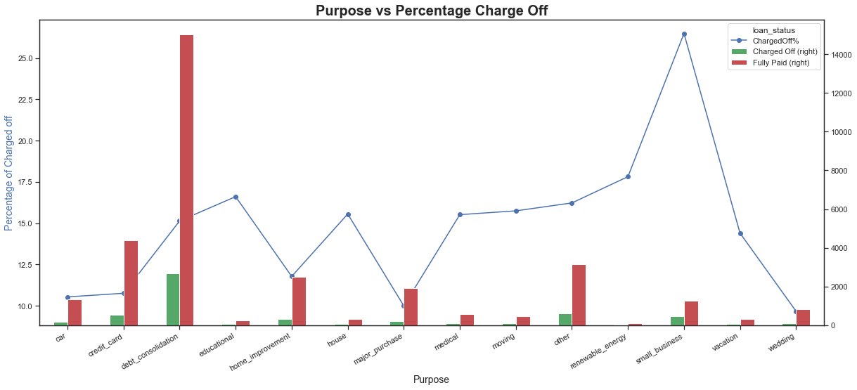
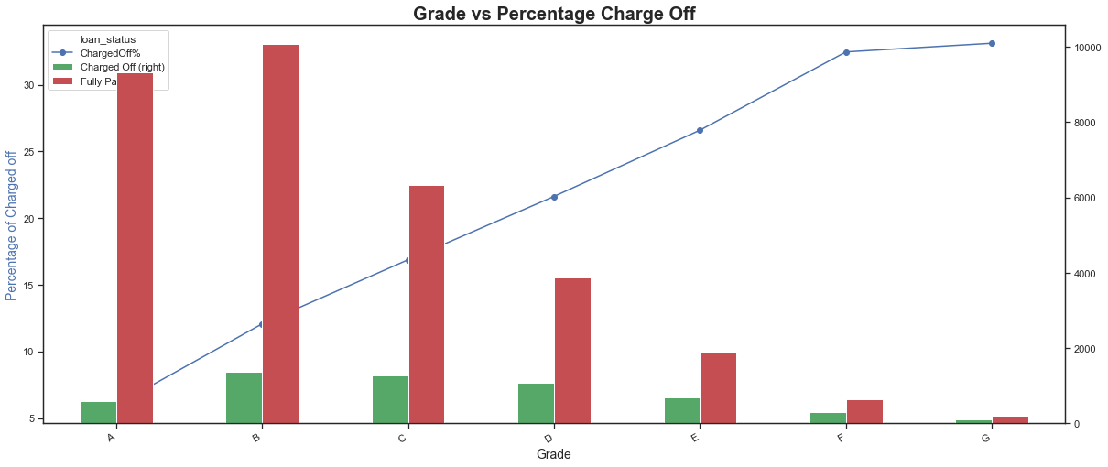

Slide 21
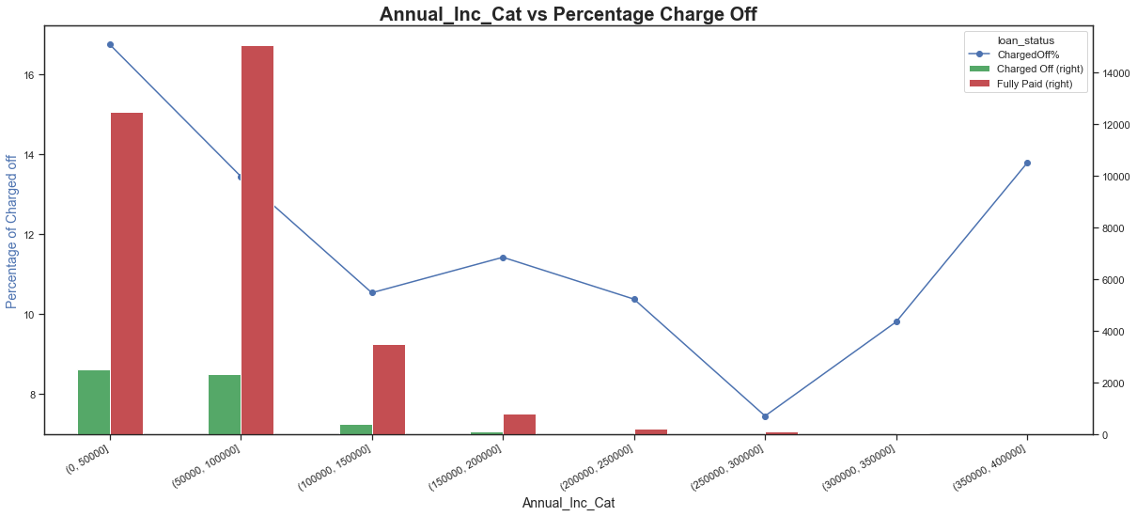
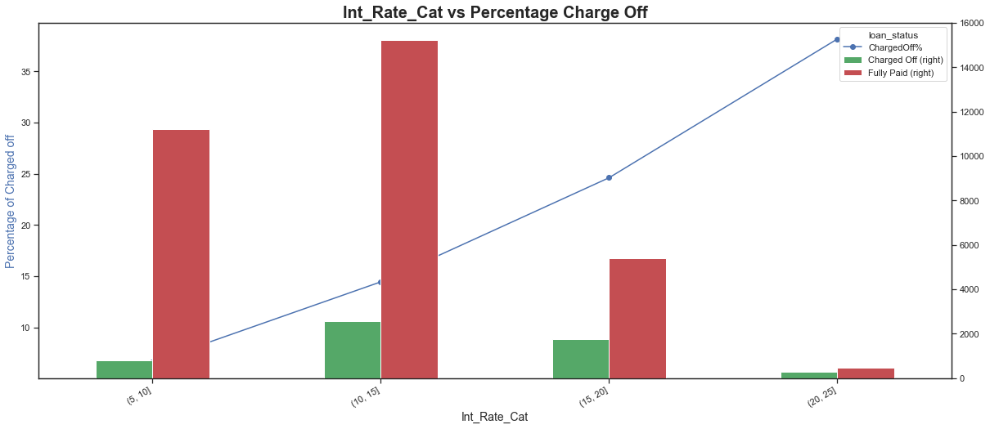

Slide 22
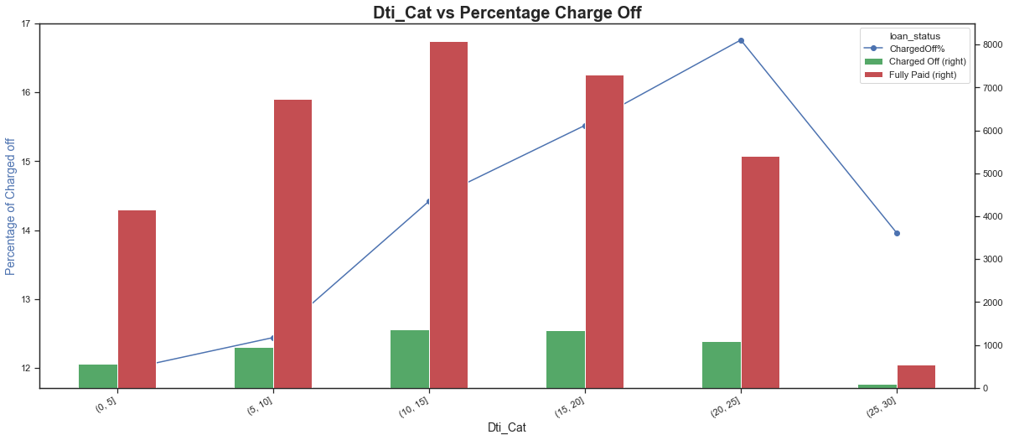
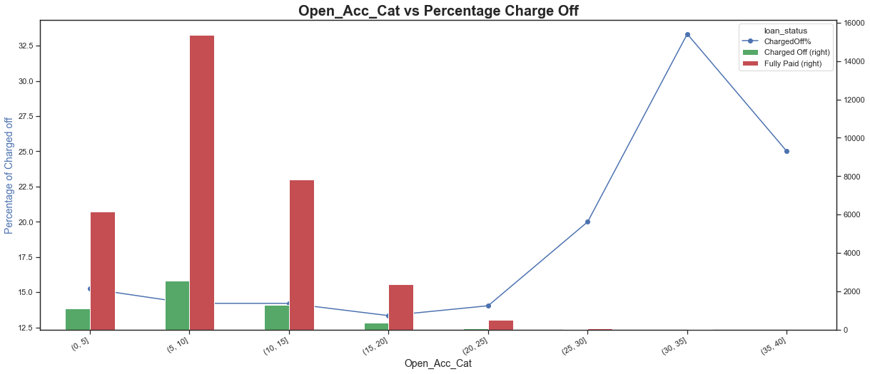

Slide 23
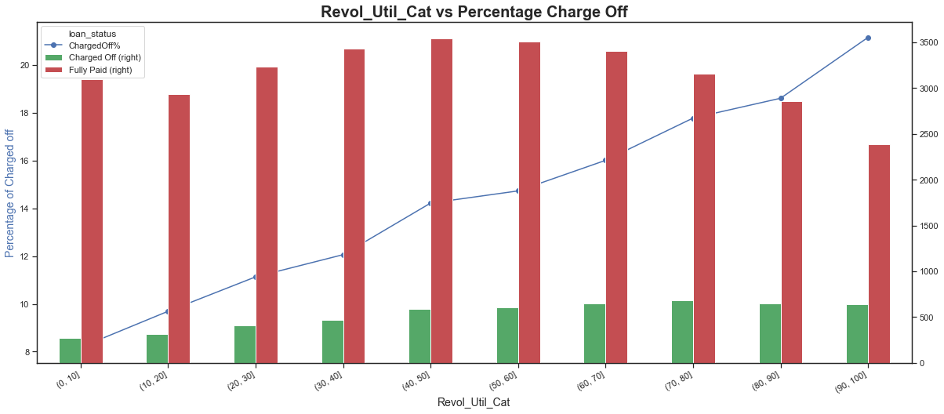
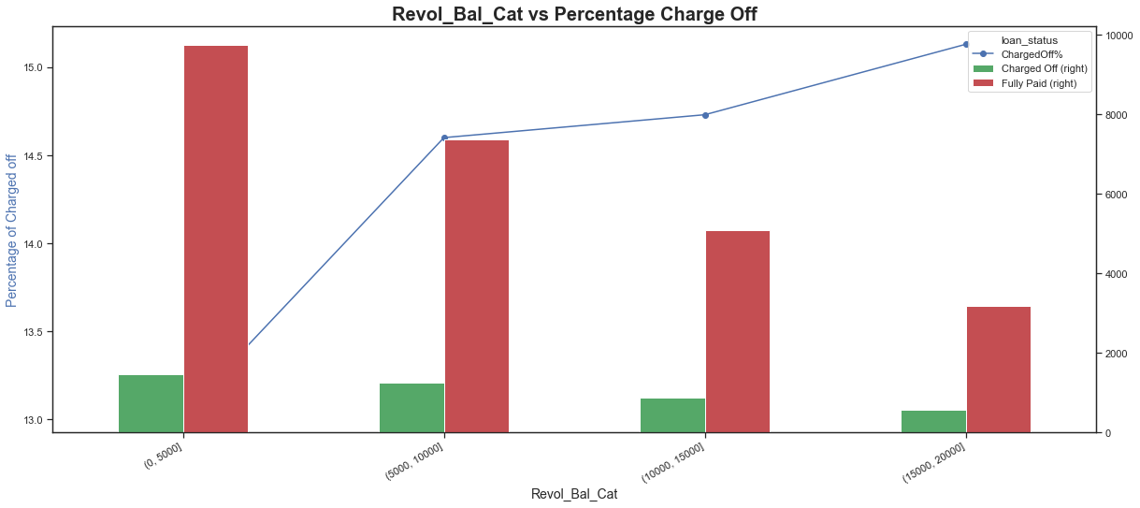

Slide 24
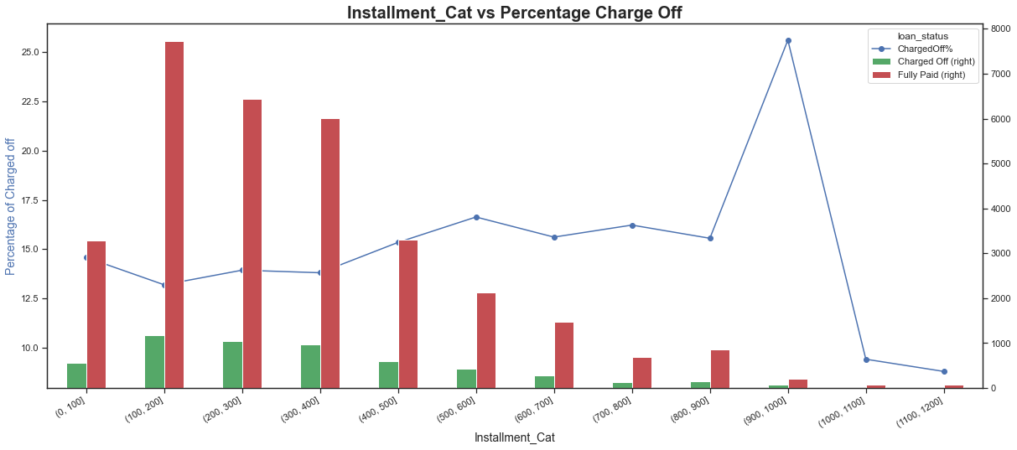
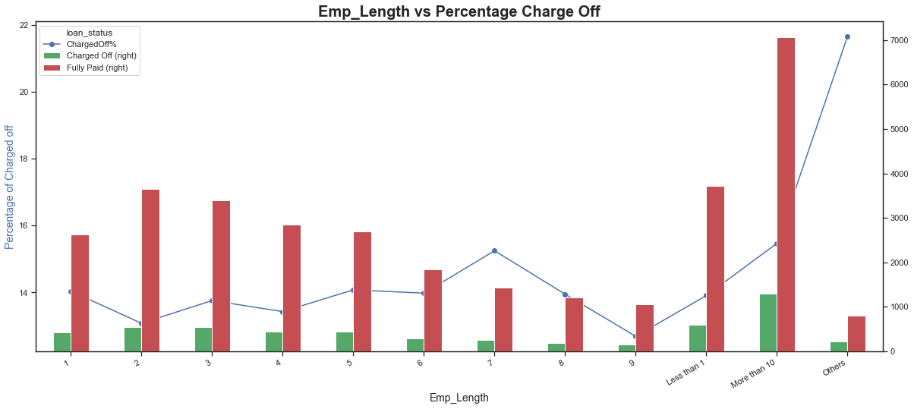

Slide 25
Recommendation Do’s and Don’ts

