Slide 1
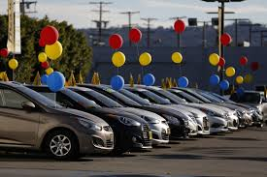
Exploratory Data Analysis for Car Sales

Slide 2
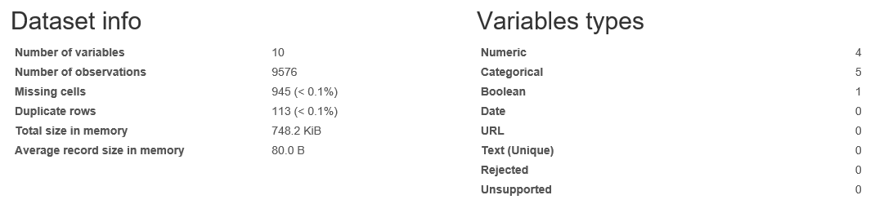
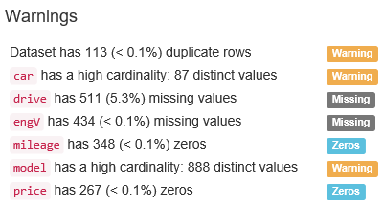
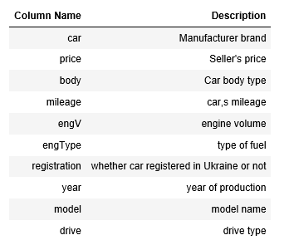
Data Description

Slide 3
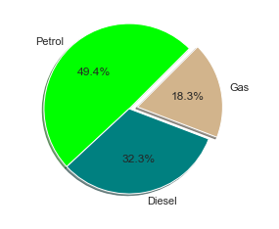
Which fuel type of cars are sold maximum and minimum?
The above graph indicates that cars with Engine/Fuel type Petrol are the first preference for sellers.

Slide 4
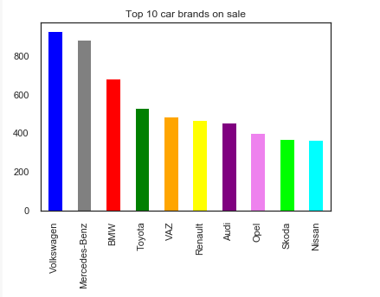
Which are the top 10 sold brands?
The above graph gives us clear picture that Volkswagen and Mercedes-Benz are most purchased brands.

Slide 5
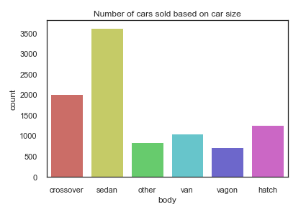
Which cars are sold maximum and minimum based on car size?
Sedan car models has top sales, and Vagon is a least sold car model.

Slide 6
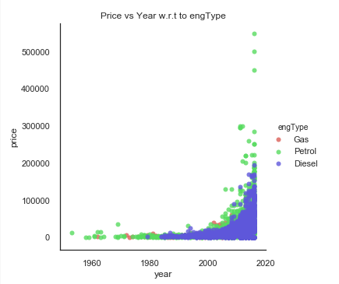
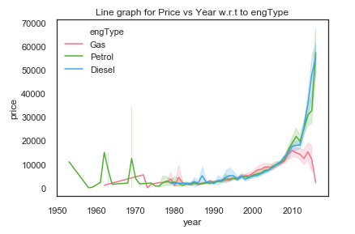
How much is increase in price of car w.r.t time as per year?
Price of car is low between 1953-2000; price has gradually get increased from year 2000. As the years increase, this shows there is significant increase in prices of cars models having engine tyep = "Petrol" as compared to "Gas" and "Diesel"

Slide 7
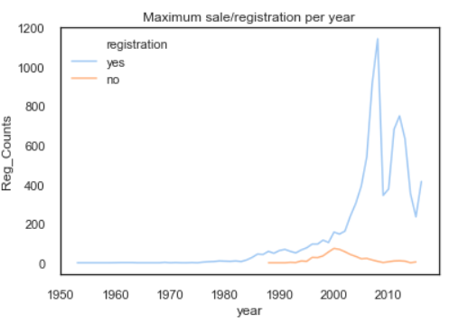
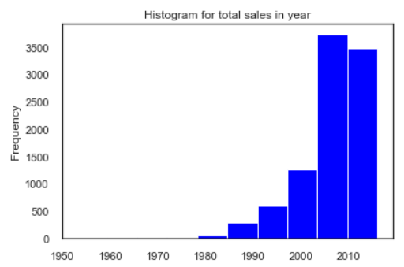
When is the maximum number of cars sold?
The above graph indicates that least sale of cars is between 1953-1982.
Maximum sale of cars is between 2000-2010, and seems to be at the peak in 2008.

Slide 8


