Slide 1
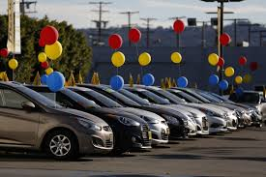
Exploratory Data Analysis for Car Sales

Slide 2
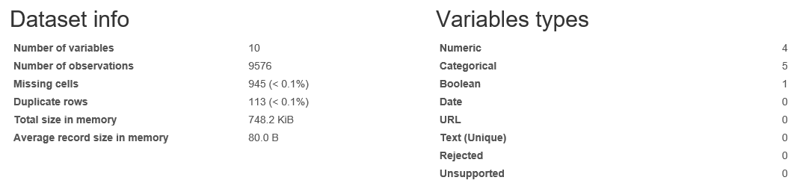
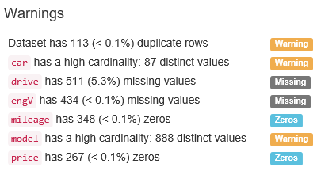
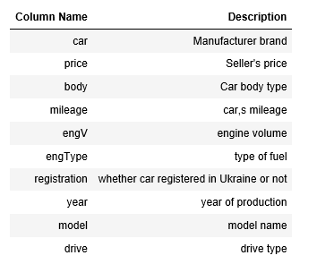
Data Description

Slide 3
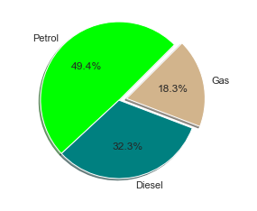
Which fuel type of cars are sold maximum and minimum?
The above graph indicates that cars with Engine/Fuel type Petrol are the first preference for sellers.

Slide 4
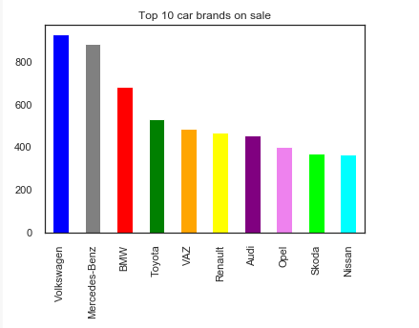
Which are the top 10 sold brands?
The above graph gives us clear picture that Volkswagen and Mercedes-Benz are most purchased brands.

Slide 5
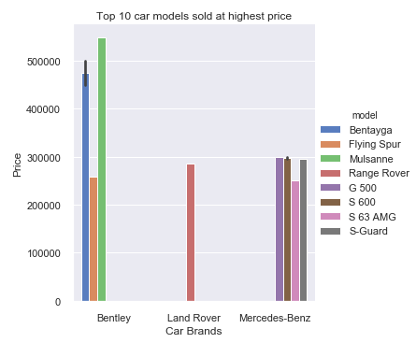
Which are the top 10 car models sold at highest price?
In this graph we can see top 10 models sold at highest price, and the model “Mulsanne” of the brand “Bentley” sold at maximum price.

Slide 6
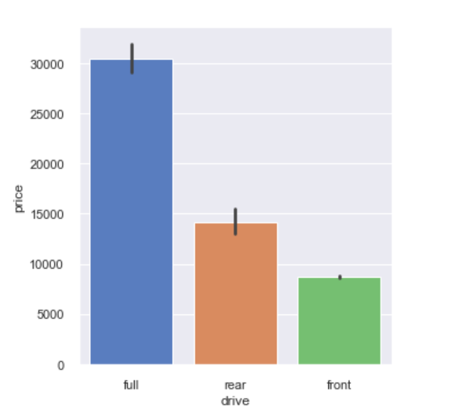
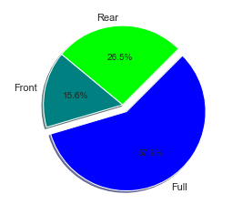
Most preferred car’s on the basis of Drive type over the years….
Here we can see most user's preferred drive type as “Full”, hence we have maximum numbers of car's sold as a drive type “Full”.

Slide 7
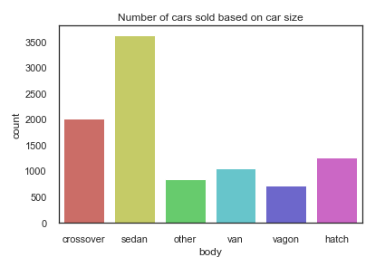
Which cars are sold maximum and minimum based on car size?
Sedan car models has top sales, and Vagon is a least sold car model.

Slide 8
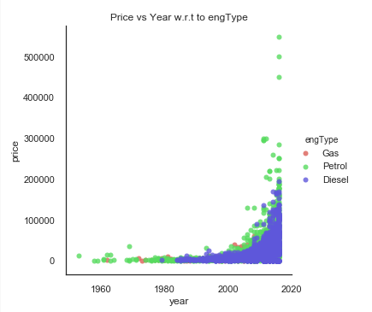
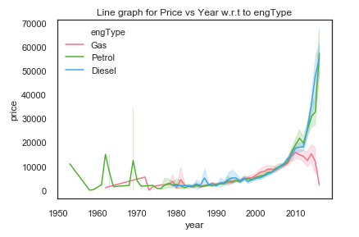
How much is increase in price of car w.r.t engine type over the years?
Price of car is low between 1953-2000; price has gradually get increased from year 2000. As the years increase, this shows there is significant increase in prices of cars models having engine tyep = "Petrol" as compared to "Gas" and "Diesel"

Slide 9
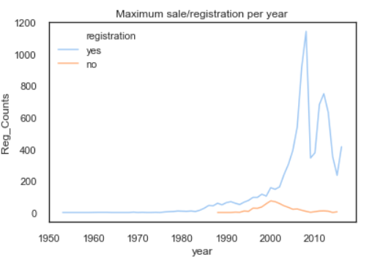
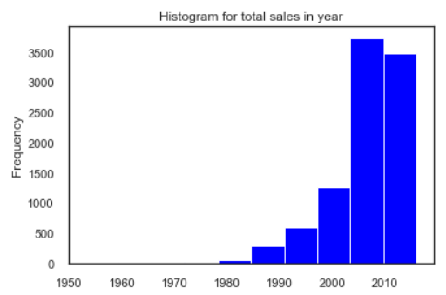
When is the maximum number of cars sold?
The above graph indicates that least sale of cars is between 1953-1982.
Maximum sale of cars is between 2000-2010, and seems to be at the peak in 2008.

Slide 10


