Slide 1
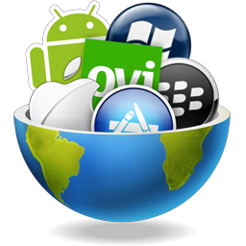
CROSS-PLATFORM MOBILE APPLICATION DEVELOPMENT
By Ramya Balaraman
(rbalaram@andrew.cmu.edu)
*http://www.simplisticsolutions.co.uk/images/icon/crossplatform.png

Slide 2
APPROACHES TO MOBILE DEVELOPMENT
NATIVE, WEB OR HYBRID?
Notes:
Choose a mobile strategy depending on the budget, project timeframe, target audience & app functionality.

Slide 3
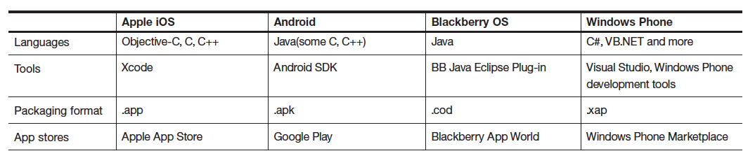
NATIVE APPS
Binary executable files on the device.
Can access all API’s made available by OS vendor.
SDK’s are platform-specific.
Each mobile OS comes with its own unique tools and GUI toolkit.
Different tools, languages and distribution channels associated with leading mobile operating systems
* IBM, Native, web or hybrid mobile app development, 2012. IBM Software Thought Leadership White Paper

Slide 4
NATIVE APPS
PROS
Easy low-level hardware access services.
Easy access to high level services important to personal mobile experience.
Full use of all functionalities that modern mobile devices have to offer.
High usability.
CONS
Code Reusability : Low
Development & maintenance: Time-consuming & expensive.
Designers are required to be familiar with different UI components of each OS.
Upgrade flexibility: Low.
Notes:
Once the app is installed, it interacts with the underlying operating system through proprietary API calls that the OS exposes. These are divided into 2 categories – Low-level API’s & high level API’s. Through low-level API calls, the app can interact directly with the touchscreen or keyboard, render graphics, connect to networks, process audio received from the microphone, receive images & video from the camera, access the GPS etc.
Higher level services include processes like browsing the web, managing calendar, contacts, photo album, the ability to send and receive phone calls etc.

Slide 5
APPROACHES TO CROSS PLATFORM MOBILE DEVELOPMENT

Slide 6
CROSS-COMPILATION
Separates build environment from target environment.
Platform-independent API using a mainstream programming language like JavaScript, Ruby or Java.
The cross-compiler then transforms the code into platform-specific native apps.
The software artifact generated can be deployed and executed natively on the device.
ADVANTAGES:
Improved performance and User Experience.
Full access to functionalities of underlying mobile OS and device specific capabilities.
DISADVANTAGES:
Highly complex as cross-compilers are difficult to program.
Need to be kept consistent with fragmented mobile platforms and operating systems available.
Notes:
Developers can use this API to build the application including UI, data persistence & business logic. The code is then processed by the compiler and transformed into platform-specific native apps.
High performance as the app is running natively on the device & improved user experience as the app has full native access to all device-specific capabilities such as integrated camera, sensors etc.

Slide 7
VIRTUAL MACHINE APPROACH
A virtual machine is used to abstract the target platform details from the application’s running code.
The framework provides both the API and runtime environment.
The runtime executes on the mobile device and enables interoperability between the device’s OS and the mobile application.
ADVANTAGES:
Improved performance and User Experience.
Full access to functionalities of underlying mobile OS and device specific capabilities.
Portability: VM’s are easier to maintain & more flexible to extend.
DISADVANTAGES:
Slower due to runtime interpretation latency.
Notes:
VM’s :easier to extend when new features are added to the device and need to be supported by the API
Runtime interpretation latency introduced when the VM is translating data and instructions to & from the underlying host platform.

Slide 8
MOBILE WEB APPS
Use standard web technologies such as HTML 5, CSS 3 & JavaScript.
Features of HTML 5 - Advanced UI components, access to rich media types, geolocation services & offline availability.
Increasing popularity of HTML 5 in rendering engines such as WebKit.
Runs on a standalone mobile web browser.
Installed shortcut, launched like a native app.
UI logic resides locally; makes the app responsive and accessible offline.
ADVANTAGES:
Multiplatform support.
Low development cost.
Leverage existing knowledge.
DISADVANTAGES:
Limited access to OS API’s.
Notes:
Another increasingly popular approach is to develop mobile web apps which run on the user’s mobile browser. These are different from mobile-optimized websites which detect when they are being accessed from a mobile device and serve HTML pages that have been designed to provide a comfortable touch experience on a small screen size.
This involves using standard web technologies such as HTML, CSS, JavaScript to build the application & make it look and behave like a native app. It is possible due to the advanced capabilities of HTML 5 including embedded SQL databases, local storage (application cache to reduce page startup time and enable offline features), animations, canvas (avoid transferring images), websockets, video playback, geolocation services etc. Mobile Google Search uses the HTML5 Geolocation API to show location-aware results. Google Maps for Mobile and Mobile Gmail both use the canvas tag to avoid transferring images.
This approach may be appealing for many applications such as ebooks, mobile banking, social interaction & email. However it may not be suited for highly interactive, CPU-intensive, visually rich applications like games, augmented reality browsers & videoconferencing.

Slide 9
HYBRID APPS
Combines native development with web technology.
The web app runs inside a thin wrapper native app.
The wrapper native app uses the OS API’s to create an embedded HTML rendering engine which provides a bridge between the browser and device API’s.
The communication between web app and native app normally happens over JavaScript via custom built API’s.
ADVANTAGES:
Flexibility of web apps combined with feature richness of native apps.
Simplified deployment and immediate availability.
Leverage existing knowledge.
DISADVANTAGES:
Poorer user experience as compared to native apps.
Access to advanced device capabilities normally restricted.
Notes:
The bridge enables the hybrid app to take full advantage of all the features that modern devices have to offer.
App developers can choose to code their own bridge or use ones provided by many of the cross-platform development frameworks such as PhoneGap.

Slide 10
CROSS-PLATFORM FRAMEWORKS
PROS
Code Reusability
Plugins
Easy for web developers
Reduced development costs
Support for enterprise & cloud services
Easy Deployment
CONS
Might not support every feature of OS
Cannot use own tools/IDE
Slower.
High end graphics & 3D support limited
Vendor lock-in
Notes:
Major frameworks, including Appcelerator and PhoneGap offer easy access to plugins and modules that can easily plug into other services or tools.
Do not have to invest in a team or developer specific to that ecosystem.
In addition to plugins and modules for specific functions, most frameworks also have the option to directly integrate with cloud services, including Salesforce.com, AWS, Box.net and others.
Deploying and compiling apps is much faster in a cross-platform scenario. This is especially true with many of the new cloud-based build tools that various frameworks are starting to push out.
If Google, Apple or Microsoft adds a new feature, the framework you are using will need to be updated to support those new additions.
Most frameworks want users to use their own development tools and suites, and that can mean that a developer has to forgo his or her own IDE preferences and use something else.
Most of the cross-platform frameworks build using their own subsets of JavaScript, which means that if you want to switch to another platform, that code you wrote before is likely not going to be reusable without a lot of work.

Slide 11
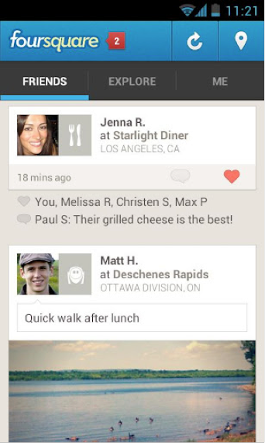
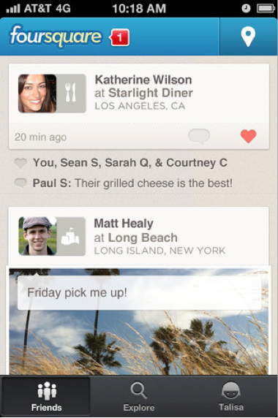
UI DESIGN CONSIDERATION
iOS
Android
* http://www.adobe.com/devnet/phonegap/articles/creating-apps-with-phonegap-lessons.html

Slide 12
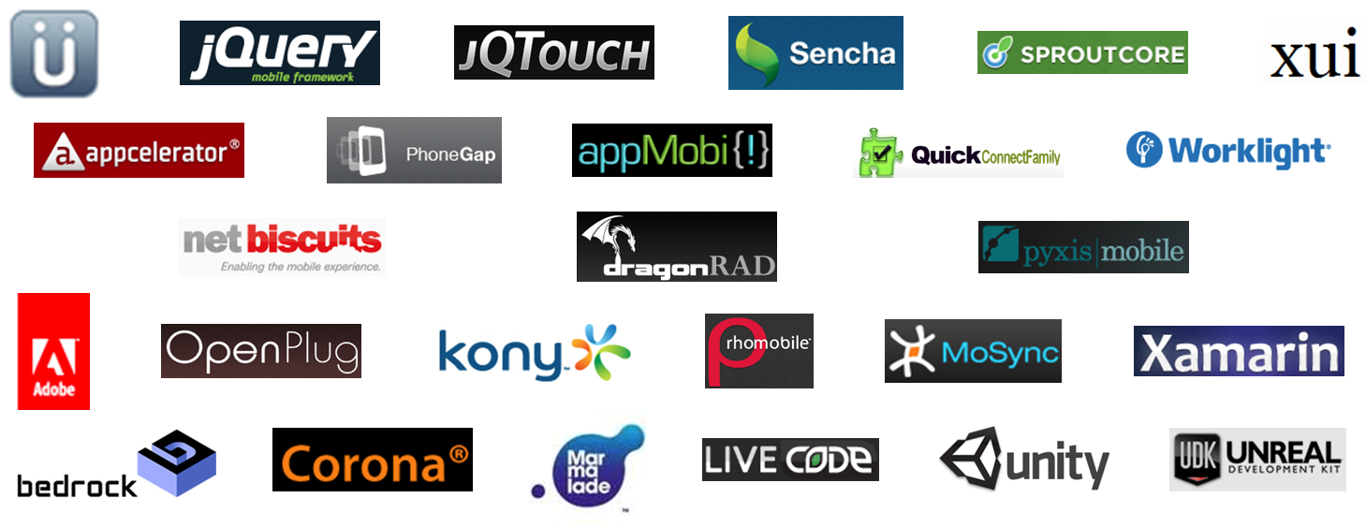
CROSS-PLATFORM FRAMEWORKS
* http://setandbma.files.wordpress.com/2011/12/wora-platforms.png

Slide 13
RhoElements – RhoMobile Suite From Motorola Solutions
TECHNICAL ARCHITECTURE:
Cross compilation using Virtual Machine.
Single source codebase written in Ruby and UI constructed using HTML 5, CSS 3, JavaScript running on Ruby interpreter on the device.
Support for SQLite enables the local storage of relational data, enabling offline capabilities for both hybrid and native HTML 5 applications.
DESIGN PATTERNS:
Model-View-Controller pattern for maintainability and best practices.
Object Relational Mapper design for easy data manipulation.
SUPPORTED PLATFORMS:
WM /WEHH , WinCE5.0+, Android 2.1+, iOS 3.0+, BB 4.6+, WP7
Notes:
The framework provides a templating language similar to Ruby on Rails views which makes it quick & easy to develop portable UI’s without compromising quality.
To provide animations on Webkit-based mobile browsers, it extends JQTouch, a mobile JavaScript micro library that provides native look-and-feel to mobile web apps
ORM component called Rhom which enables database independent data persistence using highly scalable key value pair noSQL storage systems.

Slide 14
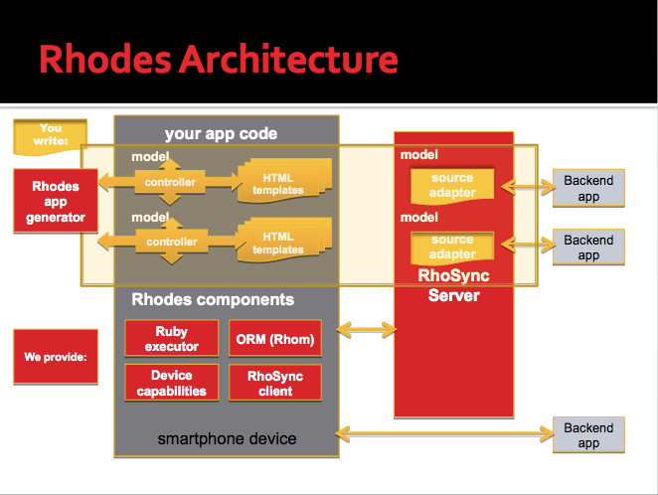
RhoElements – RhoMobile Suite By Motorola Solutions
*http://leckylao.files.wordpress.com/2010/06/screen-shot-2010-06-12-at-3-28-30-pm.png

Slide 15
RhoElements – RhoMobile Suite From Motorola Solutions
HTML 5 FEATURES:
App Caching, WebSockets, WebWorkers, Local & Session Storage, SQLite, Semantic Elements, Form Attributes
IDE USED:
RhoStudio – An Eclipse based IDE
STRENGTHS:
Design patterns used.
Applications look and behave identically on all devices.
WEAKNESSES:
Updating HTML/JavaScript code needs a complete rebuild.
Need to know Ruby well, which is not as popular as other programming languages.
Doesn’t generate source code, only native package which can restrict any further tweaking of the app.
Notes:
allowing you to efficiently separate the content from the presentation and easily make changes to a view (even simply by updating the data structure).
Rhodes gives you the starting points for a handful of different views and you can tweak the templates to fit your needs simply by updating the HTML.
Rhodes can be paired with RhoSync for back-end integration. Essentially, RhoSync handles all the communication with a remote data server and taking that data and downloading it to the device. All your application needs to be concerned with is communicating with local data. This takes care of making sure your app works the same online as it does offline–a major hurdle for many applications.

Slide 16
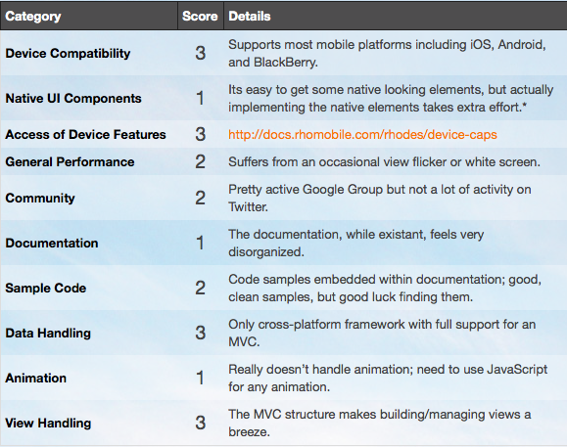
RhoElements – RhoMobile Suite From Motorola Solutions SCORE (OUT OF 3)
* http://floatlearning.com/2011/07/which-cross-platform-framework-is-right-for-me/

Slide 17
PHONEGAP From Nitobi now acquired by Adobe
TECHNICAL ARCHITECTURE:
Web approach using hybrid model.
Single source codebase written HTML 5, CSS 3, JavaScript running on a mobile browser embedded in a native app wrapper.
Device capabilities accessed through device-independent JavaScript API.
SUPPORTED PLATFORMS:
iOS, Android, Blackberry, WP7, Symbian, Palm, Samsung Bada
IDE USED:
MAC OS X & XCODE for iPhone & iPad.
Google Android SDK, Eclipse ADT Plugin, Ant as well as Eclipse IDE for Android.
Notes:
Best suited when you have an existing web application you wanna port to a mobile environment

Slide 18
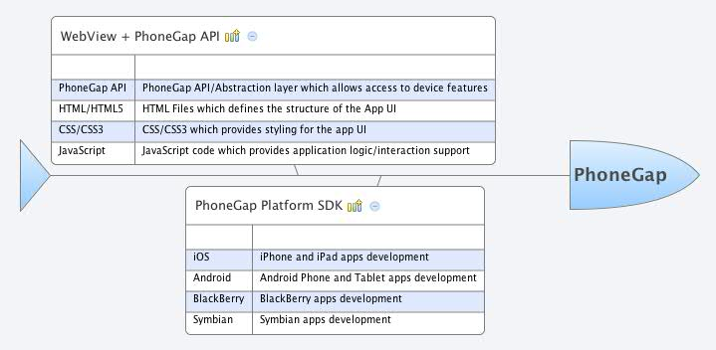
PHONEGAP From Nitobi now acquired by Adobe
ARCHITECTURE:
* http://arnab.ch/images/phonegap-architecture.jpg

Slide 19
PHONEGAP From Nitobi now acquired by Adobe
STRENGTHS:
Native wrapper source code is provided so it can be customized further.
Simple ‘drop-in libraries’ concept makes it easier to develop.
Lowers barriers of adoption for web developers.
WEAKNESSES:
Lack of support for native UI components, design patterns & development tools.
The capabilities offered by the framework is limited to what a “WebView” can do.
Different projects for different platforms
Different JavaScript files on each platform for PhoneGap itself and plugins
No native UI support
Java, Objective-C or C# requirement to create new plugins
No built-in support for push notifications
Notes:
Drop libraries in the right place and begin coding with a familiar web stack to produce a functional application quickly.
Imposes little structure and/or guidelines on how to best develop applications with it. This means users are free to architect their solutions in a
way that best suits their needs. This can be a blessing for experienced developers but can create confusion and promote bad designs within novice users.
PhoneGap does nothing to emulate the native device UI. Left the users with
the task of styling the markup to mimic a native app. Fortunately there are loads of open source
libraries specialized in exactly this. Therefore it’s not unusual to see Phonegap being used in
conjunction with other libraries like XUI and Sencha Touch.
PhoneGap API runs on a very extensible plugin architecture. If PhoneGap doesn’t already support the feature you need, you can easily write a plugin yourself. To extend PhoneGap through plugins one must know how to program in the native language of each platform.
The burden for that increases when there is a need to use multiple PhoneGap plugins because you need to search and update different files on each platform.

Slide 20
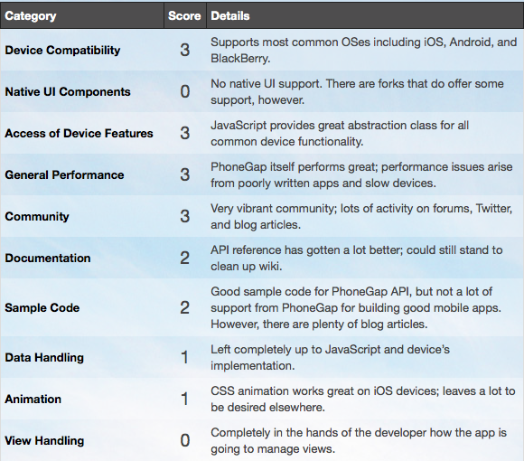
PHONEGAP From Nitobi now acquired by Adobe SCORE (OUT OF 3)
* http://floatlearning.com/2011/07/which-cross-platform-framework-is-right-for-me/

Slide 21
TITANIUM From Appcelerator Inc.
TECHNICAL ARCHITECTURE:
Cross compilation technique – Pre-compilation, front-end compilation, platform & package compilation.
Single source codebase written in JavaScript, compiled into native code and packaged for different target platforms.
Does not use browser engine to render user interface on mobile devices.
Instead the UI elements are converted to true native UI elements when deployed to the phone.
SUPPORTED PLATFORMS:
iOS, Android, Windows & Blackberry
IDE USED:
Studio, an Eclipse-based IDE
Notes:
The pre-compilation takes the app’s JavaScript code, optimizes it (reduces whitespace, reduces
the size of symbols, etc.) and then creates a dependency hierarchy of all the Titanium APIs used.
The front-end compilation step generates the appropriate platform-specific native code
The platform compiler and packager step effectively compiles the code to native
executable using platform specific tools and packages files for running either on the native
simulator, native device for testing or for final packaging for distribution.

Slide 22
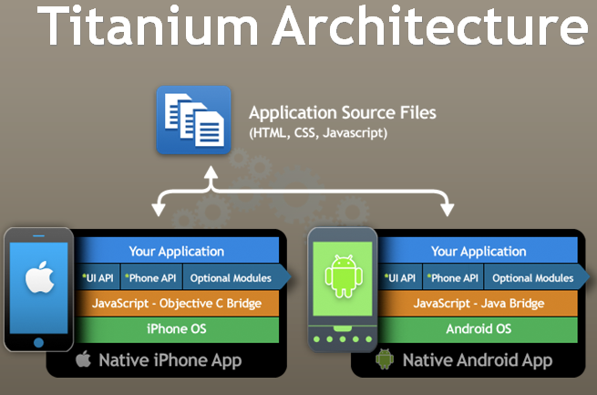
TITANIUM From Appcelerator Inc.
* http://www.linux-mag.com/s/i/articles/7719/architecture1.png
Notes:
The magic in Titanium happens during runtime in it’s bridge between the JavaScript and the native SDK. The bridge reads your JavaScript and uses it to build views that have the same features and performance as an application written in that native language

Slide 23
TITANIUM From Appcelerator Inc.
STRENGTHS:
Native code output very quick and fluid on the phone.
Easy setup and startup for developers.
Excellent documentation & examples.
Strong community forum to find out answers.
Intuitive app management environment.
Support for desktop and tablet development
WEAKNESSES:
Potentially restrictive API’s
Tries to solve too many problems in one shot supporting phones, tablets & desktops.
Notes:
Titanium provides fantastic support for native UI elements. It does exactly what it says it does: you write your view once in JavaScript and then Titanium takes care of building the UI, using the proper UI elements for each platform. Like Rhodes, Titanium has great support for loading in data from a remote server and building a native-looking view based on that data.

Slide 24
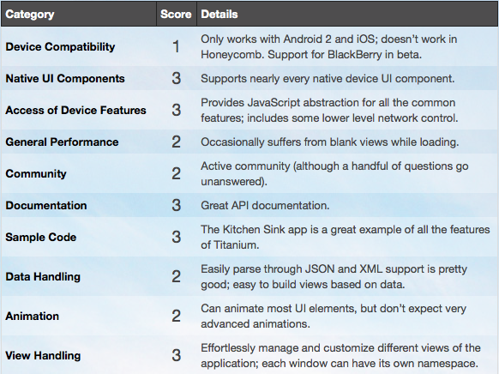
TITANIUM From Appcelerator Inc. SCORE (OUT OF 3)
* http://floatlearning.com/2011/07/which-cross-platform-framework-is-right-for-me/

Slide 25
MoSync From MoSync AB
TECHNICAL ARCHITECTURE:
Cross compilation using Virtual Machine.
Single source codebase written in C/C++ or HTML/JavaScript or a combination of both.
C++ source code → platform-independent intermediate code → application package
SUPPORTED PLATFORMS:
iOS, Android, Windows Mobile, Moblin/MeeGo, Symbian & Blackberry
IDE USED:
MoSync IDE based on Eclipse.
Notes:
takes a different approach to cross-platform mobile development in that it doesn’t use web technologies at all. It has it’s own SDK built with C/C++ that gives the developer access to many of the standard C libraries, graphic and media classes, the networking layer, native UI elements and more.

Slide 26
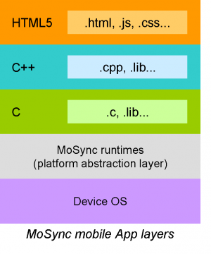
MoSync From MoSync AB
http://www.straightforward.se/storyserver/sites/straightforward.se.storyserver/files/images/MoSyncAppArchitecture.preview.png
Notes:
C++ source code → platform-independent intermediate code → application package

Slide 27
MoSync From MoSync AB
STRENGTHS:
Only one project structure for all the platforms.
The same JavaScript file.
Extend JavaScript functionality using C++ or Java and Objective-C
Native UI support
Built-in support for push notifications
Target group: Both web developers looking to enter the mobile space, as well as the ordinary PC/Mac desktop developer with knowledge of C/C++.
WEAKNESSES:
No support for accelerometer or camera in most phones.
Contains XML parsing libraries but lacking support for JSON or other data formats.
Doesn’t provide support for MVC; requires little extra effort to create views for data.

Slide 28
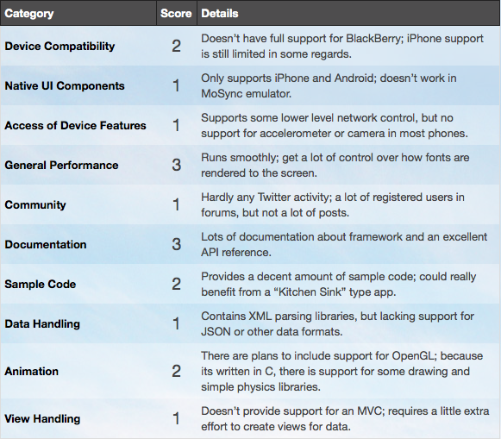
MoSync From MoSync AB SCORE (OUT OF 3)
* http://floatlearning.com/2011/07/which-cross-platform-framework-is-right-for-me/

Slide 29
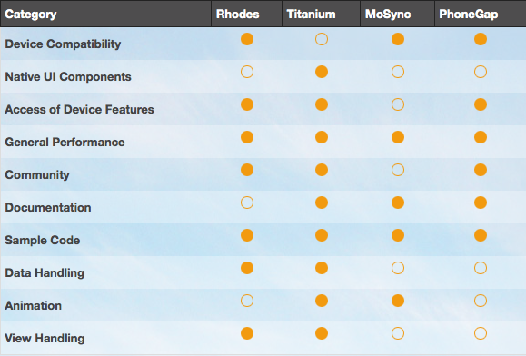
COMPARISON OVERVIEW Below is a summary of each platform and whether it offers adequate support for a given area. (Scored 2 or better in that criteria)
* http://floatlearning.com/2011/07/which-cross-platform-framework-is-right-for-me/

Slide 30
References:
http://floatlearning.com/2011/07/which-cross-platform-framework-is-right-for-me/
http://www.onlinesolutionsdevelopment.com/blog/mobile-development/why-mosync-could-be-a-better-alternative-to-phonegap/
http://mashable.com/2012/02/16/cross-platform-app-design-pros-cons/

Slide 31
THANK YOU!!

