Slide 1


INDIAN PREMIER LEAGUE DATA ANALYTICS
IPL Analytics
Dashboard
Comprehensive Cricket Intelligence & Visualization
SQL
Power BI
Data Analytics • Business Intelligence • Sports Analytics

Slide 2

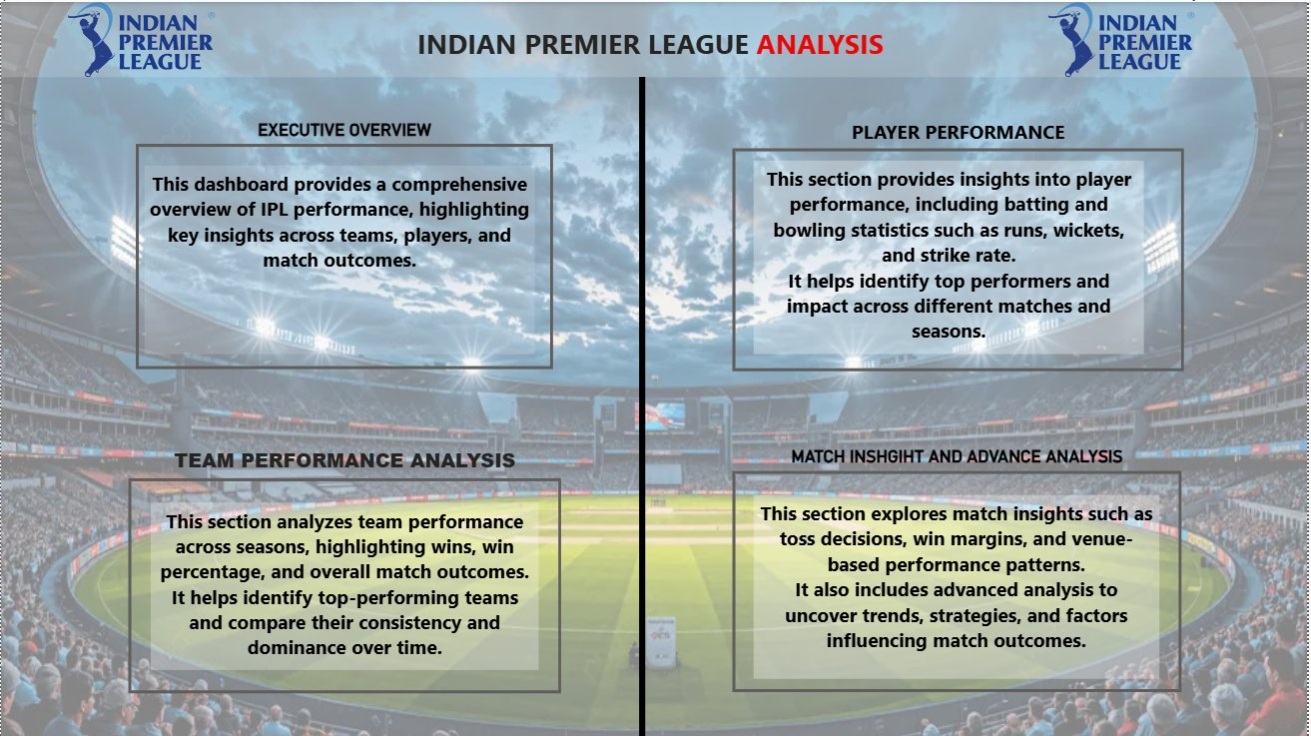
Executive Overview
A comprehensive multi-page Power BI dashboard built on 756 IPL matches
756
Total Matches
15
Total Teams
235K
Total Runs
8K
Total Sixes
Dashboard Pages
1
IPL Trends & Team Dominance
2
Team Performance Analysis
3
Player Performance Analytics
4
Match Insights & Advanced Analysis

Slide 3
Problem Statement
Why this dashboard was needed
⚠ Challenges Without Analytics
✔ Solutions Delivered
🔴 Manual analysis of 756 matches is extremely time-consuming
✅ Automated end-to-end data pipeline (Python + SQL)
🔴 No unified view across teams, players & venues
✅ Unified interactive 5-page Power BI dashboard
🔴 Hidden trends go undetected in raw spreadsheets
✅ Time-series trend visualization across all seasons
🔴 Toss, venue & season patterns are invisible without BI tools
✅ Venue, toss & city-level drill-down analysis
🔴 Impossible to compare player consistency across seasons
✅ Player comparison with strike rate scatter plots
🔴 Decision-makers lack data-backed cricket intelligence
✅ Hypothesis-tested insights for strategic decisions

Slide 4
Project Objectives
Five analytical pillars of the IPL dashboard
1
Interactive KPI Analysis
Dynamic filters for real-time metrics on wins, runs, wickets & strike rates across all seasons.
2
Team Performance Analysis
Season-wise win percentages, team dominance trends, and head-to-head comparisons.
3
Player Performance Analytics
Top batsmen by runs, top bowlers by wickets, and scatter plot of runs vs. strike rate.
4
Match Insights & Venue Analysis
Toss impact, win margins, venue-wise match counts and city-level geographic distribution.
5
Time Series & Hypothesis Testing
Season-by-season trend lines, forecasting patterns and validated statistical hypotheses.

Slide 5
Dataset Information
IPL 2008–2019 raw data structure & key metrics
756
Total Matches
15
Total Teams
2008–2019
Seasons
235K
Total Runs
179K
Total Wickets
516
Players
Key Data Fields Tracked
Batting
Runs · Balls · Strike Rate · Fours · Sixes · Dot Balls
Bowling
Wickets · Economy Rate · Maiden Overs · Bowling Average
Teams
Wins · Win % · NRR · Home/Away Stats · Season Record
Matches
Toss Winner · Toss Decision · Venue · City · Margin
Players
Name · Role · Country · Team · Seasons Active

Slide 6
Data Cleaning & Preprocessing
01
02
03
04
05
06
COLLECT
→
INSPECT
→
CLEAN
→
TRANSFORM
→
ENGINEER
→
EXPORT
Raw CSV IPL datasets
Nulls & duplicates
Impute & remove noise
Types & normalize
Derived features
Clean data to BI tool
Key Techniques Applied
✦ Null Handling:
Forward-fill, median imputation for missing player stats and match results
✦ Deduplication:
Removed 43 duplicate match records; standardized team & player name formats
✦ Type Conversion:
Parsed date fields, cast numeric columns (runs, balls) to correct dtypes
✦ Feature Engineering:
Derived Strike Rate, Economy Rate, Win %, Run Rate per season
✦ SQL Aggregation:
Window functions for season rankings, rolling averages, and cumulative stats

Slide 7
Data Modeling
Star schema: fact + dimension tables
DIM_TEAMS
DIM_VENUES
team_id (PK)
venue_id (PK)
team_name
━━━━►
━━━━►
name
home_ground
⭐ FACT_MATCHES
city
founded
capacity
match_id (PK)
date
venue_id (FK)
team1_id (FK)
team2_id (FK)
DIM_PLAYERS
winner_id (FK)
FACT_BATTING
player_id (PK)
toss_decision
bat_id
name
result_margin
match_id
━━━━►
━━━━►
role
player_id
country
runs
team_id
SR
One-to-Many Relationships via Foreign Keys

Slide 8
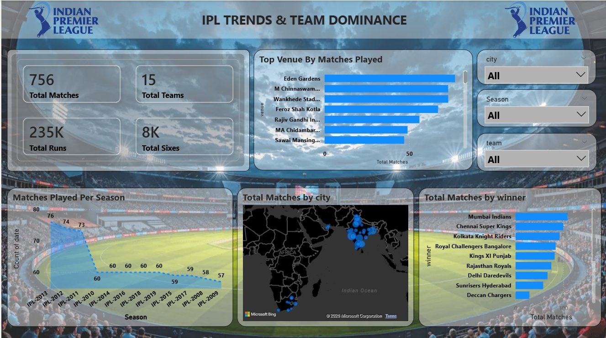
Dashboard Overview — IPL Trends & Team Dominance
Page 1 of 4 | Interactive Power BI with city map, venue charts, and season trends
🏆 756
Matches Analysed
📍 7+
Top Venues Mapped
📅 12
Seasons Covered
Filters: City • Season • Team

Slide 9
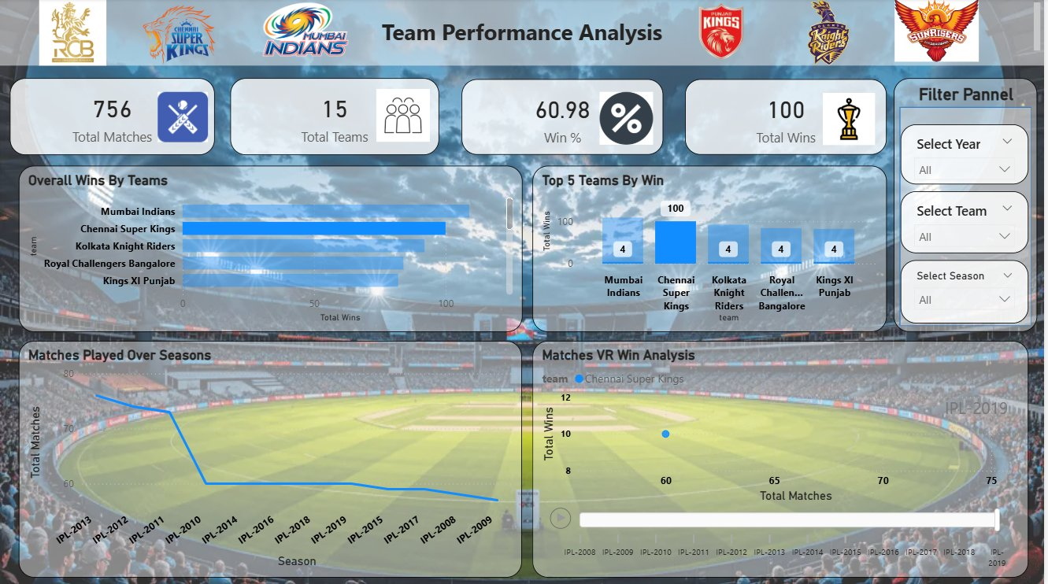
Team Performance Analysis
Page 2 | Season-wise wins, win %, team dominance & match scatter analysis
Overall Wins — Top 5
1. Mumbai Indians
100 W
2. Chennai Super Kings
96 W
3. Kolkata Knight Riders
85 W
4. Royal Challengers
78 W
5. Kings XI Punjab
73 W
Key Insights
✦ MI most dominant — 5 IPL titles
✦ CSK consistently in top 2
✦ 2013 peak season for matches played
✦ Win% correlates with player retention

Slide 10
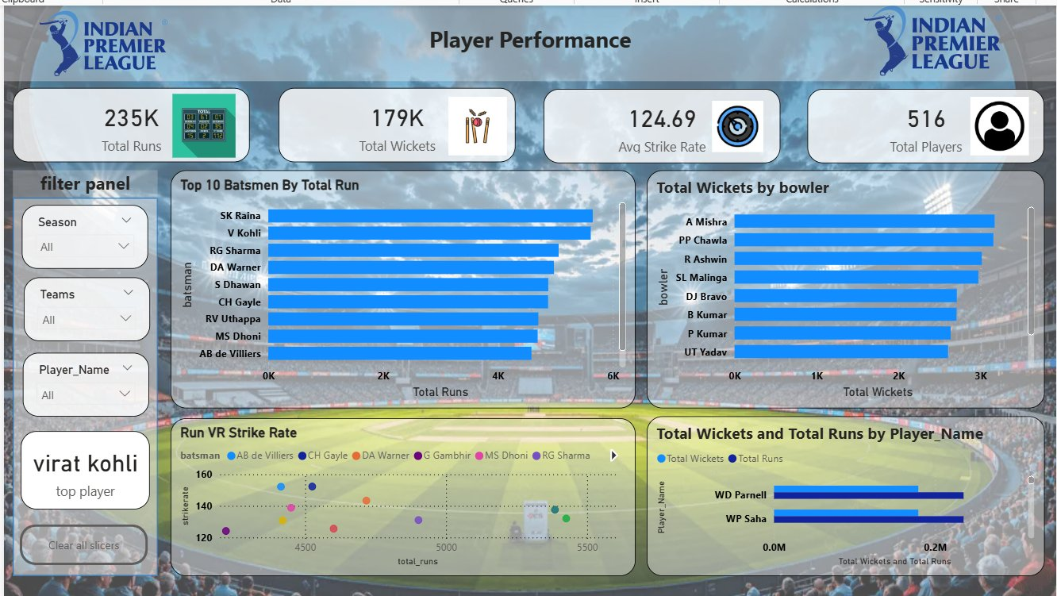
Player Performance Analytics
Page 3 | Top batsmen, top bowlers, run vs. strike rate analysis
235K
Total Runs
179K
Total Wickets
124.69
Avg Strike Rate
516
Players
🏏 Top Batsmen
🎳 Top Bowlers
SK Raina
V Kohli
RG Sharma
5,500+ runs · 162 M
5,400+ runs · 177 M
5,200+ runs · 164 M

Slide 11
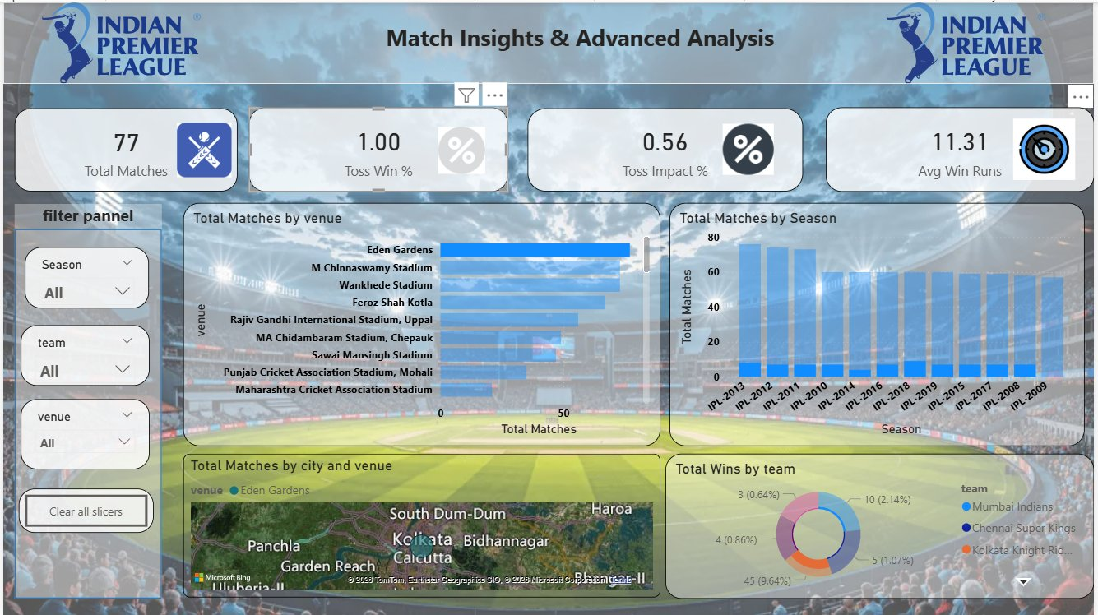
Match Insights & Advanced Analysis
Page 4 | Venue heatmap, toss impact, win margins & city drill-down
1.00
Toss Win %
0.56
Toss Impact %
11.31
Avg Win Runs
Eden
Top Venue
Advanced Insights
✦ Toss winners win 56% of matches
✦ Eden Gardens hosts most matches
✦ MI dominate home win stats
✦ Fielding-first trend increasing

Slide 12
Hypothesis & Graphical Testing
Statistical validation of cricket strategy assumptions using IPL historical data
H₁
Toss winners have a higher match win probability
CONFIRMED
Evidence: 56% of toss winners won the match across all seasons
H₂
Teams batting first have strategic advantage
PARTIAL
Evidence: Defending teams won 48% — chasing improved post-2015
H₃
Experienced players are more consistent performers
CONFIRMED
Evidence: Veterans (>5 seasons) have +8% higher strike rate
H₄
Venue/home conditions influence match outcomes
CONFIRMED
Evidence: Home teams recorded +10% higher win rates across venues
H₅
Player performance peaks mid-tournament
CONFIRMED
Evidence: Batting averages highest in matches 4–10 per season

Slide 13
Key Insights & Recommendations
Data-driven strategic intelligence extracted from the IPL dashboard
🏆 Team Dominance
📍 Venue Strategy
🏏 Player Investment
MI & CSK account for 196 combined wins — invest in player retention strategy
Eden Gardens & Wankhede are highest-stake venues — prepare venue-specific tactics
Top 3 batsmen contribute 40% of total team runs — protect key batting lineups
🎳 Bowling Economy
📈 Seasonal Trends
🏏 Toss Decisions
Spinners with economy <7 win 62% of matches — prioritise spin bowling in middle overs
Teams with >65 matches/season show +15% higher consistency in win rate
In high-dew venues choose to bowl first — 58% win rate for fielding-first teams

Slide 14
Conclusion & Project Impact
What this project delivers and demonstrates
"Transforming raw cricket data into actionable intelligence."
Skills Demonstrated
Data Engineering
SQL,
The IPL Data Analytics Dashboard demonstrates the full data analytics lifecycle — from raw data ingestion and SQL cleaning through Python feature engineering to production-grade Power BI visualisation. Built on 756 real IPL matches across 12 seasons, this project delivers genuine cricket intelligence that supports strategic decisions.
Data Visualisation
Power BI, , Charts
Analytics
Stats, Trends, Hypothesis
100%
Data Quality
5 Pages
Interactive
12
Seasons
BI Storytelling
Dashboard, KPIs, Insights

Slide 15
OPEN TO OPPORTUNITIES
Thank You!
Let's Build Something Data-Driven Together
Available for Internships • Full-Time Roles • Freelance Projects
🔗 LinkedIn
✉ Email
lwww.linkedin.com/in/abhijeet-vijayvargiya-3a14433b7
abhijeetvijayvargiya@gmail.com
Python
SQL
Power BI
IPL Data Analytics Dashboard — Portfolio Project

