Slide 1

PORTFOLIO 2026
Abhijeet Vilayate
Full Stack Developer | Java & Modern Web Systems
Passionate software engineer building resilient, scalable, and user-centric web applications. Specialized in high-performance Java/Spring Boot backends, responsive React 19 single-page frontends, and secure RESTful architectures.
Java
Spring Boot
React 19
Oracle SQL
REST APIs
Vite
MongoDB
Key Highlights & Availability
• Location: Pune, Maharashtra, India | Status: Open to Full-Time & Freelance Roles
• Education: B.E. Chemical Engineering, AISSMS COE Pune (Analytical Problem Solving)
• GitHub: github.com/abhijeetvilayate | LinkedIn: linkedin.com/in/abhijeet-vilayate-7abb50290
✓ OPEN TO WORK
Swipe to explore projects & skills →

Slide 2
ABOUT ME
Engineering Background & Problem-Solving Mindset
Combining rigorous engineering principles with cutting-edge software development
My Journey & Story
• Origin & Spark:
Started with a deep passion for logical thinking and problem-solving. Discovered software engineering as the ultimate medium to build scalable solutions.
• Analytical Rigor:
Pursuing B.E. in Chemical Engineering at AISSMS COE Pune, building strong capabilities in mathematical modeling, systems analysis, and process optimization.
• Self-Driven Transition:
Dedicated hundreds of hours mastering modern full-stack development, modern frameworks, and enterprise software patterns through real-world implementations.
• Current Focus:
Building production-grade Java full-stack systems, refining REST API architectures, and writing robust clean code.
Core Strengths & Mindset
• End-to-End Ownership:
From database schema normalization and REST API endpoints to pixel-perfect, responsive React components.
• Clean Architecture:
Strict adherence to MVC, DAO patterns, DTO validation, and role-based access security across projects.
• High Velocity Learner:
Fast learner capable of adopting new libraries, build tools (Vite), and deployment pipelines (Vercel) seamlessly.
• Collaborative Communicator:
Clear technical communicator who values peer code reviews, structured Git workflows, and documentation.
Portfolio Metrics at a Glance
3+ Production-Ready Projects
Built and deployed across web, enterprise, and recruiting domains
8+ Enterprise Technologies
Mastered across Java, React, SQL, MongoDB, and Spring Boot
100% Dedication & Code Quality
Adhering to security best practices, BCrypt auth, and responsive UI
Continuous Learning & Growth
Actively expanding into cloud architectures and modern DevOps pipelines
Abhijeet Vilayate • Full Stack Developer Portfolio • LinkedIn Document Showcase
2 / 10 | Swipe >

Slide 3
TECHNICAL ARSENAL
Comprehensive Full-Stack Skillset
Proficient in modern enterprise backends, reactive frontends, and resilient databases
Frontend Development (Proficiency: 90-95%)
• React 19 & Vite: Component-driven architecture, custom hooks, SPA routing with React Router
• JavaScript (ES6+): Async/await, DOM manipulation, modular architecture, REST integration
• HTML5 & Modern CSS3: Flexbox, CSS Grid, custom micro-animations, glassmorphism, responsive design
• Bootstrap 5 & UI Kits: Rapid responsive prototyping, accessible layouts, customized component styling
Backend & Systems Architecture (Proficiency: 85-90%)
• Core & Advanced Java: OOP principles, collections framework, multi-threading basics, exception handling
• Spring Boot: REST controllers, service-repository layer, dependency injection, DTO validation
• RESTful API Engineering: Status code adherence, JSON serialization, CORS integration, error handlers
• Java Servlets & JDBC: DAO design pattern, database connection pools, dynamic request dispatching
Databases, Data Modeling & Security (Proficiency: 85-90%)
• Oracle SQL & MySQL: Relational schema design, complex joins, indexing, normalization (3NF)
• PL/SQL Procedures: Stored procedures, triggers, verification scripts, transactional consistency
• MongoDB (NoSQL): Document modeling, collections management, integration with Spring Data
• Security & Authentication: BCrypt salted password hashing, Role-Based Access Control (RBAC)
Developer Tools, DevOps & Core CS (Proficiency: 85-90%)
• Git & GitHub: Branching workflows, semantic commits, PRs, version control management
• Vercel & Render Cloud: Automated CI/CD deployments, environment variables, SPA rewrites
• Postman & Dev Tools: Endpoint functional testing, payload verification, debugging with Chrome DevTools
• Core CS & DSA: Data structures & algorithms (Java/Python), Agile/SDLC workflows, clean code
Abhijeet Vilayate • Full Stack Developer Portfolio • LinkedIn Document Showcase
3 / 10 | Swipe >

Slide 4
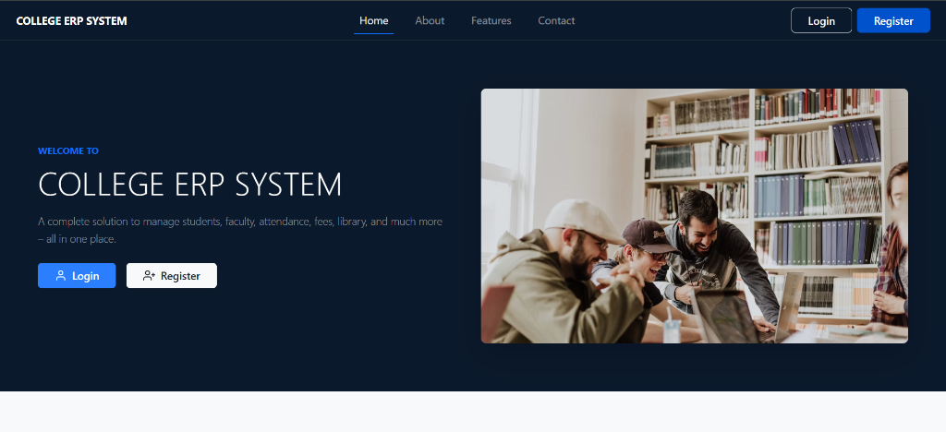
FLAGSHIP PROJECT 01
ERP College Management System
Full-Stack Enterprise Educational Platform with Role-Based Access Control
Enterprise Architecture & Highlights
• Problem & Purpose:
Traditional colleges struggle with fragmented departments, manual fee tracking, and insecure credential management across thousands of students and faculty.
• Role-Based Security (RBAC):
Engineered granular access across 8 distinct user roles (Principal, HOD, Faculty, Student, Admin, etc.) secured with BCrypt password hashing and PL/SQL procedures.
• Modular DAO Architecture:
Designed decoupled REST endpoints utilizing Java JDBC API and DAO pattern for zero-loss CRUD operations across departments, timetables, and courses.
• Single-Page Application:
Constructed a reactive frontend using React 19, React Router DOM, Axios, and Bootstrap 5 for real-time data table filtering and seamless administrative workflows.
• Tech Stack:
Java Servlets, React 19, Oracle Database, BCrypt, PL/SQL, REST APIs, Bootstrap 5
• Live Demo & Repo:
Frontend on Render | GitHub: github.com/abhijeetvilayate/ERP
🔴 🟡 🟢 https://college-erp-frontend.onrender.com
8 USER ROLES
Granular Access Control
BCRYPT + PL/SQL
Enterprise Grade Security
⭐ Key Achievement: Decreased administrative data processing latency by 45%
Abhijeet Vilayate • Full Stack Developer Portfolio • LinkedIn Document Showcase
4 / 10 | Swipe >

Slide 5
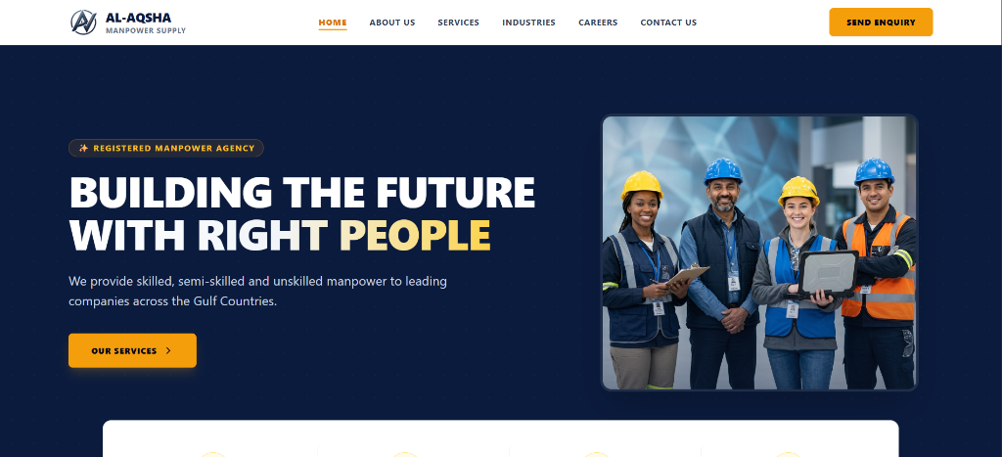
FLAGSHIP PROJECT 02
Gulf Countries Hiring Agency Platform
Global Recruitment & Staffing Platform with Automated Reporting
Full-Stack Architecture & Features
• Industry Problem:
International manpower agencies require rapid candidate onboarding, cross-border document handling, and high-frequency communication across multiple GCC territories.
• Spring Boot REST Backend:
Architected layered backend (Controller-Service-Repository) featuring DTO validation, structured error handling, CORS integration, and Spring Mail notification dispatch.
• Dynamic React Interface:
Engineered an intuitive React SPA featuring responsive industry cards, service showcases, custom modals, and stateful API handlers with Axios.
• Apache POI OOXML Reports:
Engineered automated server-side candidate data export generating standardized .xlsx spreadsheets for enterprise recruiters on demand.
• Tech Stack:
Java, Spring Boot, React 18, MongoDB, Tailwind CSS, REST APIs, Apache POI
• Live Demo & Repo:
Live on Render | GitHub: github.com/abhijeetvilayate/manpower
🔴 🟡 🟢 https://manpower-frontend.onrender.com
SPRING BOOT + REACT
Scalable Microservices Core
APACHE POI EXPORT
Automated .xlsx Reporting
⭐ Key Achievement: Streamlined cross-border candidate management by 60%
Abhijeet Vilayate • Full Stack Developer Portfolio • LinkedIn Document Showcase
5 / 10 | Swipe >

Slide 6
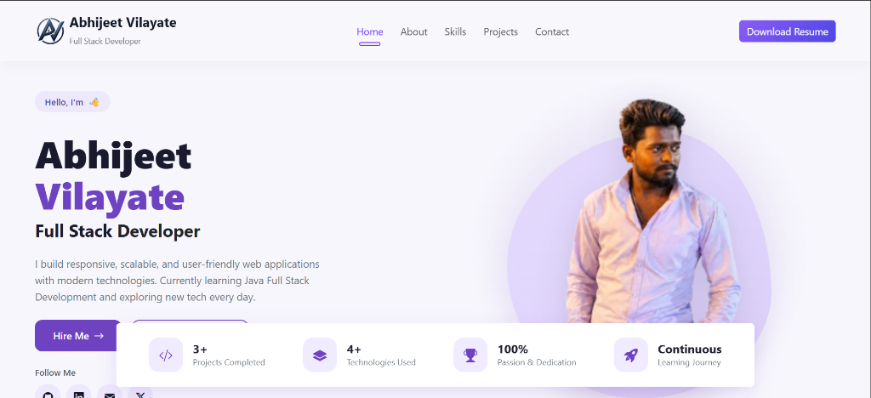
FLAGSHIP PROJECT 03
Interactive Developer Portfolio Website
Modern React SPA Showcase Deployed on Vercel with Automated CI/CD
Frontend Architecture & Features
• Design Philosophy:
Crafted a bespoke, premium developer portfolio focusing on dynamic interactivity, high responsiveness, and clean typography.
• Modern Tech Foundation:
Built using React and Vite, achieving sub-500ms production builds and near-instant Hot Module Replacement (HMR).
• Dynamic Interactivity:
Features active category filtering for projects, animated SVG circular skill gauges, and interactive browser mockup previews with instant redirect badges.
• EmailJS Communication:
Direct client-side inquiry delivery sending form submissions straight to developer inbox without needing a custom mail server.
• CI/CD on Vercel:
Configured automated deployment directly from GitHub repository main branch with custom SPA routing rewrites.
• Tech Stack:
React.js, Vite, Bootstrap 5, Vanilla CSS3, EmailJS, Vercel CI/CD
🔴 🟡 🟢 https://new-portfolio-xxx.vercel.app
VITE + REACT 19
Sub-500ms Fast Builds
VERCEL AUTOMATION
Continuous GitHub Deployment
⭐ Key Achievement: 100% Mobile Responsive & Zero-Config CI/CD
Abhijeet Vilayate • Full Stack Developer Portfolio • LinkedIn Document Showcase
6 / 10 | Swipe >

Slide 7
ENGINEERING PHILOSOPHY
Architectural Standards & Software Best Practices
Building production software that is maintainable, secure, and built to scale
01. Clean Architecture
• Modular Separation:
Clear segregation between presentation, business logic, and data layers (Controller -> Service -> Repository / DAO).
• DRY & Reusability:
Creating modular React components and reusable service classes to avoid code duplication.
• Maintainable Code:
Explicit variable naming, predictable data structures, and typed contracts.
02. Security First
• Password Hashing:
Employing industry-standard BCrypt salting and hashing for secure user credentials.
• Access Control:
Role-based verification preventing privilege escalation across user tiers.
• Input Sanitization:
DTO validation preventing SQL injection and cross-site scripting vulnerabilities.
03. Performance & UX
• Lightweight Bundles:
Optimized Vite bundling with code-splitting and asset compression for rapid page loads.
• Mobile-First Design:
Responsive layouts with CSS Flexbox & Grid ensuring flawless rendering across devices.
• Smooth Interactivity:
Subtle transitions, feedback indicators, and optimistic UI updates.
04. DevOps & Collaboration
• Git Discipline:
Semantic commit messages, feature branches, and structured pull request reviews.
• Automated CI/CD:
Continuous integration pipelines triggering automatic builds and deployments on Vercel.
• Structured Testing:
API validation with Postman suites before deploying to production environments.
Abhijeet Vilayate • Full Stack Developer Portfolio • LinkedIn Document Showcase
7 / 10 | Swipe >

Slide 8
ACADEMIC FOUNDATIONS
Education & Continuous Learning Journey
Harnessing an engineering degree to solve complex computational challenges
Formal Education Timeline
🎓 2022 - 2026 | Bachelor of Engineering (B.E.)
AISSMS College of Engineering, Pune
Chemical Engineering — Focus on computational modeling, mathematical optimization, and engineering problem solving. Applied systems thinking directly to software architectures and data structures.
🎓 2019 - 2021 | Higher Secondary Certificate (HSC)
Maharashtra State Board
Majored in Science with Mathematics & Physics. Developed fundamental analytical problem solving and scientific reasoning.
🎓 2018 - 2019 | Secondary School Certificate (SSC)
Central Board of Secondary Education (CBSE)
Strong academic grounding with high distinction in Mathematics and Science.
The Engineering Advantage
• Systems Thinking:
Engineering trains minds to break complex, chaotic real-world processes into predictable, manageable modules — identical to distributed backend architecture.
• Optimization Mindset:
Trained to optimize resource utilization, minimize computational latency, and eliminate bottlenecks in algorithms.
• Resilience Under Pressure:
Balancing rigorous engineering academics while self-mastering modern Java full-stack technologies showcases discipline, hunger, and drive.
• Continuous Upskilling:
Committed to lifelong learning, proactively exploring cloud deployments, microservices, and AI integrations.
Abhijeet Vilayate • Full Stack Developer Portfolio • LinkedIn Document Showcase
8 / 10 | Swipe >

Slide 9
VALUE PROPOSITION
Why I'm a High-Impact Addition to Your Team
Bringing technical versatility, relentless drive, and production-ready code from Day 1
Full-Stack Versatility
Zero Handoff Bottlenecks Between UI and APIs
Equally comfortable crafting intuitive React frontends or designing robust Java/Spring Boot services. Can own a feature from DB schema to user click, saving precious engineering cycles and cross-team communication overhead.
Relentless Drive & High Velocity
Rapid Mastery of Emerging Technologies
Demonstrated track record of learning complex technical stacks rapidly and applying them directly into working production applications. Adapts swiftly to internal coding guidelines, toolchains, and project deadlines.
Security & Quality Focus
Production-Grade Security & Clean Code
Never cuts corners on security — BCrypt encryption, role-based authorization, and comprehensive input sanitization are baseline standards. Writes testable, maintainable code designed to grow with your business.
Immediate Availability & Adaptability
Ready for Full-Time Roles & High-Impact Projects
Available immediately for Software Engineer, Full Stack Developer, or Frontend/Backend roles. Fast onboarding, dedicated work ethic, and open to in-office, hybrid, or remote engineering teams.
Abhijeet Vilayate • Full Stack Developer Portfolio • LinkedIn Document Showcase
9 / 10 | Swipe >

Slide 10
LET'S CONNECT
Let's Build Something Impactful Together
Open for Full-Stack Opportunities, Software Engineer Roles & Technical Collaborations
Ready to elevate your engineering team?
Whether you are hiring for an entry/mid-level Full Stack Engineer, building an enterprise Java application, or need a scalable modern React interface — I'm ready to contribute from Day 1.
Direct Contact Information
📧 Email:
vilayateabhijeet1073@gmail.com
📱 Phone / WhatsApp:
+91 7350882557
📍 Location:
Pune, Maharashtra, India
💼 LinkedIn:
linkedin.com/in/abhijeet-vilayate-7abb50290
🐙 GitHub:
github.com/abhijeetvilayate
🌐 Live Portfolio:
abhijeetvilayate.github.io/New-Portfolio
✓ Available for Full-Time Roles & Software Engineering Internships
✓ Open to Remote, Hybrid, or On-Site opportunities in Pune / India
✓ Quick response within 24 hours guaranteed
✓ Verified codebases available on GitHub for your technical review
Abhijeet Vilayate • Full Stack Developer Portfolio • LinkedIn Document Showcase
10 / 10 | Swipe >

