Slide 1
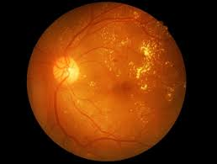
Diabetic Retinopathy Detection
Team BigFootIsReal
Shivam Gupta
Rahul Sharma
Battu Tanuj Sagar

Slide 2
Problem Statement
Diabetic retinopathy (DR) is a diabetes complication that affects eyes and can lead to blindness. Early detection of DR is crucial to prevent its progression and to manage its impact effectively. However, despite its significance, early detection remains a challenge due to lack of accessibility, expertise, and scalable solutions in many regions.

Slide 3
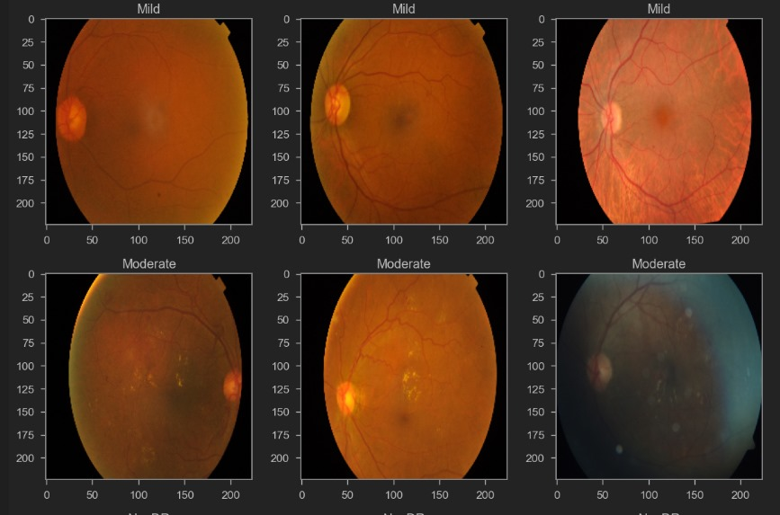
Data Visualization

Slide 4
Our Solution
RetinaCare’s strategic approach hinges on an amalgamation of technology, accessibility, and inclusivity. Our methodology orbits around rendering a platform that is not merely technologically advanced but also intuitively usable by a diverse user base, including those in resource-limited settings. The solution encompasses the creation of a simplified, yet scientifically robust, diagnostic tool that can be utilized with minimal training, ensuring its applicability even among non-medical professionals.

Slide 5


Processed & Segmented Images

Slide 6
Process Overview
Patient
Our system deployed in clinics.
Retinal Fundus Image
ML Model on the edge
Predictions available on dashboard
Alert Patients
Doctor
Send appointment request based on our analysis + doctors call

Slide 7
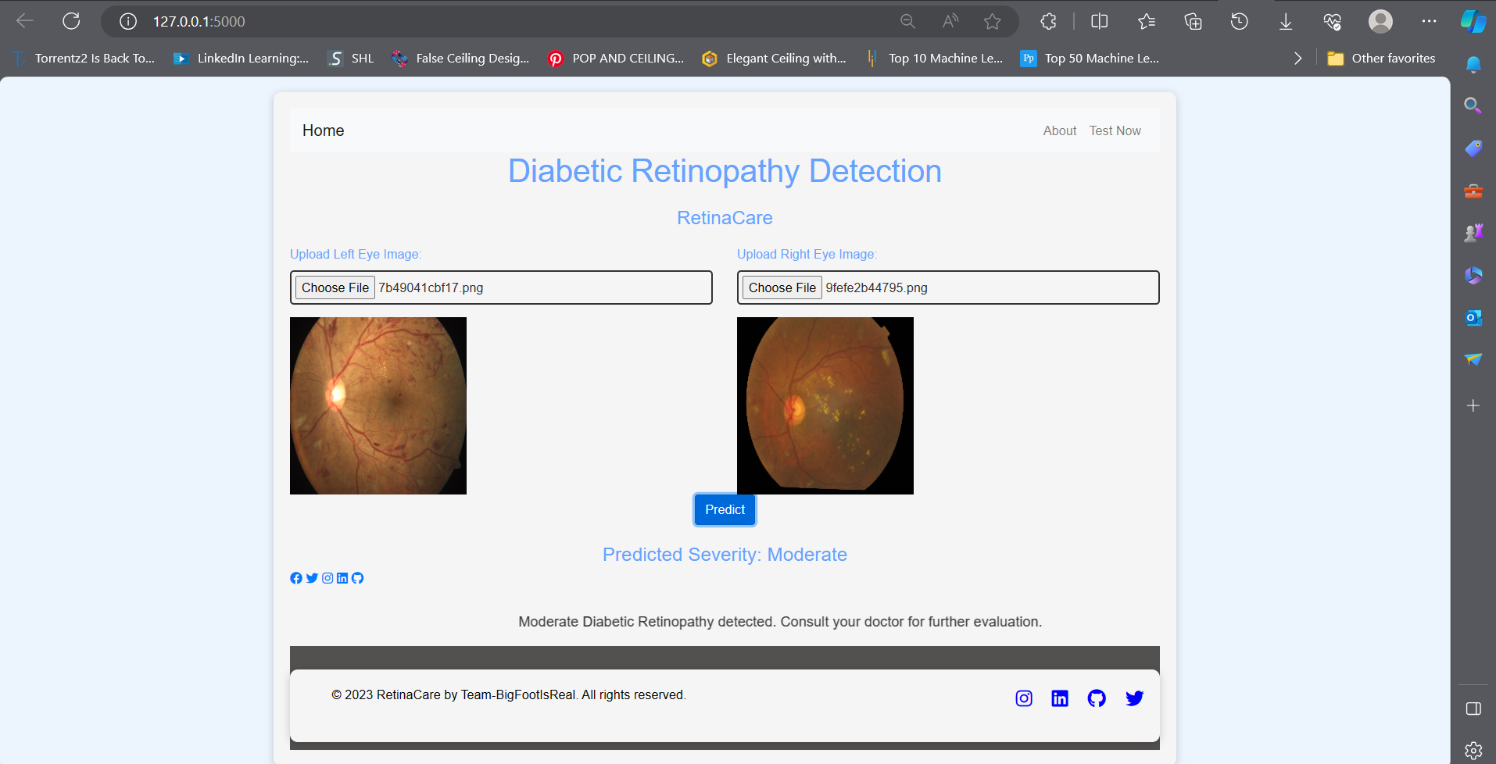

Slide 8
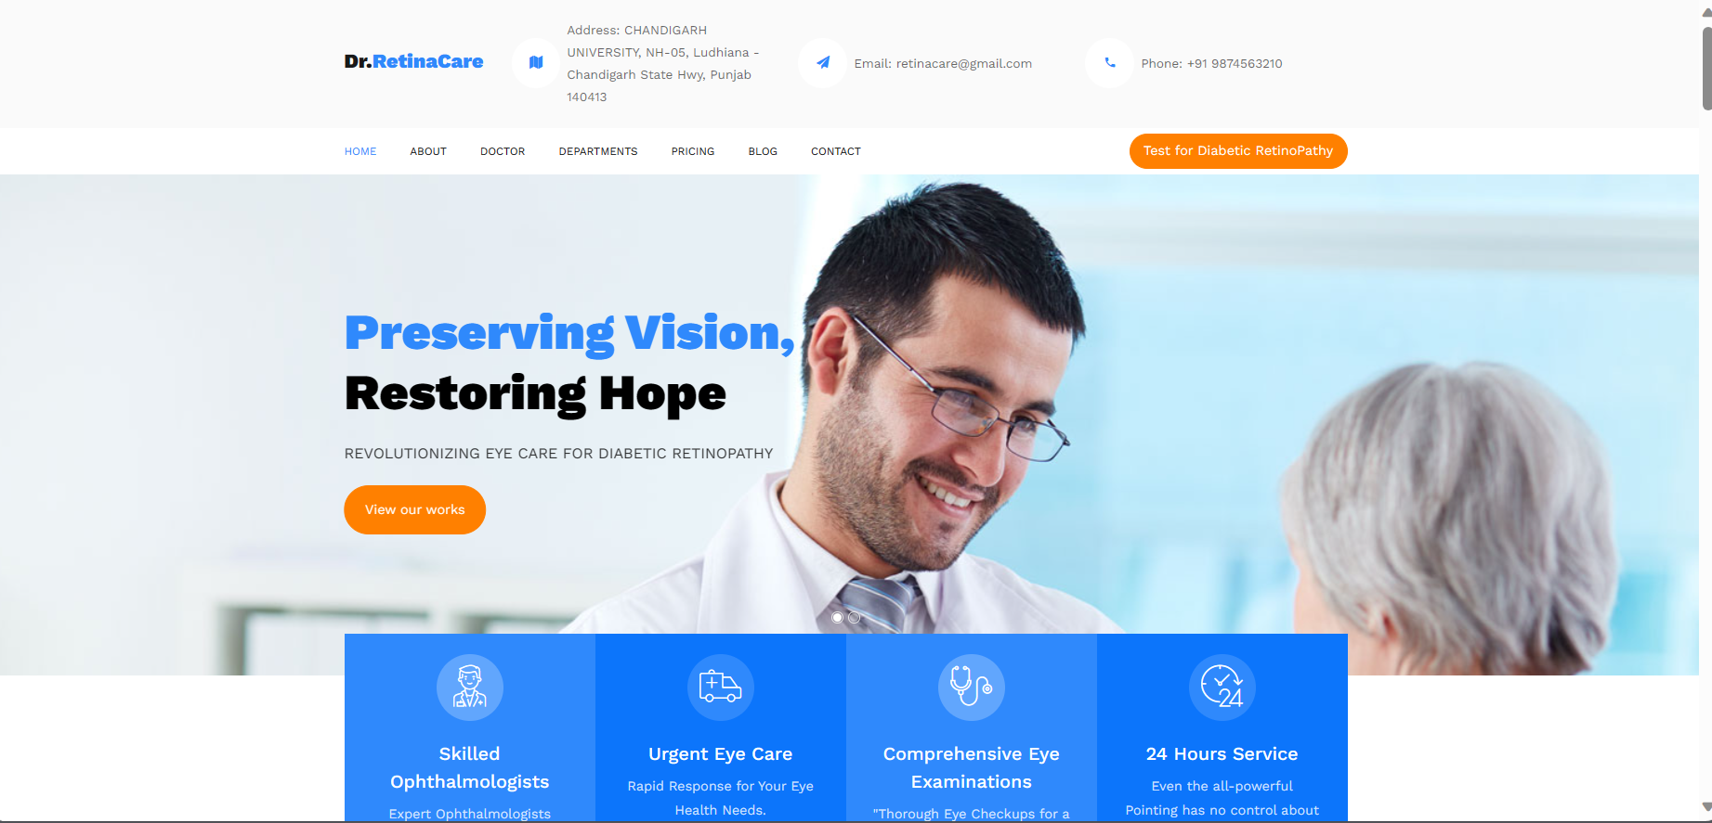

Slide 9
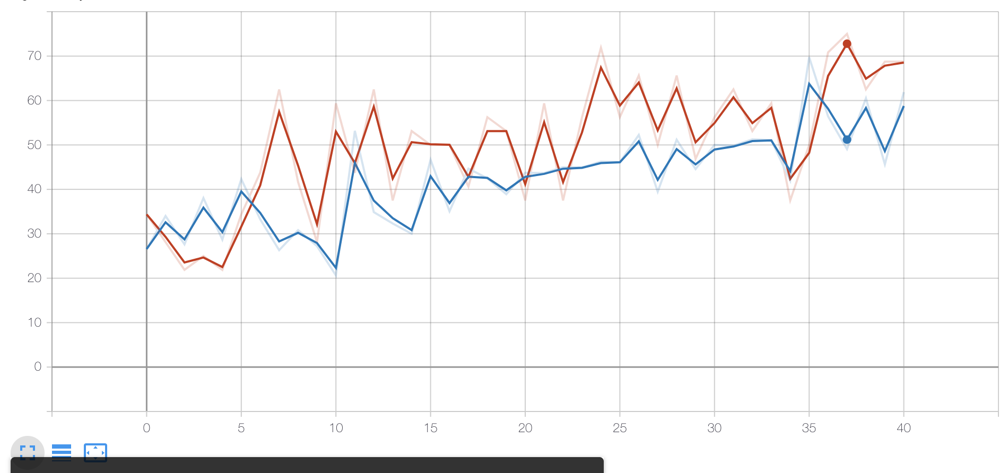
Current Progress
Accuracy of 84% on a production data of 1000 images for the base-model. Model was trained on 3662 images.
Distribution of DR cases around the world.

Slide 10
USP And Business Model
RetinaCare introduces a revolutionary business model that intertwines advanced AI technology and accessible healthcare, aiming to proficiently navigate the challenges of Diabetic Retinopathy (DR) detection and management. The model integrates a dual revenue stream: a freemium model catering to individual users and a licensing model for partnerships with healthcare institutions, NGOs, and government bodies. This strategy ensures widespread accessibility to crucial DR services for individuals, while also facilitating larger-scale, organized deployments via established healthcare entities. RetinaCare is not just a detection tool but a comprehensive DR management solution, ensuring users are navigated through a pathway of expert consultations and personalized care management. The business model places strong emphasis on community, providing a supportive network and interactive platform for users. Furthermore, operational strategies are focused on persistent technological enhancement, assuring the platform’s continued evolution and efficacy in DR management, thereby providing a scalable, reliable, and technologically advanced solution in the field of ophthalmic care.
B2B Collaborations → With Lenskart or with Hospitals

Slide 11
Use Case
Consider a rural area, where access to specialized medical care is limited. A local healthcare worker visits community members, utilizing the smartphone-compatible retinal imaging device to capture images of the eyes of diabetic individuals. These images are then uploaded to the Retina-care platform, where the AI model promptly analyzes them, identifying any potential early markers of DR.
If a risk or onset of DR is detected, the platform automatically schedules a teleconsultation with an ophthalmologist, ensuring that expert advice is accessible even in remote locations.
The specialist can then guide the patient and local healthcare worker on the next steps for management and potential referral to a nearby medical facility if in-person intervention is required, thus ensuring timely and appropriate care. (Same is the case with Lenskart home eye test)

Slide 12
Future Scope
Retina-care spans across technological advancements, geographical expansion, and diversification into other areas of ophthalmic care. By continuously evolving the AI model to align with emerging research and incorporating user feedback, the platform can ensure sustained accuracy and relevance in its diagnostics.
Geographically, after establishing a robust presence in initial target regions, Retina-care could expand to other areas, adapting to the unique needs and challenges of various demography.
Furthermore, the technology could be adapted and expanded to screen and manage other ocular conditions, gradually developing into a comprehensive ocular telehealth platform. By aligning with future technological trends, such as integrating with wearable tech for continuous ocular health monitoring, Retina-care could pioneer a new era in preventative and accessible ophthalmic care globally.

