Slide 1
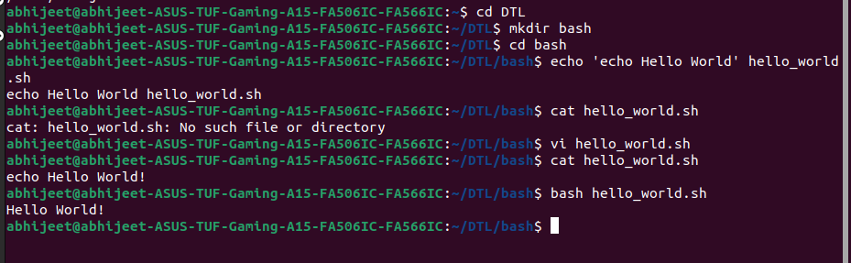
Creating new file hello_world.sh (adding text using ‘echo’)

Slide 2
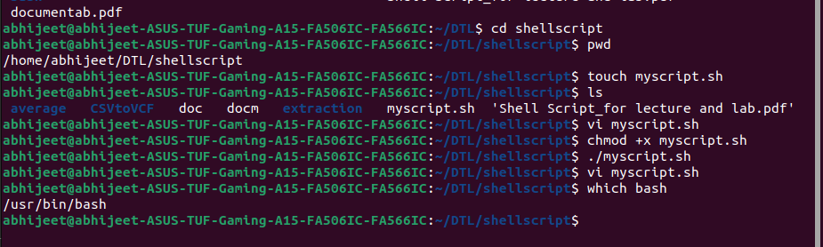
creating a file named ’myscript.sh’ and giving permission using (chmod +x) – (which – shows where my bash is ---)

Slide 3
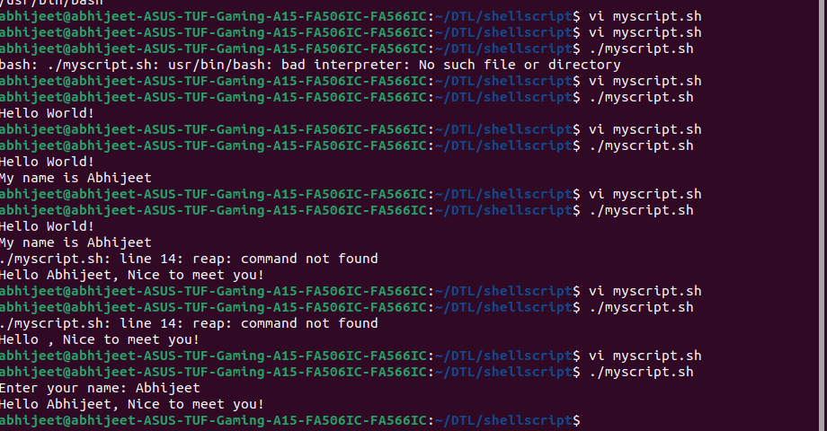
Creating file, printitng name (initiating variables) – (taking input name sfrom user)

Slide 4
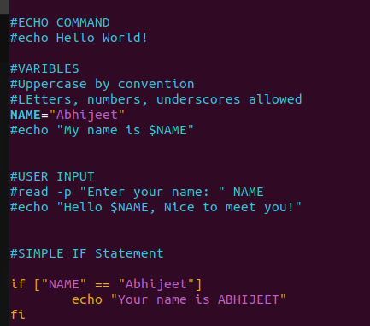

Slide 5
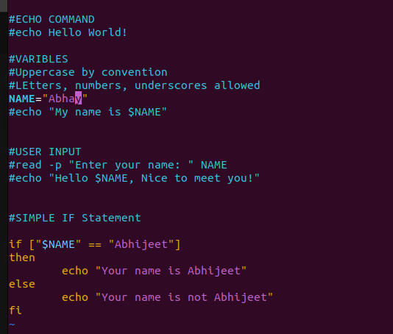
If-else statement execution

Slide 6
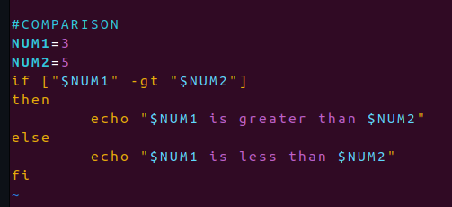
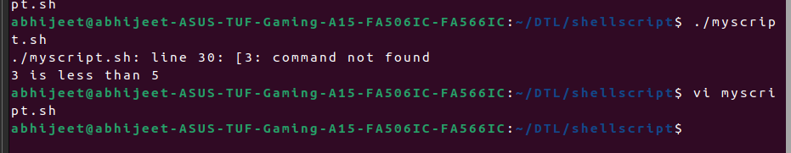
Showing to execute (COMPARISON) operator

Slide 7
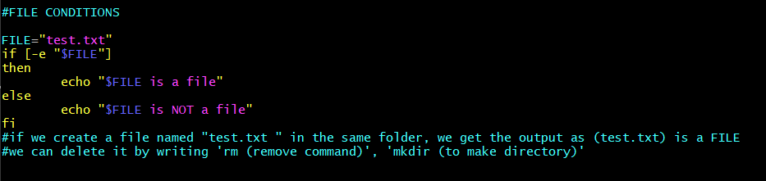
File conditioning statements

Slide 8
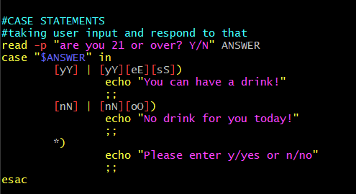
CASE STATEMENTS EXECUTON

Slide 9
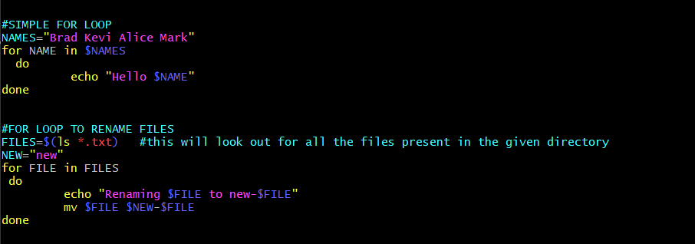
FOR LOOP EXECUTION (LOOP PROGRAM TO RENAME FILES)

Slide 10
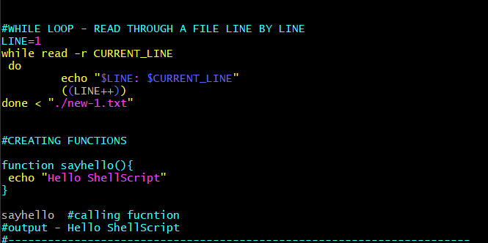
WHILE LOOP (READTROUGH A FILE LINE-BY-LINE)

Slide 11
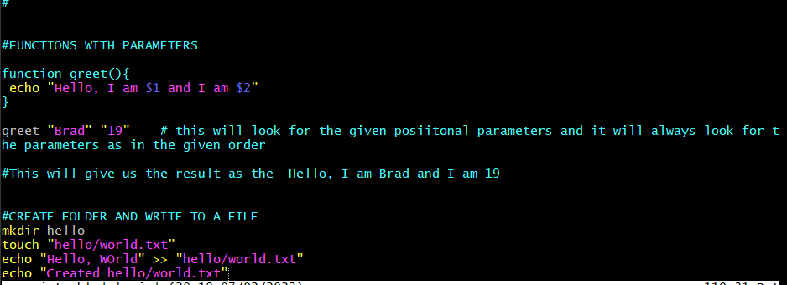
FUNCTIONS WITH PARAMETES

